Slide 1
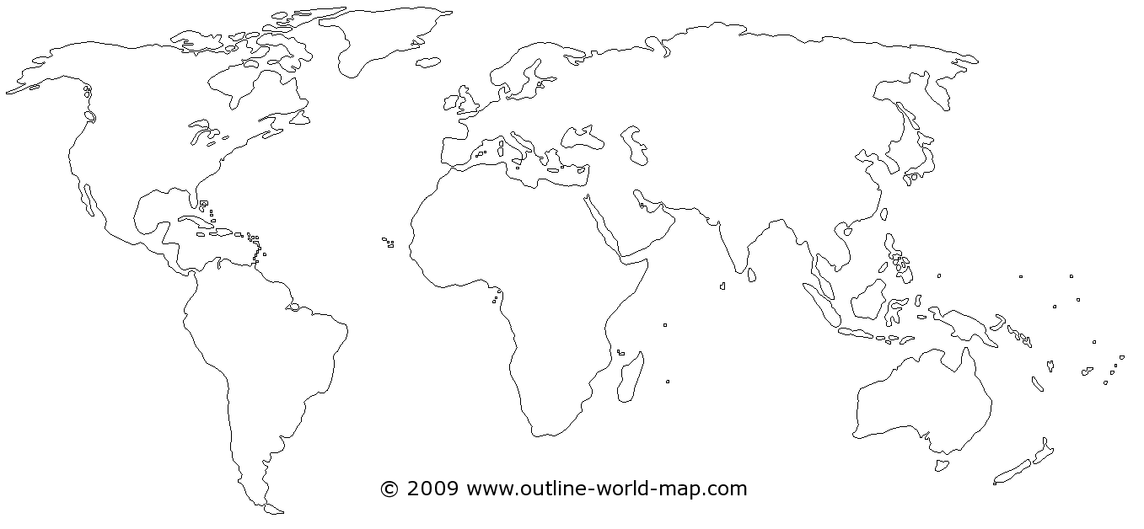
Place 'Chicken' in 6 locations on this world map: annotate (jot down rationale for each location based upon Haraway 'chicken' reading.

