Slide 1
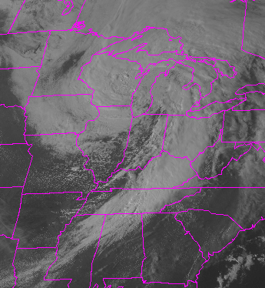
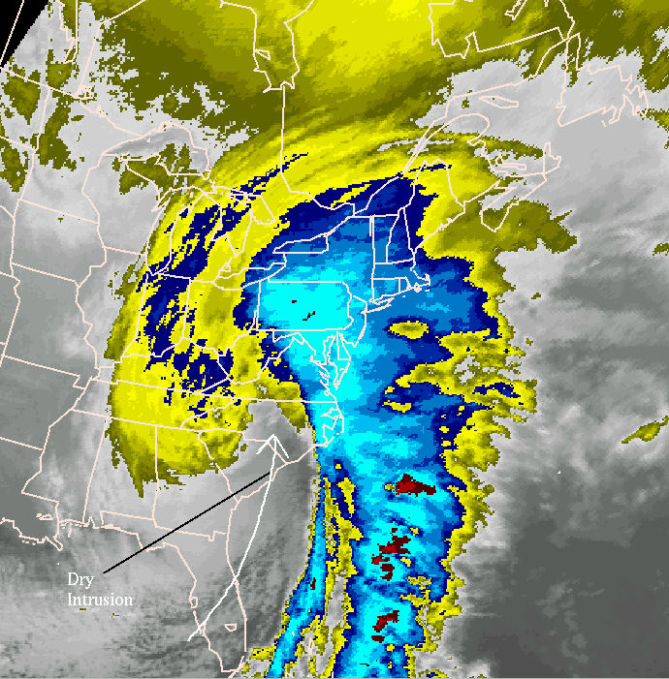
Notes:
Mid-latitude cyclones (MLC) are extratropical cyclones (ETC). There structure takes a comma shape, shown below.

Slide 2
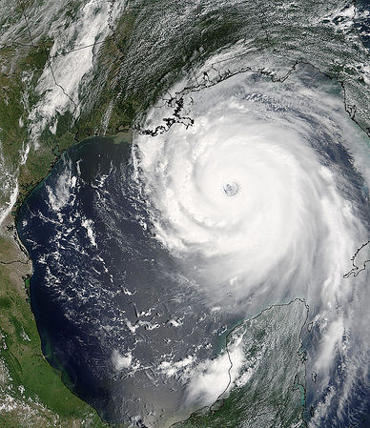
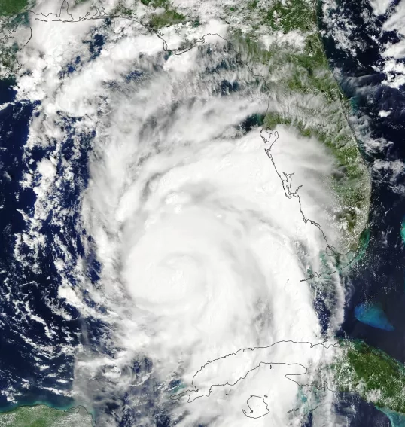
Notes:
Hurricanes are tropical cyclones (TC). Note the circular appearance and the presence of the central “eye”.
Pacific typhoons can reach 800-1000 km across. Atlantic hurricanes range from 100-600 miles across. For both, most of the strong sustained winds are in a small area around the eye.

Slide 3
Tropical cyclone (TC) vs extratropical cyclones (ETC)
TC does not have fronts, an ETC does
A TC has the strongest winds at the surface, a ETC has the strongest winds in the upper atmosphere
Form through different mechanisms
Different internal structure
Different locations where they originate and track

Slide 5
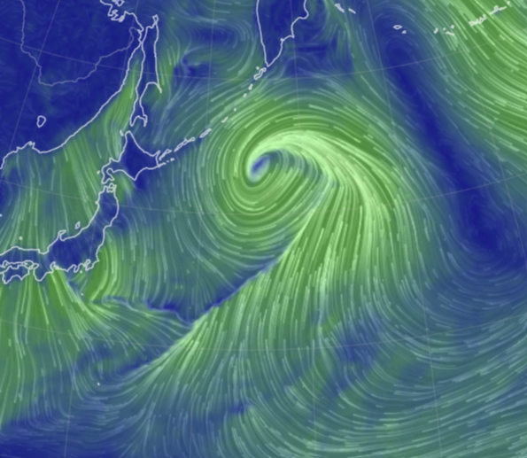

Slide 7
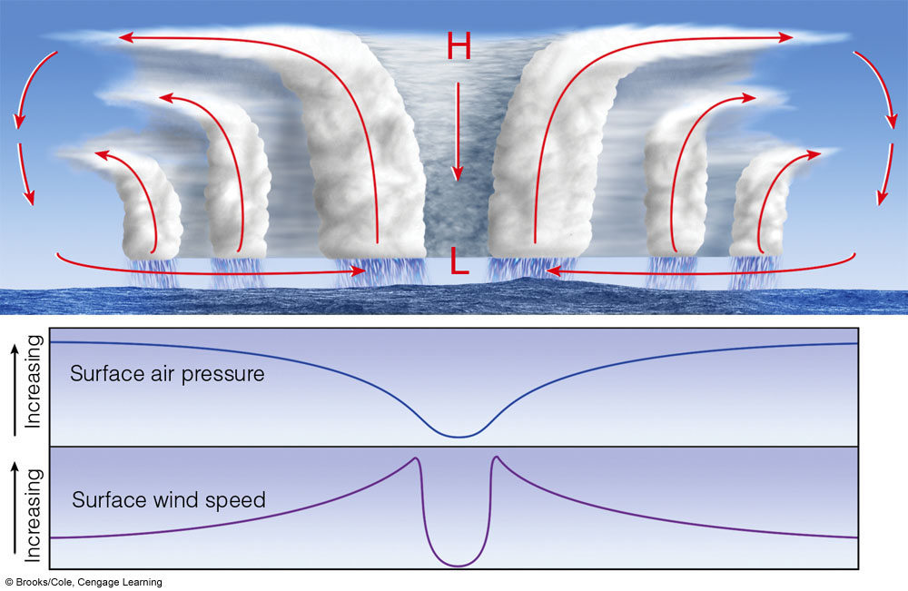
Notes:
Centrifugal force in eye keeps clouds out and dry upper air descends and warms adiabatically. The eye is 20-40 miles across.

Slide 8
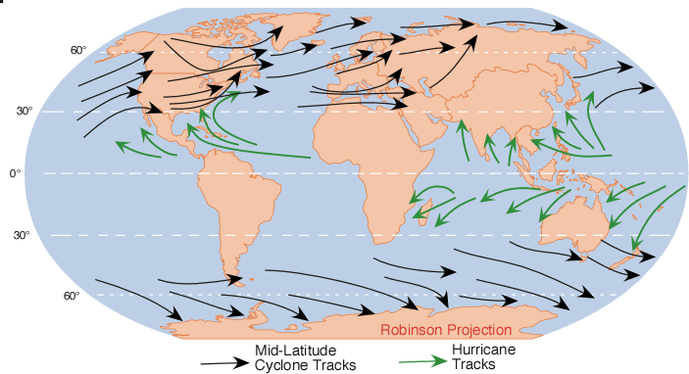
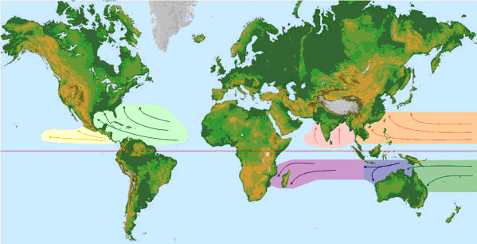
Nomenclature
Hurricanes (Atlantic Ocean)
Typhoons (Pacific Ocean)
Cyclones (Indian Ocean)
Notes:
Note that tropical storms go by different names in different areas
https://coast.noaa.gov/hurricanes/#map=4/32/-80

Slide 9
Requirements for tropical cyclone formation
Warm ocean water (at least 80°F/ 27°C)
Location between 5-25 N and S of the Equator during summer and fall months when water is warm
Northern Hemisphere hurricane season is June 1-Nov 30.
Low vertical wind shear between surface and troposphere. Low wind shear means that winds do not change speed dramatically as you go up in the atmosphere. Calm winds at the surface and in the upper atmosphere will facilitate formation
Hurricanes dissipate when they get over land – they only form at sea.

Slide 10
Stages of development of hurricane
Each level represents increase in windspeed and central air pressure
Tropical wave
Tropical depression
Tropical storm
Hurricane (winds in excess of 74 mph)

Slide 11
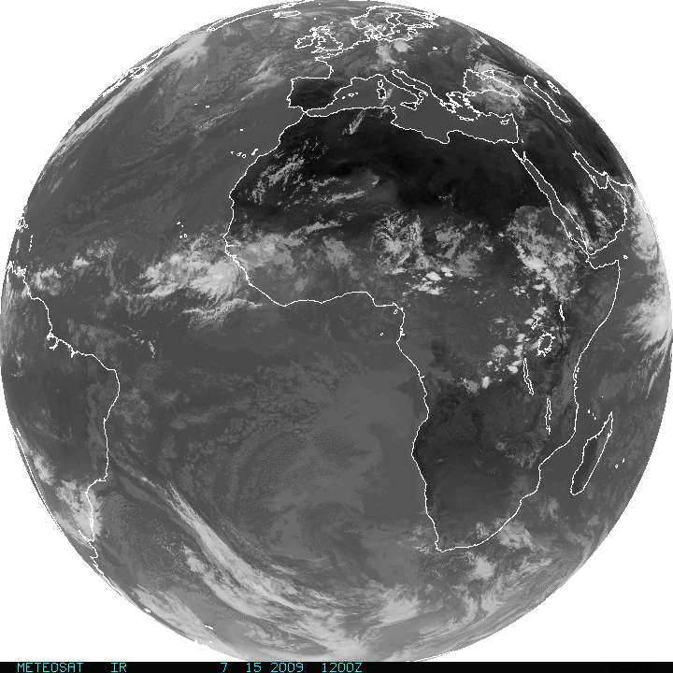
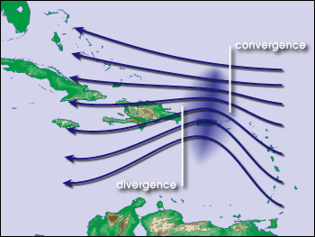
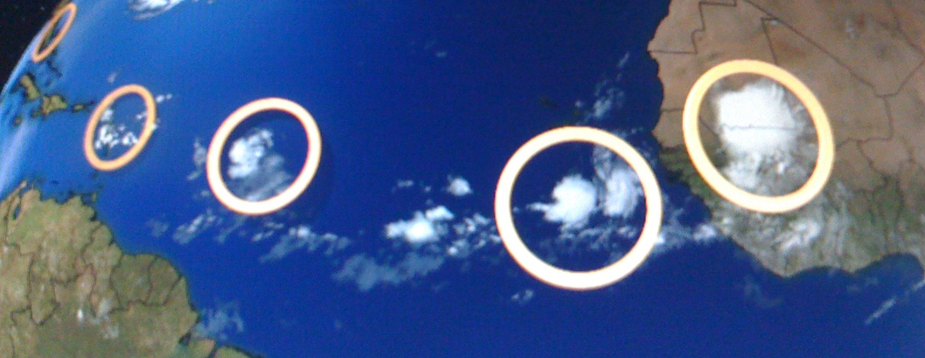
Tropical waves off African coast
Notes:
Tropical waves off African coast. These disturbances are collections of showers and thunderstorms that can lead to a hurricane.

Slide 12
Mechanisms of formation
Strong evaporation over warm ocean water
Latent heat release
High pressure forms aloft
Air moves out laterally
Descending air warms and drawn back into low pressure
Coriolis force starts rotation
Winds speed increase toward the center of rotation
Positive feedbacks develop between air pressure gradient, wind speed, wave height, and evaporation.

Slide 14
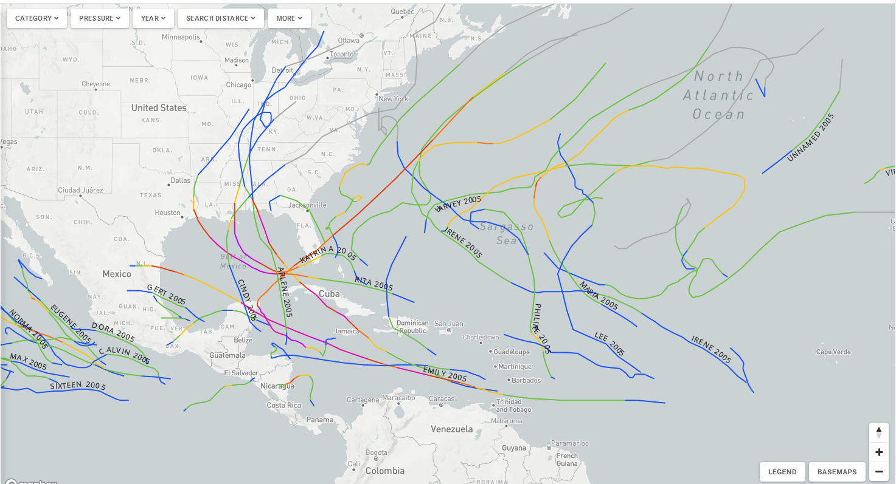
Notes:
https://coast.noaa.gov/hurricanes/#map=4/32/-80

Slide 15
Steering factors
Bermuda STHP
Tradewinds
Westerlies
Polar jet stream
Low and high pressure systems
Notes:
Transient implies that these are not semi-permanent to permanent pressure systems like the Atlantic Subtropical High Pressure – these transient lows are pressure systems that are smaller and tend to last only a few days at most. But their presence is enough to influence the steering of a hurricane.

Slide 16
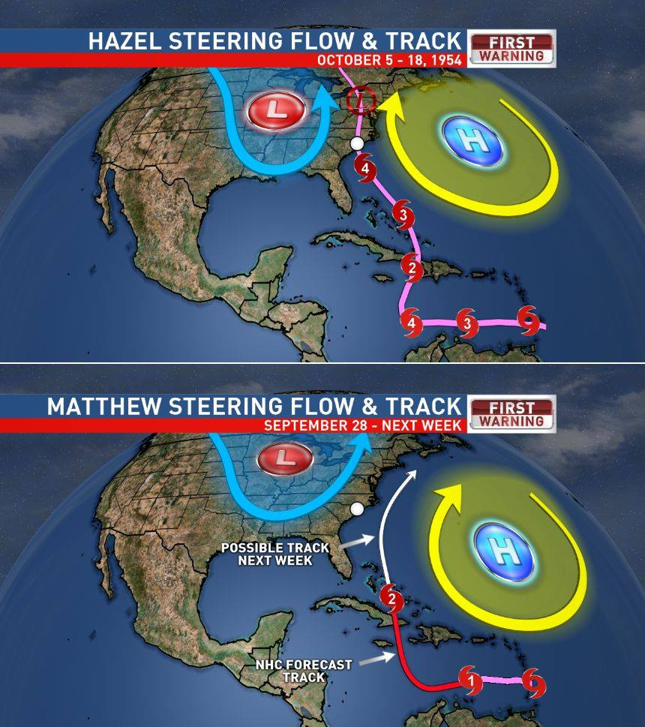

Slide 17
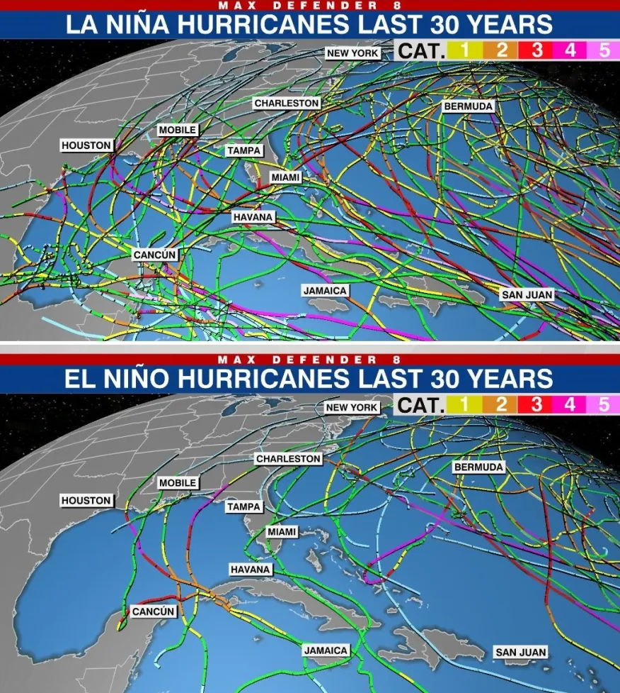
Factors shaping frequency of hurricanes in North Atlantic
El Nino: more hurricanes
Increased westerly wind shear due to polar and subtropical jet stream position breaks apart hurricanes
La Nina: fewer hurricanes
Favorable jet stream positions and decreased westerly wind shear

Slide 18
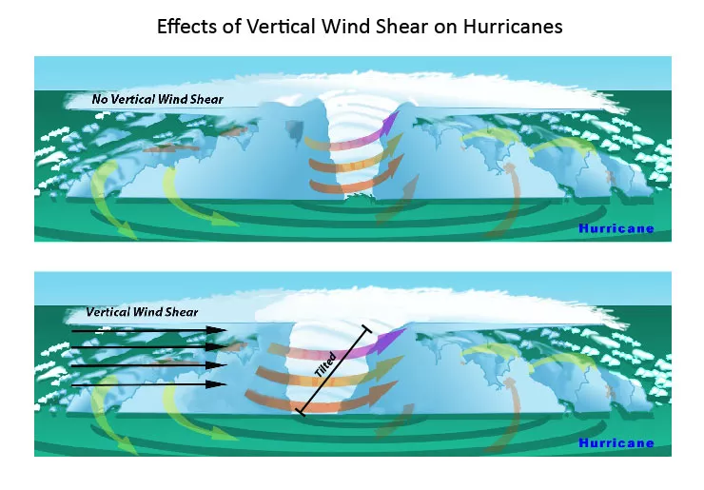

Slide 19
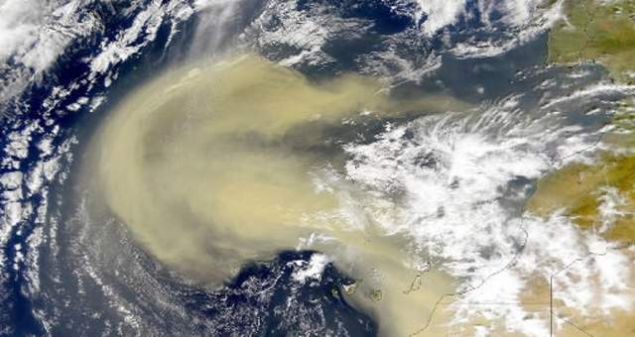

Slide 20
Factors shaping activity of hurricanes in the North Atlantic
Saharan dust
More dust : less active season in the US
Warm dry layer of dusty air limits availability of moist air in lower atmosphere to form thunderstorms
Easterly winds from off the Sahara also cause wind shear and disrupt hurricane structure

Slide 21
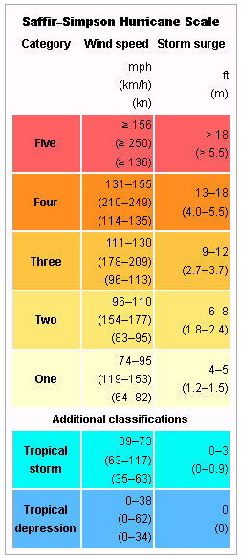
Saffir-Simpson hurricane scale
5 categories although a sixth has recently been proposed
Notes:
Indeed, the majority of hurricane-related fatalities are due to storm surge (~50%) and flooding (~27%).

Slide 22
Category 6 proposed
Winds greater than 196 miles per hour
Hurricane Patricia, 216 mph peak winds, Jalisco Mexico (2015)
Four typhoons in the in the western Pacific
Surigae, 196 mph, Philippines (2021)
Goni, 196 mph, Philippines (2020)
Meranti, 195 mph, Taiwan and the Philippines (2016)
Haiyan, 195 mph, Philippines (2013)

Slide 23
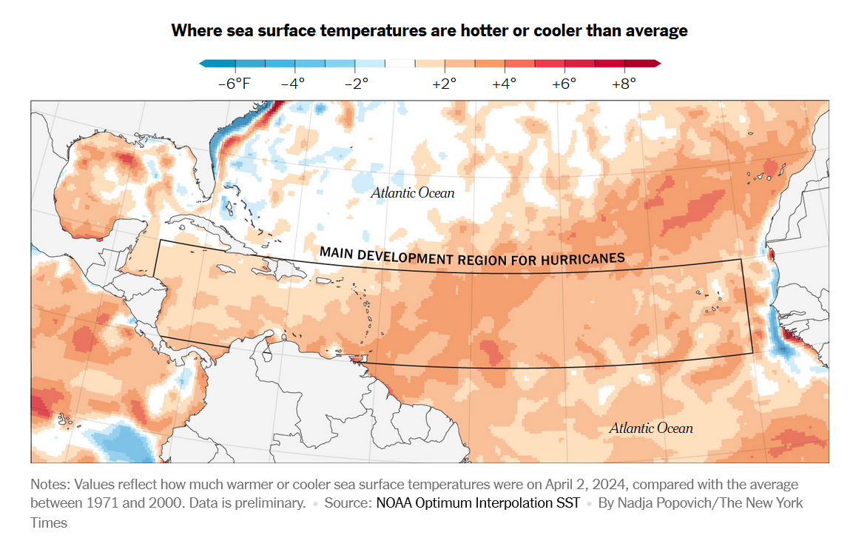
Factors shaping hurricane intensity
Ocean temperatures
Location and position of warm currents
Depth of ocean surface warm layer

Slide 24
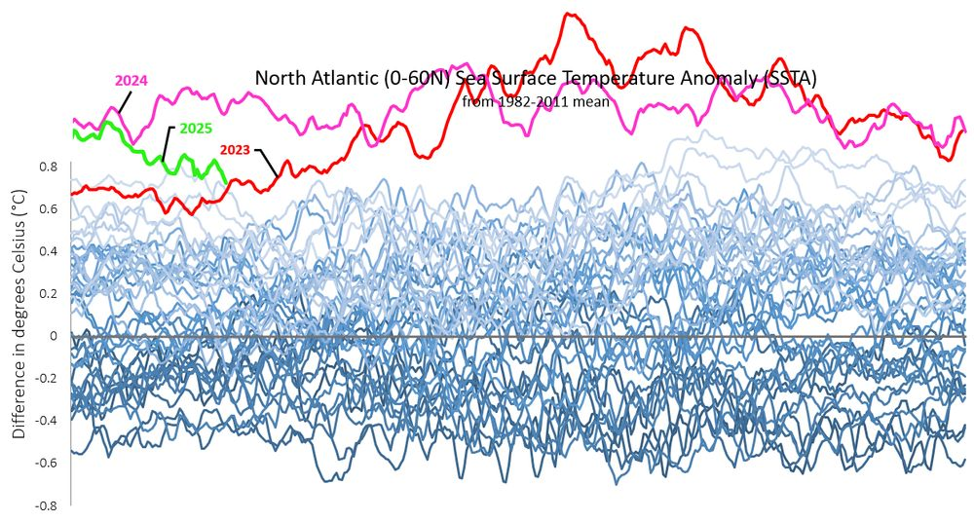

Slide 25
Notes:
http://www.myfoxhurricane.com/custom/models/rtofs/rtofs_current_gulf.html

Slide 26
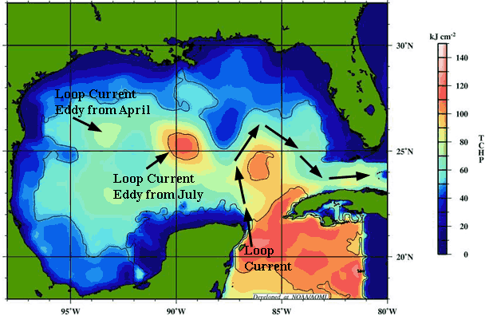
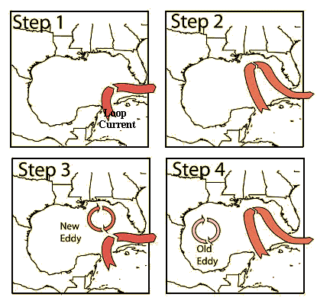
Loop currents
Notes:
Colors indicate temperature of water

Slide 27
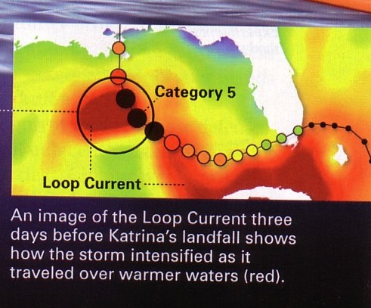
Notes:
Variable position of ocean currents can lead to unexpected changes in hurricane intensity

Slide 28
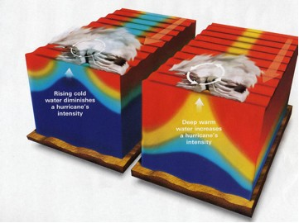
Depth of surface warm water layer
Notes:
Depth of warm ocean water is also important – the deeper the warm surface layer, the less cooler water will be pulled up due to mixing driven by hurricane low pressure and winds. So the thicker this warm layer, the stronger and more sustained a hurricane will be

Slide 29
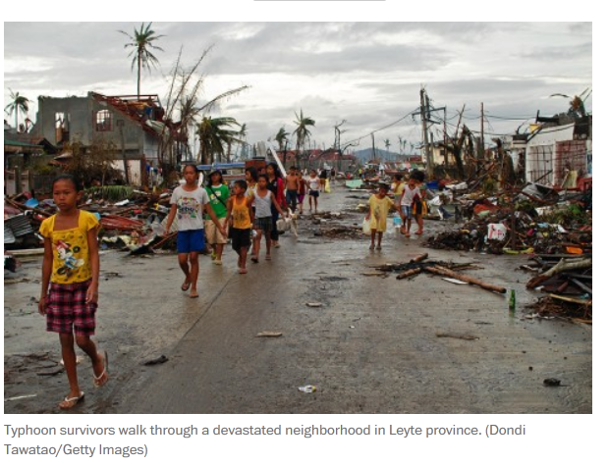
Supertyphoon Haiyan

Slide 30
Notes:
The blue Y axis represents the potential increase in a hurricane’s strength due to warmer water.

Slide 31
Notes:
https://youtu.be/8UJW84Fqhgw?si=m8UWKcQ6b_LpPUpe

Slide 32
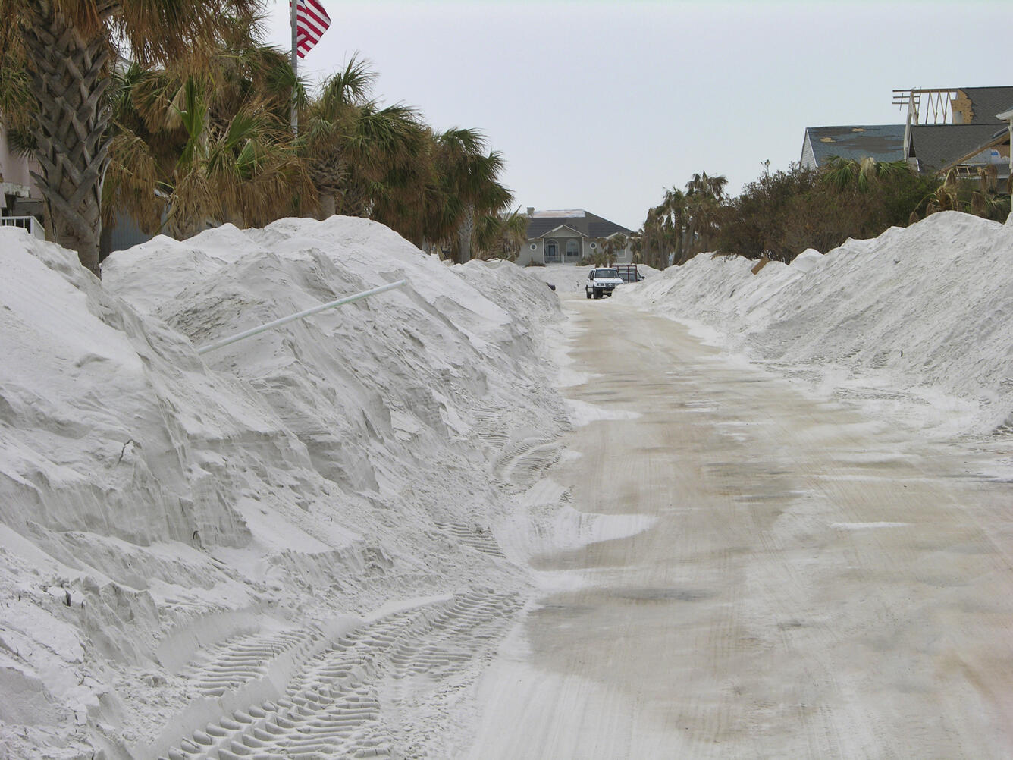
Coastal impacts
High winds
Tornadoes
Coastal flooding
Storm surge
Coastal erosion
Overwash

Slide 33
Hurricane wind field can extend far inland
Notes:
Hurricane wind regime

Slide 34
Tornadoes
Notes:
https://youtu.be/zIornya6eII?si=KWXOODsv-WCWSBy3 These tornados are typically small and short-lived but they can focus higher winds in a small area and increase overall damage

Slide 36
Speed of storm shapes flood potential – slower storms have more time to dump rainfall onto land.
High storm surges can keep inland rainfalls from draining to the sea, accentuating the flooding hazard

Slide 37
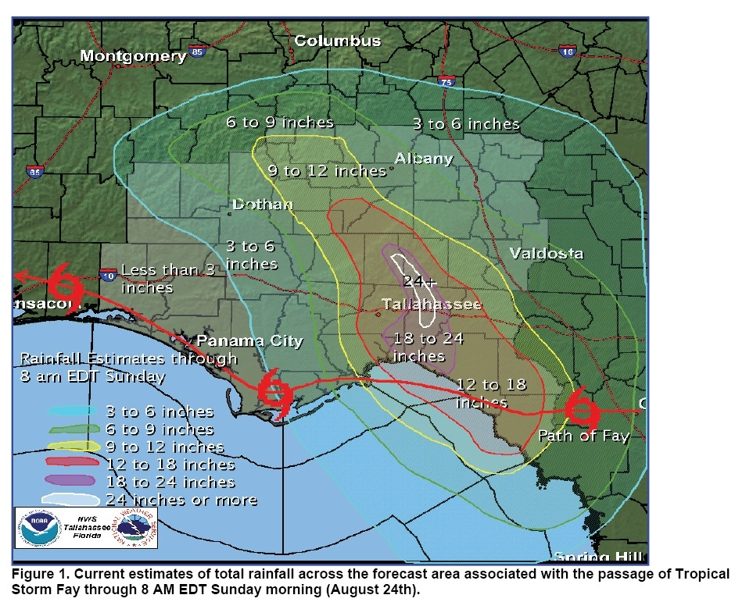
Coastal flooding
Speed of storm shapes flood potential – slower storms have more time to dump rainfall onto land, particularly if they stall just offshore.
Notes:
Speed of storm shapes flood potential – slower storms have more time to dump rainfall onto land.
High storm surges can keep inland rainfalls from draining to the sea, accentuating the flooding hazard Timing of landfall of storm with tidal heights can also shape the magnitude of flooding

Slide 38
Hurricane Harvey (2017)
Notes:
https://www.nytimes.com/interactive/2017/08/24/us/hurricane-harvey-texas.html

Slide 40
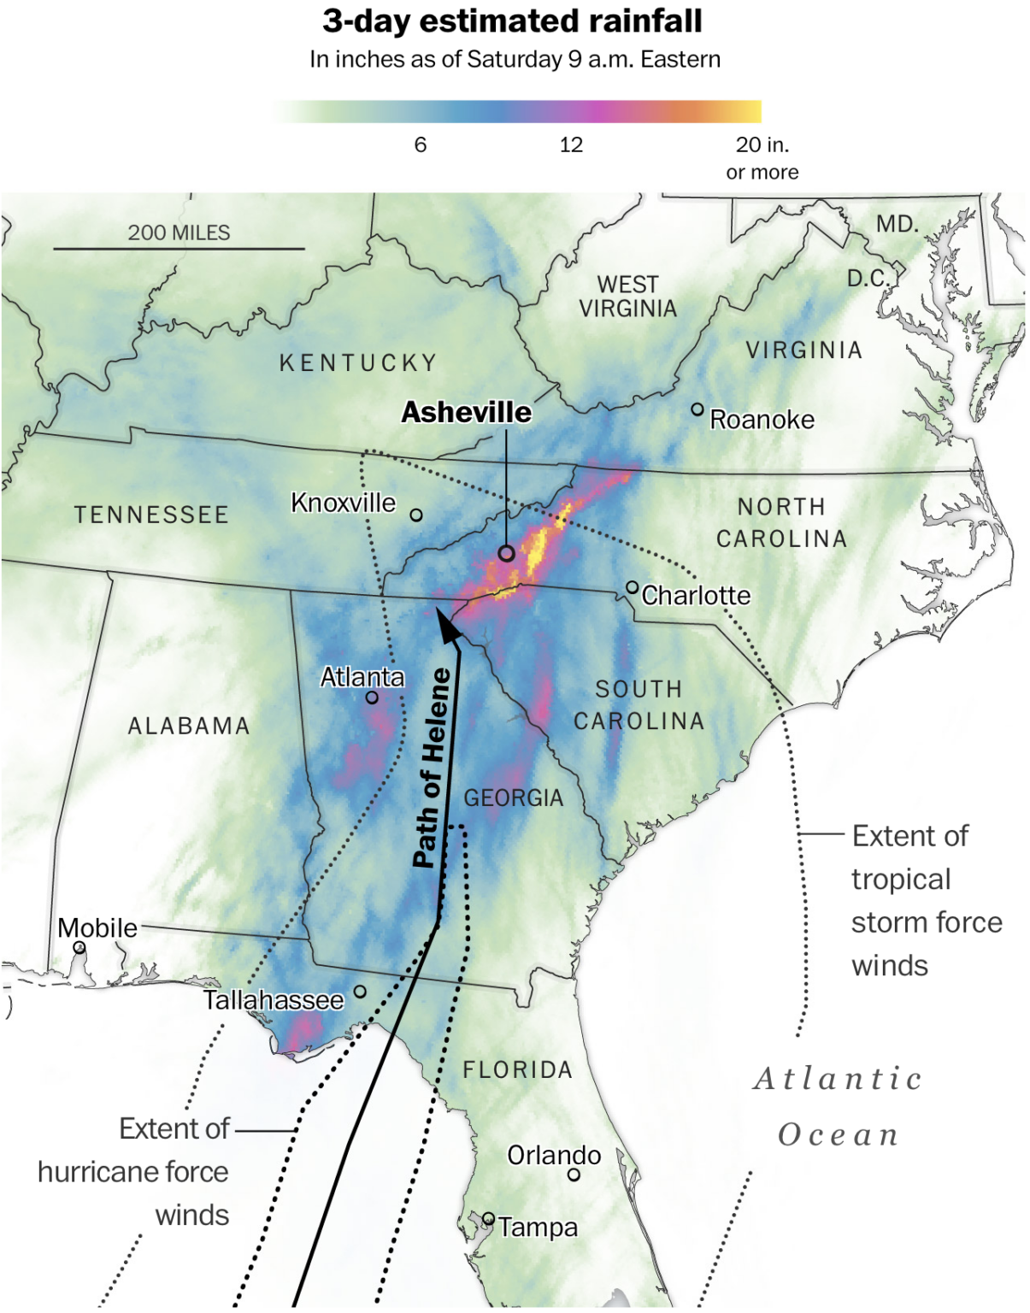
Hurricane Helene (2024)

Slide 41
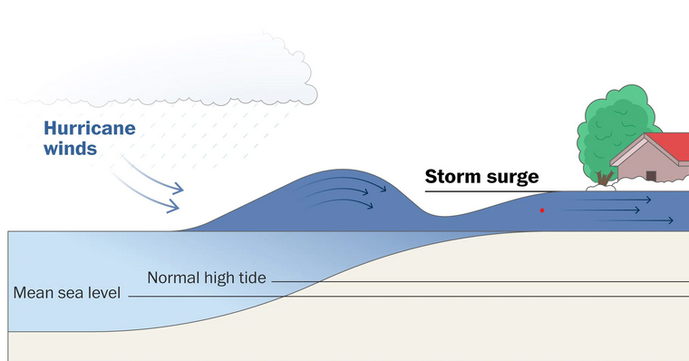
Storm surge
Factors that shape storm surge impacts on the coast
Wind speeds
Land elevation
Wind direction
Storm speed
Timing with tidal levels
Rainfall amounts
Shape of coastline
Notes:
The majority of hurricane-related fatalities are due to storm surge (~50%) and flooding (~27%).

Slide 43
Notes:
https://youtu.be/xCq6mcLwBDI?si=JPgG35PMs0F4OZBA

Slide 44
Coastal erosion

Slide 45
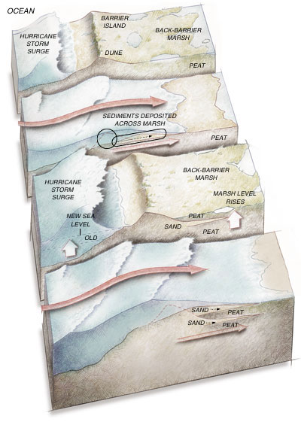
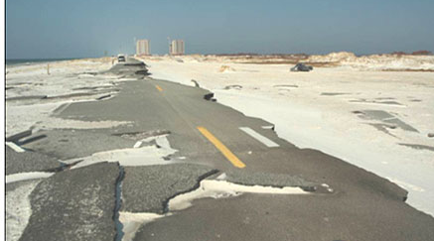
Overwash

Slide 46
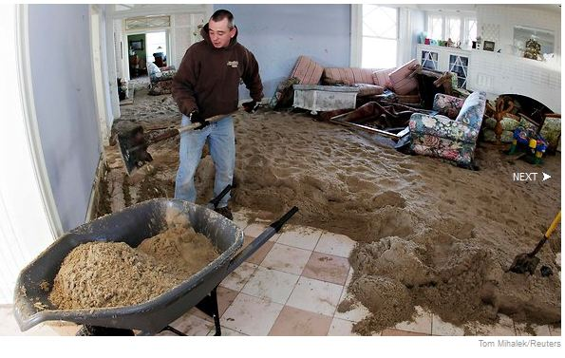

Slide 47
The dangerous versus the less dangerous side of a hurricane
Winds can become more asymmetrical in strength as the hurricane moves close to shore
Winds that blow from off the ocean on to the land are stronger
Close to land, winds will be blowing from off the land and onto the ocean, making them weaker because of surface friction and a lack of warm water for strengthening

Slide 49
