Slide 1
Geographic controls that shape temperature
Altitude
Continentality
Maritime effect
Daily and seasonal temperature lags
Cloud cover and cloud height
Urban land cover

Slide 2
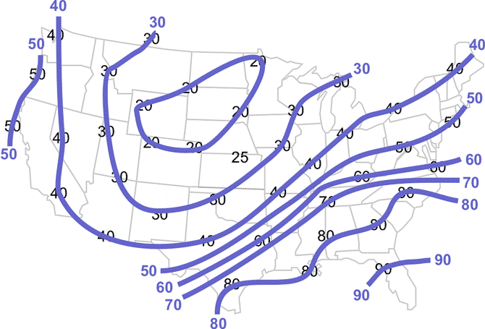
Isotherms
Lines of equal temperature
Contour interval for the map at right is 10 degrees F.
Where contour lines are close together, rapid change in temperature over short distance. Where they are far apart, slow change in temperature.

Slide 3
#1
What explains the packed isotherms and rapid turnover in
temperature at this location?
Notes:
Map shows average global temperatures for January What is an isotherm? Isotherms are lines of equal temperature Contour interval is 5 Celsius degrees

Slide 5
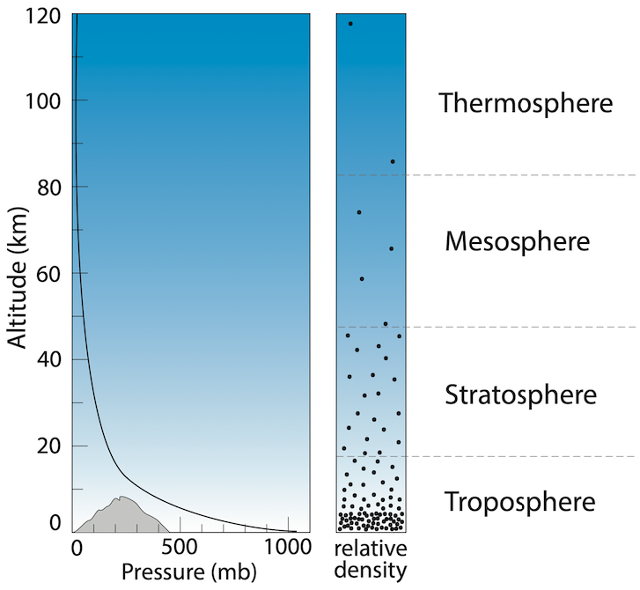
Altitude
As elevation increases, temperatures are cooler
Higher altitude: lower air pressure: fewer molecules to absorb LW radiation (i.e. more radiative cooling
Notes:
Weather takes place in the troposphere

Slide 6
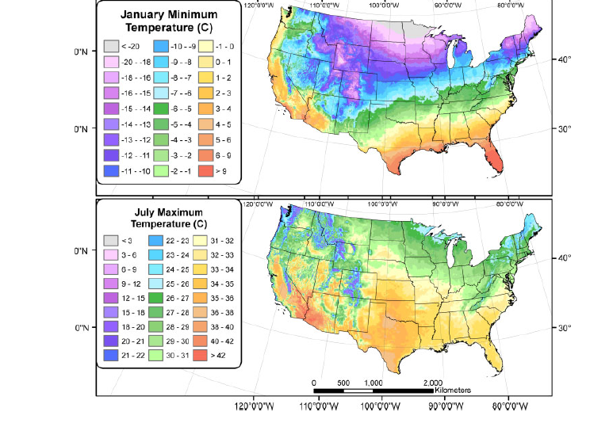
What explains the colder January minimums and the lower July maximum temperatures?
#2

Slide 7
Why are there large annual temperature ranges over interior Canada and Asia?
#3
Notes:
This is a map of annual temperature range in Fahrenheit degrees, the average expected number of degrees separating the high temperatures from the low temperatures. Interior Canada and Asia have very large temperature ranges over a year. Why?

Slide 8
#4
How would the annual temperature for Vancouver and Winnipeg
differ?
Notes:
The climate in Winnipeg is very extreme; overall, it is one of the coldest large cities in the world, with temperatures averaging below freezing from mid-November through much of March (and most nights below −24 °C (-11.2 °F) in mid-winter), although from May to September temperatures often reach 30 °C (86 °F) and sometimes exceed 35 °C (95 °F).
Vancouver's climate is unusually temperate by Canadian standards; after Victoria, it is the second warmest major city in Canada during the winter, with temperatures rarely dropping below 0°C.

Slide 9
Geographic location relative to land and water
Maritime effect
Applies to locations near large bodies of water
Here, temperature ranges are smaller
Continentality
Applies to locations distant from large bodies of water (i.e., landlocked and in the interior of continents)
Larger temperature ranges can be found in Siberia

Slide 10
Notes:
In the winter, the ocean will retain heat from the summer longer and buffer local minimum temperatures. Conversely, in the summer, the ocean will remain cool and buffer local high temperatures. Land, on the other hand, doesn’t have this temperature lag. Land heats up quickly and cools down quickly.

Slide 11
#5
Why is it cooler in south Florida?
Notes:
This is a map of forecasted high temperatures for a day in July

Slide 12
#6
What explains the isotherm shapes highlighted in red over Asia? What explains the isotherm shapes over the north Pacific?
Notes:
Map shows average global temperatures for January Isotherms are lines of equal temperature Contour interval is 5 Celsius degrees

Slide 13
Which hemisphere has the smaller average annual temperature?
#7

Slide 14
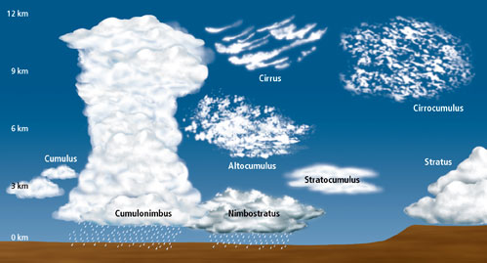
How does cloud cover impact temperature?
Cloudy conditions: small temperature range
Less shortwave coming in and more longwave retained
Clear conditions: larger temperature range
More shortwave coming in and more longwave going out
#8

Slide 15
How does cloud height impacts temperature?
#9

Slide 16
Notes:
Solar noon occurs when the sun is at its highest angle in the sky

Slide 17
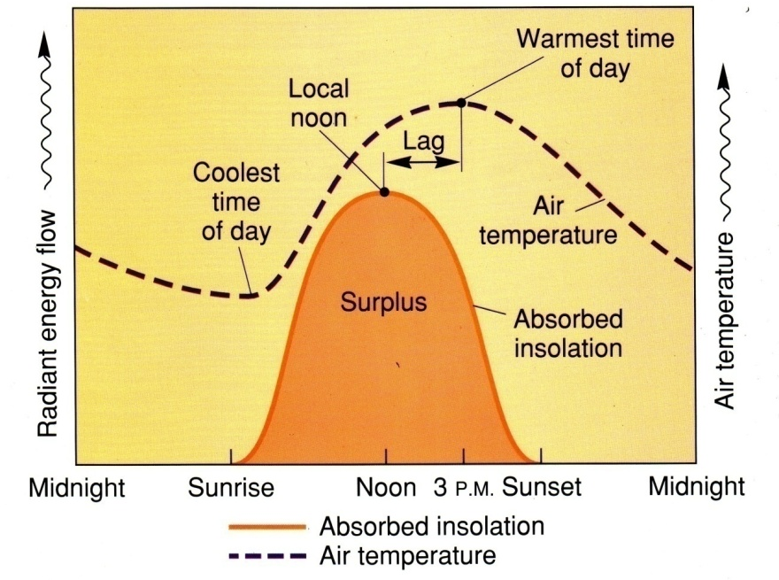
Time of day temperature lags
#10
When are our maximum temperatures in Lexington?
When are our minimum daily temperatures?
Notes:
Our highest temperatures are not at local noon, 12:00 pm, Or at solar noon, when the sun is at its highest angle in the sky.

Slide 18
Time of day temperature lags
Maximum temps occur not at 12 pm or at solar noon but 2-4 hours after solar noon (5 to 6 pm). Lag arises because time is needed for SW to be convert and reemitted as LW radiation and warm the atmosphere
Minimum temperatures occur just after sunrise. At this time, all longwave radiation has been emitted. Even when the sun is rising, there is little shortwave coming in and temperatures will typically reach their minimum then.

Slide 19
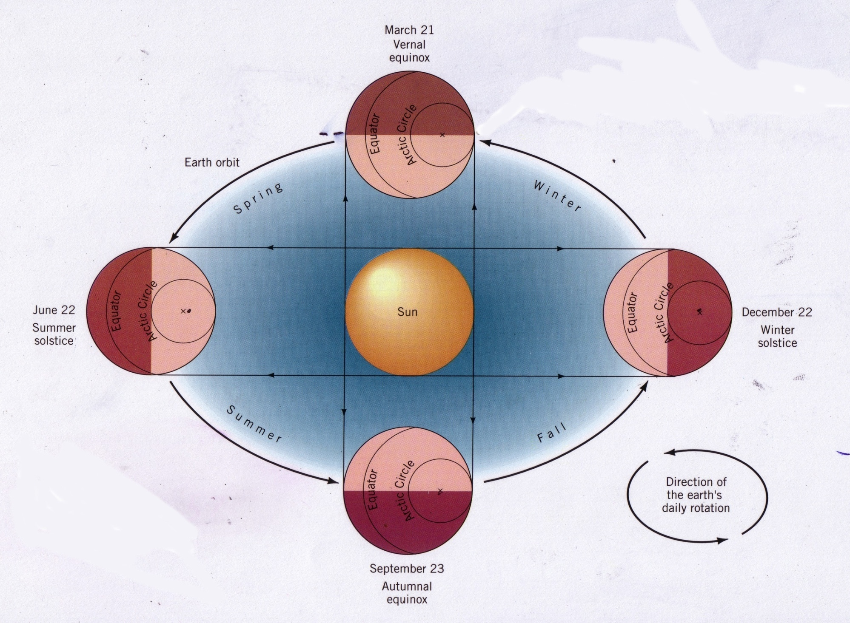
Seasonal time lags in temperatures
#11
Is the coldest day of the year on the winter solstice?
Is the hottest day of the year on the summer solstice?

Slide 20
Dec 21st: the shortest day of the year but coldest temperatures are in January and February
It takes until Jan and Feb for all LW radiation to be emitted and to dissipate
SW radiation coming in is increasing after Dec 21 but overall it is a small amount
June 21^{st:} the longest day of the year but warmest temps aren’t until August
Peaks in incoming SW radiation are in June but it takes until August for all LW to be emitted to maximally warm the atmosphere

Slide 21
Other geographic factors impacting temperature: urban heat island effects
Notes:
Heat arises from human-sources: cars and industry, Celsius temperature is on the left side and Fahrenheit is on the right.

Slide 22
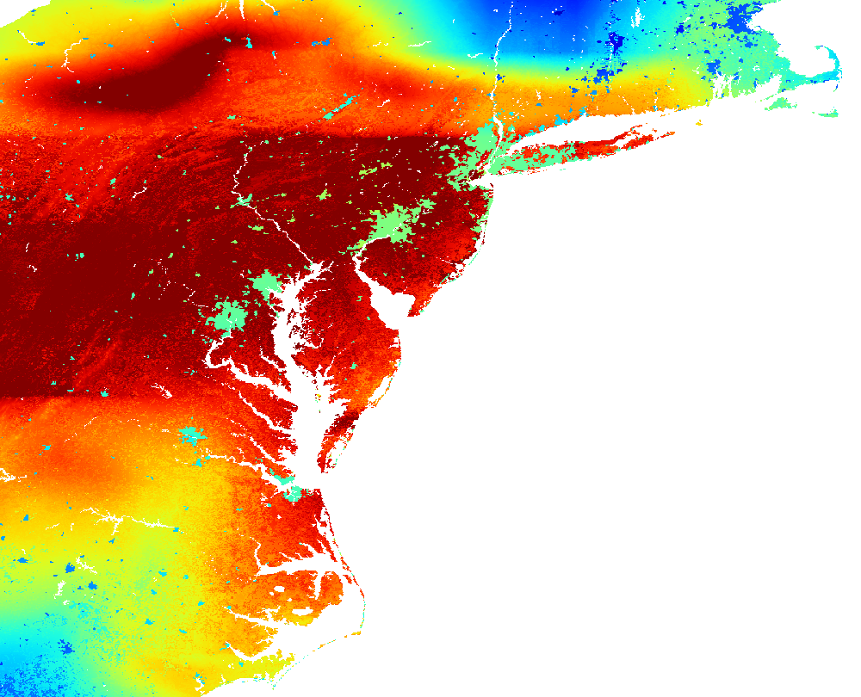
Why are urban areas warmer?
#12
Greater release of sensible heat from the combustion of fuels for transport and industry
Conductive warming and transfer of heat among buildings and paved surfaces
Less conversion of sensible heat to latent heat because less water available for evaporation
Less escape of longwave radiation to space because of urban canyons and particulate matter air pollution
Greenhouse gas production is higher in cities
Notes:
https://svs.gsfc.nasa.gov/3156/ This figure shows cities of the east coast of the US. They stand out on the map because there is less water in cities. They are covered with impervious surfaces – asphalt, concrete, roofing material. Water does not stick around after a rain event in a city, it tends to drain away quickly. This lack of water and moist soils lessens the amount of evaporation that can take place. Evaporation is a cooling process. Cities are warming than their more vegetated surroundings because there is less evaporative cooling in cities.

