Slide 1
Humidity
Measure of the quantity of water vapor in the air
Overall atmosphere is 78% nitrogen, 21% oxygen, and only 1% water vapor.
Warm air can hold more water vapor than cold air
Idealized representation of the atmosphere: a “parcel” of air

Slide 2
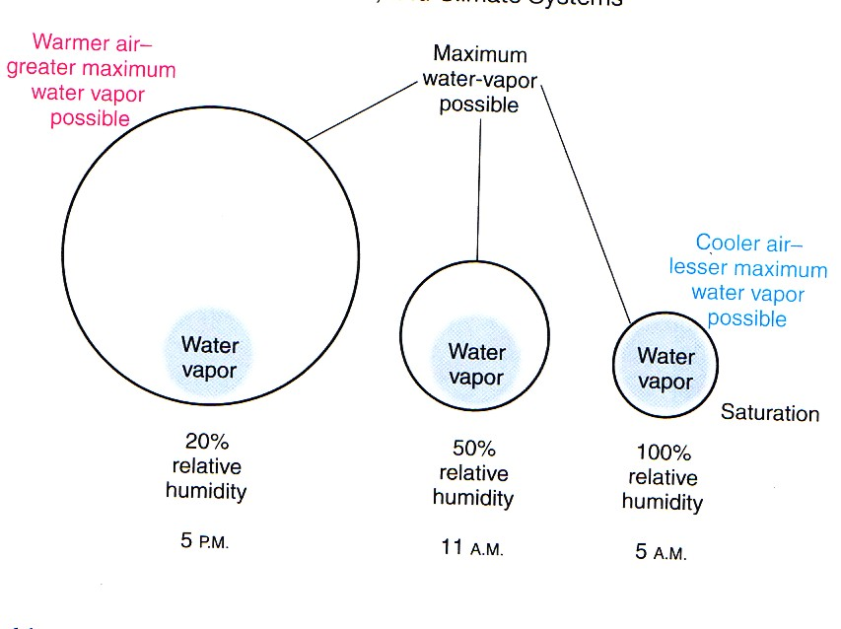
What are our diurnal patterns of humidity?

Slide 3
When RH = 100%
Air temp = dew point
AMR = SMR
Air is saturated with water vapor
Water condensates out of air
Suspended liquid water droplets form in the air, creating the potential for dew, frost, fog, and clouds

Slide 4
To reach RH = 100%
Add more water vapor to the air
Cool the air down to its dew point temperature
Lower the air pressure of the parcel which would lower its temperature. This is called adiabatic cooling.

Slide 5
Heat index
When RH is high, air is near dew point temperature and is close to the maximum amount of water vapor it can hold
Inefficient evaporative cooling for humans
Temp experienced by humans is higher than air temp
Notes:
Risk of heat exhaustion or heat stroke

Slide 6
Dew
High humidities during the day
Clear night with radiative cooling
Air temp cools to dew point
Condensation forms right at surface as dew

Slide 7
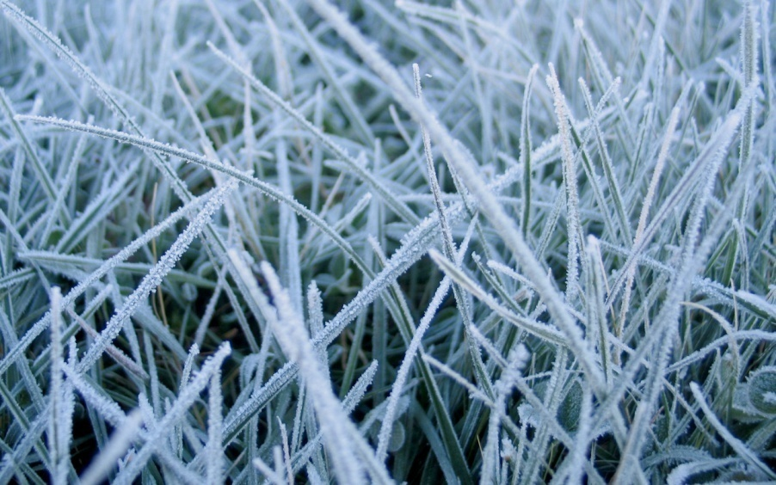
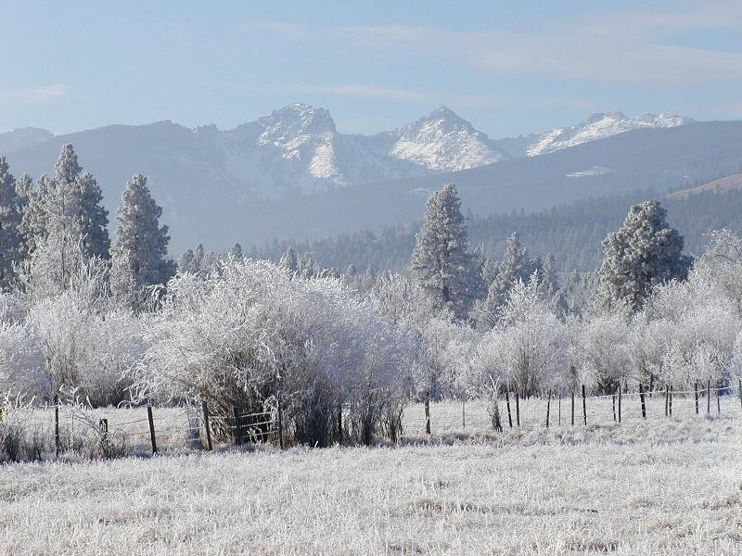
Frost
Radiation frost
Occurs on days with high humidities and clear calm nights
Dew point temperature goes below freezing a few inches above the surface
Advection frost
More common on cloudy, windy nights with strong cold air advection
Dew point temps go below freezing
Deeper freezing layer coats ground and trees

Slide 8
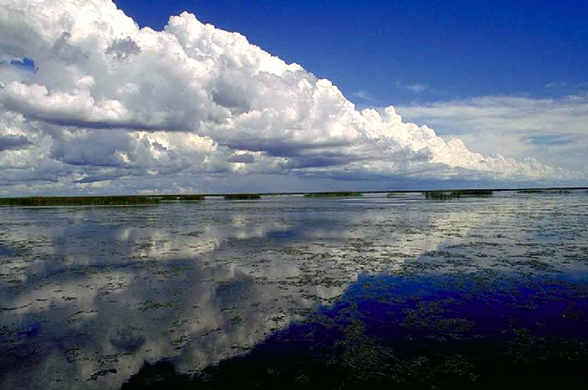
Clouds
Clouds are liquid water droplets formed from the condensation of water vapor when air is cooled to its dew point
Notes:
High clouds can be comprised of ice particles

Slide 9
Most of the water vapor is at the surface How can we get this surface water vapor to cool, condensate, and form clouds up high?
Upper
troposphere
Surface
Water vapor at surface shown in red. The y-axis
denotes altitude above the surface as a function of air pressure.

Slide 10
A lifting mechanism is needed: If you can get the surface air with water vapor to rise, cool down to its dew point temperature and condensate to form clouds
Upper
troposphere
Cooler aloft
Surface
Surface

Slide 11
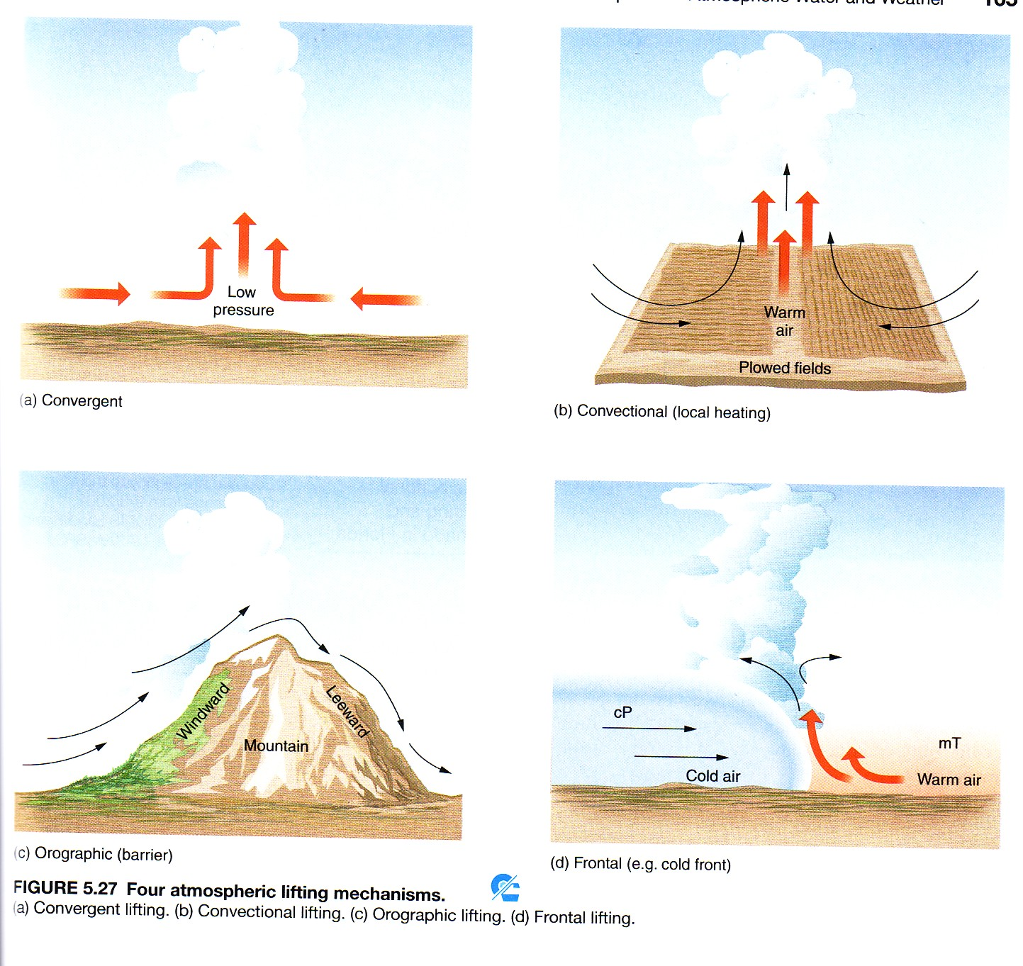
Lifting mechanisms
Wind convergence
Convectional heating
Orographic lifting
Frontal lifting

Slide 12
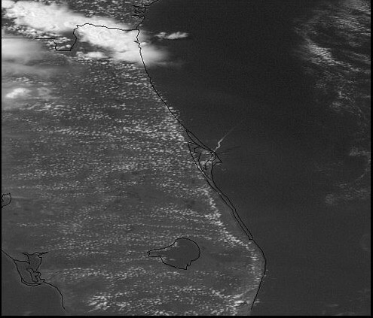
Lifting mechanisms
Surface heating

Slide 13
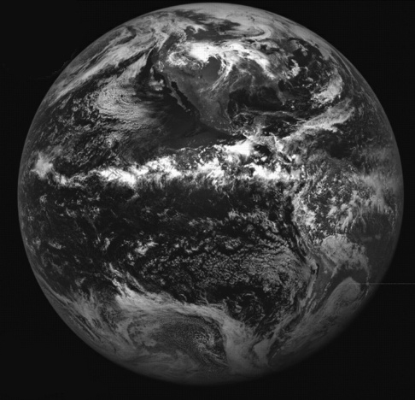
Lifting mechanisms
Wind convergence and surface heating along the ITCZ, the Intertropical Convergence Zone, on the Equator
Notes:
ITCZ, zone of wind convergence and surface heating leading to low pressure and cloud formation

Slide 14
Orographic lifting, also known as the rainshadow effect
Rain falls on one side of mountain range but not the other
This side typically faces the prevailing winds coming off of an ocean
Air is rising and cooling on windward side of mountain to produce rain
Air is sinking and warming on leeward side
Can produce rainshadow deserts like those found in Eastern Oregon and Western Washington

Slide 17
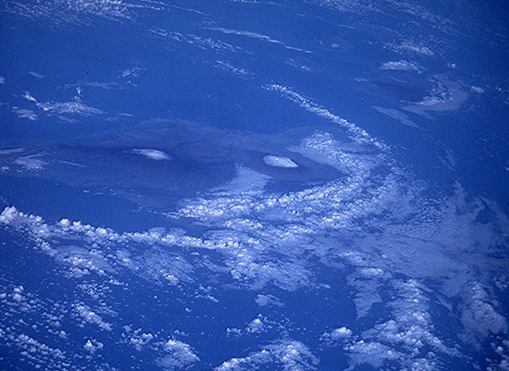
Orographic lifting
Direction that predominant winds are
blowing

Slide 18
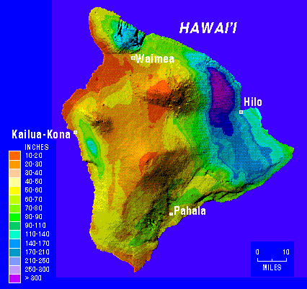
Orographic lifting
Notes:
Rainshadow effects on Hawaii

Slide 19
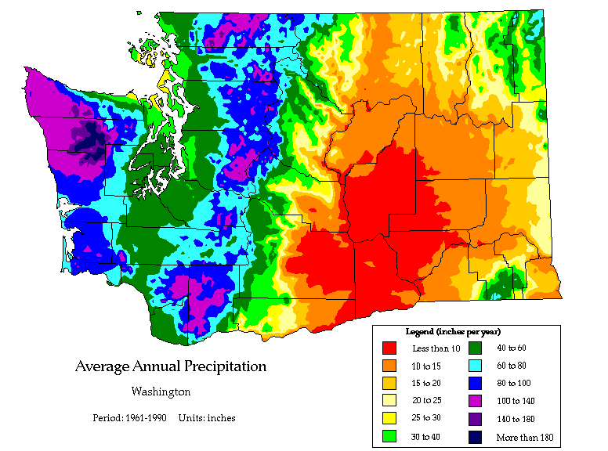
Notes:
Rainshadow effects in Washington State.

Slide 20
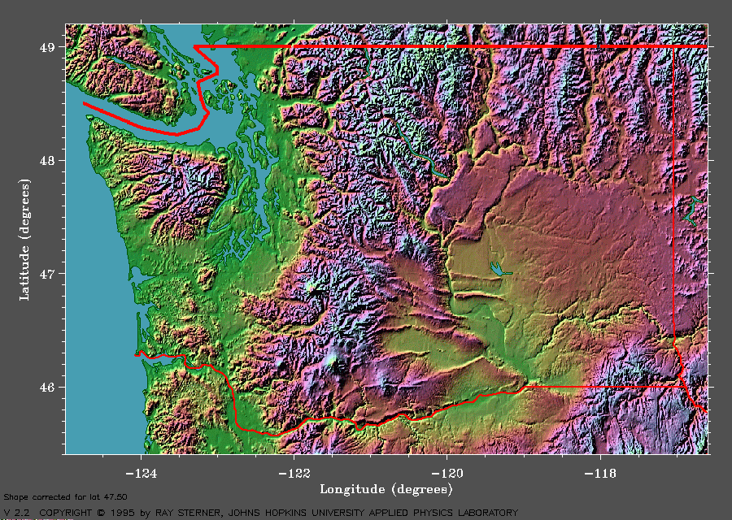
Notes:
Topography of Washington state

Slide 21
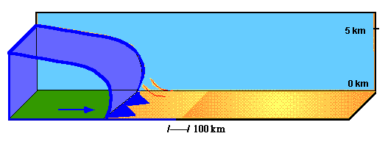
Frontal lifting
Notes:
Cold front

Slide 23
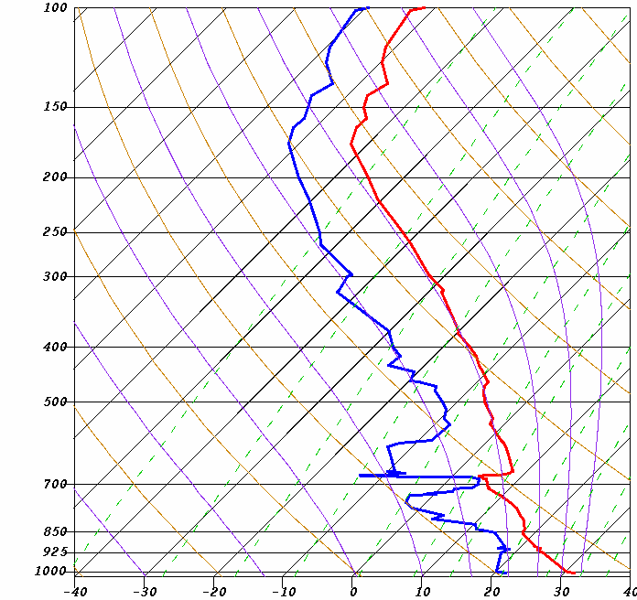
Skew t plots
Upper
troposphere
Used by meteorologists to predict the weather.
The red line shows air temp and the blue line shows dew point temp as it changes going up in the atmosphere
Clouds are likely to form where dew point equals the air temperature
Air pressure in millibars (mb)
Surface
Notes:
Tracking the temperature and dew point of a parcel of air as it is lifted through the atmosphere can be visualized in a skew-t plot, a common tool of meteorologists. Clouds are likely to form at the 700 mb level, several thousand feet up.

Slide 24
Atmospheric stability
A measure of the probability of cloud formation
Weather prediction is predicated upon knowing whether lifting is likely to be promoted or resisted
Unstable atmosphere – lifting is promoted, air rises, cools, condensates and forms clouds, and potentially, rainfall.
Stable atmosphere – lifting is resisted, even if lifted, air will not continue to rise but will sink. No clouds, clear conditions.

Slide 25
Notes:
Plastic bottle sealed at 14,000 feet, at 9000 feet, and 1000 ft (in Hawaii). Where would the air in the bottle be the coolest? The warmest? What would happen to temperature in the bottle as you went down in altitude? As you went up?

Slide 26
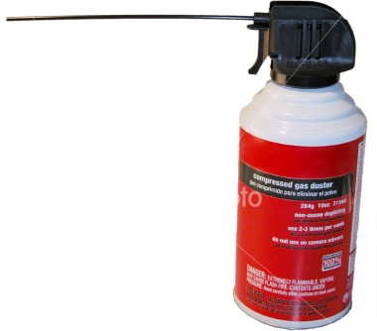
Adiabatic cooling and warming
Changing the temperature of a parcel of air by changing air pressure
Adiabatic cooling: parcel is lifted, surrounding air pressure decreases, and air parcel expands, parcel temp decreases
Adiabatic warming: parcel descends, surrounding air pressure increases, parcel contracts, parcel temp increases
Notes:
No heat is added from outside in adiabatic processes – temperature change is a function of changing air pressure

Slide 27
Stable atmospheric conditions
Clear skies; any rising motion is resisted. Low to no cloud
development. If clouds develop, high and thin.

Slide 28
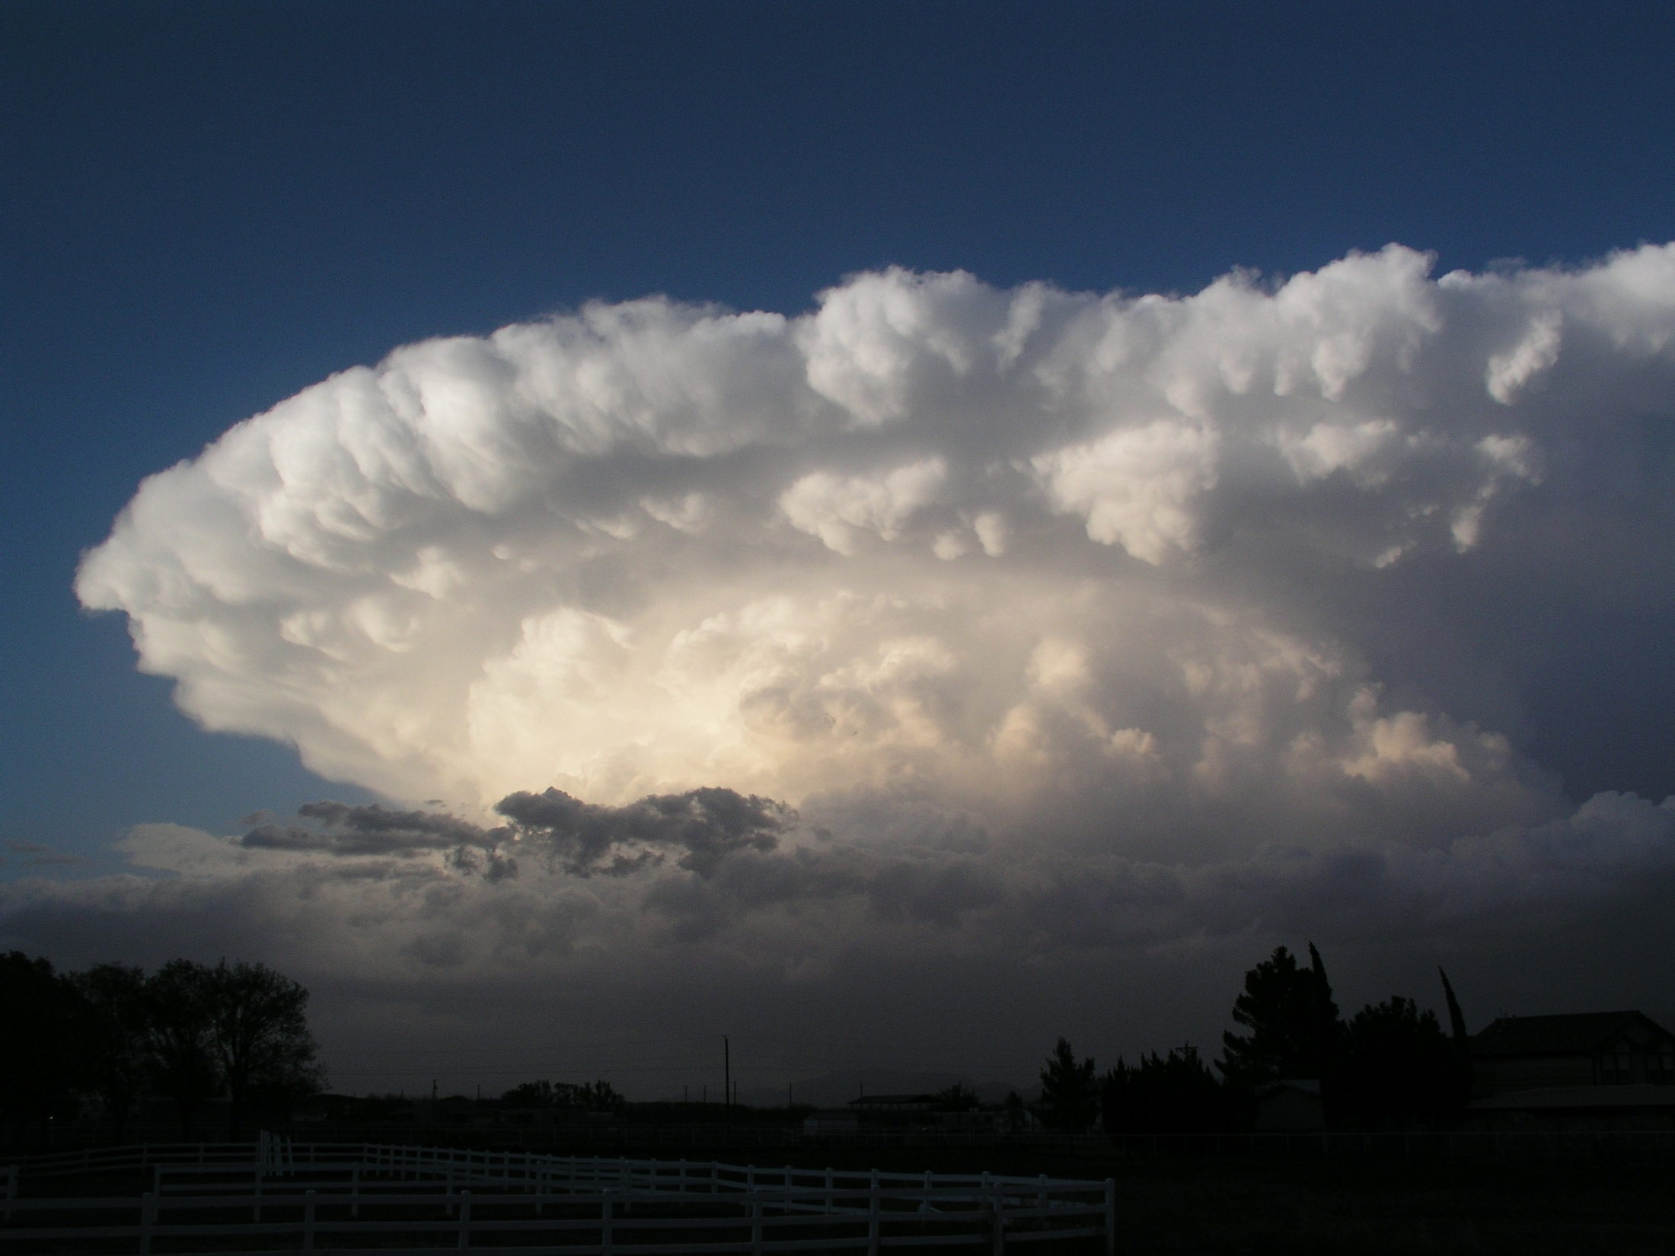
Unstable atmospheric conditions
A thunderstorm, a hallmark of unstable atmospheric conditions. Atmosphere promotes vertical motion and
cloud formation.
Notes:
Cumulonimbus clouds

Slide 29
Conditional instability
Conditional instability is the most common state of the atmosphere.
Air is stable at the surface, but with enough lifting it can become unstable and rise on its own.

