Slide 1
Air masses
Large body of air with uniform temperature and moisture
Air acquires characteristics from underlying surface
Air masses that influence eastern US
Maritime tropical air mass from Gulf of Mexico/Atlantic
Warm and moist; potentially unstable
Continental polar air mass from interior of Canada
Cool and dry; stable
Arctic air mass from North Pole and Siberia
Extremely cold and dry, stable

Slide 3
Fronts
Boundary between two air masses
Type of front is designated by the air mass that is moving
Cold front-cold advances on warm
Warm front-warm advances on cold
Stationary front-neither warm nor cold air mass is moving

Slide 4
Notes:
Cold front

Slide 5
Notes:
Warm front

Slide 6
Notes:
Cloud types differ in association with frontal type. Stratus clouds are more often associated with the passage of a warm front. Cumulus clouds are more often associated with the passage of a cold front.

Slide 7
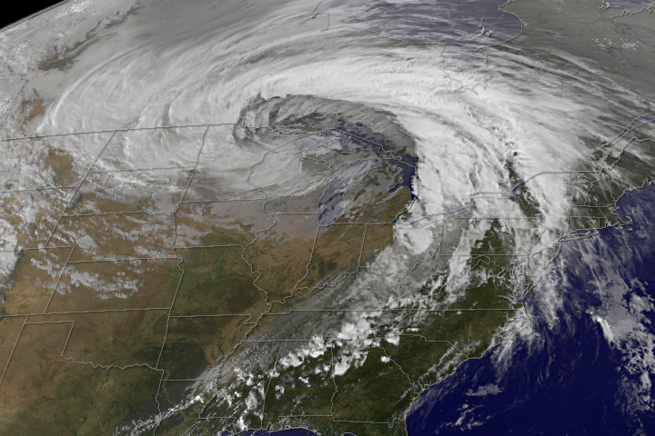

Slide 8
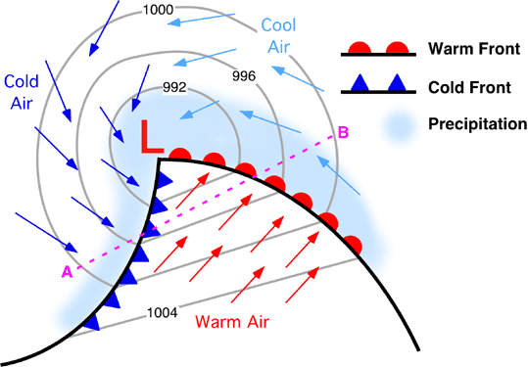
Midlatitude cyclones
Large low pressure storm system consisting of a warm and cold front
Dominant weather system for US in winter
Develops along the polar jet stream
Migrate west to east in westerlies
Also called extratropical cyclones
Can create predictable contrasts in weather conditions
Active in Lexington from fall, through winter into spring

Slide 9
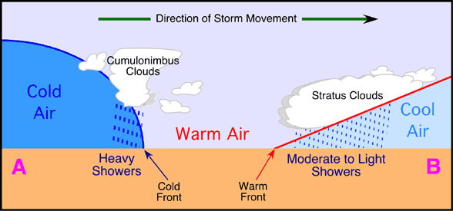

Slide 12
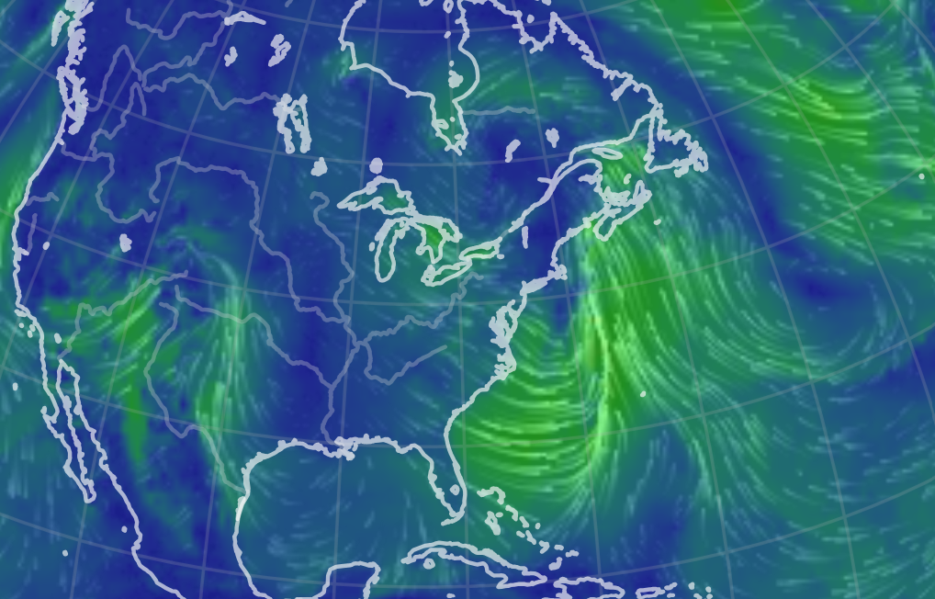

Slide 13
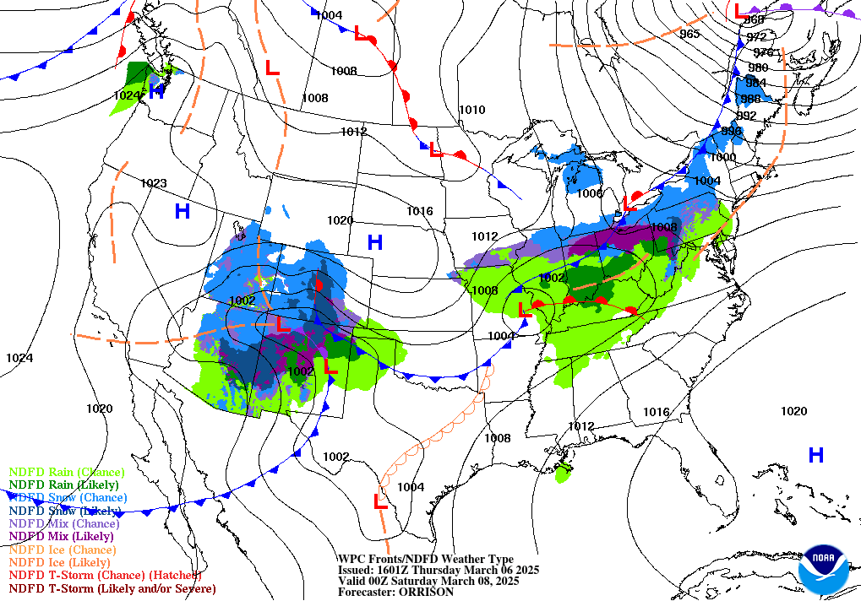

Slide 14
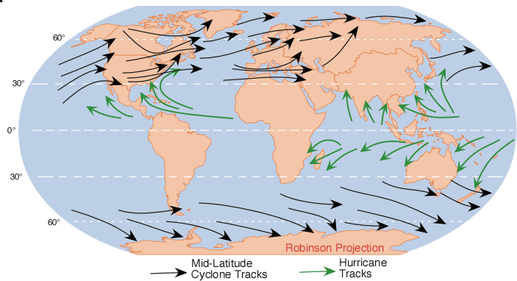
Notes:
Note the differences in where midlatitude (extratropical) storms occur and where hurricanes (tropical storm systems) occur.

Slide 15
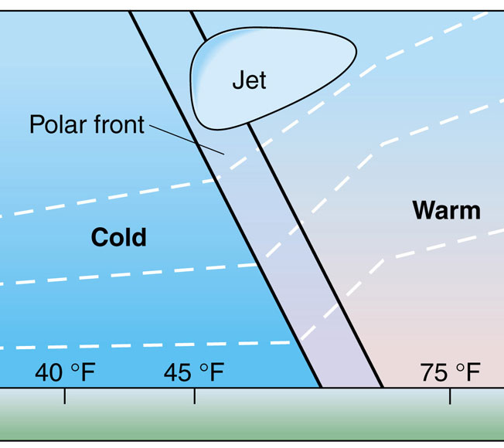
Cyclogenesisn – formation of a MLC
Requires interaction of surface and upper atmospheric processes
Surface conditions:
Strong baroclinity: a sharp contrast in temperatures over a short distance.
This enhances surface low pressure, instability, and surface lifting
Upper atm conditions:
Passage of an upper level low pressure that enhances lifting motions higher up
Lows are called ‘troughs’ in the upper atmosphere, highs are called ‘ridges’
Notes:
Cyclogenesis: formation of a midlatitude cyclone (MLC)

Slide 16
This is a map of geopotential heights showing the position of the polar jet stream
Cold air
Warm air
Low pressure trough
Open low (circulation is not closed). The trough creates downstream speed and directional divergence that enhances instability
High pressure ridge
Open high (circulation is not closed)
Surface winds on a surface isobaric map
Cold air
Warm air
Notes:
Note that there is an upper level low and a surface low that are needed to form a midlatitude cyclone.

Slide 17
Early stage
Open wave stage
Zone of strong surface baroclinity
Dissipating stage
MLCs lose organization 7-10 days after redistributing the heat that powers them
Occluded stage
Occluded front formation marks a decaying MLC.

Slide 18
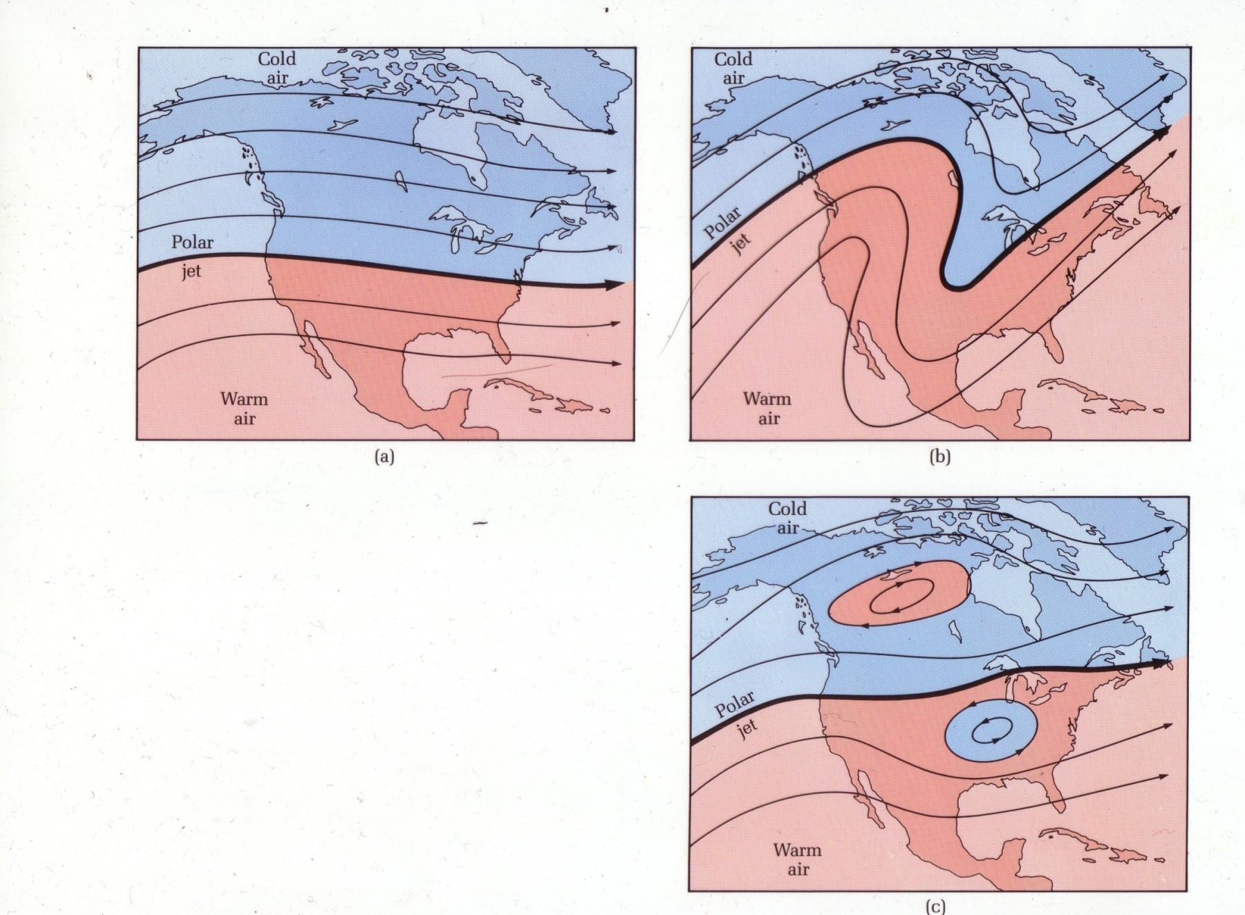
MLC’s balance the heat budget
Azonal polar jet stream flow
(waves develop in the polar jet stream)
Zonal polar jet stream flow
3. Back to zonal flow

Slide 19
MLC conveyer belts
Lifting and mixing of air occurs along ‘conveyer belts’ in MLCs
This can create the patterns of precipition, including where rain, sleet, snow or freezing rain occur

Slide 20
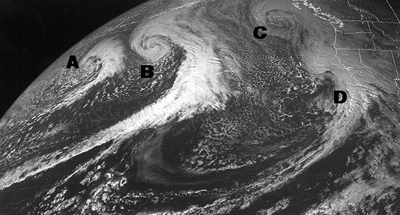

Slide 21
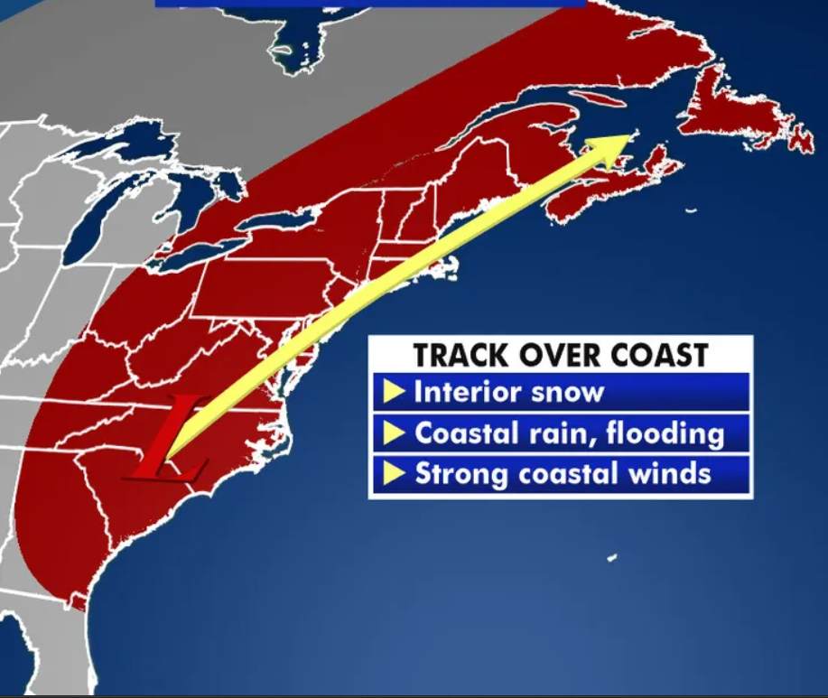
Nor’easters
These are midlatitude cyclones that become very strong
These storms can strengthen rapidly and produce heavy rain, snow, coastal flooding and wind as they follow their typical track up the US eastern coast
Winds can be as strong as a hurricane and impacts occur over much wider area than hurricanes

Slide 22
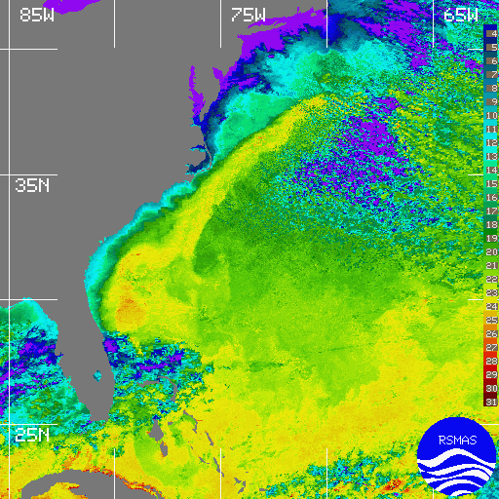
Notes:
The Gulf Stream. Because of the warm currents extending far up the coast, there is a potential for large contrasts in temperature between the cold land surface and warm ocean water. These contrasts would be particularly well developed in winter. North Carolina is the location where many nor’easters intensify due to the proximity of warm water to the cold land surfaces.

Slide 23
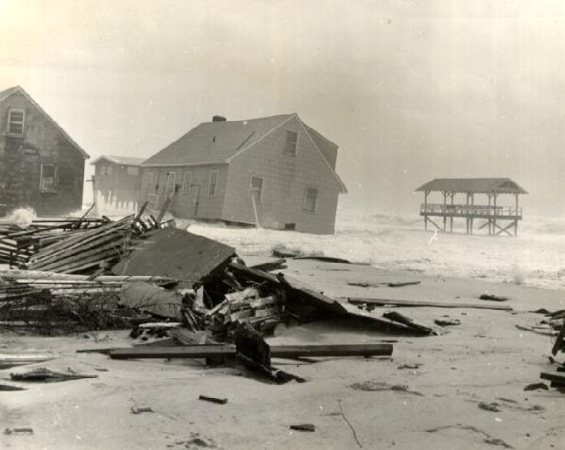
Notes:
Damage from Ash Wednesday nor’easter.

Slide 24
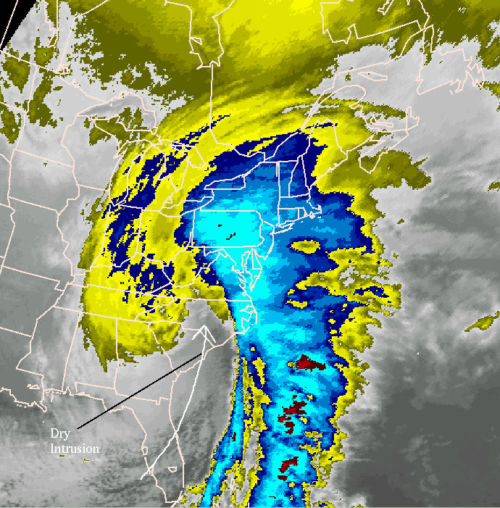
Notes:
Famous nor’easters: The Perfect Storm (1991)
Ash Wednesday Storm (1962) Storm of the Century (1993)

Slide 25
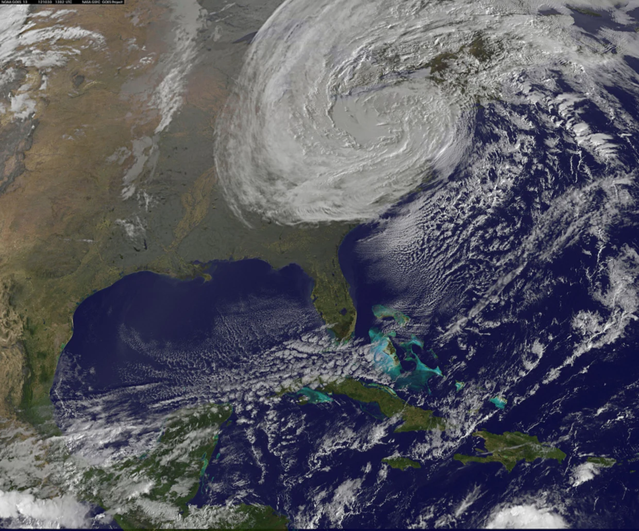
Superstorm Sandy (2012)
Began as a hurricane
Tropical storm characteristics merged with a nor’easter
Hybrid storm that created a very large wind field and flooded many coastal areas in New Jersey-New York City area
Notes:
https://www.nbcnews.com/id/wbna49611057

Slide 26
