Slide 1
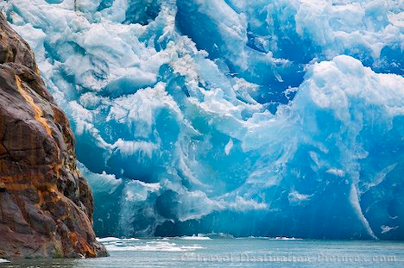
Glacial and periglaical landforms and processes

Slide 2
Glacial versus periglacial landforms
Glacial landforms are created directly by the movement and melting of glaciers. These landforms are the result of the erosive and depositional power of ice.
Periglacial landforms also form in areas that are cold but not covered by glacial ice. These landscapes are shaped by freeze-thaw cycles, permafrost dynamics, and seasonal ground ice.
While glaciers sculpt terrain through the movement of solid ice, periglacial processes alter the landscape through the expansion and contraction of water as it freezes and thaws in the soil.

Slide 3
Glaciers: a large mass of perennial ice fully or partially resting on land
Occur in high-latitude polar environments and high-altitude mountain environments (alpine)
Formed under the accumulation and recrystallization of snow
Flows slowly under the pressure of its own weight and the pull of gravity
Glacial mass balance is the difference between the amount of snow and ice a glacier gains and the amount it loses over a a year. It reflects whether it is growing, shrinking, or remaining stable

Slide 4
Types of glaciers
Cirque glaciers – form in the upper head of a valley in a mnt range. These can grow over time and begin flowing downhill as valley glaciers
Valley glaciers - flow down mountain valleys glaciers and confined by the walls of the valley
Piedmont glaciers – develop when steep valley glaciers spill out onto relatively flat plains at the base of a mountain range. Ice spreads out when no longer constrained by valley walls.
Tidal glaciers – terminate in the ocean where glaciers ‘calve’ and break off. Glacial movement is influenced by tides and ocean water dynamics.

Slide 5
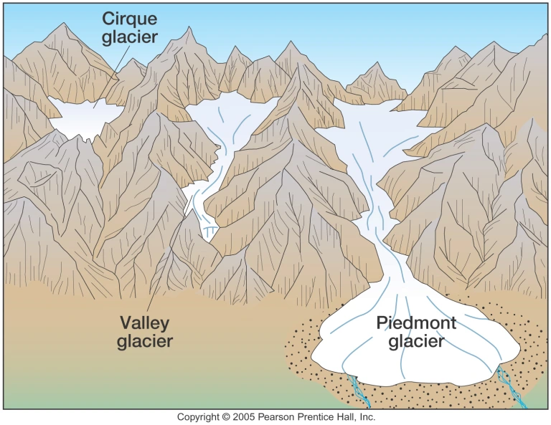

Slide 6
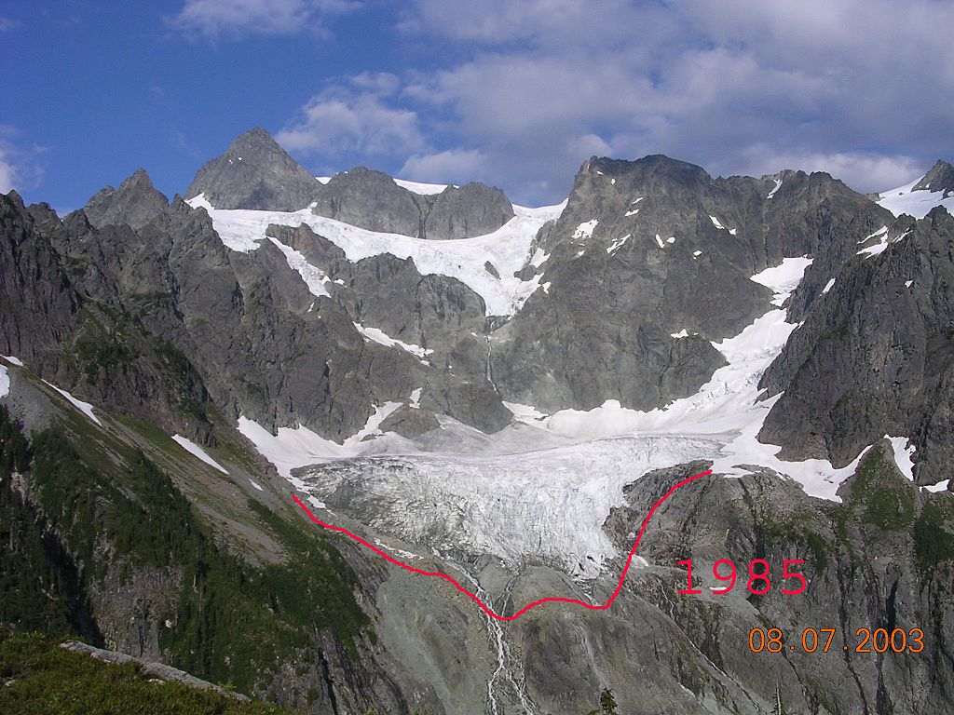
Notes:
Cirque glacier

Slide 7
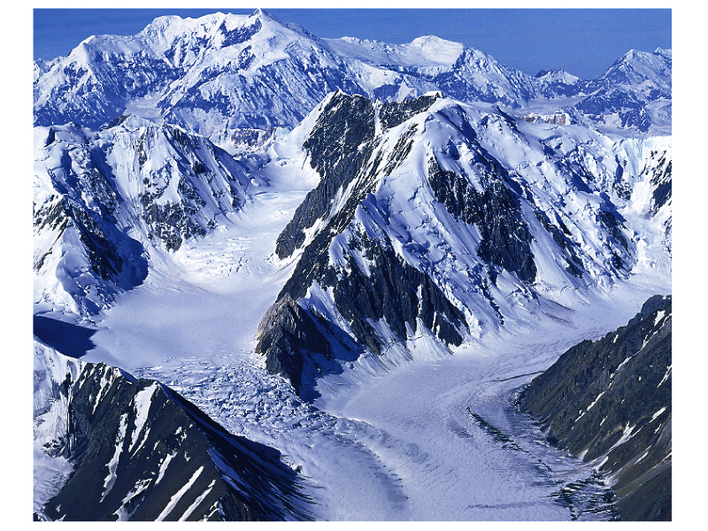
Notes:
Alpine or valley glacier

Slide 8
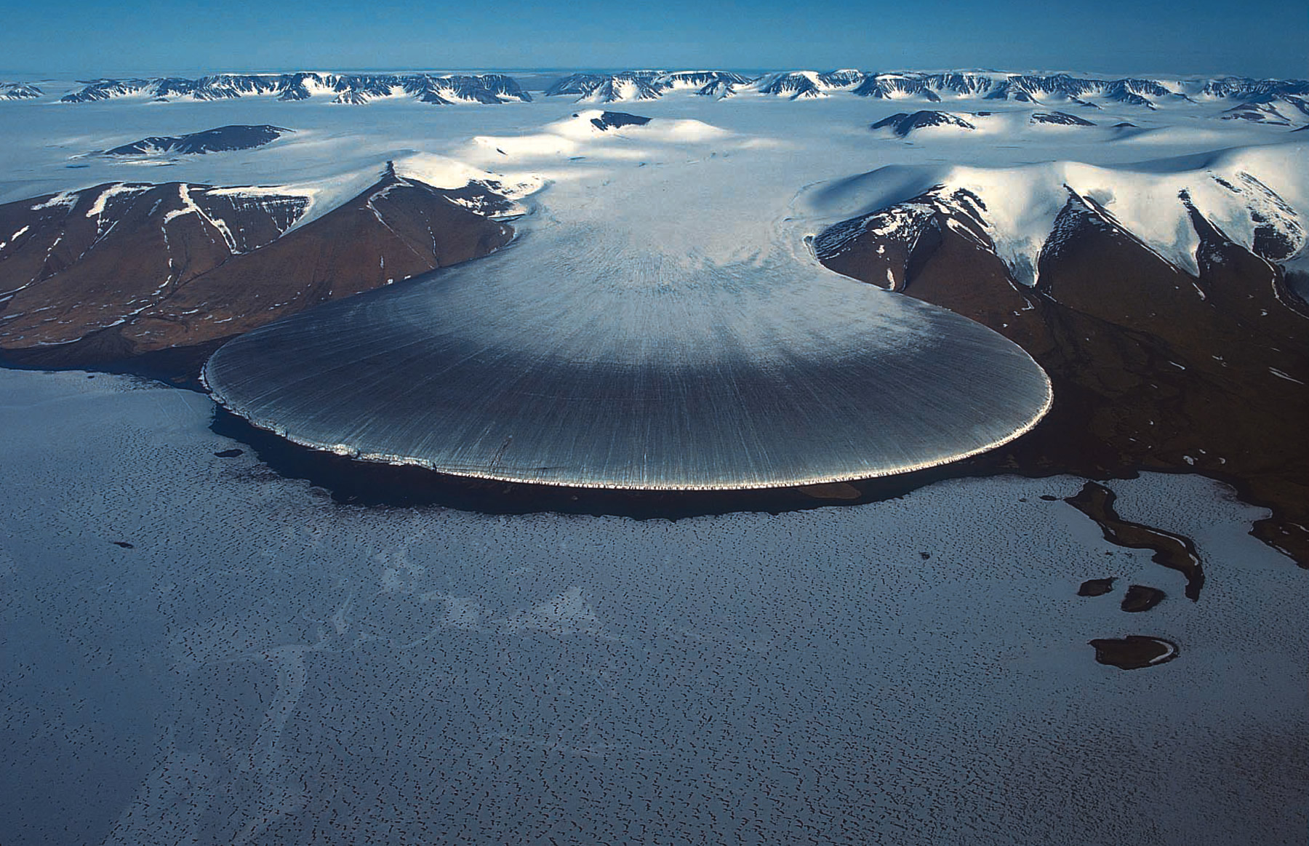
Notes:
Piedmont glaciers are formed where valley glaciers flow out from mountainous terrain and coalesce into a singe large glacier, spreading
over the lowland topography.

Slide 9
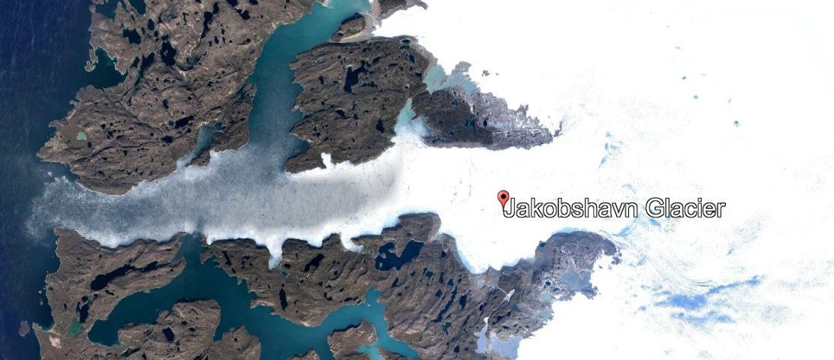
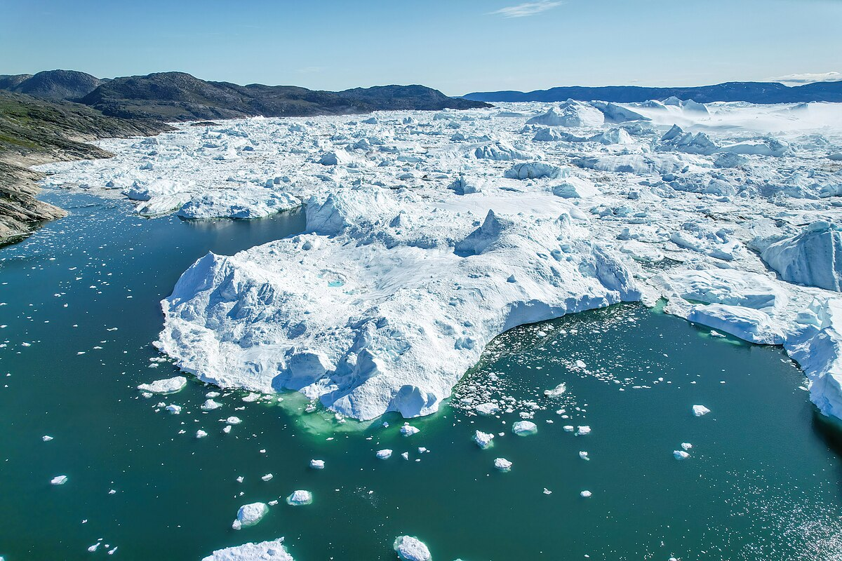
Notes:
Tidal glacier, Greenland

Slide 10
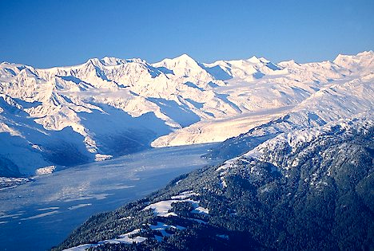
Notes:
Tidal glacier

Slide 11
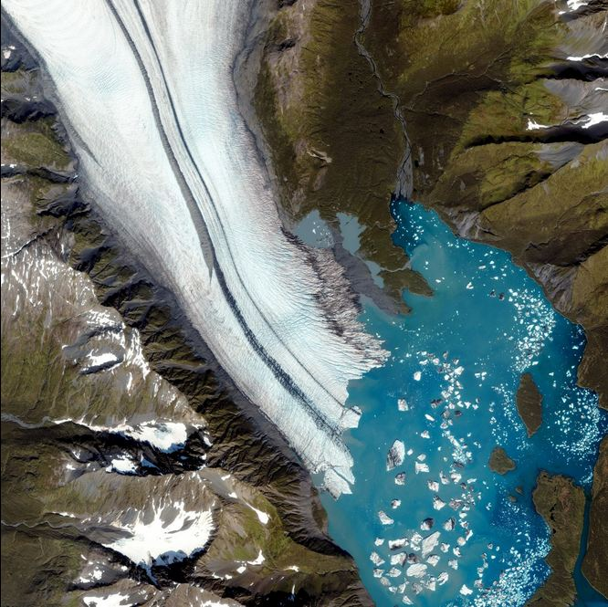
Notes:
Kenai Fjords, another tidal glacier

Slide 12
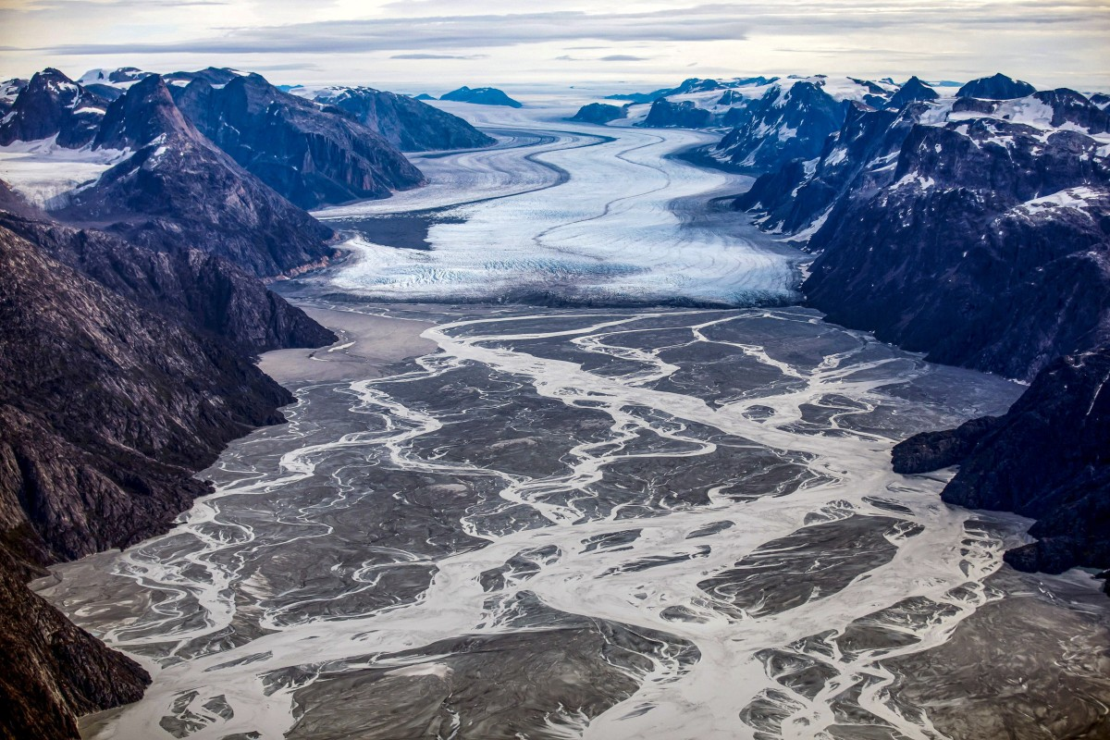
Glacial outwash plain
A glacial outwash plain is a broad, flat area formed by sediment deposited by meltwater flowing from a glacier.

Slide 13
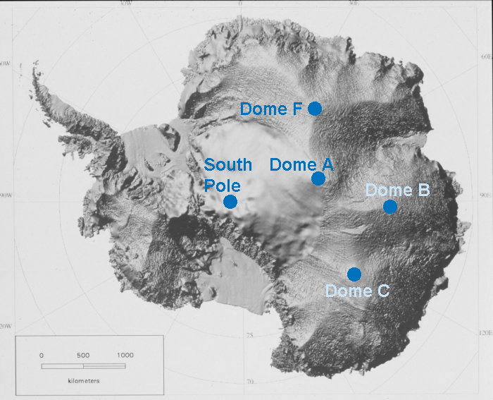
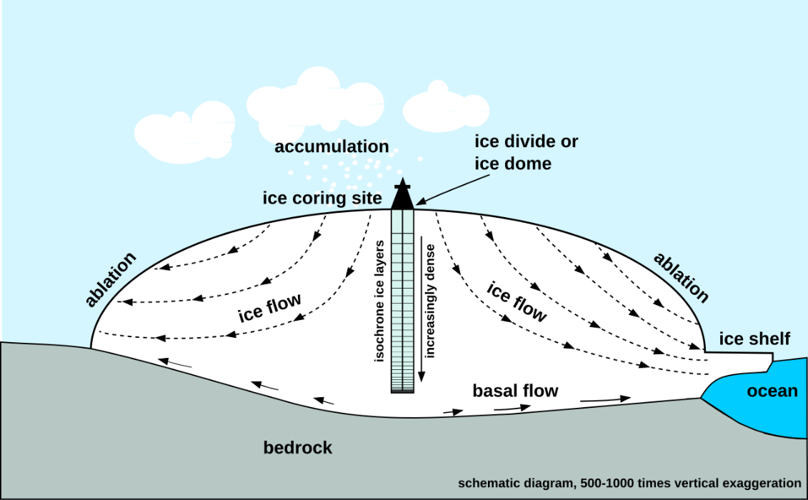
Continental ice sheets and ice domes
Antarctica and Greenland are continental ice sheets.
Ice sheets are composed of one or more ice domes with multiple glaciers
Notes:
Ice caps are smaller versions of ice sheets

Slide 14
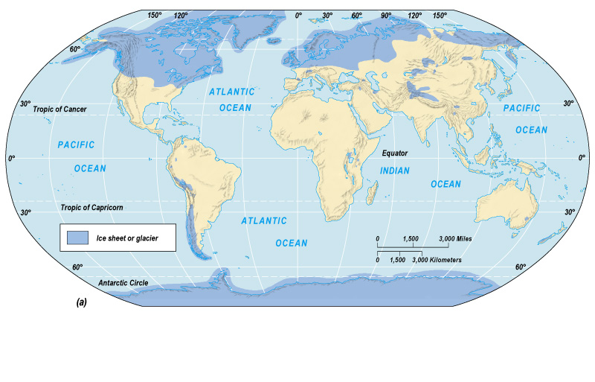
Notes:
Maximum extent of Pleistocene ice sheets and glaciers Most recent glacial maximum peaked 18,000 years ago and is considered to have ended 10,000 before present

Slide 15
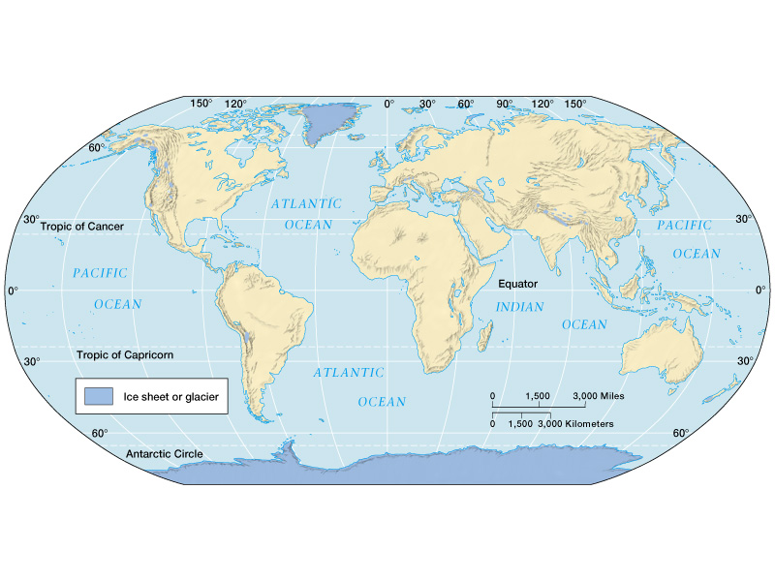
Notes:
Current extent of glaciation is about 10% of land surface

Slide 16
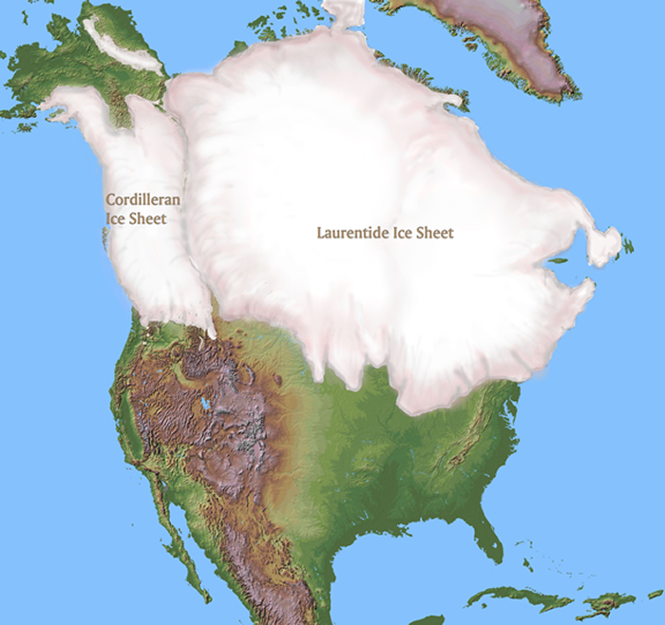
Notes:
Maximum extent of the North American continental ice sheets during the Pleistocene

Slide 17
Notes:
Greenland continental ice sheet

Slide 18
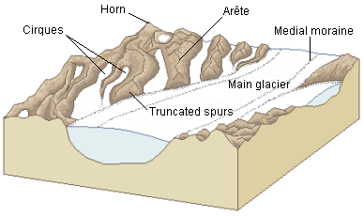
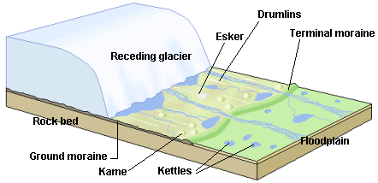
Glacial landforms
Glaciers create a combination of constructive (depositional) and destructive (erosional) landforms

Slide 19
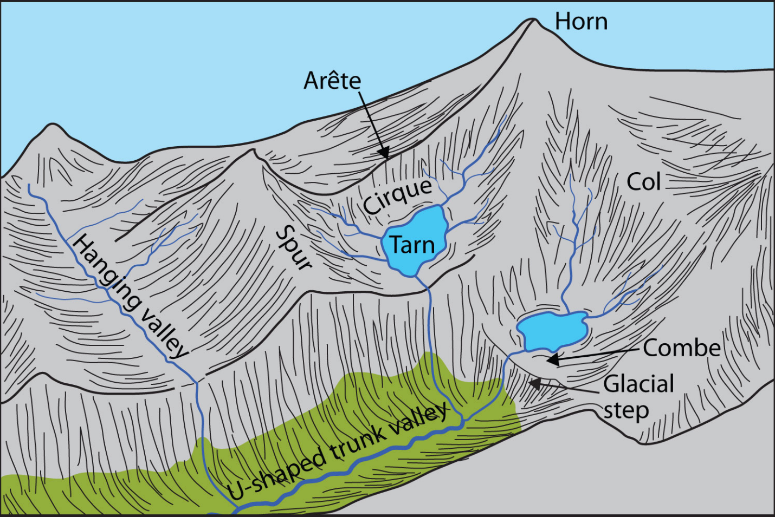
Hanging valleys (erosional)
Notes:
Created when glacially valleys intersect the ocean and are partially flooded.

Slide 20
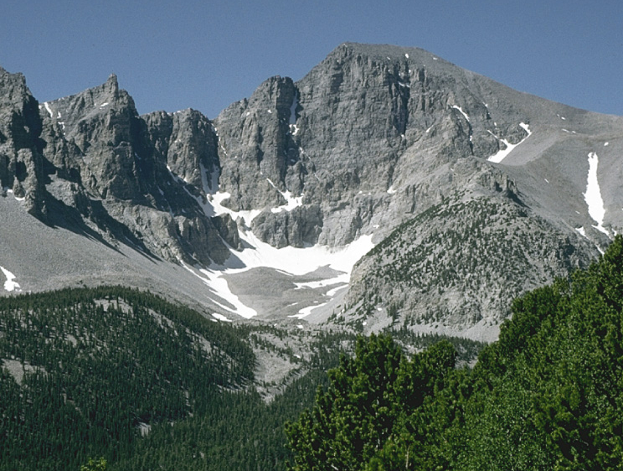
Cirques (erosional)
Notes:
Cirques are bowl-shaped eroded, depressions near-mountain top ridges where snow accumulates and forms the head of an alpine glacier. When glaciers retreat, the cirque is often the last part to melt.

Slide 21
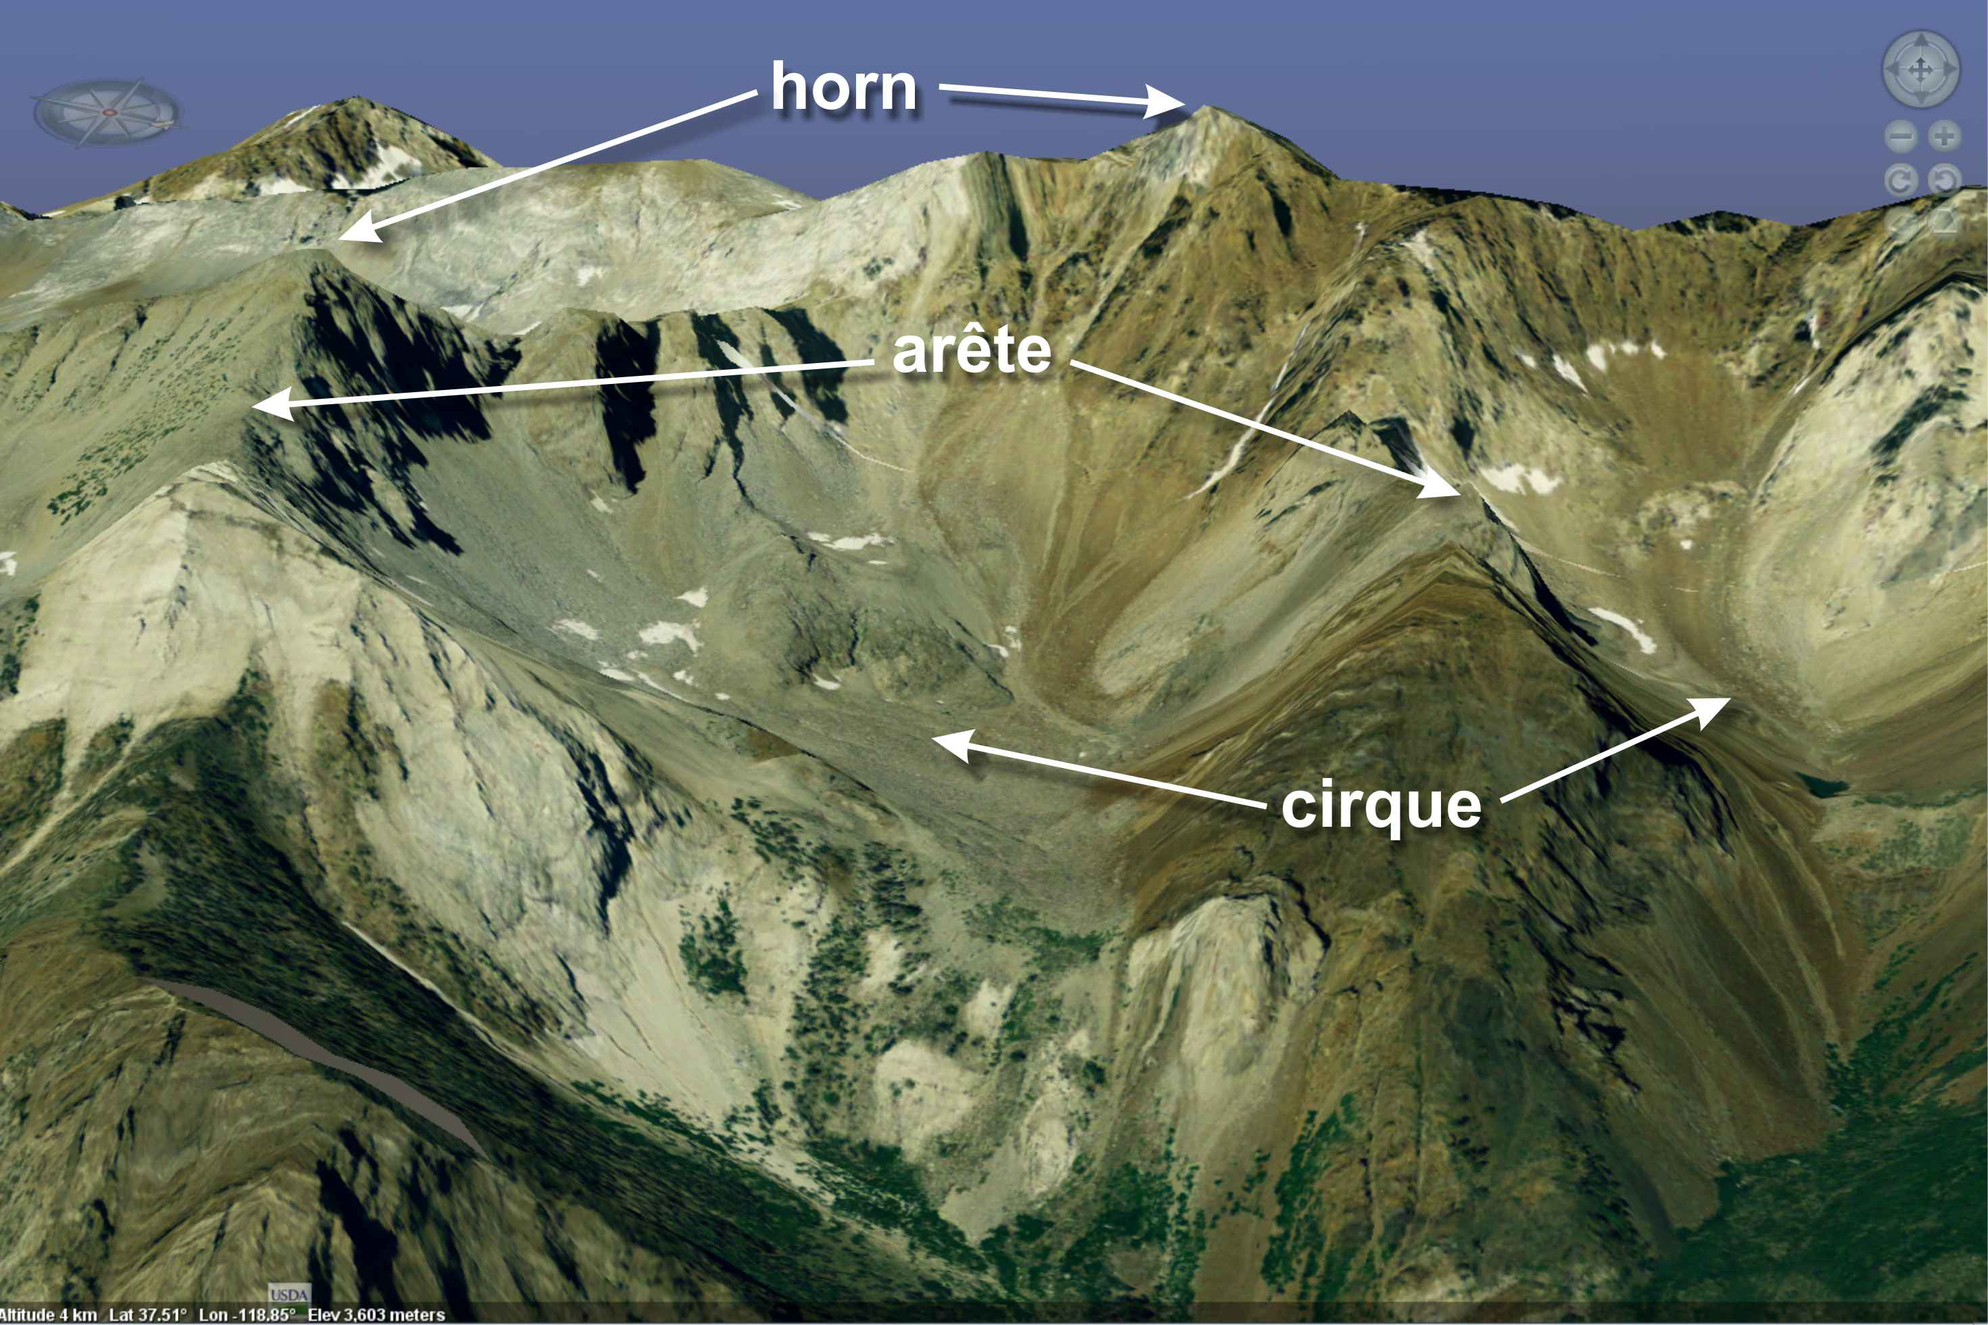
Aretes

Slide 22
Horns (erosional)

Slide 23
Fjords (erosional)
Notes:
Created when glacially valleys intersect the ocean and are partially flooded.

Slide 24
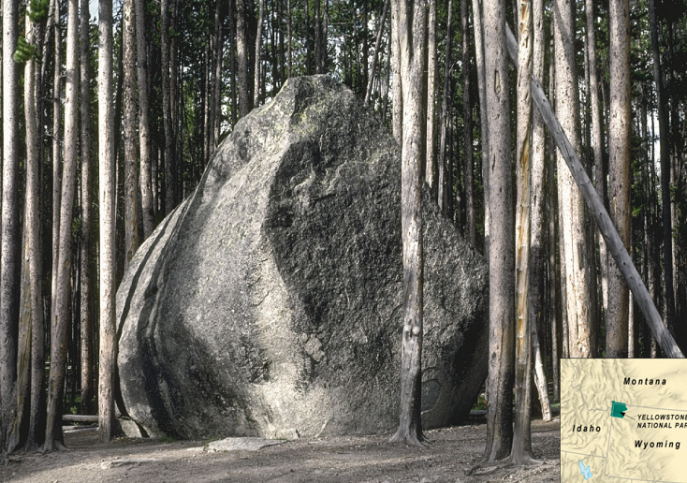
Glacial erratics (depositional)
Notes:
Glacial erratics are enormous boulders transported and deposited by glaciers, often far from their source region.

Slide 25
Moraines (depositional)
Moraines are formed by deposition of glacial sediments as glacier melts.
Lateral moraines
Long linear ridges of glacial sediments deposited along the side of the glacier parallel to its direction of movement.
Medial moraines:
Long linear ridges that form along the contact where glaciers with lateral moraines merge

Slide 26
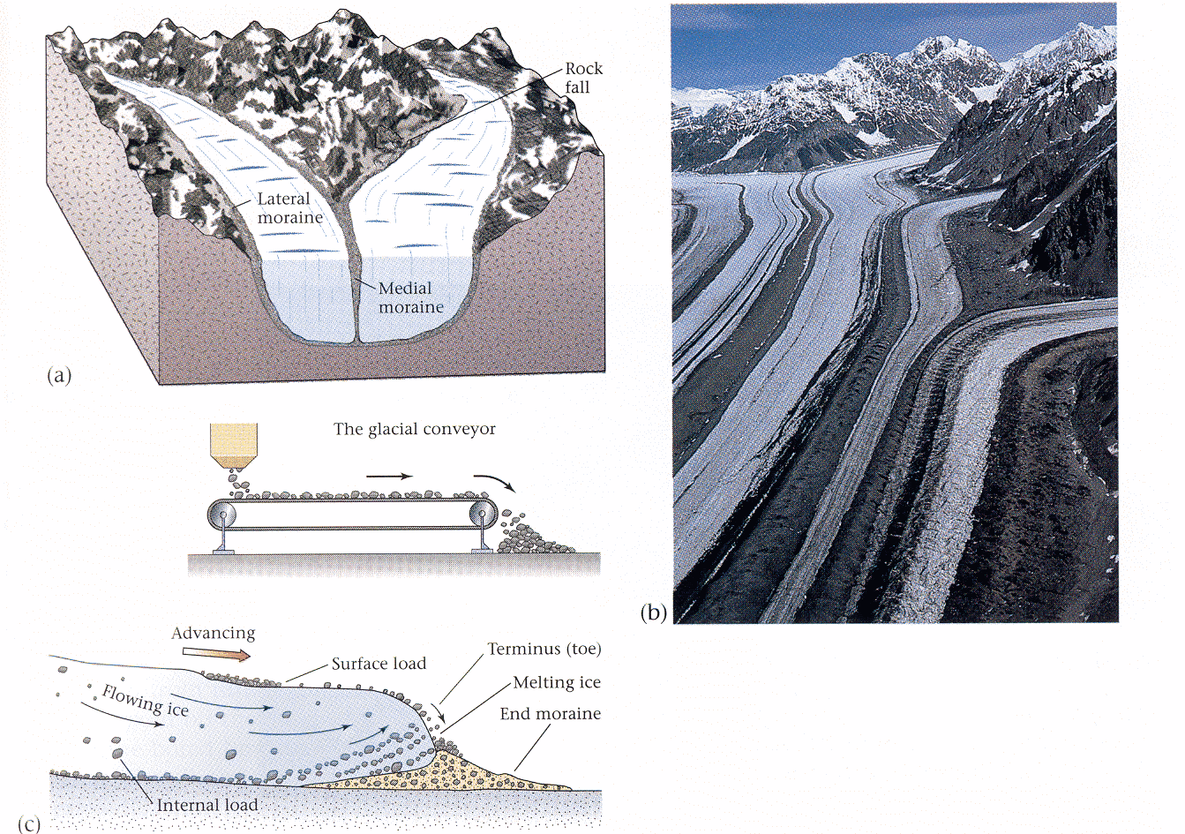
Notes:
Moraines (end/lateral/medial) are linear features deposited at bottom or along sides of glaciers.

Slide 27
Terminal moraines
Linear, arc-shaped depositional ridges that form at the terminus of a glacier. These till deposits mark the limit of glacial movement.
Recessional moraines
Linear, arc-shaped ridges deposited by the melting glacier as it retreats
They mark the gradual retreat of the glacial ice after it has already deposited its terminal moraine.

Slide 28
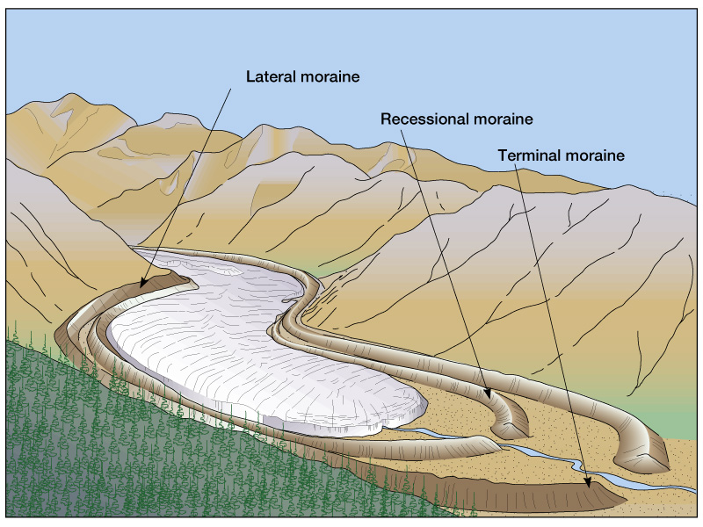
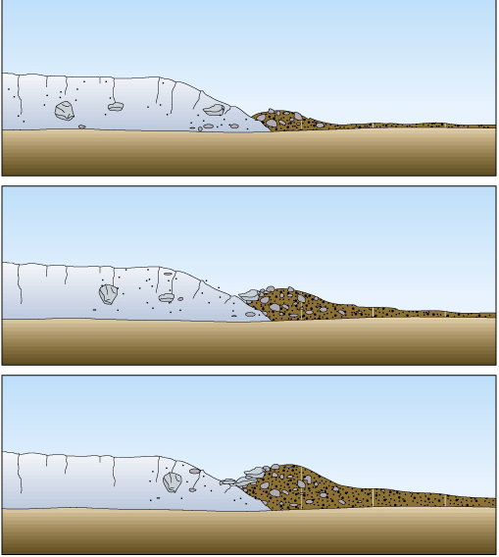
Notes:
Moraines (end/lateral/medial) are linear features deposited at bottom or along sides of glaciers.

Slide 29
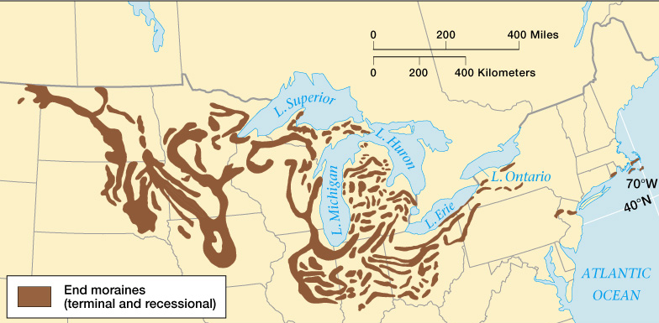
Finger Lakes Region, New York

Slide 30
Drumlins
Drumlins (depositional)

Slide 31
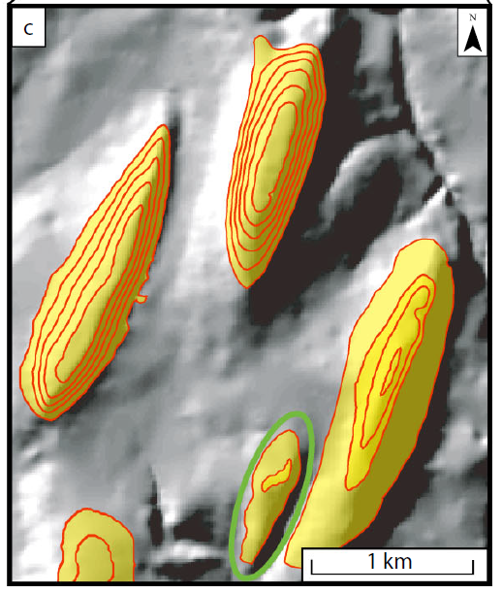
Drumlins form beneath glaciers as they move over the landscape.
They are streamlined hills made of glacial till (a mix of clay, sand, gravel, and boulders
Their alignment indicates the direction of glacier flow
Photo at right shows drumlins in eastern Canada – the direction of glacier flow was dominantly along a north to south axis
Notes:
Drumlins

Slide 32
Notes:
Drumlins

Slide 33
Notes:
Drumlins are often found in groups, called drumlin fields or swarms, and are a key feature of glaciated landscapes.

Slide 34
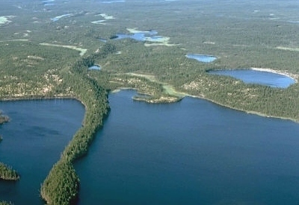
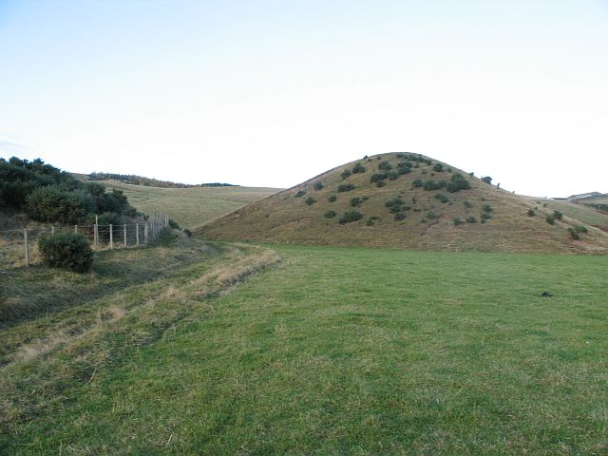
Eskers (left) and kames (right)
Notes:
Eskers (left) form when glacial meltwater carries sediment through tunnels or channels in the ice, and deposits it as the water slows down. The sediment builds up in piles that take the shape of the channels Kames (right) are created when meltwater from a glacier deposits sand and gravel in holes or fissures in the glacier. When the glacier retreats/melts these piles of sediment are left behind

Slide 35
Notes:
Theron Esker, Canada

Slide 36
Notes:
Esker formation

Slide 37
Notes:
https://www.sciencedirect.com/science/article/pii/S0169555X22003117

Slide 38
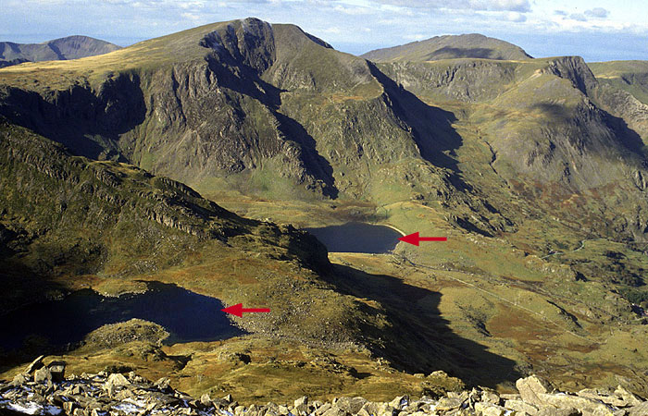
Tarns (corrie lakes)
Notes:
Tarns are small lakes that forms in a glacial cirque

Slide 39
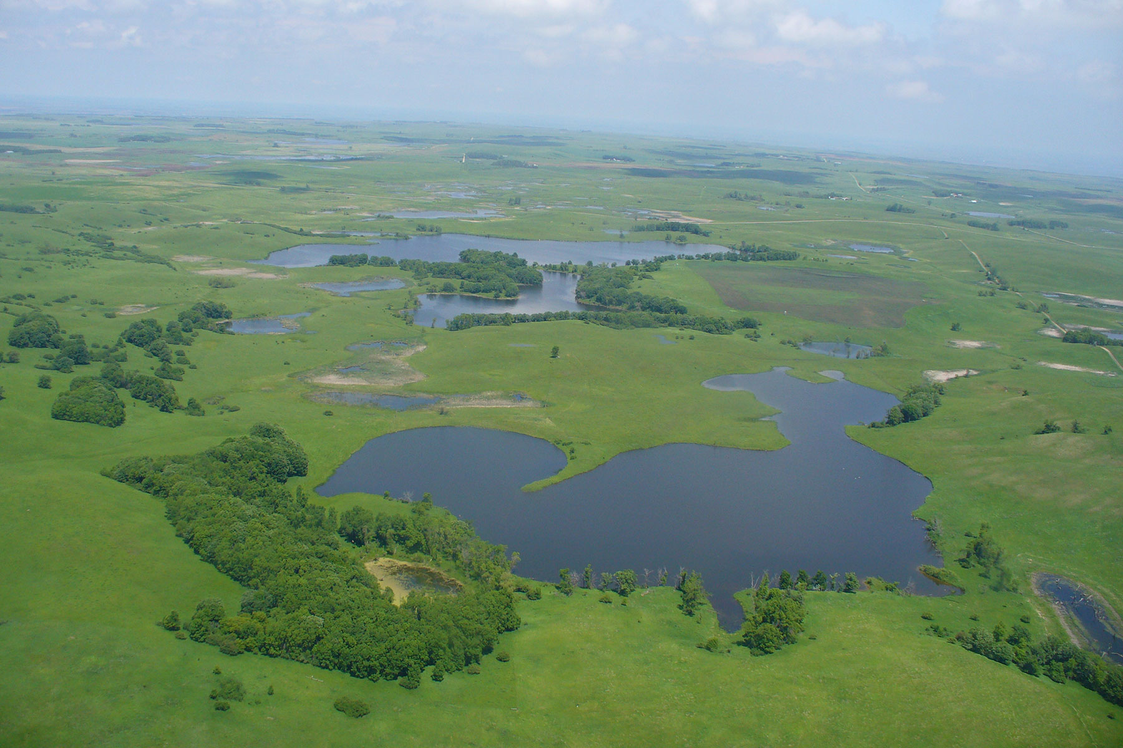
Prairie potholes

Slide 40
Prairie pothole region of the US and Canada
As glaciers retreated, they left behind uneven terrain with depressions caused by chunks of ice that had broken off and become buried in sediment.
These large blocks of ice, eventually melted, creating depressions or "potholes" in the landscape.

Slide 41
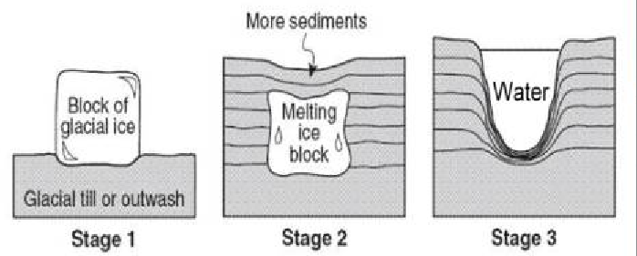
Notes:
Prairie potholes

Slide 42
Periglacial landforms develop in near glacial conditions characterized by
Perennially frozen soil (permafrost) and/or seasonally-thawed soil
The layer in the surface that thaws each year is called the active layer
Incomplete vegetation cover of herbaceous plants and dwarf trees
Snow free ground cover for part of the year
Frequent fluctuations of air temperature across freezing point
Tunda biomes often have periglacial conditions and landforms

Slide 43
Arctic tundra
Notes:
Tundra is where periglacial landforms can be found
Most tundra is in the Northern Hemisphere. Most permafrost is in the Northern Hemisphere. This is simply because there is a landmass at the latitudes where these features and conditions can develop. Permafrost is present in Antarctica. It exists mainly in the continent's ice-free areas, particularly in the coastal regions and in the dry valleys of East Antarctica, such as the McMurdo Dry Valley. These valleys, located in Victoria Land, are one of the largest ice-free regions on the continent, and they contain extensive permafrost.
Unlike the Arctic, where permafrost is more widespread and associated with tundra ecosystems, Antarctica's permafrost is found in isolated, ice-free areas surrounded by glaciers and permanent ice sheets. The permafrost in Antarctica is generally older and colder than that in the Northern Hemisphere, with some areas believed to have remained frozen for millions of years. However, in recent decades, even Antarctic permafrost has shown signs of change, particularly in response to warming temperatures.

Slide 44
Alpine tundra
Notes:
Found only in some of the highest coldest mountain ranges like those of the Tibetan Plateau. Above is Colorado. Very little permafrost is found in the Southern Rocky Mountains. Discontinuous permafrost can develop in the Middle and Northern Rockies.

Slide 45
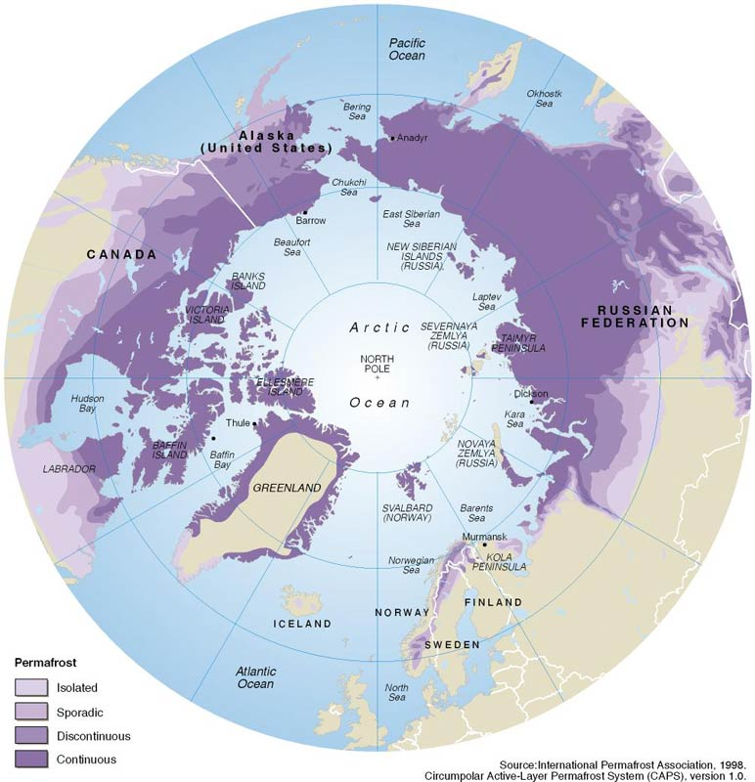
Permafrost
Ground with a temperature perennially below freezing
Permafrost soils are called gelisols
Most of the permafrost in the Arctic
Notes:
Water vapor can deposit onto ice bodies in the ground due to lower vapor pressure along surface of ice

Slide 47
Notes:
A block of thawing permafrost that fell into the ocean on Alaska’s Arctic Coast. Credit: U.S. Geological Survey

Slide 48
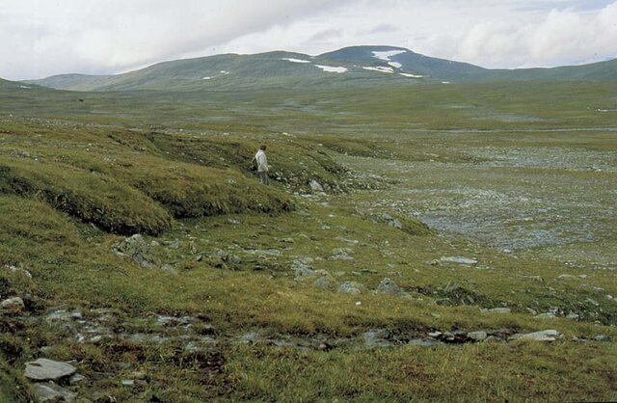
Solifluction terraces
Notes:
https://www.geologinenseura.fi/sites/geologinenseura.fi/files/hirvasetal.pdf

Slide 49
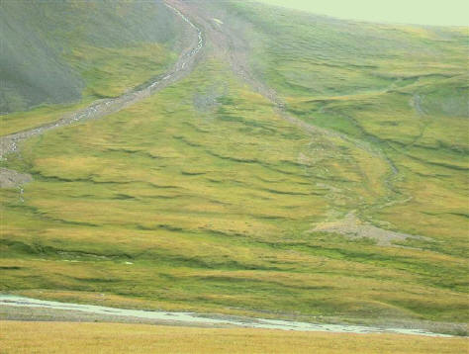
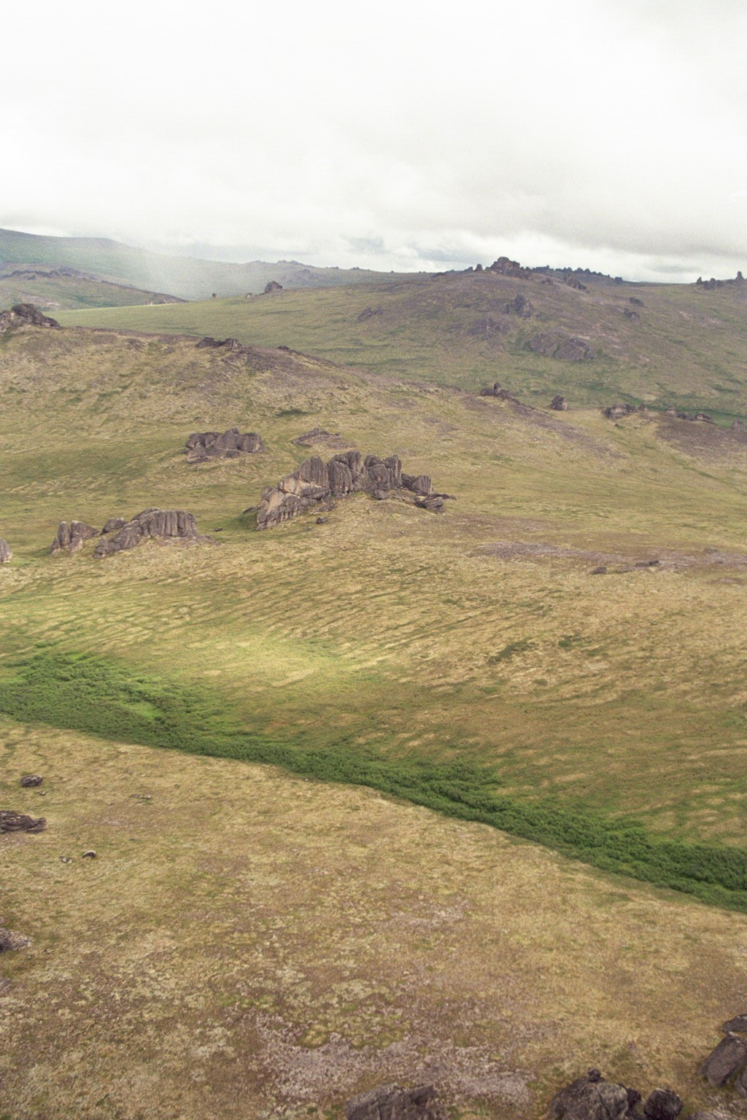
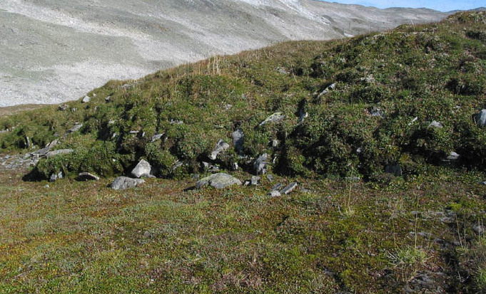
Notes:
These are solifluction lobes along the side of a mountain slope in Montana. Solifluction is a type of earth flow common in periglacial environments underlain by permafrost. During the summer the surface layer of permafrost melts (the active layer) creating a water-saturated layer that can flow slowly downslope under the influence of gravity. The underlying frozen ground acts as a sliding plane along which the mass of soil can slowly move down slope. Lobes pick up sediment and larger rocks as they flow downhill to form solifluction lobes or terraces

Slide 50
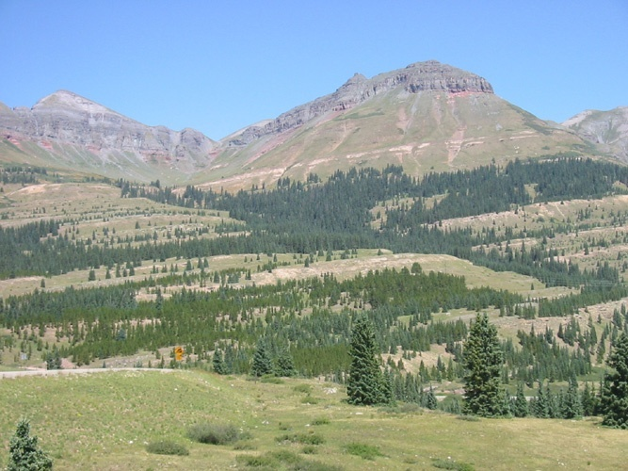
Notes:
Solifluction does not have to occur in areas with permafrost. Solifluction is a type of mass wasting, or slow downhill movement of saturated soil and regolith, commonly found in areas with freeze-thaw cycles. While it is often associated with permafrost regions, where the active layer above the permafrost thaws seasonally, it can also occur in non-permafrost environments where there are similar freeze-thaw dynamics. In such cases, water-saturated soils on slopes can still flow slowly due to gravity during thawing periods, leading to solifluction without the presence of underlying permafrost.

Slide 51
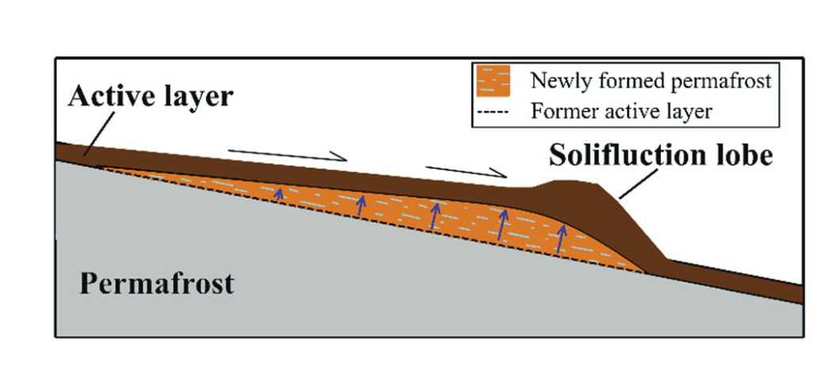
Notes:
Simplified conceptual model of solifluction lobe (terrace) displacement (black half-arrows) and permafrost aggradation over several years. Displacement of the lobe and accumulation of material draw the permafrost table upwards (blue arrows) and cause the formation of ground ice in the newly formed permafrost (light blue) https://cdnsciencepub.com/doi/10.1139/as-2016-0018

Slide 52
Drunken forest
Notes:
Drunken trees in melting permafrost near Fairbanks, Alaska. Drunken forests develop due to permafrost thaw.

Slide 53
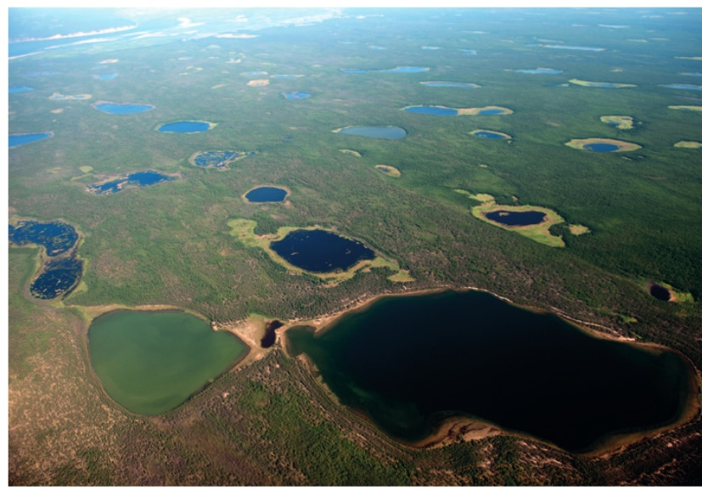
Thermokarst and thermokarst lakes
Thermokarst forms when permafrost thaws.
Because of the melting, the soil loses internal structure and can subside unevenly under its own mass.
Meltwater lakes form as a result
These are known as thermokarst lakes

Slide 54
Ice wedge polygons
Distinctive, patterned ground features found in permafrost regions.
Form due to the seasonal freeze-thaw cycles
Over time they create polygons on the surface of the ground.
Notes:
https://www.woodwellclimate.org/ice-wedges-climate-change/

Slide 55
Notes:
Ice-wedge polygons

