Slide 1
Notes:
Plastic bottle sealed at 14,000 feet, at 9000 feet, and 1000 ft (in Hawaii). Where would the air in the bottle be the coolest? The warmest? What would happen to temperature in the bottle as you went down in altitude? As you went up?

Slide 2
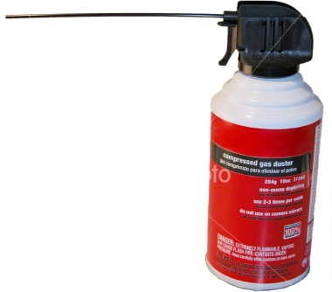

Slide 3
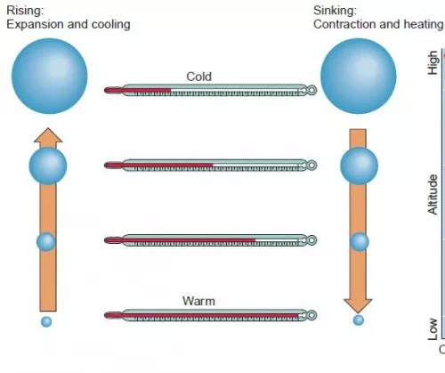
Adiabatic processes
Changing the temperature of an air parcel by changing the air pressure
Adiabatic cooling: rising air, surrounding air pressure decreases, air parcel expands, parcel temp decreases, and when cooled to dew point condensation can occur
Adiabatic warming: sinking air, surrounding air pressure increases, parcel contracts, parcel temp increases, and water evaporates
Notes:
No heat is added from outside in adiabatic processes – temperature change is a function of changing air pressure

Slide 5
Cloud condensation nuclei (i.e. dust) needed to make clouds and rainfall
Clouds are suspended droplets of water or ice
Water vapor condensates to liquid around condensation nuclei (dust)
Supercooled water is deposited as ice around freezing nuclei

Slide 6
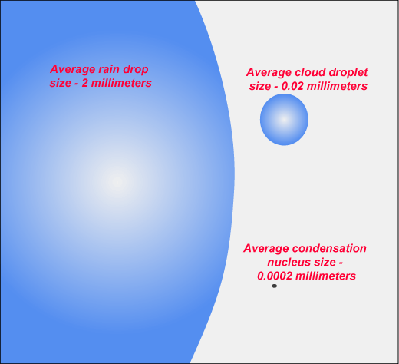
Water condensating from gas to liquid needs a surface to adhere to
In pure clean air, relative humidity must equal 120% for condensation to occur
At 120% relative humidity, air would be considered supersaturated with water vapor
Presence of condensation nuclei allows condensation at 100% relative humidity

Slide 7
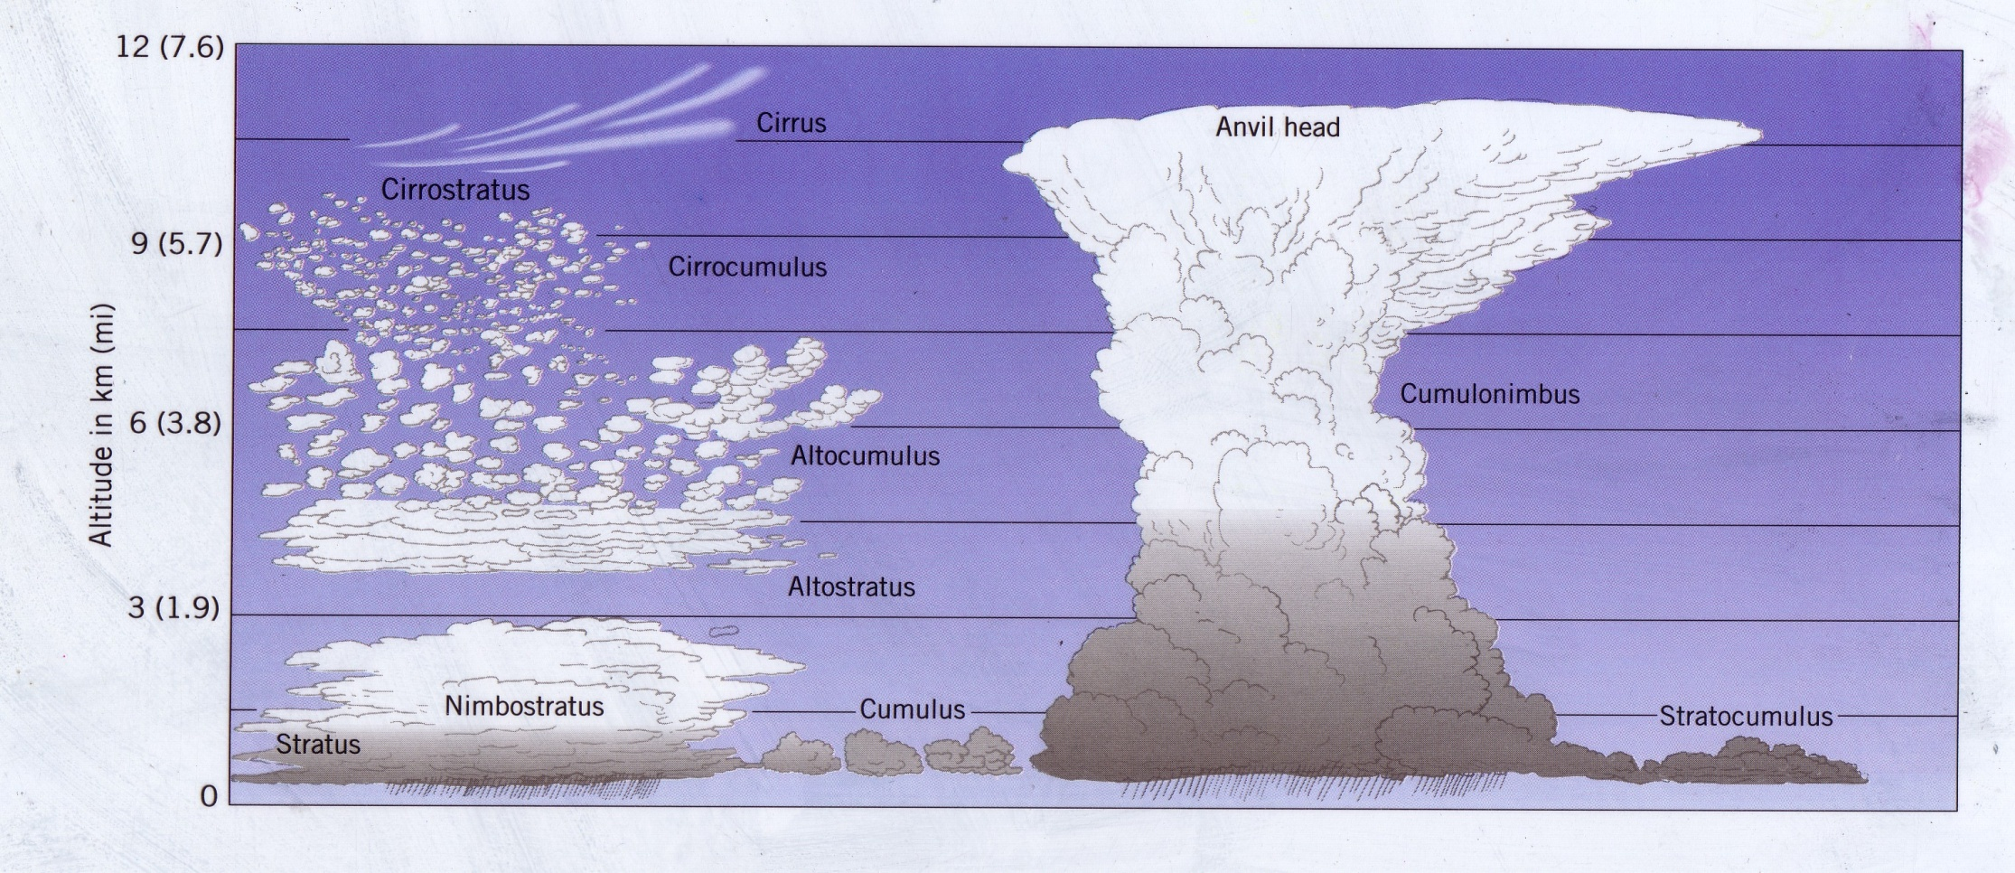
Notes:
Height of cloud base Cirrus type – high clouds (above 6 km)
Stratus type – low clouds (below 2 km)
Alto type – middle altitude clouds (between 2 and 6 km)
Nimbus type – rain producing
Shape of clouds: degree of vertical development Strato – thin sheets or blankets; lower atmospheric instability
Cumulo – round, cotton ball shape; potentially higher atmospheric instability
Average cloud duration – 10 minutes
Clouds are small liquid water droplets and for some clouds, ice crystals.

Slide 8
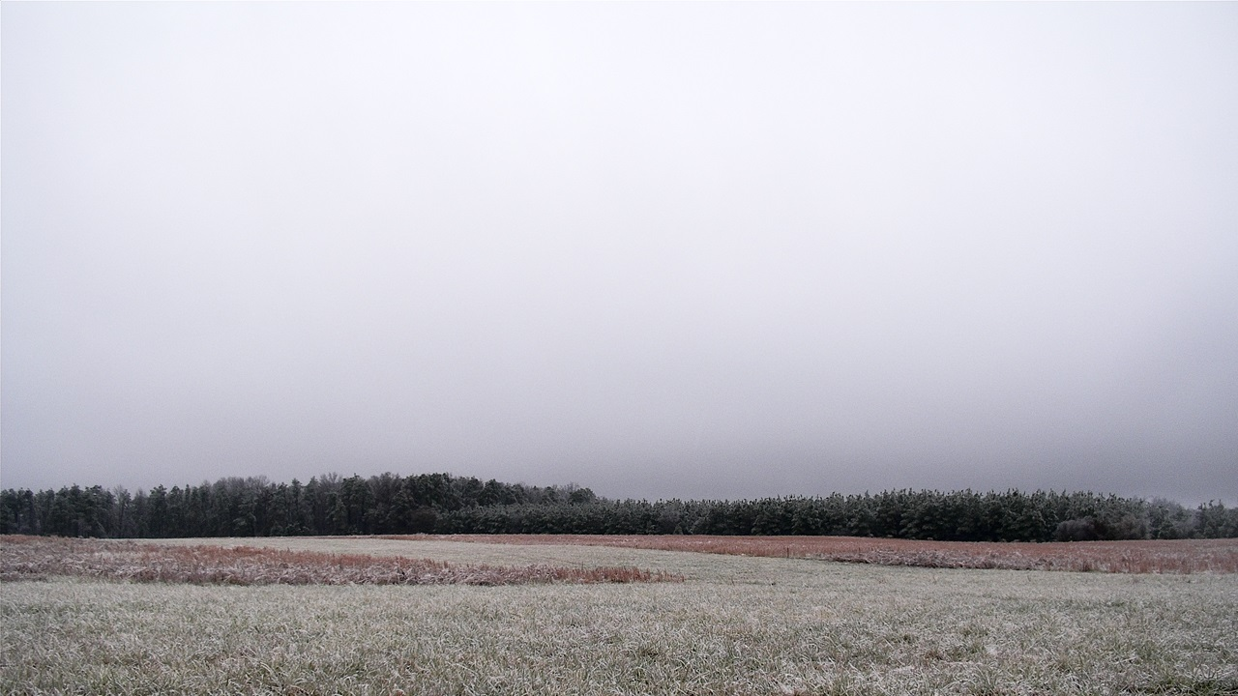
Stratus
Notes:
Stratus

Slide 9
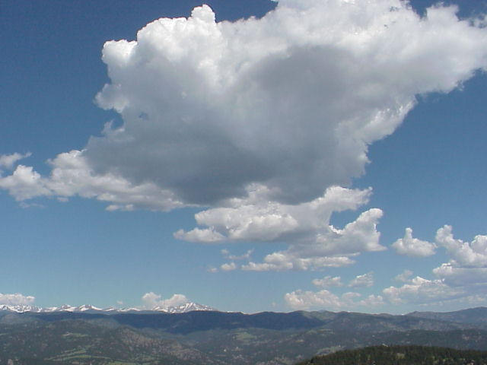
Cumulus
Notes:
Cumulus

Slide 10
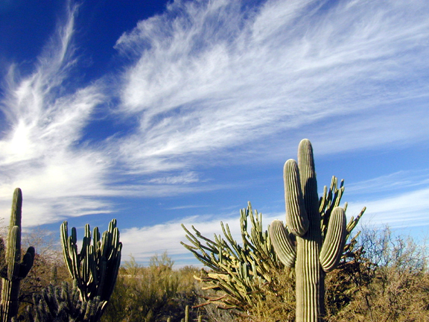
Cirrus
Notes:
Cirrus

Slide 11
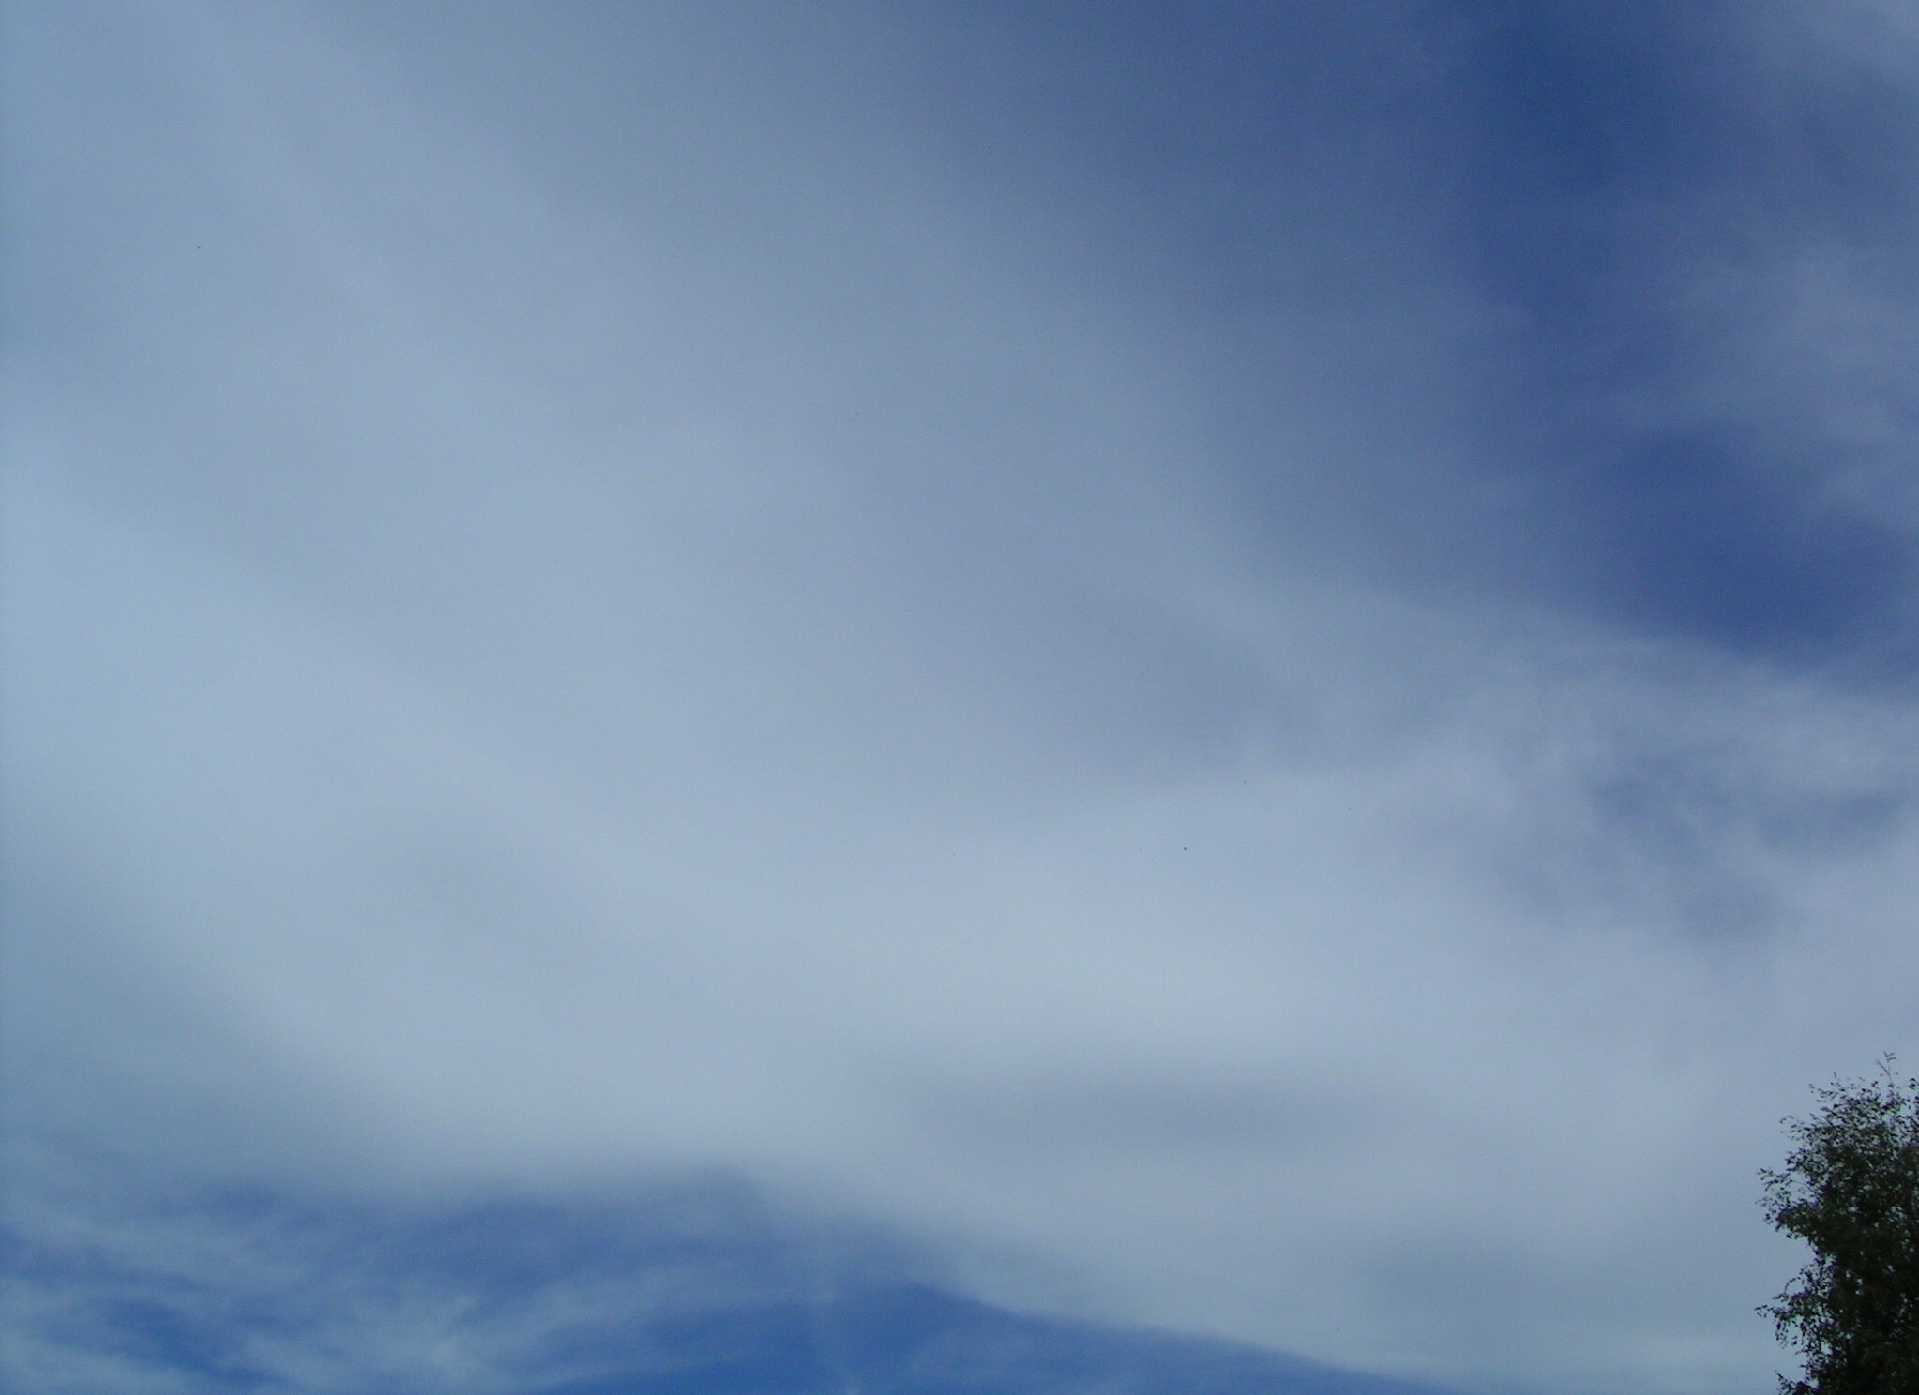
Cirrostratus
Notes:
Cirrostratus

Slide 12
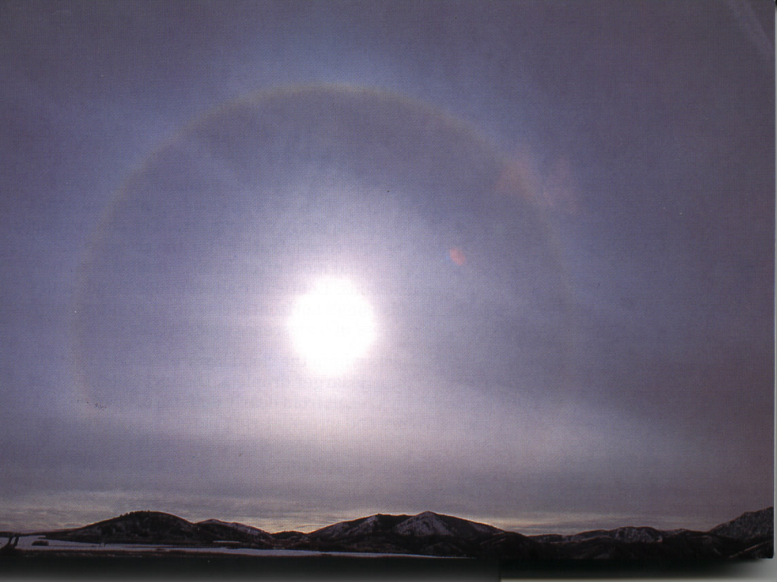
Cirrostratus
Notes:
Cirrostratus

Slide 13
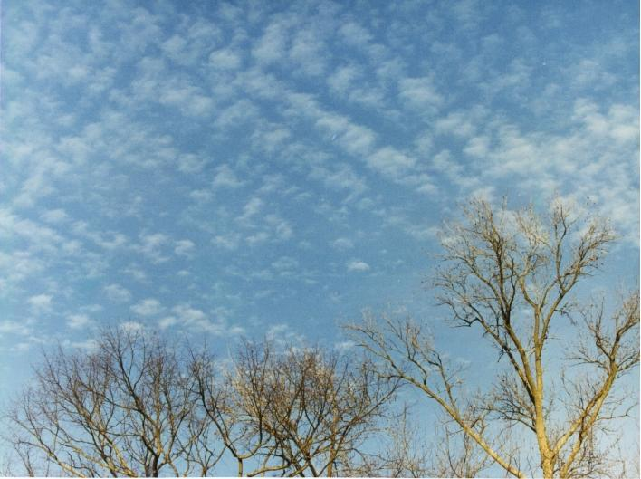
Cirrocumulus
Notes:
Cirrocumulus

Slide 14
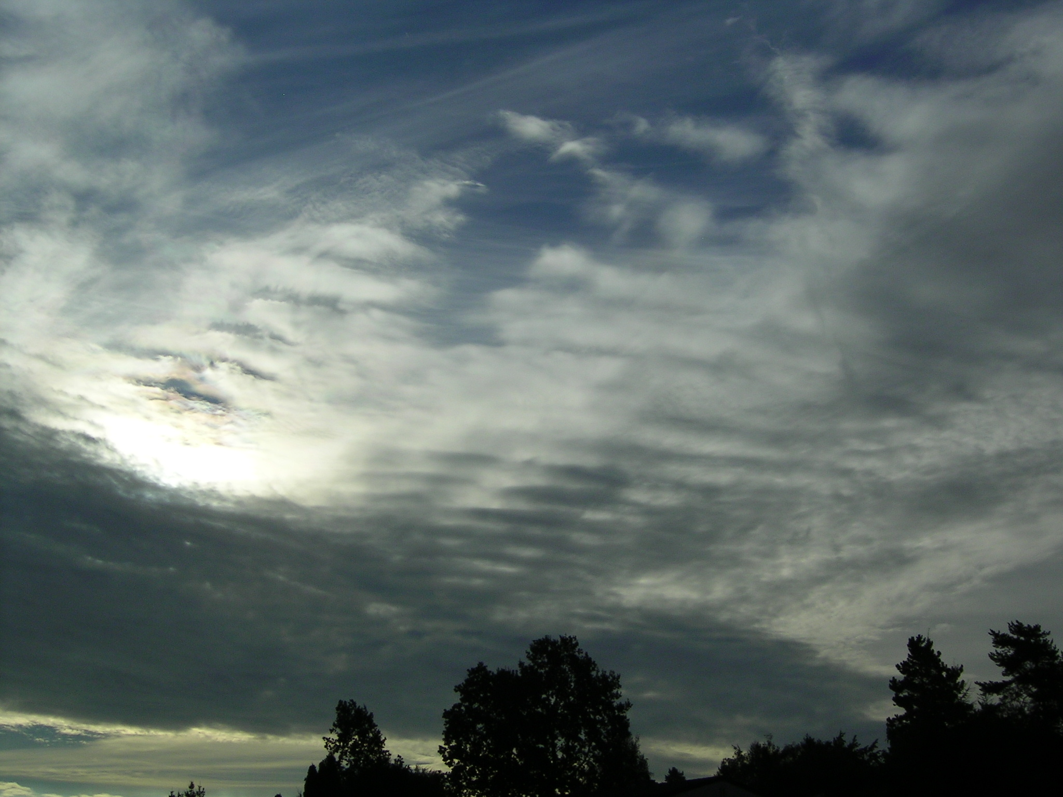
Altostratus (and cirrus, higher)
Notes:
Altostratus (and cirrus, higher)

Slide 15
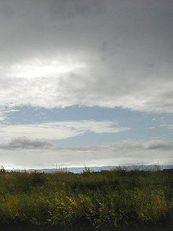
Altostratus
Notes:
Altostratus

Slide 16
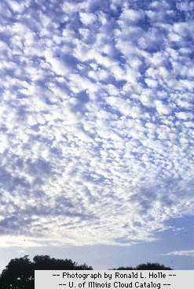
Altocumulus
Notes:
Altocumulus

Slide 17
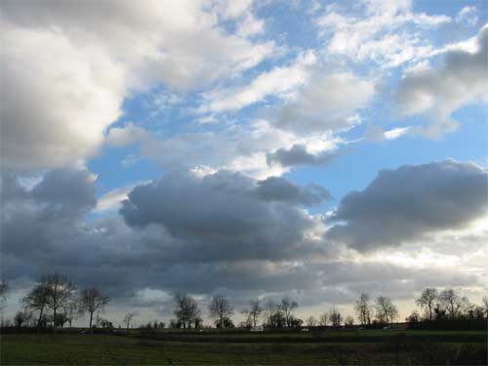
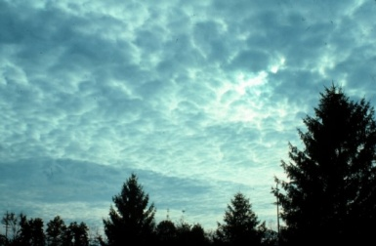
Stratocumulus
Notes:
Stratocumulus

Slide 18
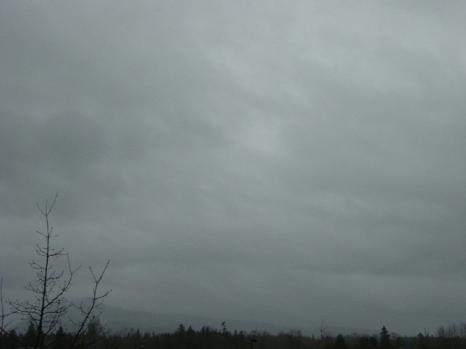
Nimbostratus
Notes:
Nimbostratus

Slide 19
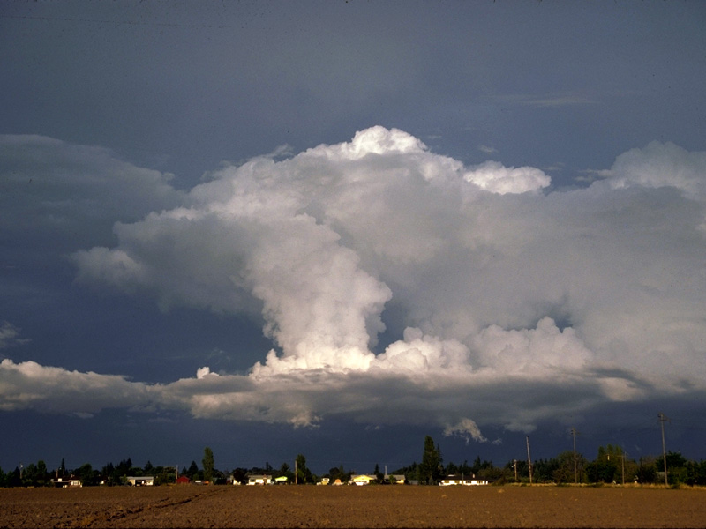
Cumulonimbus
Notes:
Cumulonimbus

Slide 20
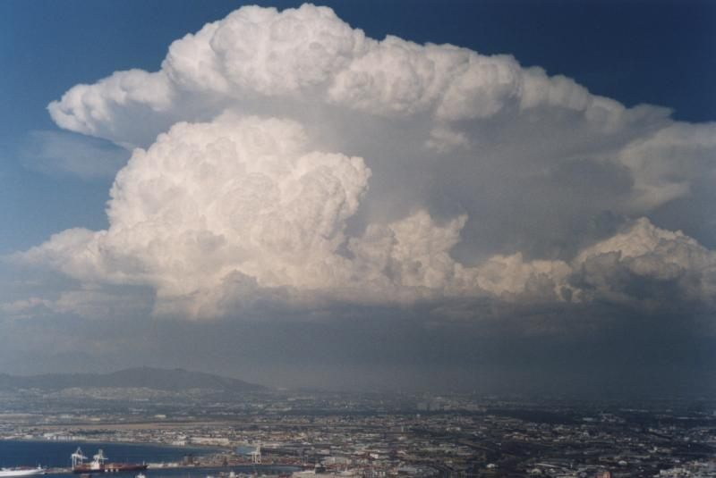
Cumulonimbus
Notes:
Cumulonimbus

Slide 21
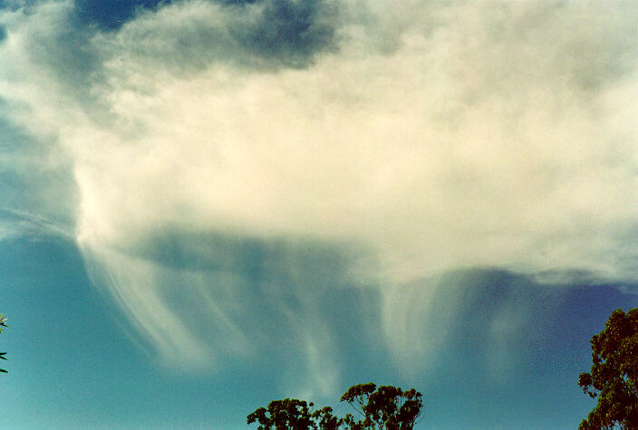
Virga
Notes:
Virga

Slide 22
Mammatus
Notes:
These clouds typically appear during thunderstorms and cumulonimbus clouds

Slide 23
NOAA Cloud Chart: https://www.noaa.gov/jetstream/clouds/nws-cloud-chart
Notes:
https://cloudappreciationsociety.org/

Slide 24
Fog: a stratus cloud at the ground
Three types of fog
Radiation fog
Advection fog
Evaporation fog
Fogs appear to ‘lift’ but that is an optical illusion as they are just evaporating from the bottom up as the longwave radiation warms the surface

Slide 25
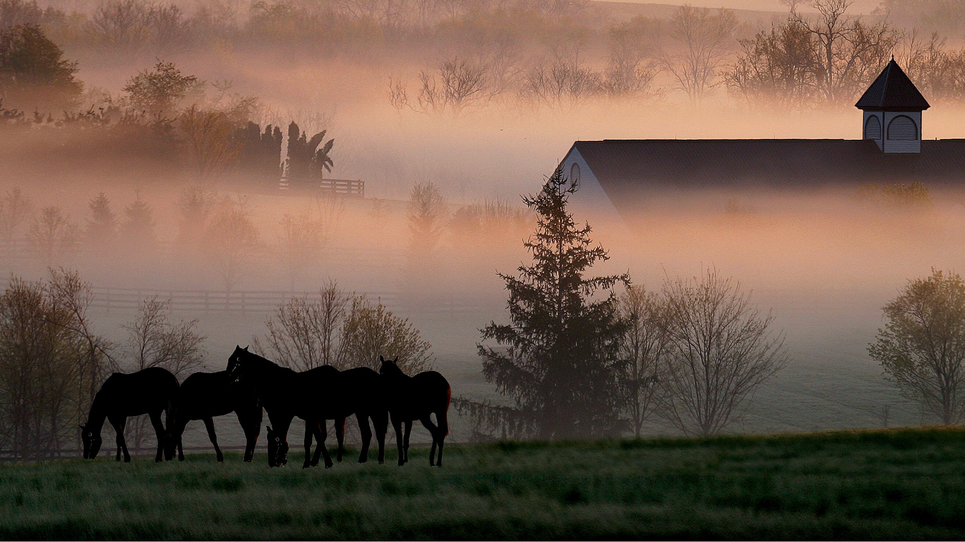
Inland radiation fogs (Kentucky) occur on clear nights when the air at the surface cools to the dew point and if
humid air is present it will condense and form tiny droplets that comprise the fog.
Inland radiation fog
Notes:
Inland radiation fog

Slide 26
Inland radiation fog, Kentucky

Slide 27
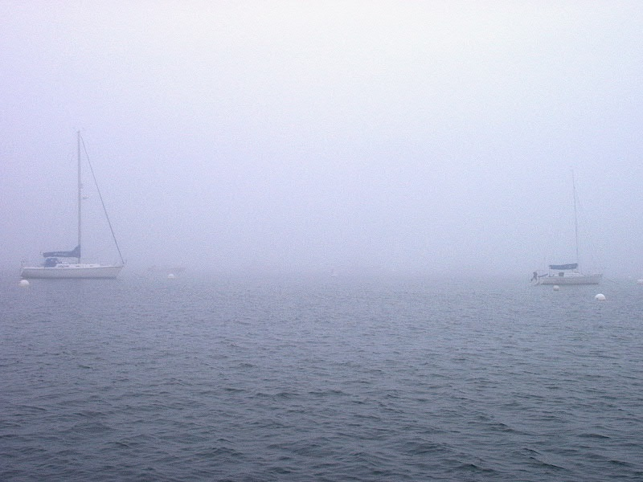
Evaporation fogs (Maine) form when warm water contributes water vapor to cold air above it, which allows the air to cool to its dew point, reach saturation, and condensate as tiny water droplets.
Notes:
Maine evaporation fog

Slide 28
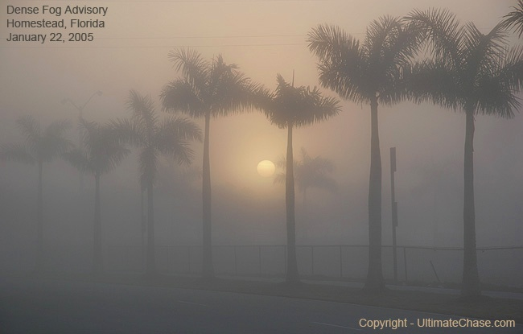
Evaporation fog, south Florida

Slide 29
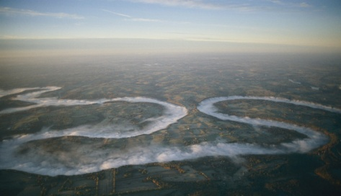
Evaporation fog, Kentucky
Notes:
Kentucky River

Slide 30
Notes:
California; advection fog

Slide 31
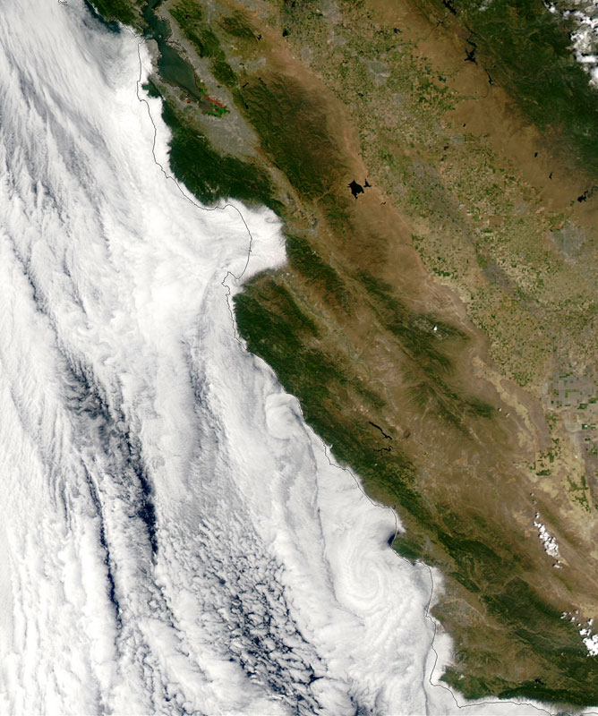
Advection fogs like those in California form when cold ocean currents cause the air above it to cool and reach its dew point and condensate. When the inland reaches warm up during the day and form a low pressure, a sea breeze blows inland, from the ocean to the land, advecting (blowing) this fog inland.

Slide 33
Notes:
https://fog.today/fogust/

Slide 34
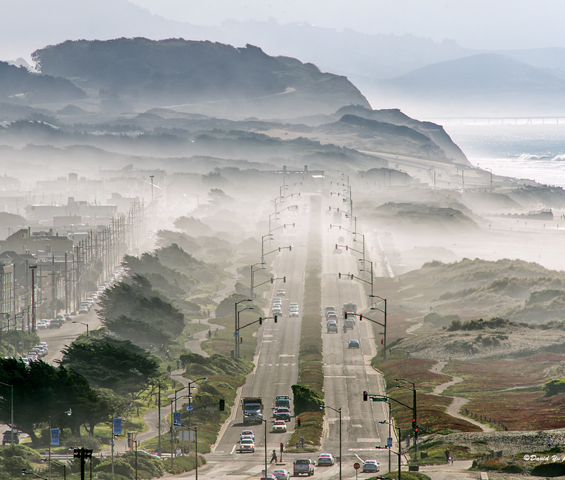

Slide 36
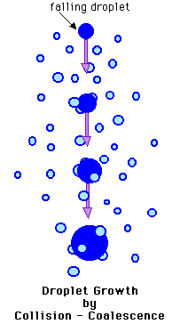
Precipitation
Collision coalescence process of precipitation formation
Water droplets collide and increase in size until large enough for gravity to pull them out of the cloud
Wind turbulence also enhances collisions
Occurs in tropics and midlatitudes
Precipitation leaves cloud as liquid water

Slide 38
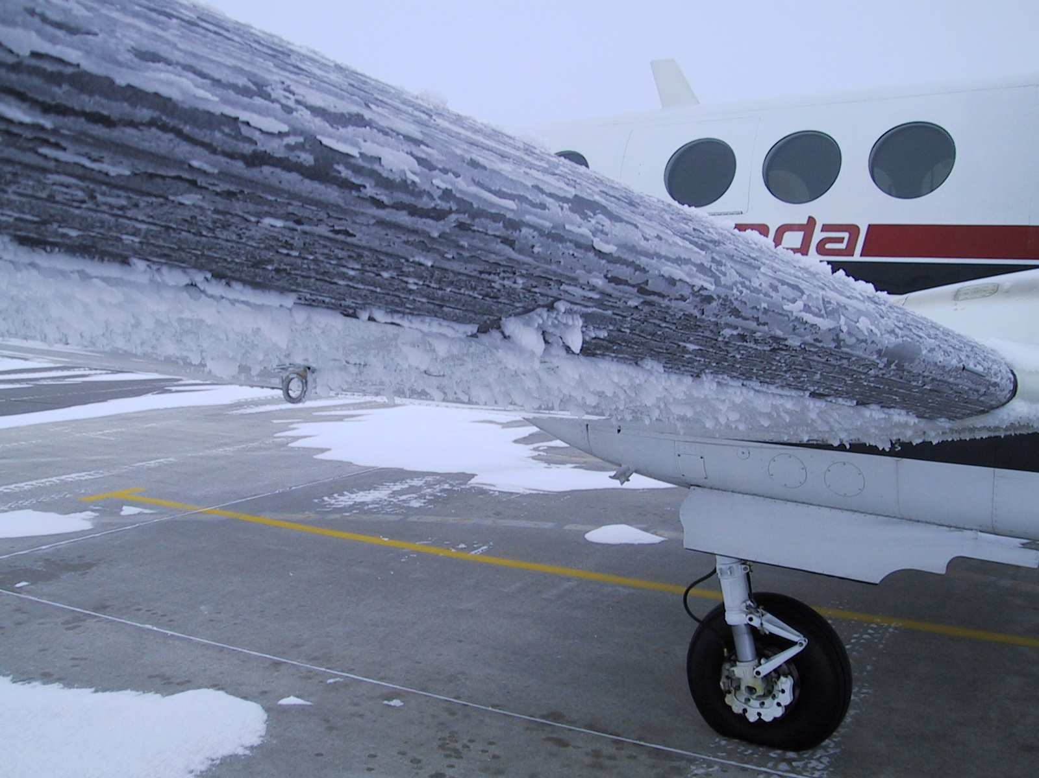

Slide 39
Bergeron process of precipitation formation
Occurs in midlatitudes to poles
Requires freezing nuclei
Three states of water present: ice crystals, water vapor, and supercooled liquid water
Supercooled water crystallizes upon contact with freezing nuclei
Ice crystals accrete to this initial particle
Ice crystal grows through deposition (water vapor goes directly to solid)
Precipitation leaves cloud as ice crystal

Slide 40
Precipitation types under Bergeron conditions
Snow – ice crystals leave the cloud and remain frozen all the way down to the ground
Sleet – ice crystals leave the cloud, melt in a warm layer below it, and then refreeze as a pellet in a cold layer above the ground
Freezing rain – ice crystals leave the cloud, melt in a warm layer below it, and then cool down in a shallow freezing layer near the surface. This cold layer isn’t thick enough to allow freezing to occur. Water droplets become supercooled, and freezes upon landing
Rain – ice crystals leave the cloud but melt and remain liquid all the way to the ground
Notes:
Pure water needs a nucleus (like dust or certain aerosols) to freeze. Without one, it can remain liquid even as temperatures drop to around -40°C. If the supercooled droplets fall quickly through the atmosphere, they don’t have time to crystallize into ice before reaching the ground. If the near-surface cold layer isn’t thick enough, the raindrops don’t have time to freeze mid-air (which would turn them into sleet) but are cold enough to freeze on impact.

Slide 42
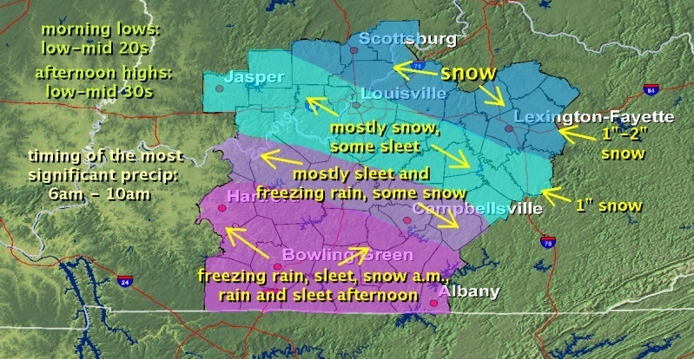
Notes:
Jan 2013

Slide 43
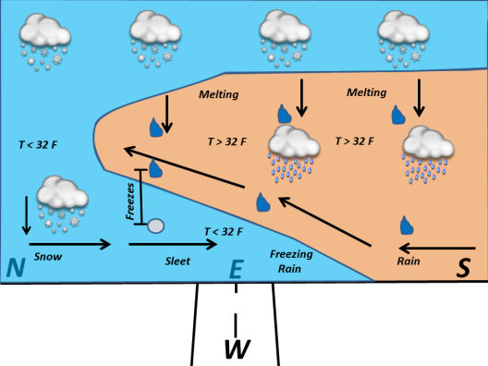

Slide 44
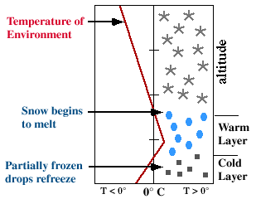
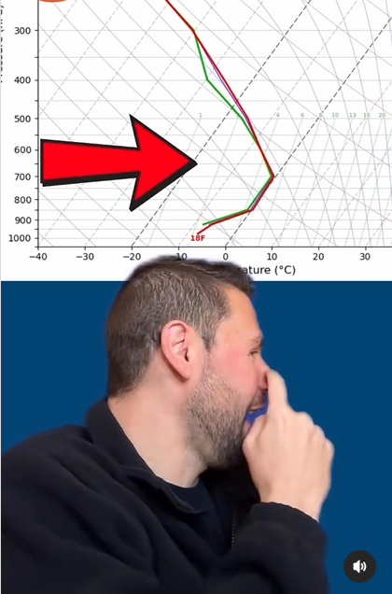
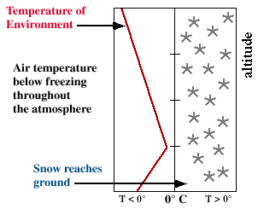
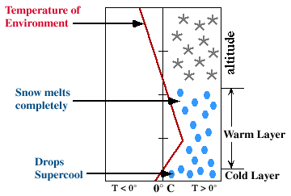
Sleet profile
Snow profile
Freezing rain profile

