Slide 1
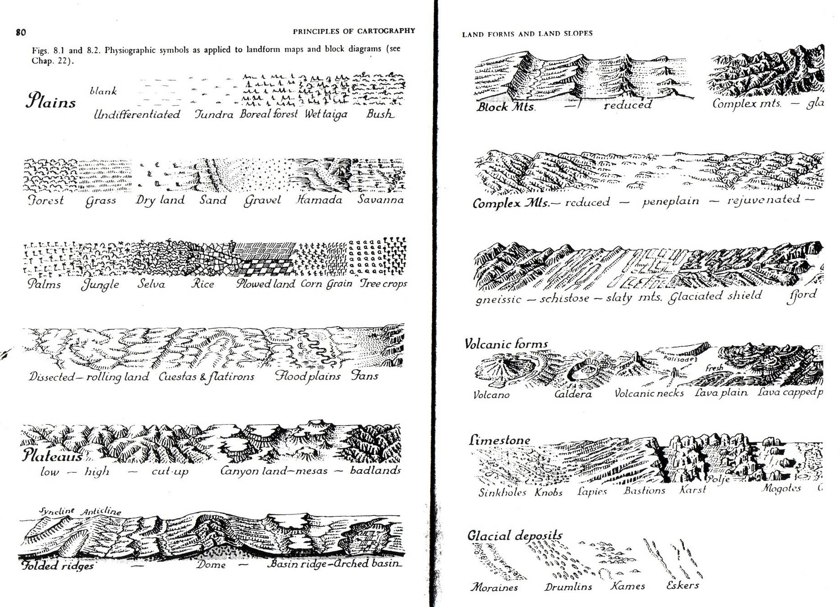

Slide 2
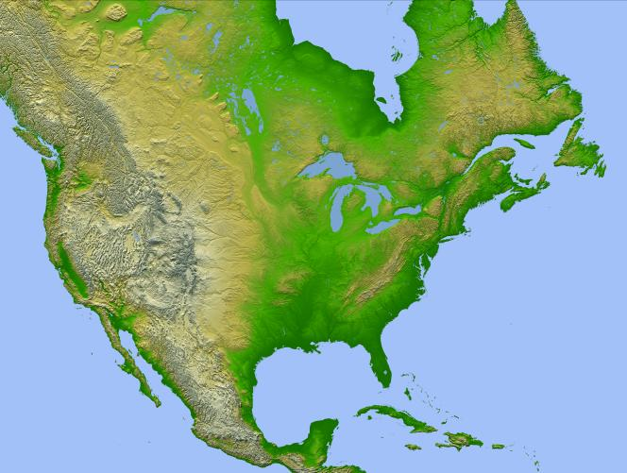
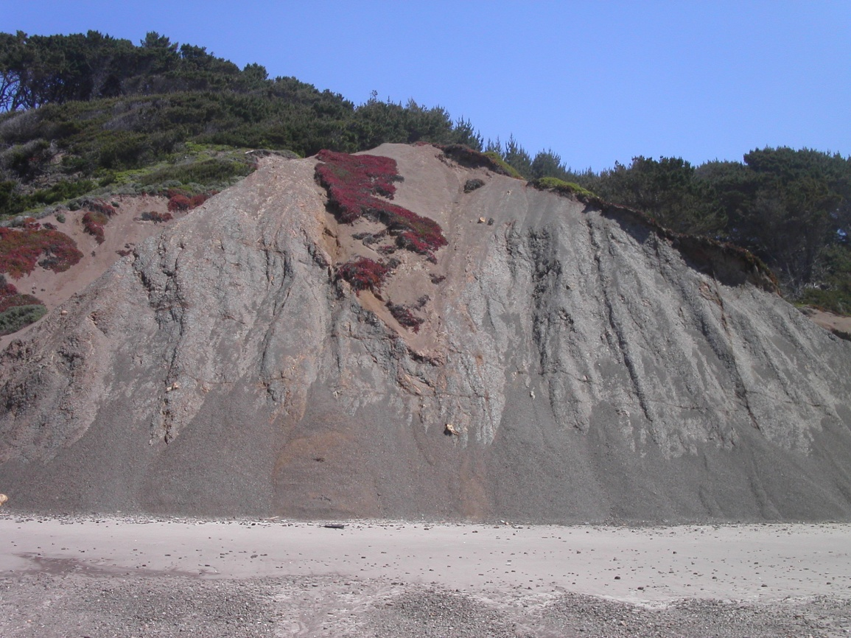
Secondary landforms: weathering, mass movement, and erosion

Slide 3
Primary (or endogenic) landform
Basic underlying form derived through internal forces of tectonism, crustal motion, and volcanism
Secondary (or exogenic) landform
Results from modification of primary landforms through weathering, mass movement, and erosion.
Powered by
Gravity
Insolation (incoming solar radiation) which drives weather and climate as well as many chemical and biotic processes above the surface) and gravity

Slide 4
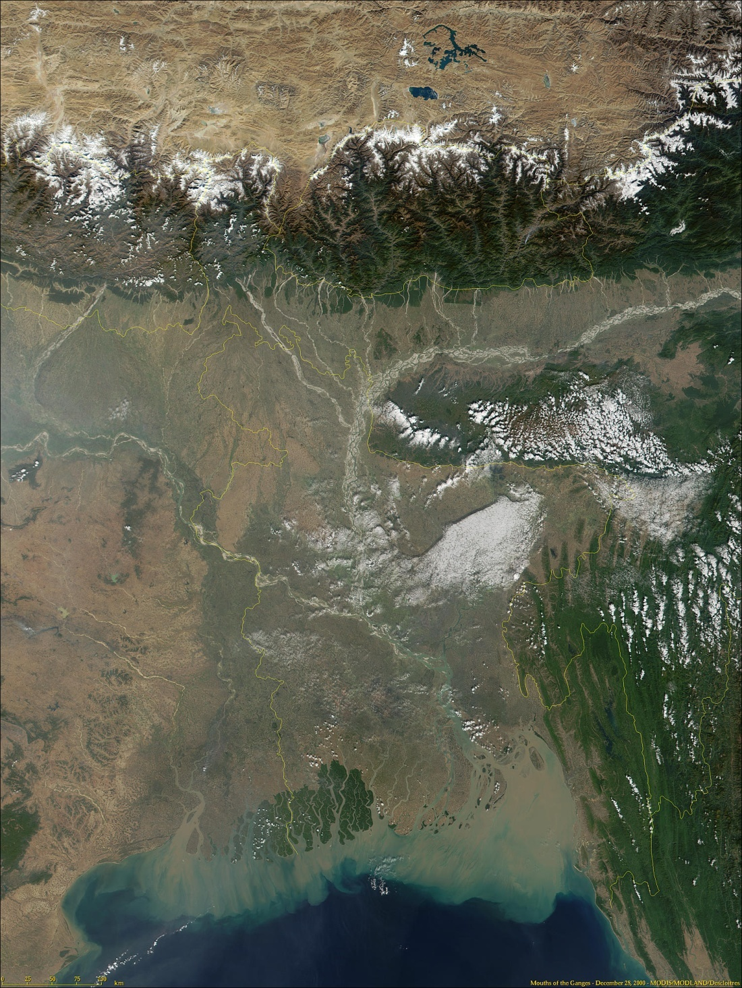
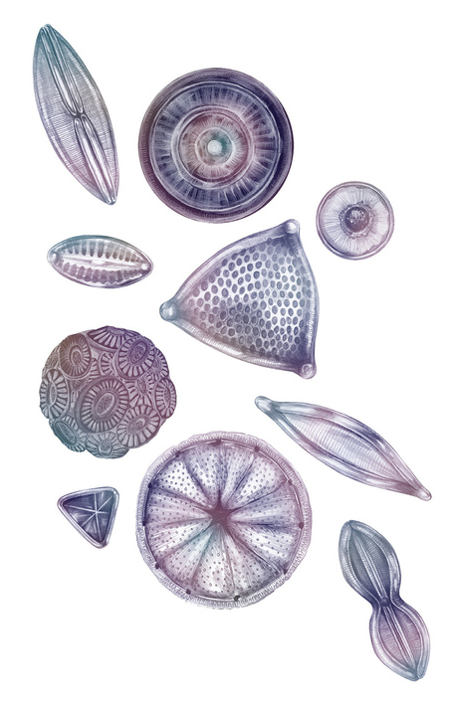
Notes:
Himalayas, Ganges River, Bangladesh, and the Bay of Bengal, left
Phytoplankton, right.

Slide 5
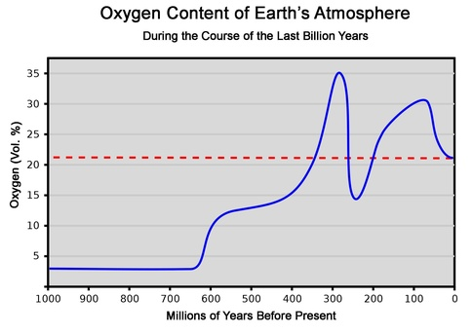
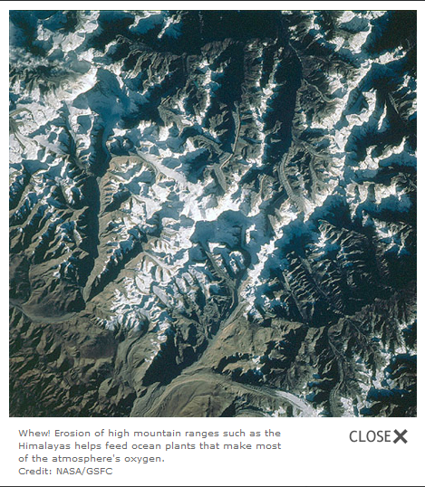
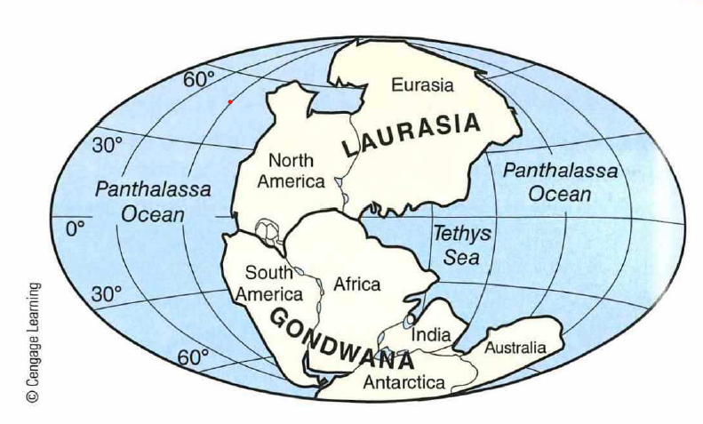
Notes:
Next time you pause to view a scenic mountain vista, consider that the oxygen your lungs are taking in resulted from the same process that raised those peaks. Researchers have connected the periodic formation of supercontinents in Earth's geological past to the nourishment of tiny, oxygen-producing sea creatures, and the process continues to this day. At least seven times, the massive plates that make up Earth's continents have slammed together--sometimes two at a time, and sometimes all of them--forming what geologists call supercontinents. Those gradual collisions severely warped the intervening crust and pushed up high mountain ranges, such as the Himalayas. Each time, over millions of years, wind and rain wore down those mountains into dust that was flushed into the sea. There, minerals containing iron, phosphorus, and other elements became food for microscopic plant life that flourished and, through photosynthesis, boosted the amount of oxygen in the atmosphere. The result was that atmospheric oxygen content rose from what they call negligible levels about 2.65 billion years ago to about 21% today.

Slide 6
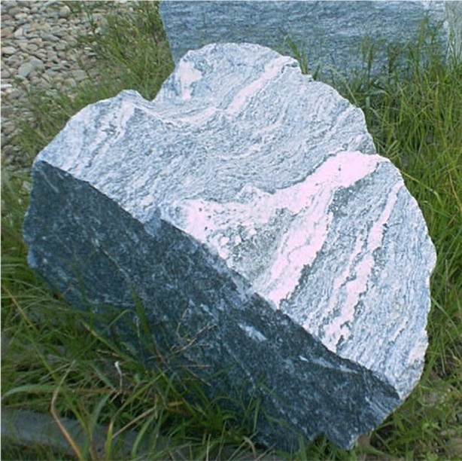
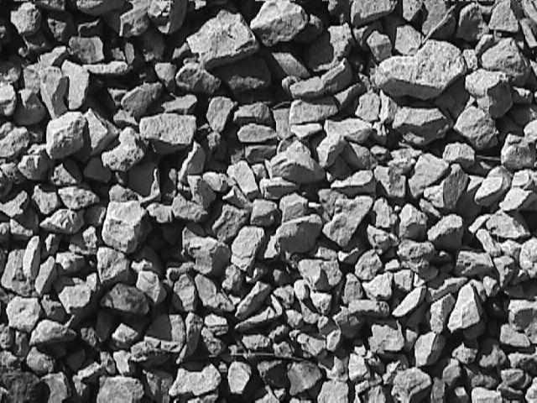
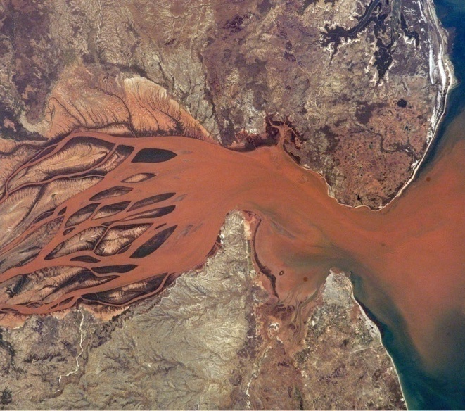
Weathering (or rock decay)
Breakdown of rocks into regolith
Regolith, once weathered may be eroded and transported by other geomorphic agents such as wind and water.
Three types of weathering processes
Mechanical
Chemical
Biological

Slide 7
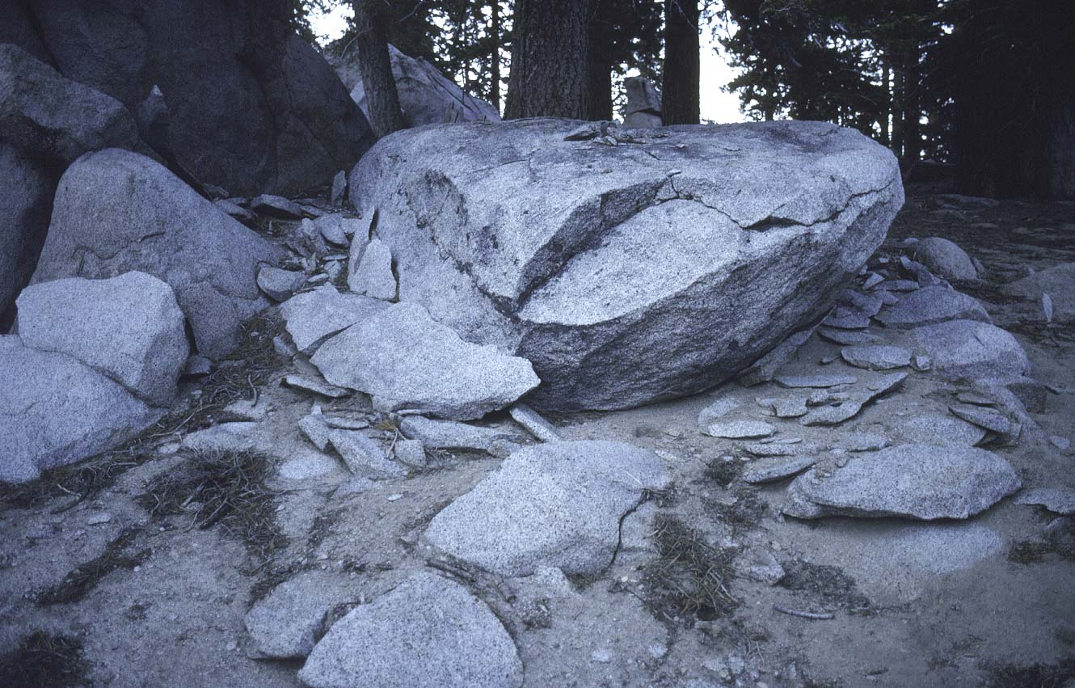
Notes:
Effects of freeze thaw on granite. Southern California, Transverse Ranges. About 8,500 feet.

Slide 8
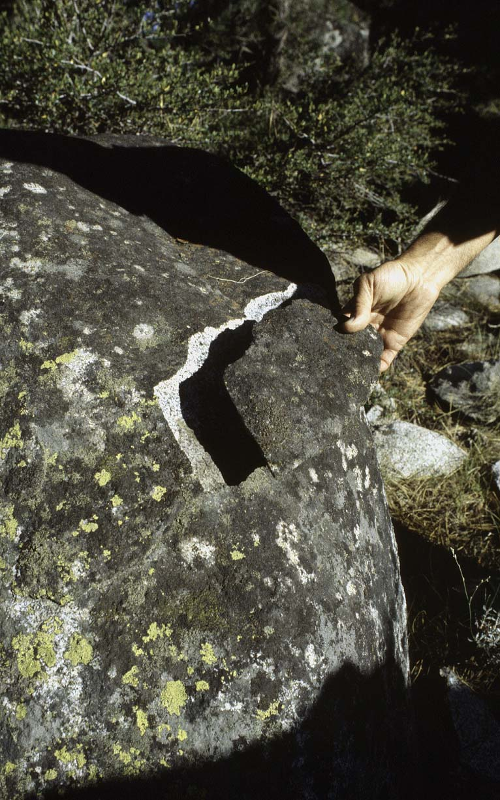
Mechanical weathering
Freeze-thaw action
Water expands volume by 9% when it freezes
Ice and frost wedges rocks apart
Notes:
Fractured piece of granite from freeze thaw activity. Eastern Sierra granite (California). About 7,000 feet.

Slide 9
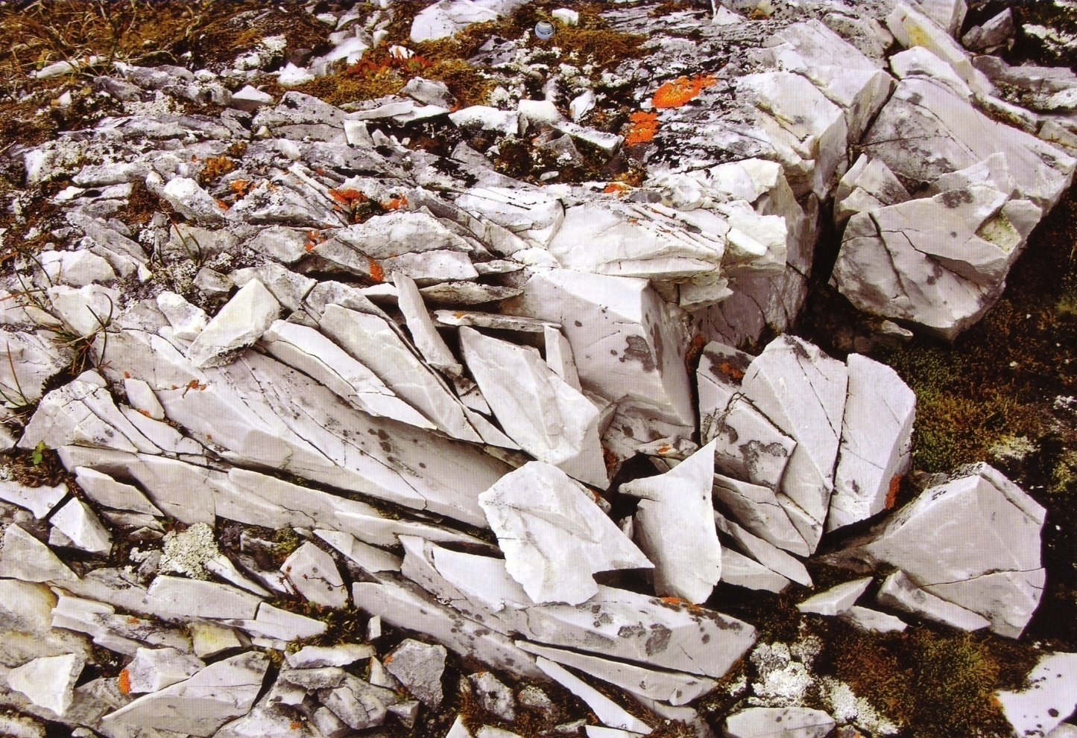

Slide 10
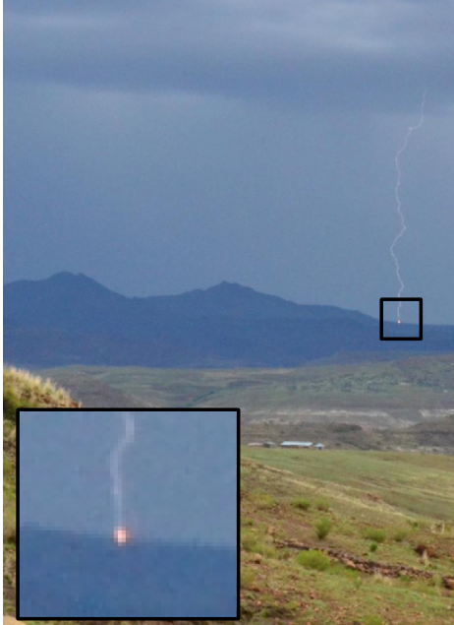
Notes:
Mechanical weathering from cloud-to-ground lightning strikes Knight, J., & Grab, S. W. (2014). Lightning as a geomorphic agent on mountain summits: Evidence from southern Africa. Geomorphology, 204, 61-70.
Lightning can contribute to the weathering of rock in areas where strikes are frequent. When lightning strikes rock, the intense heat can cause the rock to expand rapidly and then contract as it cools. This rapid thermal expansion and contraction can create cracks and fractures in the rock, a process known as thermal weathering. Additionally, lightning can induce chemical changes in the rock, particularly if it contains certain minerals, leading to further weathering. In some cases, the shockwave from a lightning strike can cause mechanical fragmentation of the rock, breaking it apart physically. Overall, while lightning may not be the primary agent of weathering in most environments, it can play a significant role in areas with frequent lightning activity.

Slide 11
Mechanical weathering
Exfoliation
Well-developed in rocks that crystallized underground and are subsequently exposed to the surface
Exposed rocks are out of thermodynamic equilibrium with surface environment
Expansion and spalling of thin sheets of rock in response to removal of overburden

Slide 12
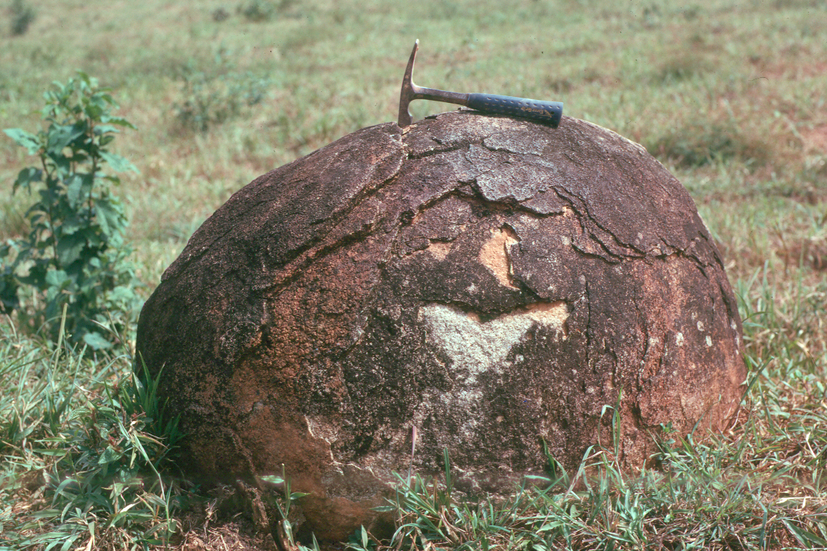
Notes:
Granite boulder, Guyana.

Slide 13
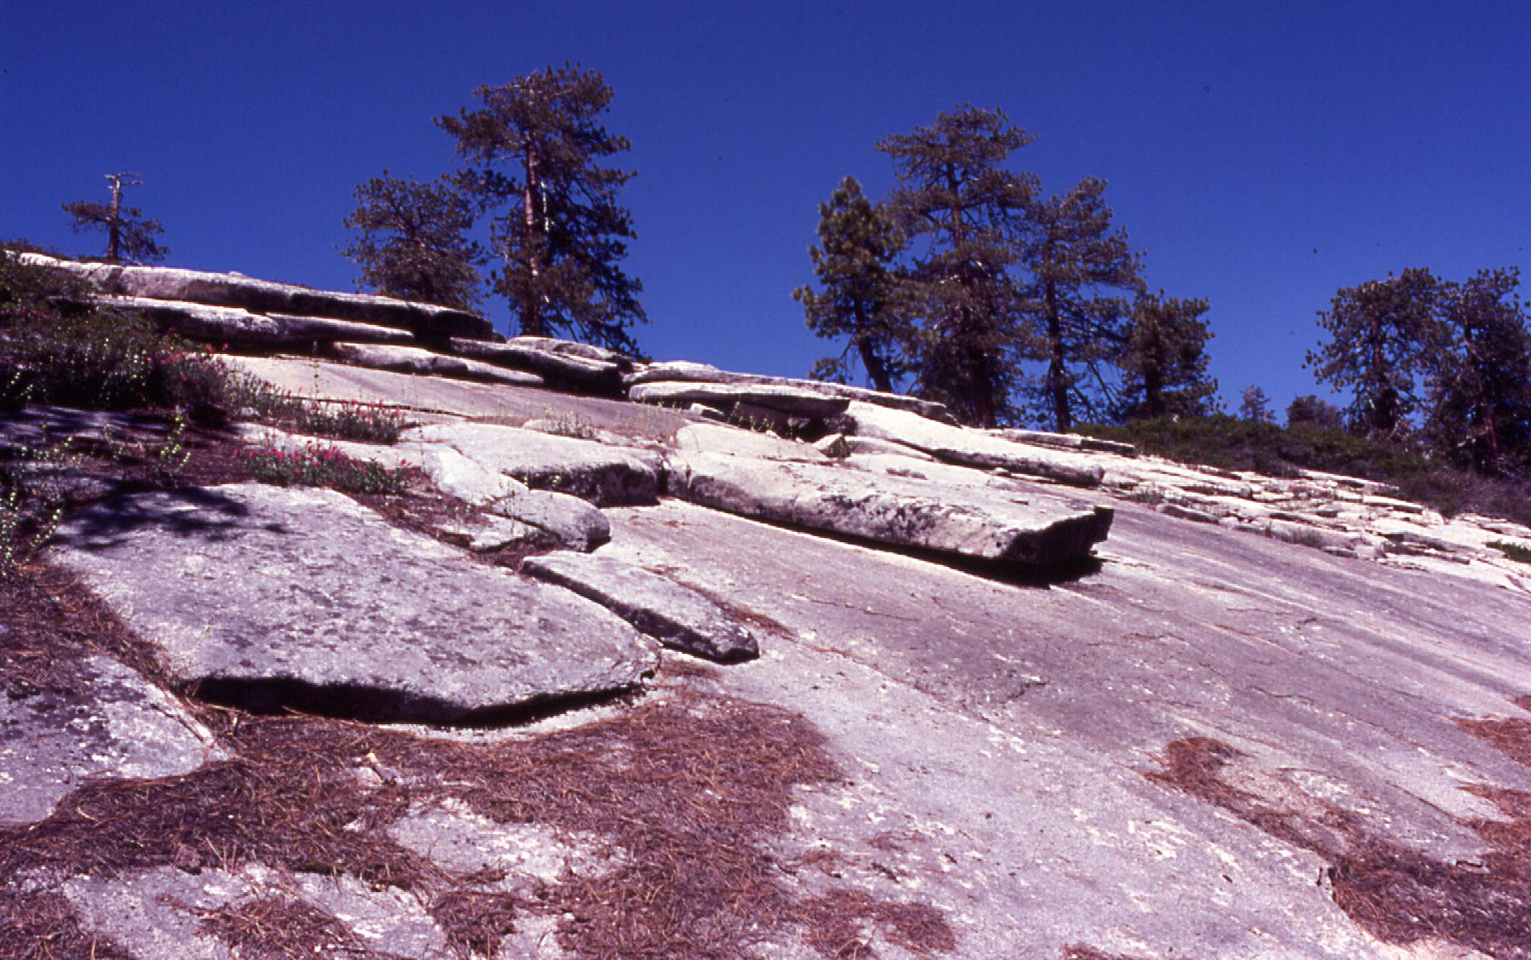
Notes:
Exfoliation, Sierra Nevada, California.

Slide 14
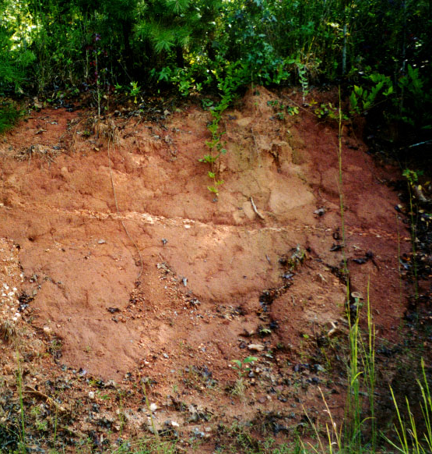
Chemical weathering
Hydrolysis
Weathering initiated by addition of water to mineral crystals
This weathered material is called saprolite if it remains in the same place where it was hydrolyzed.
Notes:
Saprolite, formed from weathering of granite Mica and feldspar, minerals in granite are hydrolyzed to form the orange clay in this photo. Note the horizontal vein of resistant quartz still in place

Slide 15
Chemical weathering
Oxidation
Incorporation of oxygen into mineral crystals
Forms oxides
Rust is an iron oxide
4Fe + 3O₂ —> 2(FeO₃)

Slide 16
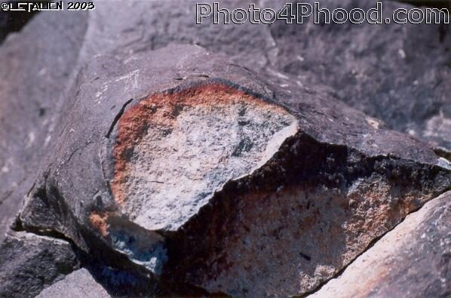
Notes:
Rock varnish reflect oxidation

Slide 17
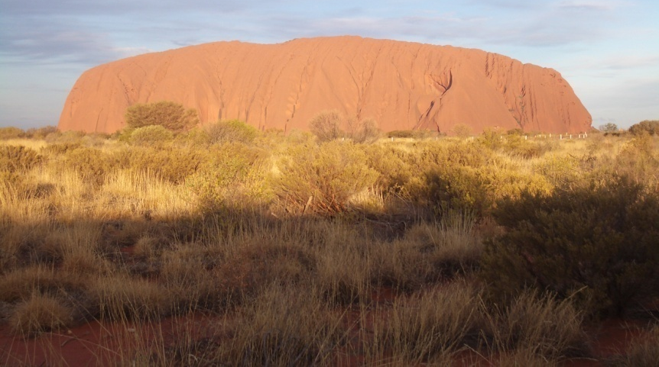
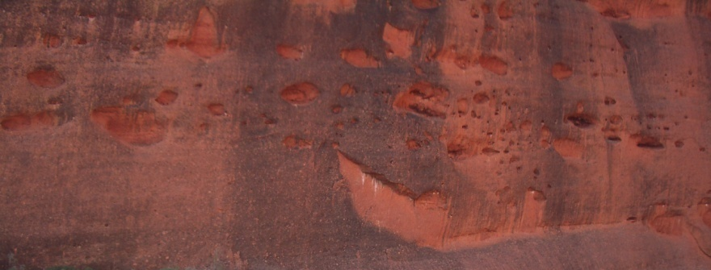
Notes:
Oxidation of Uluru in central Australia

Slide 18
Notes:
The Patterson Statue is situated in the middle of the courtyard next to the Whitehall Classroom Building and Patterson Office Tower. The statue has been chemically weathered. When copper changes to this color it is because the process of oxidation has occurred. This has happened over time as the metallic statue reacted to the rain. The statue has recently been resurfaced so that this weathering process no longer takes place.

Slide 19
Chemical weathering
Carbonation
Chemical reaction of carbon dioxide and water with carbonate minerals
Water forms weak acid in soil in the presence of carbon dioxide contributed by soil organisms:
CO₂ + H₂0 = H₂CO₃ + H⁺ + HCO₃⁻
Carbonic acid H₂CO₃ dissolves carbonate minerals (calcite, dolomite) efficiently.

Slide 20
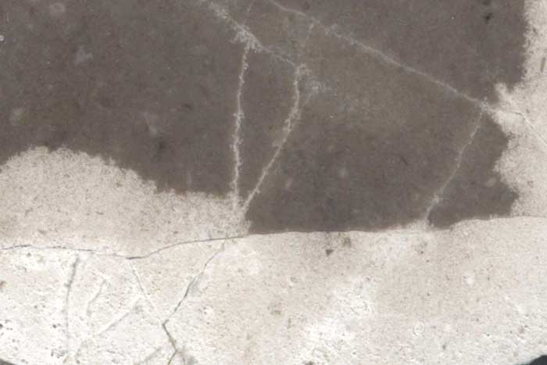
Notes:
Progression of dissolution by carbonation in limestone

Slide 21
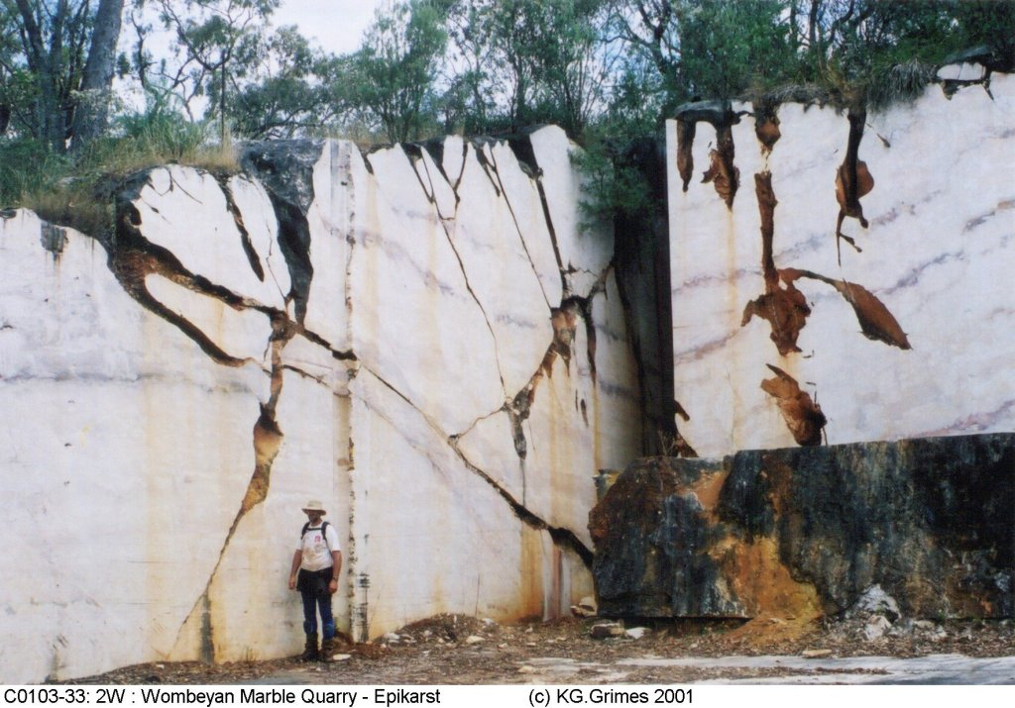
Notes:
Subsoil solution fissure in marble, New South Wales, Australia.

Slide 22
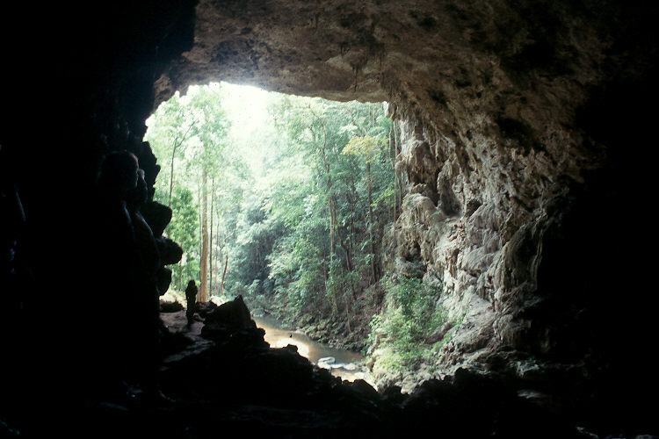
Notes:
Cavern Entrance, Belize. Thick limestone deposits and vigorous chemical weathering has resulted in extensive karst development in this tropical environment Note for scale the silhouette of the person on the path (the flat area) on the left side of the cavern, approximately one third up from the bottom.

Slide 23
Notes:
Above is a tombstone that has been in the cemetery since 1920, approximately 92 years.

Slide 25
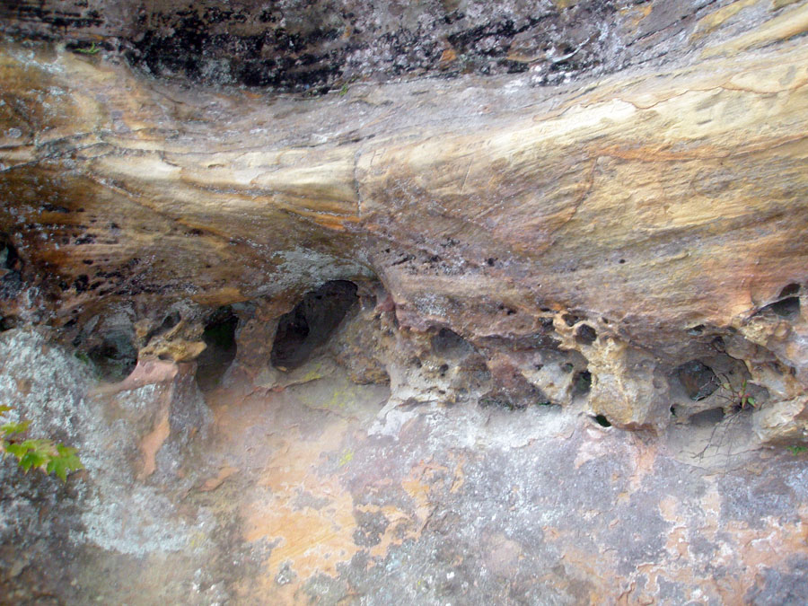
Notes:
Red River Gorge, KY Occurs in sandstones here in KY, but not in limestones

Slide 26
Mechanical and chemical weathering: tafoni
Honeycomb-like cavities
Most common in arid, semi-arid, and coastal environments
Formation reflect mechanical and chemical weathering
Naturally occurring mineral salts in rocks
These combine with moisture and go into solution (dissolve)
Winds blowing over rock surface enhance conditions for evaporation
Crystals form that pry apart rocks as water evaporates
Creates small cavity where rock was eroded
Windspeed in cavity increases
Enhances evaporation, crystal formation, and further weathering and enlargement of cavities
Notes:
http://www.colby.edu/geology/GE254/Rodriguez-Navarro.pdf
http://www.kuriositas.com/2011/08/tafoni-natures-rock-art.html A variety of other processes may also cause tafone Turbulence, funnel effects that speed up windflow tend to disperse water vapor from surface of rock and that allows more evaporation to take place, which enhances salt deposition

Slide 27
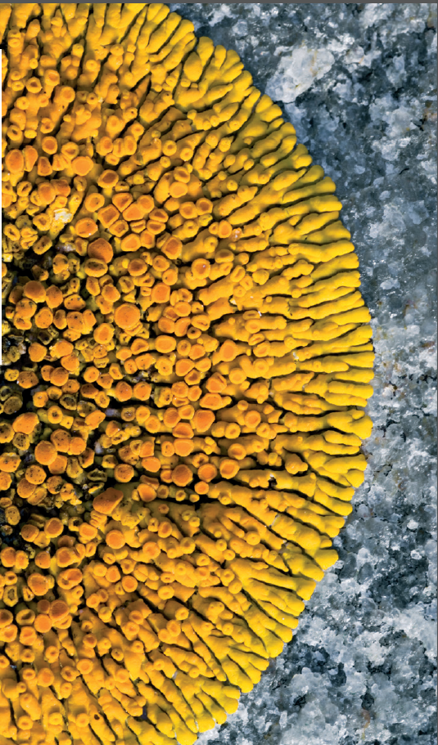
Biological weathering
Chelation
Organisms like mosses and lichens produce organic substances, known as chelates, that have the ability to decompose minerals and rocks

Slide 28
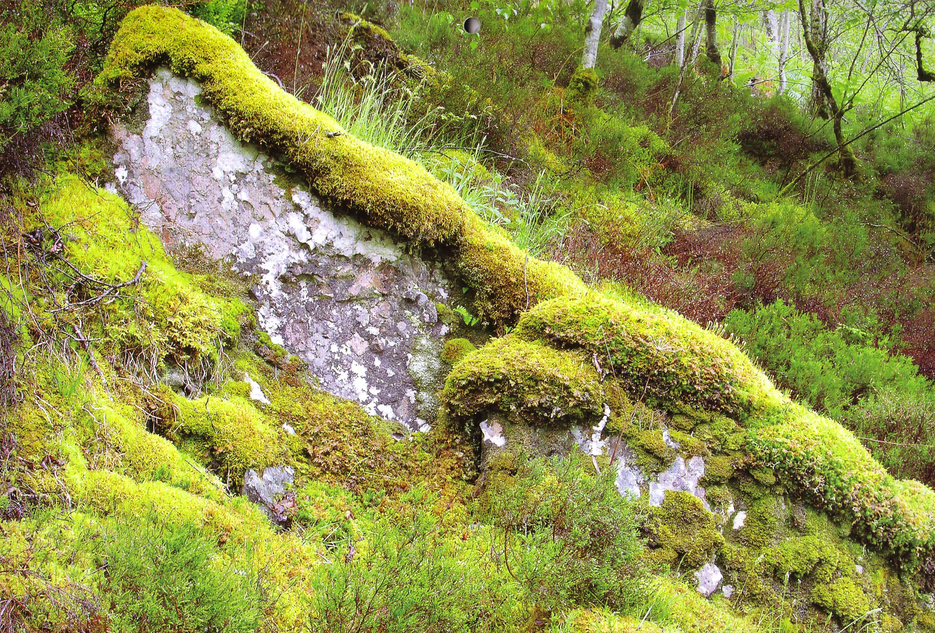

Slide 29
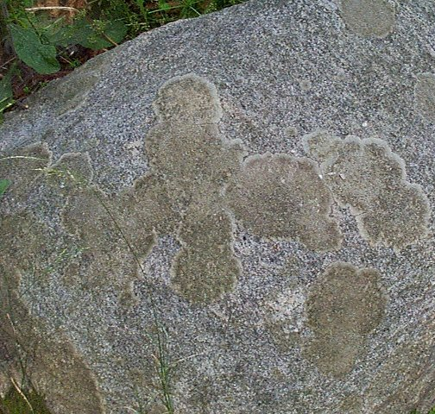
Notes:
Lichens and biological weathering. Chelation is a biological process where organisms produce organic substances, known as chelates, that have the ability to decompose minerals and rocks

Slide 30
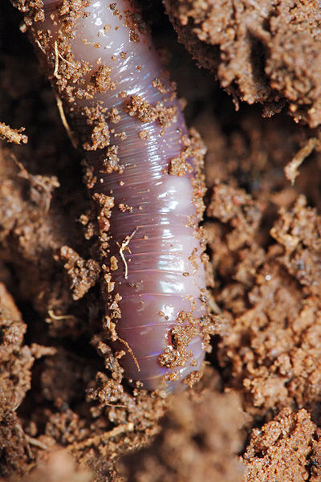
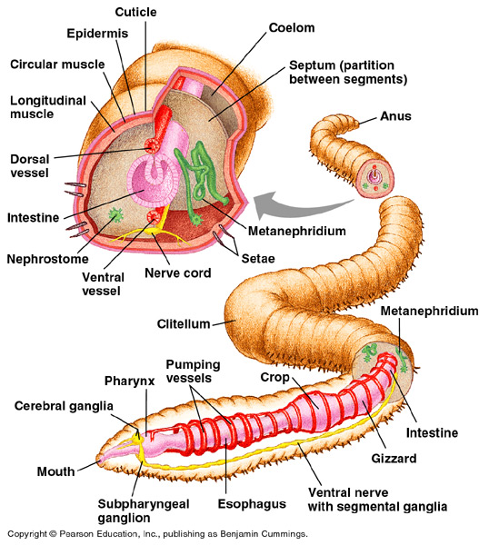
Biological weathering
Ingestion and mechanical breakdown of small rock particles

Slide 31
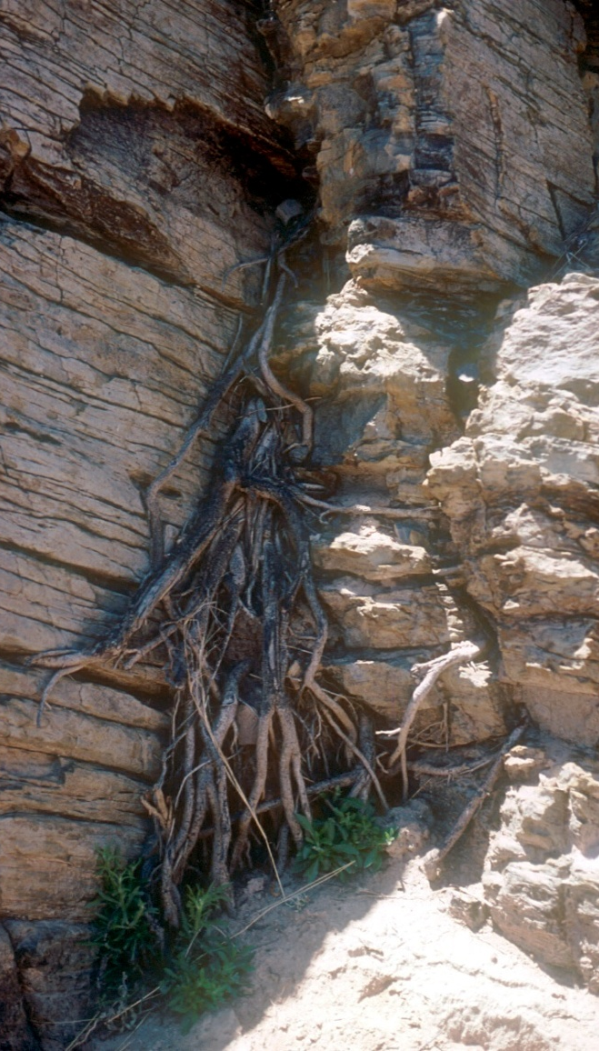
Biological weathering
Root weathering
Notes:
Roots can pry apart rocks

Slide 32
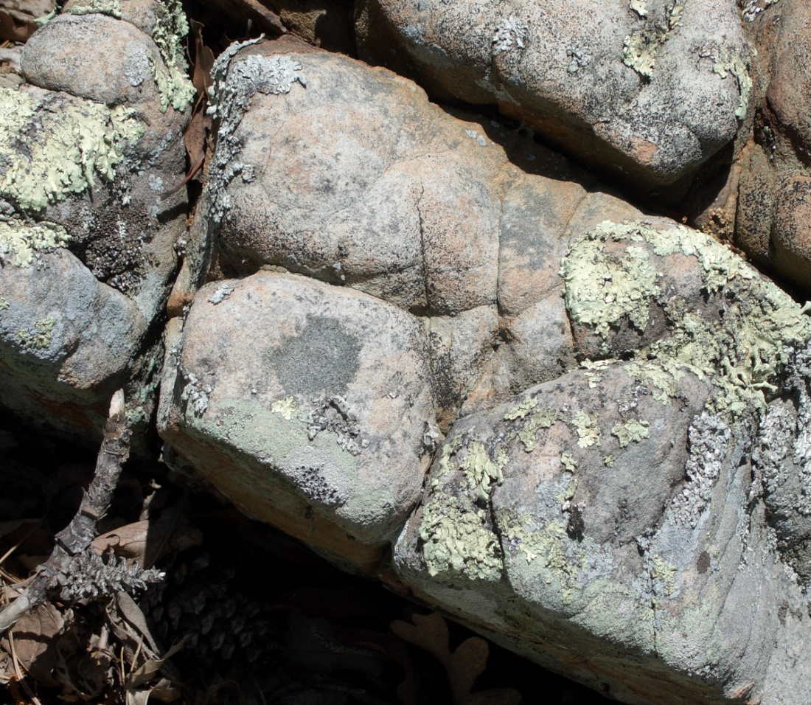
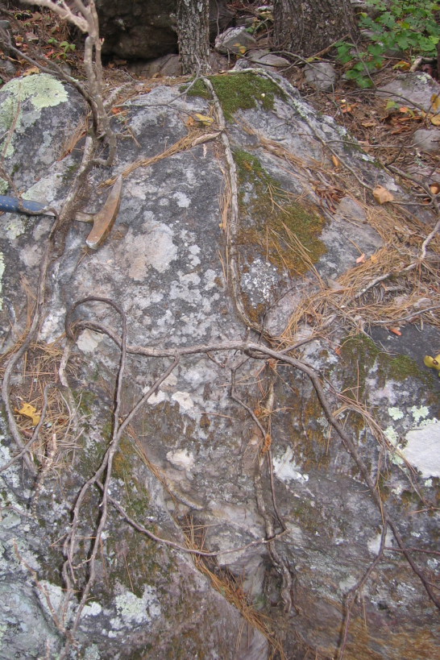
Notes:
Root grooves

Slide 33
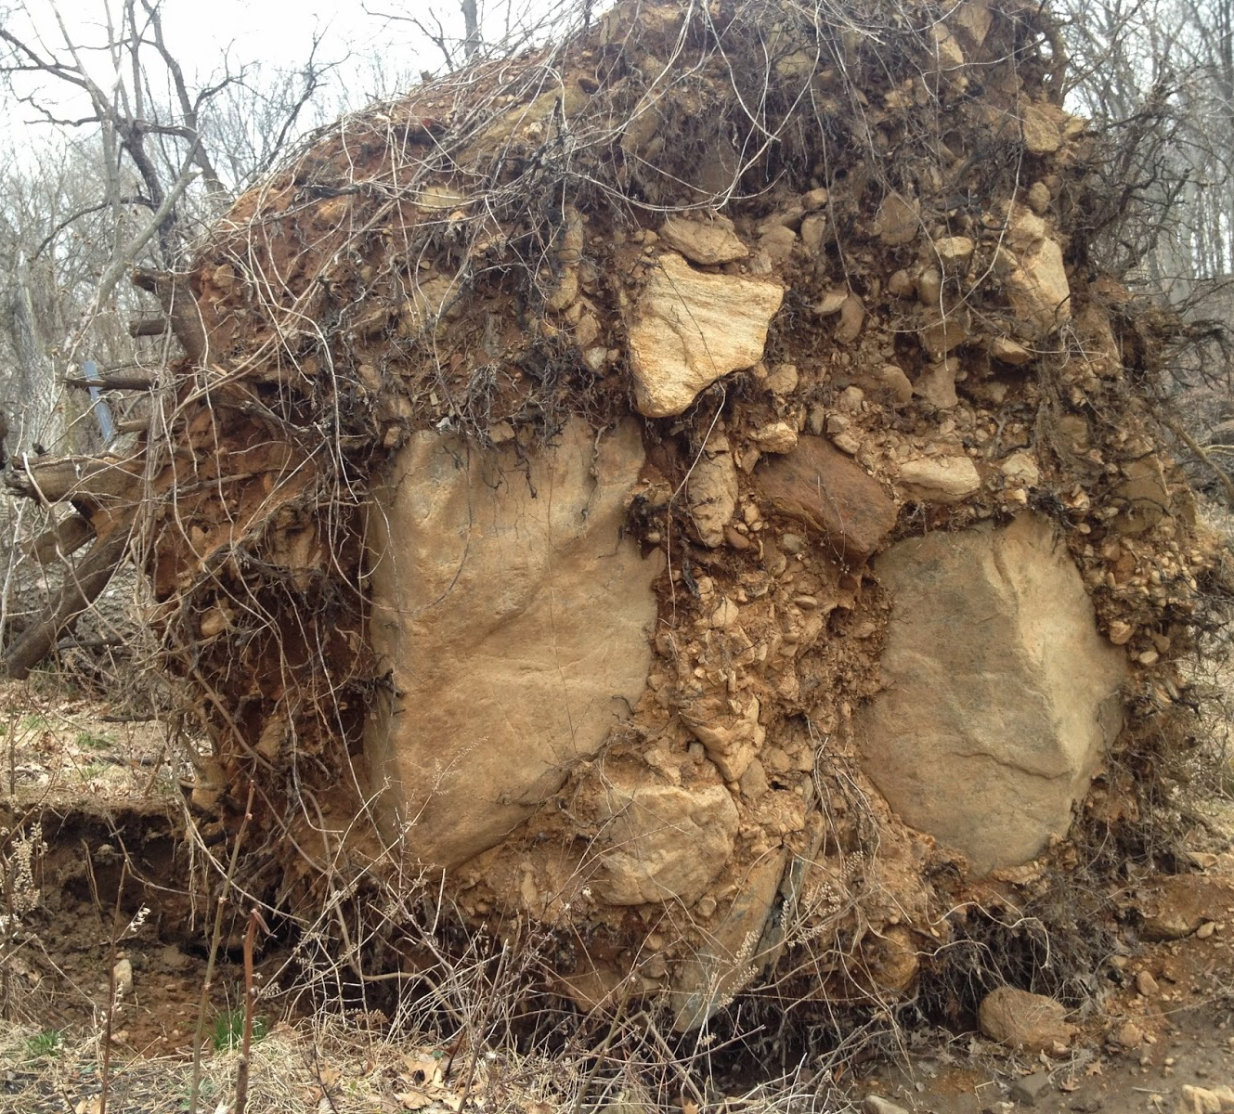
Biological weathering: treefall
Notes:
Treefall breaks apart parent rock material

Slide 34
Differential weathering
Rates of weathering differ across the earth’s surface
Two main factors
Rock type
Mineral types comprising rock shape weathering rates
Climate
Colder temps promote ice/frost wedging
Warmer temps and more rainfall promote more biological and chemical weathering

Slide 35
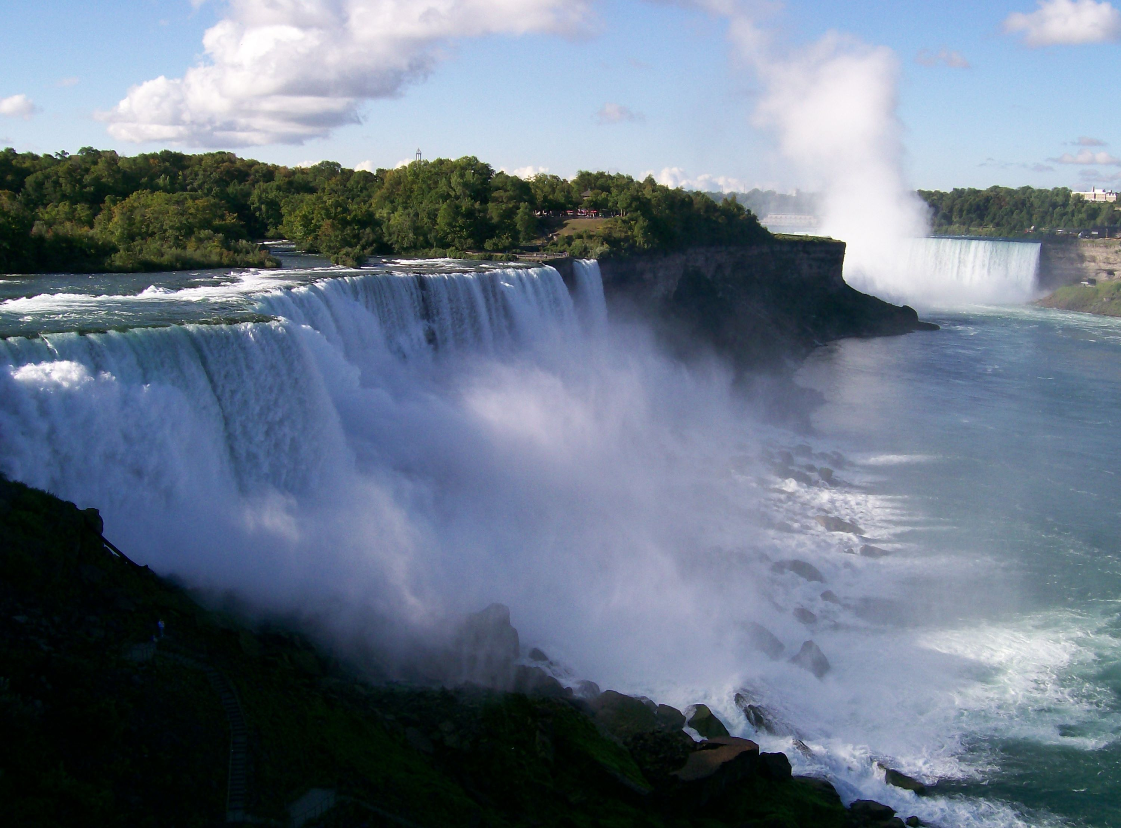
Niagara Falls

Slide 36
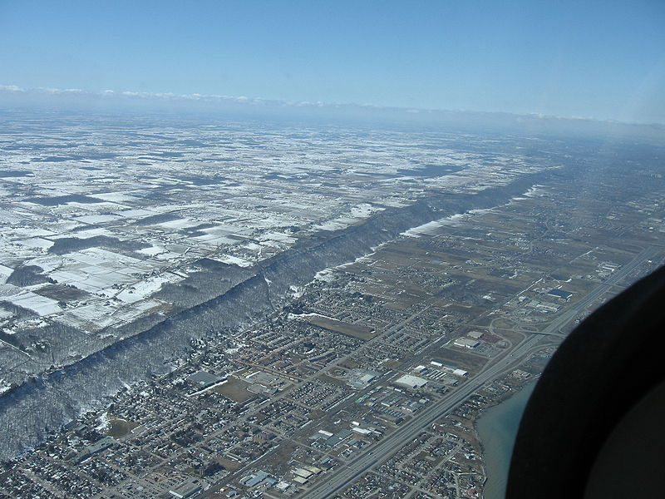
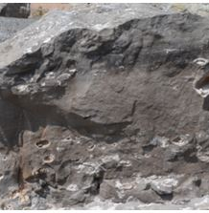
Resistant rock
Less resistant rock
Niagara Escarpment
Notes:
Niagara Escarpment The Niagara Escarpment has a caprock of dolomitic limestone (top photo at right) which is more resistant and overlies weaker, more easily eroded shale (lower photo). The weathering-resistant dolomitic limestone serves as a protective "cap". The escarpment formed over millions of years through a process of differential erosion of these two rock types. Through time the soft rocks weather away and are transported away by gravity and rainfall. The gradual removal of the soft rocks undercuts the resistant caprock, leaving a cliff or escarpment.

Slide 37
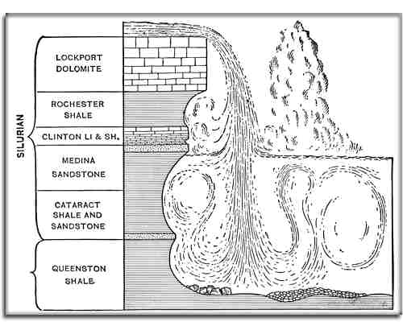

Slide 38
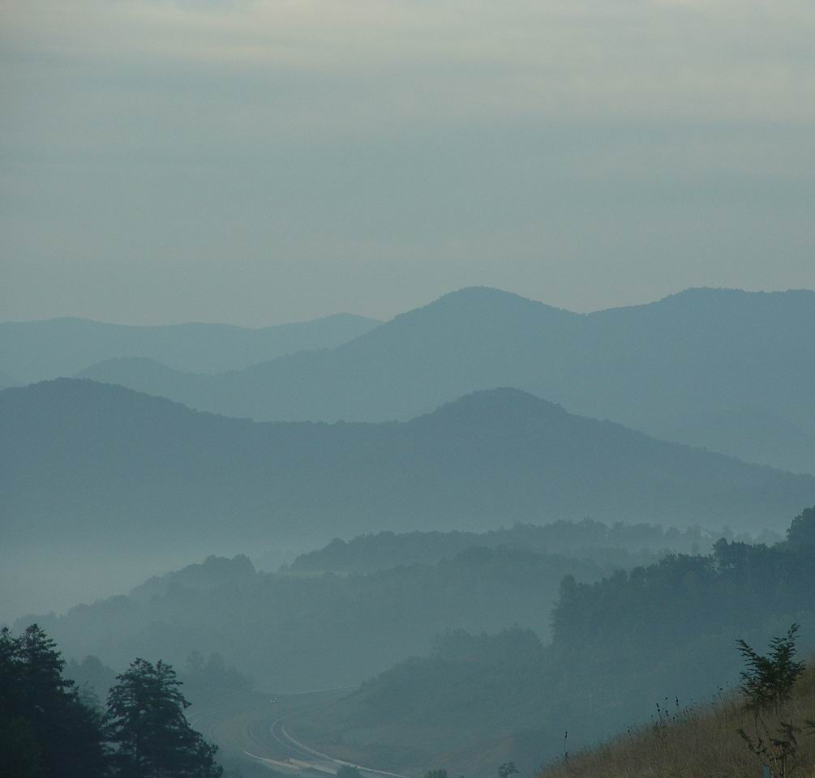
Appalachian Mts (humid climate)
Limestone, a carbonate rock, weathers quickly through carbonation and forms valleys in the Appalachians
Non-carbonate clastic rocks (sandstone and shale) are more resistant and do not weather as fast. They form ridges.

Slide 40
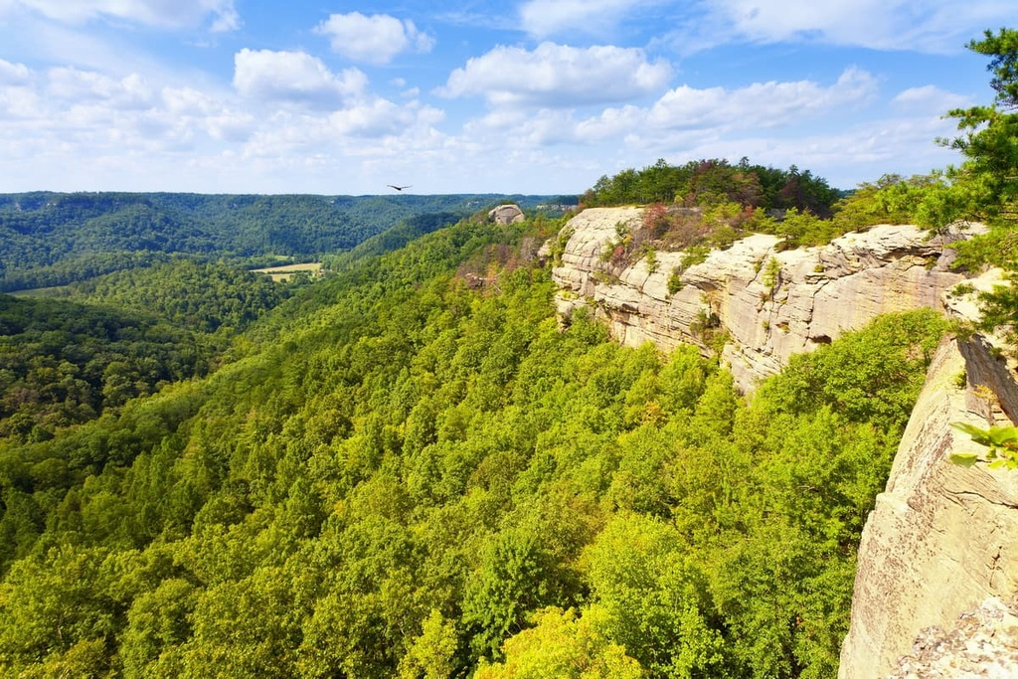
Resistant rock – sandstones
Less resistant rock - limestone
Cumberland Plateau in Tennessee and Kentucky
Notes:
Cumberland Plateau in Tennessee

Slide 41
Notes:
The Pottsville Escarpment is a resistant sandstone belt of cliffs and steep sided, narrow crested valleys in eastern Kentucky, USA. It features rock shelters, waterfalls, and natural bridges. It forms the western edge of the Cumberland Plateau.
It is largely located within the Daniel Boone National Forest, the original area of which was located to specifically include this rugged strip of land. Several significant natural areas in Kentucky are located within the escarpment zone. These include the Red River Gorge Geologic Area, Natural Bridge State Park, Cumberland Falls, Big South Fork National Recreation Area, and others.

Slide 42
Notes:
Cumberland Falls, Kentucky

Slide 44
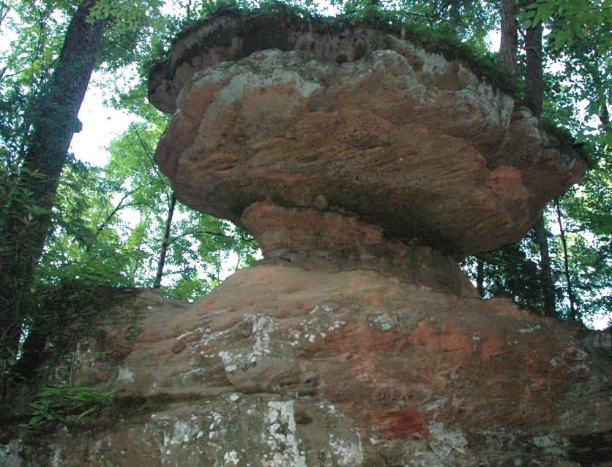
Resistant rock - sandstone
Less resistant rock - limestone
Hoodoos
Notes:
Differential weathering in Natural Bridge, KY These features are known as hoodoos

Slide 45
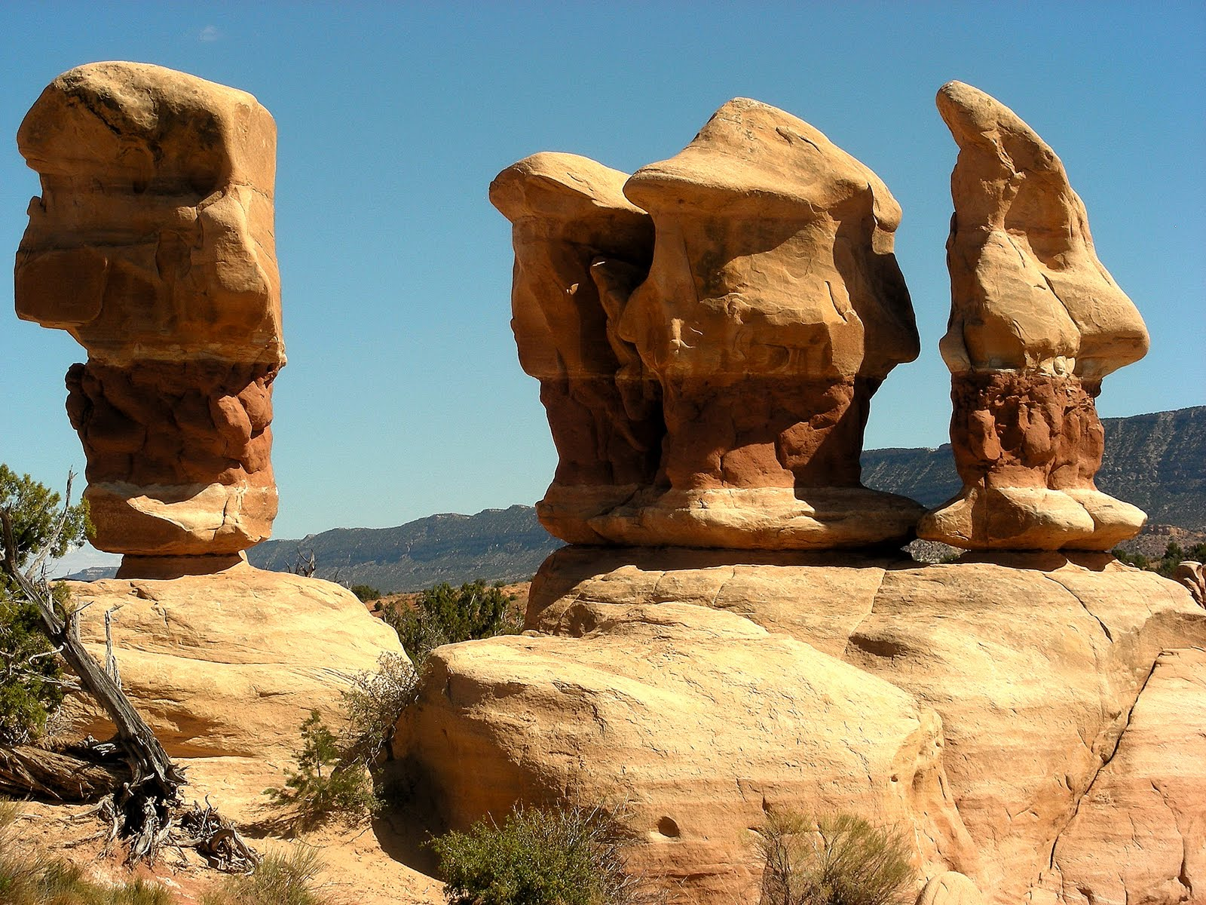
Hoodoos in US southwest, Bryce Canyon National Park

Slide 46
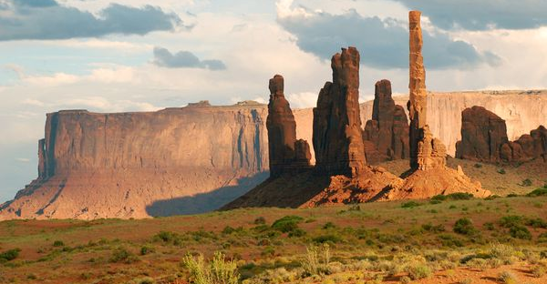
Notes:
Plateaus, canyons, mesas, buttes – these landforms arise from differential weathering. These features can also have a volcanic origin. Igneous rocks may not weather as quickly as sedimentary rocks, leaving behind volcanic necks such as the ones you see in the top photo

Slide 47
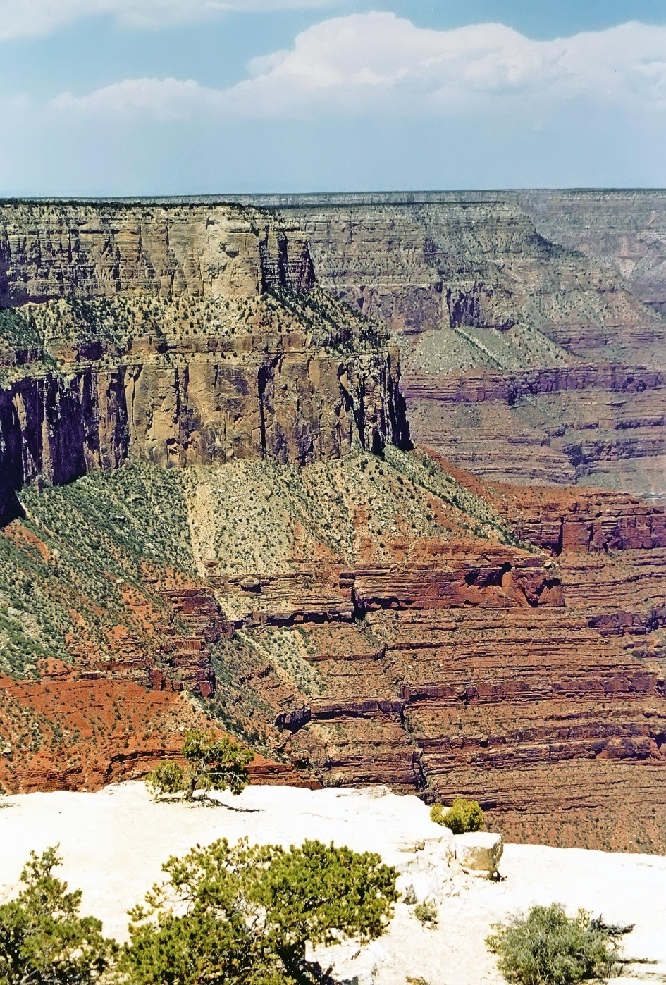
Grand Canyon (arid climate)
Here, non-carbonate rocks (sandstone and shale) weather faster than limestone (a carbonate)
Less rainfall, less karstic weathering of carbonates

Slide 49
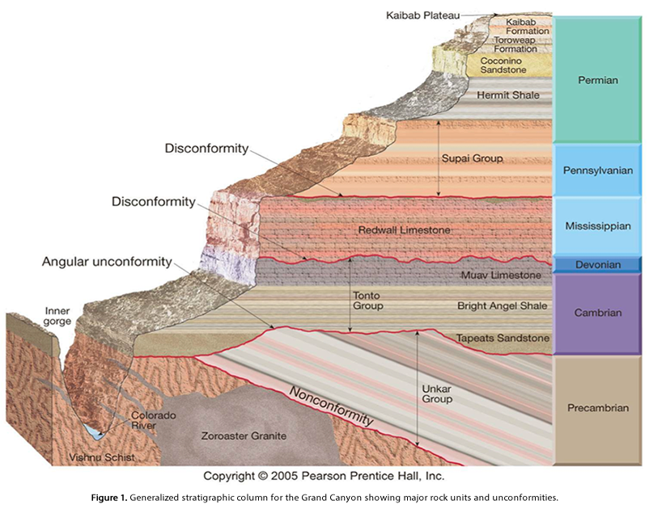
Notes:
Limestone weather more slowly than shale and sandstone (non-carbonate rocks), in dry climates. The reverse is true in humid climates. There, limestones weather faster.

