Slide 1
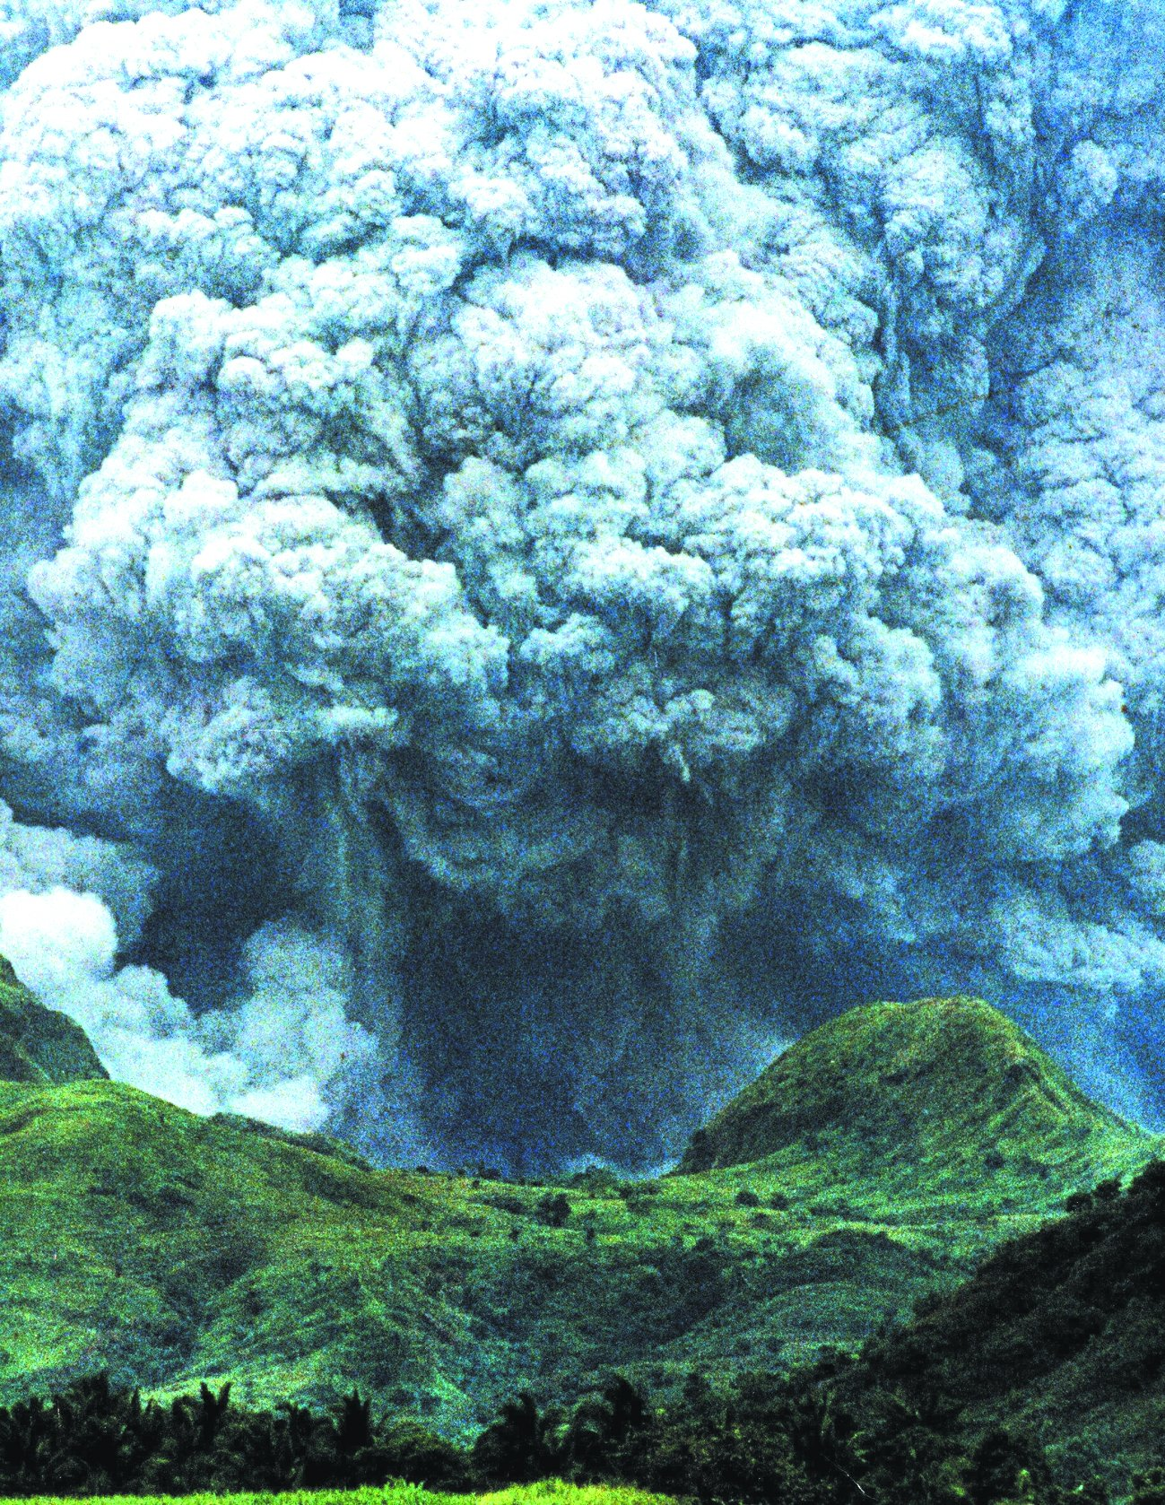
Volcanic landforms and processes

Slide 2
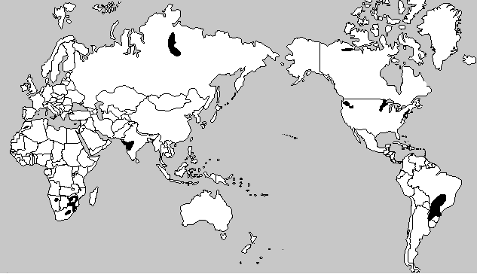
Within-plate volcanics: flood basalts
Notes:
Black areas are flood basalts

Slide 3
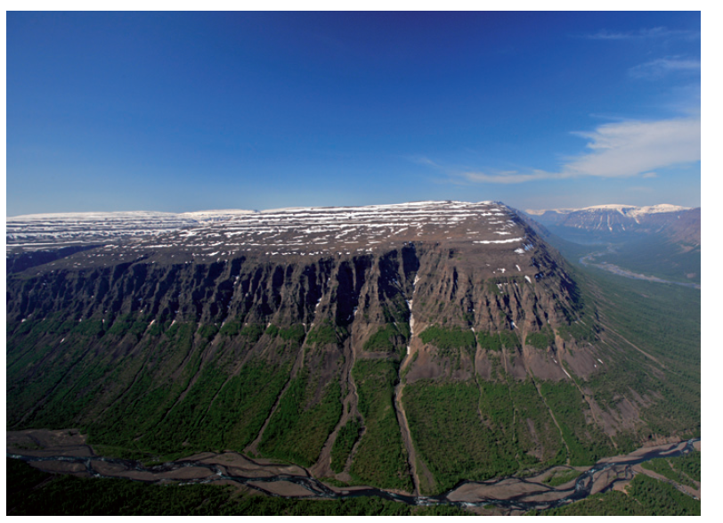
Notes:
Siberian Traps

Slide 4
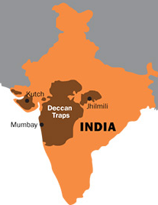
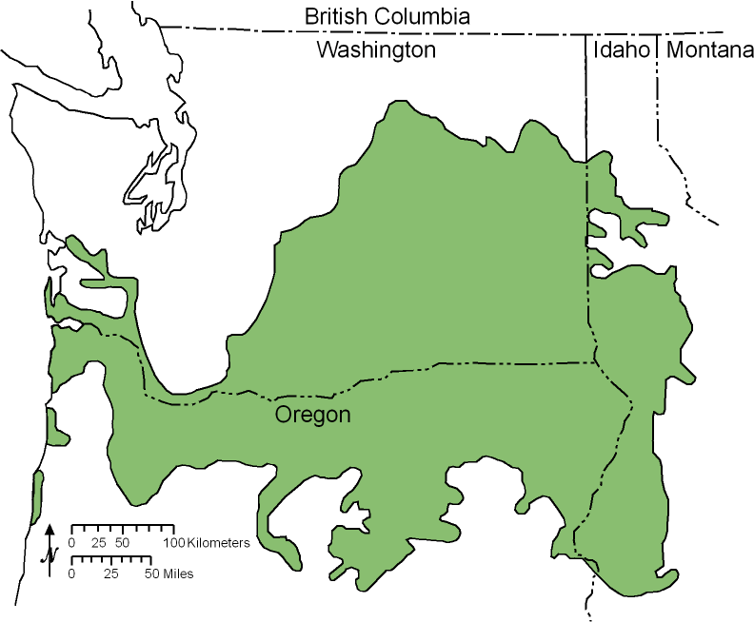
Notes:
Deccan Traps (left) and Columbia River Basalts (right) are flood basalts

Slide 5
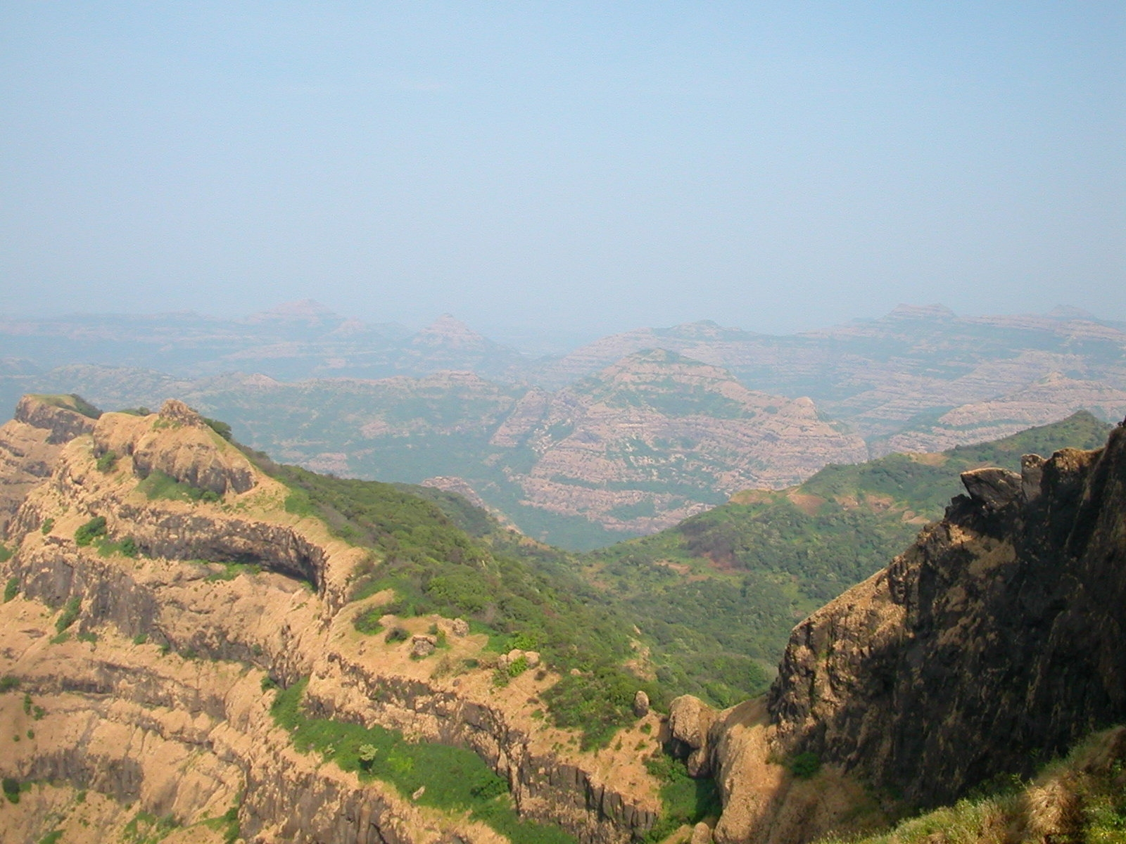
Notes:
The Deccan Traps are one of the largest volcanic provinces in the world. It consists of more than 6,500 feet (>2,000 m) of flat-lying basalt lava flows and covers an area of nearly 200,000 square miles (500,000 square km) (roughly the size of the states of Washington and Oregon combined) in west-central India. Estimates of the original area covered by the lava flows are as high as 600,000 square miles (1.5 million square km). The volume of basalt is estimated to be 12,275 cubic miles (512,000 cubic km)(the 1980 eruption of Mount St. Helens produced 1 cubic km of volcanic material).

Slide 6
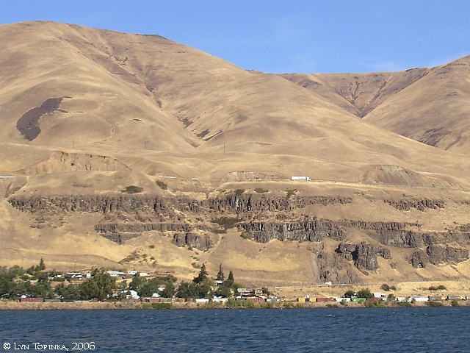
Notes:
Columbia River Basalts, Oregon

Slide 7
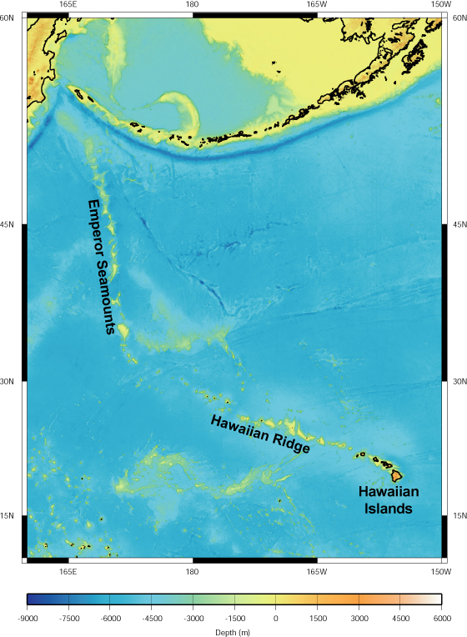
Within-plate volcanics: hotspots
Area of upwelling magma from a source deep in the mantle.
Magma melts through overlying oceanic crust (Hawaiian Islands) or continental crust (Yellowstone National Park)
Hotspot stays in the same general vicinity, they do not move with the plate because their source is deep in the mantle below the plate

Slide 8
Notes:
Hawaiian island chain Islands are all volcanic and vary in age. Age reflects when island passed over hot spot. Hawaii is the youngest. Kauai, oldest above water. Seamounts form when the exposed island erodes away. Youngest Hawaiian island is forming on sea floor

Slide 9
Hawaiian Islands
Islands are all volcanic and vary in age
Age reflects when island passed over hot spot
Hawaii is the youngest
Kauai is the oldest island above water
Seamounts form when the exposed island erodes away
Youngest Hawaiian island is forming on sea floor over hotspot

Slide 11
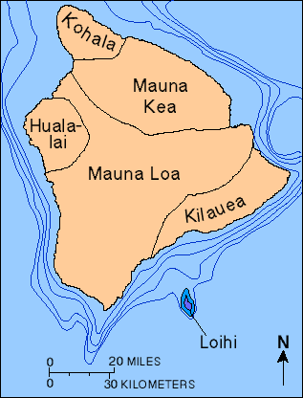
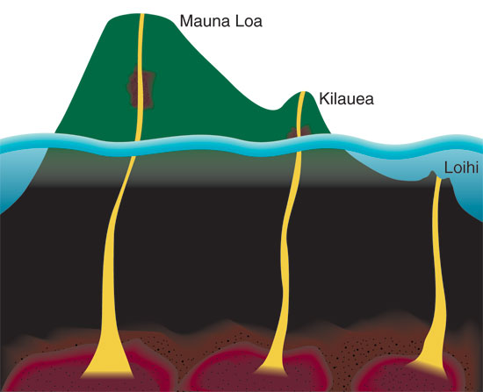
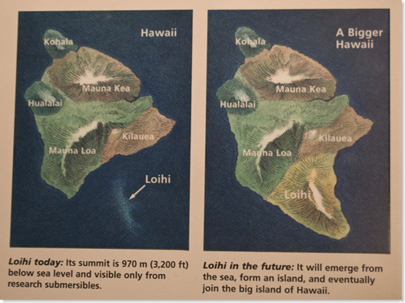
Notes:
All the volcanoes on Hawaii are active. The only other active volcano in Hawaii is on Maui and it is Mount Haleakala.
Loihi is the next island to form in the Hawaiian islands. It is still beneath the surface

Slide 12
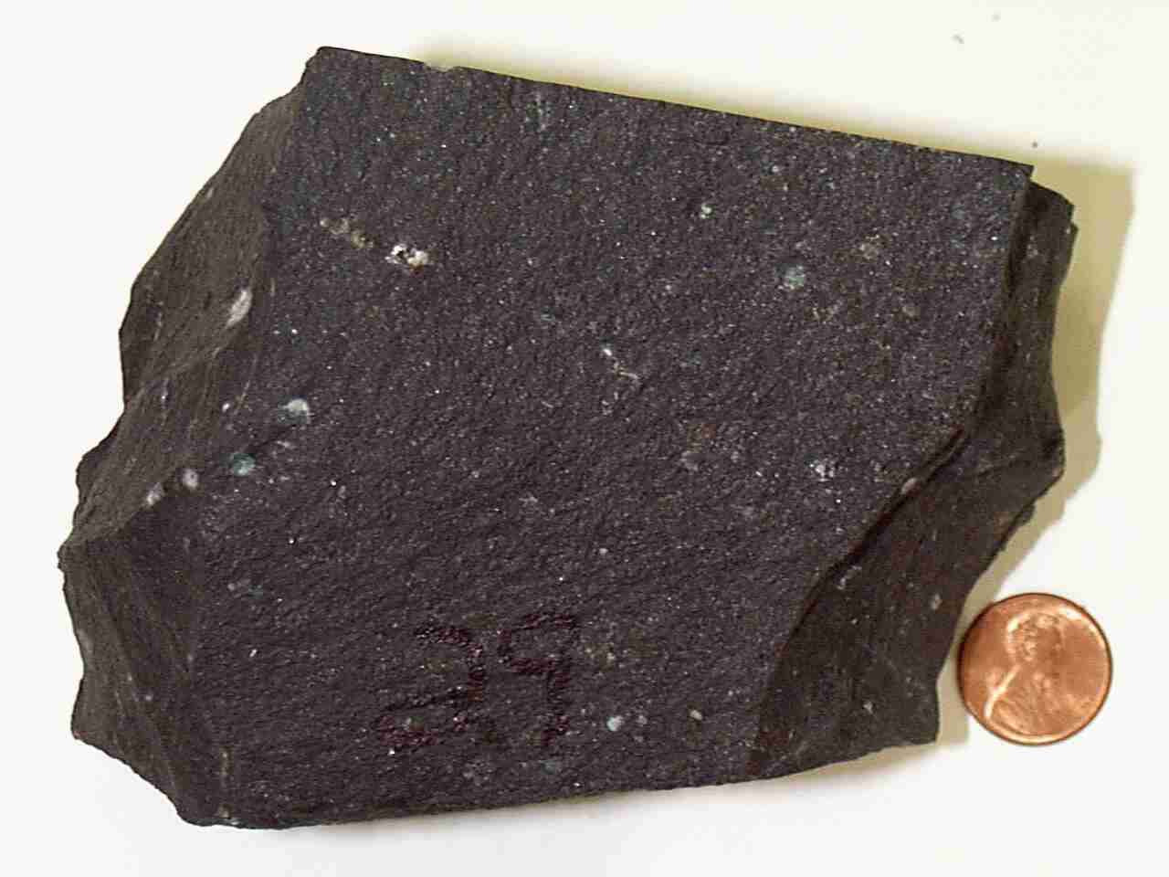
Basaltic magma
Basalt is the most common rock of the oceanic crust
Forms low viscosity magma – it is more fluid and volcanic eruptions flow instead of explode
Notes:
http://hvo.wr.usgs.gov/multimedia/index.php?display=default

Slide 14
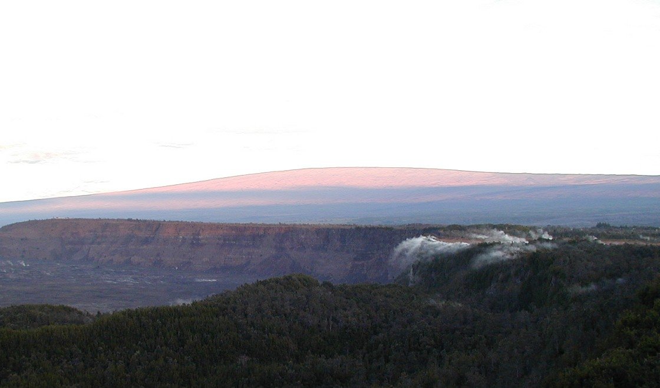
Notes:
Hawaii's Mauna Loa, a shield volcano

Slide 15
Shield volcanoes
Form from magma rich in basalt
Best developed where there is a hotspot underneath oceanic crust, like the Hawaiian islands.
Broad, gently sloping volcano
Magma can flow outward over long distances before solidifying
Volcano does not explode
Notes:
Hawaii has five main volcanoes that are considered active. Four of these active volcanoes are located on the big islands of Hawaii. They include Kilauea, Mauna Loa, Mauna Kea, and Hualalai. The other is located on Maui and it is Mount Haleakala.

Slide 16
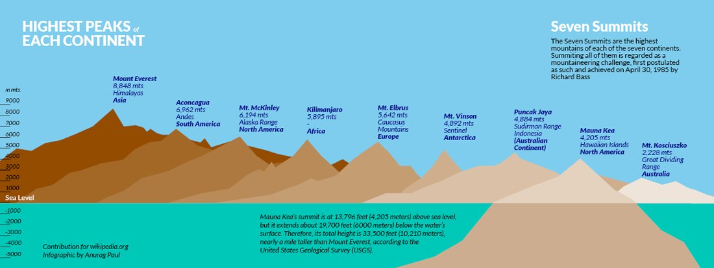
Notes:
Hawaii, if measured from bottom of the ocean to its peak, is the highest mountain on Earth.

Slide 17
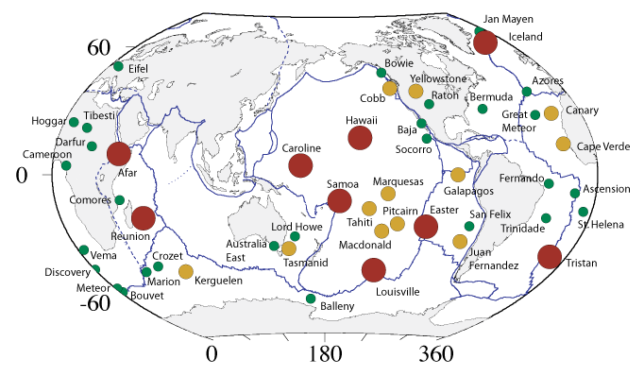
Notes:
Yellowstone is a hotspot in the middle of the North American plate. These are all mantle plume hotspots. Size and color are indicative of volume of magma of hotspot.

Slide 18
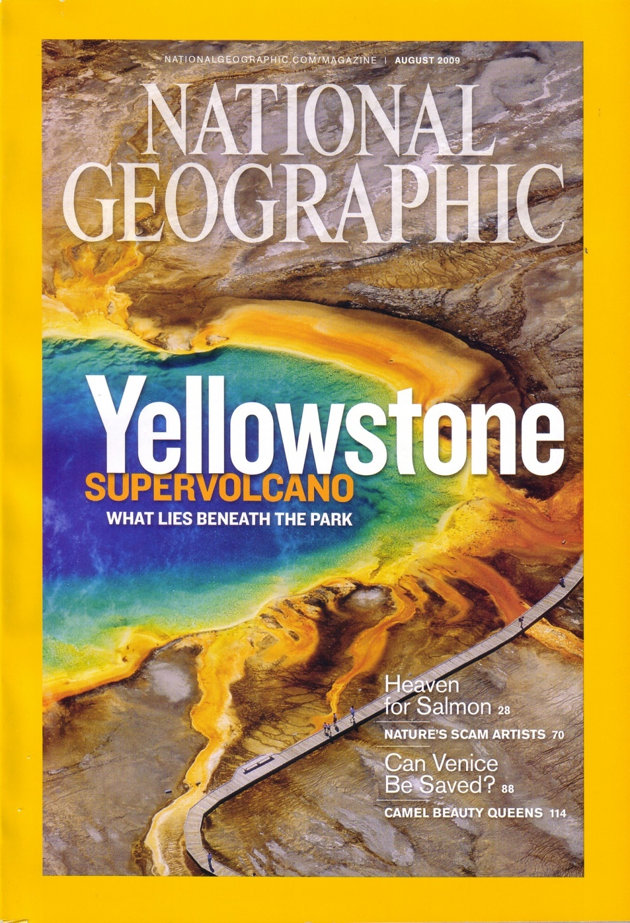
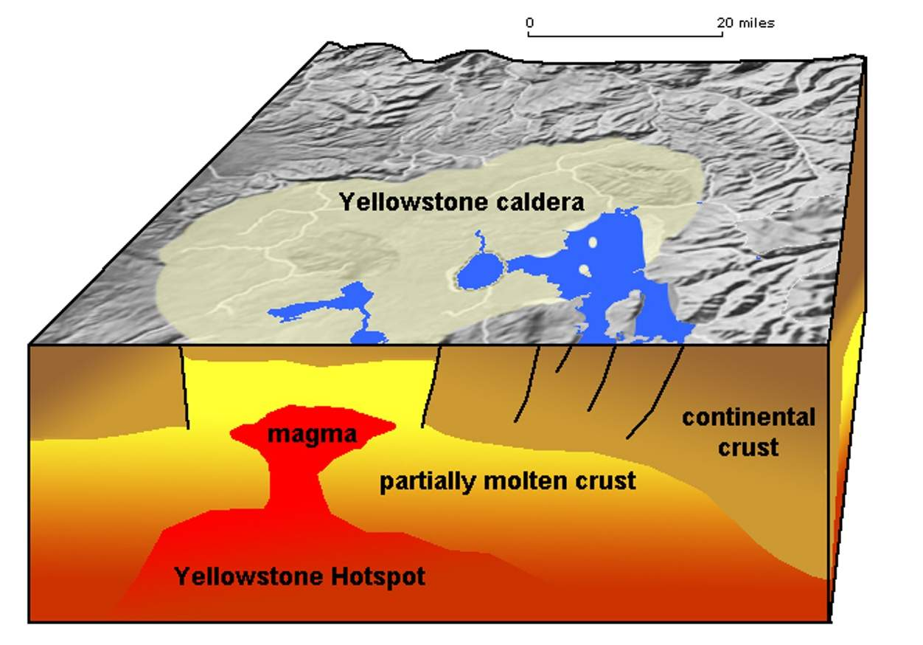
Hotspot underneath continental crust
Notes:
Yellowstone hotspot Hotspots can form under continental crust too.

Slide 19
Notes:
https://www.nps.gov/yell/learn/nature/volcano.htm Movement of North American plate over the Yellowstone hotspot

Slide 20
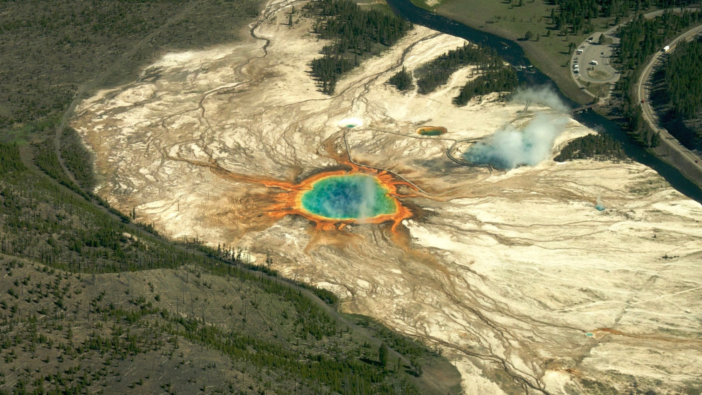
Magma in YNP is less basaltic and chemically more like continental crust that overlies the hotspot, which is composed of granite and andesite
Magma from these rock types create a different type of volcano – a composite volcano – and a potentially much more explosive.
This hotspot has produced very large eruptions in the past
Notes:
Center of Yellowstone Caldera

Slide 21
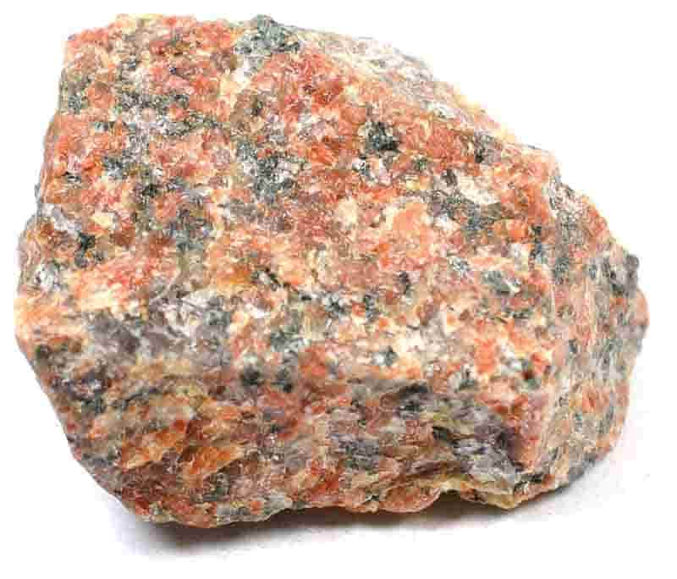
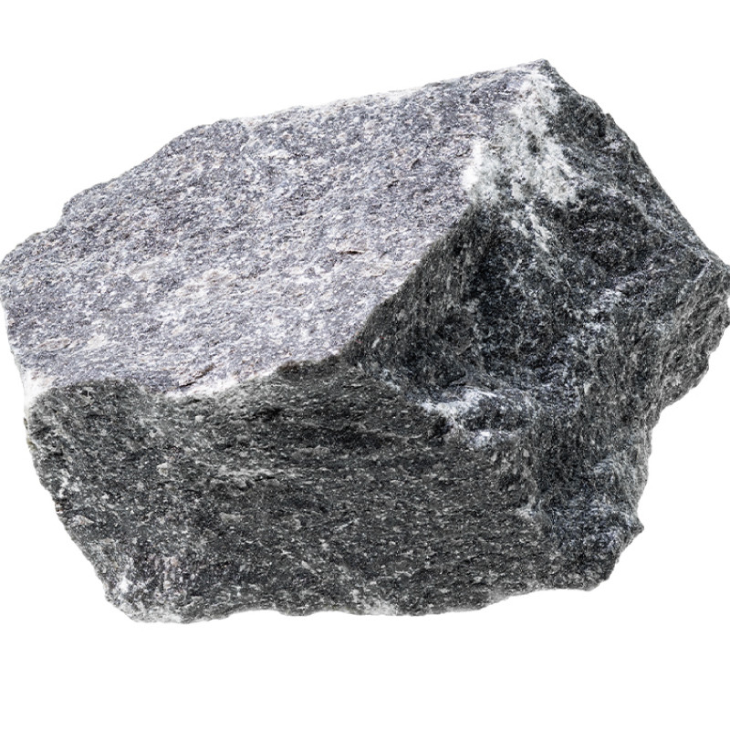
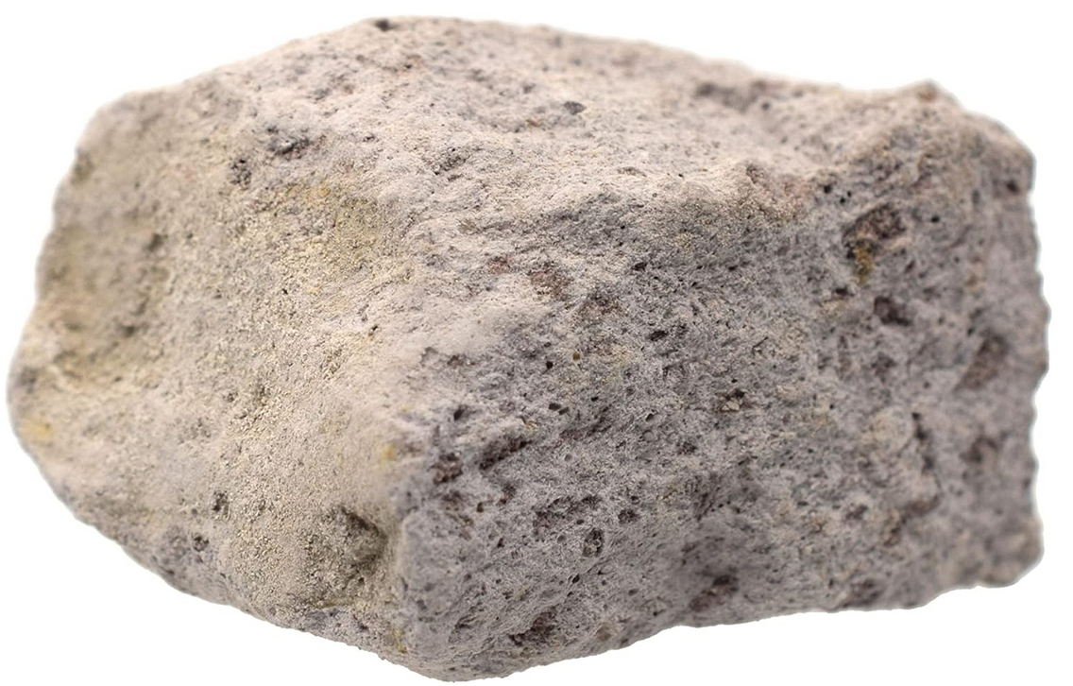
Andesitic and rhyolitic magma
Granite (top) is an intrusive igneous rock. It forms from magma rich in the minerals comprising continental crust. Granite cools and solidifies slowly underground
Andesite (middle) and rhyolite (bottom) are extrusive igneous rocks. They form from magma rich in the minerals that comprise granite and is extruded onto the surface by volcanoes. They are more silica rich than basaltic rocks
Andesitic and rhyolitic magma have a high viscosity – they do not flow well and tends to trap gas instead of letting it vent to the surface
Eruptions are explosive, rhyolitic magma more so than andesitic

Slide 23
Atolls
Ring of coral surrounding eroding volcanic island
Found in tropical seas from fringing coral reef
Island may be a hotspot volcano or a volcanic island arc

Slide 24
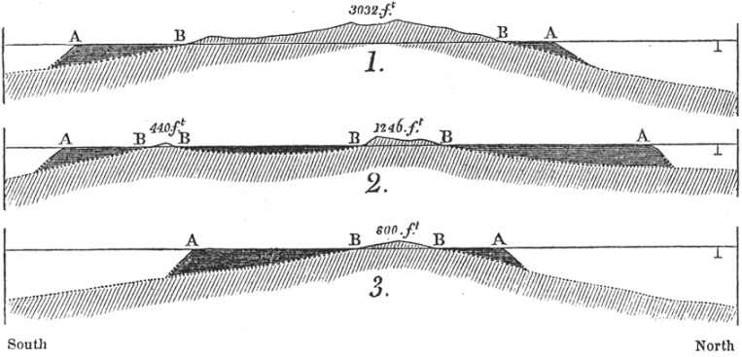
Coral atolls (from Darwin’s sketches)

Slide 25
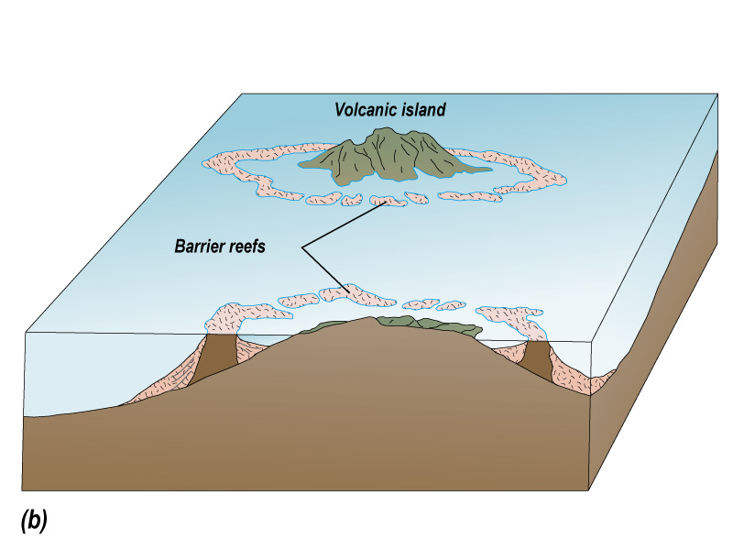

Slide 26
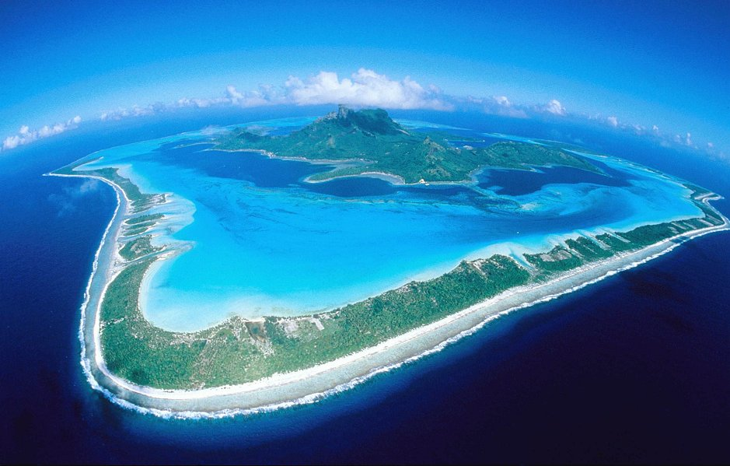
Notes:
Bora Bora,

Slide 27
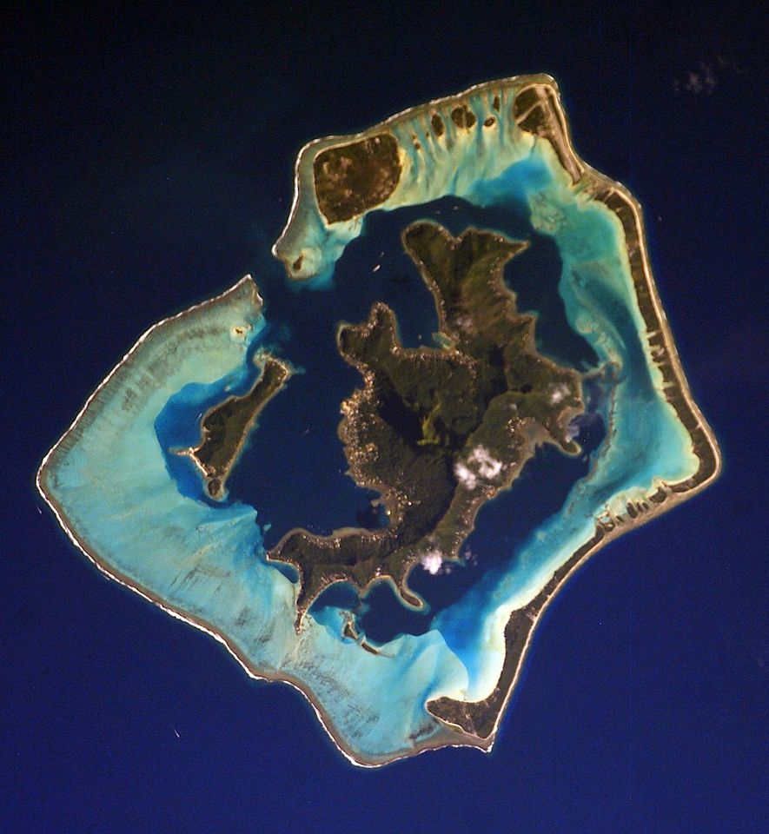
Bora-Bora is not a hotspot, it was formed from the subduction of the oceanic crust of the Pacific Plate beneath the oceanic crust of the Indo-Australian Plate
It is part of an old island arc that formed several million years ago. The volcano has largely weathered and eroded away.
Bora-Bora is an example of an atoll, a feature derived from the former active volcano with a fringing coral reef.
They only occur in the tropics where water temperatures and clarity are warm enough to support coral growth

Slide 28
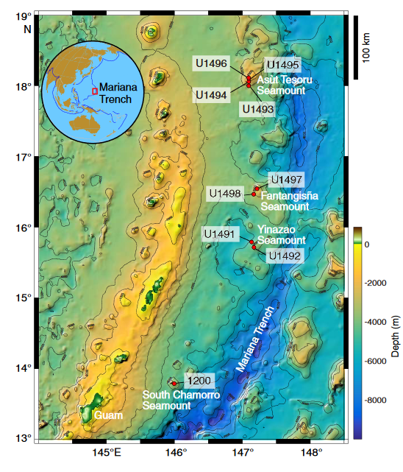
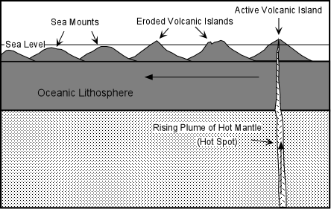
Seamounts
Volcanic island that has eroded to a level below the ocean’s surface.
Notes:
https://par.nsf.gov/servlets/purl/10281973

Slide 29
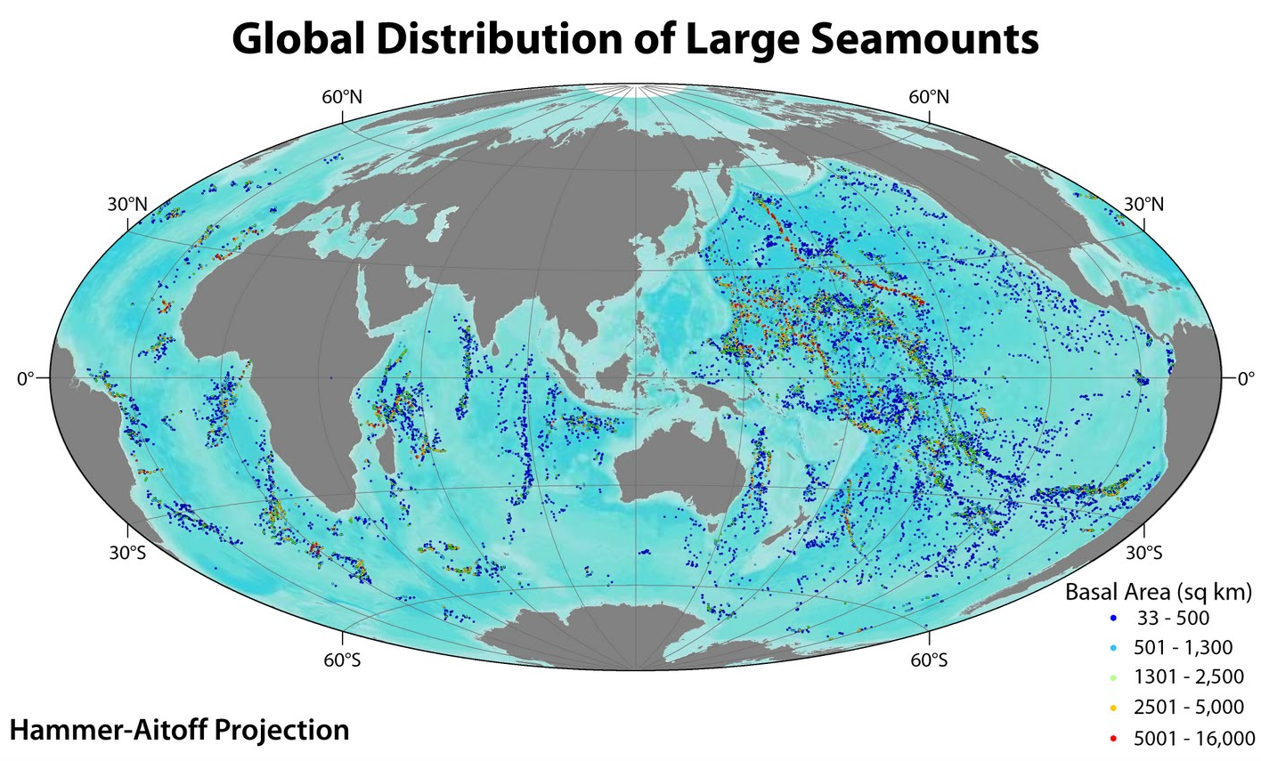

Slide 30
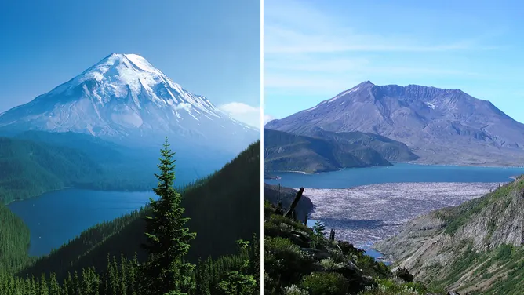
Convergent plate boundary volcanism
Notes:
Mount St. Helens before and after 1980 eruption

Slide 31
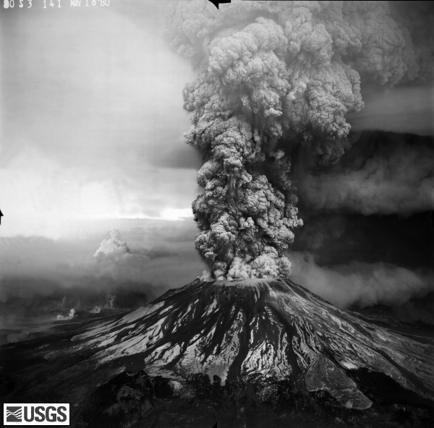
Composite volcanoes
Produced from andesitic or rhyolitic magma
Also called stratovolcanoes
Develop at continental hotspots and along convergent plate boundaries where oceanic crust is subducted underneath continental crust
Eruptions are more like explosions
Mt. St Helens (1980) eruption (right) of the Cascade Mountains and Yellowstone eruptions are examples
Notes:
http://vulcan.wr.usgs.gov/Volcanoes/MSH/Images/may18_images.html

Slide 32
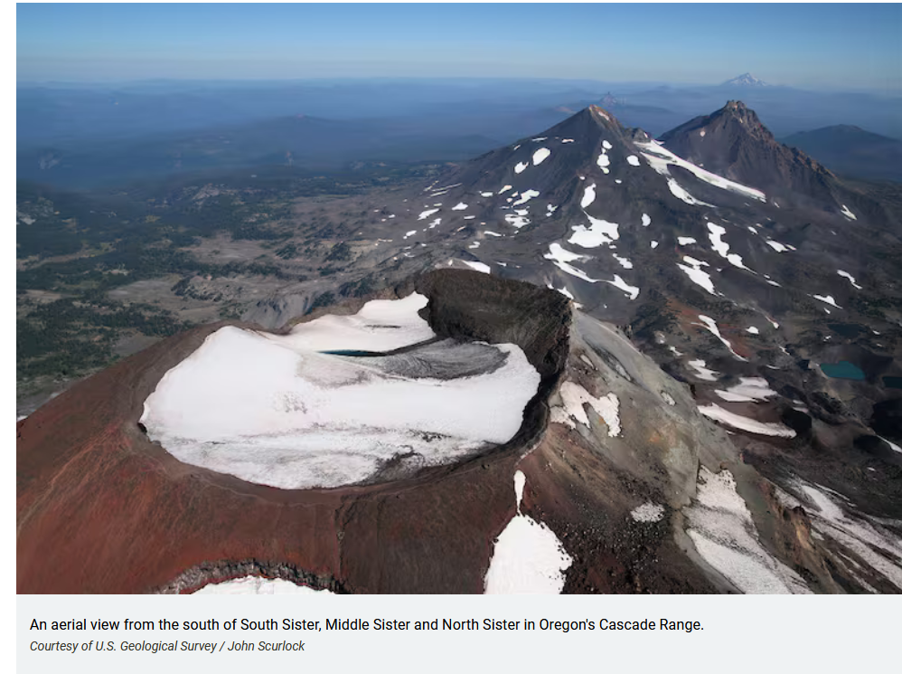
Volcanic arc mountain chain: Cascade Mountains
Notes:
These are all composite volcanoes

Slide 33
Notes:
https://www.usgs.gov/observatories/cascades-volcano-observatory/why-study-cascade-volcanoes The Cascades form a volcanic arc mountain chain

Slide 34
Notes:
Mt Ranier viewed from Seattle https://www.seattletimes.com/life/outdoors/the-best-views-of-mount-rainier-according-to-readers/

Slide 35
Volcanic arc mountain chain: Sunda arc
Notes:
Sunda volcanic arc comprises the volcanoes seen in the image above. The Australian plate with its oceanic crust is being subducted underneath the Eurasian plate.

Slide 37
Notes:
Mt Tambora, a composite volcano in Indonesia Convergent plate boundary where oceanic crust of the Australian plate is subducted under continental crust of the Eurasian plate

Slide 38
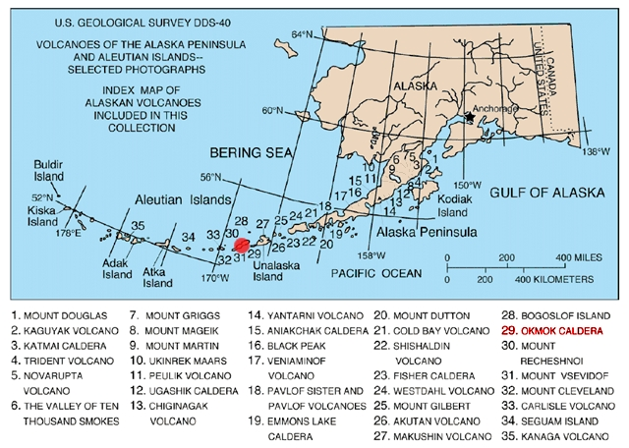
Island arc mountain chain: Aleutian Islands

Slide 39
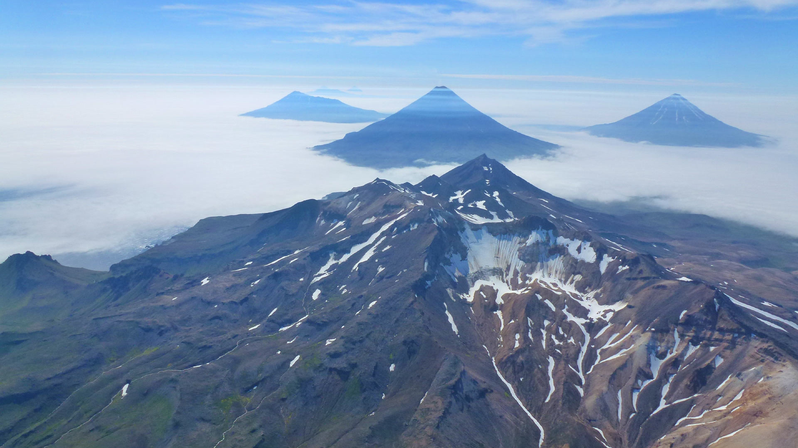

Slide 40
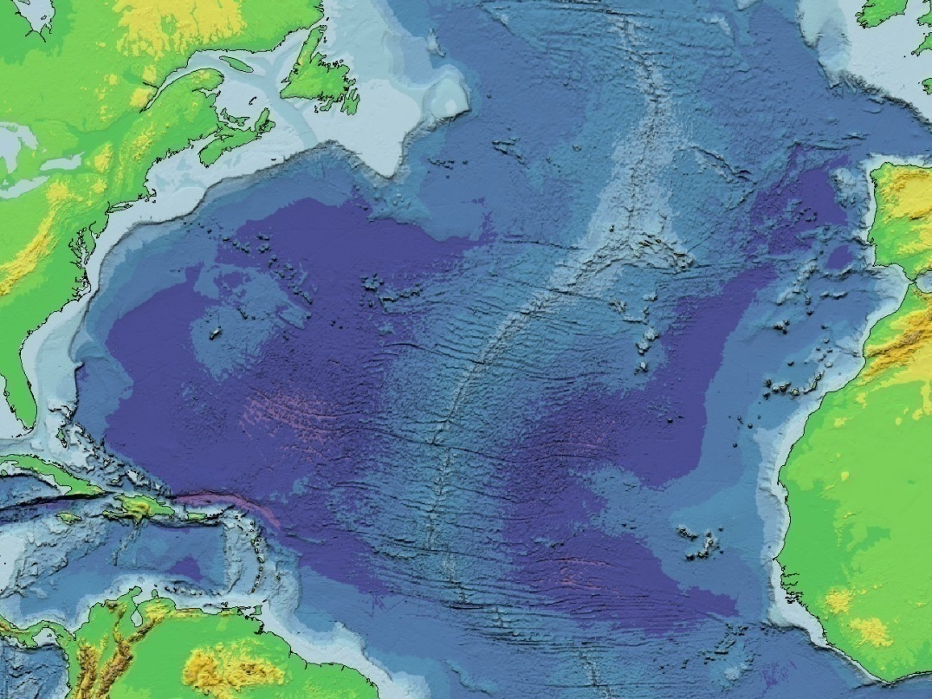
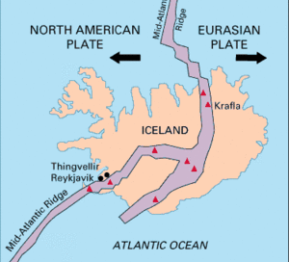
Divergent plate boundary volcanism: mid-ocean ridges
Mid-Atlantic ridge
Type of eruption: fluid, rarely explosive, magma is more basaltic
Fissure eruptions are common – no volcano, lava flows out of fissures in the ground
Iceland
Has fissures (Laki fissure) as well as shield volcanoes (Skjaldbreiður volcano)
Iceland is also a hotspot and has a few composite volcanoes (Eyjafjallajökull volcano)
Notes:
40

Slide 41
Notes:
Fissure eruption in Iceland, 2023 Laki is the name of a fissure volcano in Iceland

Slide 42
Notes:
Skjaldbreiður, a shield volcano on Iceland

Slide 43
Iceland is also located over a hotspot
Too much volcanic activity there to be associated with only a divergent plate boundary
Shield volcano eruption in Iceland (2010)
Notes:
, a composite volcano occurring on Iceland due to hotspot activity (and not divergent plate motion). Eyjafjallajökull produced andesitic magma, which is associated with composite volcanoes. This might seem counterintuitive given the association of Iceland with a mid-ocean ridge and its island location. However, several factors contribute to the more explosive magma of Eyjafjallajökull and its composite volcano morphology.
Fractional crystallization: As basaltic magma rises from the mantle, it can cool and crystallize in magma chambers beneath the surface. The removal of minerals like olivine and pyroxene (which crystallize early) enriches the remaining magma in silica, resulting in more thick viscous magma such as andesite. Magma mixing: Hot basaltic magma from the mantle can mix with cooler, more silica-rich magma in the crust, resulting in intermediate compositions like andesite.
Eyjafjallajökull is covered by a glacier, and magma interacting with glacial ice can further influence its composition and eruption dynamics. Explosive interactions between magma and ice can fragment magma, making it behave more like the magma types typical of compositive volcanoes

Slide 44
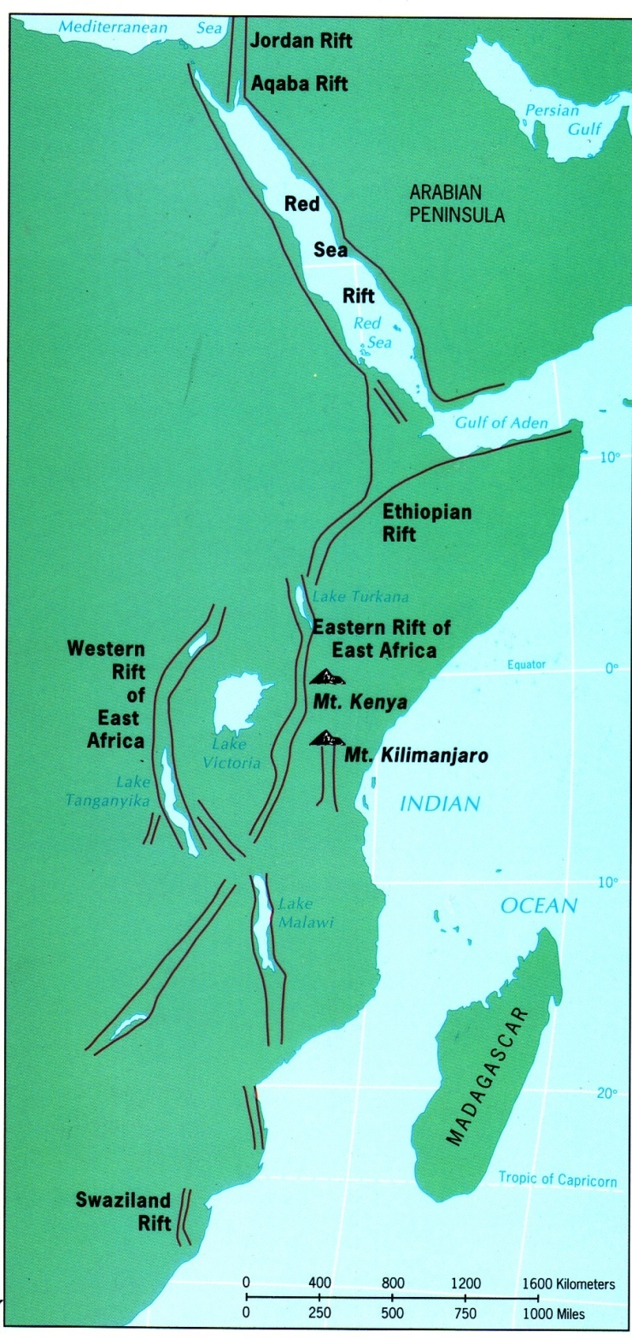
Divergent plate boundary volcanism: continental rift valleys
Rift Valley of East Africa
Spreading ridge forming underneath East Africa that will ultimately rift (break) a portion of east Africa away from the rest the rest of the continent
Rift Valley Lakes (Lake Tanganyika, Lake Victoria, Lake Malawi) fill in low lying areas of rift
Associated with composite volcanoes (Mt Kilimanjaro)
Notes:
44

Slide 45
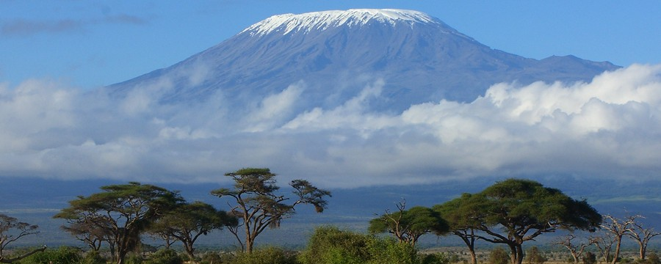
Notes:
Mt Kilimanjaro, a composite volcano

Slide 47
Notes:
North American Midcontinent Rift

Slide 48
Other volcanic landforms, processes, and phenomena
Caldera
Cinder cone
Batholiths
Dikes
Volcanic neck
Sills
Laccolith

Slide 50
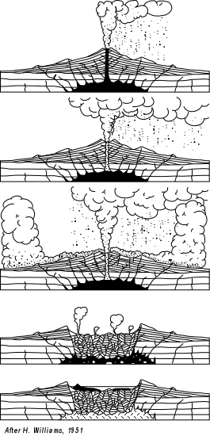
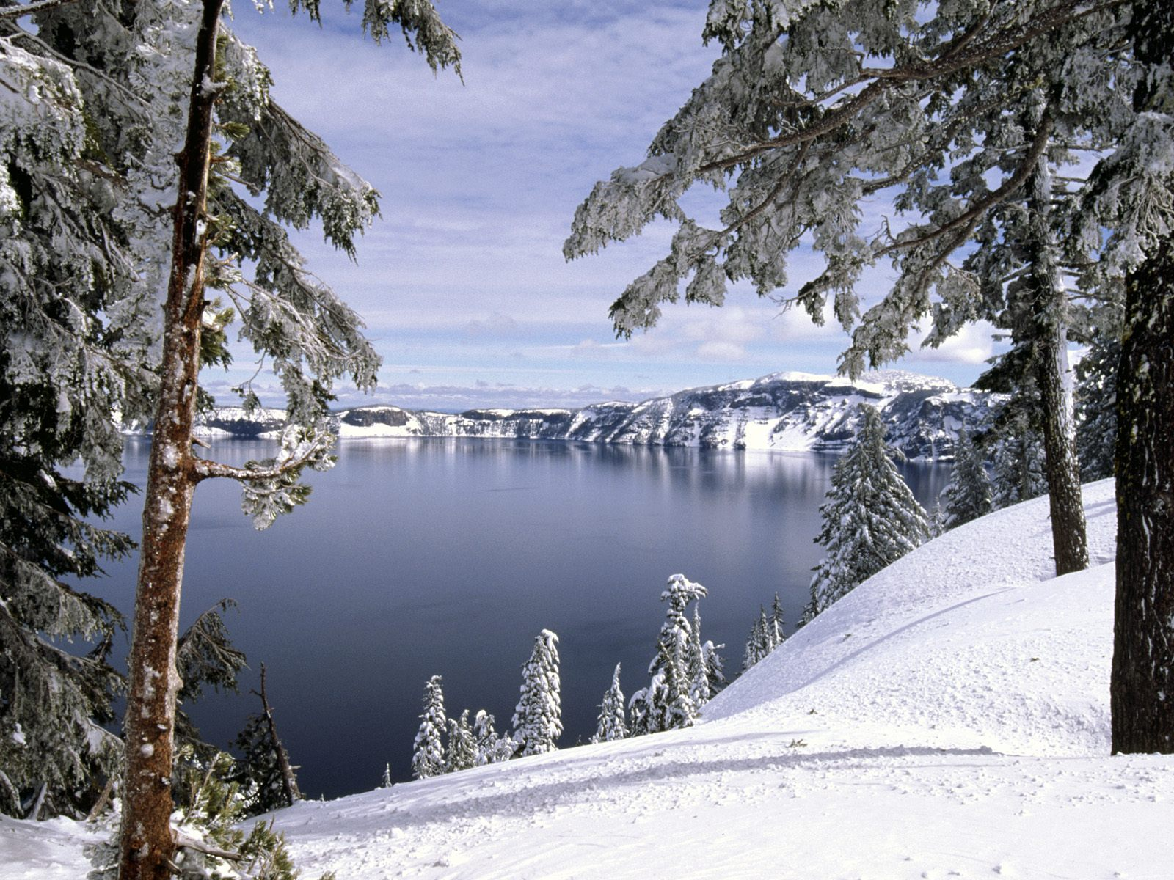
Calderas: Crater Lake Natl Park (Cascade Mountains)
Notes:
Yellowstone National Park is a very large caldera

Slide 51
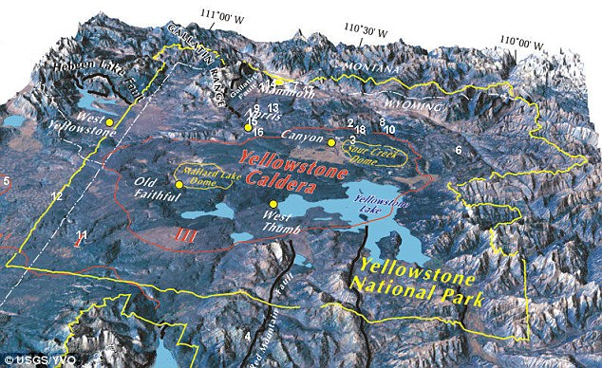
Yellowstone Caldera

Slide 52
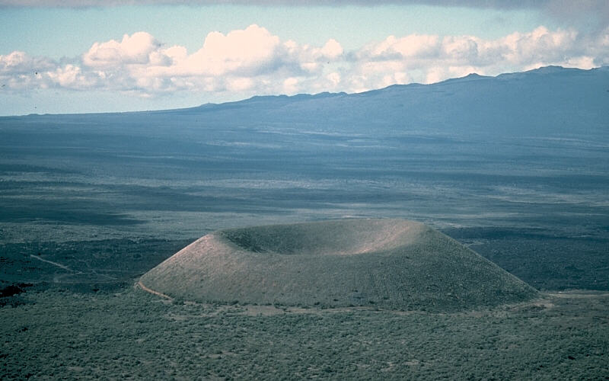
Cinder cone
Notes:
Mauna Loa is in the background Small, steep, cone-shaped volcano with a vent and crater at the top, built of pyroclastic material, chiefly tephra (volcanic ash)

Slide 53
Batholith

Slide 54
Igneous intrusions that can form surface landforms
1. Laccolith 2. Dike 3. Batholith 4. Dike 5. Sill 6. Volcanic neck
Notes:
Types of igneous intrusions As a general rule, in contrast to the active volcanic vent in the figure, these names refer to the fully cooled and usually millions-of-years-old rock formations, which are the result of the underground magmatic activity shown

Slide 55
Notes:
Dike and volcanic plug, Shiprock NM USA

Slide 56
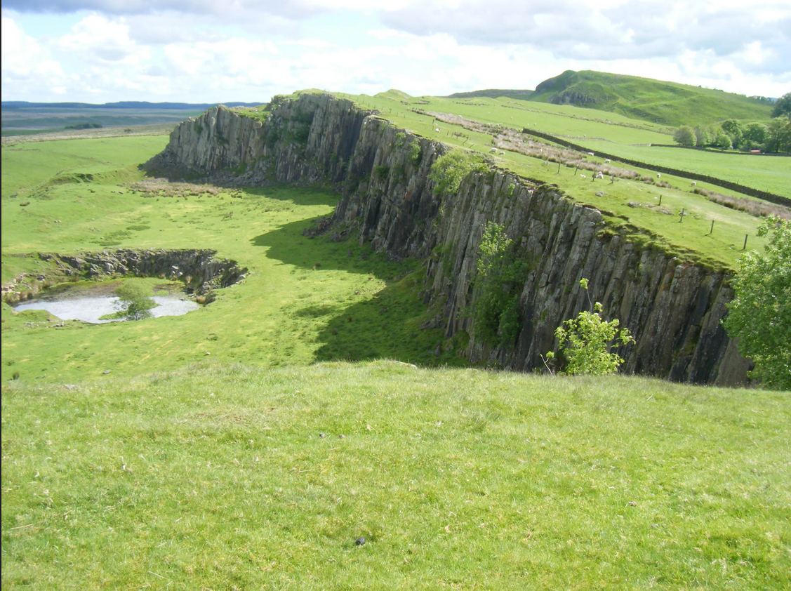
Notes:
Hadrian’s Wall is built on a sill The photo is facing east, so north is to the left, south to right.

Slide 57
Notes:
Pine Valley Mountains, UT, a laccolith complex forming mountains

Slide 58
Lahar
Type of volcanic mudflow or debris flow composed of a slurry of pyroclastic material, rocky debris, and water. These flows are extremely dangerous and can travel rapidly down the slopes of a volcano, often following river valleys.
Lahars are triggered by volcanic eruptions, heavy rainfall, earthquakes around an active volcano, as well as gravity-induced slope failure

