Slide 1
The tension at the heart of vaccinations: collective societal good versus individual interests
As vaccines reduce disease transmission, they indirectly protect the community, including individuals who are too young to get vaccinated, and the immunocompromised
Yet individuals have incentives to refrain from vaccination, to act in their self-interest. They can:
Free ride and profit from indirect protection of others who vaccinated
Reject vaccines if it maintains consistency with their political or religious views
Notes:
Vaccines ask us to consider social welfare and not just mere self-interest

Slide 2
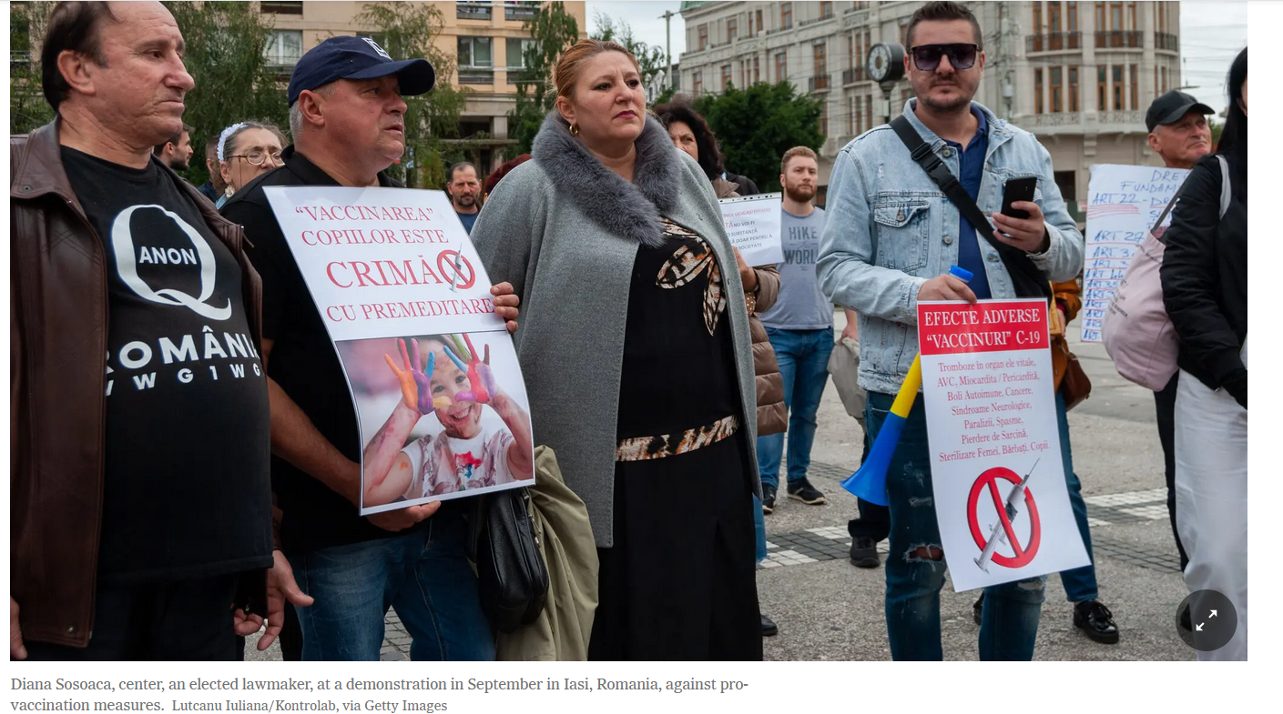
Notes:
https://www.nytimes.com/2021/11/08/world/europe/romania-covid-vaccine-refusal.html

Slide 3
Causes and correlates of hesitancy and anti-vaxxer attitudes
People who believe strongly in all-natural foods and medicines for them or their children
Religions that oppose vaccines
Mistrust in the authority of science and institutions affiliated with it
Cultural amnesia
When there is little cultural memory of diseases and their negative effects then vaccines may seem unnecessary
Political views that put individual choice above societal concerns

Slide 4
Causes and correlates of hesitancy and anti-vaxxer attitudes
Political views that put individual choice above societal concerns
Parents who believe that doctors should not dictate medical decisions about children.
Viral misinformation from social media
Opportunism
People who see anti-vaccine debates as a financial opportunity for selling books, services, or other products
Anti-vaccine debates are seen as a political opportunity, a wedge with which to polarize society.
Anti-vaxxer groups now actively seek opportunities to spin the news to make it look like vaccines are more dangerous than they are

Slide 5
Globally, vaccination coverage has flattened or declined after many decades of improvement
Even though some countries may have vaccination rates lower than needed to reduce risks, overall larger percentages of children are vaccinated today and for many parts of the world population size has dramatically increased
Slowing rates of vaccination partly caused by vaccine hesitancy and anti-vaxxer campaigns, and by economic or political instability is also a cause

Slide 6
Reading/Questions 11
Notes:
Yet there are also places in the world where basic needs of food, clean water, and shelter are needed – the need for vaccines can be overshadowed by more immediate needs

Slide 7
Infodemics and infodemiology
An infodemic is an overabundance of information – some accurate and some not – occurring during an epidemic. It makes it hard to find trustworthy sources and reliable guidance
Misinformation spreads and adds complexity to health emergency responses. Antivaxxer misinformation can go viral nationally or globally in a short amount of time
Rumor has a 3X greater chance to be shared on social media than a verified story, and lack of health literary in a population will have the capability to amplify the problem.
Infodemiology is defined as the science of managing infodemics.
Notes:
https://www.who.int/health-topics/infodemic#tab=tab_1
https://www.who.int/news-room/events/detail/2020/06/30/default-calendar/1st-who-infodemiology-conference
https://www.cigionline.org/articles/how-public-health-approach-could-help-curb-infodemic/
Sommariva, S., Vamos, C., Mantzarlis, A., Đào, L. U. L., & Martinez Tyson, D. (2018). Spreading the (fake) news: exploring health messages on social media and the implications for health professionals using a case study. American journal of health education, 49(4), 246-255.

Slide 8
Research on the spread of true and false information online
In one study, the researchers began with a dataset of all verified true and false news stories distributed on Twitter from 2006 to 2017.
The data comprise ~126,000 stories tweeted by ~3 million people more than 4.5 million times.
News was classified as true or false using information from six independent fact-checking organizations that exhibited 95 to 98% agreement on the classifications.
Falsehood diffused significantly farther, faster, deeper, and more broadly than the truth in all categories of information
Contrary to conventional wisdom, robots accelerated the spread of true and false news at the same rate, implying that false news spreads more than the truth because humans, not robots, are more likely to spread it.
Notes:
Vosoughi, S., Roy, D., & Aral, S. (2018). The spread of true and false news online. Science, 359(6380), 1146-1151.

Slide 9
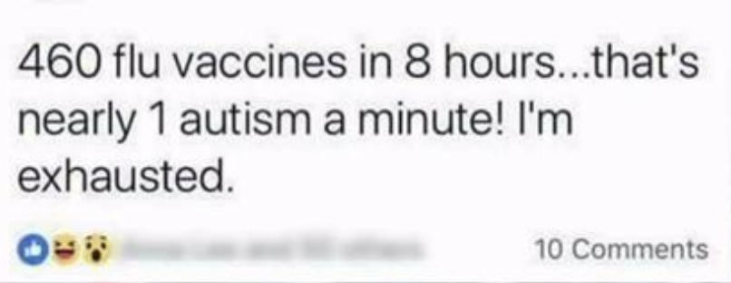
The Vaccine Confidence Project
Notes:
Monitors the misinformation and communication of emotions around vaccines to help deploy effective health outreach
Programs like the VCP monitor social media and epidemiological data to better understand the social context of vaccine acceptance
https://nurse.org/articles/nurse-facebook-post-upsets-mom/

Slide 10
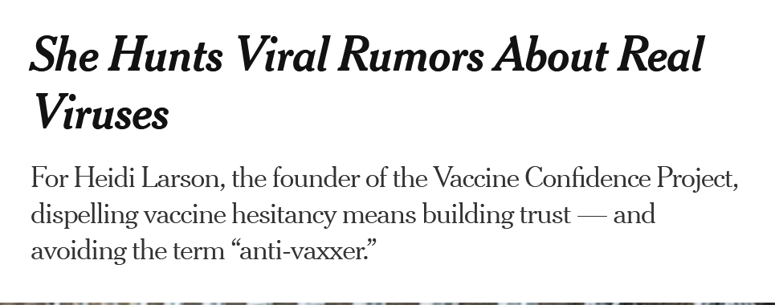
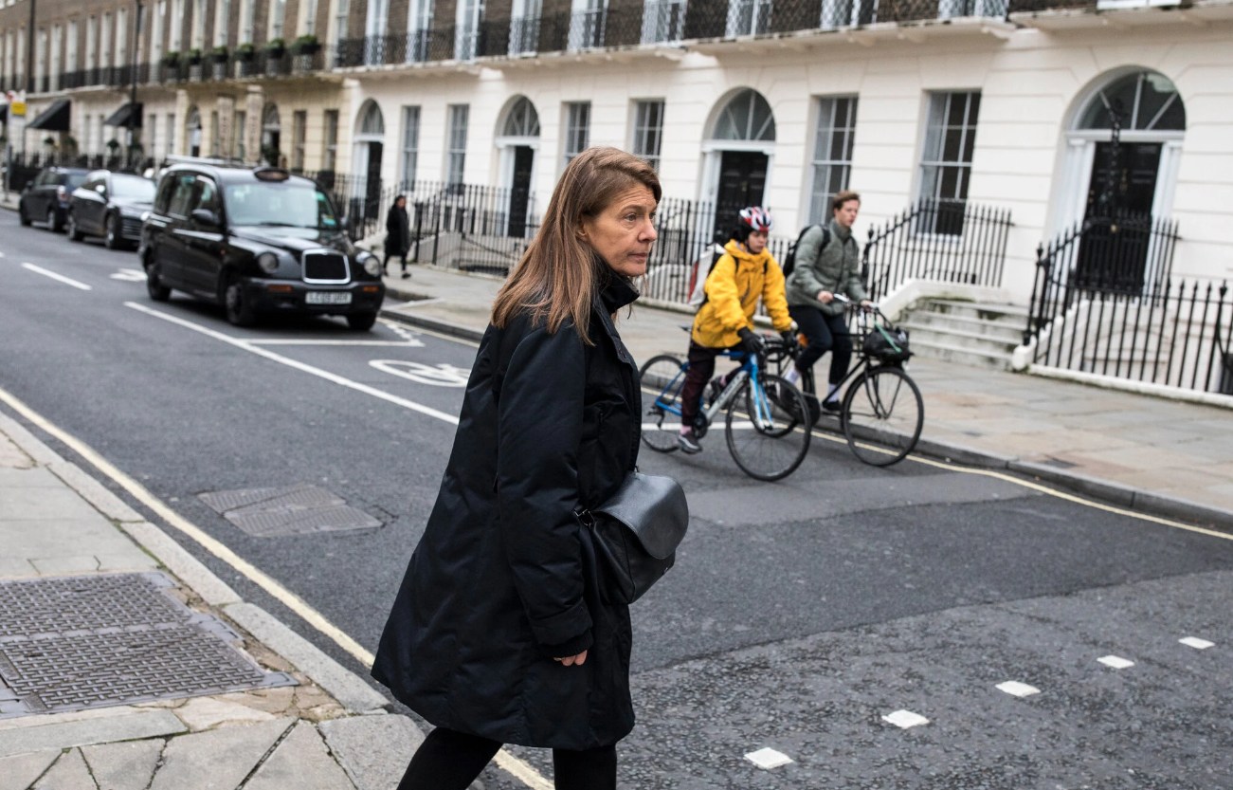
Reading/Questions 11
Notes:
https://www.nytimes.com/2020/10/13/health/coronavirus-vaccine-hesitancy-larson.html

Slide 11
Notes:
Many of those claims do not relate to the vaccine itself, but to shoulder injuries, usually in adults, that occurred because a health provider injected a vaccine in the wrong spot on the shoulder.
https://www.hrsa.gov/vaccine-compensation/index.html https://www.nytimes.com/2019/06/18/health/you-should-get-vaccinated.html
https://www.hrsa.gov/vaccine-compensation/index.html

Slide 13
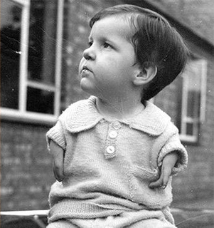
Video
Notes:
The approval process can be faulty. Thalidomide was used widely in Europe and other countries but had not yet come to the US because the newly formed Food and Drug Administration resisted commercial interests to allow the drug to enter the market. Trials of the drug were instead put into place in the US, and the hazards of thalidomide were identified, thereby allowing the US to avoid the worst of this medical science oversight. The lesson of Thalidomide encouraged the support of a rigorous drug testing program in the US and internationally.
https://helix.northwestern.edu/article/thalidomide-tragedy-lessons-drug-safety-and-regulation

Slide 14
Johnson and Johnson Covid-19 vaccine
Potentially deadly blood clotting and bleeding syndrome called thrombosis with thrombocytopenia syndrome, or TTS. The condition usually occurs within one to two weeks of vaccination.
60 confirmed cases, including nine that resulted in death
3 cases of the clotting syndrome per million doses of vaccine administered and 0.5 deaths per million doses of vaccine administered.
FDA stated that the risk outweighed the benefits of this vaccine for people who are 18 or older and can get another shot, unless they would otherwise remain unvaccinated.
Notes:
The Johnson and Johnson vaccine was authorized in February 2021, a one-shot vaccine that proponents hoped would ease the logistics of vaccination campaigns globally. https://www.washingtonpost.com/health/2022/05/05/fda-johnson-and-johnson-vaccine/

Slide 15
Reading/Questions 11

Slide 16
There is no link between vaccines and autism
Autism spectrum disorder (ASD) affects 2% of children in US. Since monitoring started 20 years ago, prevalence has increased
Understanding of the etiology of ASD is evolving
Recent studies have suggested that ASD most likely arises from interactions among genetic and prenatal environmental factors:
Mutations in genes may be inherited or arise spontaneously
Prenatal environmental exposures span infections, medications, complications during pregnancy, and exposure to air pollutants and other toxins, as well as maternal health conditions like obesity and diabetes during pregnancy
Notes:
https://onlinelibrary.wiley.com/doi/full/10.1002/bies.202000307 https://journals.plos.org/plosone/article?id=10.1371/journal.pone.0289841
https://www.healthychildren.org/English/safety-prevention/immunizations/Pages/Vaccine-Studies-Examine-the-Evidence.aspx Children with autism and/or ADHD have a reduced ability to clear out the common plastic additive bisphenol A

Slide 17
Notes:
Economic opportunism In addition to selling videos, there are also books and speaking engagements.
https://www.theguardian.com/us-news/2019/oct/31/vaxxed-2-movie-sequel-release-fears-propaganda https://www.youtube.com/watch?v=XIRXxEYnkxA&ab_channel=CinemaLibre

Slide 18
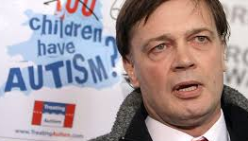
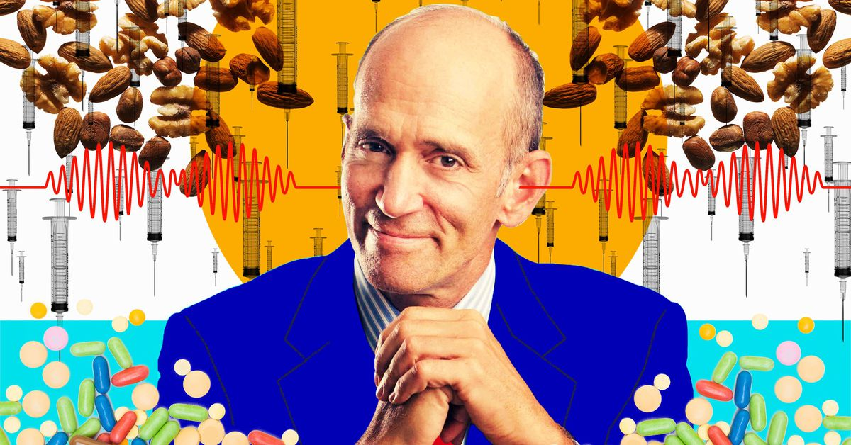
Anti-vaxxer strategies for credibility
Professional alignment
Anti-vaxxers claim traditional forms of credibility as doctors to assert their qualification as purveyors of an alternative viewpoint
Contrastive boundary work.
Parents and practitioners take pride in their innovative spirit and way of ‘thinking outside the box’.
Notes:
Tan, C. D. (2021). Defending ‘snake oil’: The preservation of contentious knowledge and practices. Social Studies of Science, 0306312721992543.
In professional alignment, anti-vaxxers strategically blur boundaries between the alternative and conventional by seeking refuge within the system they challenge. In contrastive boundary work, anti-vaxxers aim to create a new source internal legitimacy in order to insulate beliefs and practices from outside attack.

Slide 19
Antivaxxers come from disparate backgrounds
Religious groups who oppose vaccines
Libertarians who put individual choice above societal concerns
People who believe strongly in all-natural foods and medicines for them or their children
Parents who believe that doctors should not dictate medical decisions about children.
Notes:
If the anti-vaxxers only knew the facts, then they would not believe what they believe, right?

Slide 20
Confirmation bias
The anti-vaxxer sees only the evidence that confirms their pre-existing belief
Perfectionist fallacy
The anti-vaxxer claims that without complete certainty, all assumptions are equal.
Correlation is not causation
The anti-vaxxers confuse two things that are correlated but not causal. Kids just happen to take more vaccines today, but that is not causally related to increased incidences of autism
Slippery slope fallacy
The anti-vaxxers claim that if we don’t fight for the right to chose whether or not to vaccinate then it is a slippery slope to the loss of all our individual liberties.
Straw man fallacy
The anti-vaxxers create a fictitious person, someone who wants to pump kids’ bodies full of toxins – they give their fears form in a caricature of a person who doesn’t exist

Slide 21
Global HPV vaccine coverage among girls increased substantially
The share of adolescent girls globally who received at least 1 dose of the HPV vaccine, which provides protection against cervical cancer, increased from 20% in 2022 to 27% in 2023.
This was largely driven by strong introductions Bangladesh, Indonesia, and Nigeria. The use of the single-dose HPV vaccine schedule also helped boost vaccine coverage.
However, HPV vaccine coverage is well below the 90% target to eliminate cervical cancer as a public health problem, reaching only 56% of adolescent girls in high-income countries and 23% in low- and middle-income countries.
Notes:
https://www.who.int/news/item/15-07-2024-global-childhood-immunization-levels-stalled-in-2023-leaving-many-without-life-saving-protection

Slide 22
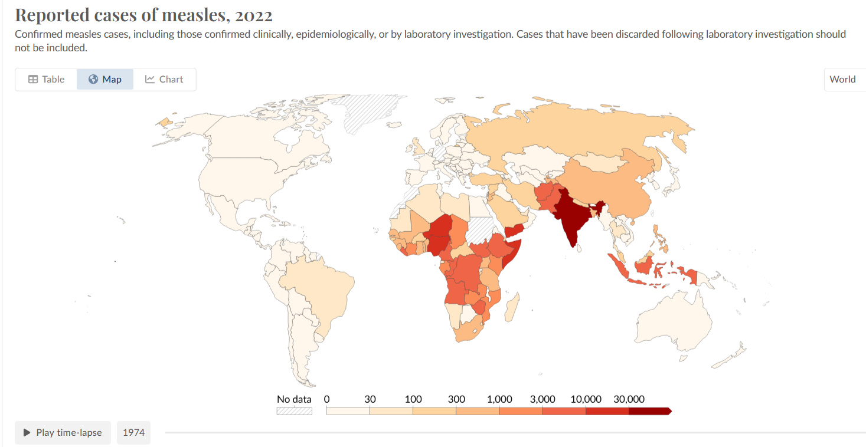
Measles has declined globally over last fifty years
Notes:
https://ourworldindata.org/grapher/reported-cases-of-measles?time=2022

Slide 23
Notes:
https://ourworldindata.org/grapher/reported-cases-of-measles?tab=chart&time=earliest..2022

Slide 24
Global measles resurgence
In the 1980s, measles killed 2.6 million a year globally
In 2016, for the first time since records were kept, global deaths fell below 100,000.
However, this trend has not been maintained
In 2023, only 83% of children worldwide received their first dose of the measles vaccine. This falls short of the 95% coverage needed to prevent outbreaks and achieve elimination goals.
Notes:
https://www.who.int/news/item/15-07-2024-global-childhood-immunization-levels-stalled-in-2023-leaving-many-without-life-saving-protection

Slide 25
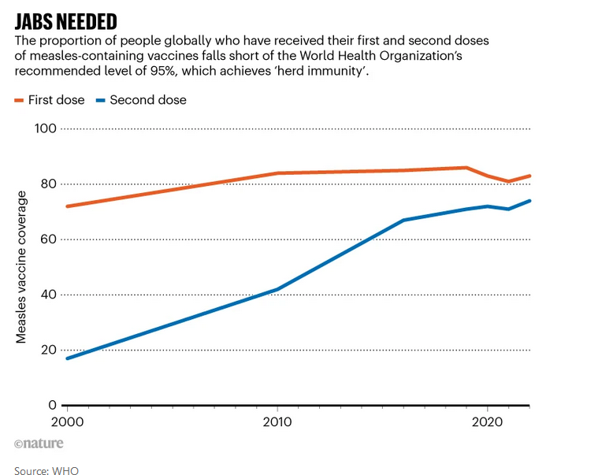
Over 2018-2023, measles outbreaks hit 103 countries, home to roughly three-quarters of the world’s infants. Low vaccine coverage (80% or less) was a major factor.
Globally, the number of measles cases increased by 18% between 2021 and 2022, and deaths from measles increased by 43%
Vaccine hesitancy and anti-vaxxer views tend to drive outbreaks in high and middle income countries; poverty, war and instability drive outbreaks in low income countries
Notes:
https://www.who.int/news/item/15-07-2024-global-childhood-immunization-levels-stalled-in-2023-leaving-many-without-life-saving-protection
https://doi.org/10.1038/d41586-024-00265-8

Slide 26
Notes:
The World Health Organization’s goal was lofty but achievable: eliminate measles from five of the world’s six regions by 2020. But recent outbreaks — even in places where elimination had been achieved — are making that goal a distant dream

Slide 27
Notes:
Vaccination rates across Europe are lower than in the United States. Various longstanding anti-vaccine movements persist there. Laws were passed in France, Germany and Italy requiring that parents vaccinate their children or at least consult a doctor about doing so. Italy and Germany imposed fines of $600 to $3,000 for failing to comply. The US CDC now recommends that American travelers under age 60 and visiting areas of central and southern Europe receive two doses of measles vaccine before going.

Slide 28
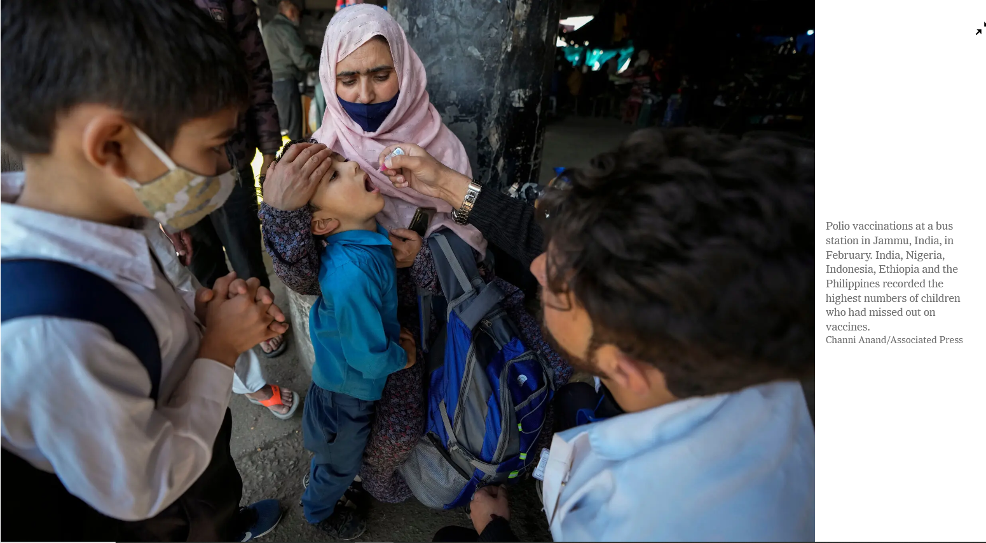
Reading/Questions 11
Notes:
The Covid pandemic interrupted routine vaccination services, leaving increased susceptibility to disease in some parts of the world
https://www.nytimes.com/2022/07/14/health/childhood-vaccination-rates-decline.html https://doi.org/10.1038/d41586-022-02051-w

Slide 29
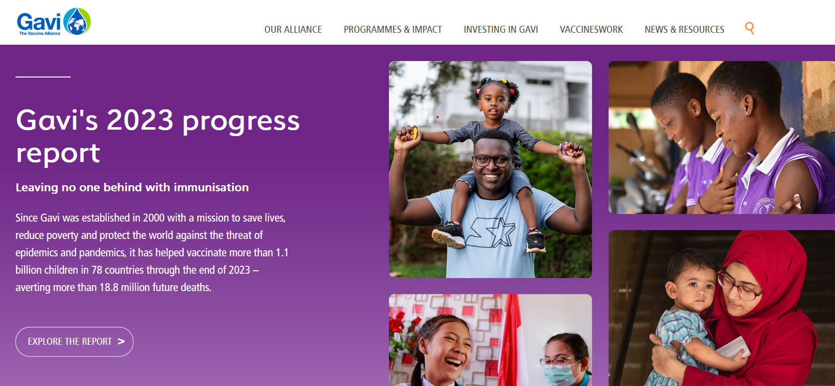
The middle income effect
Focus of childhood immunization has been on the world’s poorest people.
GAVI is an international non-governmental association that has provided billions of low-cost vaccines to the world’s poorer countries
Notes:
Berkley, S. "Vaccination lags behind in middle-income countries." Nature 569.7756 (2019): 309. Global Alliance for Vaccines and Immunization
https://www.gavi.org/

Slide 30
Manufacturing vaccines is a complex and expensive process
GAVI coordinates the availability of vaccines for countries that do not have the capacity to manufacture them
Notes:
https://www.cytivalifesciences.com/en/us/shop

Slide 31
The middle income effect
Routine immunization levels have stagnated in many middle income countries (MICs) because they are too prosperous to qualify for international support.
Costs for vaccines may be higher in MICs because they are not subsidized by other countries and organizations like GAVI.
In the middle income effect, children in weakest economies better protected than in some middle income countries
Notes:
Berkley, S. "Vaccination lags behind in middle-income countries." Nature 569.7756 (2019): 309.

Slide 32
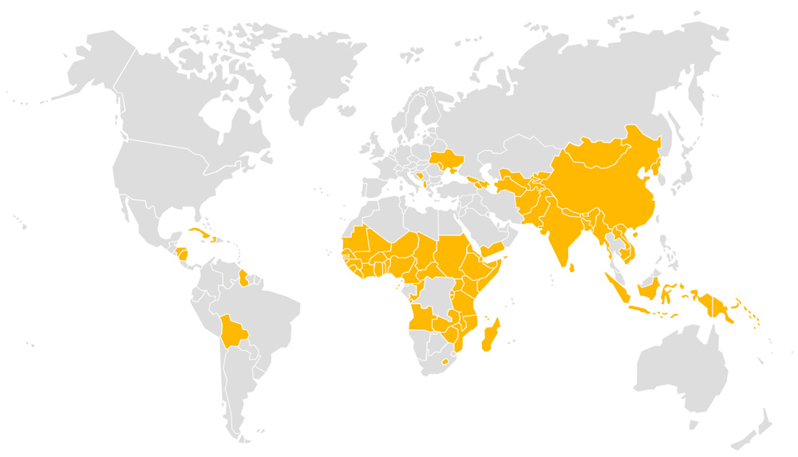
For example, Indonesia, Iraq and South Africa now rank among the ten countries with the highest number of under-immunized children worldwide, even though these countries are richer than many of their neighbors.
South Africa has a gross national income per capita of around seven times that of Rwanda. Yet only 66% of its children receive the routine three doses of the DTP3 vaccine against diphtheria, tetanus and pertussis — compared with 98% in Rwanda.
Notes:
Berkley, S. "Vaccination lags behind in middle-income countries." Nature 569.7756 (2019): 309. GAVI-supported countries shown in yellow in map.

Slide 33
Comparing costs of vaccines
In middle income countries (MICs), it costs an average of $90 per live birth for routine immunization, versus $25 in supported low-income countries.
Immunization programs in MICs may struggle to immunize vulnerable populations because:
Financial resources may not yet be allocated efficiently to do so.
Efforts to reach marginalized communities may not be a political priority.
Government is challenged to cope with rapid urbanization and increasing environmental pollution.
Large investments are needed to build vaccine-manufacturing infrastructure
Notes:
Berkley, S. "Vaccination lags behind in middle-income countries." Nature 569.7756 (2019): 309.

Slide 34
By 2025, nearly 80% of people in the lowest income brackets today — those living on less than $8 a day — will be in MICs. This is almost double the proportion in 2000.
Main burden of unimmunized people may shift from mostly low-income countries to MICs.
Notes:
Berkley, S. "Vaccination lags behind in middle-income countries." Nature 569.7756 (2019): 309.

Slide 35
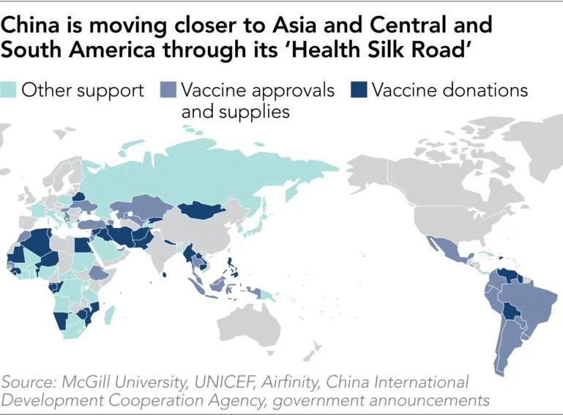
Vaccine diplomacy
Vaccine diplomacy encompasses the politics that go into the coordination of vaccine development, manufacturing, and distribution.
Involves national governments, multinational corporations, universities, and global entities like the WHO
Vaccines can reinforce existing power relationships or be used to realign them – for example, China has provided its vaccines as a way of exerting economic influence – the ‘health Silk Road’
Notes:
https://asia.nikkei.com/Spotlight/Datawatch/China-emerges-as-big-winner-in-vaccine-outreach

Slide 36
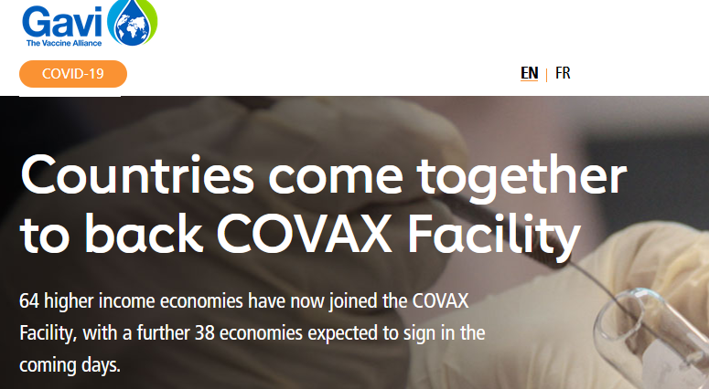
COVAX
COVAX is an example of vaccine diplomacy
COVAX pooled the resources of many countries to promote cooperation in the development and deployment of a vaccine to all people of the world
As long as the virus is circulating, odds for a new variant to emerge are elevated
Vaccine coverage needs to be thorough and available to all countries and citizens
Notes:
https://www.gavi.org/vaccineswork/gavi-ceo-dr-seth-berkley-explains-covax-pillar

Slide 37
COVAX is co-led by GAVI, the WHO and the Coalition for Epidemic Preparedness Innovations (CEPI).
COVAX was designed to discourage national governments from hoarding COVID-19 vaccines and to focus on first vaccinating the most high-risk people in every country.

Slide 38
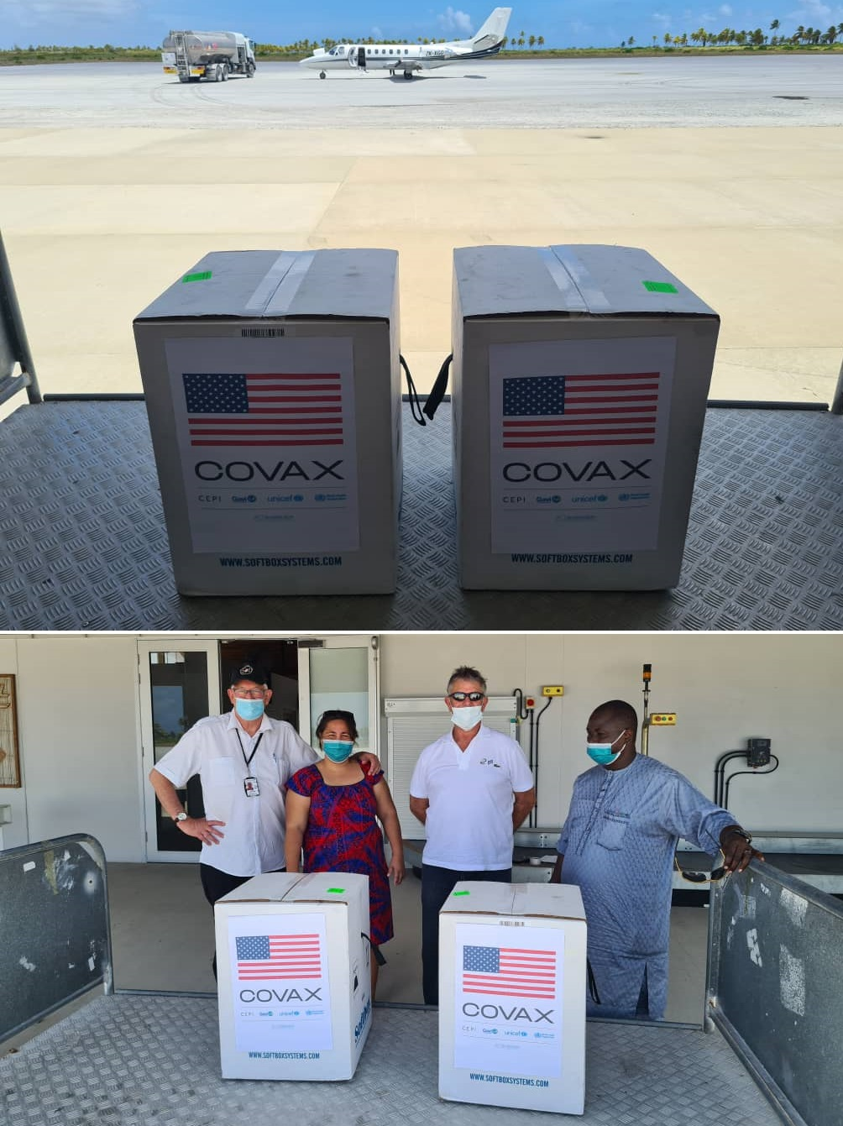
Aim was to lead to lower vaccine costs for everyone and a swifter end to the pandemic
However, COVAX fell short of its goals - countries prioritized vaccines their own citizens
By the end of 2021, more people had been vaccinated in high-income countries than in more populous low-income countries
Vaccination rates were 75% in high-income countries, but less than 2% in some low-income countries.
Notes:
https://www.nytimes.com/reuters/2020/09/03/world/asia/03reuters-health-coronavirus-vaccines-covax-exclusive.html

Slide 39
Wealthy countries had vaccine surpluses and vaccinated young children, who are at relatively low risk of serious disease.
Meanwhile, many poorer countries still did not have enough supply to vaccinate the people at highest risk of death from COVID-19.
Notes:
Low- and middle-income nations would have had lower death rates if vaccines had been shared more equitably. Equitable vaccine coverage could have prevented 1.3 million deaths worldwide. More than twice that many deaths would have been avoided if higher-income countries had also stuck with other measures to reduce transmission. https://www.nature.com/articles/d41586-022-03529-3

Slide 40
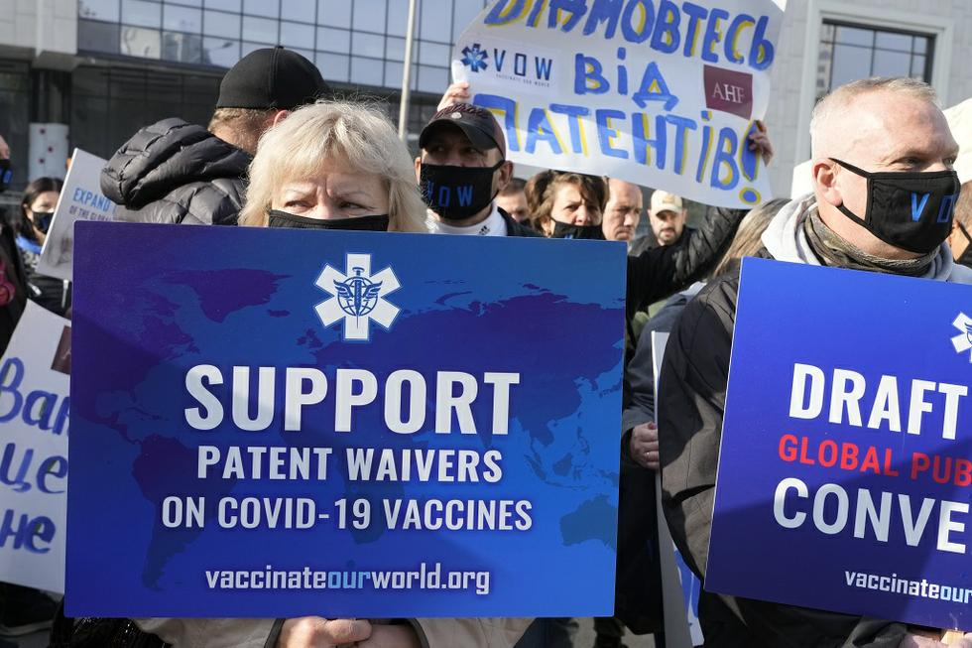
Philanthropic approach of COVAX criticized as short-term amelioration of a problem rather than a sustainable long-term solution
COVAX has good aims but addresses a symptom of a deeper problem instead of the underlying cause
Releasing patents so that other countries could make the vaccine would have helped
Notes:
One such approach that is to waive patent protections so that new mRNA vaccines can be manufactured in other countries, lessening the dependence upon wealthier nations to provide them
Releasing patents on COVID vaccines would likely have increased global vaccination rates, especially in low- and middle-income countries, by enabling local production, lowering costs, and reducing dependence on international supply chains. Patent restrictions limited vaccine availability by concentrating production in a few countries, making doses less accessible and more costly for many nations. Local manufacturing could have met demand faster and reduced logistical challenges associated with vaccine distribution. While concerns about quality control and innovation incentives exist, many argue that, given the public health stakes and public funding in vaccine development, global access should have been prioritized.

Slide 41
Political and economic cooperation was necessary for design and manufacture of Covid vaccines
The Pfizer COVID-19 vaccine took less than a year to bring to market.
Prior to this the fastest development of a vaccine was for mumps, which took four years
Ties across countries were necessary to do this
Notes:
https://www.washingtonpost.com/graphics/2020/health/covid-vaccine-update-coronavirus/

Slide 42
mRNA vaccines
The most widely used COVID-19 vaccines are patented mRNA vaccines, the first of their kind ever made and used. Big money-makers for the companies that made them: Pfizer-BioNTech and Moderna
Other types of vaccines (AstraZeneca and Johnson and Johnson) were more widely used in countries with limited access to mRNA vaccines. These were designed using established methods of vaccine production
The novelty and high efficacy of the mRNA viruses were one reason they were more expensive and patents were not waivered

Slide 44
Pfizer mRNA vaccine developed with German company BioNTech started by Turkish immigrants
Notes:
https://www.nytimes.com/2020/11/10/business/biontech-covid-vaccine.html BioNTech coordinated the development of their mRNA vaccine with Pfizer, an American company
BioNTech was co-founded by Dr. Uğur Şahin and Dr. Özlem Türeci, a married couple of Turkish descent. Dr. Şahin was born in İskenderun, Turkey, and moved to Germany at the age of four to join his father, who worked at a Ford factory in Cologne. Dr. Türeci was born in Germany to a Turkish physician who had immigrated from Istanbul. Together, they established BioNTech in 2008, focusing on individualized cancer immunotherapy and later developing one of the first COVID-19 vaccines.

Slide 45
Reading/Questions 11
Notes:
https://www.nytimes.com/2020/11/14/upshot/coronavirus-capitalism-vaccine.html

Slide 46
Extra-intestinal pathogenic E coli (bacteria)
HIV-1 (virus)
Klebsiella pneumoniae (bacteria)
Mycobacterium tuberculosis (bacteria)
Staphylococcus aureus
Notes:
Global Priority Pathogens for Vaccine R&D. Dots indicate where each pathogen appears on regional top 10 lists. Regional results are intended to inform deliberations and should not be read as regional priorities in themselves. ∗Cytomegalovirus results are provisional due to lack of systematic burden estimates. (See Appendix, page 35, for ranking of individual pathogens in each region.)

Slide 47
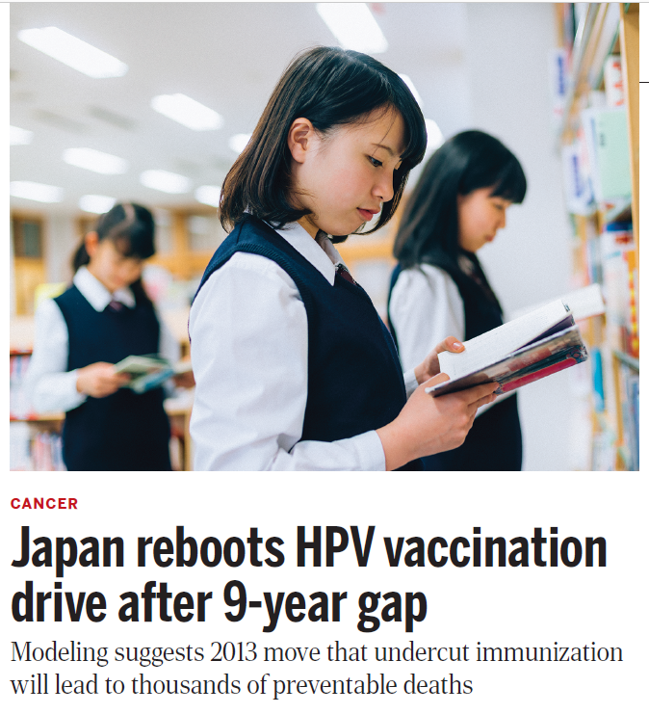
Success of Covid-19 vaccines improved attitudes toward vaccines in some places…
Japan resumed recommending that girls ages 12 to 16 get the HPV vaccination
Policy was originally dropped due to influence of anti-vaxxers – they advertised that the vaccine was unsafe and caused chronic pain, headaches, motor impairment
Unvaccinated girls suffered the symptoms attributed to the vaccines at similar rates as vaccine recipients
Notes:
In other countries roiled by unsubstantiated reports of side effects—including Denmark, the United Kingdom, and Colombia—authorities kept recommending the vaccines while investigating
the claims, says Heidi Larson, head of the Vaccine Confidence Project at the London School of Hygiene and Tropical Medicine. Vaccination says rates dipped in these countries, but quickly recovered.
But in Japan, the government was slow to review the evidence while antivaccine pressure “just became louder and louder, which eventually led to this 9-year period when HPV was not a formal policy. Normile, D. (2022). Japan reboots HPV vaccination drive after 9-year gap. Science (New York, NY), 376(6588), 14-14.

Slide 48
…while triggering more hesitancy in places where it had been uncommon.
Historically, low-income countries (LICs) were not places with widespread vaccine hesitancy and anti-vaxxer attitudes, This changed with Covid. LICs saw greater:
Distrust in the safety of the Covid vaccines because of their newness
Distrust of governments and products from outside power was also a reason for hesitancy
Rejection of Covid vaccines because they are viewed as “leftovers” the older, closer to expiry vaccines and those that do not work as well – the ones the rich countries did not want to use
Less urgency to use them as they took so long to arrive in some places
Influence of social media and anti-vaxxer discourses through the internet

Slide 49
Covid vaccines have had to be redesigned to account for mutations arising in Covid variants
This is true of many viral pathogens, as for example, influenza
Reading/Questions 11
Notes:
https://www.nytimes.com/2021/12/04/health/covid-variant-south-africa-hiv.html The great fear is a variant with “immune escape”: the ability to elude Covid vaccines or the immune response elicited by previous infection. As more and more people in South Africa get vaccinated against Covid, there is the potential for a variant to be brewing in the body of a vaccinated person. “You have a situation where you’ve got the potential to create really nasty variants,” said Dr. Abdool Karim, who has helped lead South Africa’s Covid response. Previous variants emerged when few people had access to vaccination, but now South Africa has delivered the shot to more than a third of its citizens. If vaccinated people with H.I.V. don’t have or don’t take their antiretrovirals, there could be an opportunity for the virus to mutate to evade the vaccine.

Slide 50
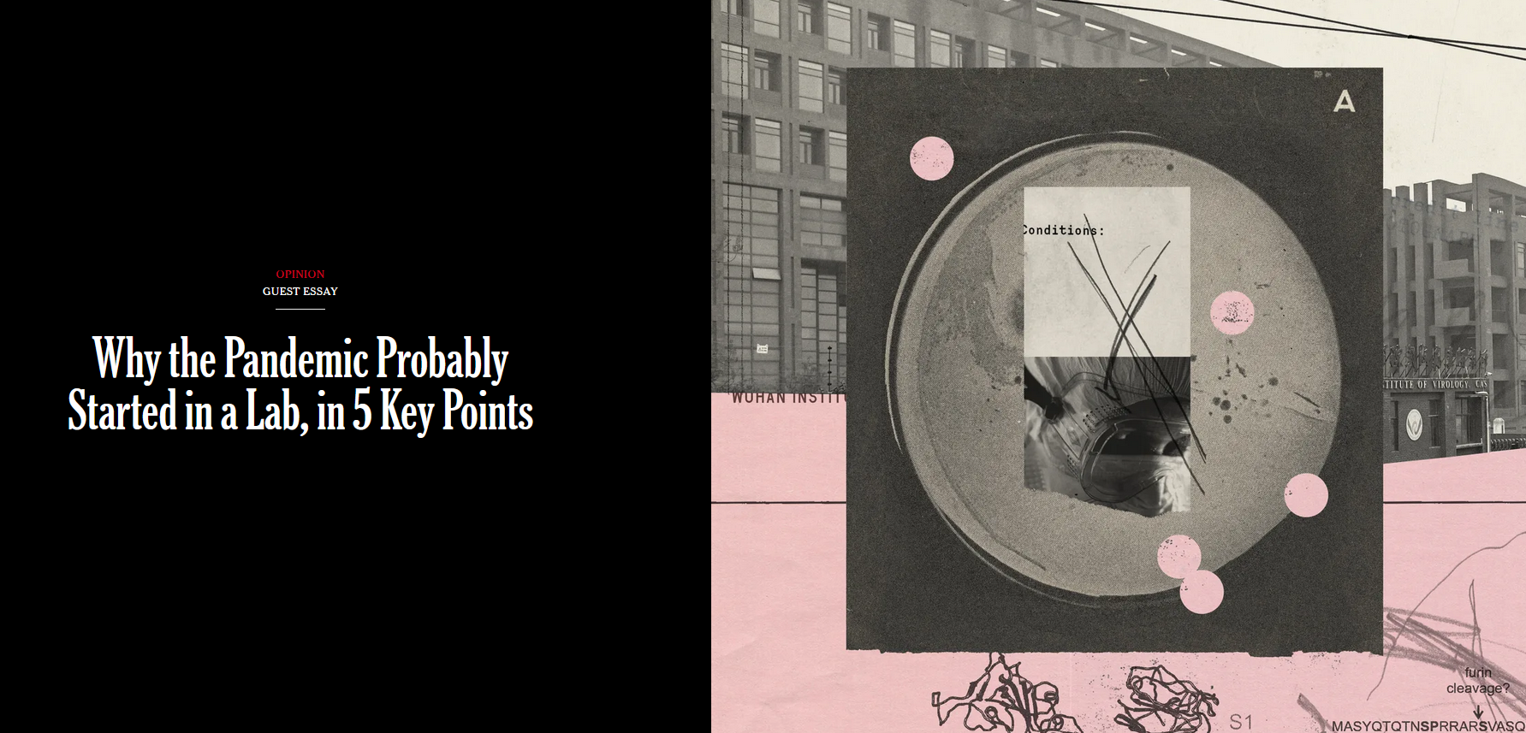
Labs were where the vaccines to slow the spread Covid were produced. It was also in labs that the Covid pandemic may have started
As research on developing vaccines for dangerous pathogens increases, so does the potential for their escape
Reading/Questions 11
Notes:
The Covid pandemic was addressed through work in a lab. It was in a lab that vaccines were developed. However, the pandemic may have also begun in a lab.

