Slide 1
Reading/Questions 5
Notes:
“The power of food” https://www.nytimes.com/2020/09/10/opinion/coronavirus-hong-kong-food.html

Slide 2
Notes:
https://www.nytimes.com/2023/07/06/health/animals-agriculture-disease-spillover.html

Slide 3
Reading/Questions 5
Notes:
https://www.nytimes.com/2023/07/25/health/swine-flu-pigs-agriculture.html

Slide 4
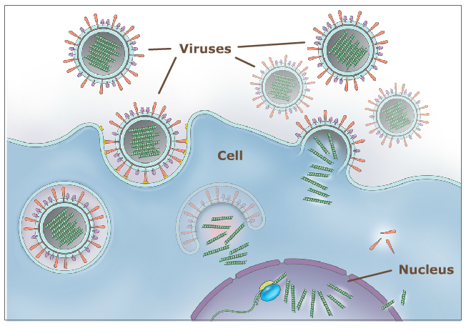
How the influenza virus works
Virus contains RNA
Virus enters outermost layer of cells in respiratory tract of infected host
RNA inserted into nucleus
Polymerases in nucleus used to make copies of viral RNA
These copies of RNA leave the cells to infect another person
Notes:
Every virus is a bunch of genes wrapped in a coat of proteins. In viruses, the genes can be made of DNA or RNA.

Slide 5
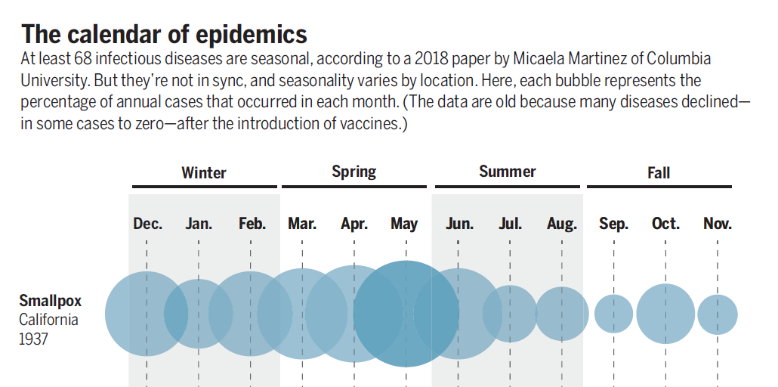
Influenza seasonality
Winter outbreaks of flu occur because:
Closer contact among humans in winter
Drying of respiratory tract cells due to warm heated air aids attachment and reproduction of virus
Weather variables, like drops in humidity have been associated with onset of flu season
.
Notes:
Participants in a morning versus an afternoon flu vaccine program had significantly higher antibody responses to two of three flu strains in the vaccine
There’s evidence of seasonal variation in the actions of human immune genes as well. In a massive analysis of blood and tissue samples from more than 10,000 people in Europe, the United States, Gambia, and Australia, researchers at the University of Cambridge found some 4000 genes related to immune function that had “seasonal expression profiles.” In one German cohort, expression in white blood cells of nearly one in four genes in the entire genome differed by the seasons. Genes in the Northern Hemisphere tended to switch on when they were switched off south of the equator, and vice versa.
https://www.sciencemag.org/news/2020/03/why-do-dozens-diseases-wax-and-wane-seasons-and-will-covid-19
Cohen, Jon. "Sick time." (2020): 1294-1297.
https://science.sciencemag.org/content/367/6484/1294.summary

Slide 6
Influenza vaccinations
Flu vaccination is a preventative stimulation of your body to produce antibodies to a particular combination of influenza virus A (IVA) and influenza virus B (IBV) predicted to be abundant during flu season.
For healthy adults, annual trivalent or quadrivalent influenza vaccines have been the major prophylactic prevention mechanism for several decades.
Decisions on vaccines made months in advance (Feb 2024 for our upcoming flu season)
Notes:
https://www.cdc.gov/flu/season/flu-season-2019-2020.htm

Slide 7
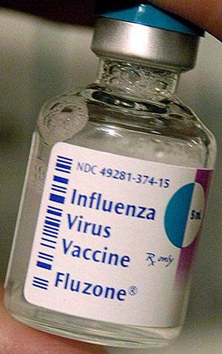
Vaccination rates remain low globally: around 40% in US and Europe, 5-10% or less in many other parts of the world
Effectiveness of vaccine can vary from year to year and for age groups
Influenza A ranged from 27-46% for adults and 46-59% for children, while for influenza B, 64-89% for children and around 60-78% for adults.
Globally, 30 bulk manufacturers of influenza vaccine produce 1.2 billion doses with only a six-month head start.
Most of the demand is in 16 high and middle income countries
Notes:
An impressive feat of biologic manufacturing something for which Big Pharma gets little credit.
Sanofi Pasteur is the world's largest manufacturer of influenza (flu) vaccines
The production and distribution process for a new vaccine takes about six months, however, during which time the circulating strains may shape-shift again. If the vaccines end up matching a given season’s viruses closely, they are up to 60 percent effective at preventing illness, the C.D.C. estimates; when they don’t, their effectiveness has been as low as 10 percent.

Slide 8
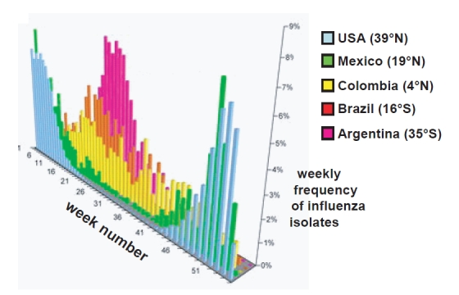
Vaccinations have to be customized
Dominance of A and B flu types vary from country to country
Countries and regions differ in when seasonal influenza occurs
Northern hemisphere: Oct – Feb
Southern hemisphere May to Sept
Equatorial areas: year-round flu season
Notes:
Lowen, Anice; Palese, Peter. (2009). Transmission of influenza virus in temperate zones is predominantly by aerosol, in the tropics by contact: A hypothesis. PLoS Currents Influenza

Slide 9
Flu vaccination coverage is not uniform globally
Green indicates vaccines made available through public health funding at low or no cost to public.
Yellow indicates vaccines available only thru private doctors, often at higher cost than vaccines provided to the public coverage
Notes:
Zheng, Y., Rodewald, L., Yang, J., Qin, Y., Pang, M., Feng, L., & Yu, H. (2018). The landscape of vaccines in China: history, classification, supply, and price. BMC Infectious Diseases, 18(1), 1-8. https://doi.org/10.1186/s12879-018-3422-0
Vaccine Preventable Diseases (VPDs) for national immunization program vaccines in China, US, UK, Russia, Brazil, India and South Africa. VPDs indicated with green are EPI vaccines in the respective countries. Gold indicates diseases prevented by national programs in the UK, US, Russia, or Brazil’s NIP but whose vaccines are not included in China’s EPI system.

Slide 10
Kentucky in the 1918 H1N1 pandemic
Nearly 15,000 people died statewide (as of Sept 17, 2022, 16,822 people have died of Covid in Kentucky)
On October 7, 1918, the state health board ordered that all places of amusement, all schools, and all churches throughout the state be closed until further notice
Kentuckians were urged to remain at home and refrain from traveling, paying social calls, entertaining friends, or attending weddings and funerals.
Most of the state’s colleges and universities also canceled classes and athletic activities.
Notes:
https://www.kentucky.com/opinion/linda-blackford/article241557031.html?

Slide 11
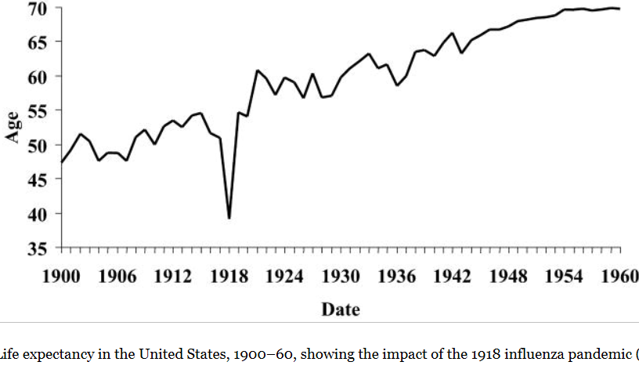
Global impacts of 1918 H1N1 flu
One third of Earth’s population infected
50-100 million deaths worldwide (7-15 million for Covid)
Life expectancy of US population suppressed by 12 years.
All countries impacted although historical records not widely available for many regions.
Secondary bacterial infections, typically pneumonia, sepsis, and organ failure was major cause of death: no antibiotic treatments available at that time.
Notes:
To maintain morale, wartime censors minimized early reports of illness and mortality in Germany, Britain, France, and the United States; but papers were free to report the epidemic's effects in neutral Spain (such as the grave illness of King Alfonso XIII), creating a false impression of Spain as especially hard hit—thus the pandemic's nickname Spanish flu.

Slide 12
Higher than average death rate in 2020 is attributed to long period in which death rate declined due to better public health and medicine.
Death rate from H1N1 in 1918 was twice that of SARS-CoV-2
6.4 deaths per 1000 people for 1918
3.5 deaths per 1000 people for SARS-CoV2
Notes:
Overall higher death rate (from all causes) in 2020 is attributed to long period in which death rate declined due to better public health and medicine. The average was quite low and so when 2020 rolled around, it really stood out. The death rate from influenza was about double that of Covid
Population in US
1918 – 105 million
2021 – 331 million
Deaths
675,000 – 1918 flu
1,150,000 – Covid to date

Slide 13
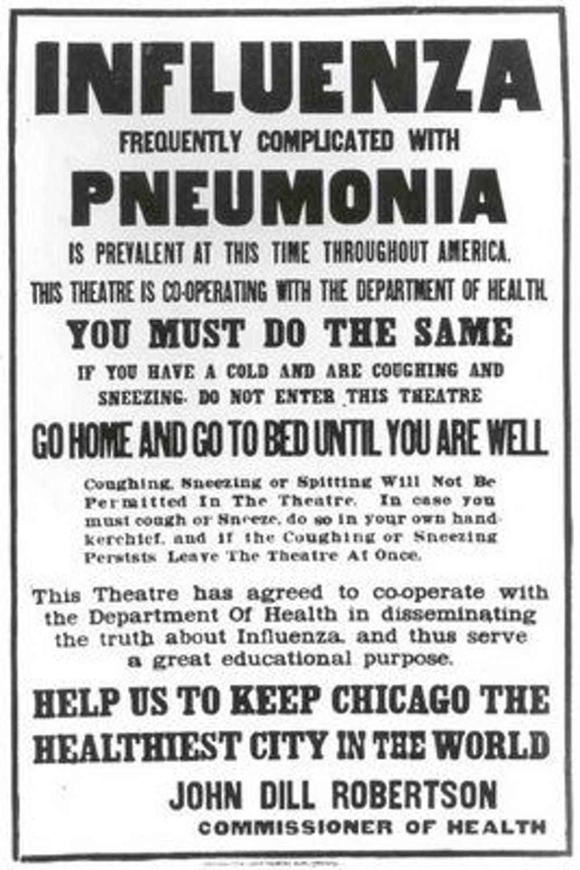
Arose from reassortment events among flu viruses circulating in humans and swine and an avian virus
1918 H1N1 genome has been sequenced from tissue samples of people who died during pandemic and were buried in cold, dry climates
Molecular properties for its pathogenicity in humans have been identified
These ‘virulence markers’ can be compared to new A influenza viruses in order to assess their pandemic potential

Slide 14
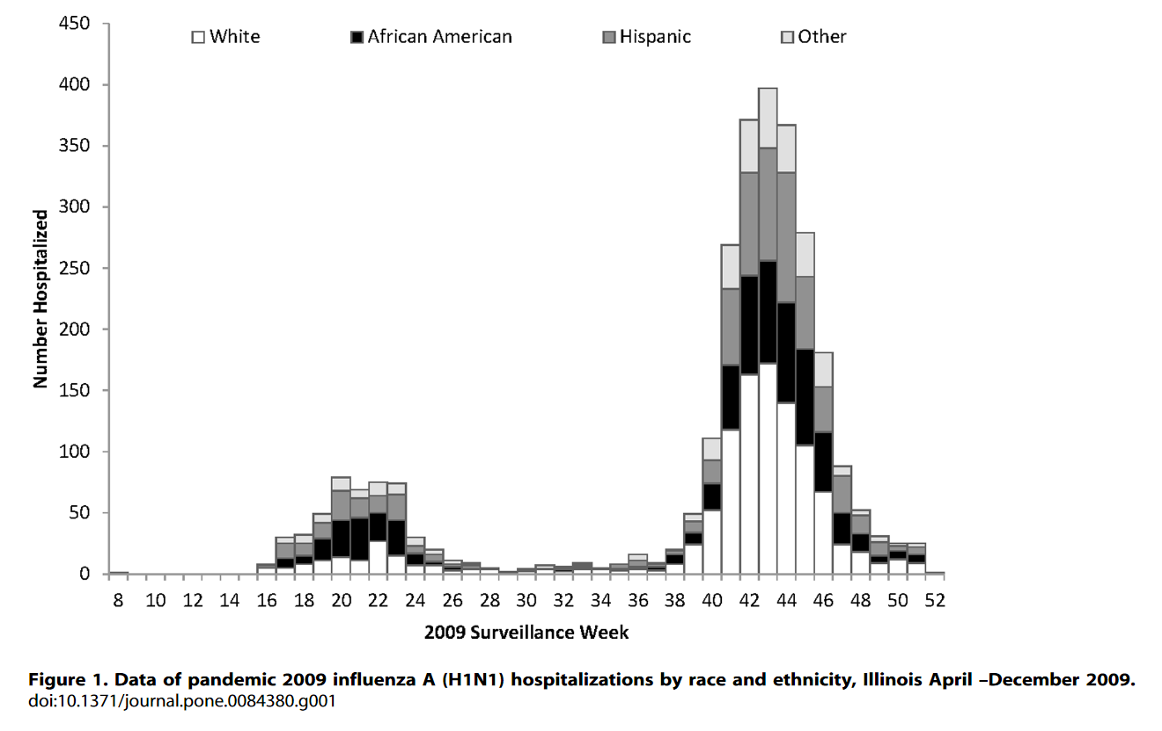
Heath disparities during 2009 H1N1 pandemic
Hospitalization rates for African-Americans and Hispanics combined were greater than for whites
Notes:
Hospitalization rates/100,000 persons for blacks and Hispanics, regardless of age or sex were 2–3 times greater than for whites
Soyemi, K., Medina-Marino, A., Sinkowitz-Cochran, R., Schneider, A., Njai, R., McDonald, M. & Aiello, A. E. (2014). Disparities among 2009 pandemic Influenza A (H1N1) hospital admissions: A mixed methods analysis–Illinois, April–December 2009. PloS one, 9(4), e84380.

Slide 15
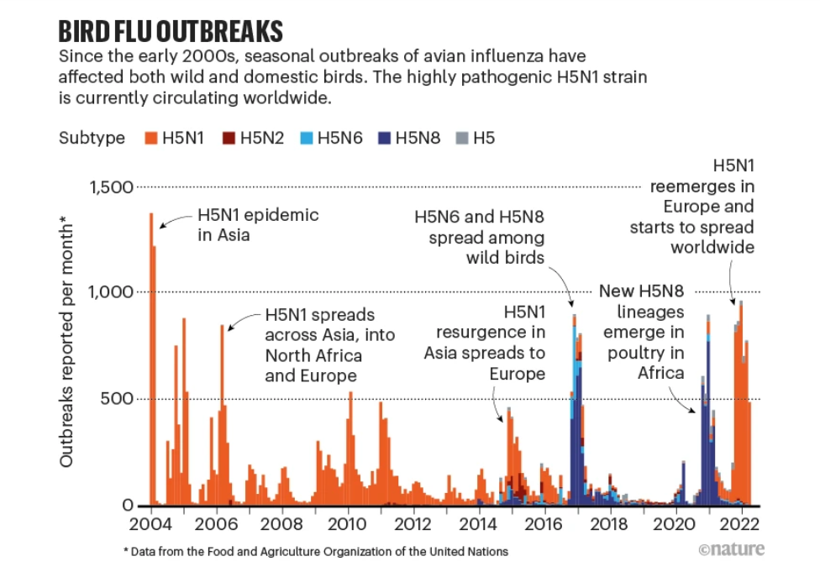
Notes:
Xie, R., Edwards, K. M., Wille, M., Wei, X., Wong, S. S., Zanin, M., ... & Dhanasekaran, V. (2023). The episodic resurgence of highly pathogenic avian influenza H5 virus. Nature, 622(7984), 810-817.

Slide 16
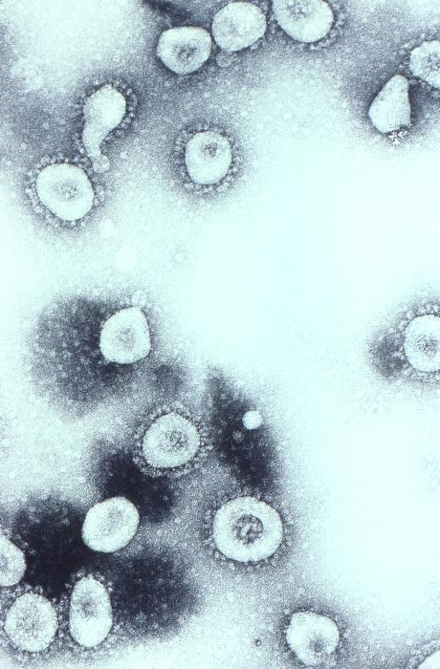
Seven presently known coronaviruses infect humans
All cause respiratory disease in humans
Four cause common colds, two (OC43 and HKU1) came from rodents, and the other two (229E and NL63) from bats.
Other three can cause severe respiratory disease and originate in bats.
Severe Acute Respiratory Syndrome, or SARS-CoV-1 (2003)
Middle East Respiratory Syndrome, or MERS-CoV (2012)
SARS-CoV-2, the current pandemic virus.
Intermediary hosts that carry these viruses into humans
With SARS-CoV-1, the intermediary is thought to be civet cats, which are sold in live-animal markets in China.
With MERS, the intermediary are camels
With SARS-CoV-2, the intermediary was likely a pangolin, another animal in the live-animal trade.
Notes:
Cyranoski, D. (2020). Profile of a killer: the complex biology powering the coronavirus pandemic. Nature, 581(7806), 22-26.
OC43 shown on the right.
MERS had a case fatality rate of 32.7% but this may be an overestimate because there may have been milder cases that remain undocumented. SARS-1 has mortality rates of 14% to 15%, with the rate for people older than 64 years to be more than 50%. SARS-2, aka Covid-19 is close to 2%. We got lucky. https://www.cidrap.umn.edu/news-perspective/2003/05/estimates-sars-death-rates-revised-upward

Slide 17
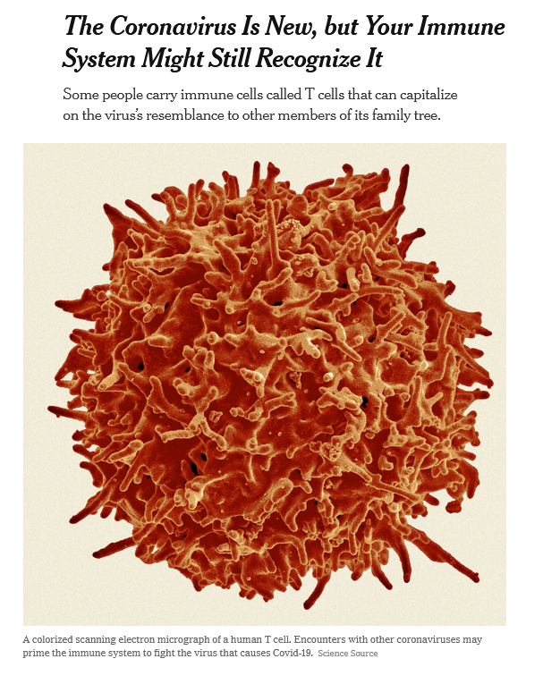
SARS-CoV-2 and exposures to other coronaviruses
Recent studies suggest that a large proportion of the population — 20 to 50% of people in some places in the world — might harbor immune system cells that recognize Covid-19 despite having never encountered it before.
These cells of the immune system were produced in response to earlier encounters with the four coronaviruses that frequently cause common colds.
Notes:
https://www.nytimes.com/2020/08/06/health/coronavirus-immune-cells.html T cells are immune cells

Slide 18
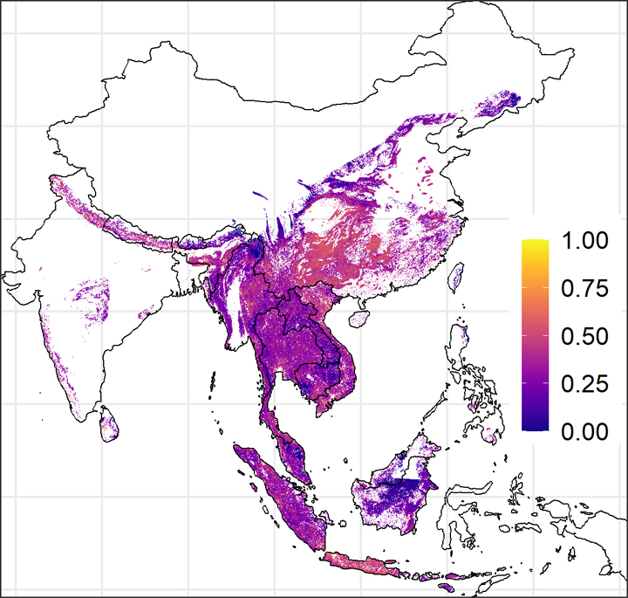
Hundreds of thousands of exposures to SARS-related CoVs annually
Some people in southeast Asia harbor antibodies against other SARS-related CoVs
Estimates are that there are some 400,000 undetected human infections with these coronaviruses each year across the region at right
These spillovers usually do not grow into detectable outbreaks.
Notes:
The risk is highest in southern China, Vietnam, Cambodia, and on Java and other islands in Indonesia
In a region with likely hundreds of millions of bats and nearly half a billion people, 400,000 isn’t that many.
https://www.science.org/content/article/sars-viruses-may-jump-animals-people-hundreds-thousands-times-year Color scale indicates relative risk of exposure with 1 being a high risk with likely exposure.

Slide 19
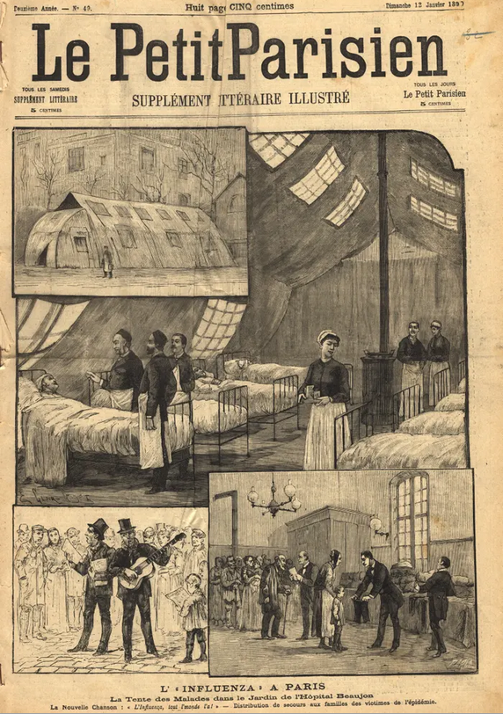
The coronavirus OC43, a common cold virus today, but…
OC43 might have been a killer in the past. A recent study has hypothesized that OC43 spilled over to humans in around 1890 from cows, which got it from mice.
OC43 may have been responsible for the Russian flu pandemic that killed more than one million people worldwide in 1889–90
This argues for the expectation that SARS-CoV-2 will evolve to be seasonal respiratory infection
But that doesn’t mean that our Covid-19 experience will always be mild like colds
Notes:
Vijgen, Leen; Keyaerts, Els; Moës, Elien; Thoelen, Inge; Wollants, Elke; Lemey, Philippe; Vandamme, Anne-Mieke; Van Ranst, Marc (2005). "Complete Genomic Sequence of Human Coronavirus OC43: Molecular Clock Analysis Suggests a Relatively Recent Zoonotic Coronavirus Transmission Event". Journal of Virology. 79 (3): 1595–1604. doi:10.1128/JVI.79.3.1595-1604.2005.

Slide 20
Reading/Questions 5
Notes:
https://www.nytimes.com/2022/02/14/health/russian-flu-coronavirus.html

Slide 21
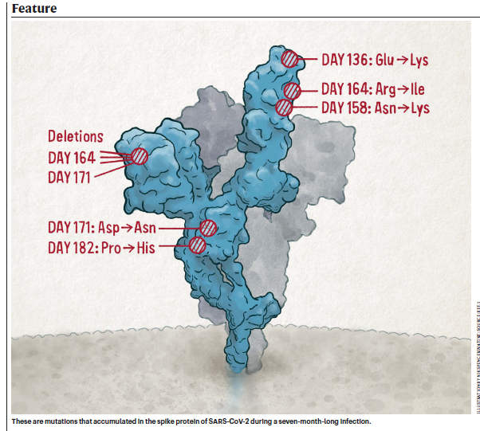
Where do Covid variants of concern (VOCs) come from? Our global health care system.
When SARS-CoV-2 lingers in the body, it accumulates mutations and genetic changes
People with chronic Covid infections may have Covid for months. They are typically immunocompromised, which are:
Long-term hospital residents or those patients with health conditions that suppress their immune systems
Patients who take medicines with immunosuppressive effects (chemotherapy).
Notes:
Callaway, E. (2022). Chronic COVID: the evolving story. Nature, 606(7914), 452-455.
When SARS-CoV-2 lingers in the body, it accumulates many of the same mutations seen in the most dangerous global variants. The mutations in a patient that was immunocompromised accumulated over a 7-month period in which she remained Covid positive. The mutations were very similar to those that appeared in the Omicron variant. This woman’s infection did not spread but it did make it apparent how immunocompromised people who harbor Covid-19 for a long time are a likely source for VOC – variants of concern. What happens in these chronic patients is that the Covid viruses with advantageous mutations have time to outcompete other viruses. When the immune system wipes that virus out quickly (acute cases), these mutations do not have time to develop nor time to become abundant enough to increase the odds of transmitting this advantaged virus

Slide 22
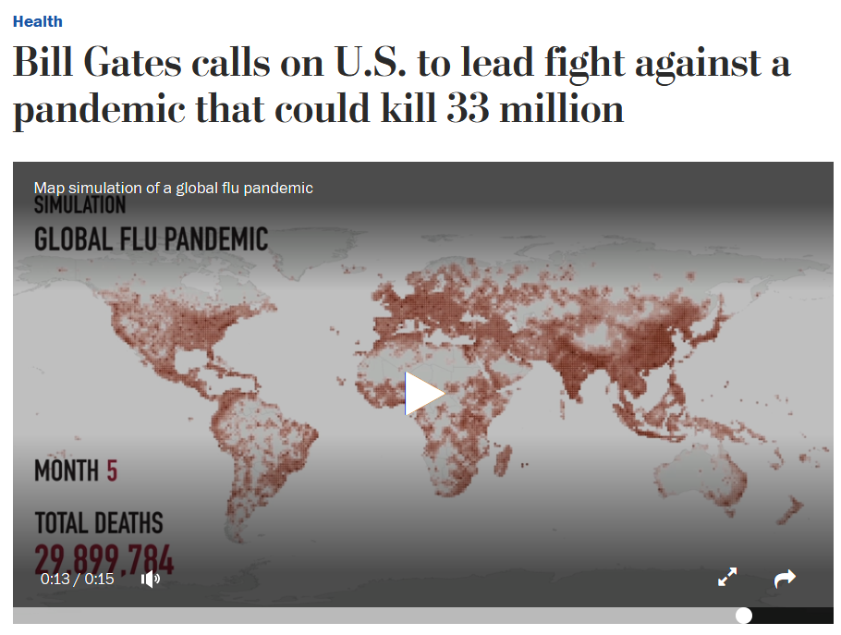
Video
Another global influenza pandemic like 1918 is considered a likely occurrence
Worst case scenario: a human B flu virus and an avian flu A virus like H5N1 in same individual human
This could allow the pathogenicity of avian flu to acquire the ability to be spread via human-to-human contacts seen in B flu viruses
Notes:
https://www.washingtonpost.com/news/to-your-health/wp/2018/04/27/bill-gates-calls-on-u-s-to-lead-fight-against-a-pandemic-that-could-kill-millions A virus as deadly as the 1918 Spanish flu could kill up to 33 million people today

Slide 23
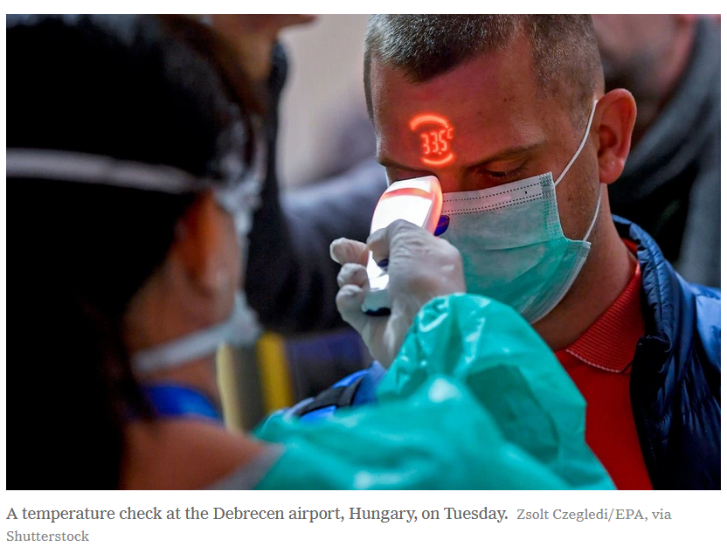
Another global pandemic is an expected reality among health scholars
Even Covid-19 was expected – we knew something like it would come.
Predictions have been made for many years that a flu or coronavirus outbreak would grow to a pandemic
Global pandemic simulations or ‘games’ conducted in the US and Europe for decades
These were undertaken to study what might happen with the emergence of a novel viral pathogen
Notes:
https://www.nytimes.com/2020/02/27/opinion/coronavirus-pandemics.html

Slide 24
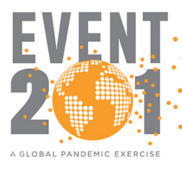
Dark Winter, Atlantic Storm, Event 201, Clade X, Crimson Contagion
Video
In many of them, power struggles arose between federal and state leaders about articulating a health response.
Hospitals were unable to handle the influx of people requiring care
The games revealed that travel bans didn’t stop the virus from spreading.
In general, these games indicated a high level of unpreparedness and an unanticipated economic fallout made worse by political fighting.
Notes:
In Crimson Contagion, tourists returned from China with a new flu virus that took hold in Chicago, Illinois, and infected 110 million Americans (the exercise assumed the pathogen was more contagious than SARS-CoV-2 is).

Slide 25
Global zoonotic surveillance (“early detection, early response”)
Top-down approaches:
Notes:
Pigs, poultry, aquatic birds need to be monitored to detect viruses well before they appear in humans.
Animals may harbor influenza viruses for a period of time before jumping into humans
Like the 1918 strain, the A H1N1 2009 pandemic precursor viruses were present in swine for long periods of time before it emerged in humans. Above, estimated risk of zoonotic disease transmission, including influenza, from pigs.
https://academic.oup.com/ofid/article/5/12/ofy318/5210928

Slide 26
Reading/Questions 5

Slide 27
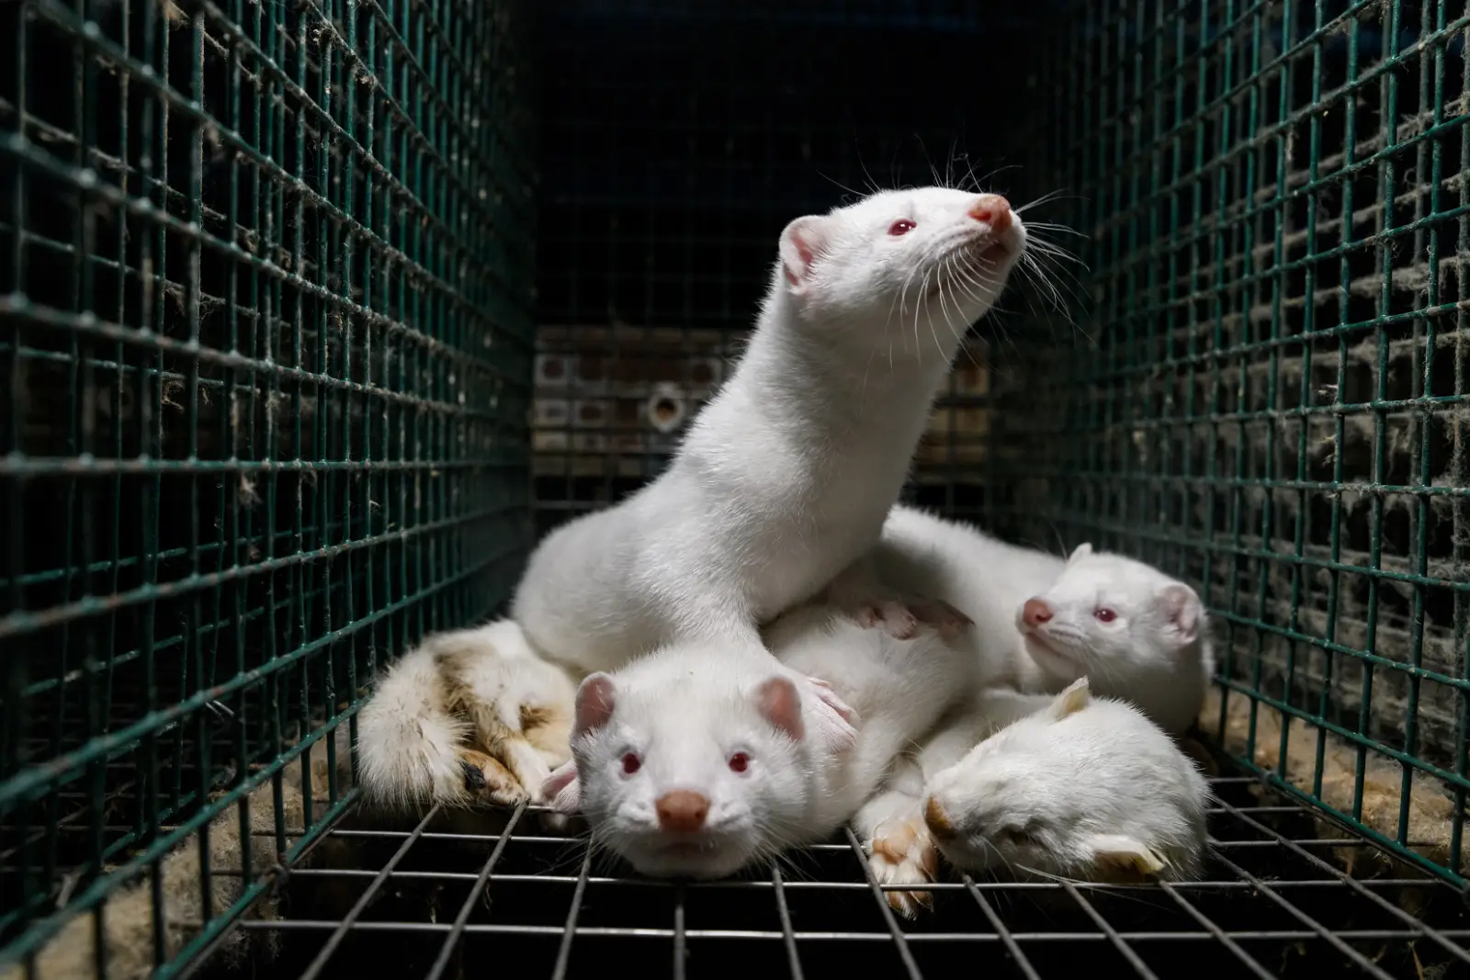
Reading/Questions 5
Notes:
https://etdh.resolvetosavelives.org/2024/avian-influenza-in-finland/

Slide 28
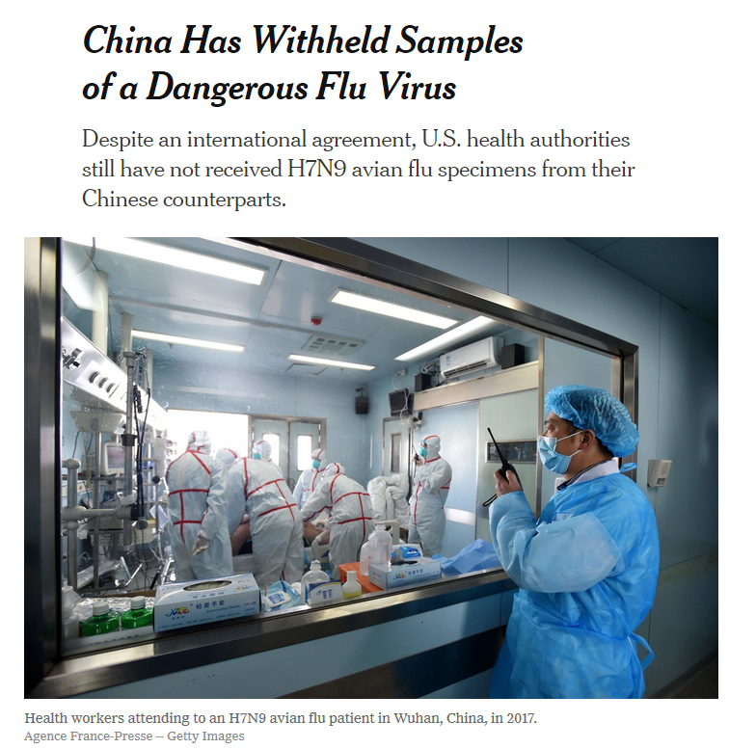
Notes:
https://www.scmp.com/news/china/policies-politics/article/2072757/china-says-bird-flu-outbreak-controllable-greater
Cases of transmission to humans reported, but has not become transmissible between humans
Highly pathogenic: 40% of approximately 800 infections have led to death

Slide 29
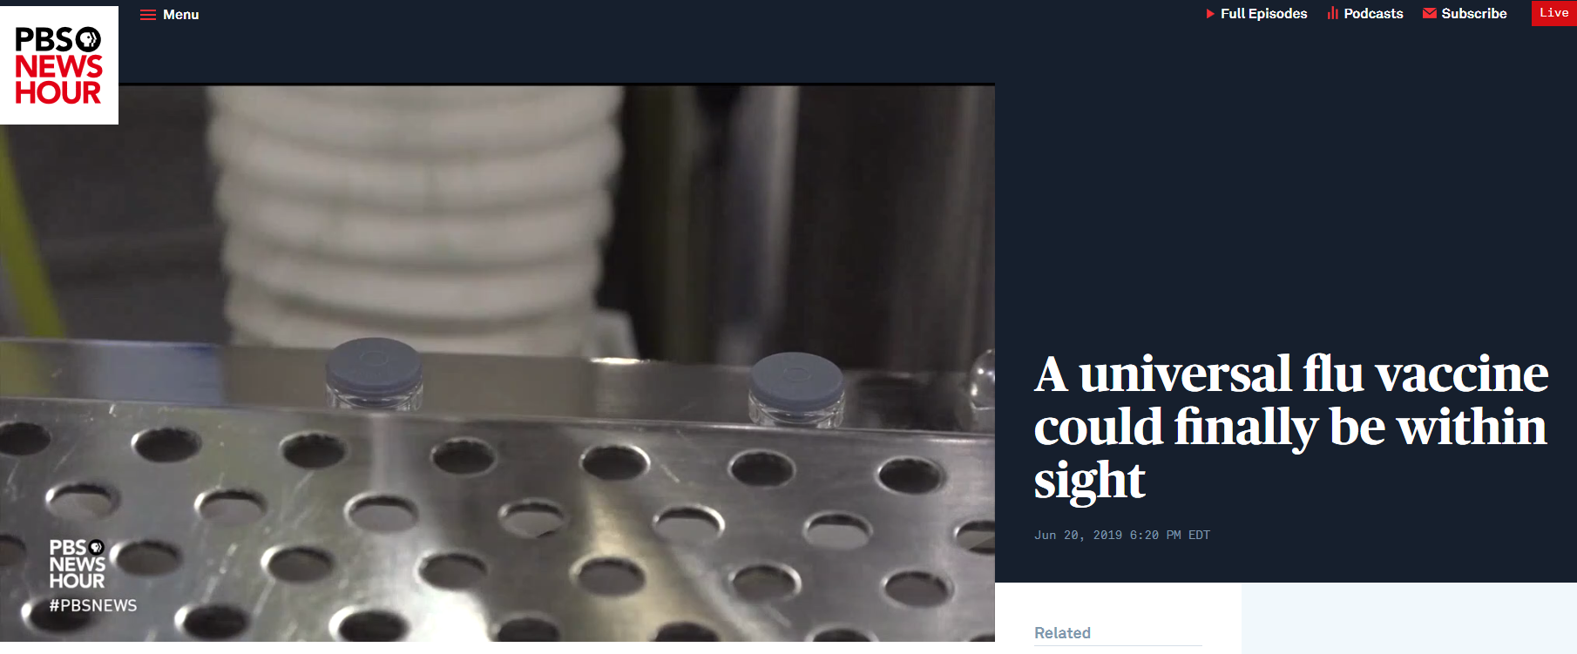
Top-down solutions: universal flu vaccine
Video
Notes:
Trials of a universal vaccine for influenza are underway as of this summer at the National Institutes of Health (NIH) Pratha Sah et al. Future epidemiological and economic impacts of universal influenza vaccines, Proceedings of the National Academy of Sciences (2019). DOI: 10.1073/pnas.1909613116
https://www.nih.gov/news-events/news-releases/nih-begins-first-human-trial-universal-influenza-vaccine-candidate
https://www.pbs.org/newshour/show/how-close-are-scientists-to-a-universal-flu-vaccine

Slide 30
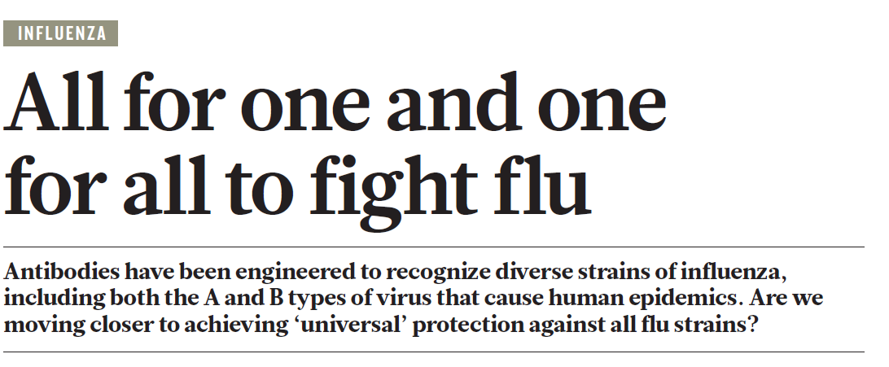
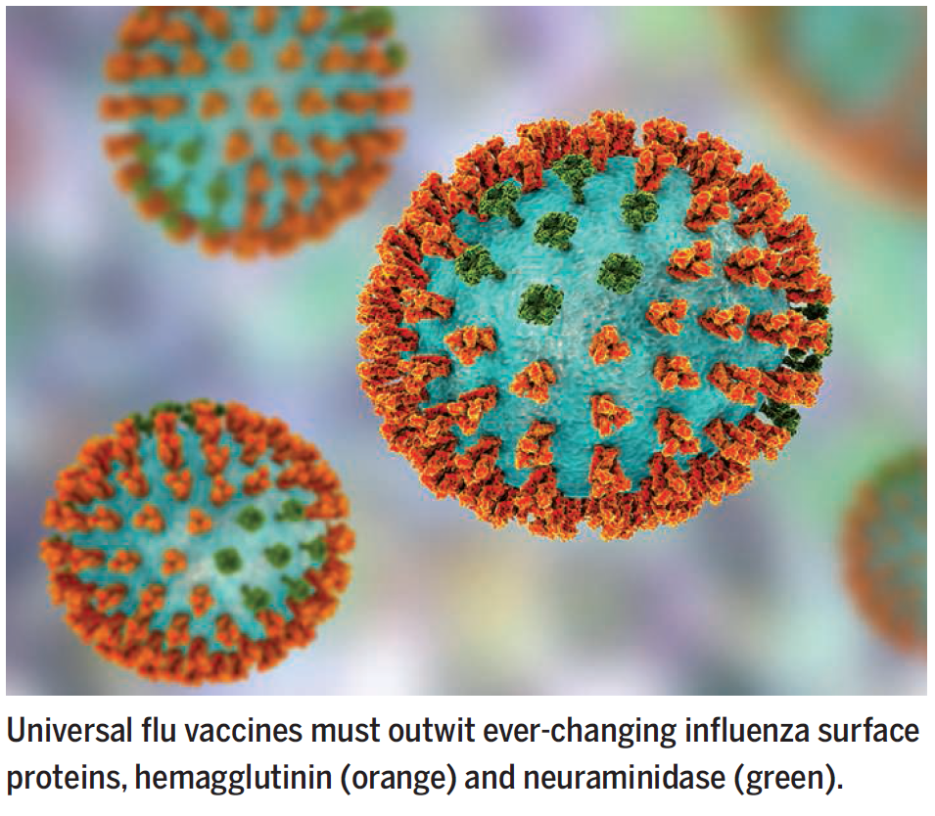
Notes:
Laursen, N. S. et al. Science 362, 598–602 (2018)
The HA proteins have a thin stalk and a rounded head, like a lollipop. The head is the part of the protein that binds to our cells, whereas the stalk contains the machinery to fuse the viral and cell membranes, making possible the transfer of genetic material. The HA head tends to be the structure our immune system — on its own or prompted by a vaccine — recognizes as an invader and for which it produces neutralizing antibodies.
The immune system normally responds to influenza virus by making neutralizing antibodies to regions of the viral spike, the hemagglutinin, that vary year to year. This natural response protects against circulating subtypes but necessitates production of new vaccines annually. Newer vaccine approaches have succeeded in eliciting broadly neutralizing antibodies to highly conserved yet vulnerable stem regions of the hemagglutinin and suggest potential pathways for the development of universal influenza vaccines.
We thought the surface of the flu virus was infinitely variable. But actually, there are some places that rarely change drastically

Slide 31
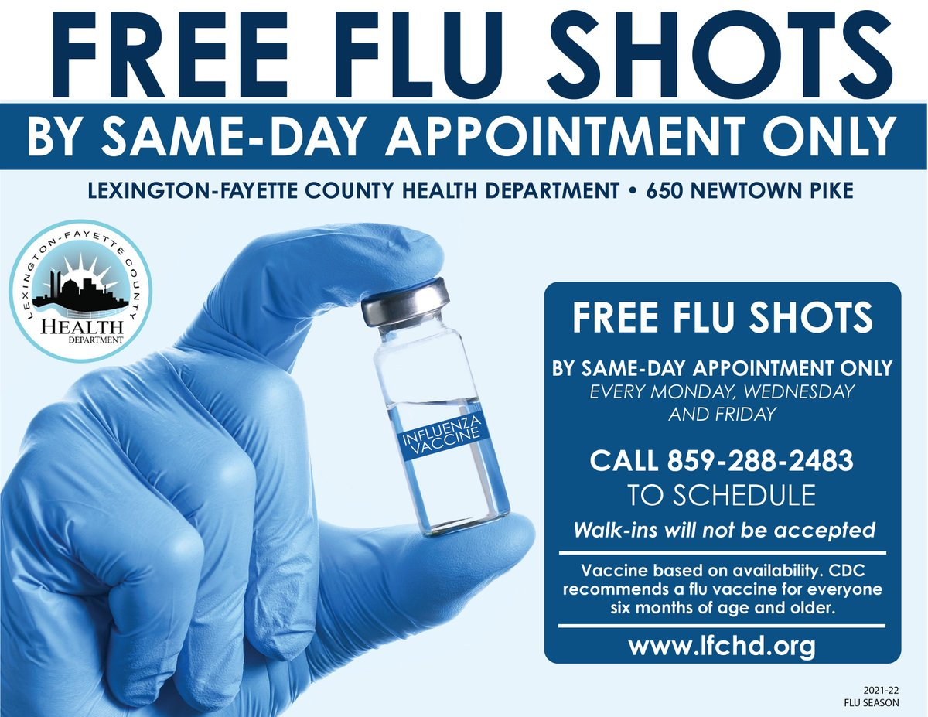
Bottom-up solutions: building preparedness at local levels
Need to build infrastructure to respond to a pandemic emergency with an everyday system that can be scaled up, not a “break-glass-in-case-of-emergency”
Making sure antiviral drugs like Tamiflu are widely available to patients with the flu
Developing better flu health awareness campaigns in local communities
Getting vaccinations to every individual
Notes:
These approaches can be critical of the big ‘moon-shot’ approaches to develop single bullet solutions. But they don’t always have to be. Both top-down and bottom-up solutions are needed.
https://www.lfchd.org/2021fluseason/

Slide 32
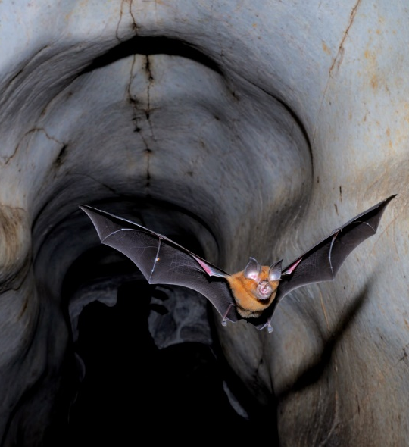
Influenza viruses and coronaviruses
Different taxonomic viral families with contrasts in what kind of human host cells they infect and use to reproduce
Influenza main impact is on the lungs, coronaviruses impact all major organs
Influenza viruses exhibit mutation (drift) and reassortment (shift) up to three times more often than coronaviruses do.
Bats are a major, but not exclusive, reservoir for coronaviruses
Notes:
https://theconversation.com/what-is-the-ace2-receptor-how-is-it-connected-to-coronavirus-and-why-might-it-be-key-to-treating-covid-19-the-experts-explain-136928 Coronaviruses are from the family Coronaviridae, influenza viruses are from the family Orthomyxoviridae ACE2 is present in all people but the quantity can vary among individuals and in different tissues and cells. Some evidence suggests that ACE2 may be higher in patients with hypertension, diabetes and coronary heart disease A horseshoe bat (Rhinolophus affinis) exits a cave at dusk, in Perak state in Malaysia, one of the countries where severe acute respiratory syndrome–related viruses may frequently infect people
https://www.science.org/content/article/sars-viruses-may-jump-animals-people-hundreds-thousands-times-year

Slide 33
Notes:
Civet cats

Slide 34
Notes:
A pangolin in Kuala Lumpur, Malaysia, in 2002. Prized in China as a delicacy and for the purported medicinal virtues of their scales, pangolins are said to be the most trafficked mammal in the world
https://www.nytimes.com/2020/03/05/opinion/coronavirus-china-pangolins.html

Slide 35
Notes:
Lytras, S., Xia, W., Hughes, J., Jiang, X., & Robertson, D. L. (2021). The animal origin of SARS-CoV-2. Science, 373(6558), 968-970.

Slide 37
Notes:
Animals on sale in Wuhan seafood market: (a) King rat snake (Elaphe carinata), (b) Chinese bamboo rat (Rhizomys sinensis), (c) Amur hedgehog (Erinaceus amurensis) (the finger points to a tick), (d) Raccoon dog (Nyctereutes procyonoides), (e) Marmot (Marmota himalayana) (beneath the marmots is a cage containing hedgehogs), and (f) Hog badger (Arctonyx albogularis).

Slide 38
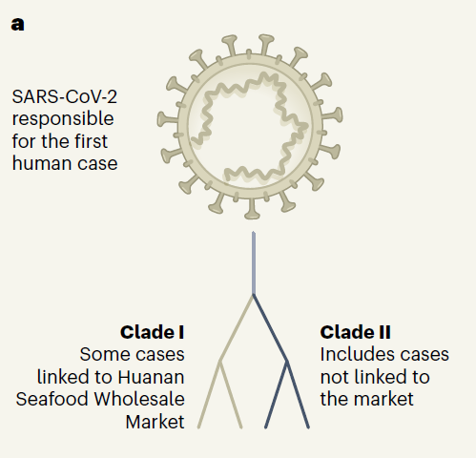
Dual emergence of SARS-CoV-2
Simplest explanation is that SARS-CoV-2 ‘jumped’ into humans from an animal host at a wet market in Wuhan, China in Dec 2019
Viral genomes from nine of the earliest know human cases for which samples are available suggest multiple origins
Six humans with ties to the market (Clade 1)
Three humans with no ties to the market (Clade 2)
Notes:
Their appear to be two major phylogenetic lineages (clades) of SARS-CoV-2 during the early phase of the outbreak in China. They are distinguished by two distinctive nucleotide differences, suggesting multiple origins for the human infections transmitted to people in Shanghai (which is about 800 kilometers by road from Wuhan).
There are no differences in clinical outcomes between infections with the two SARS-CoV-2 lineages
The two clades differ by only two nucleotides out of the approximately 30,000 nucleotides in the SARS-CoV-2 genome Koutsakos, Marios, and Katherine Kedzierska. "A race to determine what drives COVID-19 severity.“ Nature, June 29 (2020): 366-368.

Slide 39
This supports the idea that the market might not have been the origin of the pandemic.
Instead, clades I and II originated from a common viral ancestor and spread independently at the same time: clade I through the market and clade II outside it.
Therefore, the animal-to-human transfer might have occurred elsewhere, seeding transmission chains that found their way to the market —where the high density of humans facilitated uncontainable spread in, and beyond the market
Notes:
Koutsakos, Marios, and Katherine Kedzierska. "A race to determine what drives COVID-19 severity.“ Nature, June 29 (2020): 366-368.

Slide 40
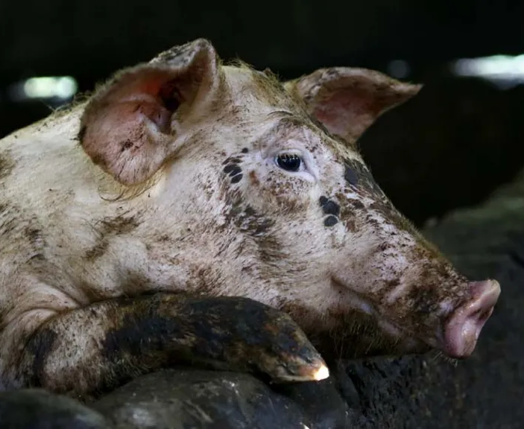
Covid and African swine fever
Shortage of pork in 2019 in China because of the African swine fever virus pandemic – millions of pigs culled
Consumers and food sellers may have resorted to alternative meats, including farmed or captured wildlife, especially that shipped in from southern China where wildlife is traditionally consumed
Frozen susceptible-animal carcasses of civet cat, bat, and pangolin, could potential have played a role in the emergence of SARS-CoV-2.
Notes:
Lytras, S., Xia, W., Hughes, J., Jiang, X., & Robertson, D. L. (2021). The animal origin of SARS-CoV-2. Science, 373(6558), 968-970. Africa swine fever virus does not infect humans The virus is not dangerous to humans, but is highly contagious - and incurable - in boars and pigs. According to the UN, the fatality rate is "up to 100%".
It emerged in East Africa in the early 1990s, moved through sub-Saharan Africa, and has also been recorded in Europe.
In August 2018, China - which has half the world's pigs, and where pork is often a staple food - confirmed an outbreak of ASF.
Since then, more than one million pigs have been culled in China, plus more than five million in Vietnam. Farmers in China have been promised compensation for culled pigs worth a minimum of 80% of the market price. The number of pigs is down by about 40% in China, the AFP news agency reported, and the price of pork is up by at least half. China has sold 30,000 tonnes from its pork reserves in an effort to increase supply and hold down prices. Mongolia, the Philippines, Laos, have also culled tens of thousands of pigs in total.

Slide 41
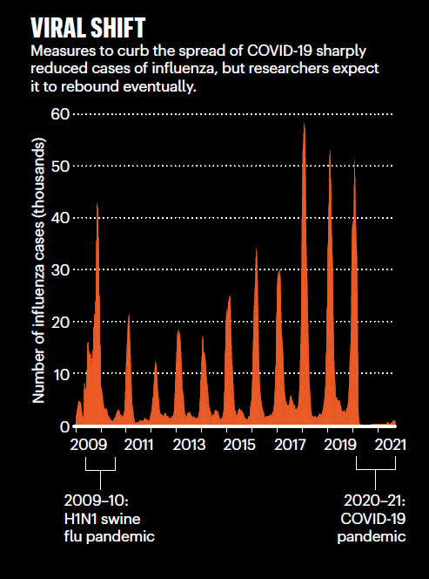
Covid’s impact on the flu
Seasonal influenza activity dropped to historically low levels in early 2020 due to face mask use, social distancing, movement restrictions
The US recorded just 646 flu deaths in the 2020–21 season — the annual average is in the tens of thousands.
The United States recorded just 646 flu deaths in the 2020–21 season — the annual
average is in the tens of thousands.
Notes:
http://www.influenzacentre.org/Centre_Activities_WHO_GISRS_Surveillance.html
It is possible for someone to be infected with the coronavirus and influenza at the same time. Hospitals may not be able to handle a double surge, a twindemic of influenza and Covid
Jones, N. (2021). Why easing COVID restrictions could prompt a fierce flu rebound. Nature.

Slide 42
Possible extinction of influenza B/Yamagata lineage because of SARS-CoV2 pandemic
B viruses impacts adults more and tends to travel globally
Covid lockdowns and masks greatly reduced transmissions
No animal reservoir for B influenza – only found in humans
Effective B flu vaccine has been in place for decades
Notes:
https://www.theatlantic.com/science/archive/2023/04/yamagata-flu-transmission-lineage-extinction/673662/ Koutsakos, M., Wheatley, A. K., Laurie, K., Kent, S. J., & Rockman, S. (2021). Influenza lineage extinction during the COVID-19 pandemic?. Nature Reviews Microbiology, 19(12), 741-742. The SARS-CoV-2 pandemic has seen a notable global reduction in influenza cases of both influenza A and B viruses. In particular, the B/Yamagata lineage has not been isolated from April 2020 to August 2021, suggesting that this influenza lineage may have become extinct
Infection with influenza B virus (IBV) accounts for around a quarter of the annual influenza burden. With circulation of IBV only in humans and no established animal reservoir, high vaccination coverage that induces broad immune protection provides a potential pathway to eradication of IBV. The considerable reductions of influenza circulation globally due to COVID-19 may have already precipitated the extinction of the B/Yamagata lineage.
Indeed, B/Yamagata viruses have a lower effective reproductive number than B/Victoria viruses, and B/Yamagata epidemics have a slower initial growth phase with shorter transmission chains than B/Victoria epidemics. This may make B/Yamagata more vulnerable to breakdowns in onward transmission, especially in the context of social distancing and movement restrictions.
School-aged children and adolescents are more frequently infected with B/Victoria viruses, whereas adults over the age of 25 years are more frequently infected with B/Yamagata viruses. Consistently, in 2008–2019, B/Yamagata viruses demonstrated greater global movement than B/Victoria viruses. The reduction in global mobility due to the COVID-19 pandemic likely impacted B/Yamagata more
Even as of 2017, circulating B/Yamagata viruses have all been from a single lineage, whereas several lineages existed before. There has not been a need to update the B/Yamagata vaccine component since Although B/Yamagata viruses have continued to evolve genetically, where these changes are taking place have not impacted transmissability. Thus, the onset of the COVID-19 pandemic coinciding with a period of low incidence and low antigenic diversity, coupled with prolonged use of a well-matched influenza vaccine, may have enabled massive suppression of B/Yamagata during the pandemic.

