Slide 1
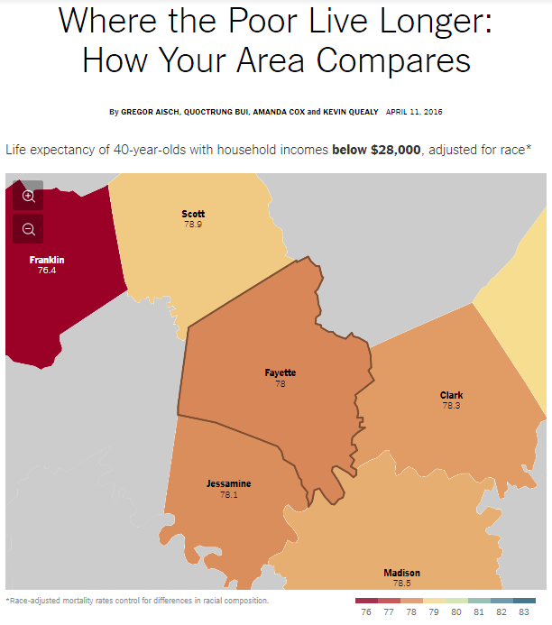

Slide 3
Photos
Notes:
But these contrasts can vary over small distances – to use a word from earlier lectures, economic disparity can be hyperlocal
https://www.nytimes.com/interactive/2020/09/05/opinion/inequality-life-expectancy.html

Slide 4
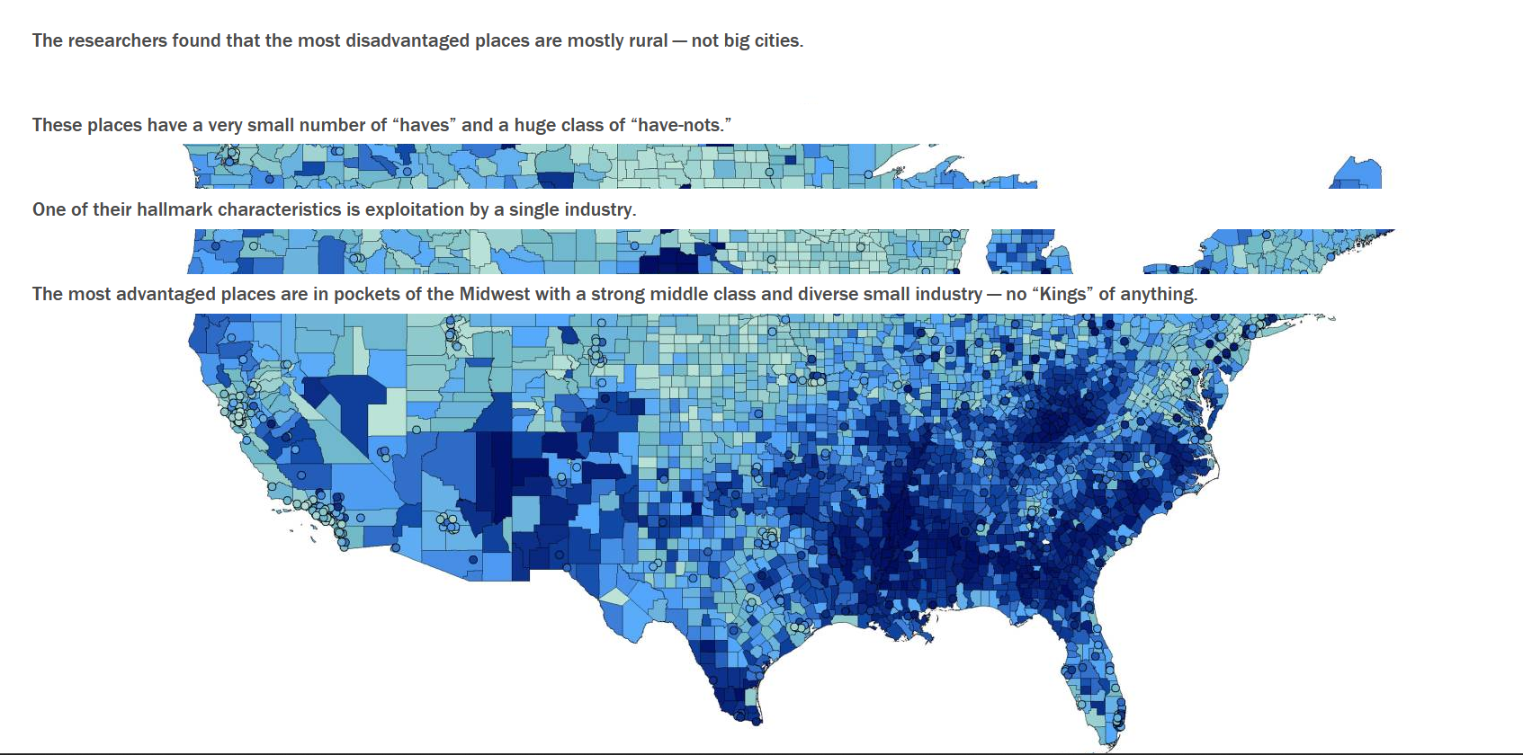
Notes:
https://www.princeton.edu/news/2023/11/15/kathryn-edins-new-book-offers-groundbreaking-insights-american-poverty-and-where The map revealed that the most disadvantaged places are mostly rural, centered in three pockets: Appalachia, the Cotton and Tobacco Belts of the Deep South, and South Texas. Cities including Chicago, Los Angeles and Miami didn’t rank even among the 600 most disadvantaged places in the nation

Slide 5
The nonmetro mortality penalty
Applies outside of large metropolitan areas, where there is
Limited access to healthcare
Higher prevalence of chronic diseases
Lack of economic opportunities
Workplace risks
Notes:
https://www.ineteconomics.org/perspectives/blog/mortality-crisis-redux-the-economics-of-despair
https://www.nytimes.com/2022/10/05/opinion/mortality-penalty-inequality-education.html
Monnat, S. M. (2020). Trends in US Working-age non-Hispanic White mortality: rural–urban and within-rural differences. Population research and policy review, 39(5), 805-834.

Slide 6
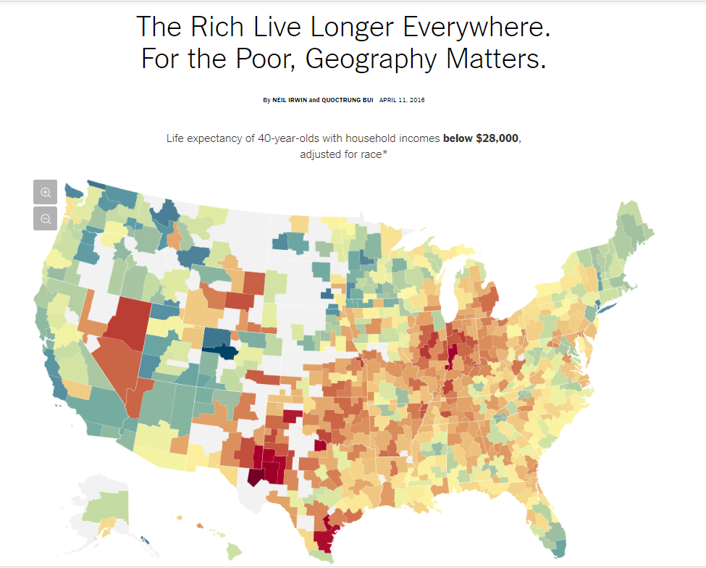
Simplistic to think only of a rural-urban divide as an arbitrator of health
Also simplistic to think that all cities are the same in how the rich and poor live
A productive question to ask is where and under what conditions do the poor live longer?

Slide 7
Race-Adjusted Expected Age at Death vs. Household Income
for Men in Selected Major Cities
90
85
Expected Age at Death for 40 Year Olds in Years
80
New York City
San Francisco
Dallas
75
Detroit
70
0
5
10
15
20
$30k
$60k
$101k
$683k
Household Income Ventile
Notes:
Chetty, R., Stepper, M., Abraham, S., Lin, S., Scuderi, B., Turner, N., ... & Cutler, D. (2016). The association between income and life expectancy in the United States, 2001-2014. JAMA 315(16), 1750-1766.

Slide 8
Race-Adjusted Expected Age at Death vs. Household Income
for Women in Selected Major Cities
90
85
New York City
San Francisco
Expected Age at Death for 40 Year Olds in Years
80
Dallas
Detroit
75
70
0
5
10
15
20
$27k
$54k
$95k
$653k
Household Income Ventile

Slide 9
Race-Adjusted Expected Age at Death for 40 Year Olds in Bottom Quartile
Top 10 and Bottom 10 CZs Among 100 Largest CZs
Top 10 CZs |  |  |  |  | Bottom 10 CZs
Rank | CZ |  | Expected Age at Death |  | Rank | CZ | Expected Age at Death
1 | New York, NY |  | 81.8 (81.6, 82.0) |  | 91 | San Antonio, TX | 78.0 (77.6, 78.4)
2 | Santa Barbara, CA |  | 81.7 (81.3, 82.1) |  | 92 | Louisville, KY | 77.9 (77.7, 78.2)
3 | San Jose, CA |  | 81.6 (81.2, 82.0) |  | 93 | Toledo, OH | 77.9 (77.6, 78.2)
4 | Miami, FL |  | 81.2 (80.9, 81.6) |  | 94 | Cincinnati, OH | 77.9 (77.7, 78.1)
5 | Los Angeles, CA |  | 81.1 (80.9, 81.4) |  | 95 | Detroit, MI | 77.7 (77.5, 77.8)
6 | San Diego, CA |  | 81.1 (80.8, 81.4) |  | 96 | Tulsa, OK | 77.6 (77.4, 77.9)
7 | San Francisco, CA |  | 80.9 (80.6, 81.3) |  | 97 | Indianapolis, IN | 77.6 (77.4, 77.8)
8 | Santa Rosa, CA |  | 80.8 (80.5, 81.2) |  | 98 | Oklahoma City, OK | 77.6 (77.3, 77.8)
9 | Newark, NJ |  | 80.7 (80.5, 80.9) |  | 99 | Las Vegas, NV | 77.6 (77.4, 77.8)
10 | Port St. Lucie, FL |  | 80.7 (80.5, 80.9) |  | 100 | Gary, IN | 77.4 (77.1, 77.8)
Note: 95% confidence intervals shown in parentheses

Slide 10
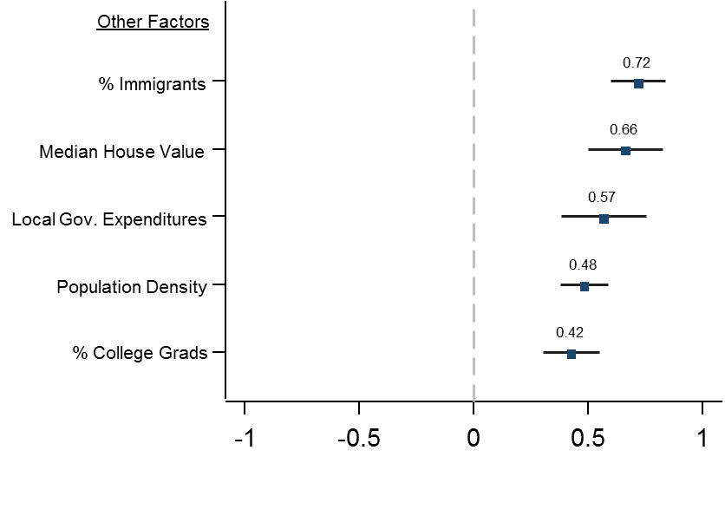
Correlations of Expected Age at Death with Other Factors
For Individuals in Bottom Quartile of Income Distribution
Notes:
Obesity and smoking were greater risk factors
But these in the chart are the geographic risk factors, those that relate to where you live and the kind of social environments that exist there
Importantly, these findings do not necessarily imply that income has a causal effect on life expectancy: that is, giving someone or an area more money will increase their lifespan – there is something related to the environments of cities that have high percentages of immigrants, high median house values, and higher local government expenditures that increase lifespan for the poorest. Data was from 1.4 billion anonymous earnings and mortality records

Slide 11
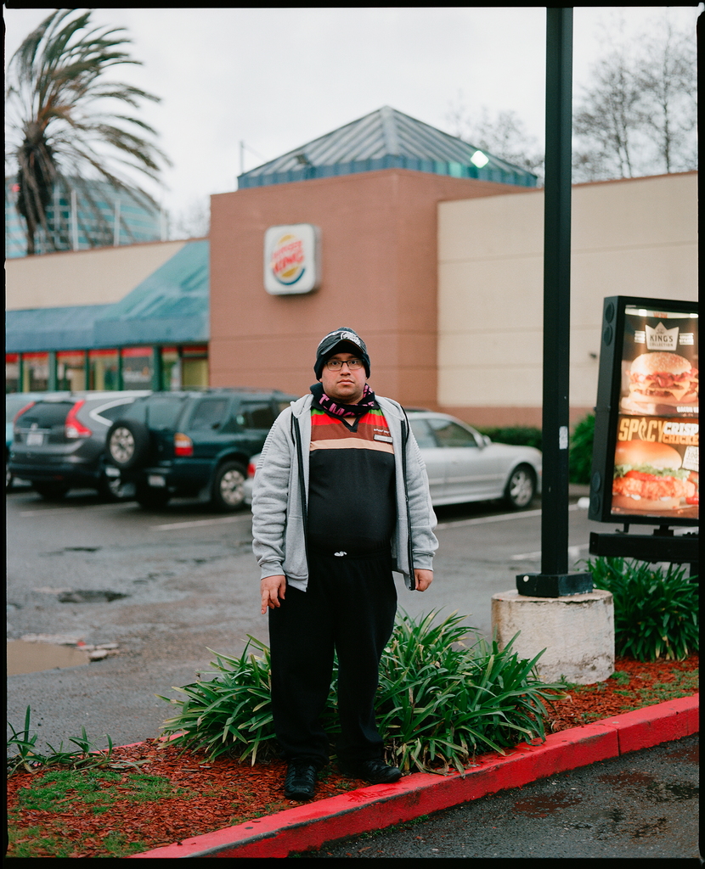
A living wage is effective medicine
Notes:
A living wage is effective medicine. The best medicine to address the health needs of the working poor is an increase in the minimum wage.
Julio Payes was working 80 hours a week at two full-time jobs. A permanent resident from Guatemala who came to the United States on a work visa, Payes labored in Emeryville, Calif., a city of roughly 12,000 residents and almost 22,000 jobs, sandwiched between Oakland and Berkeley. He began his day with the graveyard shift at a 24-hour McDonald’s, where he served burgers and fries from 10 p.m. to 6 a.m. Afterward he had two hours to rest and shower. Then he’d clock in at Aerotek, going anywhere the temp service sent him between 8 a.m. and 4 p.m. To stay awake, he loaded up on coffee and soda. Each job paid minimum wage.
“I felt like a zombie,” Payes told me. “No energy. Always sad.” Yet just to afford basic necessities, he had to work up to 16 hours a day, seven days a week. Back then, he and his mother and two siblings all shared a single, unfurnished room. Once, his younger brother, Alexander, who was 8 at the time, told him he was saving money. “I want to buy one hour of your time,” Payes remembers his brother telling him. “How much for one hour to play with me?” Payes looked at his brother and wept. Not long after that, Payes fainted from exhaustion in the aisle of a grocery store. He was 24.

Slide 12
The working sick
Low-skilled workers reported fewer unmet medical needs in states with higher minimum-wage rates.
In low-wage states, workerswent to work sick and skipped medical appointments
Increases to the minimum wage are associated with decreased rates of smoking
Higher wages allow parents working in the low-wage labor market to keep the refrigerator stocked
Notes:
https://www.nytimes.com/interactive/2019/02/21/magazine/minimum-wage-saving-lives.html
But in January 2018, an accounting error accidentally raised Cutler’s hourly wage from $12.32 to $15.50. She figured she had earned the extra pay from picking up more shifts, and she took it straight to the grocery store. At first she didn't think she’d like broccoli, but she did. “I tried fruits and vegetables,” she said. “I tried salads. I experimented with foods I’ve never eaten. And I felt much better.” Cutler’s temporary raise didn’t launch her into the middle class, but it did influence her behavior in ways that benefited her health.
When U.P.M.C. discovered the glitch in February, Cutler was summoned to the director’s office. She remembers being told: “You’ve been accidentally paid. All that money, it’s not yours.” Her employer dropped her wage to $13.68 and reclaimed the overage from her next paycheck. For Cutler, it was back to McDonald’s.
When UPMC reduced her paycheck, Cutler took on extra shifts to cover the loss. It wore her down. During one shift, she tried to lift a full pan of mashed potatoes from the hot box. The pan was too heavy, and both Cutler and the potatoes crashed to the floor, hurting her back. She limped to the emergency room, where she was given lidocaine patches and sent home on bed rest. The next morning she was in so much pain that her mother had to help her get dressed. She missed seven days of work, for which she was not compensated.

Slide 13
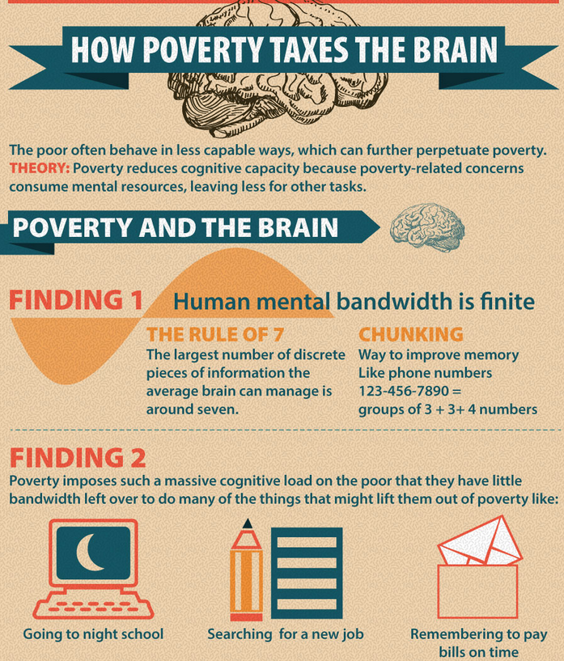
The bandwidth tax of poverty
Being poor reduces a person’s cognitive capacity
When preoccupied by poverty, we have less mind to give to the rest of life
Notes:
Experience of poverty has health consequences beyond the physical
https://www.csmonitor.com/USA/2015/0515/In-global-fight-against-extreme-poverty-a-potential-game-changer
Cannot neutralize poverty 'by keeping the focus on the characteristics of poor people

Slide 14
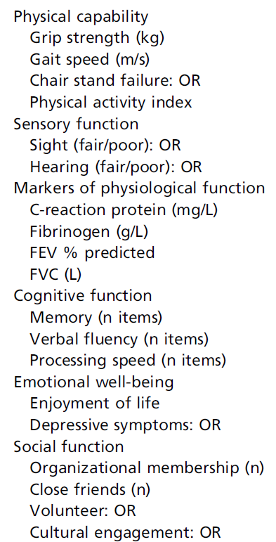
The rich and the poor age differently
Less affluent sectors of society age more rapidly than more privileged groups.
Lower socioeconomic status (SES), as defined by wealth, has been associated with faster decline in age-related functions (right)
Notes:
Steptoe, A., & Zaninotto, P. (2020). Lower socioeconomic status and the acceleration of aging: An outcome-wide analysis. Proceedings of the National Academy of Sciences, 117(26), 14911-14917.
This was an 8-year study involving 5000 people.

Slide 15
But you don’t necessarily have to be rich to live a long time
In Ikaria, Greece, life spans are eight to ten years longer on average than Americans and they are twice as likely to live to 90
Many of these old people are not wealthy and could even be considered poor in terms of income
Notes:
The question then is not so much one of why the poor more prone to shorter lifespan – those indicators are not hard to see. Instead, the question can be framed as to what conditions promote longer lifespans and better health in the poor. https://www.washingtonpost.com/news/worldviews/wp/2012/10/25/a-greek-islands-secrets-to-long-life-in-11-bullet-points/ https://www.nytimes.com/2012/10/28/magazine/the-island-where-people-forget-to-die.html https://www.nytimes.com/slideshow/2012/10/28/magazine/ikaria-centenarians/s/ikaria-centenarians-slide-FRXG.html

Slide 16
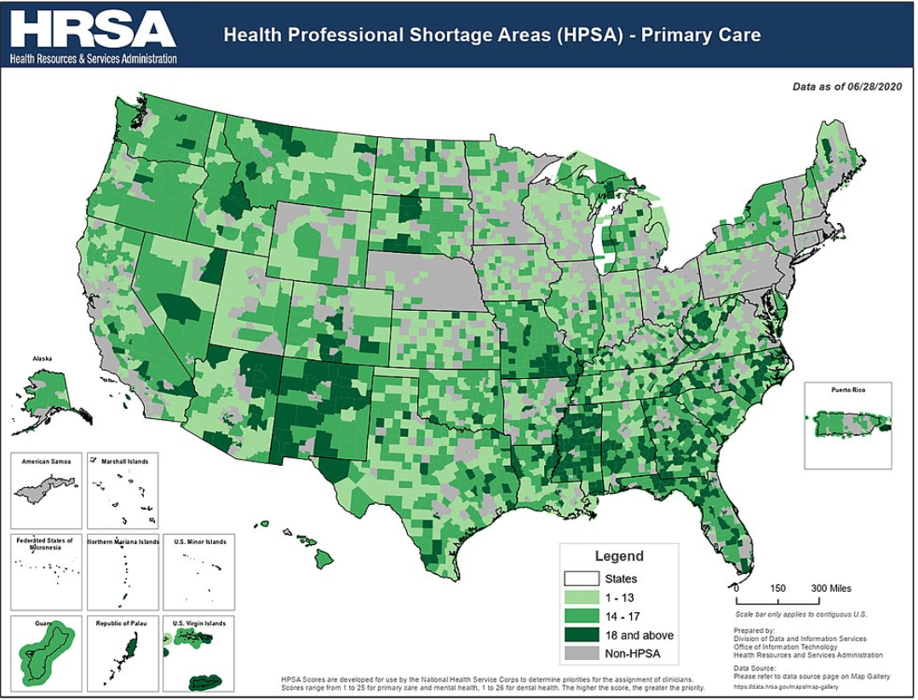
Economic disparity and health accessibility
Defined in terms of physical distance as in medical ‘deserts’
Defined as a relative distance - a treatment may be close by but unavailable due to monetary cost Distance can also be economic: access to medicines or treatments may not exist because the profit incentives to develop or provide them are low

Slide 17
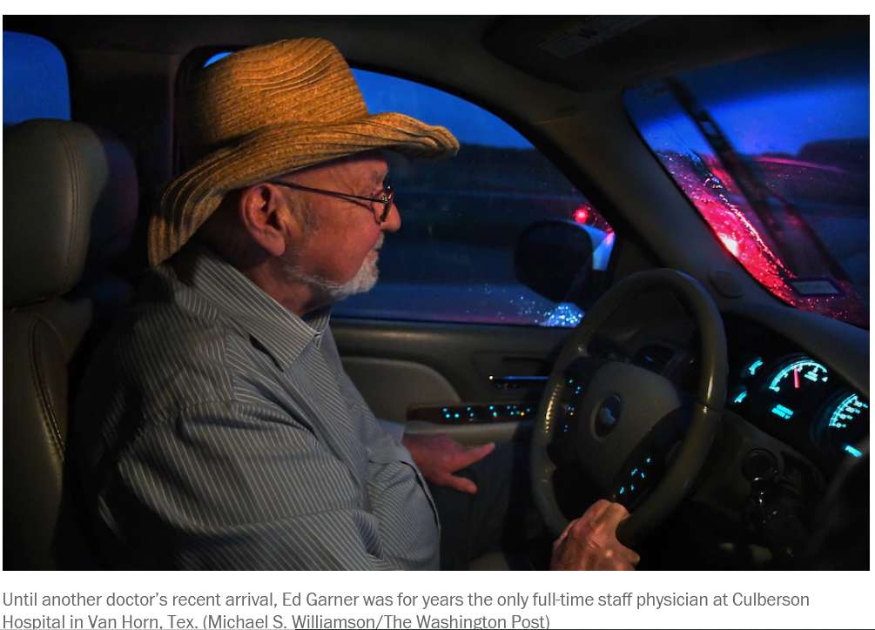
Notes:
More babies are born premature when obstetric services leave rural towns because pre-natal care is no longer available

Slide 18
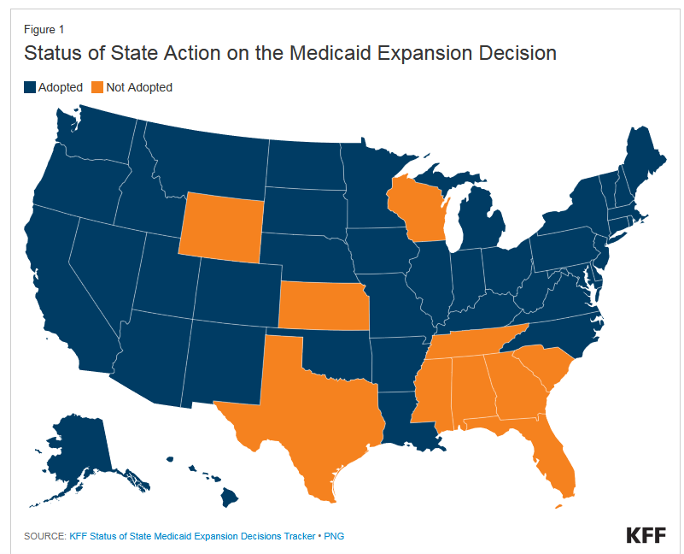
Why are rural hospitals closing?
Video
Shrinking rural populations
Rural residents are older, sicker, and poorer
Aging hospital facilities
Large number of uninsured
Medicaid coverage gap - if a state did not adopt Medicaid expansion, only the very poor qualify for Medicaid, leaving many people unable to afford insurance or pay for health care
Financially unrealistic for hospitals that operate on a for profit model when many patients can’t pay
Notes:
https://www.kff.org/medicaid/issue-brief/how-many-uninsured-are-in-the-coverage-gap-and-how-many-could-be-eligible-if-all-states-adopted-the-medicaid-expansion/
While millions of people have gained coverage through the expansion of Medicaid under the Affordable Care Act (ACA), state decisions not to implement the expansion leave many without an affordable coverage option. Under the ACA, Medicaid eligibility was to be extended to nearly all low-income individuals with incomes at or below 138 percent of poverty ($17,236 for an individual in 2019). This expansion fills in historical gaps in Medicaid eligibility for adults and was envisioned as the vehicle for extending insurance coverage to low-income individuals, with premium tax credits for marketplace coverage serving as the vehicle for covering people with moderate incomes. While the Medicaid expansion was intended to be national, the June 2012 Supreme Court ruling essentially made it optional for states.
In states that do not expand Medicaid, many adults, including all childless adults, fall into a “coverage gap” of having incomes above Medicaid eligibility limits but below the lower limit for Marketplace premium tax.

Slide 19
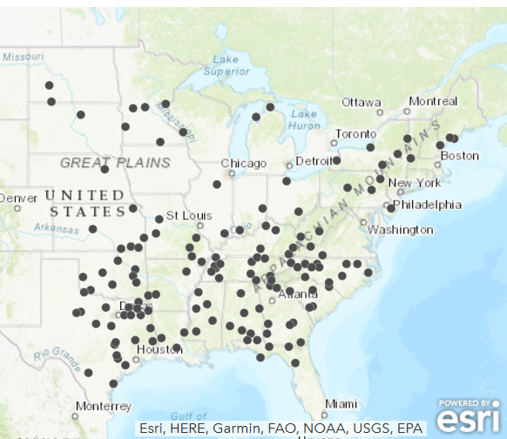
Rural hospital closures
Notes:
Kentucky had fewer hospitals closures because the state government voted to extend Medicaid

Slide 20
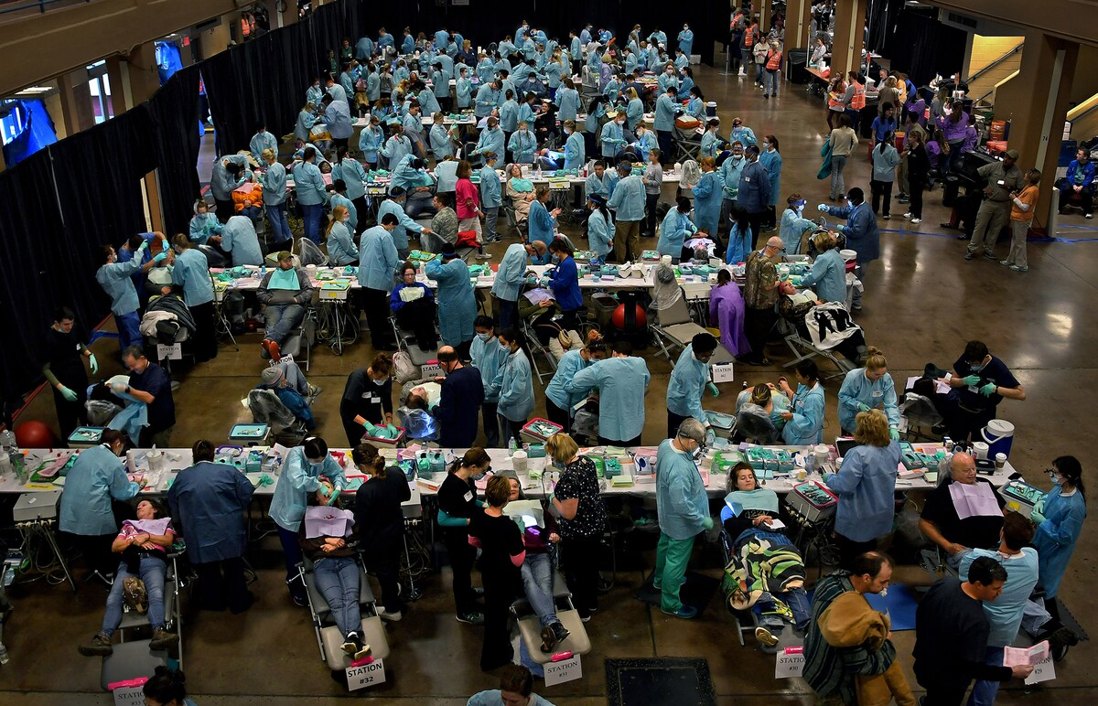
Health care shortage areas
Tennessee has recently lost 14% of its rural physicians and 18% of its rural hospitals, leaving 2.5 million residents with insufficient access to medical care.
A record 50 million rural Americans live in "health care shortage areas," where the number of hospitals, family doctors, surgeons and paramedics has declined to 20-year lows.
Notes:
Because of hospital closures in TN, many counties can be several hundred miles away from the nearest hospital. Even dentists are hard to get to. A free dental and health clinic drew crowds in Knoxville, TN. Many had drove hours to get there. https://www.washingtonpost.com/national/the-clinic-of-last-resort/2019/06/22/2833c8a0-92cc-11e9-aadb-74e6b2b46f6a_story.html
https://www.nytimes.com/2018/07/17/us/hospital-closing-missouri-pregnant.html

