Slide 1
Terms
The Great Gatsby Curve
exchange value vs use value
surplus labor and surplus value
value chain
wage theft
types of shop, right-to-work state
industrial lockout
labor slowdown
base and superstructure
structural inequality
trickle-down economics
Taylorism
Weberian social stratification

Slide 2
The Great Gatsby Curve
This curve shows how hard it is for children to overcome their parents' income level.
The US has a high concentration of wealth in a few people and our society does not have much income mobility
Notes:
The Great Gatsby is an American novel written by F. Scott Fitzgerald. It portrays the lives of the very wealthy in the 1920s. It’s use here is to convey that American society today is more unequal, and less mobile than many other countries in the world.
https://www.brookings.edu/blog/social-mobility-memos/2015/05/19/the-great-utility-of-the-great-gatsby-curve/

Slide 3
Exchange value versus use value
Use value: value derived solely from the uses to which a commodity or service can actually be put, and the human needs it fulfills.
Exchange value: value in a market for this commodity or service that arises due to a third factor, typically money.
Exchange value is abstracted from its use value by money. So instead of labor and use defining value, exchange in the marketplace becomes the marker for value.
In this way, the work (labor) that goes into a commodity or service becomes hidden.
Thus the more labor it takes to produce a product does not mean it has more value for those who made it. Value is directed toward those who control the means of production and who sell or exchange the product or service.

Slide 4
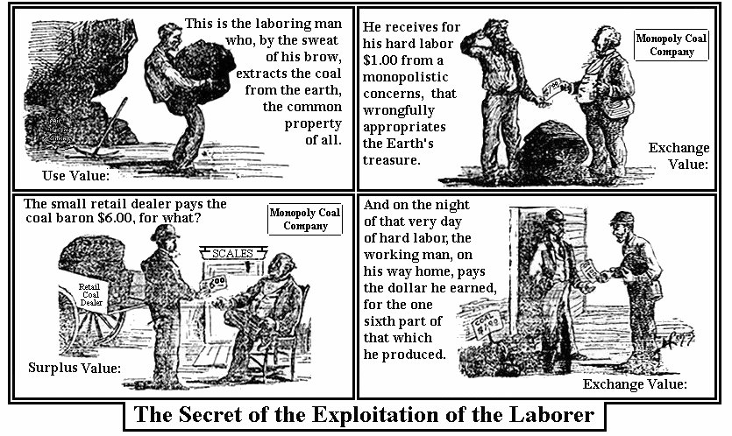
Surplus labor and surplus value
Labor that produces a value beyond that which is needed for the livelihood of the worker or workers who perform it.
Workers may be paid less than the value their labor has added to the goods and services.
This surplus value, as produced through surplus labor, may not be equitably redistributed to the workers

Slide 5
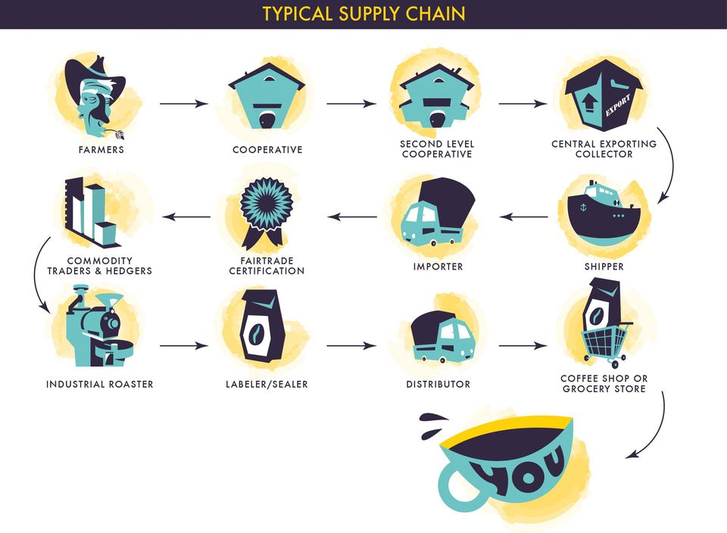
Value chains
Chain of production that reveals how value is transferred.
Downstream companies capture surplus labor upstream in a chain.
They benefit from this added value
Value downstream does not always move back upstream to where this surplus labor was taken
Fair trade certification systems provide means to insure that added value is passed back up the chain to the workers
Notes:
The profits from selling the coffee to the consumer may not necessarily filter back down to the farmer. Their coffee beans have been given greater value, yet their role in the generation of this value can be hidden or ignored by the way in which the commodity chain is assembled and functioned
Global value chains deepen the exploitation of labor by capital and the geographical transfer of value from poor to wealthier nations

Slide 6
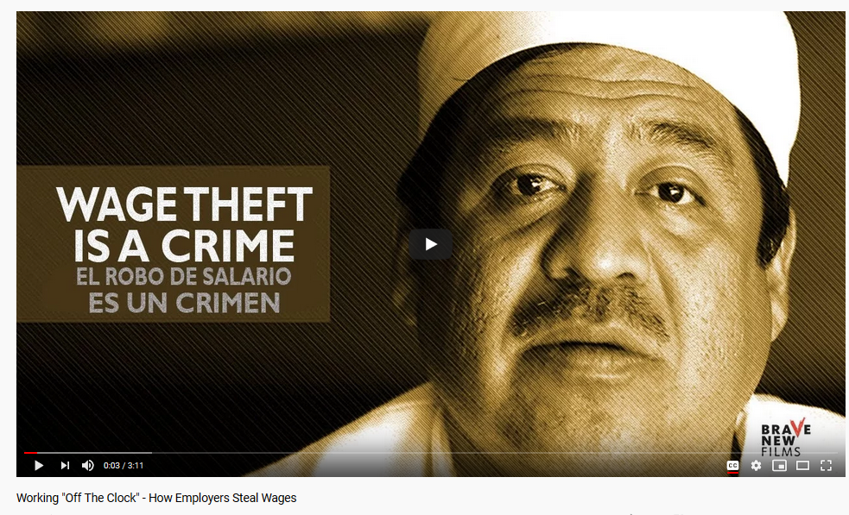
Wage theft
Wage theft is a method of cutting the costs of production.
It is a strategy of increasing profitability by squeezing more unpaid labor from workers who are compelled to work for low wages.
Can be achieved through a low hourly wage, shorting the worker hours on their paycheck, or not paying overtime
This is common among those who have little power to address workplace conditions

Slide 7
Shops
Terms used to describe status of union membership and collective negotiation in the workplace
Closed shop - a company that only employs union members and requires them to secure and maintain union membership as a condition of employment.
Union shop - a company that doesn’t require employees to join a union in order to be hired, but they must join within 30 days of employment.
Open shop - a company that may have a union, but hires both union and non-union employees, and union membership is not a requirement for continued employment.
Right-to-work - state laws ban companies from demanding that their employees pay union dues or fees as a condition of employment.
Notes:
https://law.jrank.org/pages/22749/Labor-Labor-Practices-Closed-Shop-Union-Shop-Agency-Shop-Open-Shop.html
Agency shop - a company that has a union, but hires both union and non-union employees, and union membership is not a requirement for continued employment; however, non-union employees have to pay a fee to cover collective bargaining costs.

Slide 8
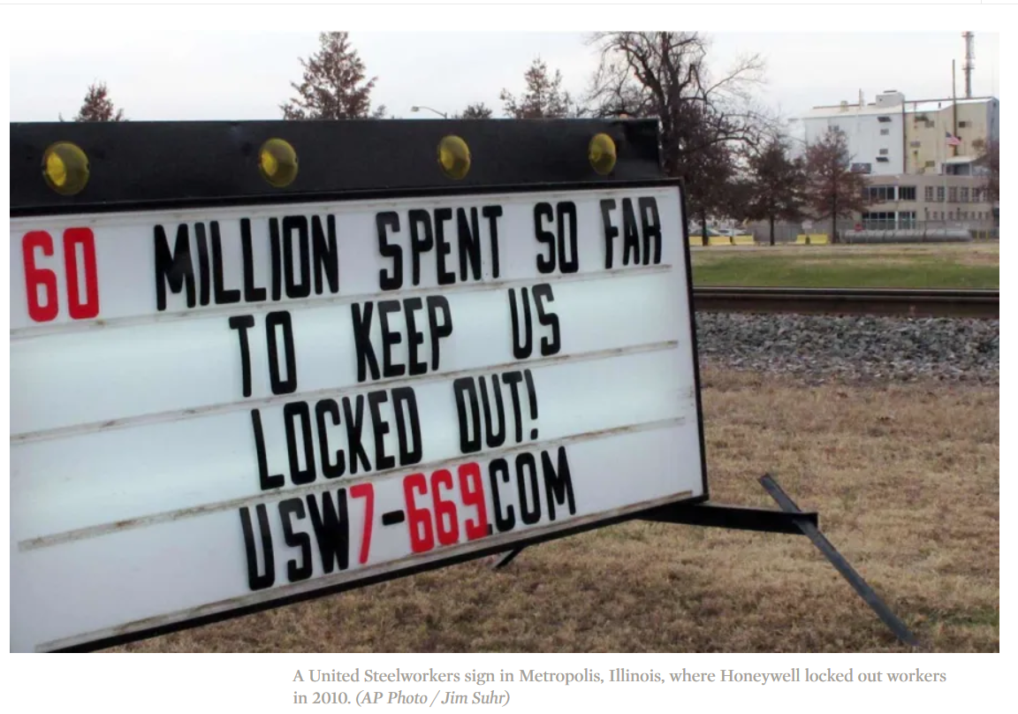
Industrial lockout
The lockout is a work stoppage initiated by the employer
The boss applies pressure to workers in a labor dispute by suspending operations as well as pay.
Notes:
https://inthesetimes.com/working/entry/18371/steel_workers_fight_back_against_corporate_lockouts_and_exploitation

Slide 9
Labor slowdown
A slowdown is an industrial action in which employees perform their duties but seek to reduce productivity or efficiency in their performance of these duties.
A slowdown may be used as either a prelude or an alternative to a strike, as it is seen as less disruptive as well as less risky and costly for workers and their union.
Striking workers usually go unpaid and risk being replaced, so a slowdown is seen as a way to put pressure on management while avoiding these outcomes
Notes:
Other times slowdowns are accompanied by intentional sabotage on the part of workers to provide further disruption.

Slide 10
Economic base and ideological superstructure
Society consists of two parts: the economic base and ideological superstructure.
The base comprises the forces and relations of production (e.g. employer–employee work conditions, the divisions of labor, and property relations) into which people enter to produce the necessities and amenities of life.
The base determines the superstructure which includes the culture, institutions, political power structures
The relation of the two parts is not unidirectional – superstructure also influences the base

Slide 11
Structural inequality
Inequality is structural when policies keep some groups from obtaining the resources to better their lives. It prevents those who are discriminated against from realizing the same economic conditions as others.
This inequality arises from an entrenched system of privilege created by institutions within an economy. These institutions include the law, business practices, and government policies. They also include education, health care.
Structural inequality differs from the individual forms of inequality. That's where racism, sexism, and the like are exhibited by individual behavior.
Many people think that all inequality is due to personal biases that can be overcome individually. However, structural inequality holds that there are larger more entrenched structures that are not embedded in any one individual.
Notes:
http://blogs.reuters.com/great-debate/2014/02/03/the-other-inequality-is-structural/
https://www.thebalance.com/structural-inequality-facts-types-causes-solution-4174727

Slide 12
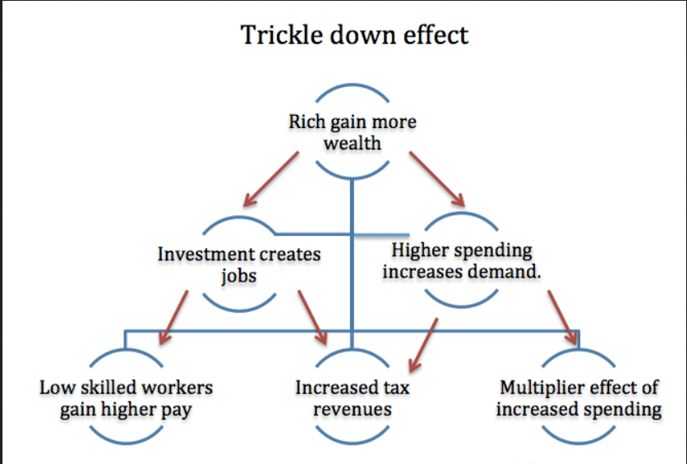
Trickle-down economics
Term used to summarize how tax cuts on higher incomes and on corporations and businesses will stimulate economic growth and this benefit will trickle down to the less wealthy
Notes:
https://knowledge.wharton.upenn.edu/article/trickle-economics-flood-drip/

Slide 13
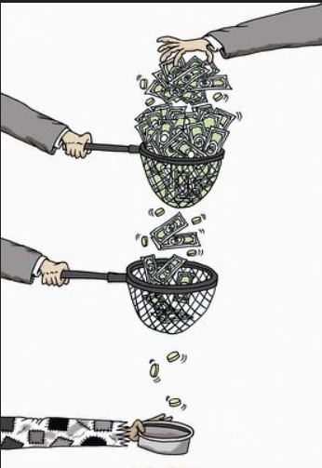

Slide 14
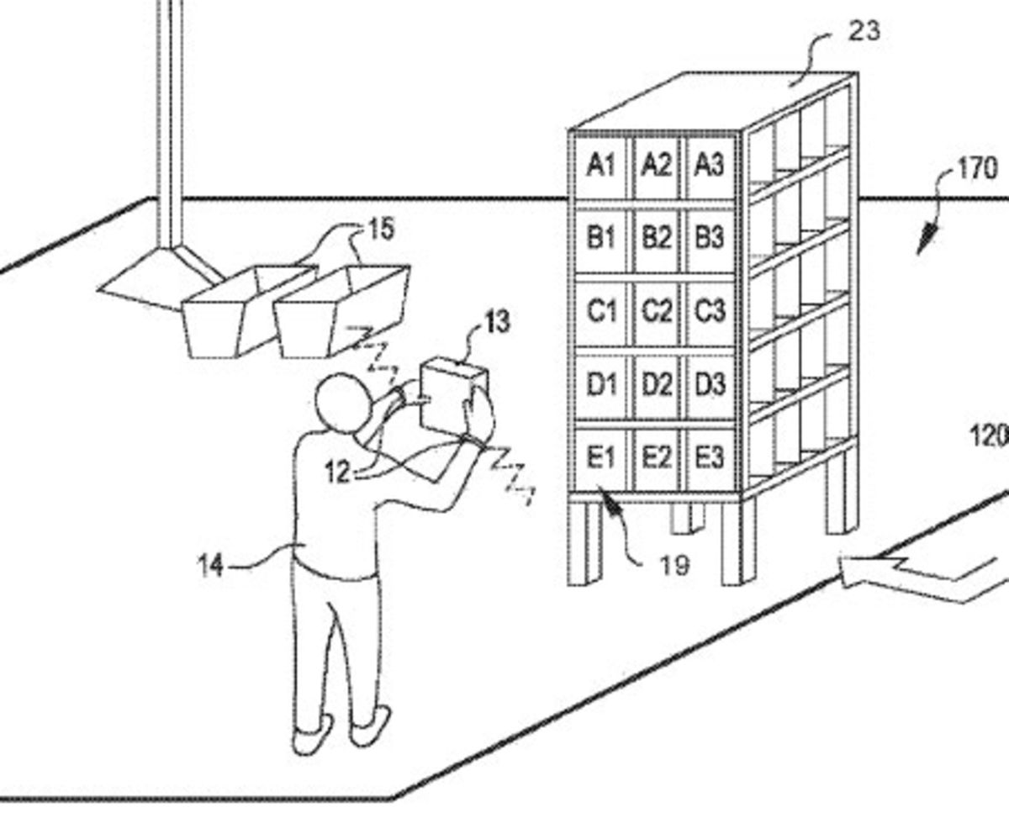
Taylorism
A factory management system developed in the late 19th century to increase efficiency by evaluating every step in a manufacturing process and breaking down production into specialized repetitive tasks
Notes:
https://www.jacobinmag.com/2018/02/amazon-wristband-surveillance-scientific-management
https://www.businessinsider.com/amazon-employees-describe-peak-2019-2

Slide 15
Weberian social stratification
Hierarchical stratification produced by economics (wealth, ownership and assets) but also:
Prestige: education, occupation, fame, reputation
Power: ability to achieve goals

