Slide 1
Grain Safety Training
Beam Institute Employees
Aug. 19, 2021
Sam McNeill, PE
Extension Agricultural Engineer
Biosystems & Ag. Engineering
UKREC – Princeton, KY
270-365-7541 x 21326
sam.mcneill@uky.edu
www.uky.edu/bae

Slide 2
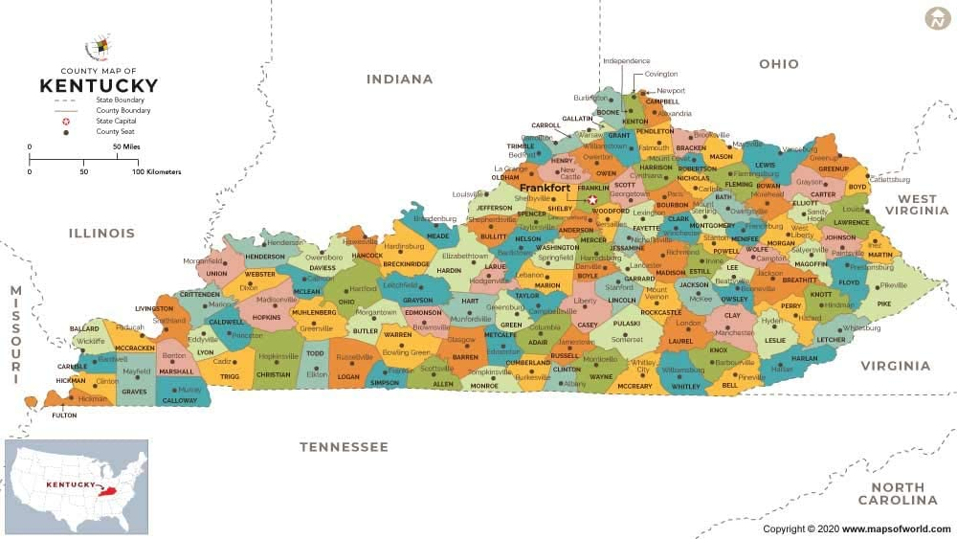
UK @ Princeton, KY

Slide 3
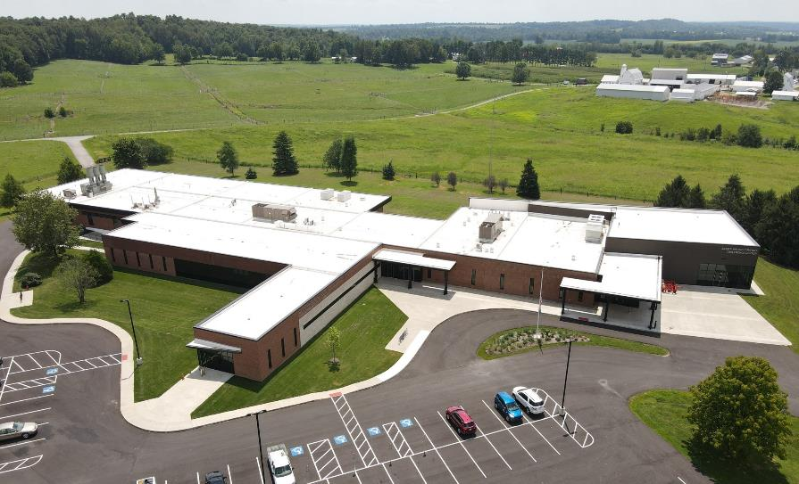
UKREC @ Princeton, KY

Slide 4
Grain Handling Safety –
What Are the Risks?
Grain dust explosions
Dust exposure / pesticide applications / fumigation
Back injuries when lifting objects improperly
Tripping hazards from wet surfaces/obstacles
Climbing/falling hazards from ladders
Electrical shock when working on wiring
Working in a confined space
Suffocation potential in bulk grain
Lost time and wages and death
Notes:
Grain Handling Safety – What are the Risks? / Topics of Concern
Back injuries can result from improper lifting technique when moving grain bags or grain handling equipment.
Tripping hazards and/or falls can result from wet walking surfaces or obstacles left in walkways, or when climbing ladders.

Slide 5
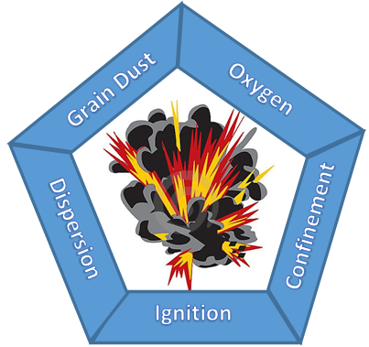
What Causes Grain Dust Explosions?
Fuel source
Oxygen
Heat source
Confinement
Dispersion
Source: engineering.purdue.edu/FFP/research/dust-explosions
Notes:
5
This figure shows the 5 elements that are needed for a grain dust explosion to occur (the GDE Pentagon from Purdue Univ.) Eliminating one factor could avoid a major dust explosion.

Slide 6
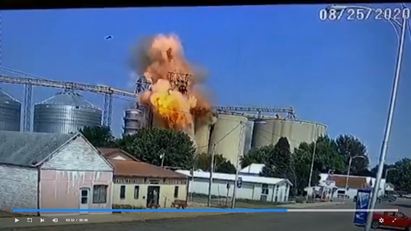
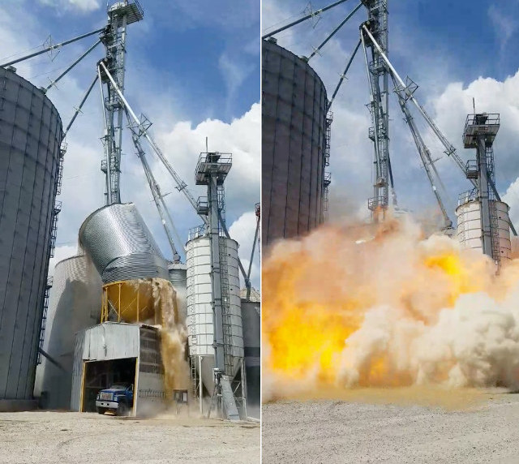
Examples of U.S. Grain Dust Explosions
Indiana farm in 2017
Iowa elevator in 2020
Notes:
6
According to Purdue Univ. reports, there were 8 grain dust explosions in the U.S. in 2020, resulting in NO fatalities and 9 injuries.
In 2017, there were 7 grain dust explosions, 5 fatalities and 12 injuries.
The 10-year average for injuries is 8.1 and 1.7 for fatalities.
In 2020, the grain types identified in the explosions included two cases of corn, two wheat, two mixed feed, one rice, and one dietary fiber.
In 2020, dust explosions occurred in 8 different states, one each in Arkansas, Illinois, Iowa, Kansas, Ohio, Missouri, Nebraska, and Texas. Four of these explosions occurred in a grain elevator, and the remaining four in a feed mill, corn mill, rice mill, and grain processor for dietary fiber.
In 2017, dust explosions occurred in 7 different states, 2 in Wisconsin and one each in Indiana, Iowa, Minnesota, Nebraska, and Oregon. Five of these explosions occurred in a grain elevator, and one each in a grain mill and a pet food plant.

Slide 7
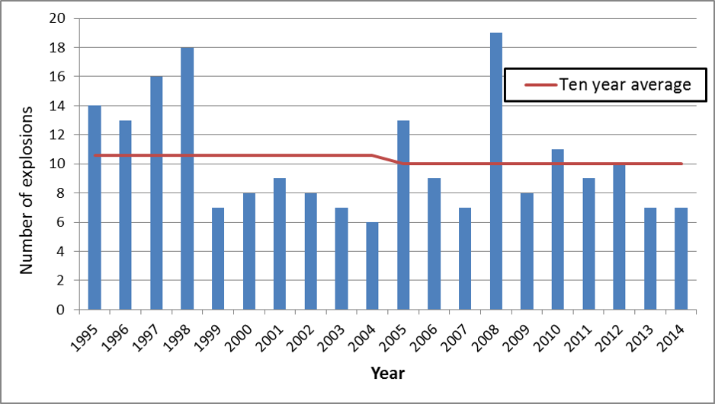
US Grain Dust Explosions from 1995 – 2014
Notes:
7
Grain dust explosion prevention: Grain dust explosions are a hazard faced by any industry handling grain-based materials. Research ay Purdue Univ. has shown that grain dust explosions have been occurring at a constant rate in the US over the past decade. They conduct hazard awareness and safety training amongst workers in grain elevators, feed mills, and grain processors. DE in the US over the 20-yr period shown ranges from 6 (in 2004) to 19 per year (in 2008). The 20-yr average has been a little over 10/yr.
Source: https://engineering.purdue.edu/FFP/research/dust-explosions

Slide 8
Ag. Dust Explosions – Leading States
Notes:
8
U.S. Agricultural dust explosions –leading states from 1958 to 2020.

Slide 9
Probable Ignition Sources
Notes:
9
Probable ignition sources for grain dust explosions reported in 2006 to 2014.

Slide 10
Non-fatal Injuries & Illnesses in 2019
Source: US Bureau of Labor Statistics (bls.gov)
Notes:
10
Number of nonfatal occupational injuries and illnesses involving days away from work by industry and age of worker, private industry in 2019.
Source: https://www.bls.gov/iif/soii-data.htm#dafw

Slide 11
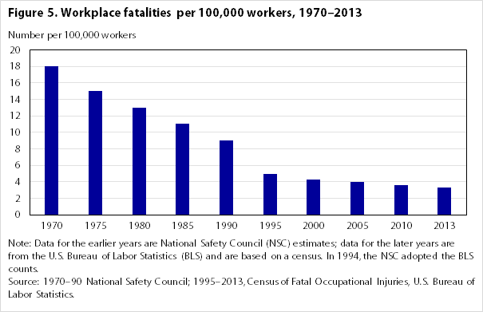
US Fatalities from 1970 – 2013
Notes:
11
U.S. fatalities for all occupations/causes from 1970 – 2013. Number per 100 k workers (ag, construction, mining, etc.). Source: https://www.bls.gov/opub/mlr/2015/article/labor-law-highlights-1915-2015.htm

Slide 12
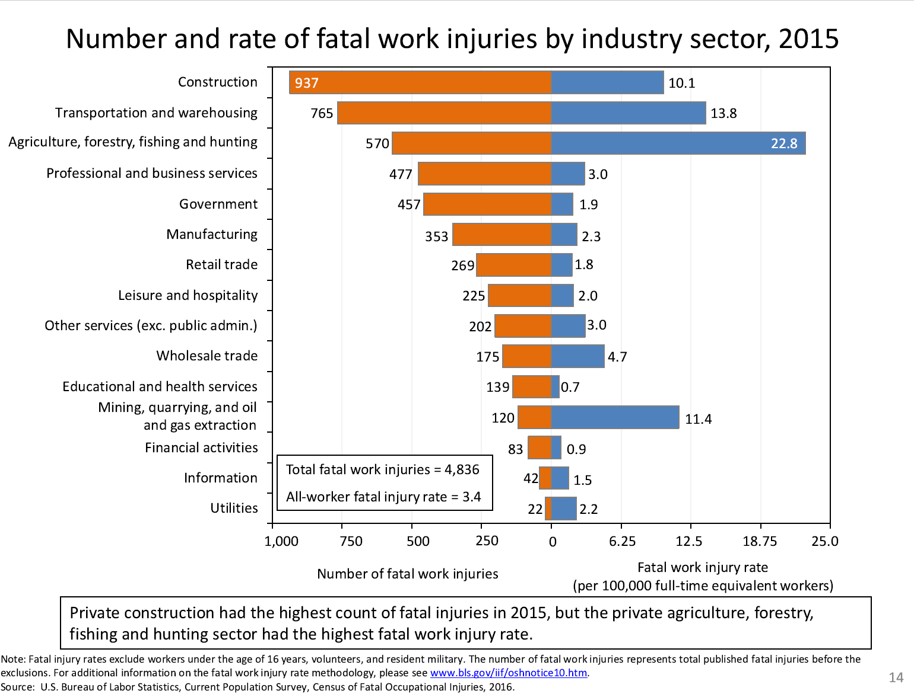
Non-fatal Injuries & Illnesses in 2019
Source: US Bureau of Labor Statistics (bls.gov)
Notes:
12
Number and rate of fatal occupational injuries by industry sector in 2015.
Source: https://www.bls.gov/iif/oshnotice10.htm.

Slide 13

Source: US Bureau of Labor Statistics (bls.gov)
Notes:
13
Number of fatal occupational injuries by state in 2015.
Source: https://www.bls.gov/iif/oshnotice10.htm.

Slide 14

Kentucky cases
2018 | 83
2019 | 78
Source: US Bureau of Labor Statistics (bls.gov)
Notes:
14
Number of fatal occupational injuries by state in 2019. (78 in KY in 2019 and 83 in 2018).
Source: https://www.bls.gov/iif/oshnotice10.htm.

Slide 15
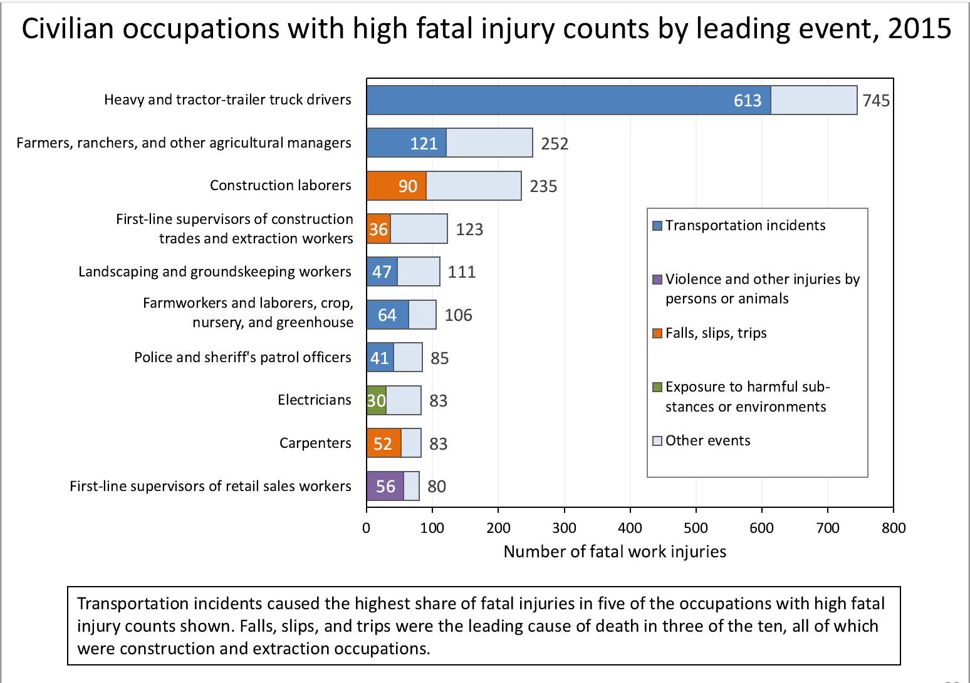
Source: US Bureau of Labor Statistics (bls.gov)
Notes:
15
Number and rate of fatal occupational injuries by industry sector in 2015.
Source: https://www.bls.gov/iif/oshnotice10.htm.

Slide 16
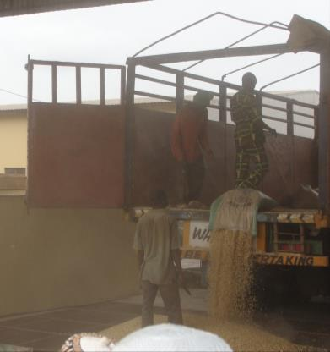
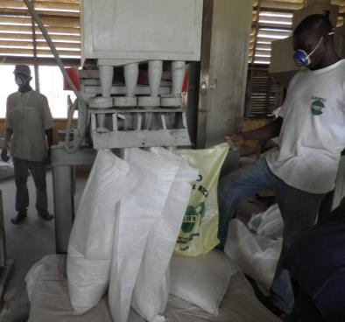
Grain Dust in Working Areas
Receiving bagged grain
Rice milling house

Slide 17
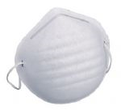
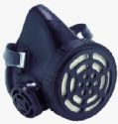
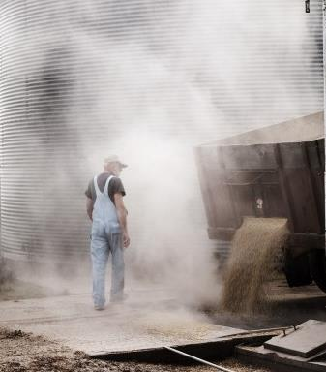



Personal Protection Equipment
Grain Dust
Grain dust
  Lung protection
  Eye protection
  Ear protection
Notes:
A single strap dust mask provided only minimal lung protection.
Use a 2 strap mask instead for a better fit/protection.

Slide 18
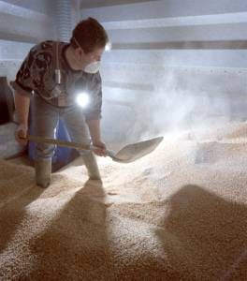
Protect Lungs from Grain Dust
Disposable masks
(N-95) offer minimal protection
Silicone or rubber respirators offer better protection
A self-contained breathing apparatus (SCBA) is required for fumigation

Slide 19
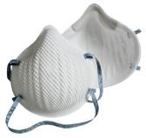


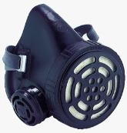
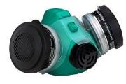
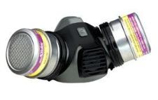
PPE Options for Lung Protection
Masks with two straps fit better ($2-4)
Multi-purpose single filter mask for dust, mist and fumes
Multi-purpose twin filter masks provide more surface area (~$30-70)
Notes:
Dust masks with two straps provide better fit.
Reusable single filter mask for dust/mist/fumes ($21 + $4 /7 filters).
Low cost Multi-Purpose Respirator ($33) is reusable unit ideally suited for dusts, fumes, mists, pesticides and paint spray. The respirator features dual, replaceable filters ($4.5) and cartridges ($14) and is designed for comfort and proper sealing.

Slide 20


Putting on a Respirator
Step 1
Step 2
Notes:
Best way to put on a dust mask:
Hold the respirator in your hand with the nosepiece toward your fingertips.
Position the mask over your mouth and nose.

Slide 21


Putting on a Respirator
Step 3
Step 4
Notes:
Best way to put on a dust mask:
Hold the respirator in your hand with the nosepiece toward your fingertips.
Position the mask over your mouth and nose.
Pull the top strap over your head and place above ears.
Pull the bottom strap over your head and place below ears.

Slide 22


Putting on a Respirator
Step 5
Step 6
Notes:
Best way to put on a dust mask:
Hold the respirator in your hand with the nosepiece toward your fingertips.
Position the mask over your mouth and nose.
Pull the top strap over your head and place above ears.
Pull the bottom strap over your head and place below ears.
Shape metal nosepiece to nose.
Adjust straps until fit is comfortable.

Slide 23


Putting on a Half-mask
Step 1
Step 2
Notes:
Best way to put on a respirator:
Hold the respirator under your chin with the nosepiece facing up.
Place the top strap on the top of your head.

Slide 24


Putting on a Half-mask
Step 3
Step 4
Notes:
Best way to put on a respirator:
Hold the respirator in your hand with the nosepiece toward your fingertips.
Position the mask over your mouth and nose.
Attach bottom straps behind neck.
Adjust face piece and straps for comfortable fit.
Full & Half Face are made with Silicone or Hycar Rubber, Hycar about 20 to 30% more expensive. Rubber is stronger that Silicone (25 MPa vs 5 MPa) but, Silicone resists weather much better and can stand higher temperatures.

Slide 25
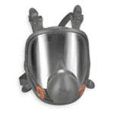

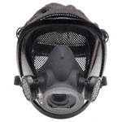
Full Face Respirators
Cover entire face to provide breathable air and protect eyes from irritation
Filters priced separately/match hazard
Prices range from $200 to $500 + filters
Notes:
These full-face respirators are made by Moldex. Full-face reusable respirators are NIOSH-rated cover the entire face to provide breathable air and protect eyes from irritation caused by gases, vapors, and airborne particles. Cartridges can be changed when they become dirty or when specific hazards are encountered. Filters and cartridges are compatible with a specific brand and mask model. Prices range between $200 - $500.

Slide 26

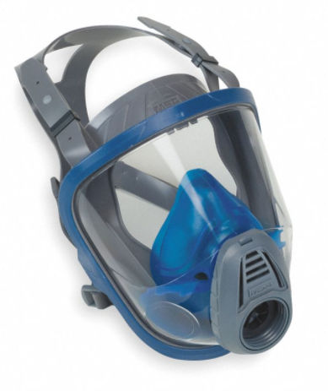
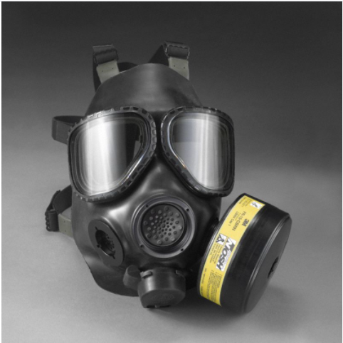
Full Face Gas Masks (CBRN)
Cover entire face to protect workers from chemical, biological, radiological and nuclear hazards
Prices range from $250 - $500 + canisters ($450)
Notes:
These full-face gas masks (made by Honeywell North) cover the mouth, nose, and eyes to protect first responders from CBRN (chemical, biological, radiological, nuclear) hazards. They use a replaceable canister to filter one or more hazards from the air. The lens and seal prevent hazards from reaching the face and eyes.

Slide 27

Multi-gas Detectors
Hand-held, battery operated
Measures oxygen, carbon monoxide, methane, hydrogen and hydrogen
Prices range from $700 to $1000
Notes:
These full-face respirators are made by Moldex. Full-face reusable respirators are NIOSH-rated cover the entire face to provide breathable air and protect eyes from irritation caused by gases, vapors, and airborne particles. Cartridges can be changed when they become dirty or when specific hazards are encountered. Filters and cartridges are compatible with a specific brand and mask model. Prices range between $200 - $500.

Slide 28



Powered Air Purifying Respirators (PAPR)
Intermediate protection
Filters air with or without helmet
Prices range from $700 to $1300 + filters
Notes:
From Gemplers.com

Slide 29
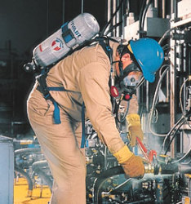
Self Contained Breathing Apparatus
Fumigation requires a Self-Contained Breathing Apparatus (SCBA) for maximum protection
Price ~$2500

Slide 30
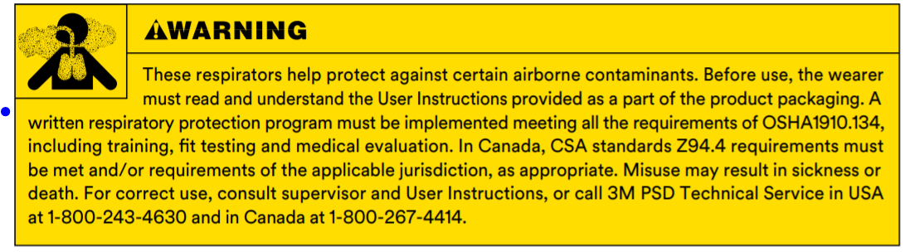
OSHA Requirements for Respirators
Training
Fit test
Medical evaluation

Slide 31
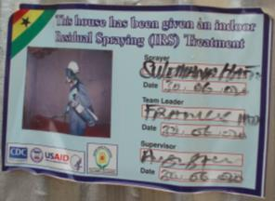

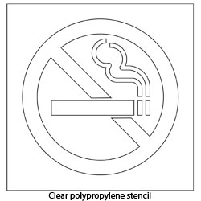
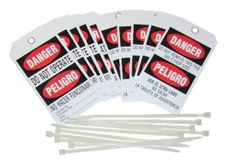
Warning Signs Indicate Application
Lock out / Tag out

Slide 32
Research – example studies
Dust induced lung diseases
Respiratory health status of 3098 Canadian grain workers
Effects of grain dust on lungs prior to and following exposure to dust control
Predictors of respiratory stress in grain workers
Effective of edible oil to control grain dust
Notes:
Universities have conducted research on the effects of grain dust on human lungs.
Selected titles from a Google search on “grain dust control”
Effects of Grain Dust on Lungs Prior to and Following Dust Remediation: A 2008 report from the Journal of Occupational and Environmental Medicine (copyrighted by the American College of Occupational and Environmental Medicine) showed that grain dust control was effective in improving lung function of smokers, former smokers and non-smokers.
Other journals…
Journal of the American Oil Chemists’ Society

Slide 33

Safety Equipment Suppliers
Notes:
Another screen shot of a equipment supplier showing their line of respiratory protection equipment.
Note the current prices range from ~$1 each for dust masks, ~$17 - 35 for half face respirators, $100 – 300 for full face respirators, $700 – 1300 for powered respirators , and $2500 for a SCBA.

Slide 34
Confined Spaces
Definition: Any space with a small entry/exit area that is large enough to work in but not designed for continuous occupancy.
Some examples…
  Grain storage bins/tanks
  Dump pits
  Liquid storage tanks
  Fermentation tanks
Notes:
Refer to OSHA FatalFacts No. 16 – 2018 “Confined Space Entry on a Farm” where a farm worker was overcome by CO2 produced in an 8000 gallon whey tank, passed out and perished before he was able to be rescued.

Slide 35
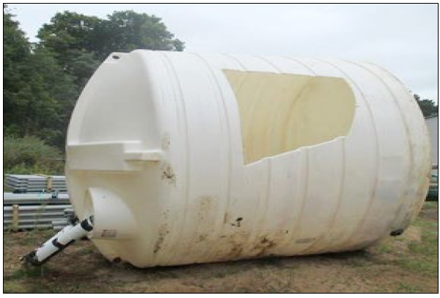
Confined Spaces
Example from a dairy farm…
An 8000 gallon whey tank with a broken ball valve
A worker entered through a 16-in opening
Operator climbed on an adjacent storage bin to monitor progress, but observed that the worker was lying face down inside the tank
Fire department responded, cut a hole in the tank to retrieve the worker who had suffocated
Take home lesson: Be aware of potential hazards and do NOT enter a confined space without a work permit or proper supervision
Notes:
Take home lesson for Beam employees:
Be aware of potential hazards and
Do NOT enter a confined space without a work permit or proper supervision

Slide 36
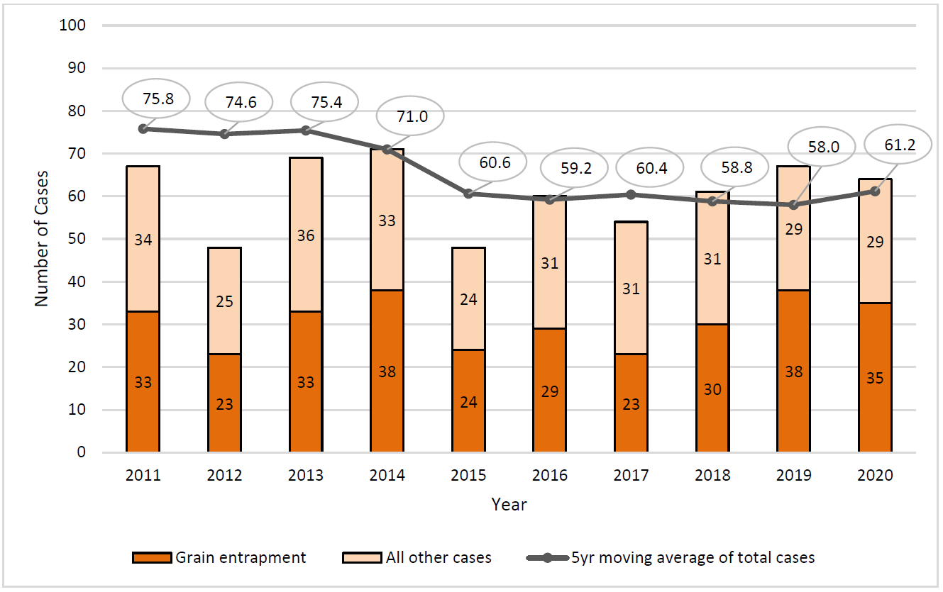
Reported Confined Spaces Incidents
Notes:
36

Slide 37
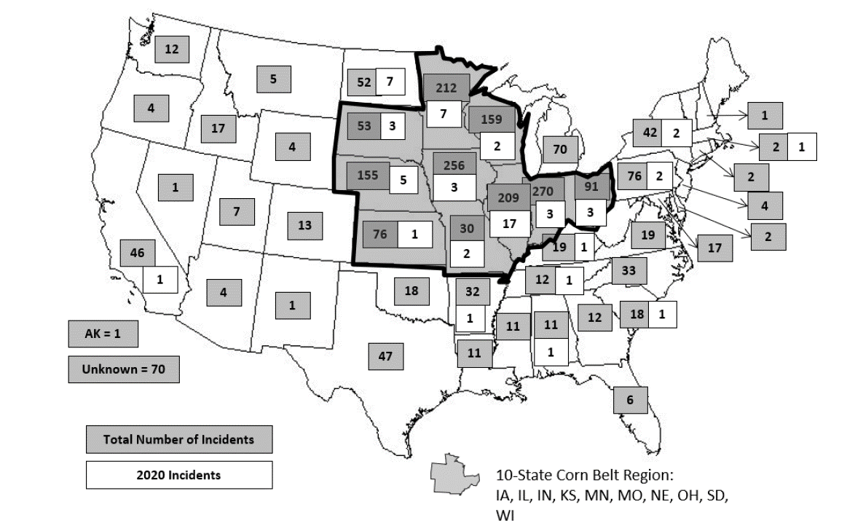
Confined Space Cases (1962 – 2020)
Notes:
37
Geographic distribution of agricultural confined space cases from 1962 - 2020 (n=2181).

Slide 38
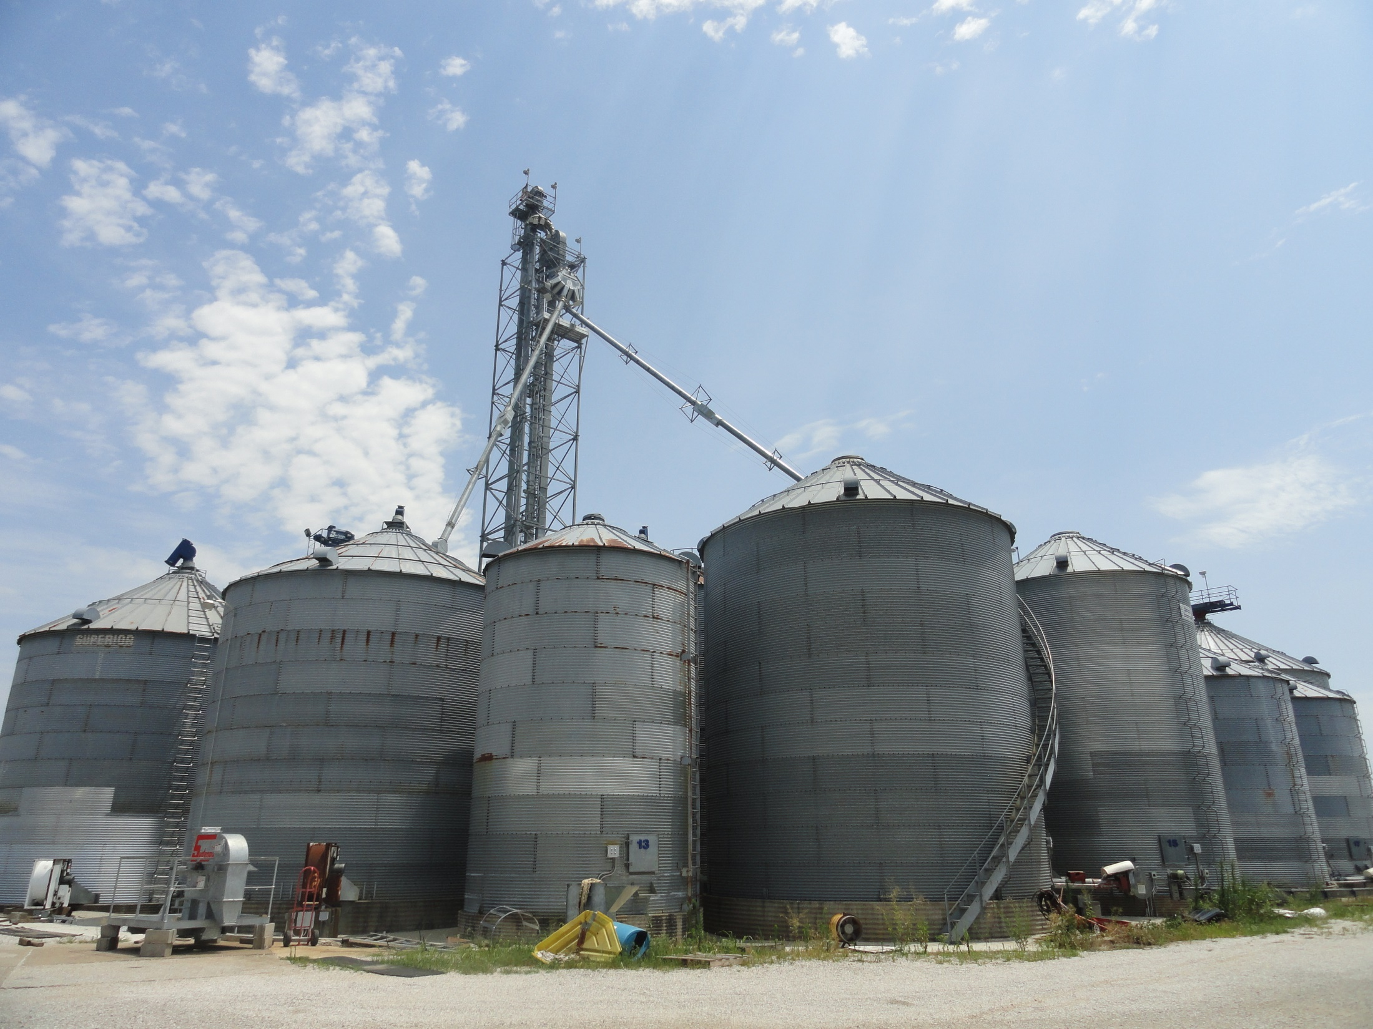
Ladders / Stairs on Grain Bins
Notes:
38
Exterior ladders without cages…most bins in KY.

Slide 39
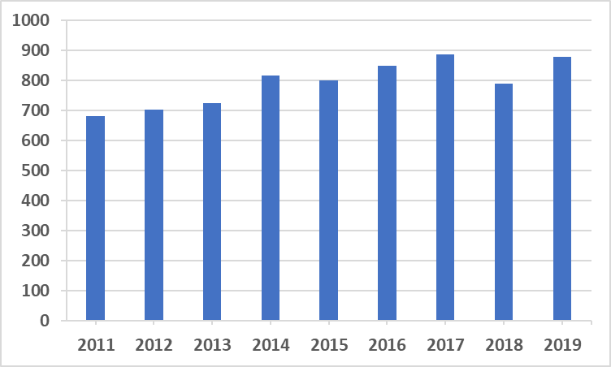
US Fatalities from Slips, Trips and Falls
Source: US Bureau of Labor Statistics (bls.gov)
Notes:
39
Fatalities by detailed event for all occupations (ag, construction, mining, etc.)

Slide 40
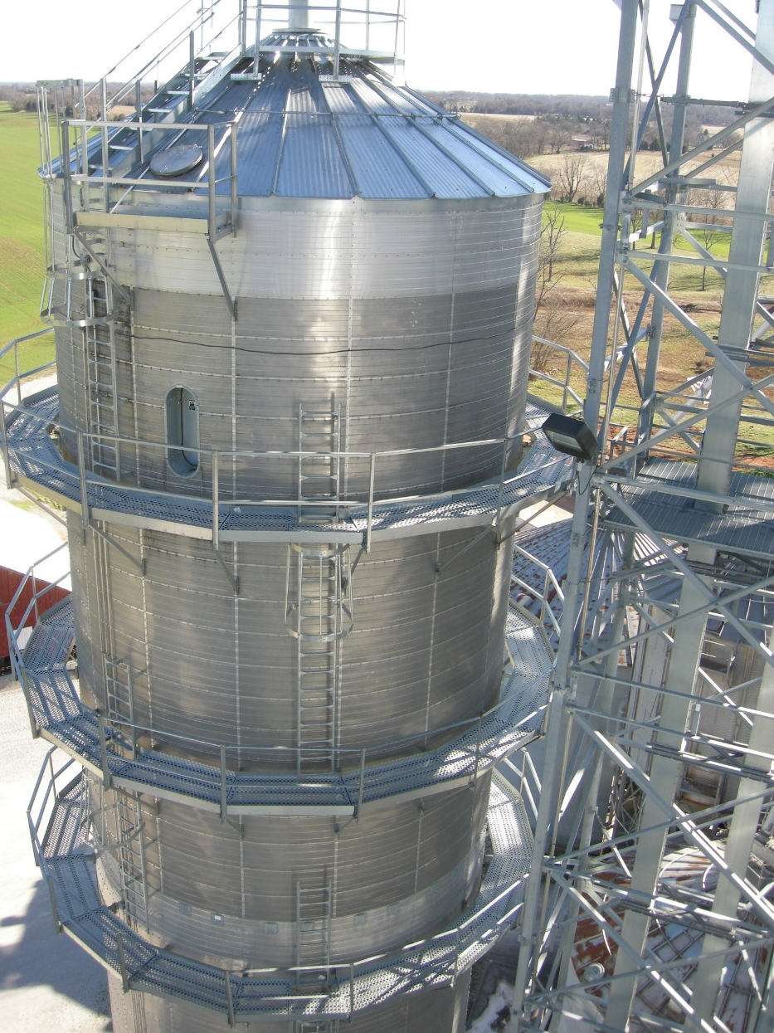

Ladders / Cages on Grain Bins
Notes:
40
Exterior ladders without cages…most bins in KY.

Slide 41
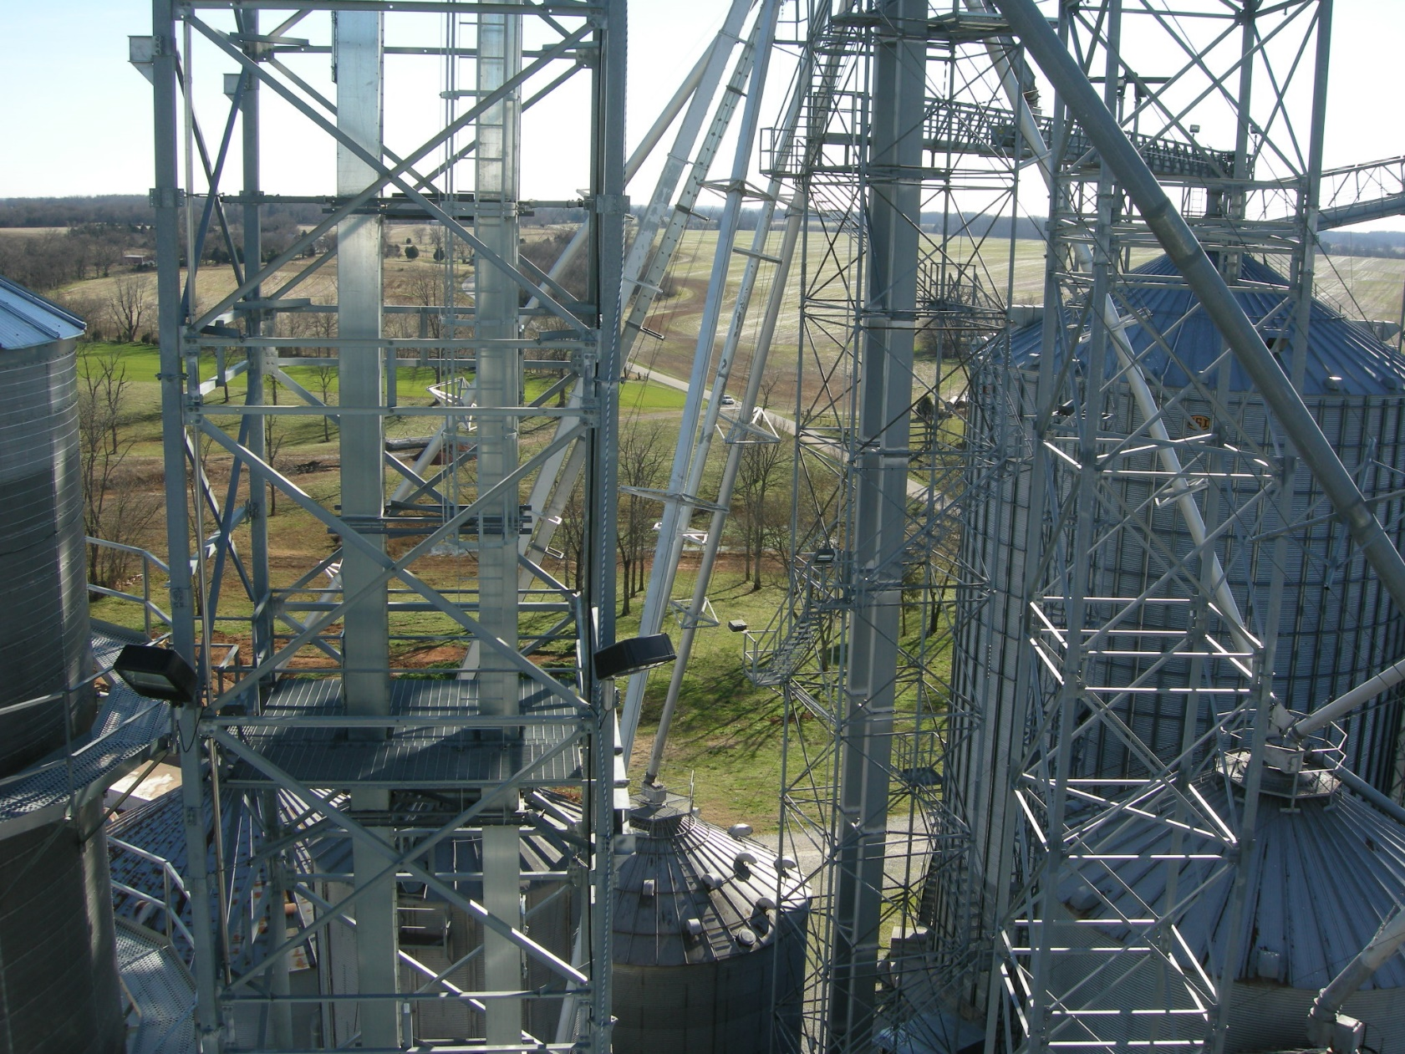
Ladders / Cages on Bucket Elevators
Notes:
41
Exterior ladders without cages…most bins in KY.

Slide 42
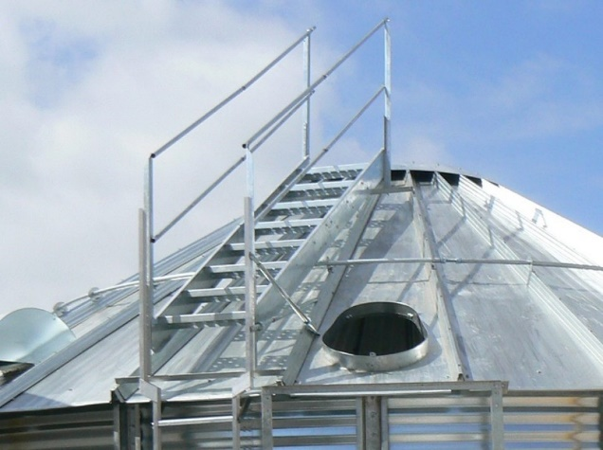
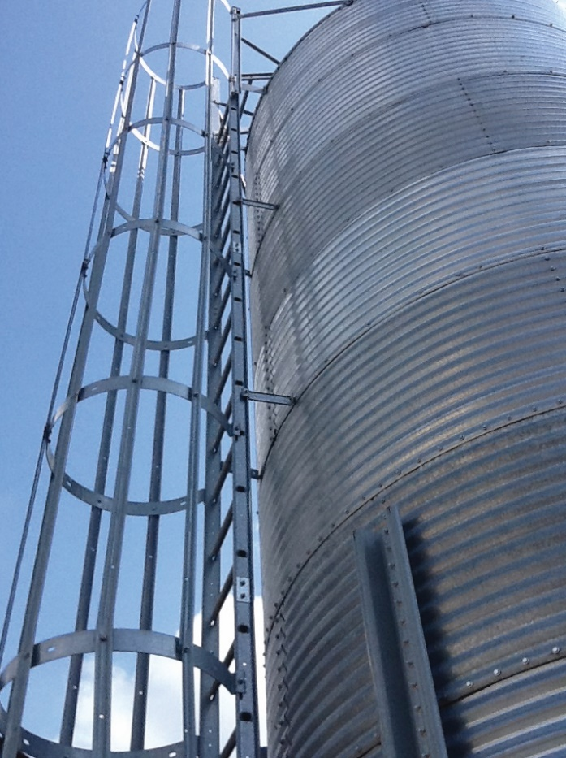
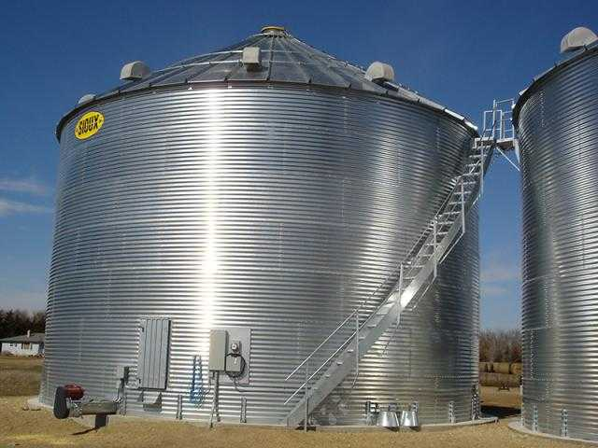
Ladders / Stairs on Grain Bins
Notes:
42
Exterior ladders now have rest stations every 20-ft or so.

Slide 43
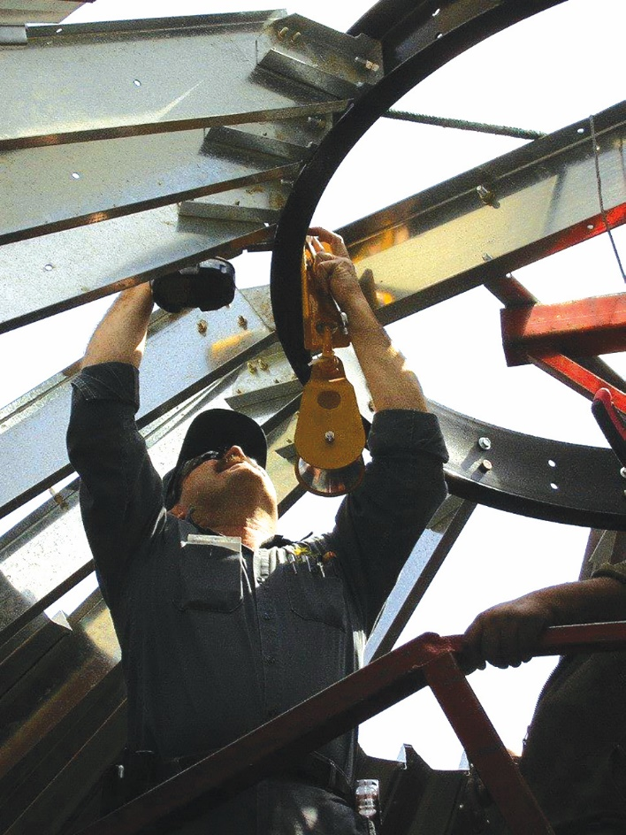
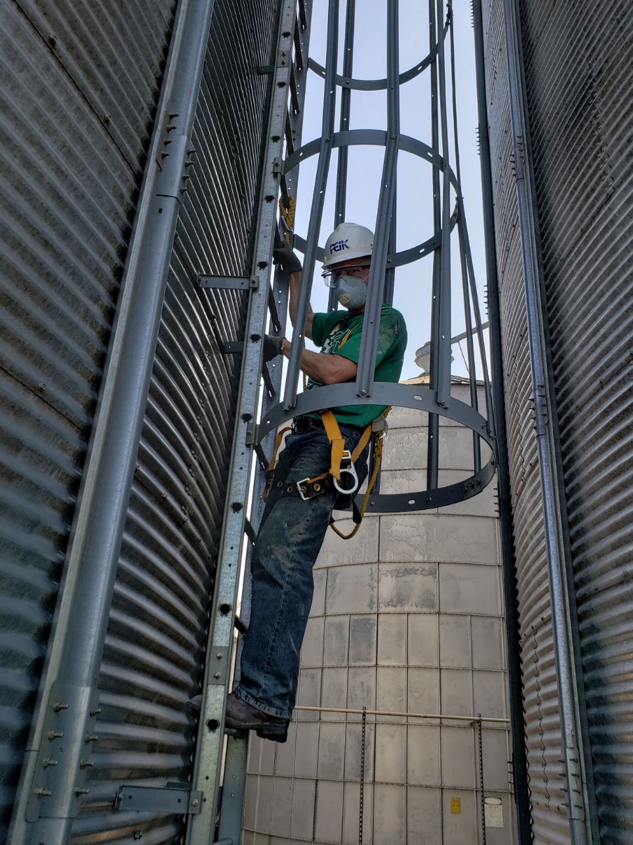
Climbing Harness & Anchor Points
Notes:
43
Exterior ladders now have rest stations every 20-ft or so.

Slide 44
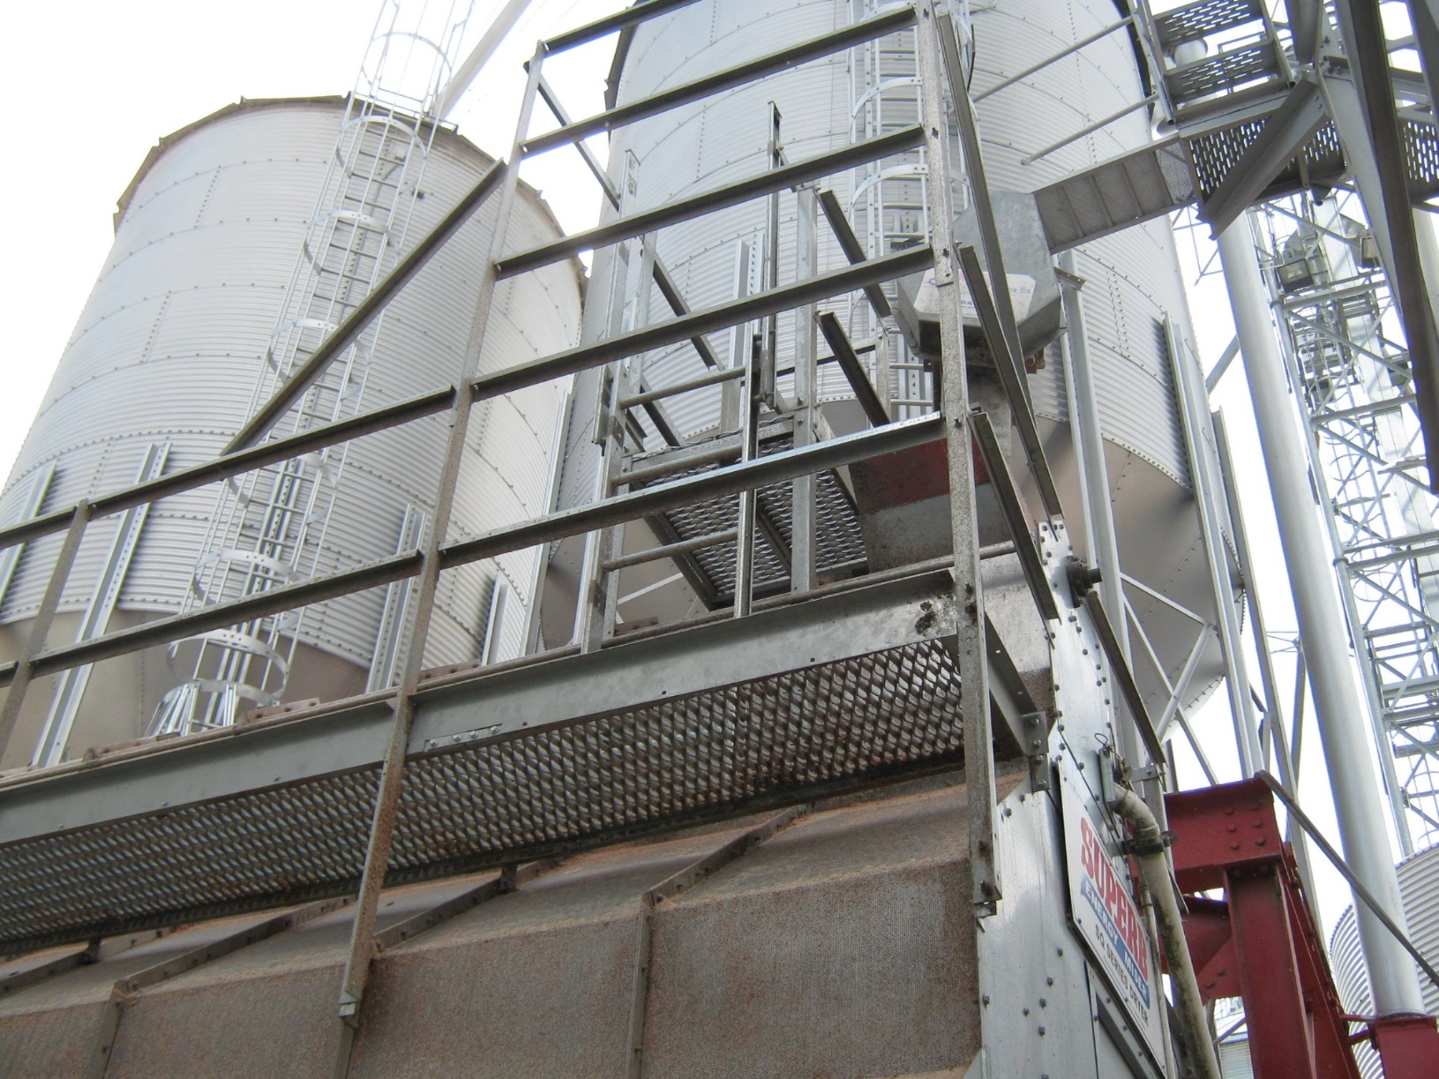
Railing with Grated Floor on Grain Dryer
Notes:
44
Exterior ladders now have rest stations every 20-ft or so.

Slide 45
Safety Equipment for Grain Warehouses
Taken from Natural Resources Institute (nri.org)
First aid kits
Googles, rubber gloves, boots, and overalls
Fire extinguisher(s) (ABC type)
Empty drum (to fill with water/sand for firefighting)
Gas/face masks & filters
Gas detector tubes & sampling line
Phosphine meter

Slide 46

Safety Resources
Universities
National Agricultural Safety Database (nasdonline.org)
US Bureau of Labor Statistics (bls.gov)
Occupational Health & Safety Administration (osha.org )
National Institute of Occupational Safety and Health (cdc.gov/niosh)
Center for Disease Control (cdc.gov)
Notes:
The purpose of this Respirator Selection Logic (RSL) is to provide guidance to respirator program administrators on respirator selection that incorporates the changes necessitated by the revisions to the respirator use and certification regulations and changes in the National Institute for Occupational Safety and Health (NIOSH) policy. This RSL is not intended to be used for selection of respirators for protection against infectious agents or for chemical, biological, radiological or nuclear (CBRN) agents of terrorism. While respirators can provide appropriate protection against these agents, the information necessary to use the selection logic is generally not available for infectious disease or bioterrorism agents (e.g., exposure limits, airborne concentration). Similarly, CBRN terrorism events may involve chemicals that can quickly degrade respirator materials or have extremely low toxic levels that are difficult to measure.

Slide 47

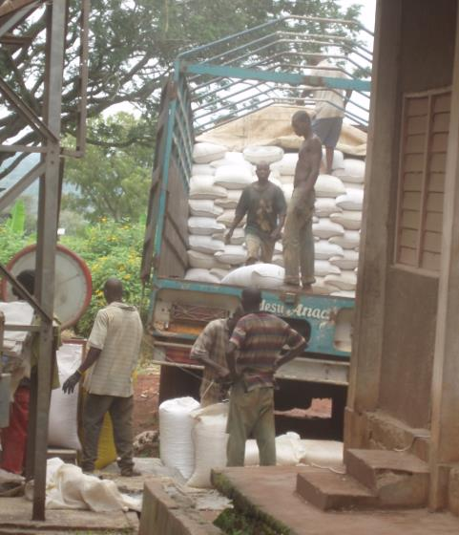
Lifting Heavy Grain Bags

Slide 48

Ready for a Break?!
Notes:
Great Big Canvas©
Construction Workers Resting on Steel Beam Above Manhattan.

Slide 49
Grain Storage Management
GS 101 – Basic relationships
Managing grain in storage
  Sanitation
  Loading
  Aeration
  Monitoring
Safety considerations
Resources
Notes:
Basic relationships
Allowable Storage Time
Biology 101 – insects and mold growth
EMC

Slide 50
GS 101
Factors that impact grain quality
  Moisture content
  Temperature
  Initial Condition (BC & FM)
  Oxygen availability

Slide 51
Allowable Storage Time for Corn
MC | Temperature
% | 40 | 50 | 60 | 70 | 80
16 | 763 | 339 | 151 | 85 | 47
18 | 291 | 130 | 58 | 32 | 18
20 | 144 | 64 | 29 | 16 | 9
22 | 85 | 38 | 17 | 10 | 6
26 | 42 | 19 | 8 | 5 | 3
Time before corn loses ½% in dry matter.
Source: ASABE
Notes:
51

Slide 52
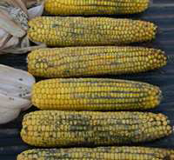
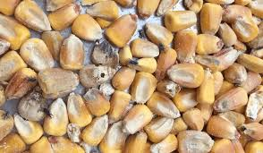
Losses Caused by Insects and Molds
Heating
Weight loss
Decreased germination
Mycotoxins
Price discounts
  Infested - 5¢
  Musty - 10¢
  Sour - 10¢
Notes:
52

Slide 53
Insects Like to be Warm
Temp. range | Effect
< 32 | Death in minutes
40 – 60 | Death in days
66 – 77 | Sub-optimum
82 – 90 | Optimum
95 | Development stops
122 | Death in minutes
Source: P. Fields, USDA 1992

Slide 54
Molds Also Like Moisture
Notes:
Each mold species has its own preference for moisture in the surrounding environment (relative humidity). Molds generally grow faster as moisture increases.

Slide 55
Equilibrium Moisture Conditions for Corn
Notes:
Each mold species has its own preference for moisture in the surrounding environment (relative humidity). Molds generally grow faster as moisture increases.

Slide 56
Safe Storage Conditions for Corn
Winter
Summer

Slide 57
Safe Storage Moisture Contents
Grain | Max. MC, % wb
 | Fall | Spring | Summer
Corn | 15.0 | 14.0 | 13.0
Sorghum | 14.0 | 13.5 | 13.0
Soybeans | 13.0 | 12.5 | 12.0
Wheat | 13.5 | 13.0 | 12.5

Slide 58
Cost of Storage (₵/bu)
Pts. < Market | Corn 15.0 | Wheat 13.5 | Soybeans 13.0
1.0 | 7.1 | 8.0 | 15.8
2.0 | 14.1 | 16.0 | 31.6
3.0 | 21.2 | 23.9 | 47.5
$/bu | 6.00 | 7.00 | 14.00
Notes:
58

Slide 59
Storage Tips to Control Risks
Check grain moisture and temperature going into storage
Minimize broken kernels
Screen grain for mycotoxins
Clean grain prior to binning
Practice S.L.A.M.
Notes:
Knowing the temp & MC indicates how long the grain can be stored without any problems. (AST).
Kernel damage can occur from the combine or rough handling (excessive drops or augers running at less than full capacity). For example, a screw auger running at 700 rpm at ¼ capacity can generate 7x more damage to corn kernels compared to 400 rpm at full capacity.
Mycotoxin screening can be especially useful when selling grain to local livestock producers.
Clean grain will store better that grain with excess BC/FM.
Sanitation, Loading, Aeration and Monitoring are the watch words that summarize good storage management.

Slide 60
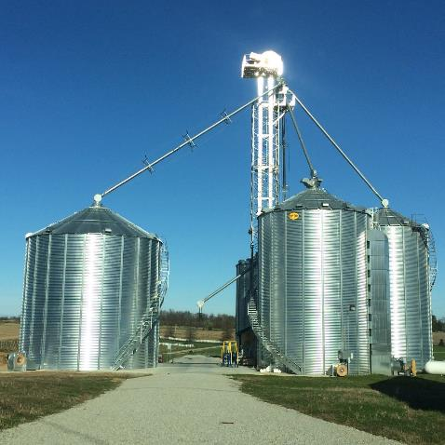
Sanitation
Equipment
Combine(s)
Carts/truck beds
Handling equipment
Dryers
Bins
Notes:
Remove old grain from combines, carts, truck beds, augers and any other equipment used for harvesting, transporting or handling grain. Newer conveyors are designed to be self-cleaning, but older conveyors may require removing cover plates to extract loose grain from the corners of the housing.

Slide 61
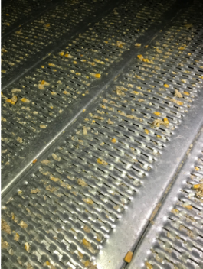

Sanitation + Sealing
Inspect bins
Look for daylight through holes in roof and walls – repair as needed
Inspect/clean debris off roof vents
Notes:
Sweep loose material from the floor of the bin, inspect sub-floor aeration ducts and remove loose debris. Use a wet-dry vac to contain material rather than a blower to disperse material and use proper PPE (respirator and eye protection as a minimum).

Slide 62
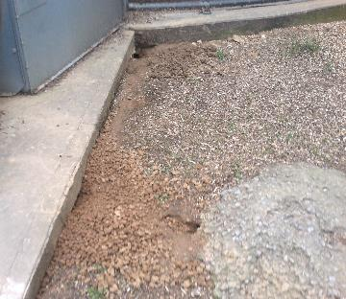
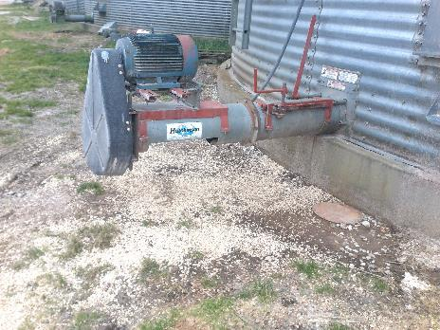
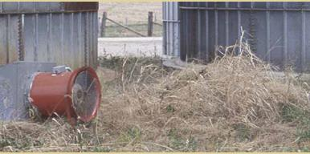
Sanitation – Outside
Outside the bins
Remove spilled grain
Mow weeds to reduce rodent activity
Notes:
Remove any spilled grain, weeds and tall grass around bins to reduce the likelihood of rodent activity and/or insect infestations.

Slide 63
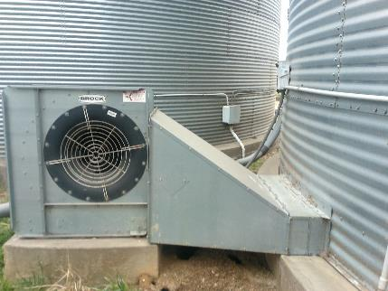

Sanitation – Outside
Outside the bins
Inspect fan transitions and bottom ring
Seal with expanding foam as needed
Notes:
Prior to harvest, inspect the seal around the bottom ring of the bin, plus metal ducts and flashing to prevent air leaks which can rob fans of efficient operation and add to drying and aeration time and costs.

Slide 64


Sanitation – Outside
Outside the bins
Clean electrical boxes – dryers & bins
Inspect drive assemblies
Notes:
Remove any spilled grain, weeds and tall grass around bins to reduce the likelihood of rodent or insect infestations.

Slide 65


Missing shrouds in work area
Drag conveyor
drive
Auger conveyor
drive pulley

Slide 66


Missing shrouds on dryers

Slide 67

Bin Loading – Don’t Overfill

Slide 68
Bin Loading
Manage trash and fines
  Control grain damage by combine
  Run augers full and ASAP
  Clean grain before storage
  Use a spreader to fill small bins
  Core the bin to remove fines/trash from the center

Slide 69
Manage Trash and Fines
Notes:
69

Slide 70
Core Small Bins after Filling to Remove
Trash and Broken Kernels
Core 1/3 to 1/2 bin diameter
Reduce height of grain peak
Removes center core of BCFM
Improves airflow in center of bin
Provides space for monitoring grain surface
Notes:
70

Slide 71

Core Large Bins Daily to Remove
Trash and Broken Kernels
Notes:
71

Slide 72
Aeration Cooling Cycle
Airflow cfm/bu | Hours to cool | Mode
0.1 | 150 | C
0.5 | 30 | C
1.0 | 15 | I
Rule of thumb:
AT = 15 / cfm/bu

Slide 73


Stored Grain Temperatures in KY

Slide 74
Cost of Aerating Grain
Fan HP | Airflow cfm/bu | Time Hours | Cost $ | Cost ¢/bu
3 | 0.10 | 450 | $ 135 | 0.29
7.5 | 0.25 | 180 | $ 135 | 0.29
30 | 0.50 | 90 | $ 270 | 0.57
Three aeration cycles for 47,000 bu
Electricity at 10 cents/kwh

Slide 75

Temperature Cable System
Thermocouple sensor cables
Cable suspension system
Leadwire extension
Readout plug
Display
instrument
D
C
B
A
A
B
C
D
Notes:
75

Slide 76

Temperature Cable System
Notes:
76

Slide 77



Insect Monitoring Tools
Grain probe
Pitfall trap
Automated system

Slide 78



Automated Insect Monitoring
opisystems.com
Notes:
78

Slide 79




Commercial Fan Controllers
grainsystems.com
stepsgms.com
advancedgrainmanagement.com
intellifarms.com
Notes:
The Autoflow Control System is exclusive to Maxim Top Dry and available on all bin sizes from 18' to 36' diameter. Autoflow controls allow operation in automatic batch mode or continuous flow mode. In batch mode the Autoflow controls fill, dry and dump each batch automatically. During operation in continuous flow mode, the dryest one-third of the grain in the drying chamber is dumped and replaced with wet grain. The drying chamber is never completely empty and the wetter grain is always exposed to the higher temperature air. This results in higher drying rates and more consistent moisture removal throughout. Autoflow features automatic shutdown in the event of fill switch failure or empty wet supply, plenum high temperature protection, auger fill delay and automatic or adjustable staged starting of fans and heaters. The Autoflow monitors fan and heater conditions (8 total) indicating which unit to shut down in the event of a malfunction, controls multiple auger systems for installations without a wet hopper tank, and automatically closes chutes in the event of a power loss. Autoflow includes four sensors for grain moisture averaging (more sensors yield better accuracy), motor starters for fill systems, batch counter, reliable rotary fill switches (power paks mounted externally for easier service) and has a 25 memory recall to keep track of unit shutdown including dates and times. Autoflow control boxes can be installed in a separate location from the drying bin. This can help prevent dryer controls from being tampered with or vandalized. Autoflow also offers an optional "Watchdog" software package that allows all dryer operation to be monitored remotely through a personal computer. Autoflow is totally microprocessor based (no moving parts) and is completely driven by easily upgradeable software.
The CompuDry Command Center constantly monitors conditions, such as grain moisture, grain temperature, plenum temperature, and controls all components of the system. You make some intial settings to the Command Center, concentrate on harvesting your crop, and keep grain in the bin...while the Command Center does the rest. It is designed with the operator in mind, it’s easy to use and gives you fingertip control of your entire in-bin continuous flow system.

Slide 80



CO2 - Early Spoilage Detection
grainpro.com/grainpro-co2-analyzer
Notes:
Field experiments were conducted in storage silos at Purdue to evaluate carbon dioxide sensors to monitor spoilage in grain prior to spoilage detection by traditional methods such as visual inspections and temperature cables. Carbon dioxide concentrations in the storage silo were monitored up to eight months and correlated to the presence of stored-product insects, molds and mycotoxin levels in the stored grain. The data showed that safe grain storage was observed at CO 2 concentrations of 400 to 500 ppm. Higher concentrations of CO 2 clearly showed mold spoilage or insect activity inside the grain storage silo. Carbon dioxide concentrations of 500 to 1200 ppm indicated onset of mold infection where as CO 2 concentrations of 1500 to 4000 ppm and beyond clearly indicated severe mold infection or stored-product insects infestation. The percent kernel infection was in the range of 30% for CO 2 concentrations of 500 to 1000 ppm to 90% for CO 2 concentrations of 9000 ppm. Fungal concentrations were in the range of 2.0 ×10 2 colony forming units per gram (cfu/g) at 500 ppm CO 2 concentration to 6.5 ×10 7 cfu/g at 9000 ppm CO 2 concentration. Fungi of genera Aspergillus spp., Penicillium spp., and Fusarium spp. were isolated from spoiled grain. High concentration of fungi and presence of mycotoxins (aflatoxin: 2 ppb and Deoxynivalenol (DON): 1 ppm) were correlated with high CO 2 concentration in the silos. The findings from this research will be helpful in providing more timely information regarding safe storage limits, aeration requirements and costs of spoilage mitigation measures such as turning, aerating and fumigating grain. Additionally, it will provide information on preventive stored grain quality management practices that should reduce residue levels of mycotoxins, pesticides and other foreign material in our food supply. The CO 2 monitoring technology will increase the quality and quantity of stored grain, while saving the U.S. and global grain production, handling and processing industry millions of dollars annually.
Elevated CO2 levels in localized pockets of a grain mass are caused by insects, fungi, and grain metabolism. These hotspots may occur away from temperature cables in bins, silos, tanks and warehouses making early detection of spoilage difficult. For grain stored in ground piles or bunkers that typically do not have temperature cables, considerable economic loss may result in the absence of CO2 monitoring. The primary objective of this study was to monitor CO 2 levels for early detection of spoilage. Three large tanks and two ground piles were monitored at a commercial grain handling facility (grain elevator) in the Midwestern U.S. Each tank held approximately 12,500 t and the ground piles held approximately 40,000 and 50,000 t of maize each. Four CO2 sensors each were installed at the top (near the vents) and base (exhaust air stream of fans) of each tank. The CO 2 sensors were connected to master radios that received signals from the sensors and transmitted data wirelessly to a slave radio connected to a PC located in the office about 300 m away. For each ground pile, a sensor was installed in the air stream of several exhaust fans. The study was conducted from April - Sept 2005 in the large tanks and from January - May 2006 for the ground piles. The CO2 levels ranged from 500 ppm (0.05 %) to 5,000 ppm and higher levels of up to 2.5 % were recorded with a portable CO 2 monitor. The high CO2 levels were confirmed by the extent of spoilage which ranged from 15 to 25 % when maize was moved out from the large tanks in September 2005. CO2 monitoring of the ground piles storing newly harvested maize became an important decision-making tool for the operations manager with respect to early detection of spoilage.

Slide 81




Temp and RH Monitoring
Partial list of vendors
  AgSense (agsense.com)
  Amber Agriculture (amber.ag)
  BinCheck (intellifarms.com)
  Bin-Sense (binsense.com)
  CMC Industrial Electronics (cmciel.com)
  GSI /GrainViz (grainsystems.com)
  Govee Wireless (amazon.com)
  Integris/OPI (advancedgrainmanagement.com)
  SafeGrain (safegrain.com)
  Smart Switch (stepsgms.com)
  The Boone Group (rolfesatboone.com)
  Tri-State Grain Conditioning (tsgcinc.com)
Notes:
Here’s a partial list (12 vendors) that sell and service temperature and/or relative humidity sensors, including some very low-cost, hand-held monitors to sophisticated electronic controllers to manage fan operation based on pre-selected environmental conditions. Examples include the small digital hygrometer in the upper right that can be ordered from Amazon for ~$5; the Govee Wireless Hygrometer in the bottom left, which features a Mini Bluetooth Humidity and Temperature Sensor with Data Export for iOS Android with an alert for home, greenhouse, Hemp seed/flower storage…$20 also on Amazon.com.

Slide 82
Approximate Costs
Temperature Cables:
  0.5 – 1.5 ¢/bu
Fan Control Circuits:
  0.3 – 1.5 ¢/bu
Aeration Systems:
  10.0 – 20.0 ¢/bu

Slide 83


Be Alert When Inspecting Stored Grain
Notes:
83

Slide 84

How does grain flow out of a bin?
Notes:
84

Slide 85


What are the implications?
Notes:
85

Slide 86


What if a cavity develops?
Notes:
86

Slide 87

What if grain sticks to the wall?
Notes:
87

Slide 88


Always Work in Pairs !!
Notes:
88

Slide 89




Bin Rescue in Spring 2005

Slide 90



Mock Rescue by EMS
Notes:
90

Slide 91

Coffer Dams Retard Grain Flow
Notes:
91

Slide 92

Reported Grain Entrapments
Notes:
92
Number of annual grain entrapment cases recorded between 2011 and 2020. (Purdue Univ.)

Slide 93

Grain Entrapments by State
1962 – 2020
n = 2181
Notes:
93
Geographic distribution of agricultural confined space cases from 1962 - 2020 (n=2181).

Slide 94

Grain Handling Safety
If you must enter a bin use extreme caution…
  Shut off and lock-out unloading conveyers (LOTO)
  Use a climbing harness and safety line
  Use a respirator
  Position someone outside the bin
  to monitor activity
  Avoid the center of the bin
  Have a coffer dam on site

Slide 95
University Resources
Agricultural Engineering Departments in Midwest
Iowa State University |extension.iastate.edu/grain
Kansas State University | grains.k-state.edu/
North Dakota State University | ag.ndsu.edu/graindrying
Oklahoma State University | bae.okstate.edu
Purdue University |
engineering.purdue.edu/ABE/engagement#PostHarv
University of Arkansas | bio-ag-engineering.uark.edu/
University of Kentucky | uky.edu/bae/grain-storage-systems
University of Tennessee | https://bess.tennessee.edu/
Notes:
Biosystems (Biological) and/or Agricultural Engineering Departments in the Midwest…
Iowa State, Kansas State, North Dakota State, Oklahoma State, Purdue, Univ. of Arkansas, UKY, Minnesota, Mississippi, TN, etc.

Slide 96

Grain Handling Resources
American Society of Agricultural and Biological Engineers (asabe.org)
Journal of Agricultural Safety and Health (elibrary.asabe.org)
Midwest Plan Service (mwps.org)
NC-213 (oardc.ohio-state.edu/nc213/)
USDA Grain Lab in KS (ars.usda.gov)
Grain Elevators and Processors Society (geaps.org)
Grain Handling Safety Coalition (grainsafety.org)
GrainNet (grainnet.com)
Notes:
Midwest Plan Service
1. Managing Dry Grain in Storage (AED-20)…2004..$5.00
2. Grain Drying, Handling and Storage Handbook (MSPS-13)….2018…$74.00
3. Low Temperature and Solar Grain Drying Handbook (MWPS-22)…1980…$5.00
4. Dry Grain Aeration System Design (MWPS-29)…1999…$25.00

Slide 97
Thank You and Stay Well!
Sam McNeill, PhD, PE
Extension Agricultural Engineer
Biosystems & Agricultural Engineering
UKREC – Princeton, KY
Office: 859-562-1326
smcneill@uky.edu
www.uky.edu/bae
Notes:
Contact info. Office phone number shown is direct line from main campus.

