Slide 3
Sept. 12 PD Sign-In Sheet
Be sure and sign-in here!
https://docs.google.com/spreadsheets/d/1lqxv8vMNoLsHXqrxB7003BCC7H_9-3sAARPDlCVYwLo/edit?usp=sharing

Slide 6
Supporting English Learners during Virtual/Distance Learning

Slide 7
Important lesson learned from Spring 2020…
Districts that did the best in supporting ELs during distance learning were ones that already had solid relationships with EL families
The better schools knew families, the more effective partnerships around distance learning were
https://www.colorincolorado.org/article/distance-learning-ell-technology

Slide 8
Tips for Communicating with EL Families from a Distance
Identify families’ preferred methods of communication
Check in frequently
https://www.colorincolorado.org/article/distance-learning-ells-family

Slide 9
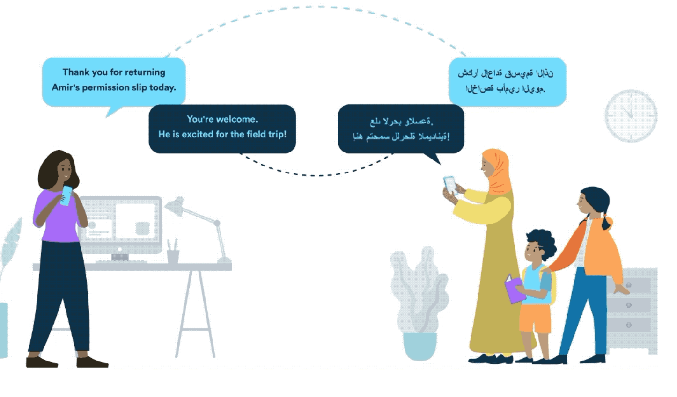
Tips for Communicating with EL Families from a Distance
Try an app that translates communication into families’ preferred languages
Talking Points
Remind
https://www.colorincolorado.org/article/distance-learning-ells-family

Slide 10
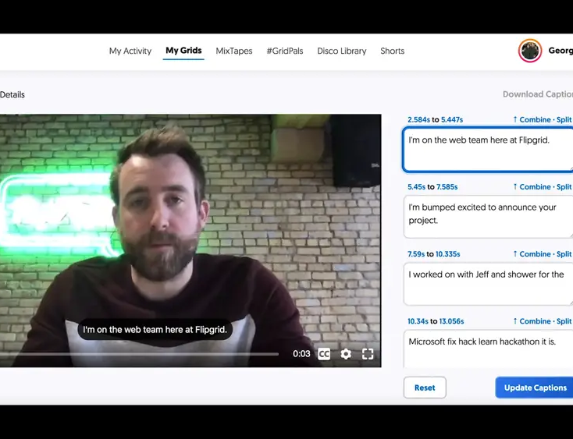
Tips for Communicating with EL Families from a Distance
Use videos!
Parents may understand oral English better than written
Video provides visual context and can be viewed multiple times
Some videos (e.g. Google Meet, Flipgrid) have closed captioning – turn it on!
https://www.colorincolorado.org/article/distance-learning-ells-family

Slide 11
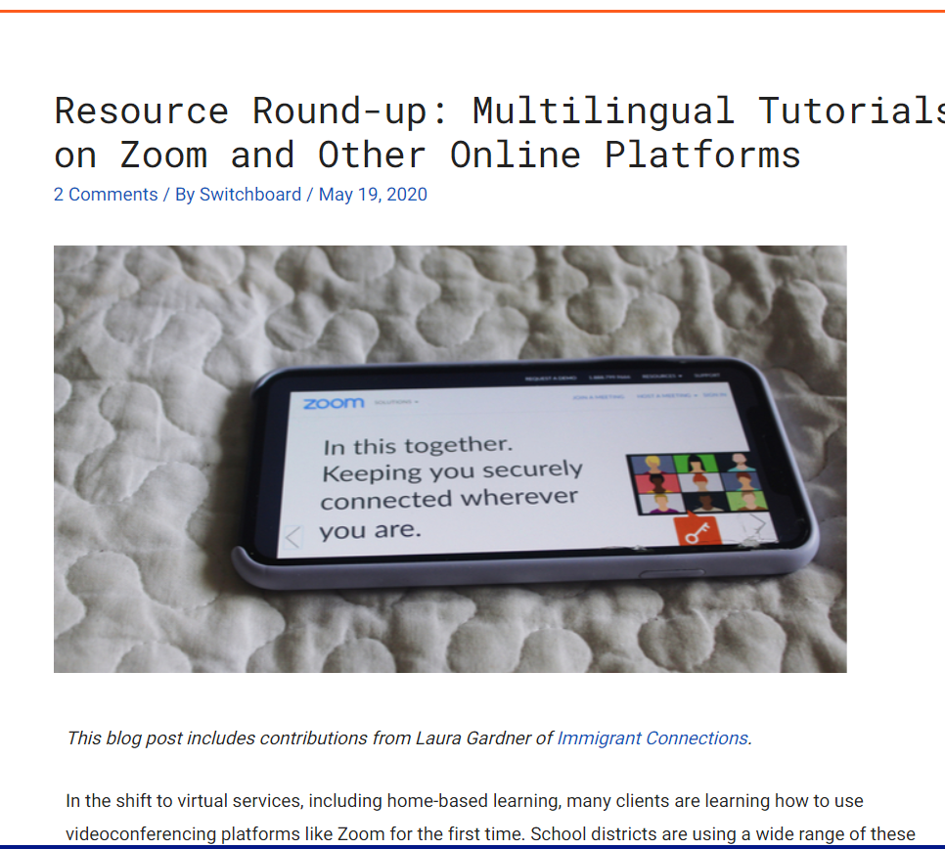
Tips for Communicating with EL Families from a Distance
Provide training and tech support in home languages
Google Classroom tutorials in many languages
Multilingual tutorials for Zoom and other platforms

Slide 12
Modifying Online Instruction to Support ELs
https://www.colorincolorado.org/article/distance-learning-ell-technology

Slide 13
Structure, structure, structure
https://www.colorincolorado.org/article/offline-learning-ells
Less is more
There are lots of neat online tools out there – use only a few!
Set up a clear and simple dashboard or learning activity page
Bitmoji classrooms are amazing…but can be overwhelming!
Repeat the same lesson structure with different content, for example:
Opening video
Reading
Comment on discussion board
Connect with a partner
Write/record short discussion of take-aways from learning
Bitmoji classrooms also eat up a lot of data for students who use parents’ smartphones

Slide 14
Emphasize Language Production
https://www.colorincolorado.org/article/offline-learning-ells
EL students at home are not likely to have much English language exposure
Focus on academic learning and use academic language
Avoid only skills-based activities
Build interaction, even if you aren’t using real-time video
Students can post messages via writing, audio, or video and respond to each other
Keep writing or recording assignments short
Live instruction can be hard for ELs to follow online!
Create videos that students can review multiple times for practice
Especially good for greetings, lessons, and other important information

Slide 15
Get students using academic language during distance learning
Valentina Gonzalez: https://elementaryenglishlanguagelearners.weebly.com/blog/10-ways-to-get-students-using-academic-language-during-distance-learning-beyond
Technique | F2F Instruction | Distance Learning Modification
Linguistic frames | Sentence frames, sentence stems, paragraph frames | Make stems/frames available on LMS for everyone Show students how to use them online with peers
Picture Word Induction Model | Students list words they know about a picture (usually related to topic of study), then generate written text | Video record yourself labeling the visual Create a shared image that students can add words to
Interactive Word Wall/GVM | Students organize the words in ways that are meaningful, adding visuals as needed | Build interactive word wall on Google Slides or PowerPoint Include images, words, and hyperlinks Students can add to word wall at own pace

Slide 16
Supporting EL Learning at Home

Slide 17
Remember Funds of Knowledge?
All parents have the ability to support their children’s learning
This is an excellent time to
Learn about and build upon students’ funds of knowledge
Draw upon home language and cultural resources

Slide 18
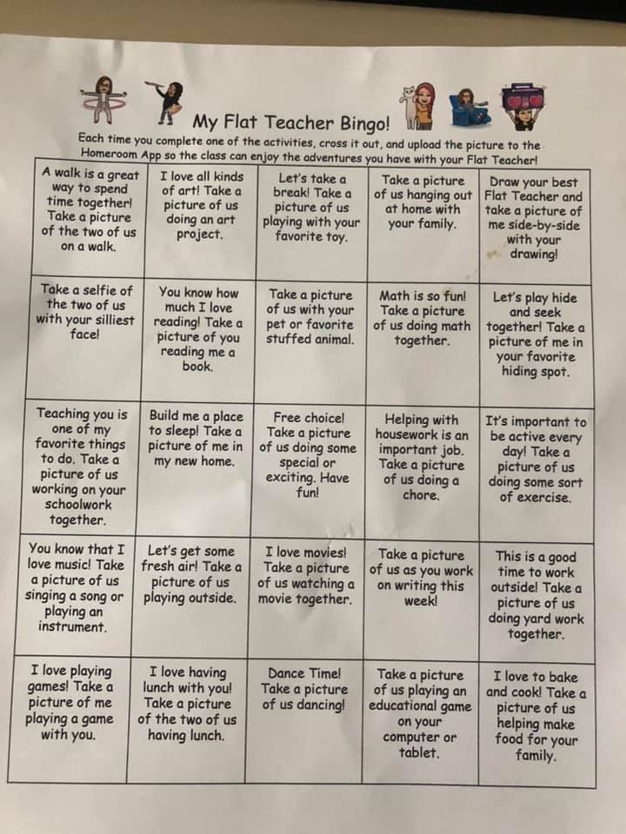
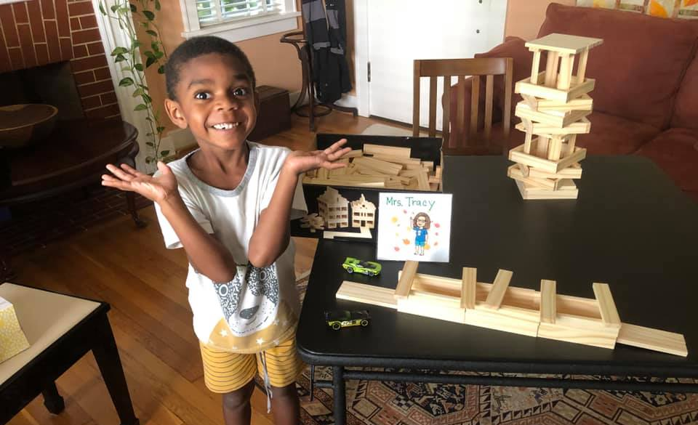
Use the home as an academic resource
Design activities and assignments that draw upon students’ everyday lives and use their home language/ culture as a resource

Slide 19
Oral Language Development for ELs
Tell family stories in the home language
Provide question prompts connected to literacy or social studies topics for “daily family discussion” topics
Ask students to describe things using rich language
A favorite object
A room in their home
A family member or pet
A family recipe
A family tradition
Turn students into “family historians” or “family researchers” to record oral history from family members

Slide 20
Reading Development for ELs
Use household items (cereal boxes, nutrition labels, coupons, etc) to build print awareness (for younger learners) or genre knowledge (for older learners)
Send students on a “literacy walk” in their homes or neighborhoods to document different types of texts in their lives
Students with cameras can take photos of the texts
Students without cameras can draw pictures
Use current events – NewsELA is your friend!
Print out hard copies for packets if students don’t have digital access

Slide 21
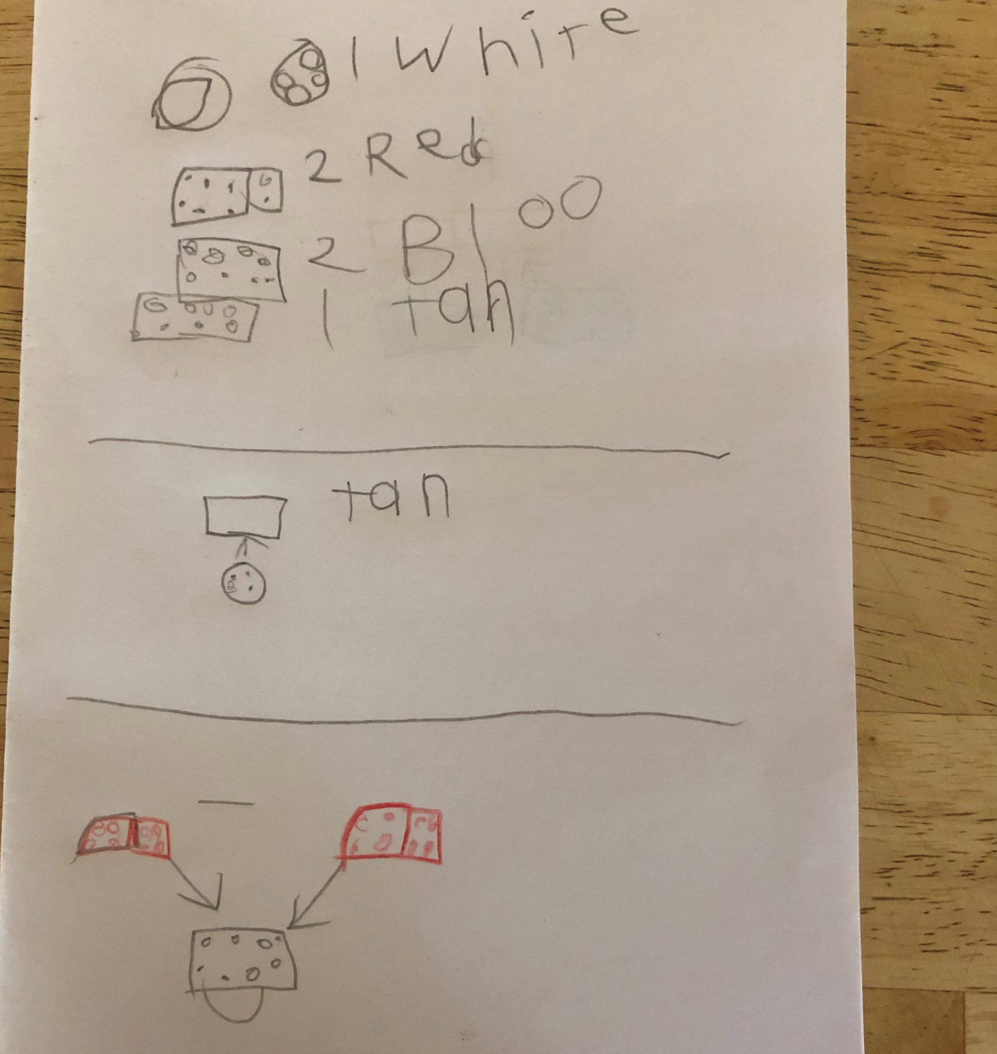
Writing Development for ELs
Build upon students’ need to connect with others
Teacher/student or student/student pen pals
Credit for writing letters/notes/emails to loved ones who are quarantined elsewhere
“Morning Message” in sidewalk chalk for neighborhood
Write and post reviews of books, movies, other media, recipes
Write and share “how-to” pieces on fun activities at home
Create comics or Zines that could be shared digitally or in hard copy
This is a great time to try Family Journals!
Create a prompt for both child and parent to respond to

Slide 22
https://www.colorincolorado.org/article/offline-learning-ells

Slide 23
https://www.colorincolorado.org/article/offline-learning-ells

Slide 24
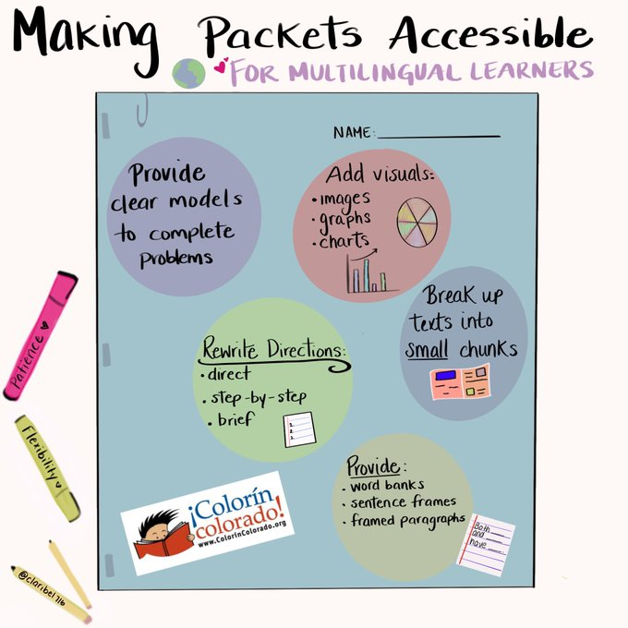
Image courtesy of Clarabel González

Slide 25
Creating Accessible Packets for ELs: Language
Rewrite directions to be direct, step-by-step, and brief
Translate, if possible, into students’ home language
Reduce text & break text into small, manageable chunks
Provide sentence stems and framed paragraphs for written responses
https://www.colorincolorado.org/article/offline-learning-ells

Slide 26
Creating Accessible Packets for ELs: Visual Support
Provide a clear model of how to complete each activity/problem
Add visuals (image, graphs, charts) to support text in each chunk
Send home appropriate manipulatives or materials with packets OR suggest items that may be in the home
Straws cut short for math/counting practice
Sticks and stones for 10s and 1s
https://www.colorincolorado.org/article/offline-learning-ells

Slide 27
Creating Accessible Packets for ELs: Organization
Put practice problems/questions immediately after a model
Offer choices in how students complete the packet, rather than requiring students to go from start to finish
Offer choices for students to demonstrate what they’ve learned
Students can use a different text/problem to match their interests, culture, language, or background
https://www.colorincolorado.org/article/offline-learning-ells

Slide 29
Project PLACE Surveys
Self-Efficacy Survey: https://uky.az1.qualtrics.com/jfe/form/SV_9zspJIDEG0YL4JD
PD Survey: https://uky.az1.qualtrics.com/jfe/form/SV_dcLriyPvGfhmIf3

Slide 30
Advanced Leaders Presentations
Samantha Arnold
Taylor Browning
Nicole Naylor
Brittany Manion

