Slide 1
Morning Meeting
Why? How?
http://bit.ly/2mSq41V
Eric Miracle
Eric.Miracle@fayette.kyschools.us
MaKayla Adkins
Makayla.Adkins@fayette.kyschools.us

Slide 2
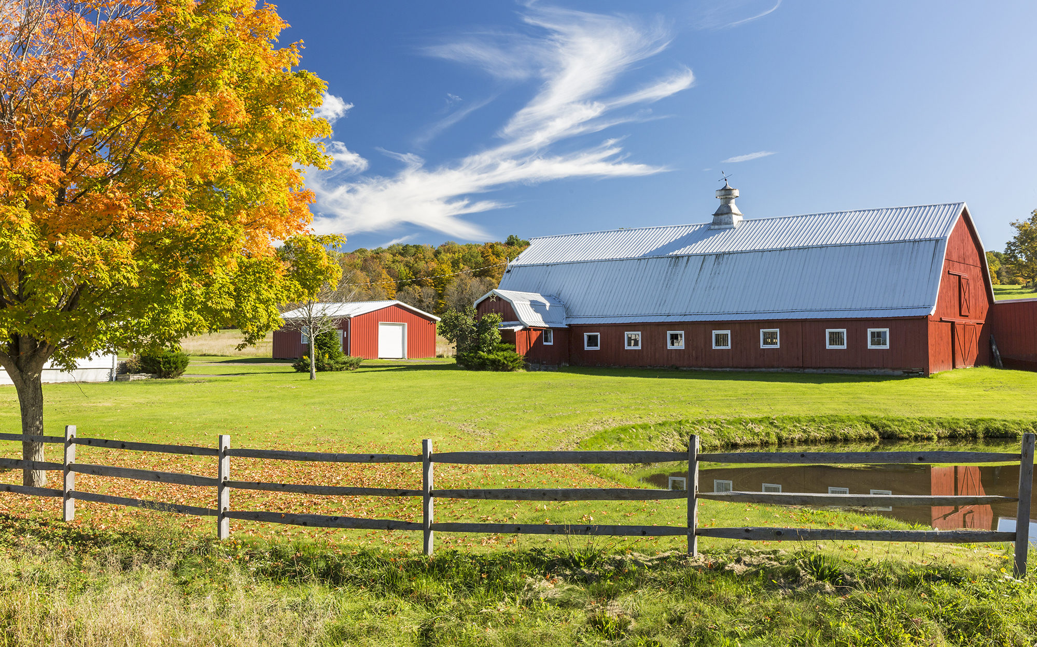
What we do!

Slide 3
Purposes of Morning Meetings
Morning Meeting sets the tone for respectful learning and establishes a climate of trust.
The tone and climate of Morning Meeting extend beyond the meeting and allows for extraordinary moments..
Morning Meeting motivates students by addressing two needs: the need to feel a sense of belonging and the need to have fun.
Morning Meeting merges social, emotional, and intellectual learning.
Notes:
For middle schoolers this is also called CPR, Circle of Power and Respect.

Slide 4
Morning Meeting
with
Second Language Learners
Knowing the answers to these questions will help you to better plan your meetings to ease the child’s transition.
What are the traditions for greeting people in your child’s culture?
What has your child learned about how to behave towards adults and peers?
Is it culturally acceptable to touch another child (handshake)?
Is it culturally acceptable to make eye contact?

Slide 5
Communicate with Parents
Dear Parents.
There’s a wonderful new beginning to your child’s school day! It’s called Morning Meeting and it’s a great way to build community, set a positive tone, increase excitement about learning, and improve academic and social skills.
Parent Letter Example

Slide 6
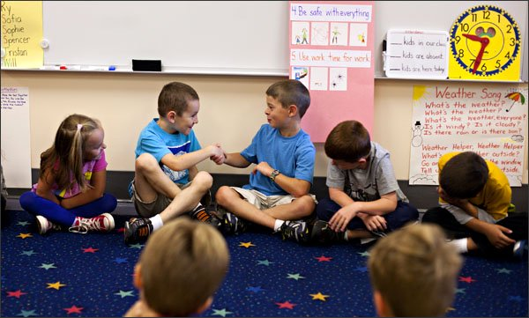
Greeting
-Model what you are expecting students to do
-Greet each other by name each and every day as a part of Morning Meeting
-Make eye contact
-Be intentional & creative
- Set the expectations for this and how you
want it done each day, keep it routine so they
know what to expect
-Link to ideas of greetings
Notes:
Demonstrate with one group prior to discussing the slide

Slide 7
Sharing
Why do we all share thoughts / feelings / ideas? Our students do the same
Use this time to gain more knowledge of your students and to build relationships with your students
This is a time for students to share important events in their lives
It’s about what the student sees as important, not as what we see as important
Be intentional and include information about yourself so students can get to know you.
Link to questions

Slide 8
Group Activity
Are you implementing Kagan?
Short, fast-paced, and involves everyone in the class.
Some activities may have clear academic skill-building components, may tie into current topics, or can be “just for fun”.
Must be accessible to ALL students.
Start off with one to two activities and allow students to master them before adding in another activity.
Ready to use group activities!

Slide 9
Morning Message
-The goal is to inform students, while also helping them think and problem solve.
-The message lets students know what will be happening that day, which could be changes to the schedule, what they will be learning, or whose birthday it is.
-Throughout the message, mistakes are made and students will then help you correct the mistakes during morning meeting.
-The message serves the purpose of being informative and educational. This does not have to be lead by the teacher. Give the responsibility to the kids.
Notes:
Middle High school- can focus on the academics

Slide 10
Example Morning Message
Good mornnig boys and girls? I hop you all had a wonderfull weekend! I am excited to hear about it during our Morning Meeting. Please turn in your permissioon slips in the black tray bye my desk. Then get your belongings that you will need for math.
Our schedule be different today because we have an assembly this afternoon at 1:15. We will still have recess, so please don’t worry about that! :) I’m so thankful you are here today!
-Mr. Miracle

Slide 11
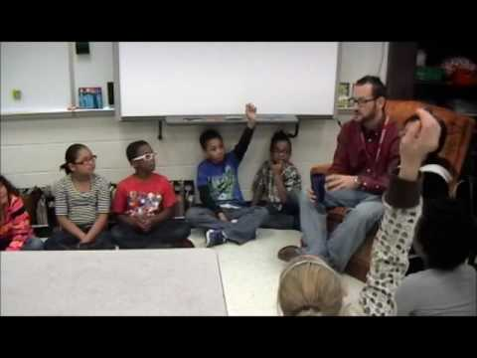
Example Morning Meeting - 3rd Grade

