Slide 1
Critical Consciousness
Presentation By: Raychel Harrison

Slide 2
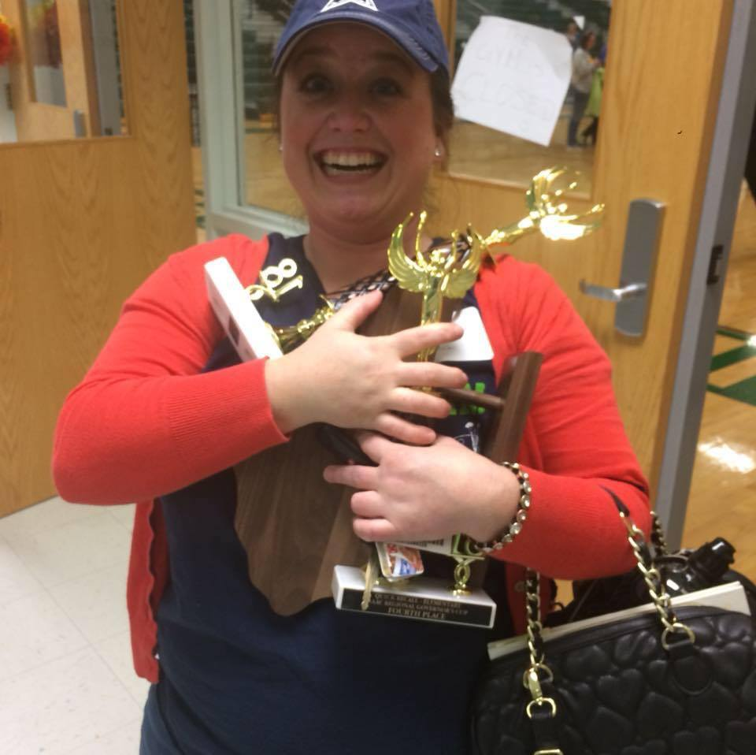
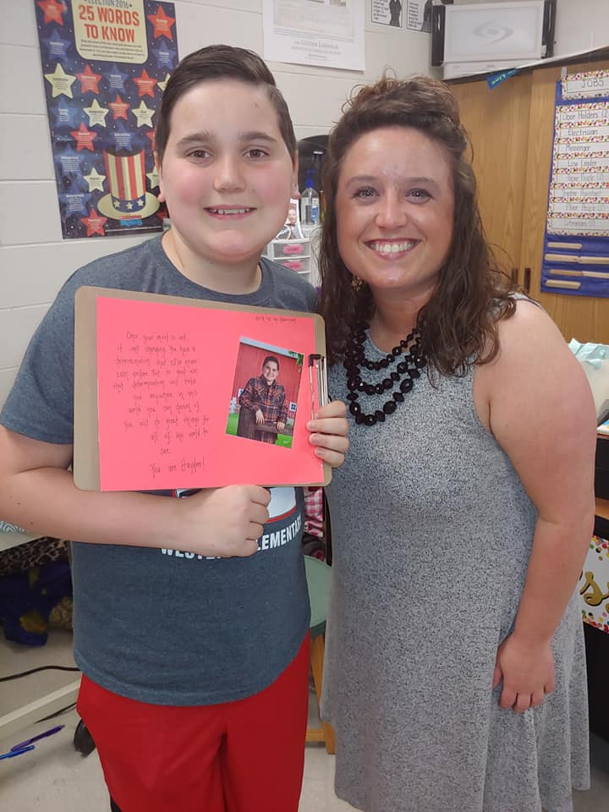
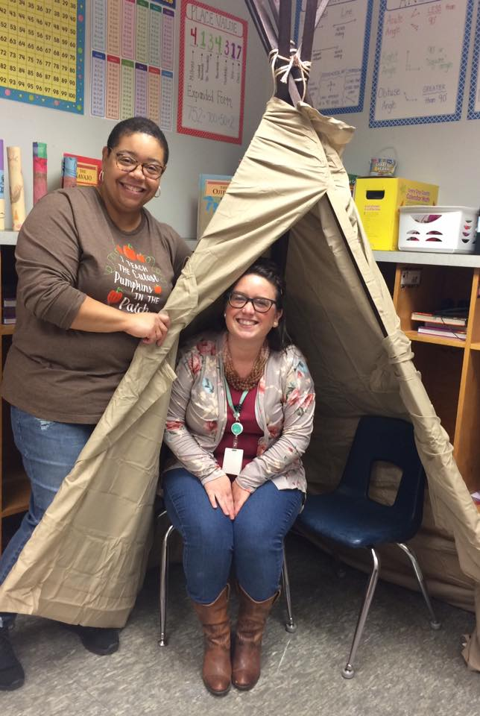
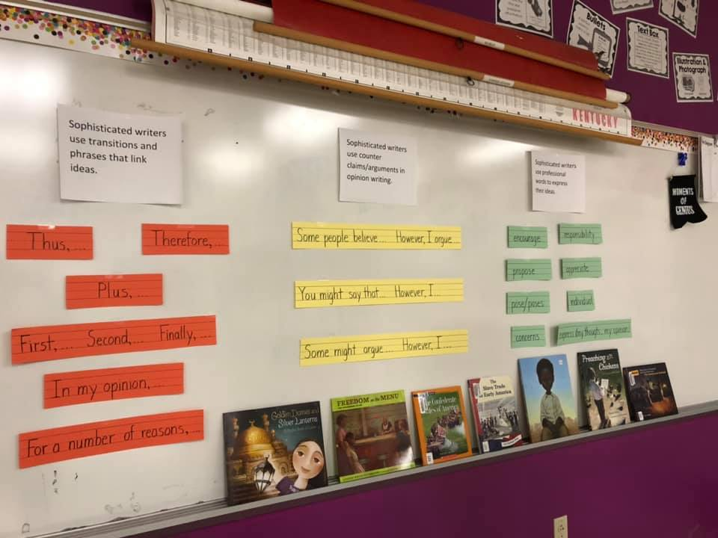
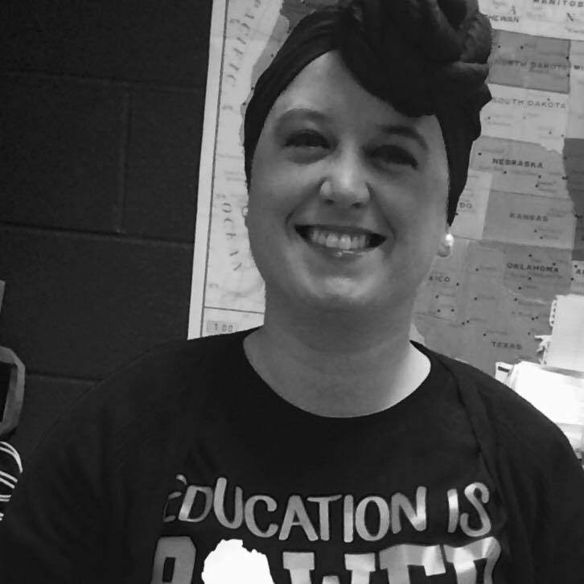
Personal Introduction!
Who I am & small background…
Small story in my own journey of CRITICAL CONSCIOUSNESS

Slide 3
Simulation of CLASSROOM ACTIVITY
Each table will pick someone to come get an ACTIVITYCARD!
Each table will pick a speaker for their table.
You will have 2.5 minutes to discuss your ACTIVITY CARD. Each table has a different card with a different topic. (Warning: May cause discomfort ☺)
The speaker from your group will then read your card to the entire group and explain what your group talked about. How does the card make you feel? What is your opinion? Did your entire group feel the same way about the topic? What questions come to your mind?

Slide 4
Simulation Explanation
How I use this in my classroom!
What is your goal?
How do I start this from the beginning of the year?
What about the parents?
Cross Curriculum importance

Slide 5
Classroom Examples:
Small group Literature Study
Student Reactions
Where this led us…..
https://www.facebook.com/571364706598442/videos/577519982692190/?t=7

Slide 6
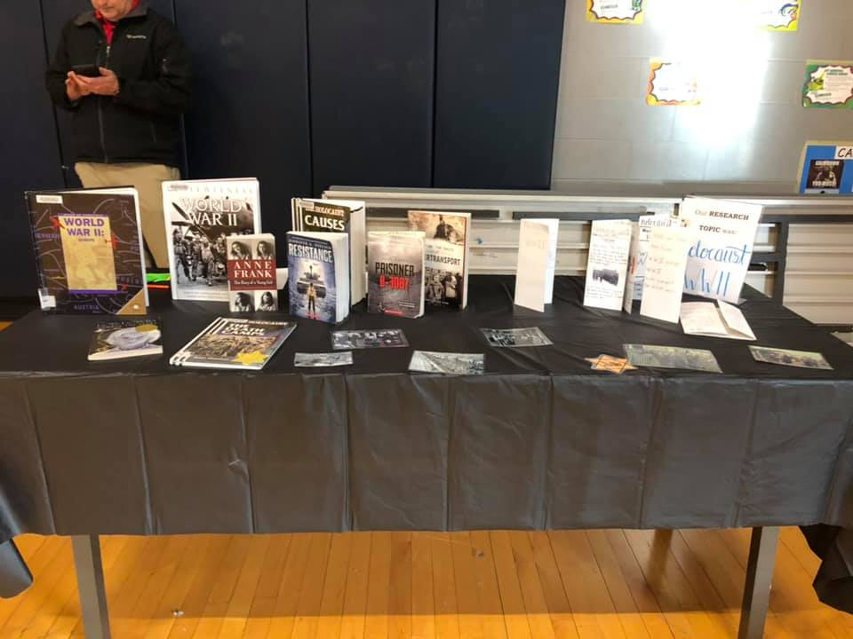
Examples Continued…
Student Exhibitions
How where this planned?
What students worked on?
How they tied to tons of standards?

Slide 7
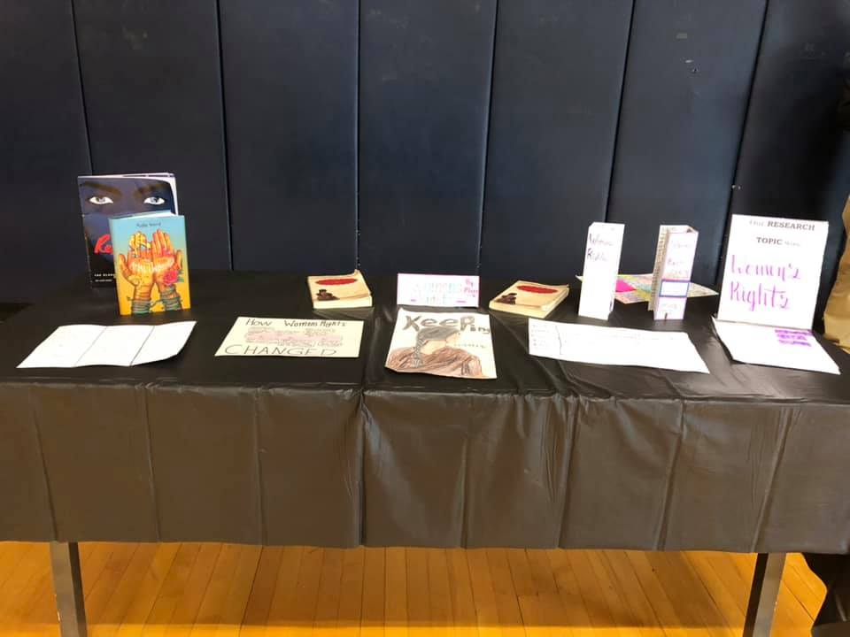
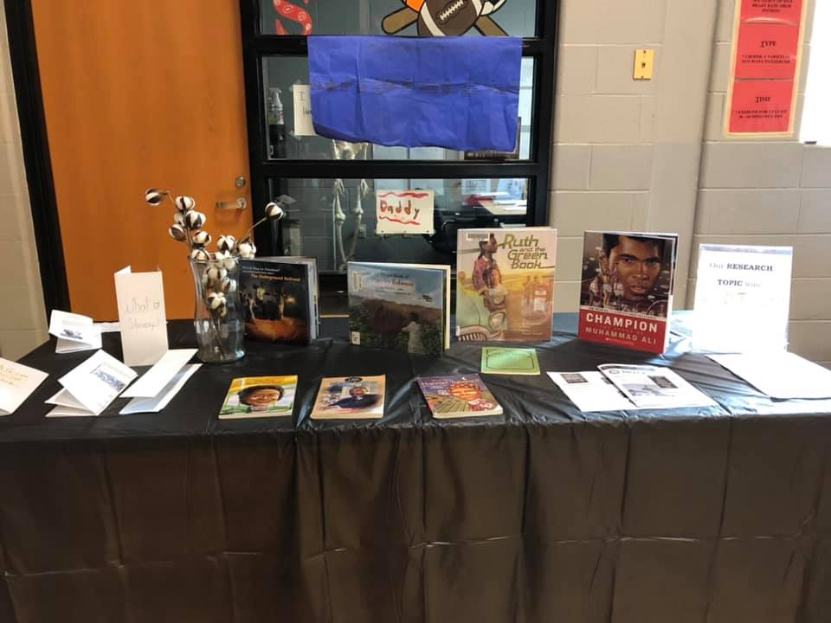
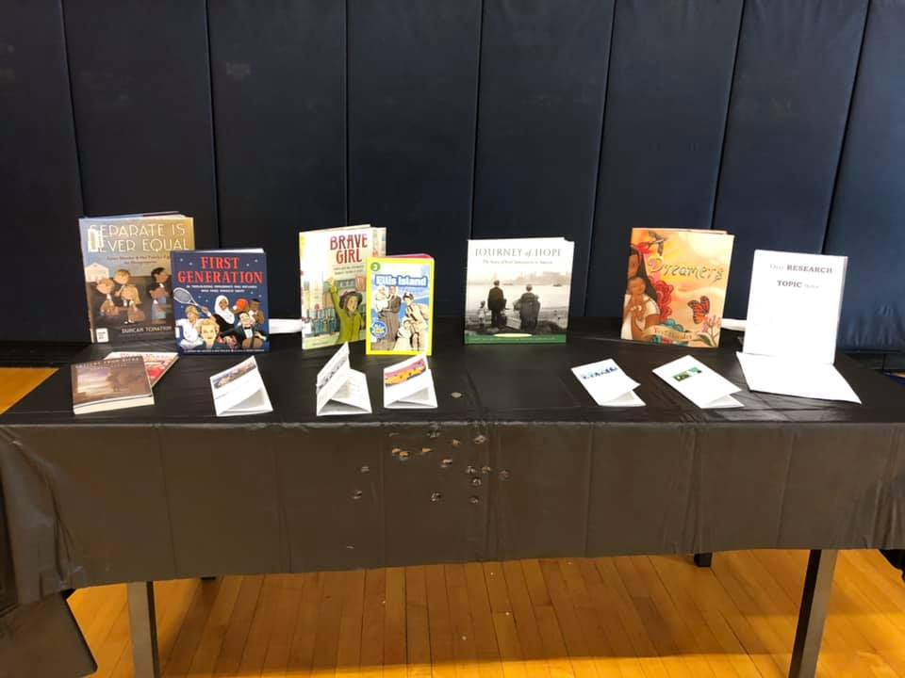

Slide 8
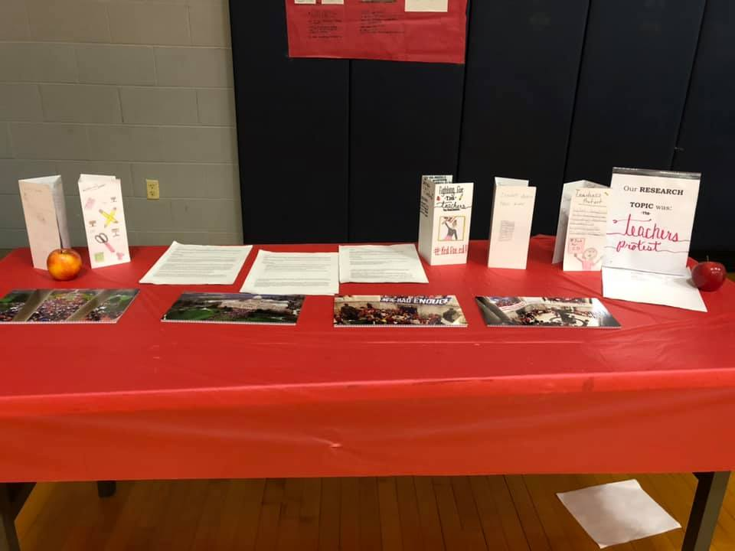

Slide 9
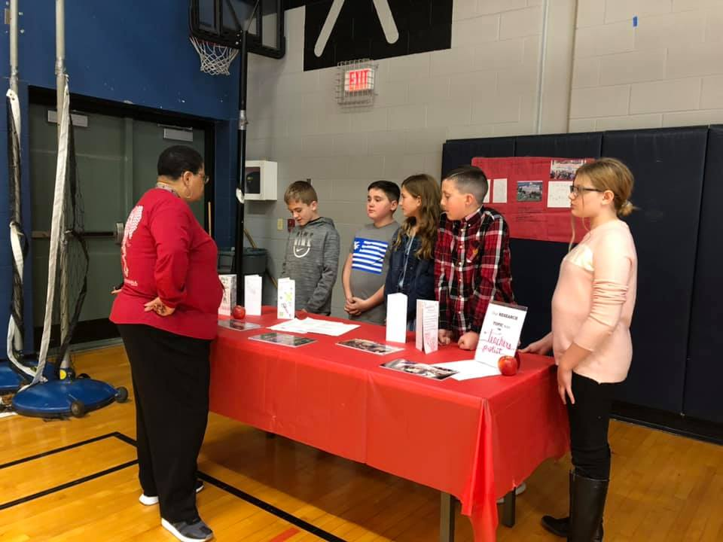
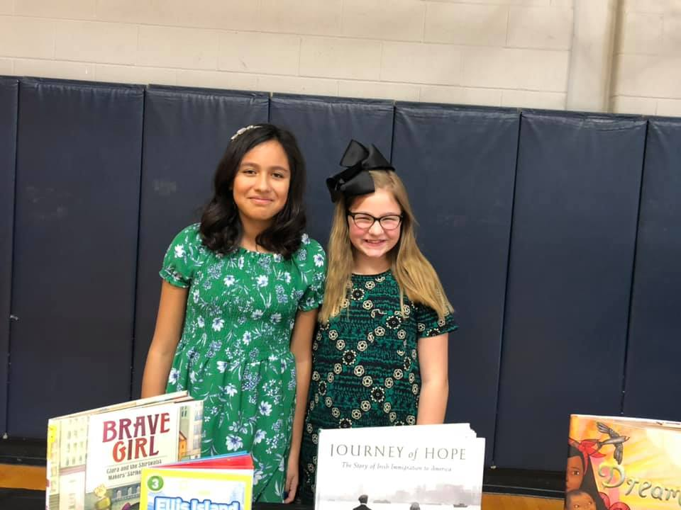

Slide 10
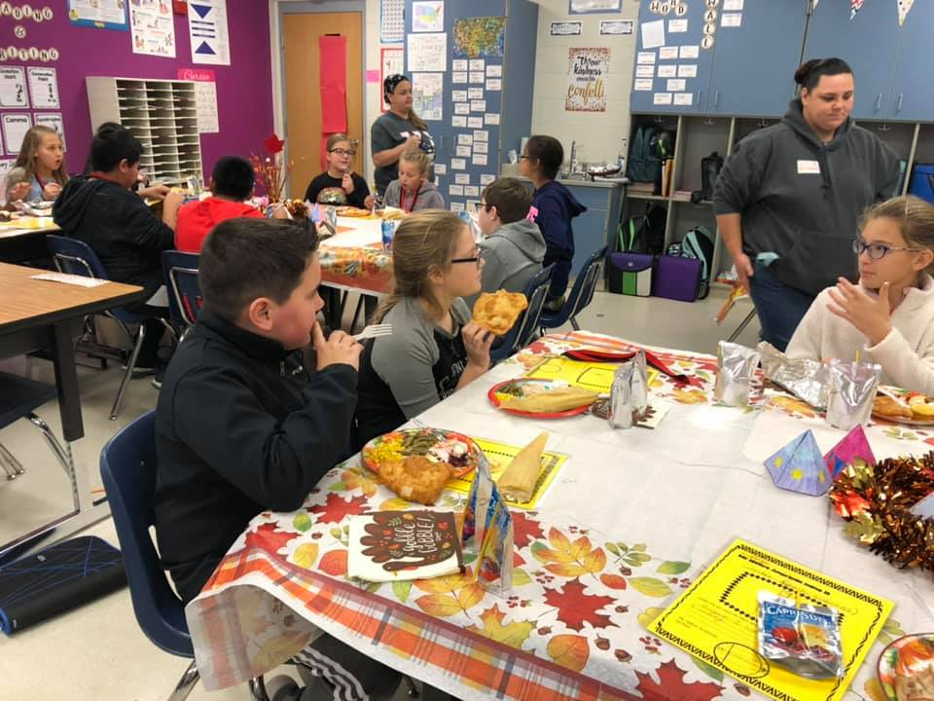
Examples Continued…
Native American Unit & Thanksgiving!

Slide 11
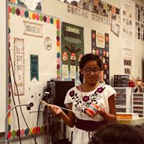
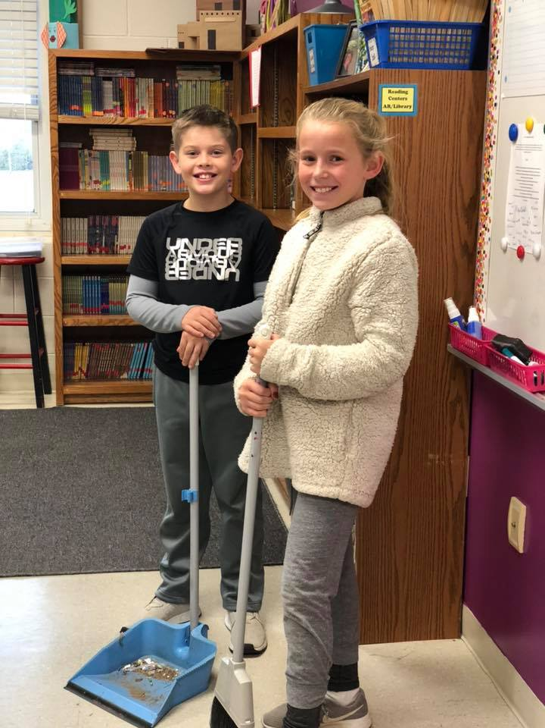
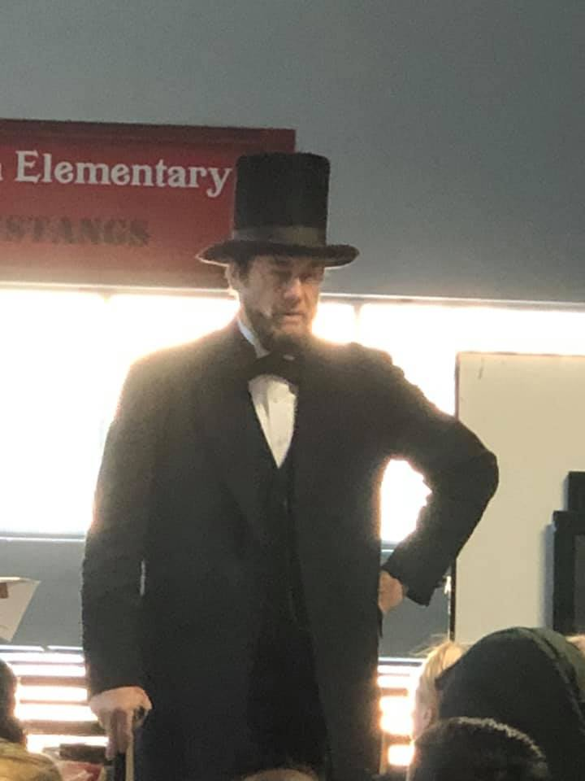
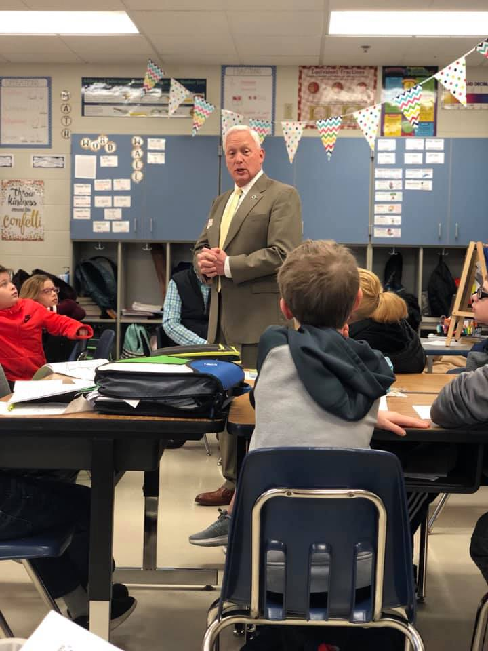

Slide 12
QUESTIONS…Comments… Hesitations?
Contact Information:
Raychel Harrison
raychel.harrison2@scott.kyschools.us

