Slide 1
CRITICAL CONSCIOUSNESS
The curriculum and planned learning experiences provide opportunities for the inclusion of issues important to the classroom, school, and community
The curriculum and planned learning experiences integrate and provide opportunities for the expression of diverse perspectives

Slide 2
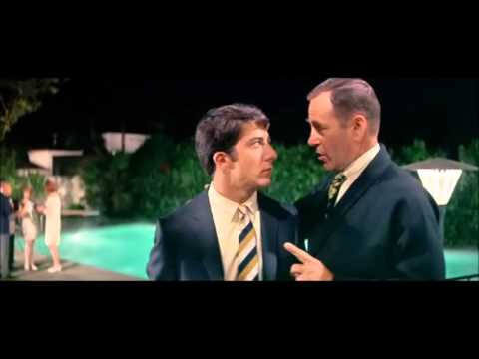

Slide 3
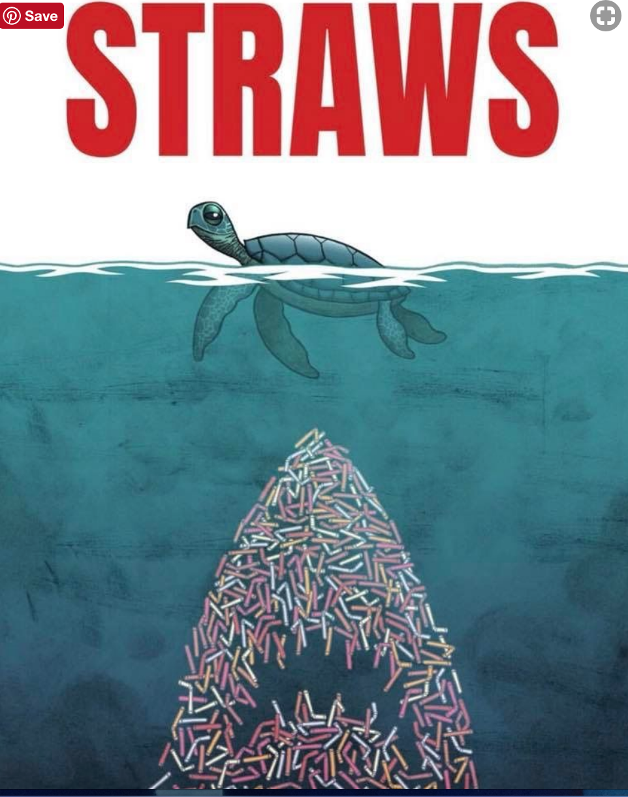

Slide 4
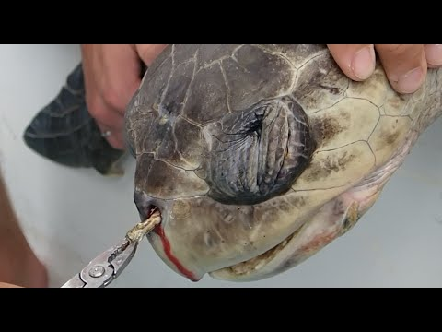

Slide 5
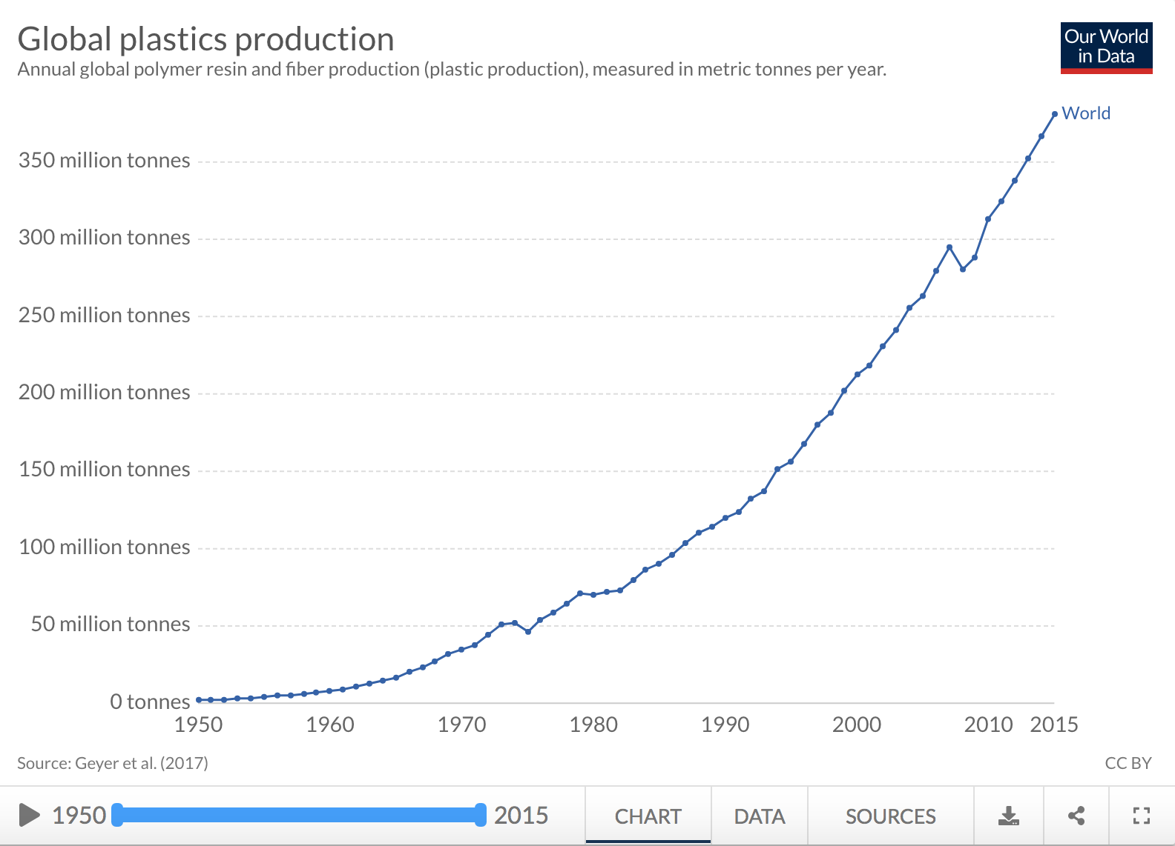
Notes:
Benjamin should have listened to that guy!

Slide 6
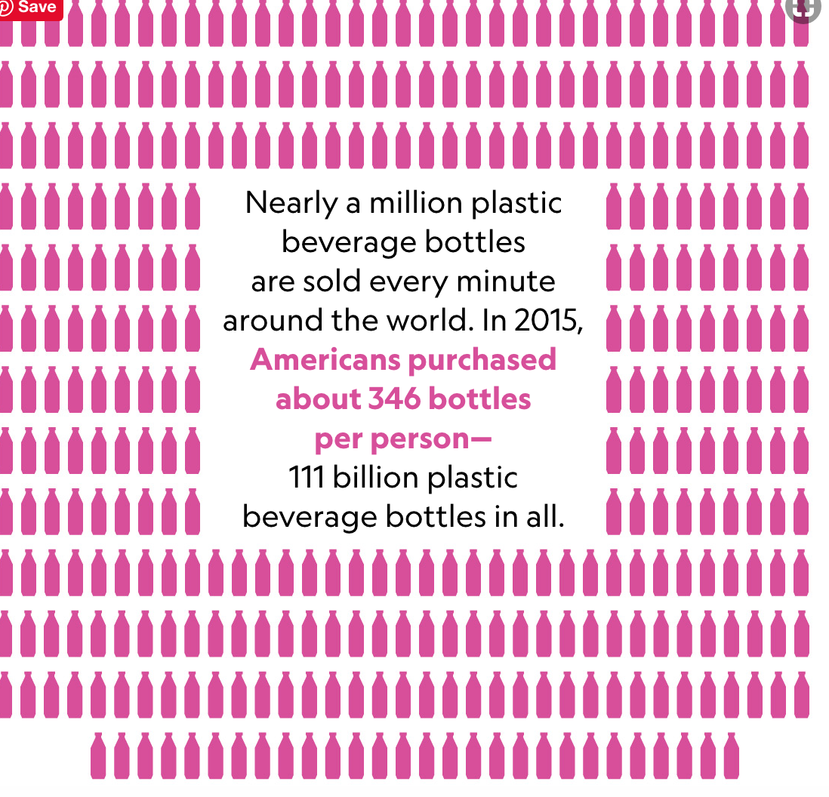

Slide 7
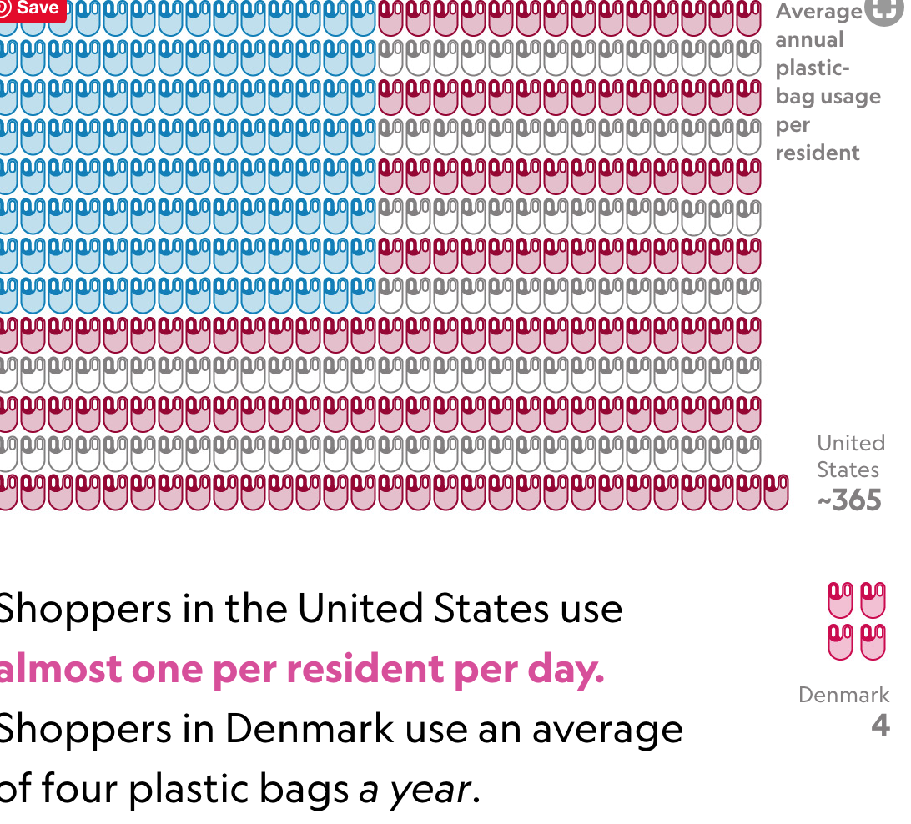

Slide 8
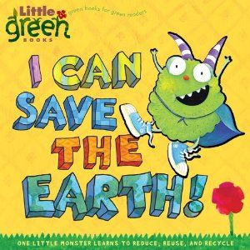
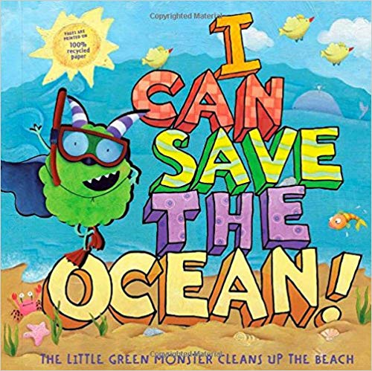

Slide 9
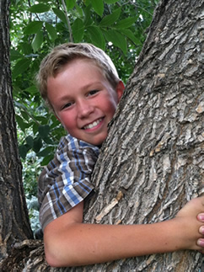
MILO CRESS, A 9 YEAR OLD FROM COLORADO STARTED A STRAW FREE MOVEMENT. “HERE’S THE THING: THIS PLANET’S NOT A PLACE THAT KIDS WILL INHERIT AT SOME POINT, FAR OFF IN THE DISTANT FUTURE. WE LIVE HERE RIGHT NOW, AND WE SHARE THIS PLANET ALREADY.” - MILO CRESS

Slide 10
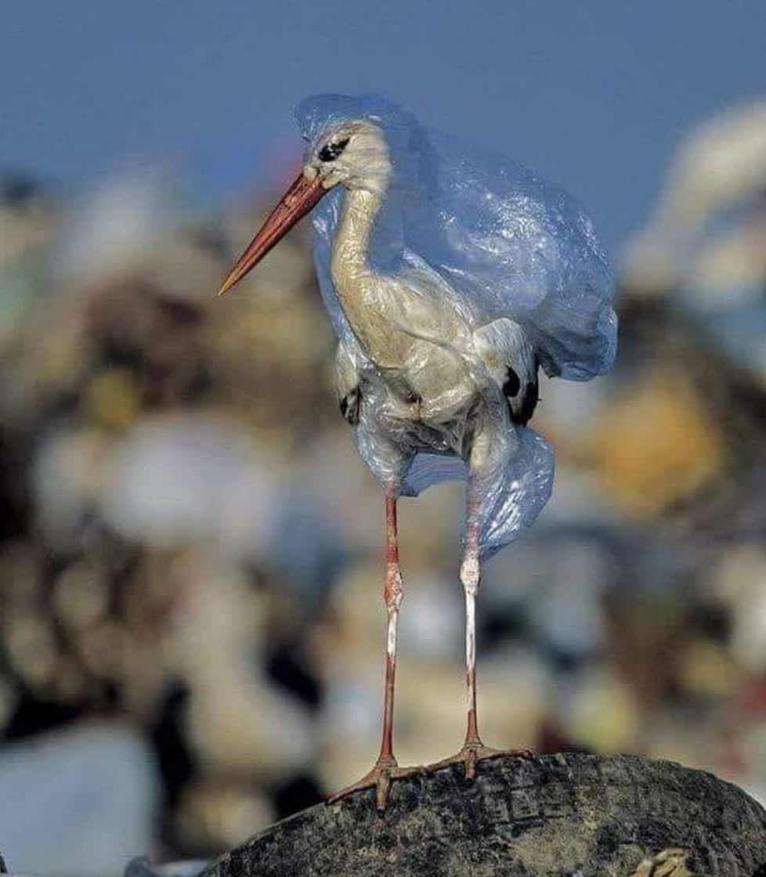
Students discuss how plastic bags are used as a convenience (for humans)

Slide 11
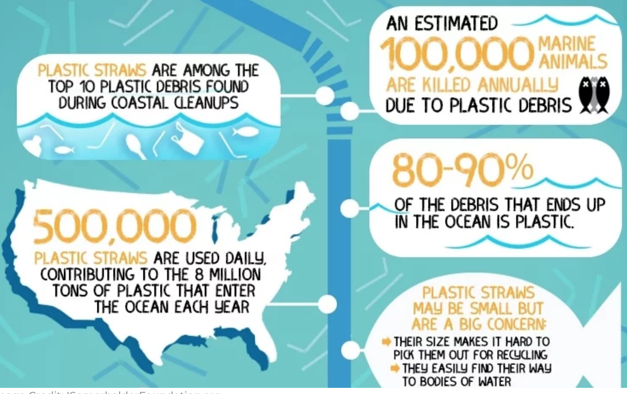

Slide 12
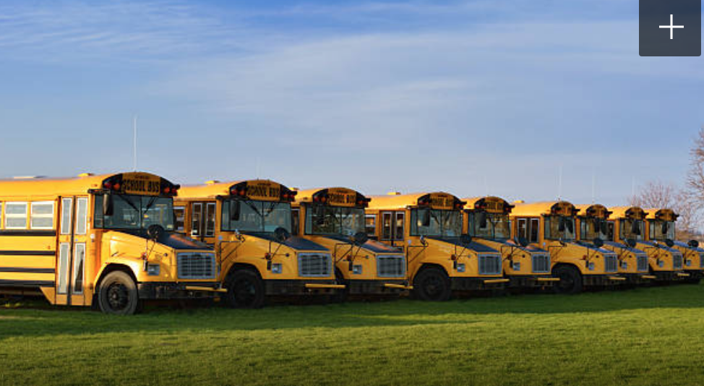
EACH DAY IN THE UNITED STATES, 500 MILLION STRAWS ARE DISPOSED OF. THAT IS ENOUGH TO FILL 46,400 SCHOOL BUSES.

Slide 13
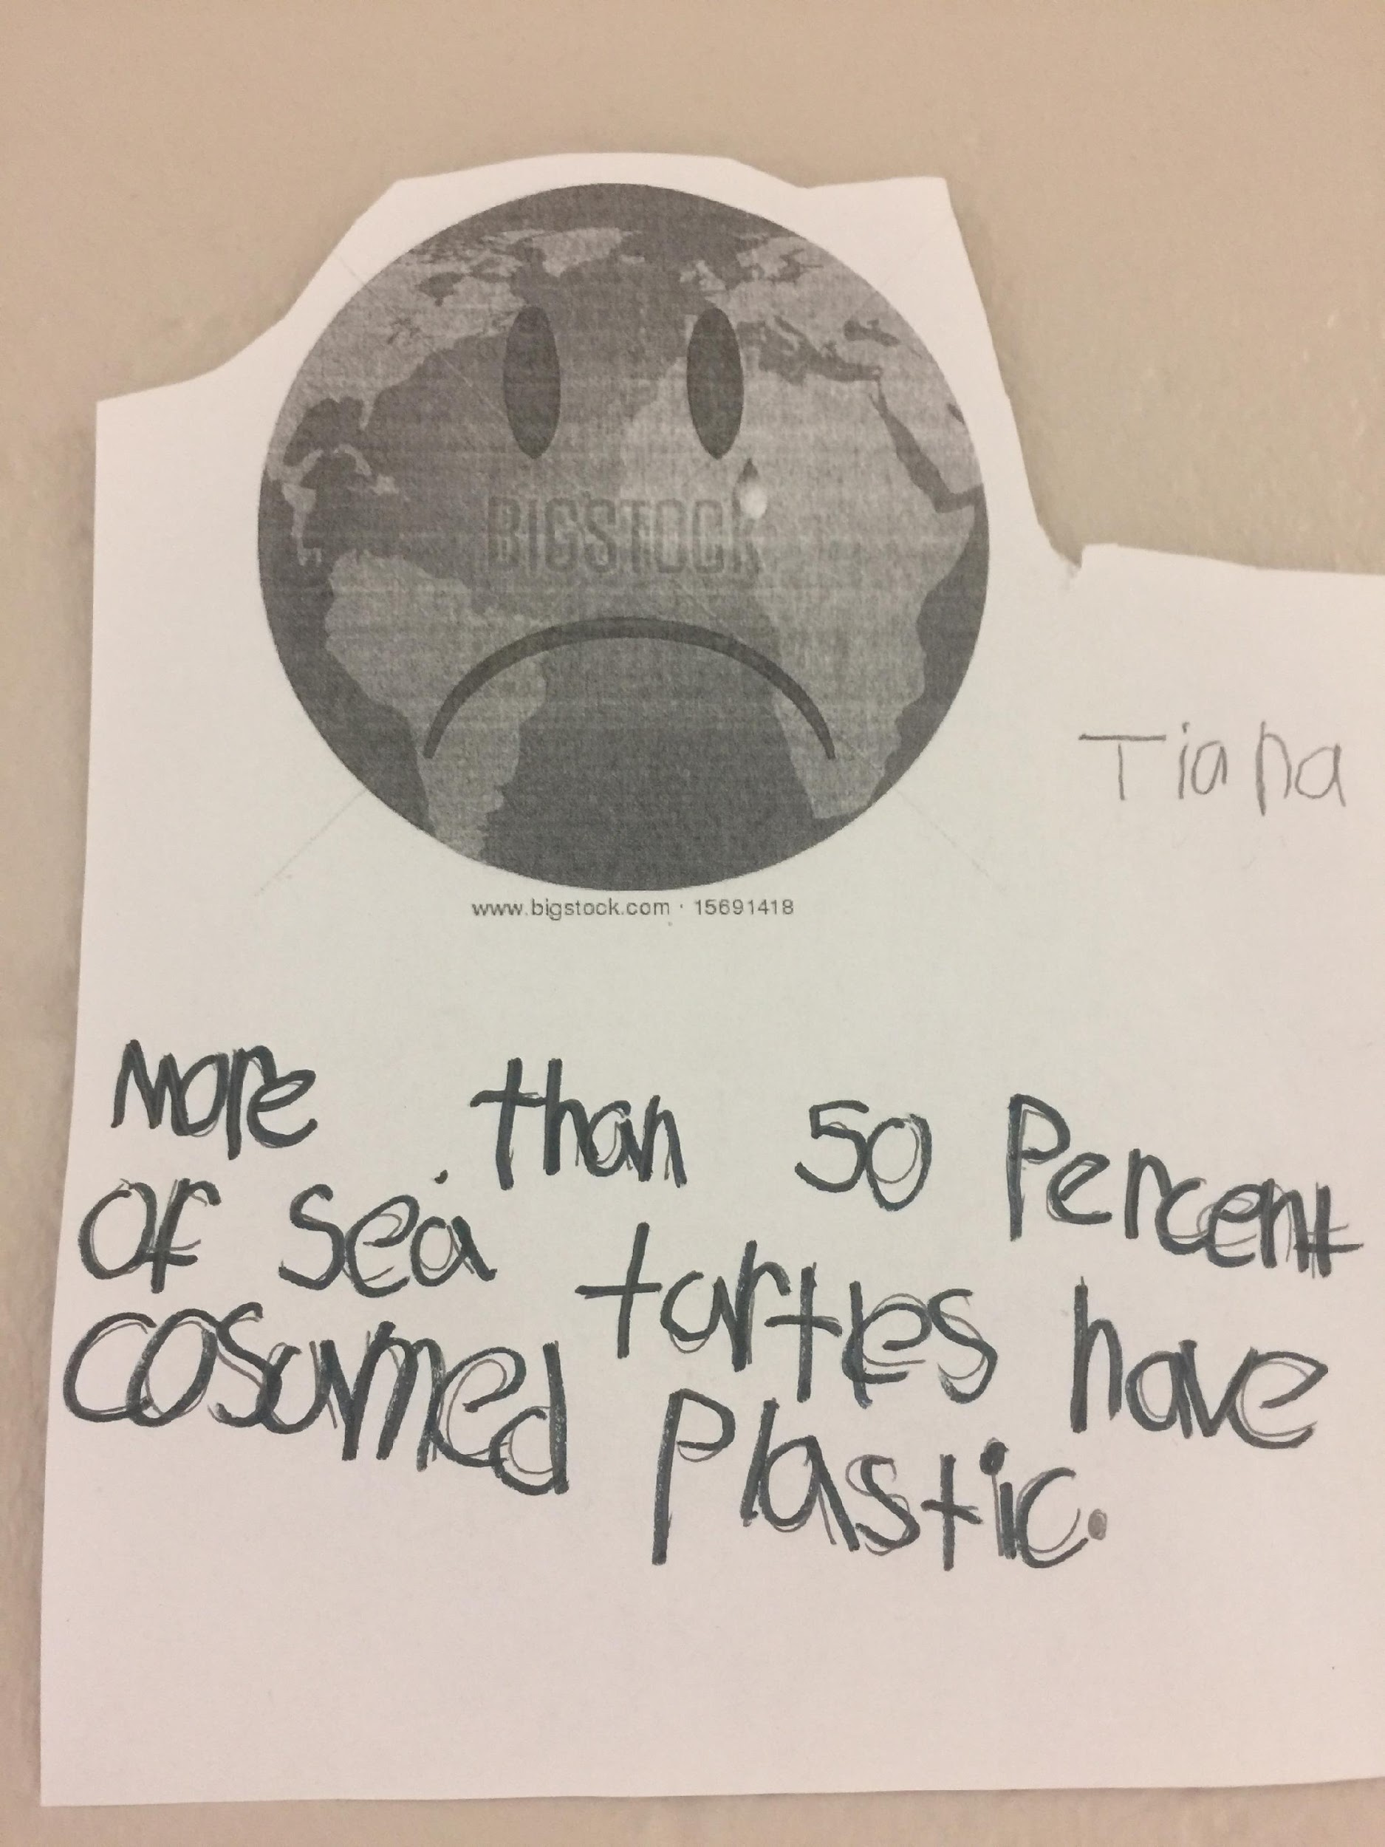
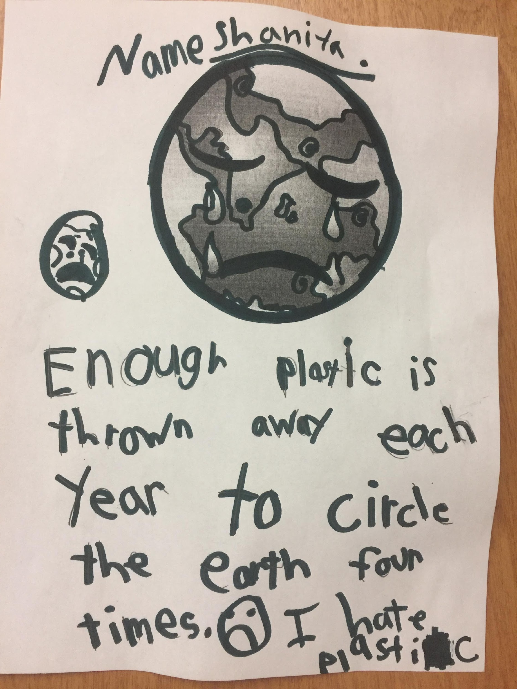
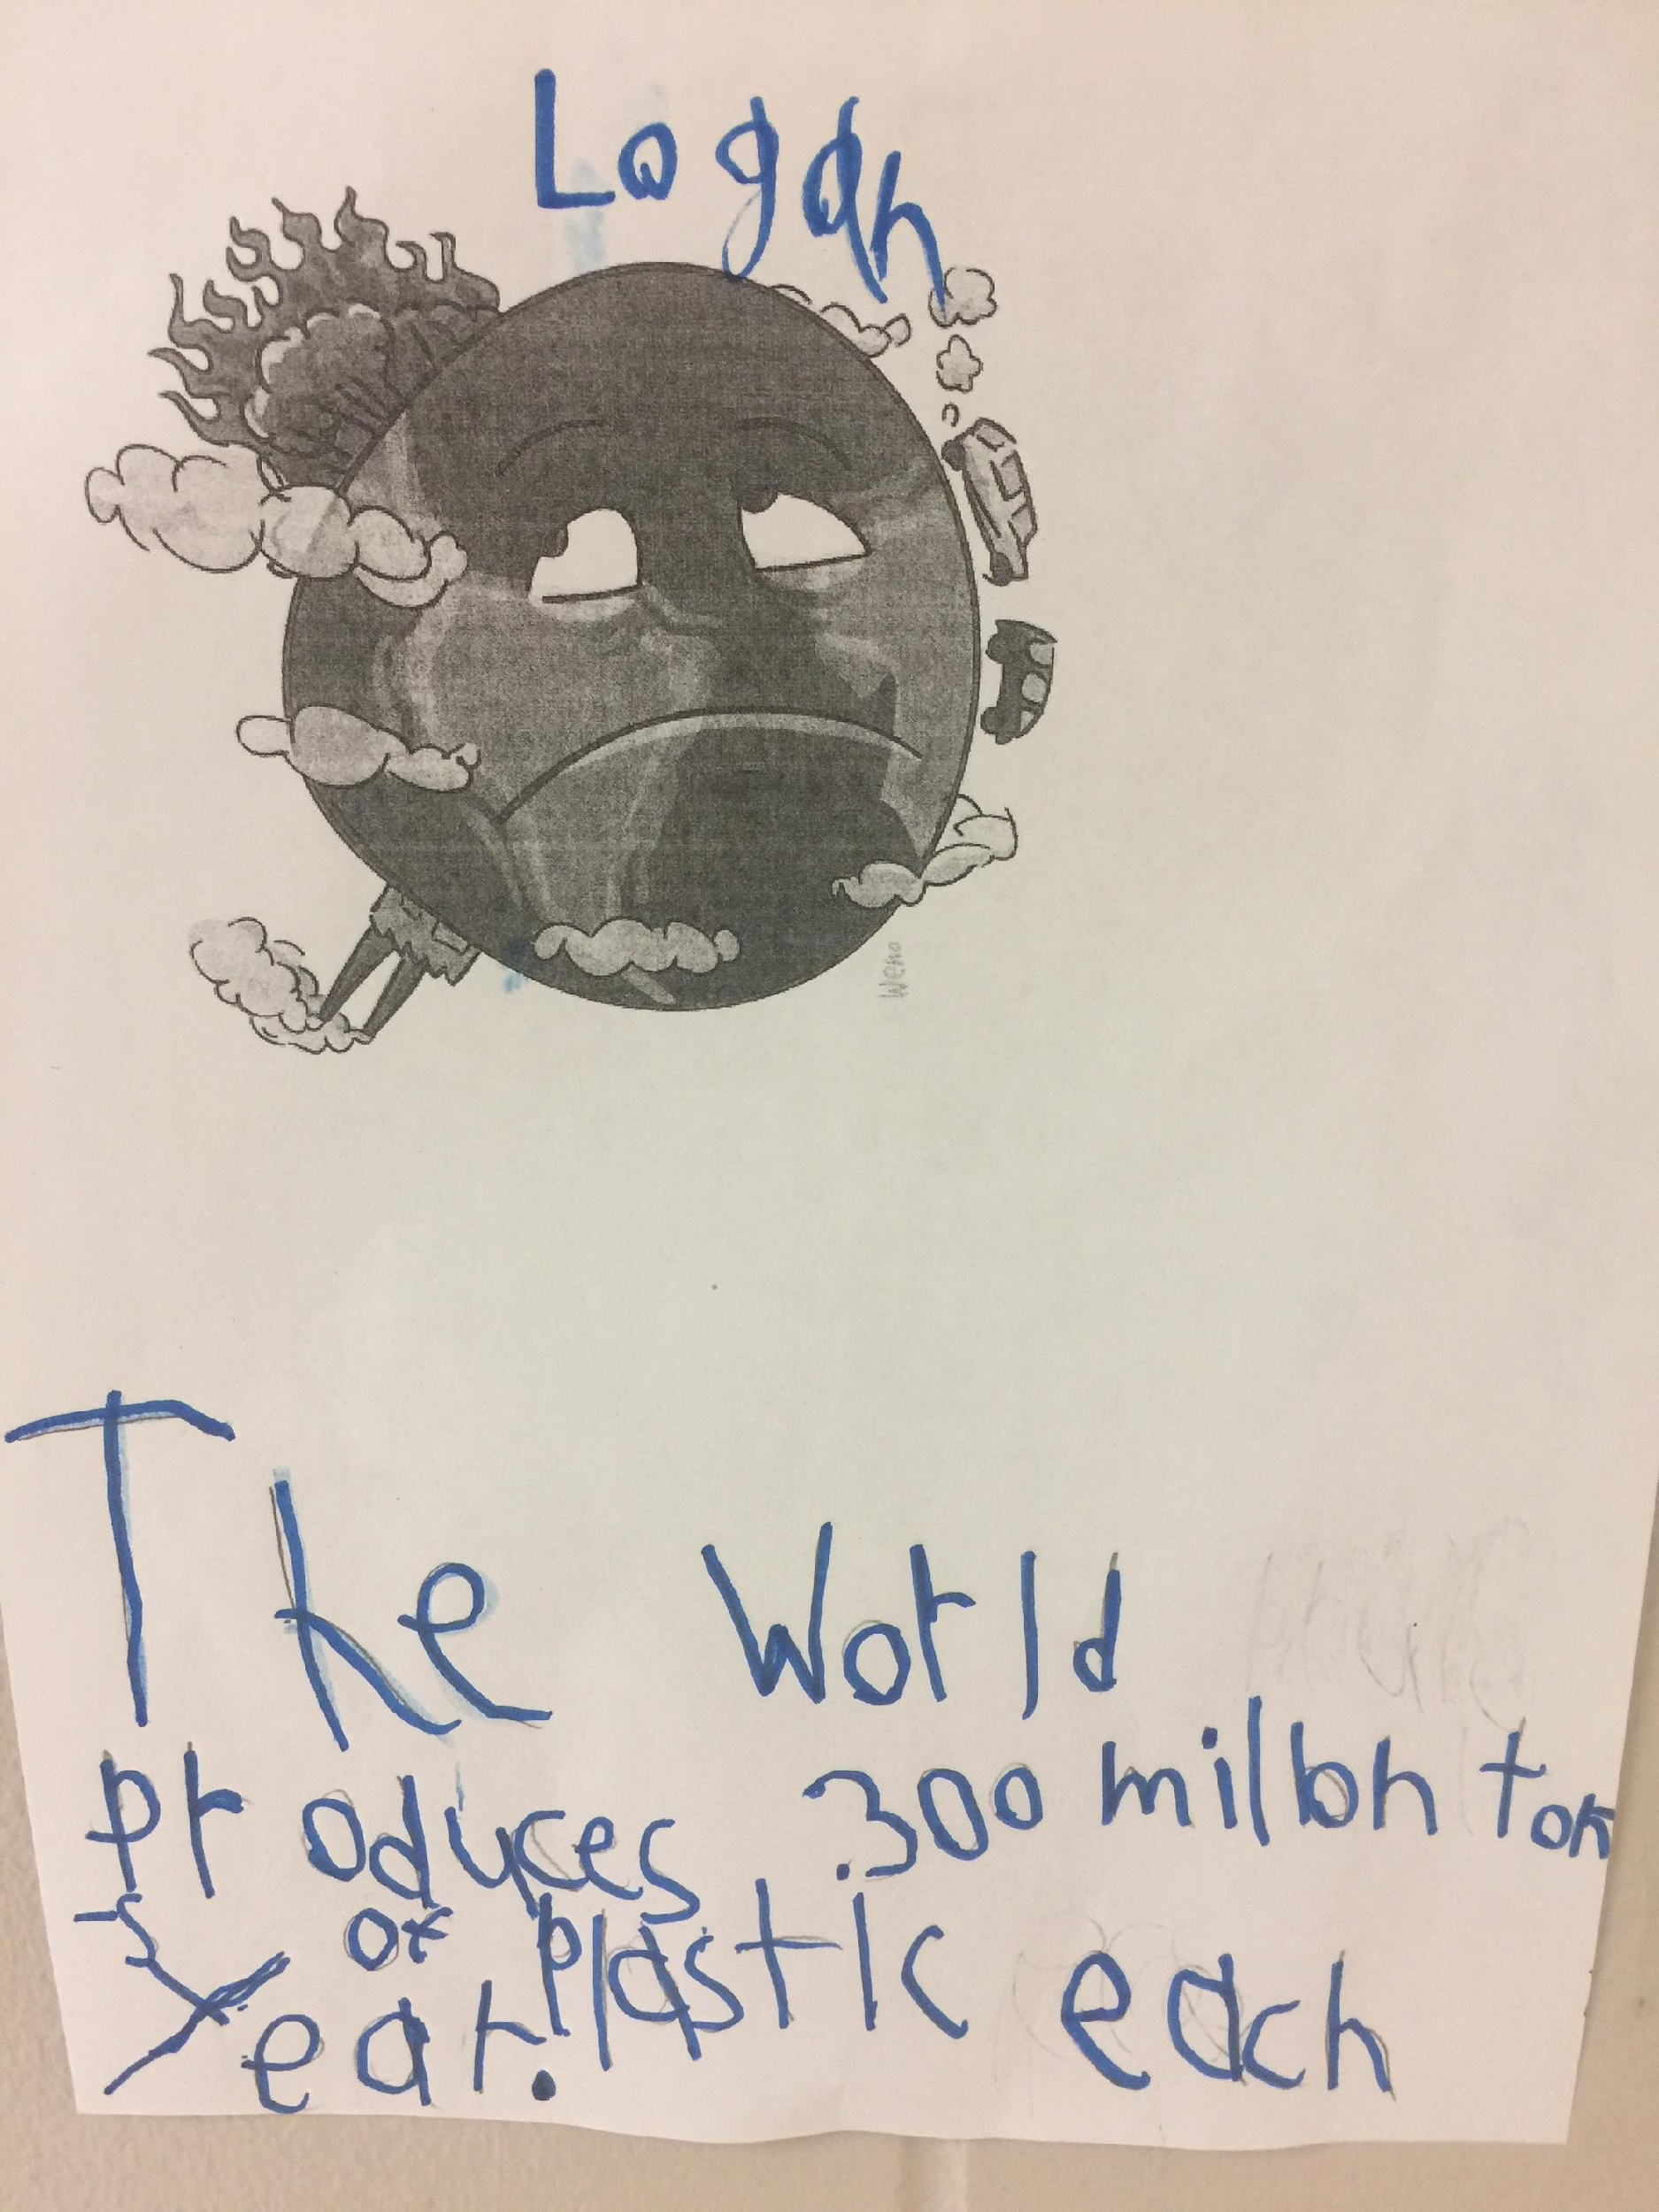
CRITICAL CONSCIOUSNESS
Students at Tates Creek Elementary were very disturbed by images of ocean life being destroyed by plastic pollution. The students did research on the effects of plastic and other pollutants in our oceans. They made posters in order to educate the public about the millions of plastic straws being dumped into our oceans on a daily basis
Cafeteria monitors reported hearing the children implore others to not use straws and save the fish!

Slide 14
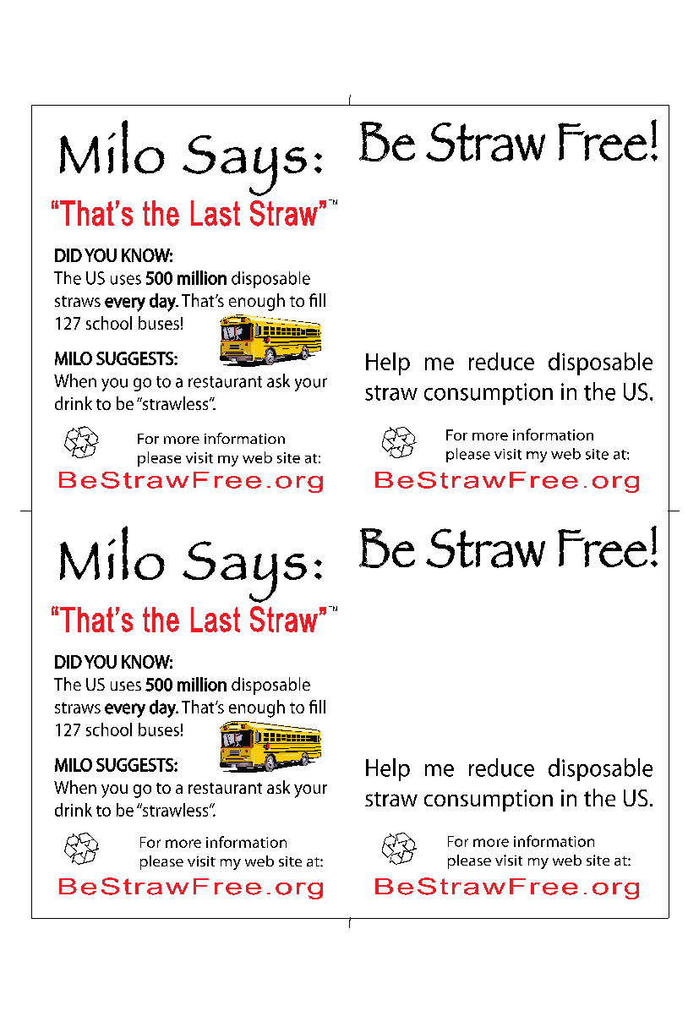

Slide 16
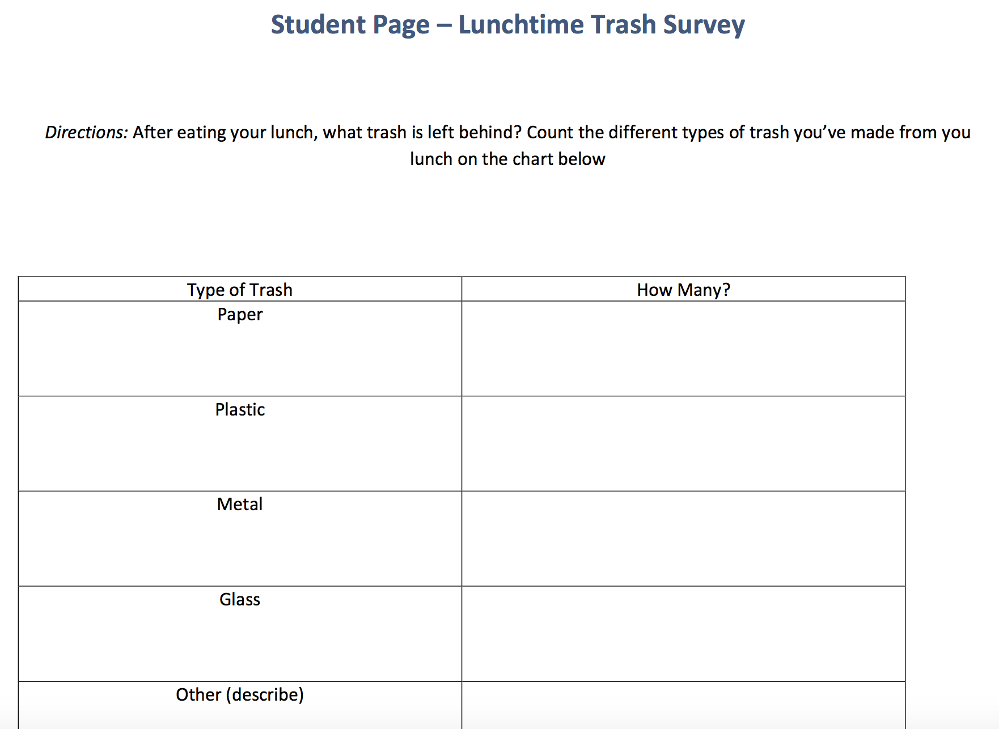

Slide 18
LISTEN RESPECTFULLY TO OPPOSING ARGUMENTS!

Slide 20
CRITICAL CONSCIOUSNESS
On the Table discussion on school & community safety

Slide 21
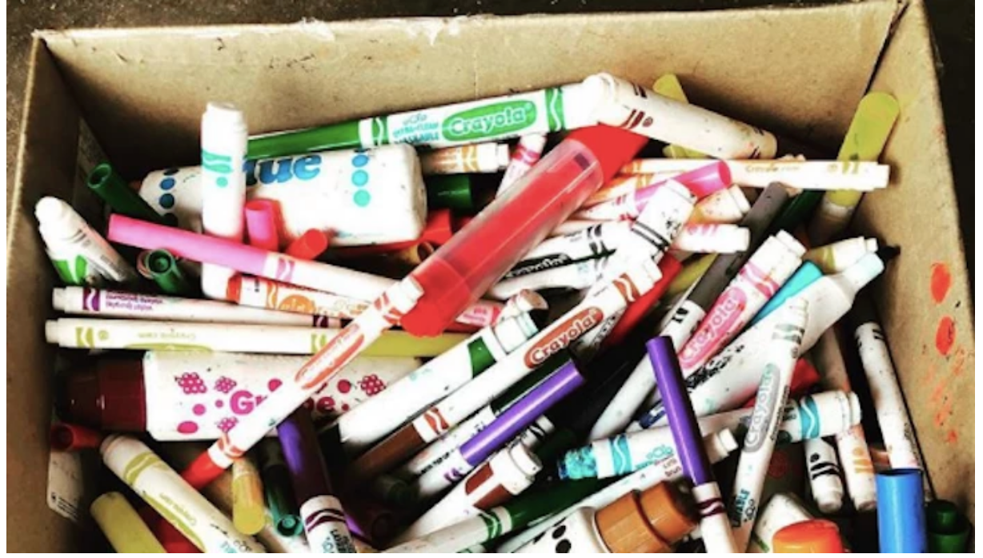

Slide 22
PLANTING TREES WITH THE URBAN FOREST INITIATIVE

Slide 23
TWO RECYCLING BINS/RECYCLING CARDBOARD

Slide 24
FIELD TRIP TO THE MRF

Slide 25
PRESENTATIONS FOR CLASSROOMS

Slide 26
WATER BOTTLE REFILLING STATIONS/TEACHER ENVIRONMENTAL ACADEMY

Slide 27
KENTUCKY ENERGY FOR YOUTH

Slide 28
PARTNERSHIP WITH BLUEGRASS GREEN SOURCE/PLASTIC LID COLLECTION

Slide 29
PLASTIC BAG COLLECTION AND LIDS

Slide 30
Sustainability Resources
*Bluegrass Greensource- You can check out classroom items. They have classroom sets of trash grabbers, micro scopes to look at water organisms, water testing kits, and on and on.
*Teacher Environmental Academy by Bluegrass Greensource SO INFORMATIVE
*Novelis aluminum recycling in Berea- online lessons
*NEED.org (National Energy Environmental Project). - all free downloadable materials- by grade levels, free teacher workshops- local, regional, state, national AWESOME

