Slide 1
Project PLACE c3 Follow-up #1
September 25th

Slide 2
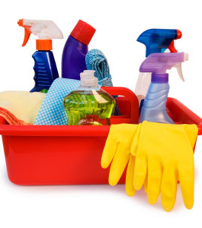
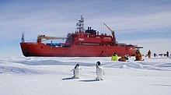
Housekeeping, door prizes, and an icebreaker

Slide 3
Storientation
1. Take an index card. Don't show anyone!
2. Top left corner: Write one word that describes you.
3. Top right corner: Write your favorite holiday.
4. Bottom left corner: Write your favorite food.
5. Bottom right corner: Draw a picture that captures your essence (think like the artist formally known as Prince).
6. Turn your card over when you are finished.

Slide 4
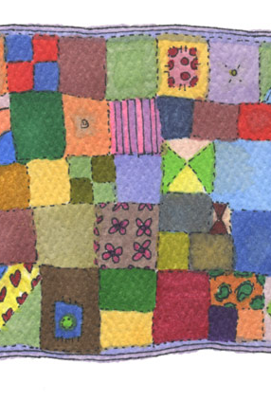
Storientation
7. Choose the person with the closest birthday to be the keeper of the cards. Shuffle them and hand them back out to everyone (it's okay if you end up with your own card!).
8. Start with the person to the right of the card keeper and introduce the person on your card.
If you have your own card or know the person whose card you hold, keep it a secret!
Once everyone is introduced, try to guess who each card belongs to!
9. Tape your index cards together to make a group quilt.

Slide 5
Storientation
What are your ideas for using Storientation in your own work?
How could you use this strategy to develop community in your classroom?
How could you use this strategy with families?
This Photo by Unknown author is licensed under CC BY-SA-NC.

Slide 6
Where we have been
Serving English Learners and all students in culturally and linguistically diverse classrooms through:
Classroom Relationships
Family Collaboration
Assessment
Instruction
Discourse
Critical Consciousness

Slide 7
Instruction: Academic Language

Slide 8
What is academic language?
What is your definition of academic language?
What are the characteristics of academic language?

Slide 9
What is academic language?
Academic language refers to the oral, written, auditory, and visual language proficiency required to learn effectively in schools and academic programs—i.e., it’s the language used in classroom lessons, books, tests, and assignments, and it’s the language that students are expected to learn and use fluently.
(Great Schools Partnership)

Slide 10
Academic Language
Content-specific Vocabulary
Used less frequently; need to be explicitly taught
Neurons, denominator, reef
General Academic Vocabulary
Used in a variety of contexts; need quick clarification; built through extensive reading
Effect, structure, perspective
Language Structures
Grammatical building blocks (tense; conjunctions, prepositions, sentence-level, etc.)
As a result, because, around

Slide 11
Teaching Academic Vocabulary
Recommendation: Teach a small set of words intensively across several days
Use short, engaging informational texts as a platform
Use multiple modalities (writing, speaking, listening)
Give student-friendly explanations, concrete examples, non-examples, drawings
Teach independent word learning strategies (word parts, cognates)

Slide 12
Explicitly Teaching Vocabulary
Choosing the Words:
Choose just a few (maybe 5-8).
Words central to text understanding
Words frequently used in the text
Words that might appear in other content areas
Words with multiple meanings
Words with affixes
Cross-language potential (cognates)

Slide 13
Choosing words
Which vocabulary words would you choose to teach?
http://www.watchknowlearn.org/Video.aspx?VideoID=34363&CategoryID=9479

Slide 14
A K-2 example
flows
Things that flow:
Water, air, blood, energy
Synonyms:
Runs, moves, goes along, passes
Other forms:
flow, flowing, flowed
Antonyms: stays still; doesn’t move
Definition: moves from one place to another in a smooth, steady way
Ocean (oceana)
Flows
Collects
Algae (algas)
Brook
Trickles
Notes:
After modeling, divide into grade level groups. Give each group a text from the CCSS exemplar appendix. Have the groups 1. choose the words they would teach; 2. Explore cognates and other forms. Come up with a 3-5 day plan to introduce, teach, and reinforce the vocabulary using the strategies in the book. Post plan and gallery walk.

Slide 15
Build independence
 | -ed | -ing
trickles | trickled | trickling
flows | flowed | flowing
collects | collected | collecting
 | -s
algae
brook | brooks
ocean | oceans
Notes:
----- Meeting Notes (4/20/18 20:37) -----
Grade level group work begins here.

Slide 16
Application Part 1: Content & General academic vocabulary
1. In grade level groups, examine the exemplar text and identify the content—specific and general academic vocabulary you would teach. (5 minutes)
2. Use pp. 141-153 of English Learners Day by Day, K-6: A Complete Guide to Literacy Content-Area and Language Instruction (Celic, 2009) to explore how you would teach content-specific academic vocabulary with the text at your table. (15 minutes)
3. Use the materials at your table to create a vocabulary learning activity to display for the whole group to see. (10 minutes)
Examples: Word sorts, book talk, pre-reading predictions, picture sorts, concept maps, hierarchical graphic organizer.
Use the CCSS exemplar text, planning sheet, and ELL Day by Day to begin a plan….

Slide 17
Academic Vocabulary & language structures
Brick & Mortar Words

Slide 18
“Brick” words = content vocabulary
Topic-specific words and phrases needed to talk about a topic
Key words you might look for in a comprehension assessment
Often the ones highlighted by curriculum materials
Specific nouns, verbs, adjectives, adverbs
May be basic, general or specialized
Examples:
Basic: tree, art, shoes, dry
General: debate, government, assignment
Specialized: germinate, denominator, democracy, homonym
Dutro, S. & Helman, L. (2009). Explicit Language Instruction. In L. Helman (ed), Literacy Development with English Learners (pp. 40-63). New York: Guilford Press.

Slide 19
“Mortar” words = functional vocabulary
Functional words & phrases
The “glue” that holds the content together
Requires knowledge of grammatical features, syntax and conventions
Examples:
A, an, the
If…then
Because
May have been
Before
Accountable Talk is a great example of “mortar” phrases!

Slide 20
Mufaro’s Beautiful Daughters – John Steptoe
Sharks – Seymour Simon
One day, Nyasha noticed a small garden snake resting beneath a yam vine. “Good day, little Nyoka,” she called to him. “You are welcome here. You will keep away any creatures who might spoil my vegetables.” She bent forward, gave the little snake a loving pat on the head, and then returned to her work.
From that day on, Nyoka was always at Nyasha’s side when she tended her garden. It was said that she sang all the more sweetly when he was there.
Sharks are fish, but they are very different from most fish. They belong to a class of fish known as Chondrichthyes (kon-DRIK-these). The name comes from the Greek words chondros, which means cartilage, and ichthyus, which means fish. Like all fish, sharks have backbones, but unlike other fish, sharks have no other bones. Their skeletons are made of cartilage, a tough, white, flexible material, just like the stuff at the end of your nose and in your ears.

Slide 21
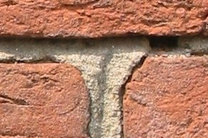
“mortar words” are abstract
You can’t point to a picture
Difficult to act out or demonstrate
Often relate to sentence structure
Articles
Prepositional phrase
Verb phrase
Pronoun + referent
Indicate negation
Abstract descriptors
Because these words are difficult to infer from context, they must be explicitly taught!
As a teacher, you need to
Be aware of mortar words in texts AND
Plan to teach them!

Slide 22
Sentence Frames
Example: Comparing
What is it?
____ and ____ are similar because they both ____.
Both ____ and ____ are/have/can ____.
____ and ____ have ____ in common.
The traits they have in common are ___________.
They are similar because ________.
In comparison, _____ is ______.
Frames leave one or more portions of the sentence blank
Blanks can occur at beginning, middle, or end
Or in several locations
Model specific language structures, forms, and patterns
TIP: Provide several variations of the language pattern!

Slide 23
Paragraph Frames
Example: Comparing
What is it?
Both ____ and ____ are ________. However, _____ are ____ whereas ____ are ____. On the one hand, ______ and _____ are similar because ________. On the other hand, they are different because ________.
Frames provide the overall paragraph structure, while leaving blanks for content
Model structures that connect ideas across sentences
Allow students to demonstrate content knowledge in writing, while also removing some of the cognitive load of having to also come up with the language structures

Slide 24
Language Stems & frames
Both strategies are appropriate for written or oral responses
They can be used to
Introduce a language structure (i.e., before reading a text)
Help students practice writing their own sentences with the target structure

Slide 25
Scaffolding academic language development

Slide 26
Common text structures students encounter
Description
Sequence
Sharks
Habitat
Food
Types
Body
Beginning
Middle
End
Comparison
Cause & Effect
Cookie
Milk
Straw
Frogs
Toads
Turtles | Tortoises

Slide 27
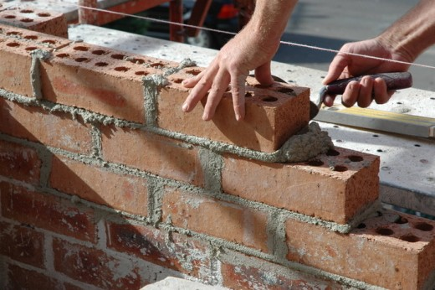
Text Structure: Description
Sharks
Habitat
Food
Types
Body
Author describes a person, place, thing, topic, or idea by listing:
Characteristics
Features
Examples
Important “mortar words”
For example
Characteristics are
Have/do/are

Slide 28
Text Structure: Description
Language Support: Draw pictures or play charades for various characteristics
e.g., large, small, meat-eating, long, heavy
Hands-On Activity: Classroom scavenger hunt for items that fit specific descriptions
Graphic Organizer: Draw or write characteristics on a web
Sentence Frames:
The dwarf goby is the ____ fish.
The Siberian tiger is 14 feet ____ and weighs 500 _____.
A _____ and a ______ both have hands like ours.

Slide 29
Text Structure: Sequence
Beginning
Middle
End
Important “mortar” words:
First, second, third
Next
Then
Finally

Slide 30
Text Structure: Sequence
Language Support: Use pictures of foods or bring in examples of actual foods for students to handle
Hands-On Activity: Compare the caterpillar’s food to the school lunches for the week
Graphic Organizer: Calendar or timeline
Draw pictures or write words for each food on corresponding day
Sentence Stems:
On Monday, he ate…
On Saturday, he ate…
Sentence Frames:
On ____, the caterpillar ate one ____.
On Thursday, he ate through four _____, ___ he was still ____.
On ____, he ate through ____ oranges, ____ he ___ still hungry.

Slide 31
Text Structure: Comparison
Frogs
Toads
Signal “mortar” words:
Different
In contrast
Alike
Same as
On the other hand
Turtles | Tortoises

Slide 32
Text Structure: Comparison
Language Support: Pictures or diagrams
Hands-On Activity: Sort picture or word pairs into same/different categories
Graphic Organizer: T-Chart or Venn diagram
Sentence Frames:
Frogs have _____, but toads have _____.
Both ____ and ___ have ______ in common.
____ and ___ are similar because they both ____.

Slide 33
Text Structure: Cause & Effect
Cookie
Milk
Straw
Signal “mortar” words:
Reasons why
If…then
As a result of
Therefore
Because (of)
In order to

Slide 34
Text Structure: Cause & Effect
Language Support: Use realia to act out the story
Hands-On Activity: Memory/Concentration game to match pictures of cause and effect
Graphic Organizer: T-chart or flowchart
Sentence Frames:
If you give a ___ a _____, he’s going to ____.
When you ____, he will _____.
As a result of _____, the mouse wanted _____.

Slide 35
Techniques for Scaffolding academic Language development
Teach
Teach sentence & paragraph frames
Provide
Provide experiential, hands-on learning opportunities related to the content & topic
Use
Use graphic organizers to help writers plan and show relationships between ideas

Slide 36
Your Task: Application
Use your team’s text & add to your vocabulary plan from the morning (30 minutes):
Analyze your text for “mortar” words & phrases
Select a language structure and target frames to focus on in your lesson
Identify a hands-on, contextualizing activity that connects to the text and its structure
Hint: Appendix G of your book has great ideas!
Create a graphic organizer(s) that could be used for either making sense of the text or planning writing
Create 2-3 appropriate sentence frames for the task and target language structure
Bonus challenge: Try creating sentence frames for different levels of language proficiency!

Slide 37
Break time!

Slide 38
Generative Vocabulary matrix
Dr. Rebecca Powell

Slide 40
Advanced Leaders Presentations
Samantha Arnold
Taylor Browning
Nicole Naylor
Brittany Manion

Slide 41
Your Turn to Share
How’s It Going???
In school groups, create at least one poster that shows what you have implemented so far:
What have you tried?
What is working?
What has surprised you?
What barriers have you encountered and how have you tackled those barriers?
What do you plan to do next?
Notes:
Work on this for 25 minutes. Then, 25 minutes to walk around, share, leave feedback for groups.

