Slide 1
Creating and Using a Generative Vocabulary Matrix (GVM)
Developed by Dr. Sue Larson

Slide 2
Benefits of a GVM
Provides a visual display to help students conceptualize content
Provides a “semantic map” that helps students see relationships between concepts
Provides a place to capture academic vocabulary and language and revisit it

Slide 3
Steps for Creating a GVM for a Standards-Based Unit of Study
1. Gather a text set. This can consist of articles, books, pictures, videos, individuals to interview, etc.

Slide 4
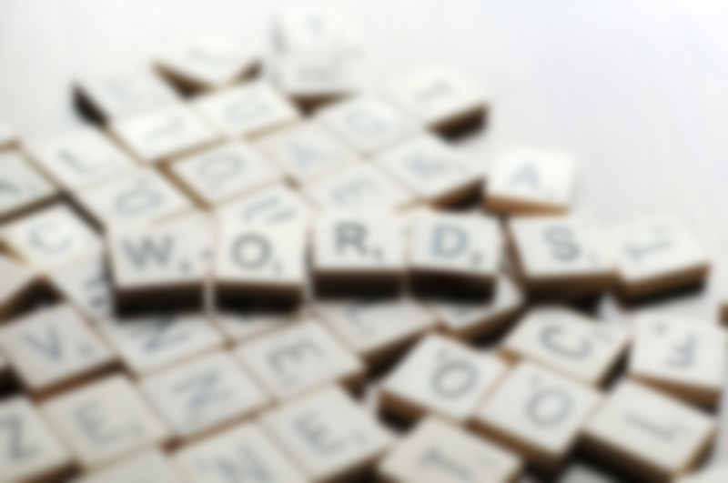
Use the text set to preview the vocabulary and academic language.
What are specific vocabulary words you want to teach/reinforce?
What are some transition words you want to teach/reinforce?
What words/language do you want them to use in their writing/speaking?

Slide 5
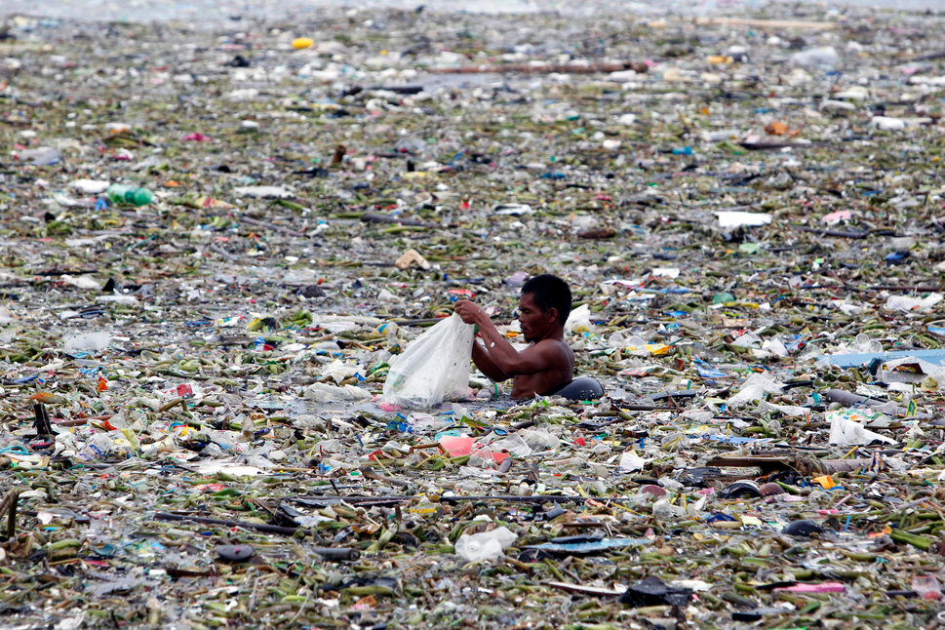
Think of a “spark.”
This is a motivator that is used to spark students’ interest in the study.
Examples:
Video
Picture(s)
News article
Objects

Slide 6
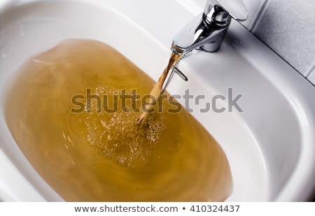

Slide 7
Think of a final product
Speech
Article
Brochure
Presentation
Letter
Book
Dear Representative,
I’m writing to you because I am concerned about the water problems in Martin County, Kentucky…

Slide 8
Plan the GVM
Essential “big idea” question(s)
Basic concepts
Semantic structure that supports the concepts
Academic language
Consider section for student “wonders”

Slide 9
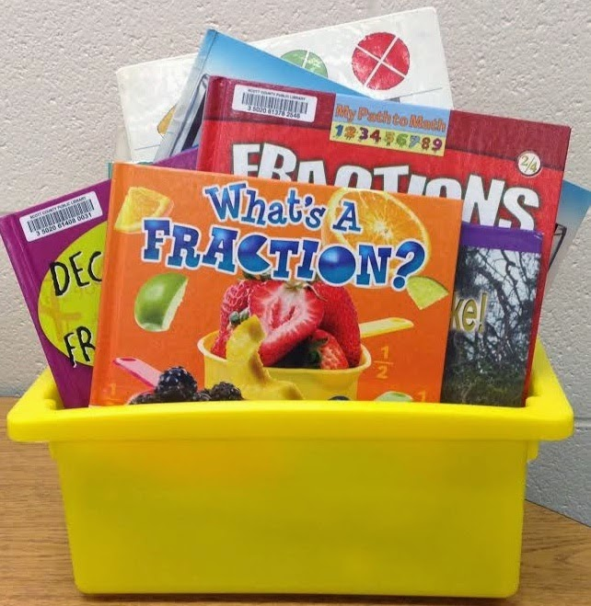

Slide 10
Begin to implement the GVM with the “spark” followed by a text that you discuss with your students. After reading/viewing, add words and pictures (if applicable) to the GVM.
IMPORTANT: The GVM needs to be “generated” with students. You will start with a basic plan, but your students will continually contribute to the study and add to the GVM.

Slide 11
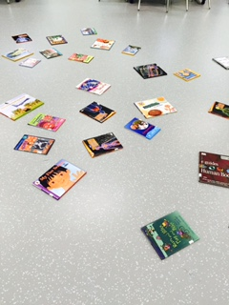
7. Students EXPLORE a variety of TEXTS

Slide 12
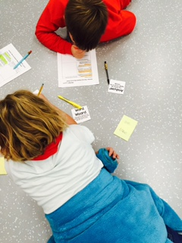
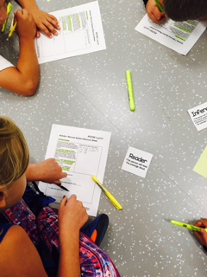
NOTE: Using a graphic organizer can be helpful for ELs

Slide 13
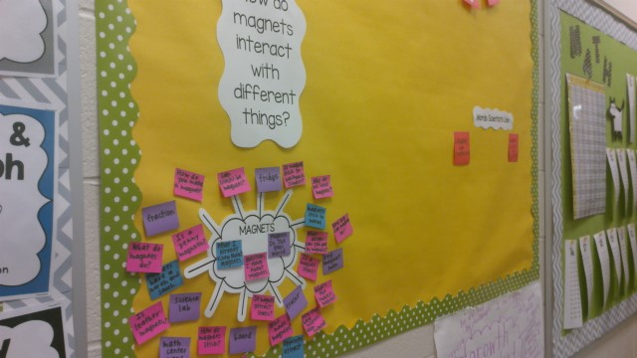
magnets inquiry 2.MP4

Slide 14
As your students read, research, and learn more information about the topic, the information is added to the GVM.
New vocabulary words and “mortar words” are also added that are essential for talking and writing about the concepts.

Slide 15
“A GVM may be organized as a web, table, flow chart, array, cycle, Venn, sequence, problem/solution, or other text structure, depending upon the curricular goal.”
Larson, S. (2014). Using a Generative Vocabulary Matrix in the Learning Workshop.

Slide 16
Semantic categorization is what distinguishes the GVM from a “word wall.”
A student groups the words bar model, circle model, and number line together after explaining how the three concepts are related.

Slide 17
8. The concepts and vocabulary on the GVM are used to assist students as they work on their final products (where applicable). Model how to refer to the language and information on the GVM as you develop a written or oral product.

Slide 18
EXAMPLES

Slide 19
Plants and animals use their external parts to help them survive, grow, and meet their needs.
Kindergarten

Slide 20
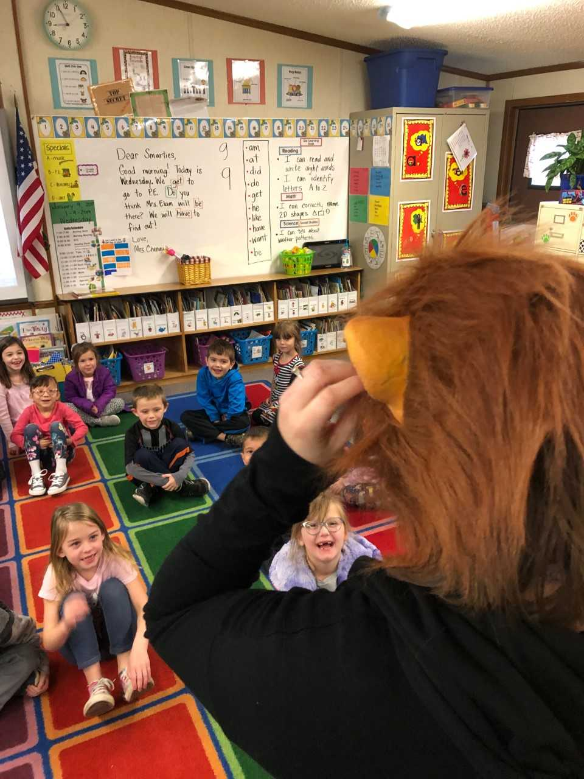
Spark

Slide 21
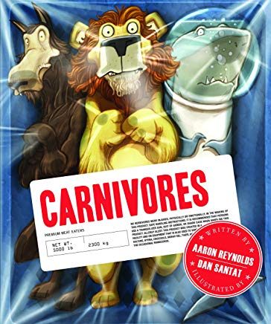
Reading a text

Slide 22
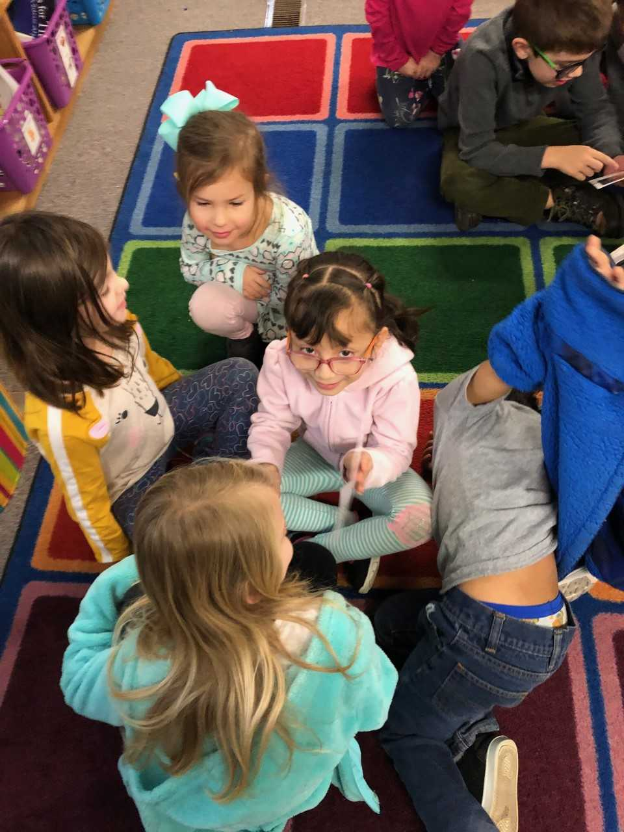
Exploring pictures
What kind of teeth do
carnivores have?
What kind of teeth do
herbivores have?
How do their teeth help
them grow and survive?

Slide 23
Beginning the GVM
Encourage students to use academic language as they add to the GVM. “A horse is an herbivore because… (it eats
plants ).”
Assist students with language production as needed.

Slide 24
Adding to the GVM
Students categorize by deciding where the pictures/labels and vocabulary should be placed.

Slide 25
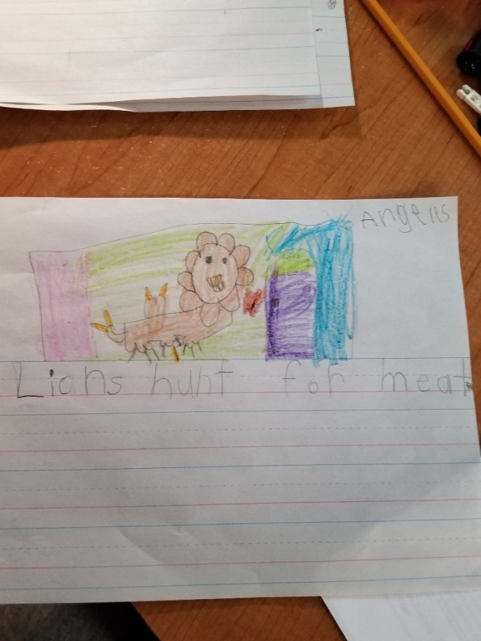
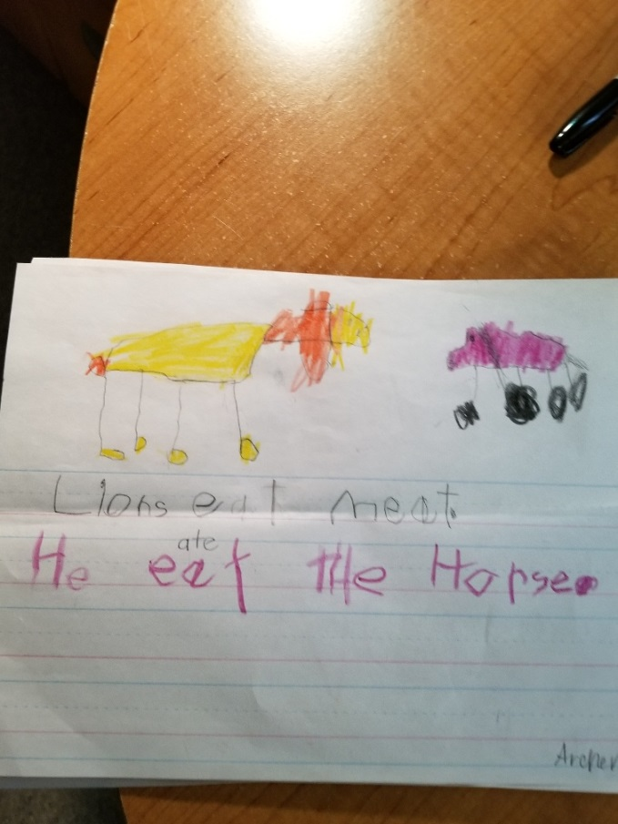
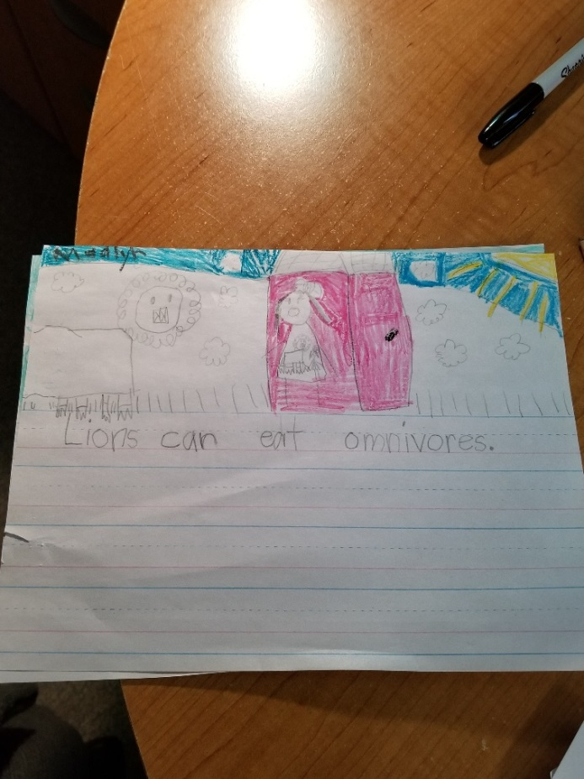
Final product
Model how to use the pictures and words on the GVM to create a final product.

Slide 26
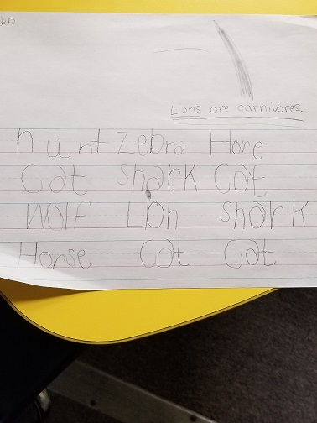
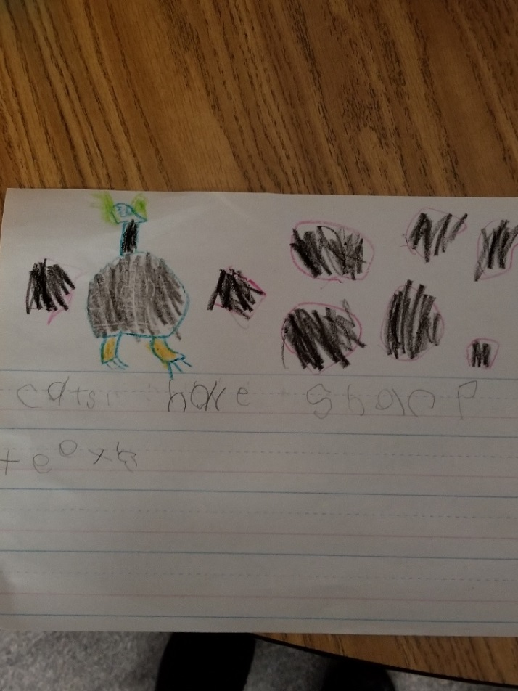

Slide 27
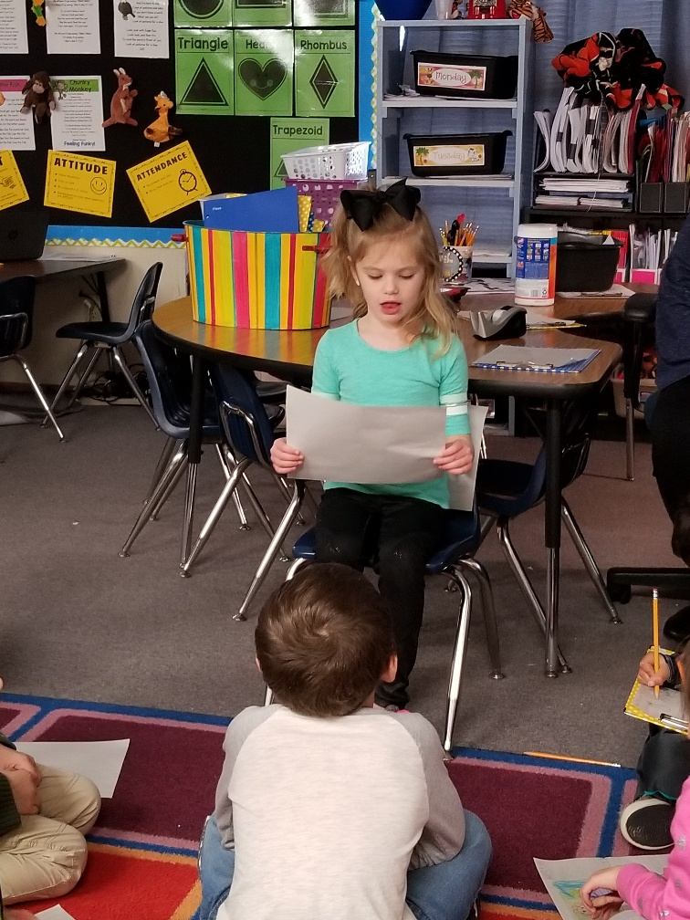
Celebrate!

Slide 28
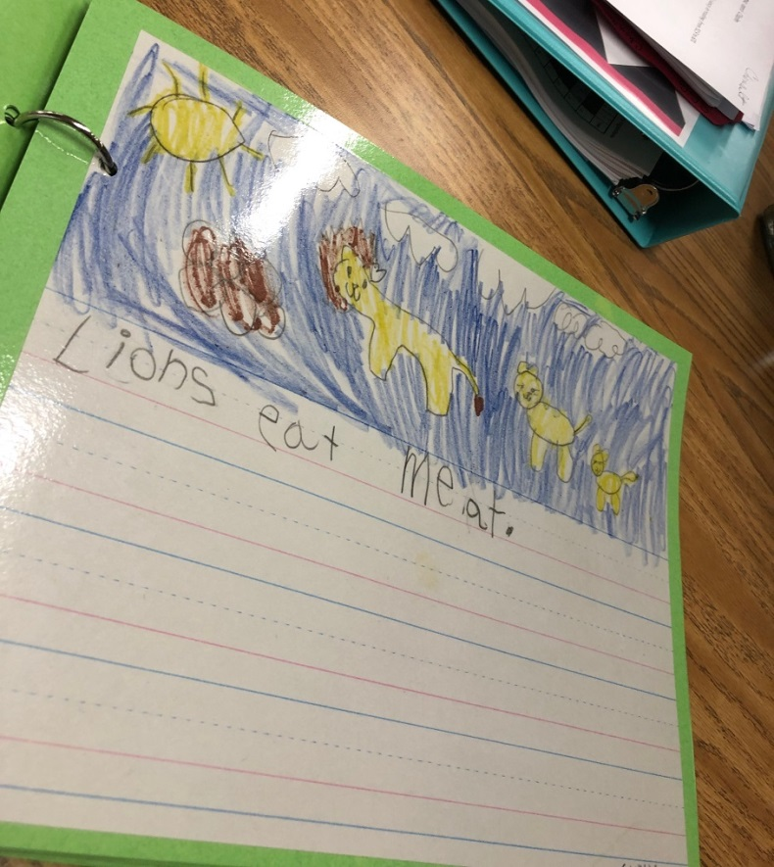
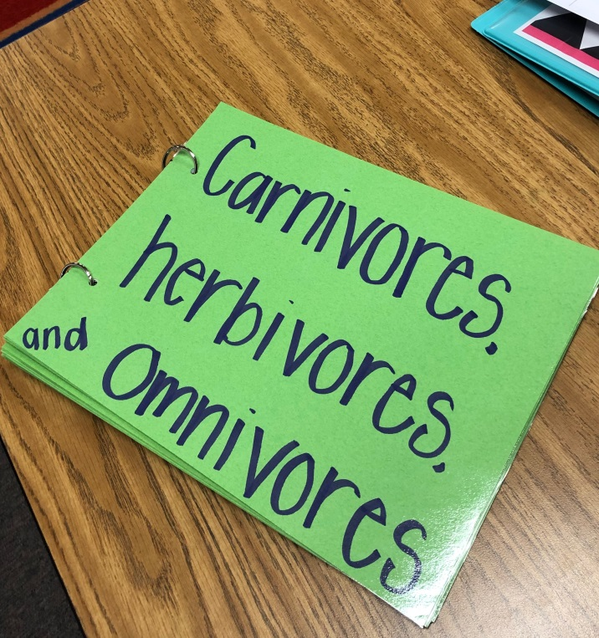

Slide 29
Stephanie Chenault K.wmv

Slide 30
Plants and animals use their external parts to help them survive, grow, and meet their needs.
First Grade

Slide 31
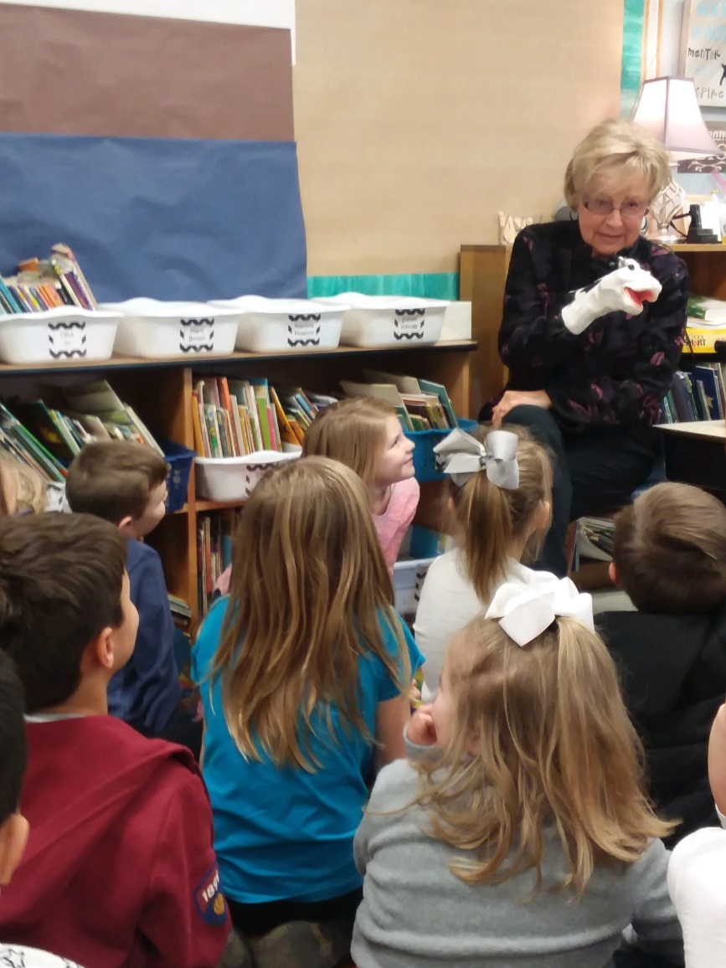
Spark

Slide 32
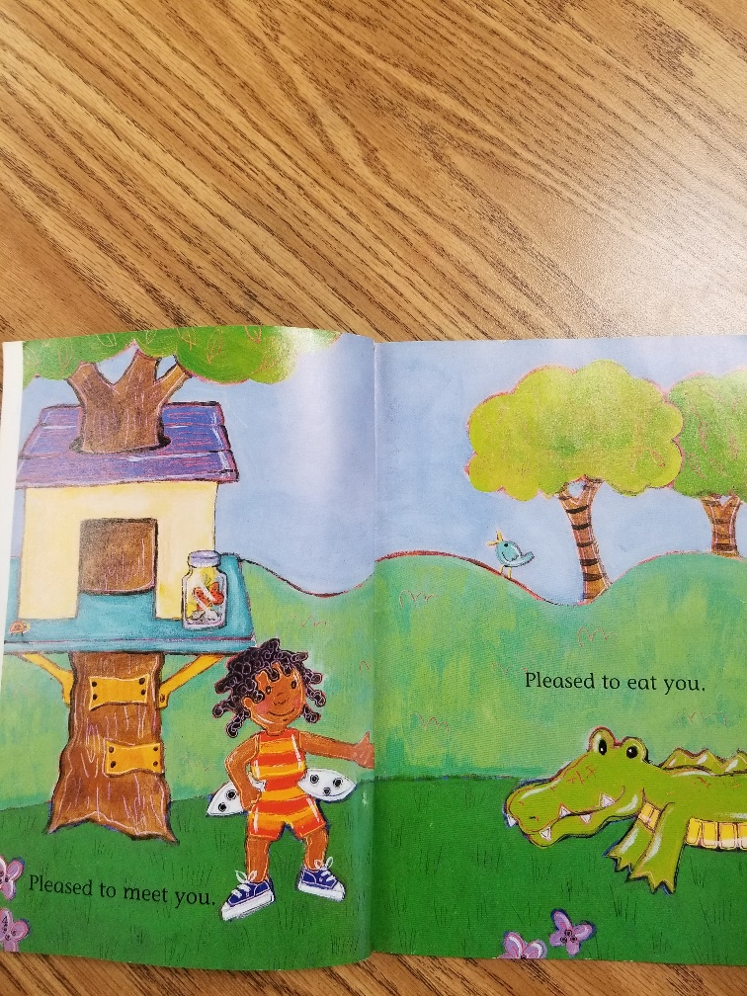
Reading an initial text

Slide 33
Learning about carnivores
https://video.nationalgeographic.com/video/worlds-deadliest

Slide 34
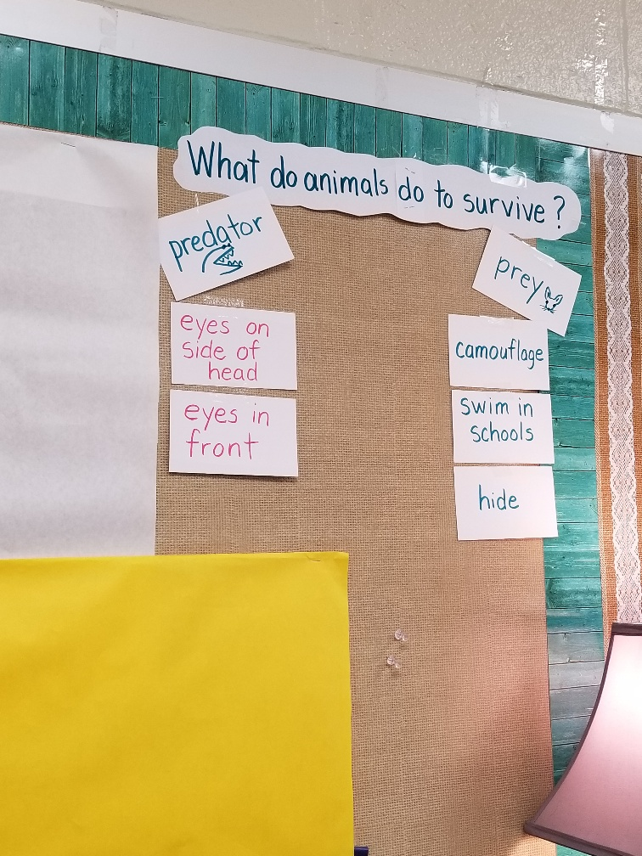
Beginning the GVM

Slide 35
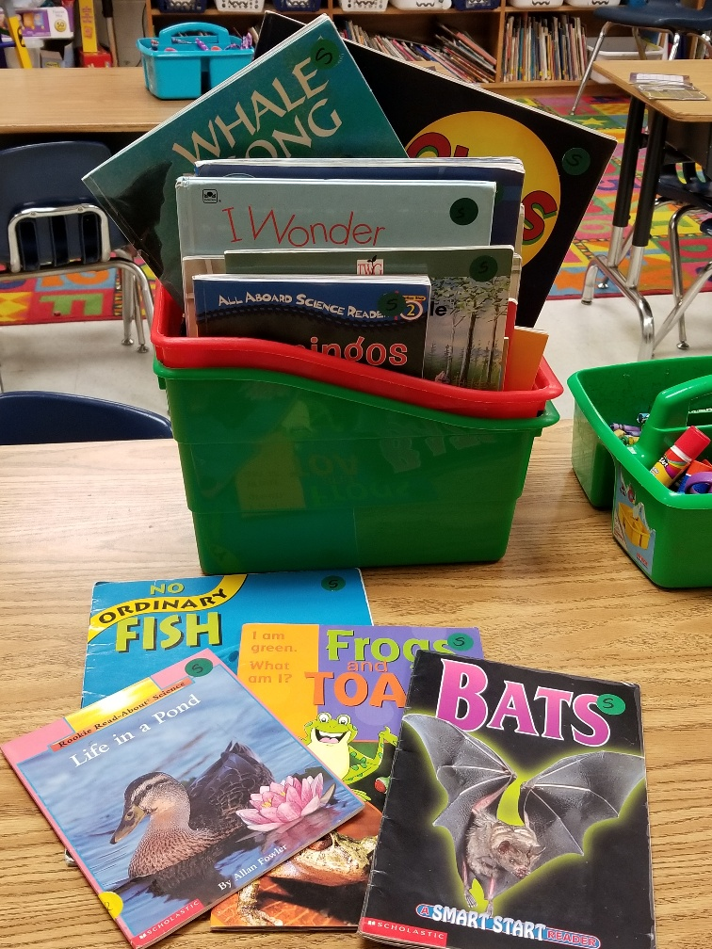
Reading additional texts

Slide 36
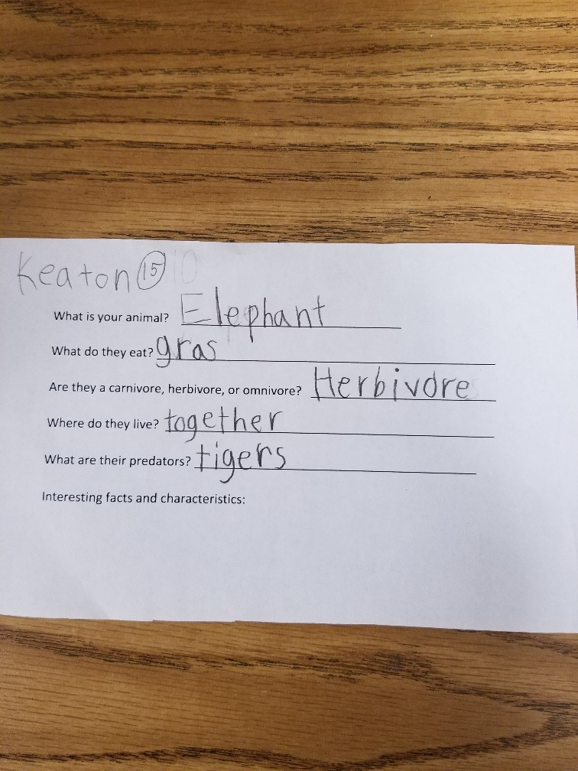
Doing research

Slide 37
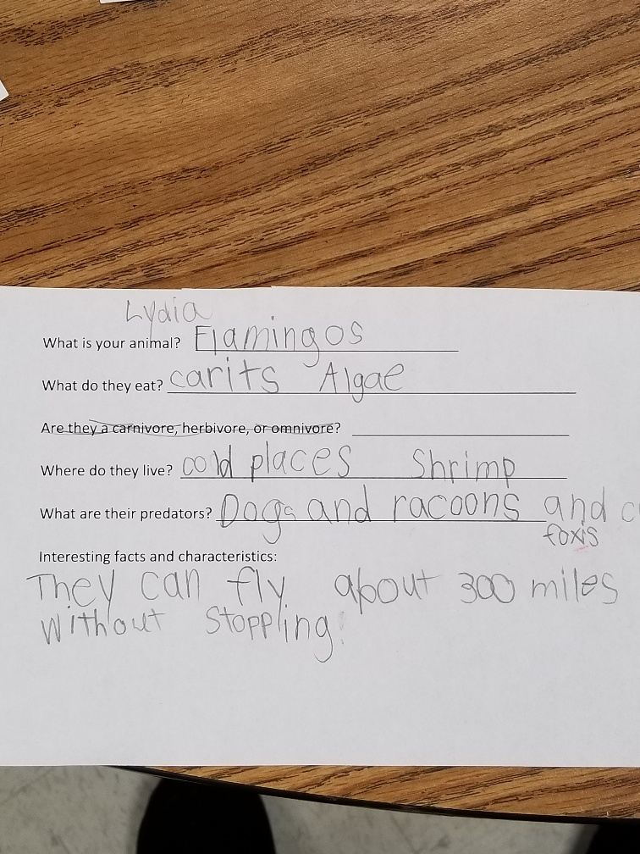

Slide 39
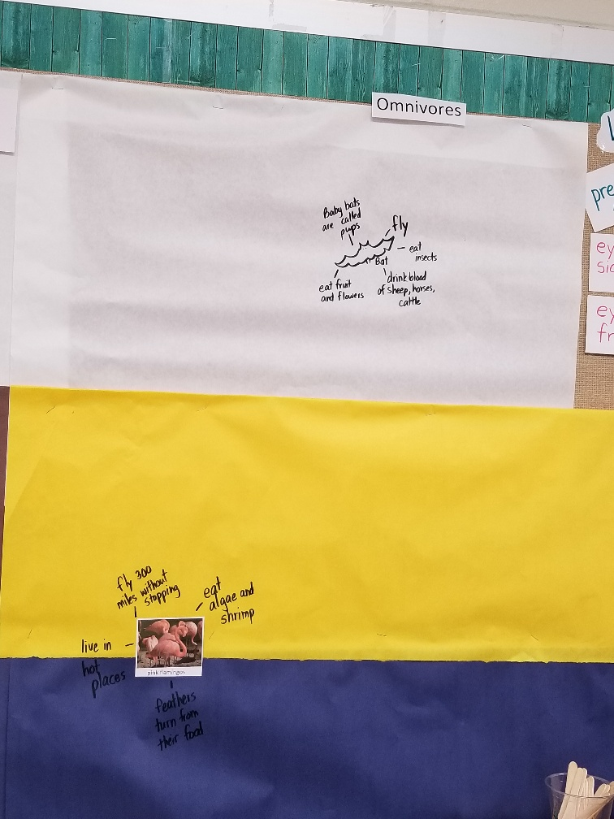
Adding to the GVM

Slide 41
Final Product
Model how to use the pictures and words on the GVM and the research organizer to create a final product.

Slide 42
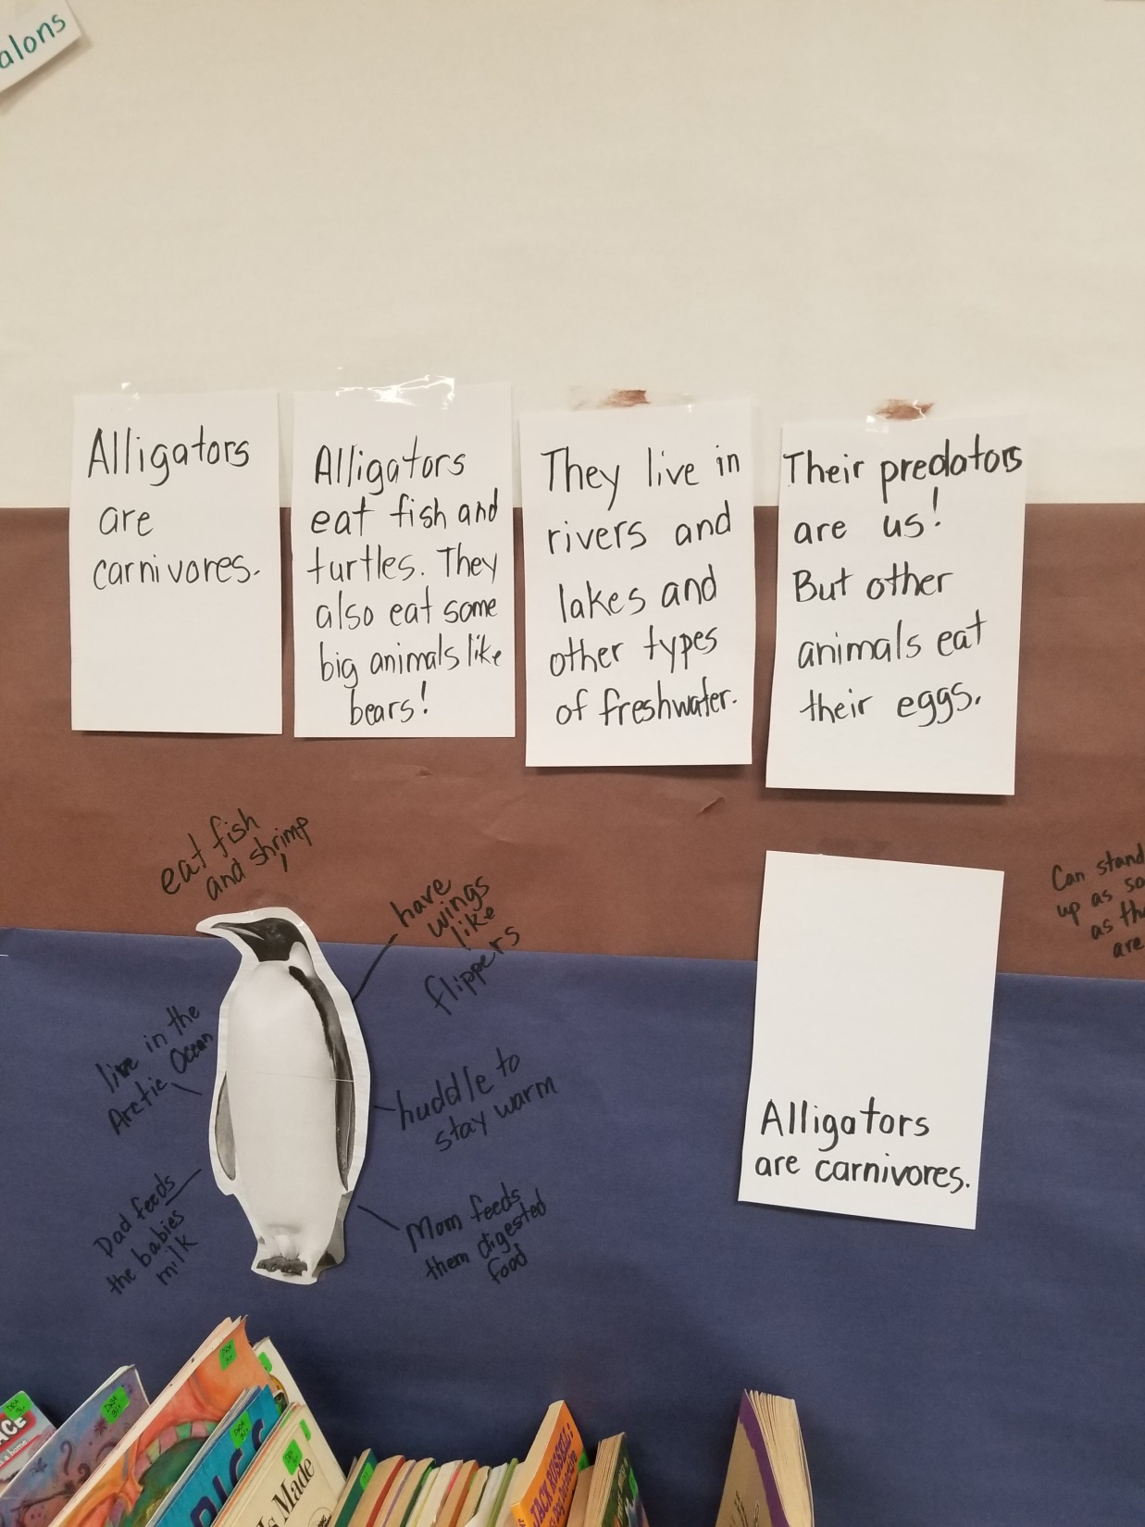

Slide 43
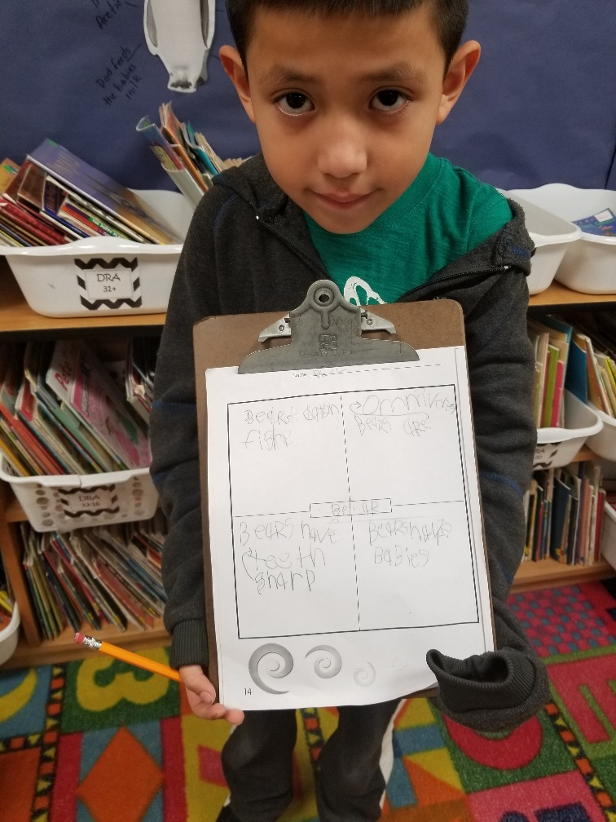
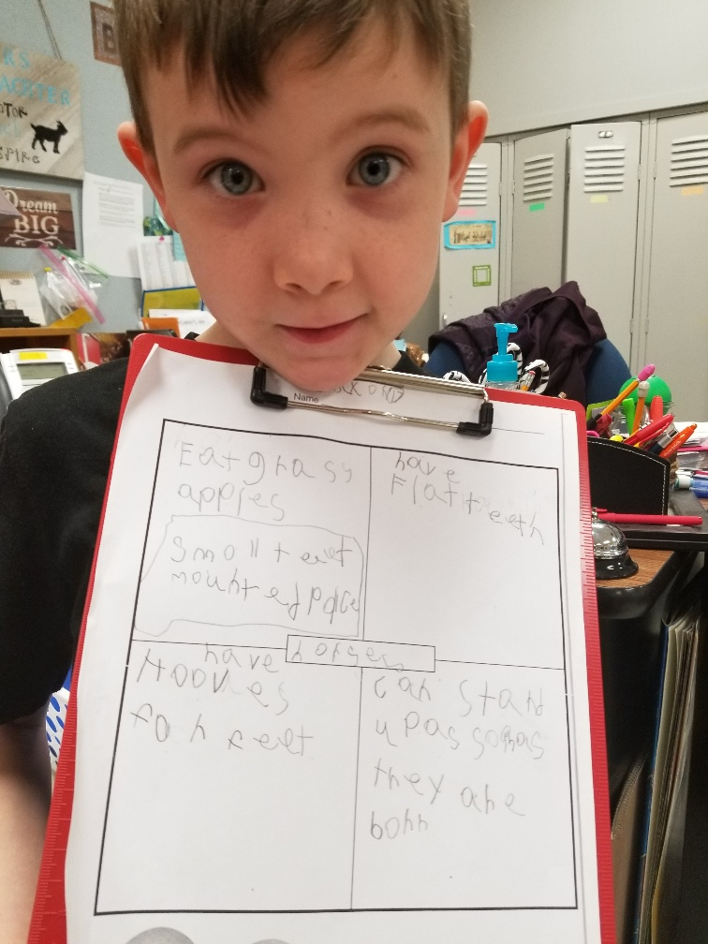
Supporting student writing
Using a graphic organizer

Slide 44
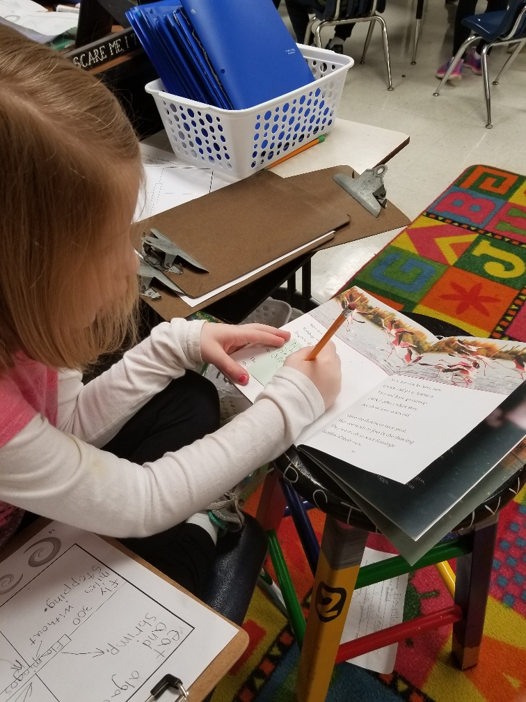
Using texts and the GVM

Slide 45
Learning to write like a writer!

Slide 46
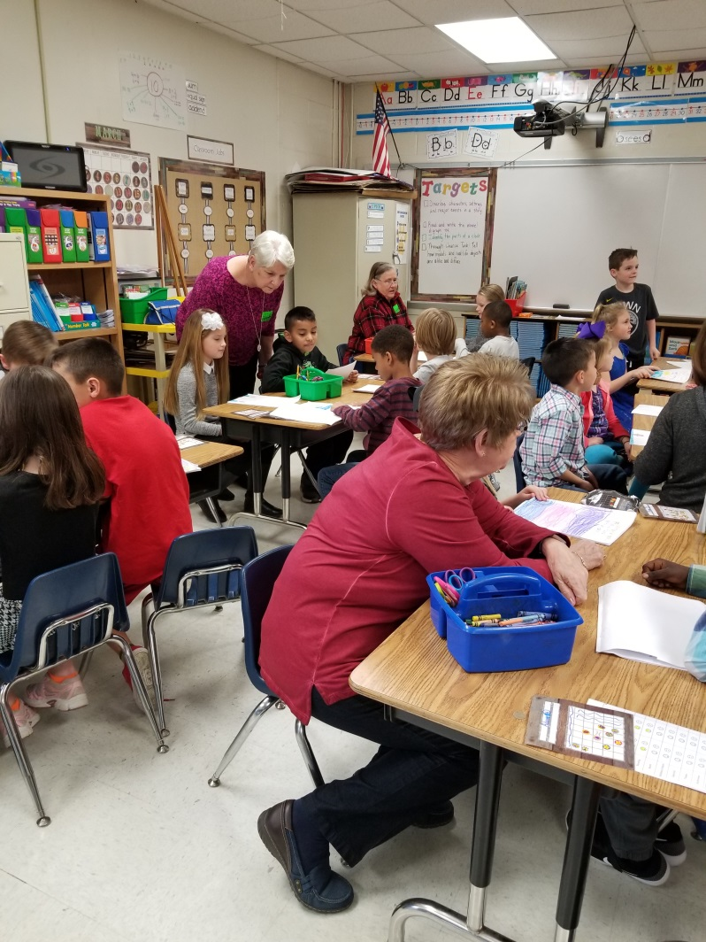
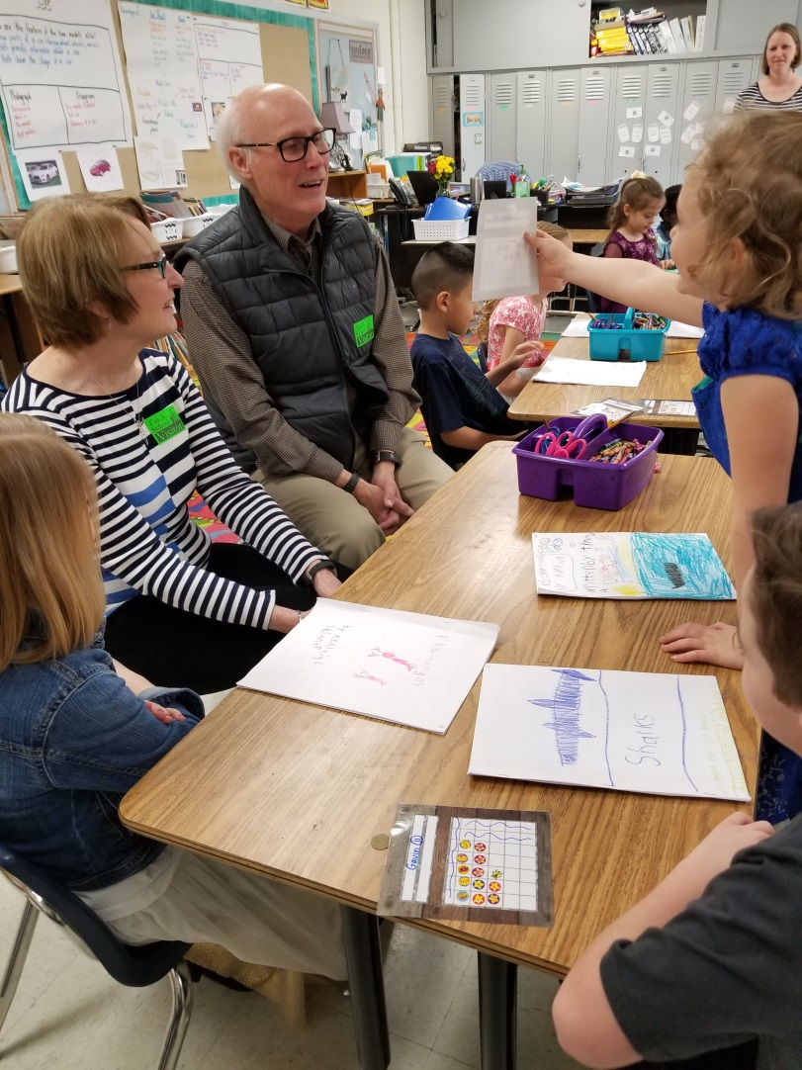
Celebrate!

Slide 47
More examples…

Slide 48
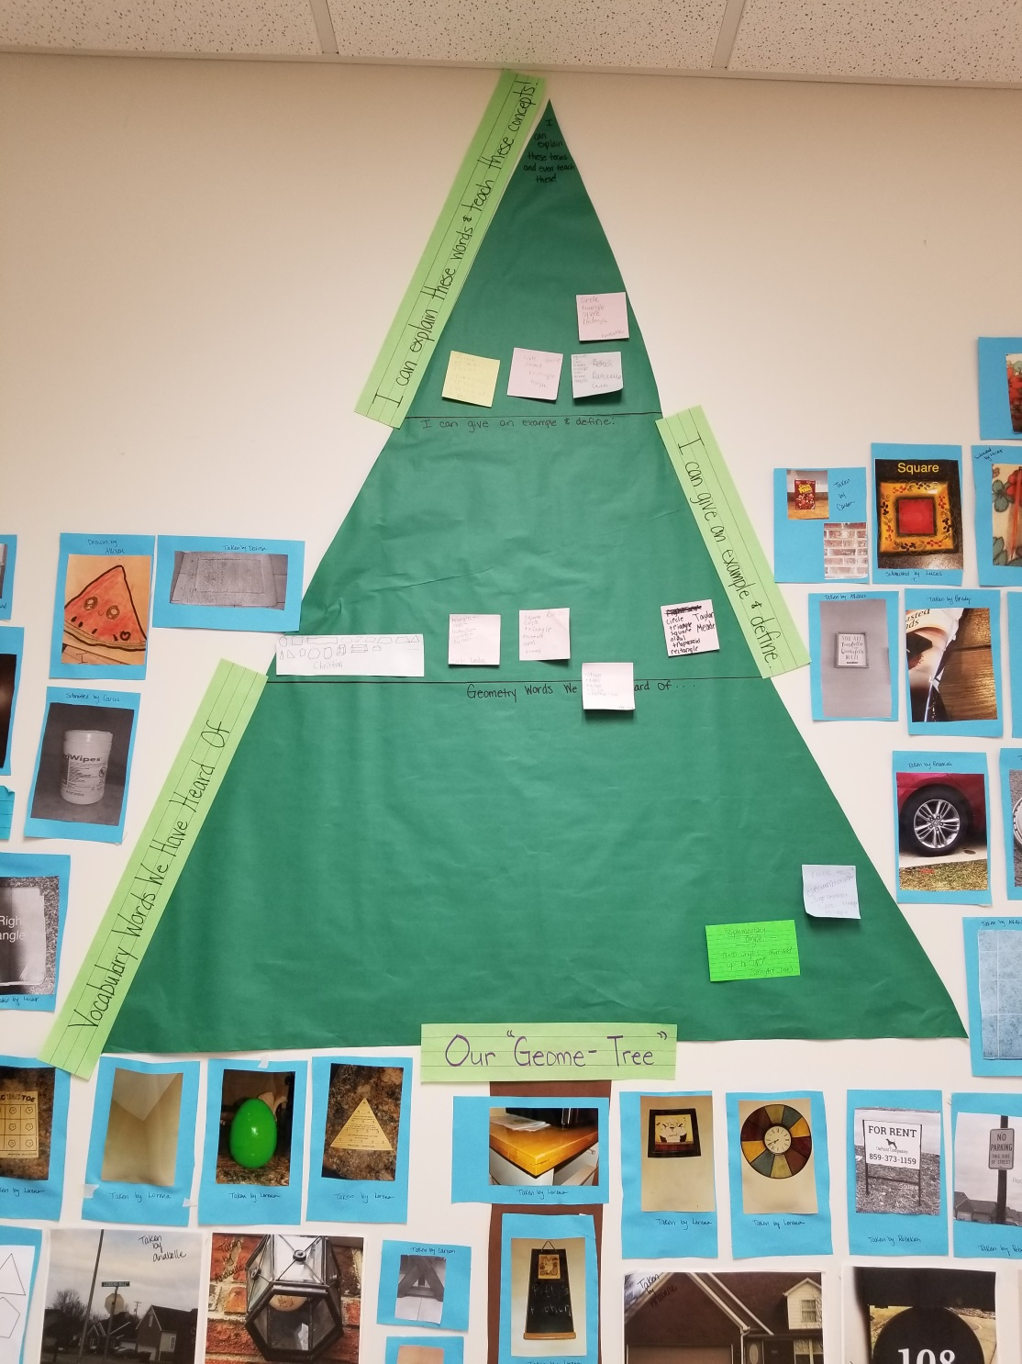
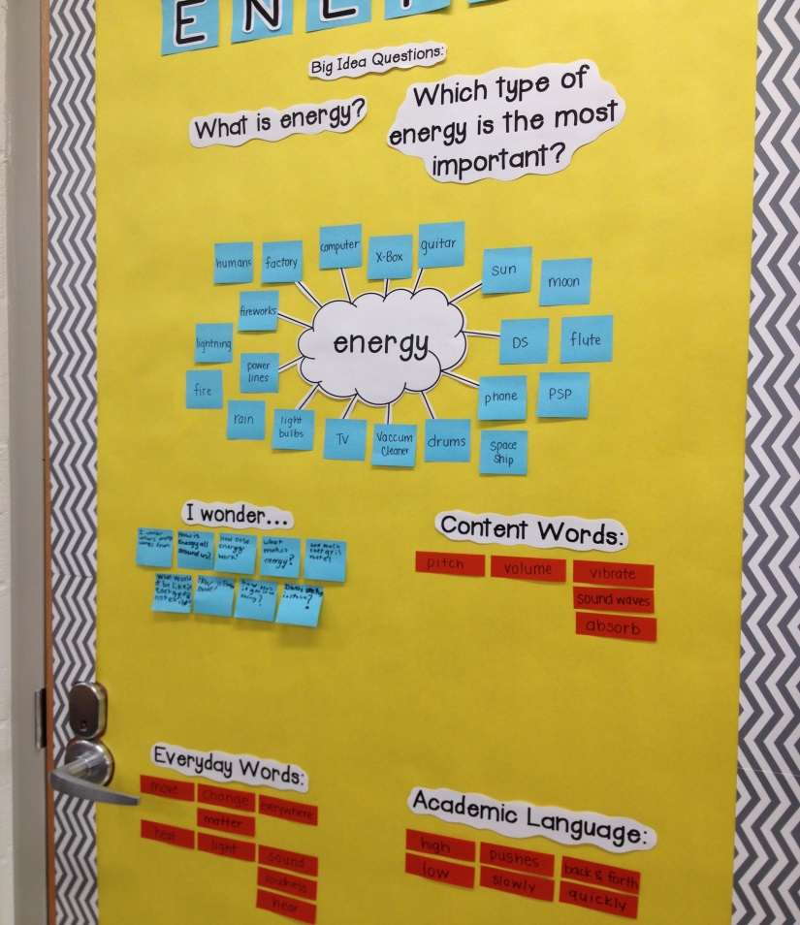

Slide 52
“Because the GVM technique
scaffolds the process of generating conceptual
knowledge, the resulting format
will depend upon the nature of the
content. For example, the life cycle of a
butterfly might be represented as a cycle
diagram. Attributes of an animal might
be displayed as an array.” (Larson, 2014)

Slide 53
A GVM can also be used with a literature study.
It can be very simple, where students identify new vocabulary words and categorize them in ways that make sense to them (parts of speech; we know these/we are still learning these/we never heard of this word; etc.)

Slide 54
OR a literature/content combined GVM…
“The students are making an art piece as we go through the unit with Tangram pieces and then a writing piece along with it.” (Ashley Mangum, 5th grade, Lemons Mill Elementary)

Slide 55
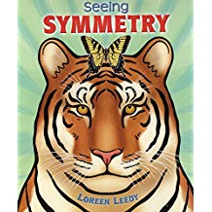
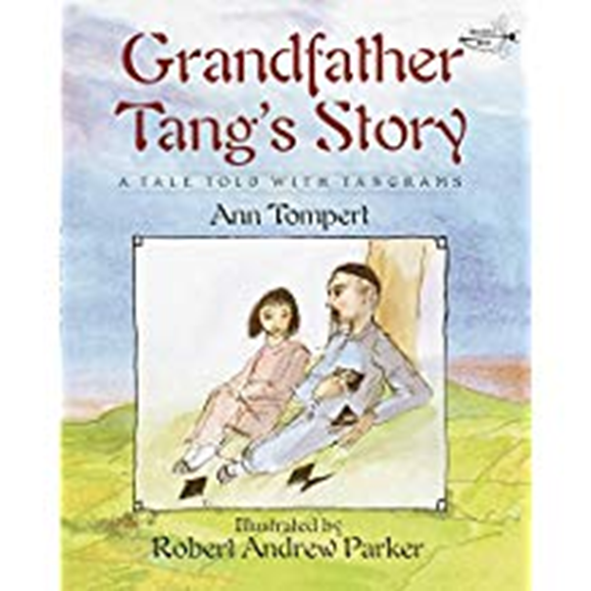
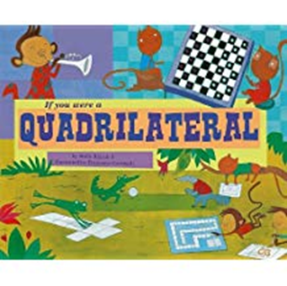
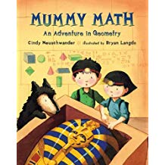
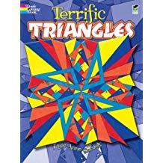
Text Set
+

Slide 56
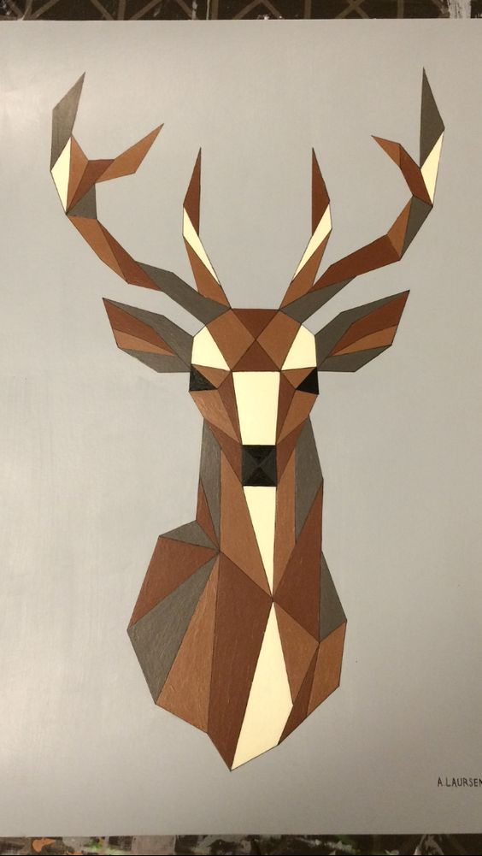
SPARK: Gallery Walk

Slide 57
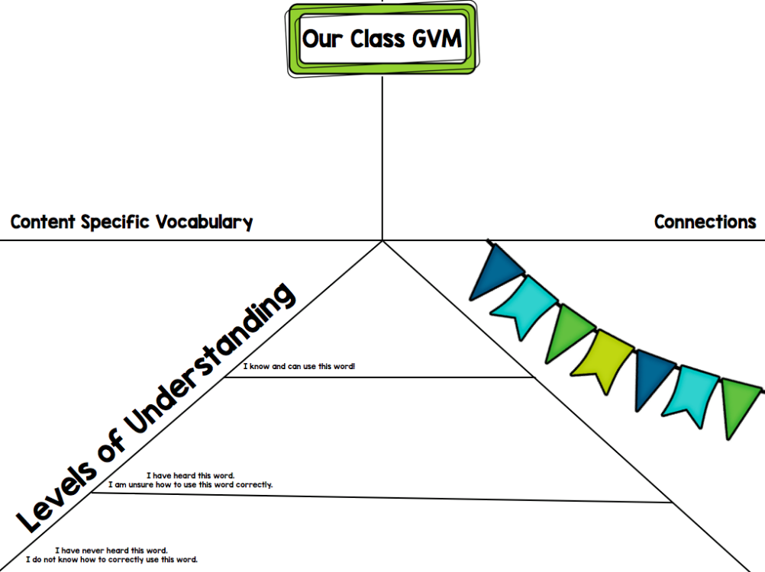

Slide 59
QUESTIONS? COMMENTS?
Sue C. Larson (2014), “Using a Generative Vocabulary Matrix in the Learning Workshop,” The Reading Teacher

