Slide 1
Project place summer institute
Day 3: July 24, 2019

Slide 2
Icebreaker: what's in a name?
One of the first things we're given is a name
Knowing a name can mean knowing a person

Slide 3
What's in a name?
1. Write your full name on a slip of paper
Include given names, middle name(s), hyphenated names, nicknames, religiously assigned names, cultural adaptations of name, etc.
2. Pair off with someone you don't know well
3. Ask each other:
Does your name have any special meaning?
Where does your name come from?
What does your name mean to you?
4. Switch partners and repeat

Slide 4
What's in a name? Debriefing
How did it feel to answer questions that you may never have been asked before?
Was there information you left out? Why?
Did any of your peers' responses surprise you? Why?
Did you have any preconceived notions or assumptions about anyone's names before the activity?
How could this activity be useful in your classrooms?

Slide 5
Family Collaboration

Slide 6
Family collaboration
The teacher establishes genuine partnerships (equitable relationships) with parents/caregivers
The teacher reaches out to meet parents in positive, non-traditional ways
The teacher intentionally learns about families’ linguistic/cultural knowledge and expertise to support student learning

Slide 7
Funds of knowledge

Slide 8
Funds of knowledge: Definition
"We use the term funds of knowledge to refer to these historically accumulated and culturally developed bodies of knowledge and skills essential for household or individual functioning and well-being"
(Moll, Amanti, Neff, & Gonzalez, 1992)

Slide 9
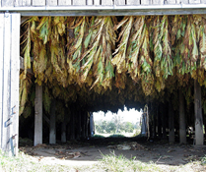
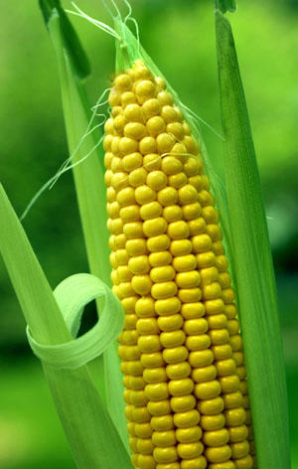
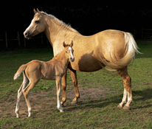
FOK Examples: Ranching & Farming
Horses & animal management
Raising tobacco
Soil & irrigation
Hunting, tracking, dressing

Slide 10
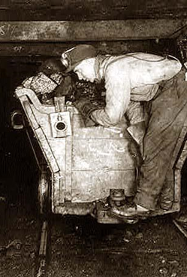
FOK Examples: Mining & natural resources
Minerals
Blasting
Timbering
Equipment maintenance

Slide 11
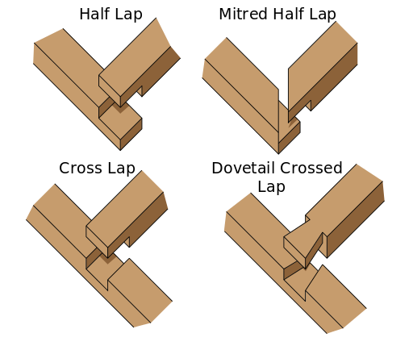
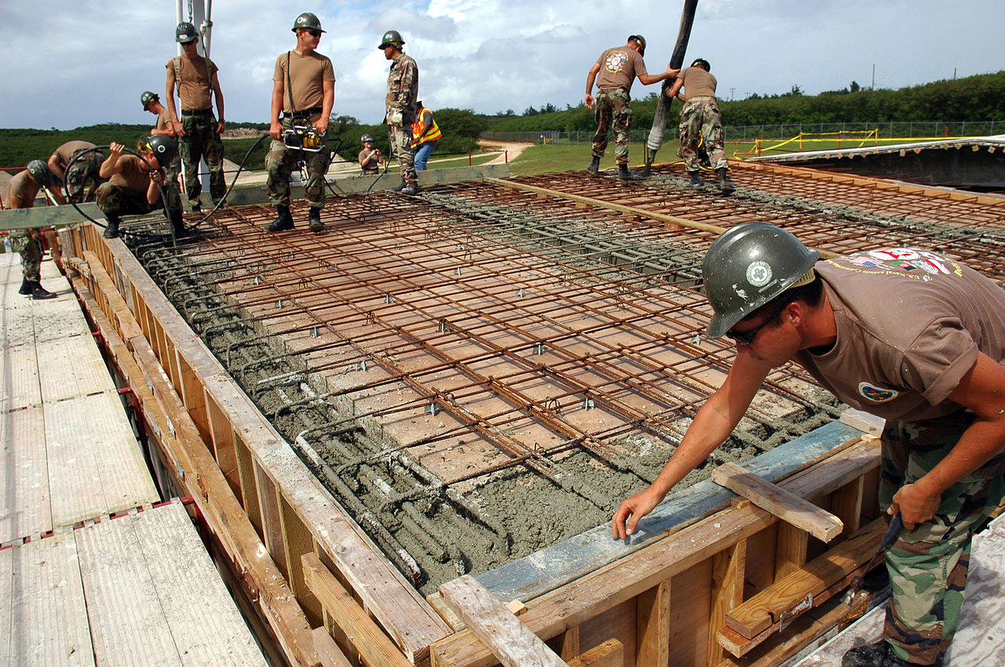
FOK examples: Construction
Carpentry
Masonry
Roofing
Painting
Design & architecture

Slide 12
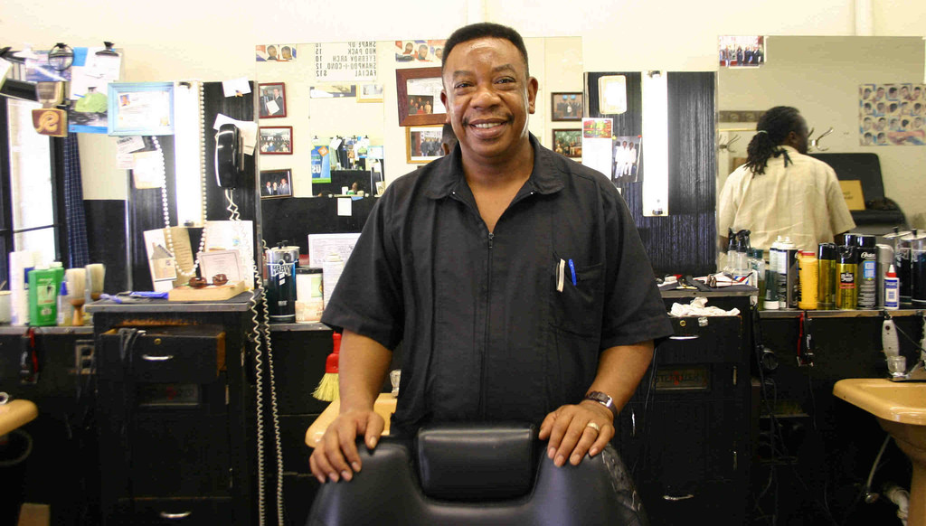
FOK examples: Business
Market values
Appraising
Renting & selling
Building codes
Accounting
Labor laws

Slide 13
FOK examples: medicine
First aid procedures
Nursing
Midwifery
Folk medicine
Herbal knowledge

Slide 14
FOK Examples: household management
Budgeting
Child care and child development
Cooking
Home/appliance repair

Slide 15
FOK Examples: faith/religion
Holy texts (Bible, Quran, etc)
Calendars
Rites, rituals, festivals
Moral knowledge & ethics

Slide 16
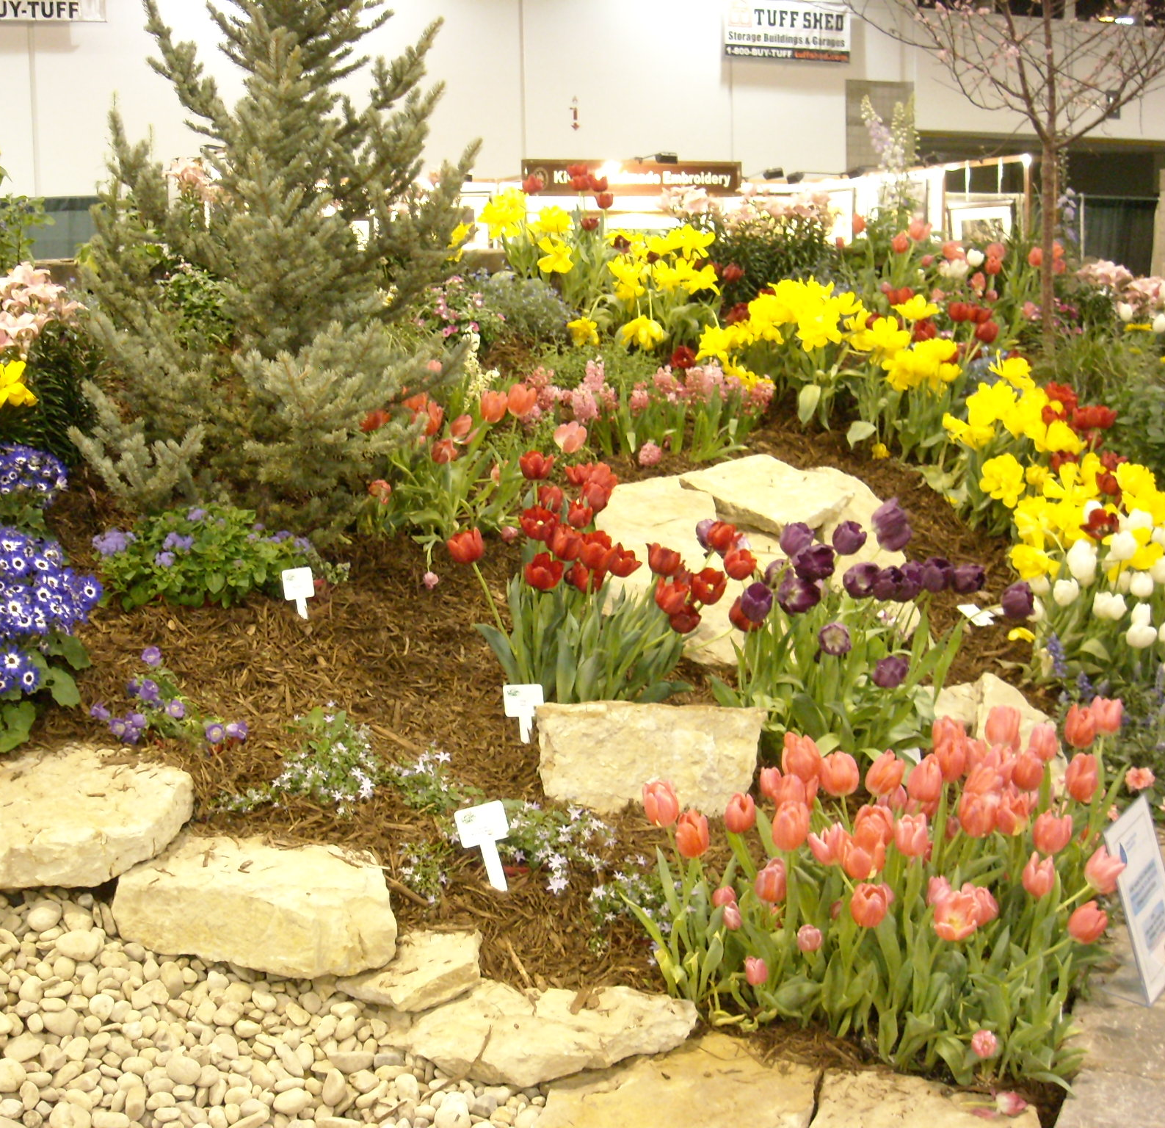
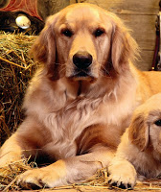
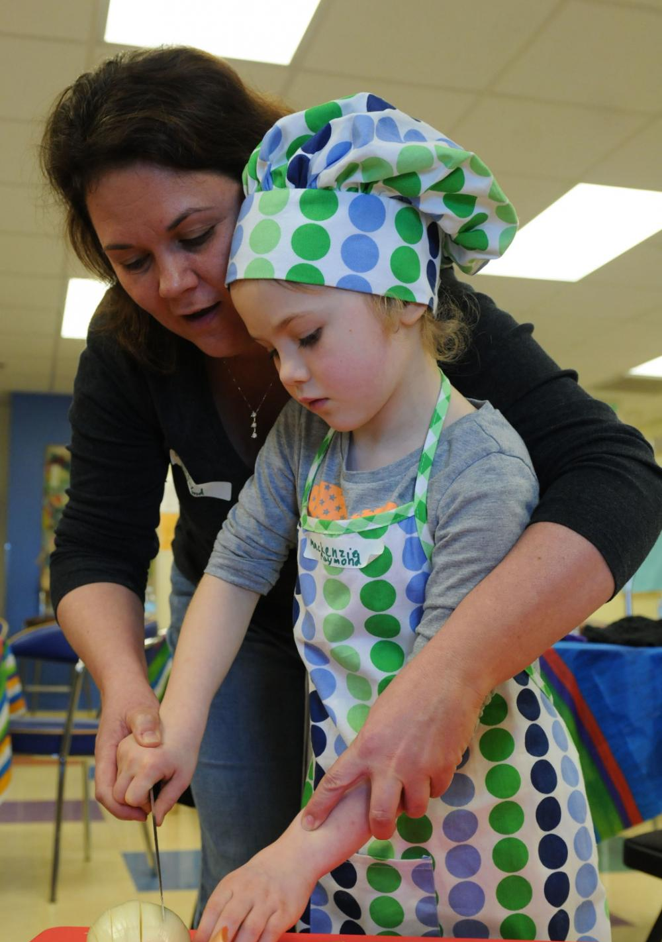
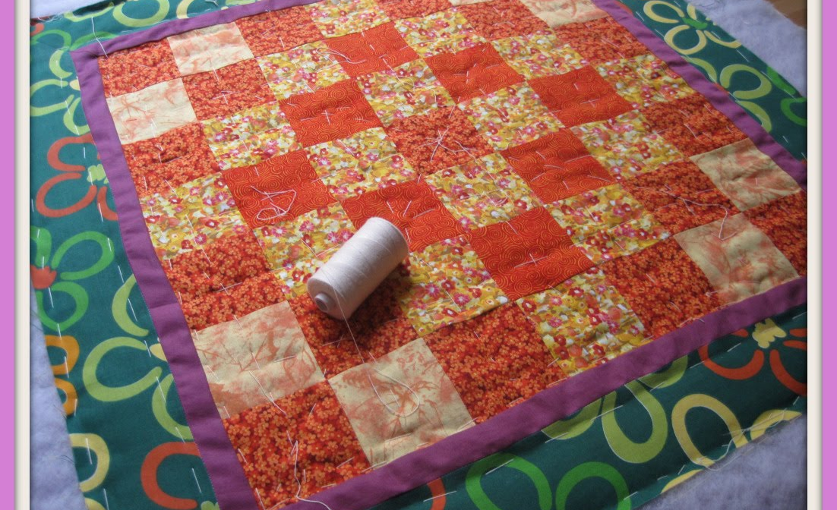
My familial funds of knowledge
Dogs
Cooking
Gardening
Quilting

Slide 17
Why funds of knowledge for teaching?
"By drawing on household knowledge, student experience is legitimated as valid, and classroom practice can build on the familiar knowledge bases that students can manipulate to enhance learning in mathematics, social studies, language arts, and other content areas"
(Gonzalez, Moll, & Amanti, 2005, p. 43)

Slide 18
FOK: Your task
Think about your own family (of origin or of creation). List some of your family's funds of knowledge on the graphic organizer
Share your FOK with your table group
Discuss:
Similarities and differences in FOK
How could you gather information on your students' FOK?
How could you use the FOK in instruction?

Slide 19
Family visits

Slide 20
Fishbowl: Family visits
Advanced Leaders will share about the family visits they conducted this summer
Audience observes for about 20 minutes
Then, audience may ask questions and generate further dialogue
What insights did you gain?
What was difficult or unexpected?
What was easy/went well?
Who did you visit and why?

Slide 21
Family Visits: Debriefing
Jot down notes in response to each prompt:
WHAT: What happened? What did you notice?
SO WHAT: Why is it important? What did you learn?
NOW WHAT: What actions make sense based on what happened?
Then, share your thoughts with a partner
Create a foursome and share again

Slide 22
Bringing it all together
Example Unit on Families

Slide 23
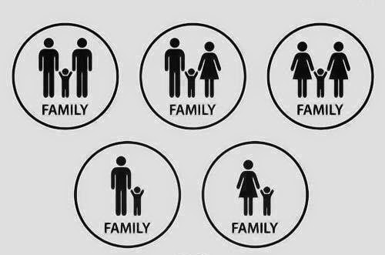
Morning Meeting
Critical Consciousness
Social Studies
Science
Math
Literacy/Language Arts
Supporting academic language
Bringing in families
Partnering with the community

Slide 24
Family Unit: Morning Meeting
This is an excellent opportunity to start learning about your students' families and their Funds of Knowledge!
Try activities such as:
What's in a name?
7 Circles
Interview person of the day/week about family and FOK
Have students bring in an object or a bag of items that reflect their families
Family diversity bingo

Slide 25
Family Unit: Literacy/ELA
Read Brightly
Family diversity
Blended families
Military families
Single moms
Grandparents
Family history
Colours of Us
adoption
Mixed-race families
LGBTQ+ families

Slide 26
Family UNIT: Literacy/ELA
"Where I'm From" poems
Family Message Journals
Family oral history projects
Photography projects
Digital family scrapbooks

Slide 27
Family Unit: Math
Survey classmates or school on family structure and people living in the home
Create charts/graphs to share the results
Use students' families to contextualize concepts
e.g. in word problems

Slide 28
Family UNIT: Science
Comparisons to other animals
Group structures
How many offspring at one time
How long offspring stay with parents
Role of each parent in caring for offspring
Genetics

Slide 29
Family unit: Social studies
What families look like around the world
How family names work in other cultures
How to use library resources for genealogy research

Slide 30
Family unit: supporting academic language
Use photos of students' families in the picture word induction method
Discuss what students see in the photo
Students generate labels for what they see (objects or activities)
Students discuss an appropriate title for the picture
Students use the generated vocabulary to compose a text about the photo
The text is used repeatedly for various shared reading activities
Students can use the labeled photo to write on their own

Slide 31
Family unit: Supporting Academic Language
Explicitly use sentence stems and frames that they can use in speaking and writing
This is my __________.
This is my __________. His name is _____.
My ______ and my _____ both ______.
My _____ is _____, but my _____ is _____.

Slide 32
Family unit: Critical consciousness
How are families represented in textbooks and literature? Do they reflect our families?
Critically analyze representation in texts
Evaluate representations across books in the classroom, school, or community library
Compare to learners' experiences
Research books that represent various family structures
Create a recommended purchase list for the classroom, school, or community library

Slide 33
Family UNit: Family involvement
Most of the lesson ideas already mentioned can involve family members!
Family members bring in (and read) a "must-read" text that reflects their family structure or cultural/linguistic background
Interview family member about "must-read" texts

Slide 34
Family Unit: Community Partner
Local Library
Recommended texts
Genealogy research
Grant-writing

Slide 35
Teacher panel
FAMILY COLLABORATION

Slide 36
Expert Teacher Panel
Stephanie Chenault
Jill Robertson
RayeGina Edens
Elisabeth Darce
Margo Schenning

Slide 37
CRIOP Indicators: Family Collaboration
Establishing
equitable partnerships with families,
Reaching
out to families in non-traditional ways (and places),
Encouraging
family involvement
Learning
about and using families' funds of knowledge.

Slide 38
Questions
1. What strategy/strategies did you implement?
2. How does the strategy address one of the 4 areas of family collaboration?
3. What were some challenges you faced in implementing the strategy and how did you work to overcome these challenges?
4. What were the impacts of the strategy/strategies on students and their families?

Slide 39
Working with community Partners

Slide 40
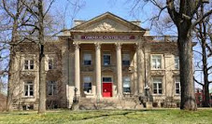
Community partners: Introduction
Carnegie Center for Literacy & Learning
Global Lex

Slide 41
Community Partners: Shift & share
Their mission and work
The ways they currently support schools and/or English learners and families
8 min: CPs and teachers will engage in question/answer and discussion:
What schools need
What community partners need
What an effective partnership might involve (e.g., activities, roles of each partner, etc)
What each partner would gain from the partnership
2 min: Community Partners will provide a quick overview:

Slide 42
Community Partners: Debriefing & Next steps
1: What?
Individually, jot down a few ideas about what you gained from the Shift & Share with community partners
Get in groups of 3, share your ideas, and jot down new ideas
2: Now what?
Individually, jot down some action steps you plan to take
Share your steps with your group and briefly "crowdsource"them

Slide 43
Collaborating with the community
Identify and integrate resources and services from the community to strengthen school programs, family practices, and student learning and development

Slide 44
collaborating with the community: Sample Practices
Information for students and families on community health, cultural, recreational, social support, and other programs and services
Information on community activities that link to learning skills and talents, including summer programs for students
Service integration through partnerships involving school; civic, counseling, cultural, health, recreation, and other organizations and agencies; and businesses
Service to the community by students, families, and schools
Participation of alumni in school programs for students and as mentors for planning for college and work

Slide 45
Collaborating with the community: Challenges & Redefinitions
Challenges:
"Community" to mean not only the neighborhoods where students' homes and schools are located but also neighborhoods that influence student learning and development
Solve turf problems of responsibilities, funds, staff,and locations for collaborative activities
Redefinition:
Inform families of community programs for students, such as mentoring, tutoring, and business partnerships
Assure equity of opportunities for students and families to participate in community programs or to obtain services
Match community contributions with school goals; integrate child and family services with education
"Community" rated not only by low or high SES qualities but also by strengths and talents to support studnets, families, and schools
"Community" means all who are interested in and affected by the quality of education,not just families with children in the schools

Slide 46
Collaborating with the community: Expected Results
Students
Parents
Knowledge and use of local resources by family and child to increase skills and talents or to obtain needed services
Teachers
Ability to make knowledgeable, helpful referrals of children and families to needed services
Awareness of careers and options for future education and work
Awareness of school's role in the community and of community's contributions to the school
Specific benefits linked to programs, services, resources, and opportunities that connect students with community
Awareness of community resources to enrich curriculum and instruction
Increased skills and talents through enriched curricular and extracurricular experiences
Interactions with other families in community activities
Openness to and skill in using mentors, business partners, community volunteers, and others to assist students and augment teaching practice

Slide 47
School-community partnerships
"School-community partnerships, then, can be defined as the connections between schools and community individuals, organizations, and businesses that are forged to directly or indirectly promote students' social, emotional, physical, and intellectual development. Community, within this definition of school-community partnerships, is not constrained by the geographic boundaries of neighborhoods, but refers more to the 'social interactions that can occur within or transcend local boundaries' (Nettles, 1991b, p. 380)."
Epstein et al, 2009, p. 31

Slide 48
Forms of school-community partnerships
Student-centered:
Provide direct services or goods to students
Mentoring/tutoring, job-shadowing opportunities, incentives
Family-centered:
Have parents or entire families as their focus
Workshops, family services, parent/family fun & learning nights
School-centered:
Benefit the school as a whole
Beautification projects, school gardens, classroom assistance
Community-centered:
Focus on community and citizens
Charitable outreach, art/science exhibits, community revitalization projects

Slide 49
Examples of community partners
Businesses & corporations
Local, national, franchises
Universities and educational institutions
Community colleges, vocational/trade/tech schools, high schools
Health care organizations
Hospitals, mental health facilities, health departments, health foundations
Government and military agencies
Fire & police departments, chamber of commerce, city council, military base
National service and volunteer organizations
Rotary, Lions, YMCA, Scouts, United Way, Urban League, Peace Corps, AmeriCorps/VISTA
Faith-based organizations
Churches, mosques, synagogues, charities

Slide 50
(more) Examples of community partners
Senior Citizen organizations
Nursing homes, senior centers, Road Scholars
Cultural and recreational institutions
Zoos, museums, libraries, recreational centers
Media organizations
Newspaper, radio stations, cable networks, etc
Sports franchises and associations
Major/minor league teams, college/university teams, sports-related groups
Other community organizations
Fraternities/sororities, foundations, neighborhood associations, political groups, alumni
Community individuals

Slide 51
what does an effective partnership involve?
Action team
Starting points
Present strengths
Needed changes
Concrete action plan
Time
Materials
Funding
Resources and support
Students
Community members
Parents
Teachers
Responsibilities
Sense of community
Expectations
Links to goals
Details
Costs
Evaluation
Effects on goals
Implementation
Indicators of success/quality

Slide 52
Family & Community Liaisons
Hilda Campos

Slide 53
Community partners: your task
Work with the people at your table & use the graphic organizer
For each category, brainstorm at least one local group that might be a good fit for partnering with your school or classroom
Indicate the type of partnership they might be able to provide
We'll make a master list

Slide 54
Thinking through your action plan for family & Community engagement
Describe the event: Popsicles in the Park – teachers will be available in a neutral area so that families can meet them, get to know the teachers, and start to establish positive relationships. Teachers can also use this as an opportunity to get to know families, their funds of knowledge, and their children's learning strengths and needs | Which type(s) of involvement does this event target? (see handout) ⃝ Parenting ⃝ Communicating ⃝ Volunteering ⃝ Learning at Home ⃝ Decision-Making ⃝ Collaborating with the Community
How will you know if your event has enhanced family & community involvement? Teachers will be able to identify who a child lives with, the best person to contact, and perhaps one aspect of the family's funds of knowledge.
Notes:
Materials: Family/community action plan template

Slide 55
Action Plan: Team Members
Team Members | Who? | How? | Resource | Benefits
School personnel | Teachers Paras Front office staff | Meet and greet Informal discussions Fun activities that identify FOK | Providing activities | Developing + relationships Learning FOK
Family members | Students Caregivers Extended family | Talking with school personnel Helping with fun activities | Providing information about family | Positive relationship with school staff
Comm. partners | Migrant education office | Providing information about services Translation services | Information providers | Identification of families who qualify for services

Slide 56
Action plan: Activities
Activity | Who | FOK | Resources | Evaluation
Meet & greet | Everyone | Opportunity for informal info-gathering | List of questions to ask | Can teachers provide information for attendees?
Info table | Migrant ed staff |  | Handouts | Number of people contacted
What's in a name? | Teachers, paras | Family traditions | What's in a Name? prompts | Number of individuals who complete
Family book | Teachers, paras | Family structures | Pre-made sheets with sentence stems, staplers, crayons, markers | Number of books collected
Family tree/ forest | Teachers, paras | Family structure | Family tree graphic organizers | Number of family trees collected

