Slide 1
Project place summer institute
Day 2: July 23, 2019

Slide 2
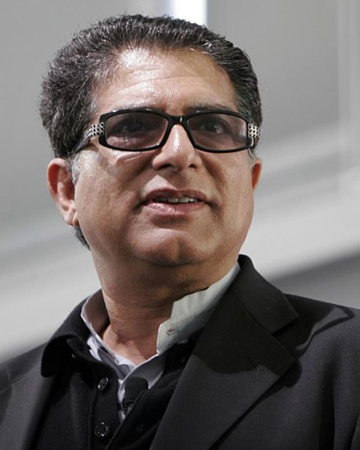
Six Word Memoir
…captures the essence of your life in just SIX WORDS.
Stephen Colbert:
Well, I thought it was funny.
Deepak Chopra:
Danced in fields of infinite possibilities.
Notes:
Materials: Sentence Strips for Memoirs

Slide 3
Here are some more examples…

Slide 4
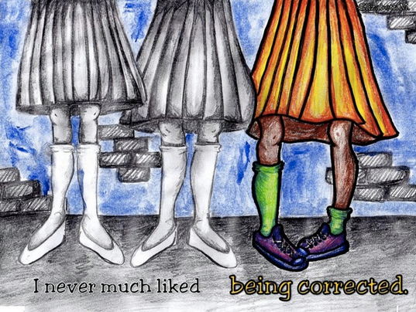

Slide 15
Your Life. Six Words.
YouTube clips:
4th Graders' 6-word memoirs
6th Graders' 6 word memoirs
Write a memoir that captures the/an essence of your life. Use just SIX WORDS.

Slide 16
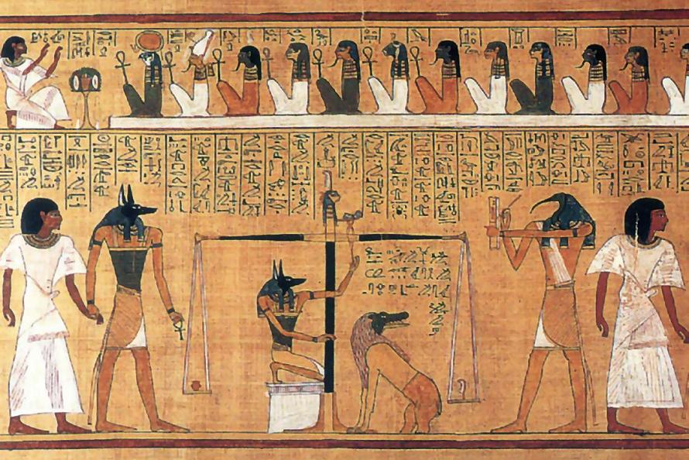
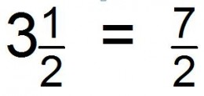
Not Just in Language Arts
image of a fossil
Egyptian art
improper fraction

Slide 17
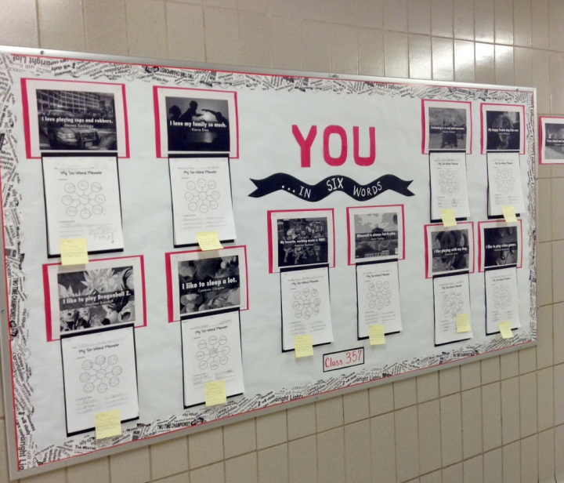
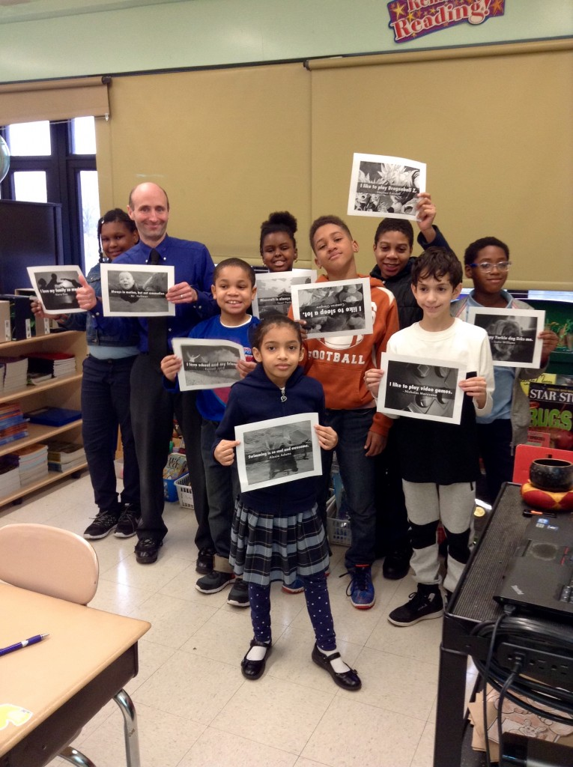
Classroom Of The Month: Mr. Hollman’s 5th Grade Special Education Class at the Helen Keller School in Bronx, New York
January 18, 2016 by Team Six
http://sixwordmemoirs.com/about/classroom-of-the-month-mr-hollmans-5th-grade-special-education-class-at-the-helen-keller-school-in-bronx-new-york/
“I love my family so much.”
“I like to sleep a lot.”
“I like playing with my dog.”
Excerpt from article: Six-Word Memoirs proved to be a fitting alternative to more formal essay writing for Hollman’s students. “They would not have to write a full essay, but they would have to make every word and every detail count,” said Hollman.

Slide 18
A Scaffold: Mimic a Model
I dance so I can fly. (by zsuzsu)
I __________________ so I can _________________.
Never underestimate a small community's power. (by J3nny)
Never underestimate a ____________ _______________ _____________.
On vacation, life's sweet as waffles. (by LouHope)
On _______________, life’s ________________ as _____________.
Yes Gianna, You can be President. (by G_Austin)
Yes ____________________, you can be _____________________.

Slide 19
Setting Up the Classroom

Slide 20
Taking a Look Inside Classrooms
How can you create an environment that enhances EL student learning?

Slide 21
Classrooms are complex!

Slide 22
Social/emotional (positive thinking, Leader in Me, Growth Mindset, etc).
Learning supports (word walls, charts, etc.)
Components of Classroom Environment
Management: Relationship Building, Management System (e.g. clips, tokens, CHAMPS, rewards, etc.)

Slide 23
We will examine…
Learning supports (word walls, charts, etc. )
Social/emotional (positive thinking, Leader in Me, Growth Mindset, etc. )
Components of Classroom Environment

Slide 24
Social/emotional climate
Leader in Me
Growth Mindset
Positive Affirmation
Consider: Where is the cultural dimension in these programs?

Slide 25
These are excellent programs, but in a classroom designed to serve diverse learners, they may not be enough. Why? Because they often do not acknowledge students’ cultural identities and the important role that those identities play in developing a positive image of oneself as a learner.

Slide 26
“To overcome negative stereotypes and to develop a positive identity, students must be provided with positive images and messages about their race or ethnicity.” (p. 41, Literacy for All Students)

Slide 27
Analyze a Classroom
What do you notice about the social/emotional environment displayed in this video of a culturally responsive classroom? How is it similar to your classroom? How does it differ from your classroom?
https://www.youtube.com/watch?v=_uOncGZWxDc

Slide 28
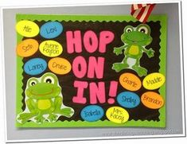
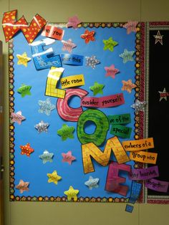
Culturally neutral images

Slide 29
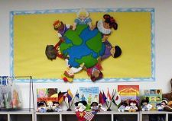
Cultural images that affirm our students as vital members of the classroom community

Slide 30
“…consider the message that we send to our students when none of our classroom displays contain images of individuals who look like them, or show examples of their language or community practices.” (p. 36, Literacy for All Students)

Slide 31
Something to ponder…
Whose classroom is it?
Yours? Your Kids? Both?

Slide 32
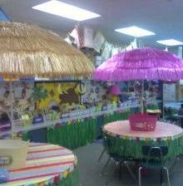
Who owns this classroom?

Slide 33
Who owns this classroom?

Slide 34
Another question to ponder…
Can your classroom be truly responsive to your students and their families BEFORE you actually know them?

Slide 35
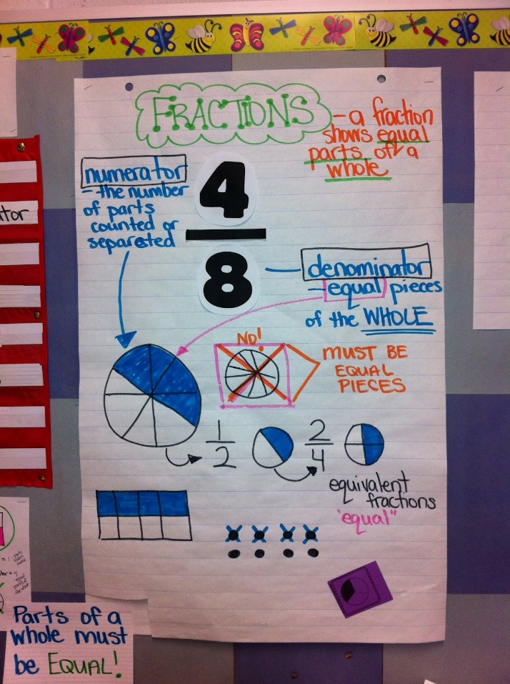
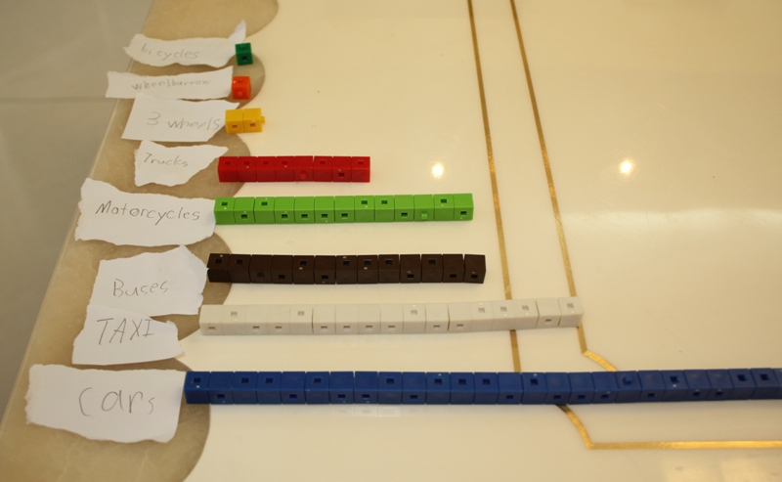
LEARNING SUPPORTS

Slide 36
Questions to consider:
How much time do your students spend working without teacher support, and is this appropriate for their age level?
How effective is that independent learning time?

Slide 37
One important resource for ELs is their peers
Brock & Raphael, 2005
“The researchers videotaped literacy lessons that occurred in a fifth grade classroom in which Deng, a second language learner from Laos, was a student. They later played back the video excerpts and, with the assistance of Deng and an interpreter, were able to determine when confusion had occurred during instruction. Importantly, Deng’s comprehension tended to break down the most during whole group instruction. . . Deng’s participation in small group activities was relatively high, and his peers were able to clarify confusing points.” (Literacy for All Students, p. 98)

Slide 38
However…
If students spend much of the day working independently or in small groups with limited teacher guidance, is this learning time effective?
How can you maximize the effectiveness of this independent learning time?

Slide 39
Gallery Walk: Examples of Supports FOR ENGLISH LEARNERS (Subject – Math)
Your task:
Rotate to each station in the gallery walk.
Take pictures, jot down ideas, and/or make mental notes.
What do you notice?
What learning supports are provided for ELs in this classroom?

Slide 40
Have a conversation at your table.
What did you notice? What supports are available for ELs?

Slide 41
Evaluate your own classroom
HANDOUT: Self-Assessment Checklist for Student Independent or Small Group Work
Notes:
Materials: Self-assessment handout

Slide 42
MORNING Meetings
Set
the tone for respectful learning
Establish
a climate of trust
Motivate
students to feel significant
Create
empathy and encourage collaboration, and
Support
social, emotional, and academic learning
A tool for building Classroom Relationships
Northeast Foundation for Children, 2009

Slide 43
Morning meeting: How does it work?
Eric Miracle
Fayette County Schools
MaKayla Adkins
Clark County Schools

Slide 44
From the CRIOP
Element: Classroom Relationships
Indicator: The teacher creates a learning atmosphere that engenders respect for one another and toward diverse populations

Slide 45
US School Culture
Teachers seek and value students’ points of view.
Students are encouraged to question (and challenge) their teachers.
Teachers recognize that students must attach relevance to the curriculum.
Errors are a natural part of the learning process.

Slide 46
What if your ELs’ prior education …
Your Task: Identify challenges these students would face in your classroom and ways you can help support them.
did not focus on students’ points of view and oriented students to the culture’s accepted views?
discouraged active questioning (and never challenging) of the teacher?
expected students to master the curriculum with the understanding that its “relevance” will come with maturity?
believed making mistakes in front of others causes one to lose face?

Slide 47
Cultural Support for ELs
Sensitivity to the fact that our school practices are cultural and not the norm for many immigrant children.
Help diverse learners understand and function within a U.S. education system’s values, beliefs and practices.

Slide 48
Family Artifacts: Whose is it?
Select a timer for your group.
The person to the right of the timer spends 1 minute telling about their family artifact. Do not interrupt!
Then group members spend 2 minutes asking questions to learn more.
Repeat for each group member.

Slide 50
Learning about families: Three levels
Within-Classroom
Connecting Classroom to Home
Community Event

Slide 51
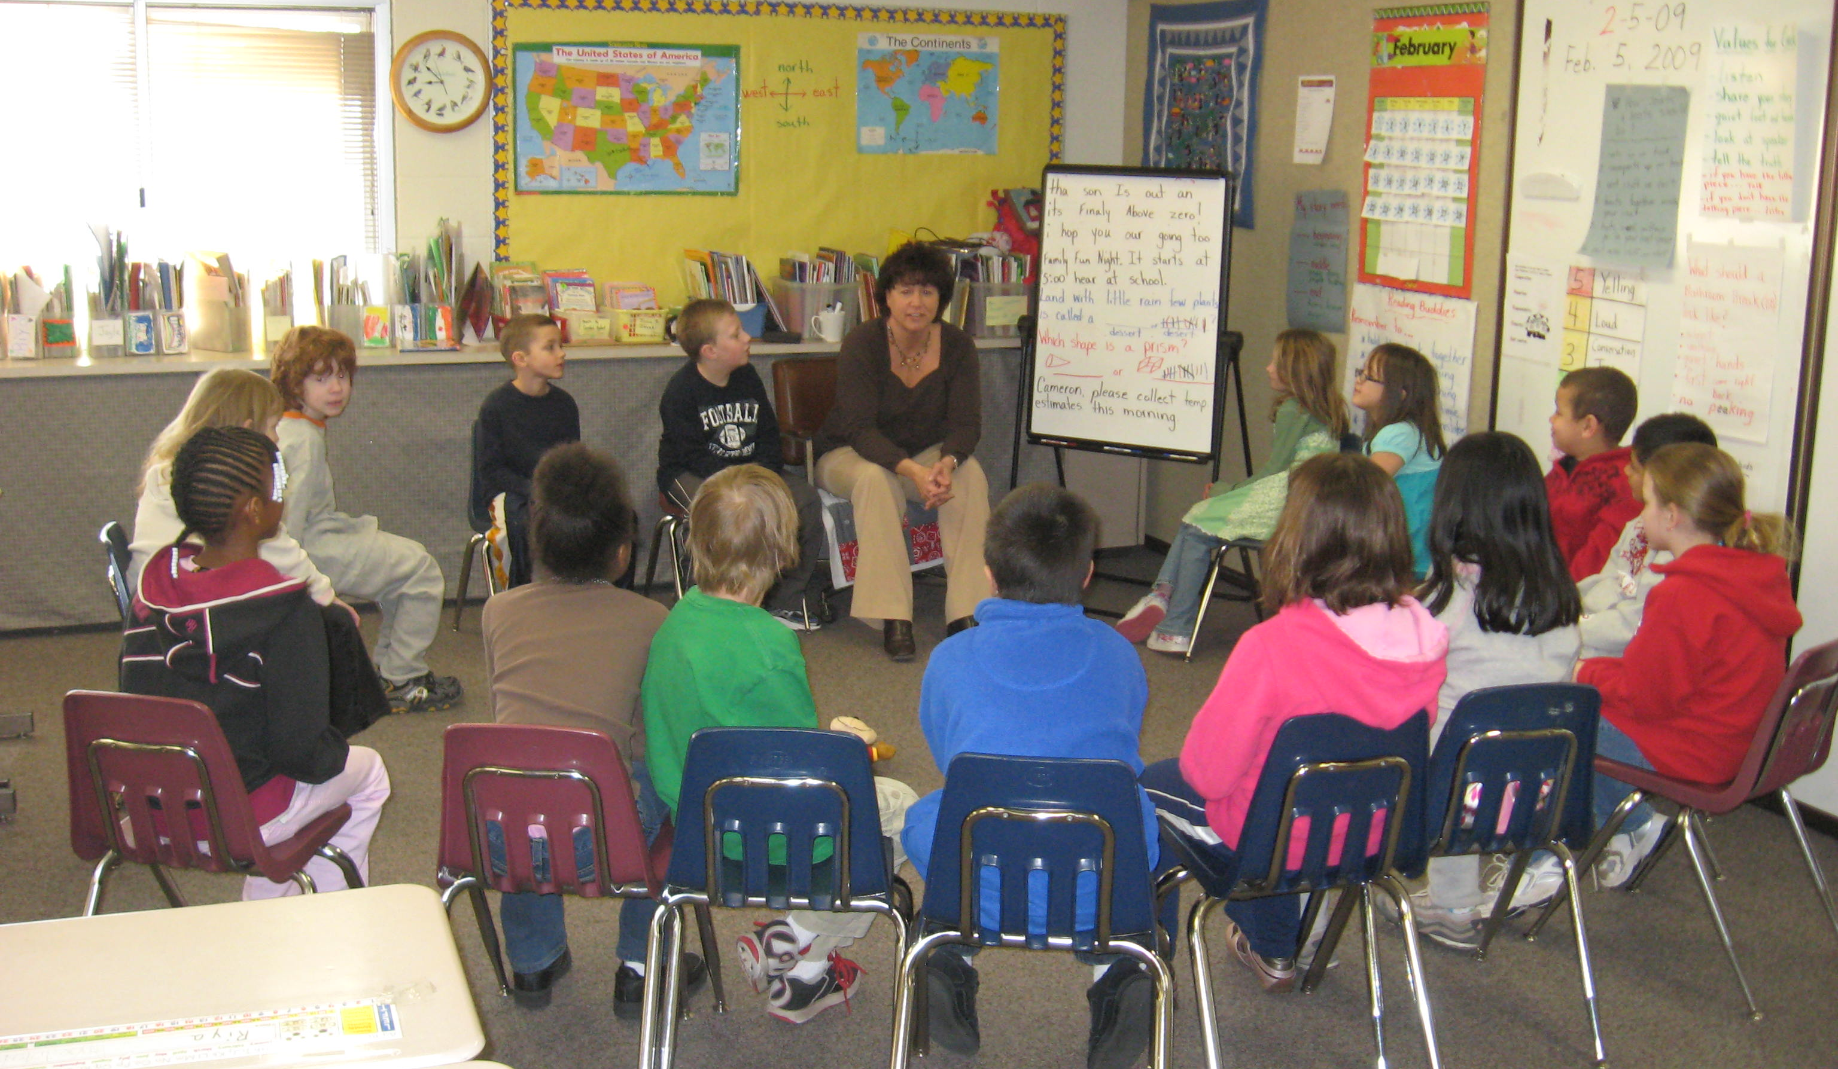
Level 1: within-Classroom
Morning Meeting

Slide 52
Morning Meeting: Common structure
Greeting
Students greet each other by name
Sharing
Students share ideas and information in a structured format
Group Activity
Examples: active games, math activity, choral reading, singing, chanting, etc
Message
Practice academic skills and build community by reading and discussing a daily message

Slide 53
Morning Meeting: Integrating criop
Greeting
Another great opportunity to learn about Funds of Knowledge!
Message
Great opportunity to integrate Family/Community connections and Critical Consciousness!
Group Activity
Great place to try Kagan strategies to enhance discourse! Great opportunity to learn about Funds of Knowledge!
Sharing
Great opportunity to try incorporating home languages!

Slide 54
Greeting: techniques to try
Have students greet in their preferred language, or in the home language of someone else
Brown Bear greeting
Kristen, Kristen who do you see?
I see Susan looking at me!
Toss a ball or koosh or beanbag to another child, who returns the greeting
Spiderweb
Pass a ball of yarn; each person holds the yarn in their hands, greets a child somewhere across the circle, and then passes the yarn to that person
More ideas http://eflawrence.weebly.com/uploads/5/2/3/1/5231977/morning_meeting_greeting_book.doc.pdf

Slide 55
example: Around the world
Using an inflatable globe, each person will send greetings from some country.
Decide ahead of time how countries will be selected (e.g., the closest country to the learner's right thumb when they catch the globe)
The 1st learner begins: "Good morning, ___" and then tosses the globe to that learner
Recipient: "Greetings, [sender], from [country]. Good morning, [new recipient]"

Slide 56
Sharing: Techniques to try
Share identity or Funds of Knowledge information with a partner or small group:
What your name means and why your family chose it
7 Circles of identity
Who counts as "family" to you?
Activities you do with your family
Important aspects of your culture
Report on a favorite/meaningful book or object
Report on results from family/community homework activities
Have students respond to a Question of the Day, a Conversation Starter drawn from a hat, etc.
Be creative!
Introduce/practice new Kagan strategies or listening techniques

Slide 57
Example: Gratitude converstaion starters
Each person at in your group should respond to the following conversation starter:
What is one thing a family member did for you this week that you are thankful for?
Variations:
Discuss the group's responses – what similarities and differences are there?
Give each person a different question, which they should ask to everyone in their group
Print the Gratitude Conversation Starters, send them home with students, and ask them to start conversations with family members
More ideas:
https://creativefamilyfun.net/gratitude-conversation-starters/

Slide 58
Activity: Techniques to try
Community-Building Activities
A Warm Wind Blows
Academic Activities
Make words game
Telephone or Zap/Electricity
Improv
Nonverbal birthday lineup
Follow-the-leader, Mother May I, Simon Says
20 Questions
Sparkle
Buzz game
Categories game

Slide 59
Example: forehead dots
Each student gets a colored dot taped or stuck to their forehead
Each student must figure out what color dot they have, without asking any other kids for help – no verbal communication!
The first team that arrives together (with the correct colored dots on their heads) wins

Slide 60
Message: techniques to try
Share the pen!
Family Challenge
Academic Show & Tell
A student of the day can share a meaningful photo or object, then dictate a message about it
Incorporate other academic language techniques
Picture Word Induction Method with photos
Family-related sentence stems/frames for students to use in family journals
Puzzle message
Create a riddle or challenge for your students to solve or complete during the day,or to share with families
Try an oral message
Play "Telephone" and see if your message is repeated accurately
Have students take turns crafting a message about their family for the meeting
Write a question or an activity for students to do with family members, then be prepared report on it during the next meeting's sharing time

Slide 61
Example: Pen-Pal Letter
Write your message in the form of a letter to students
Share something about yourselves
Ask a question or two for your students
Encourage students to write to you during language arts, during center time at a writing center, etc
Keep it going by writing back!

Slide 62
Level 2: Connecting home and school
Reading Logs 2.0
Family Journals
Family/Community Interviews & Surveys

Slide 63
Reading logs 2.0: Tracey Tevis
Each night (Monday-Thursday), read for 20 minutes. Reading and practicing literacy skills can look different to each student/family. This year, we want to incorporate the awesome reading skills that our families are practicing at home. Below are different activities that students may do on their own or with their family that will count for reading 20 minutes. Every week you must have 4 squares shaded in. They may be any four squares that you would like. Once a square is shaded, you cannot use it again for the week. Don’t forget to have your parent initial the activity that you completed.

Slide 64
Reading logs 2.0: Jill Robertson
For first graders, we would like you to read or be read to 20 minutes each night (Monday – Thursday). This year we want to celebrate the awesome reading skills that our families practice at home. Below are different activities that students may want to do with their family and count it as reading for 20 minutes. Every week you must have 4 squares colored in. Don’t forget to have a parent comment!

Slide 65
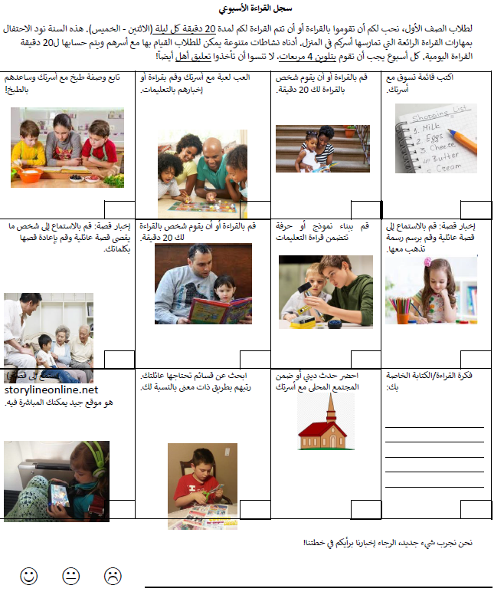
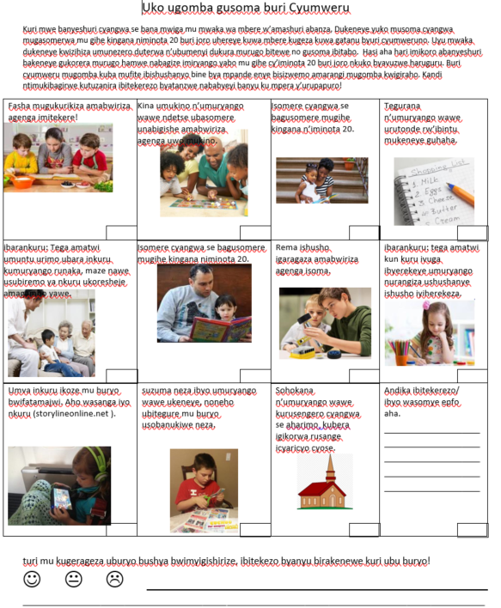

Slide 66
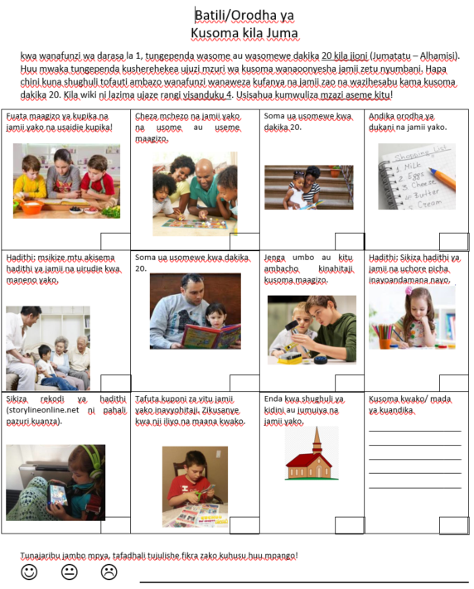

Slide 67
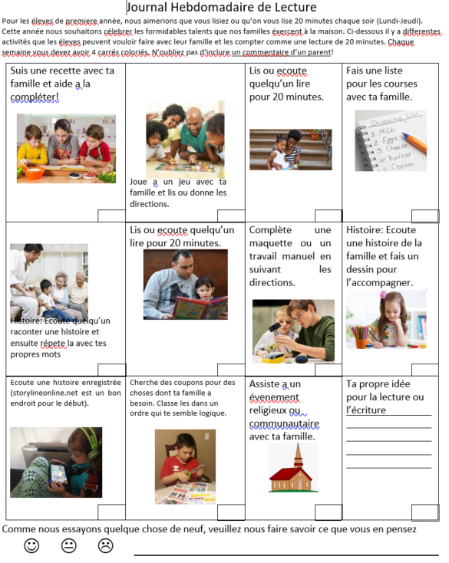

Slide 68
Home reading journals (Allen, Ch. 5)
Students select a text to take home with the Home Reading Journal
The texts are read together
Child can read to family
Family and child craft a response in the journal
Can be dictated by child
Family member can read to child, or
Teacher responds to the journal entry
Child can write or draw
Each can write own response
If nobody can read,then look at the pictures

Slide 69
Weekend journal/family message journal (Allen, ch. 5)
A dialogue between families and teachers about a variety of topics
These are sent home on a regular basis
Weekly, every other week, etc
Teacher OR child writes a letter, question prompt, or conversation starter
Anyone at home can respond – parent, sibling, grandparent, cousin, neighbor
Can respond in a variety of multimodal ways (e.g., drawings)
Can respond in any language
Child discusses the response with the family and may translate the message for the teacher
Process repeats
Either by exending a conversation OR
Starting a new conversation

Slide 70
Integrate Family into content areas: Surveys & interviews
Help your students design, implement, and interpret surveys or interviews they can conduct with family members, people in the community, etc
Topics can be connected to units in language arts, science, social studies, or math
Survey results can be charted or graphed
Interviews can be transcribed
Results from surveys and interviews can be published and shared
Great opportunity to:
Learn about families' Funds of Knowledge
Connect to Critical Consciousness!

Slide 71
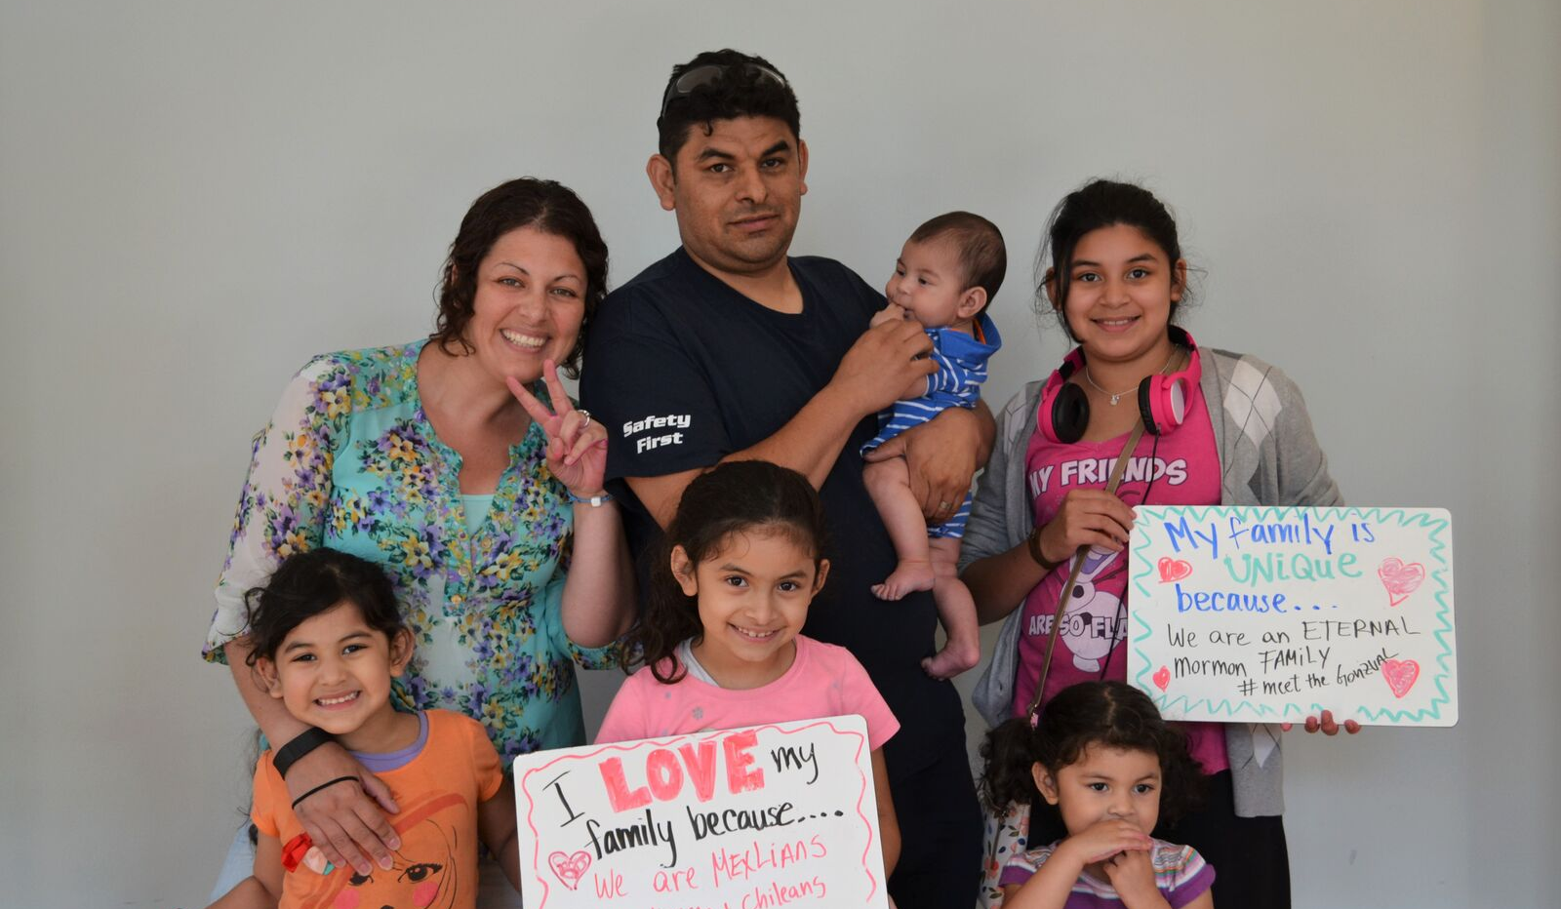
Level 3: Community events
Family Night...about Family!
(Partnership with the Carnegie Center)

Slide 72
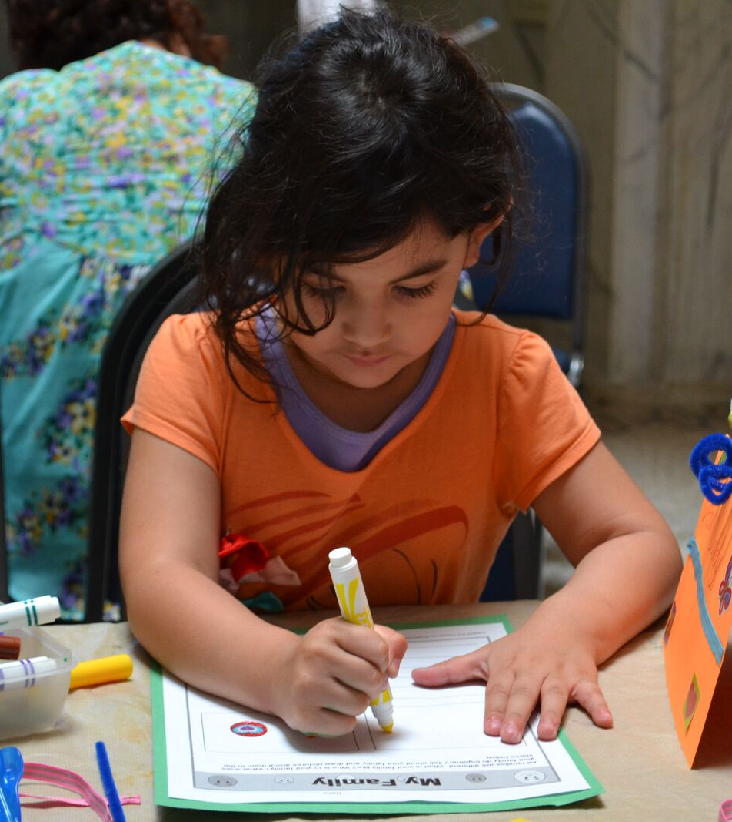
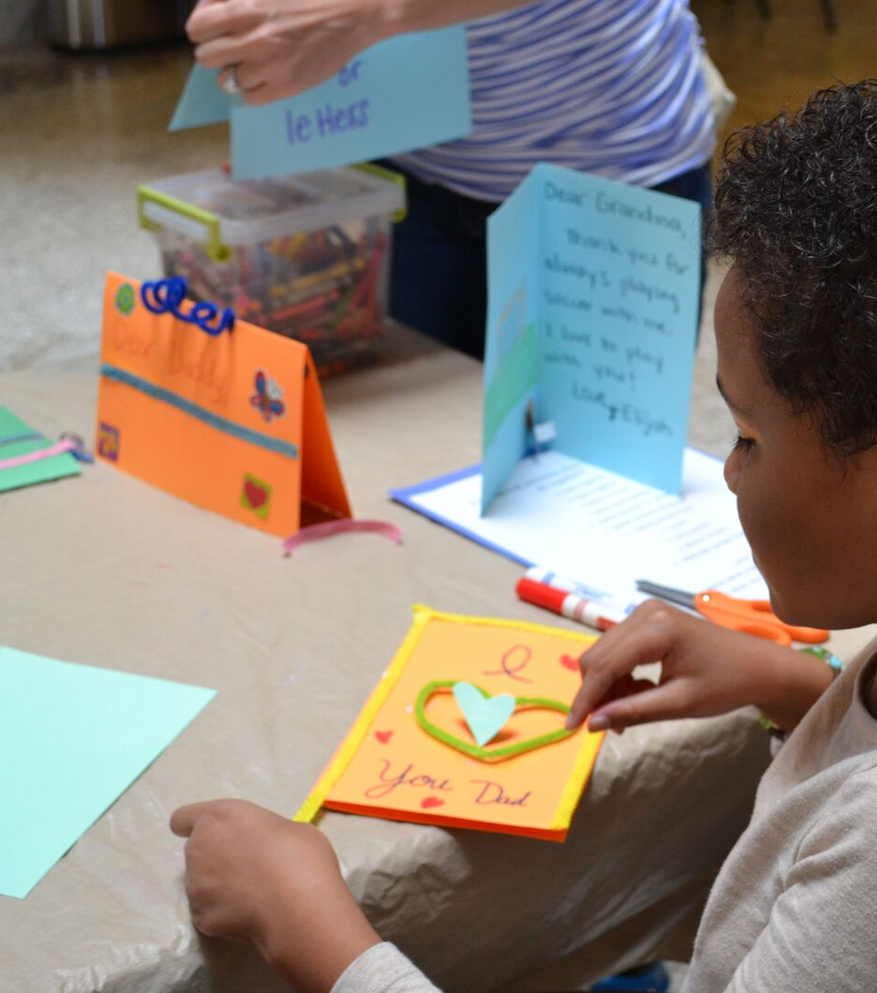
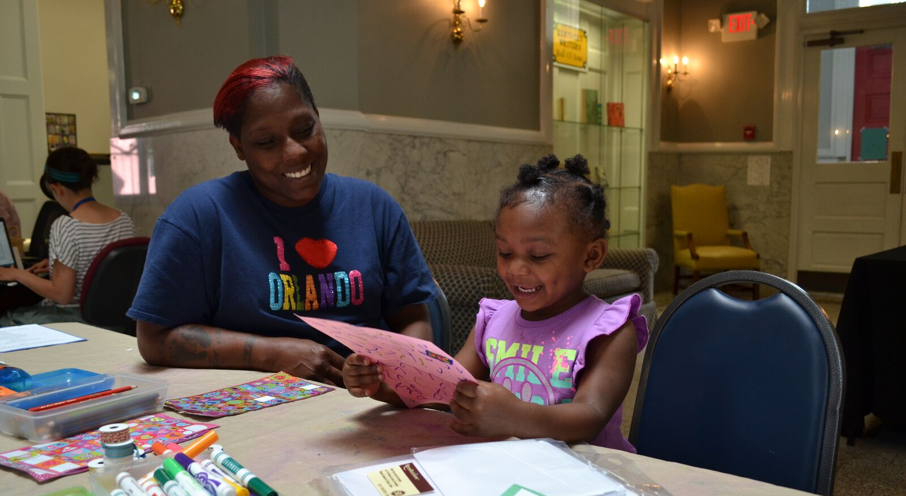
Letters & Greeting cards

Slide 73
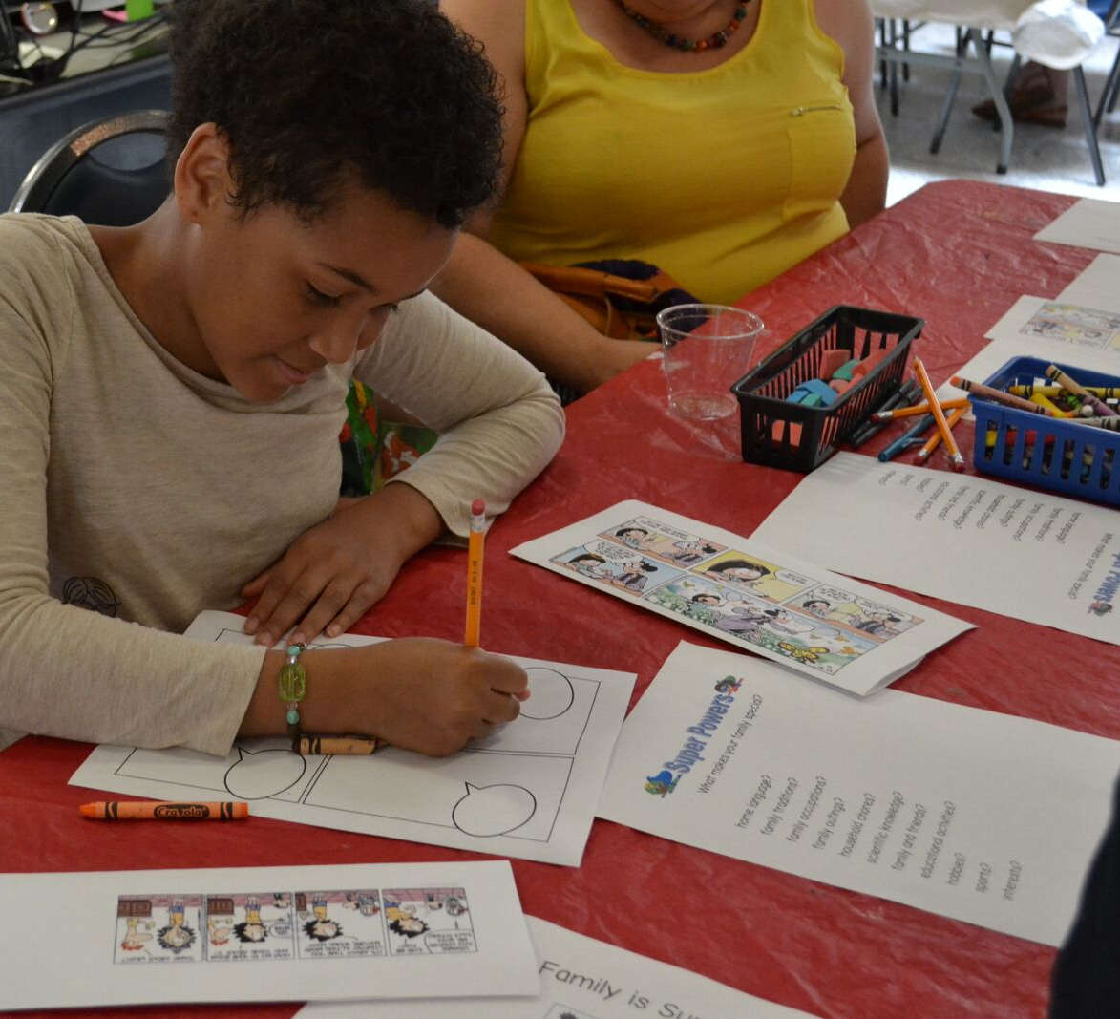
Family Comics & Superhero stories

Slide 74
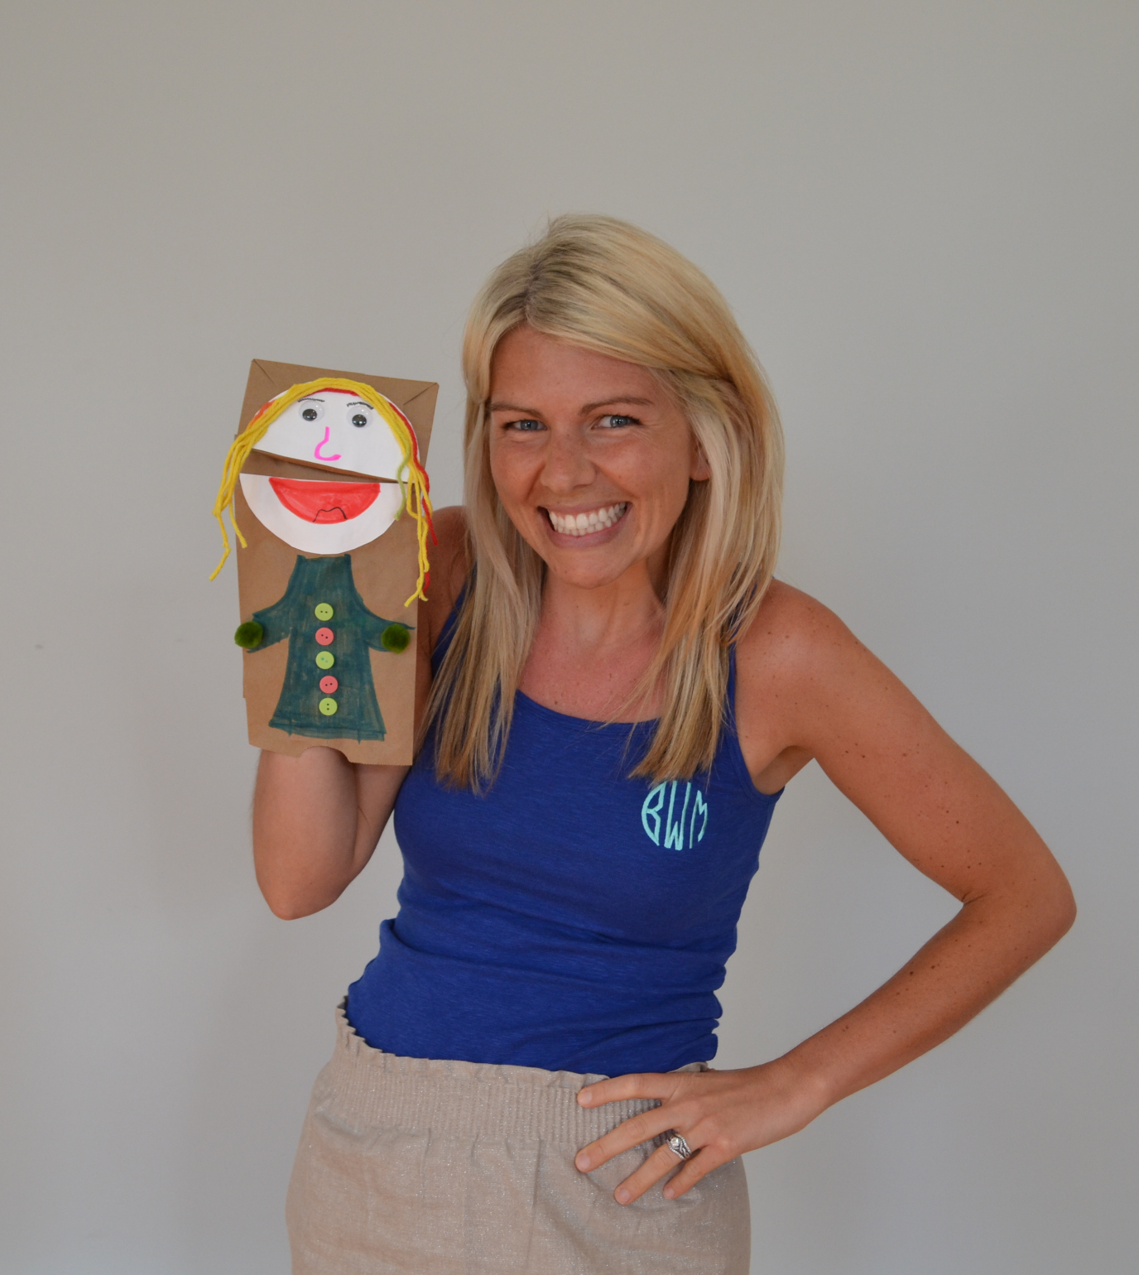
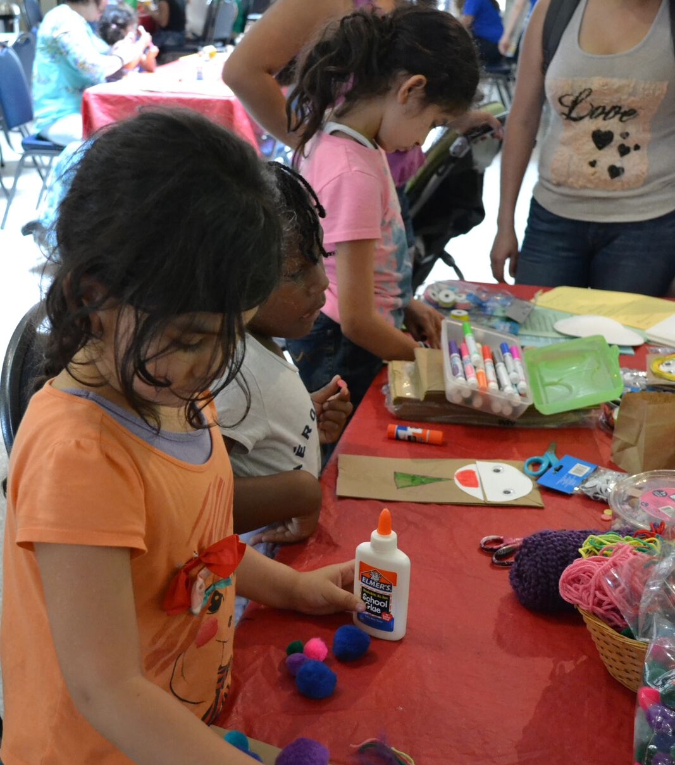
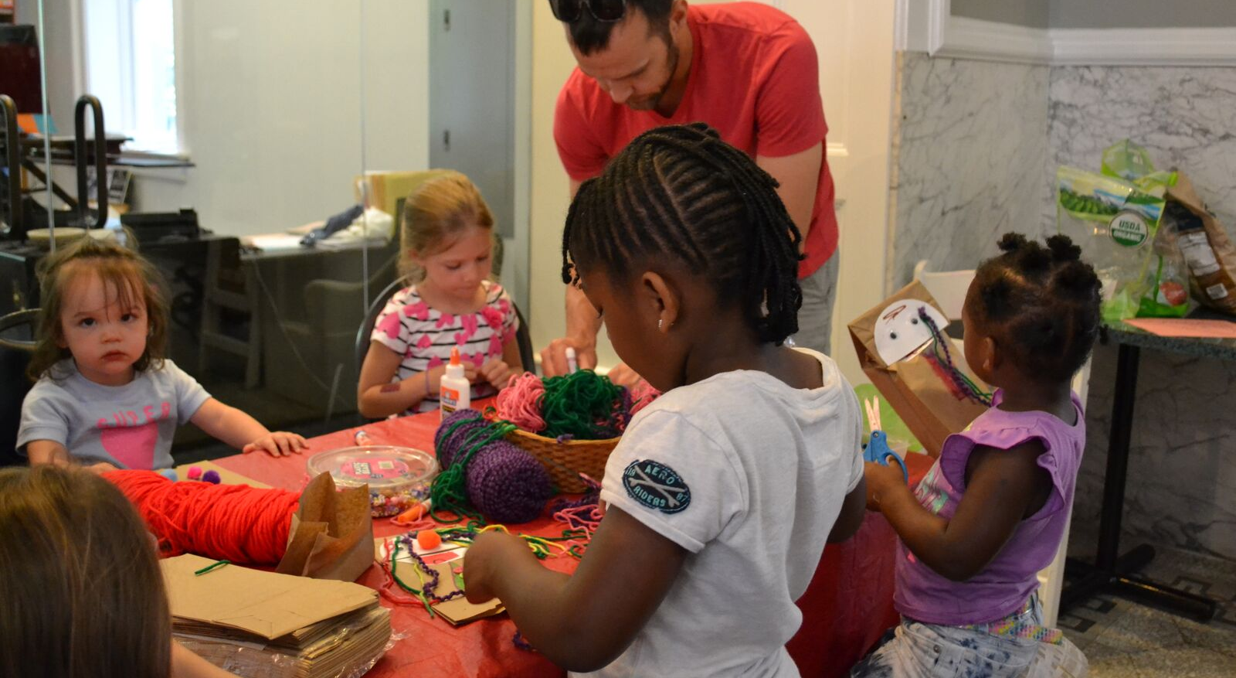
Family puppets

Slide 75
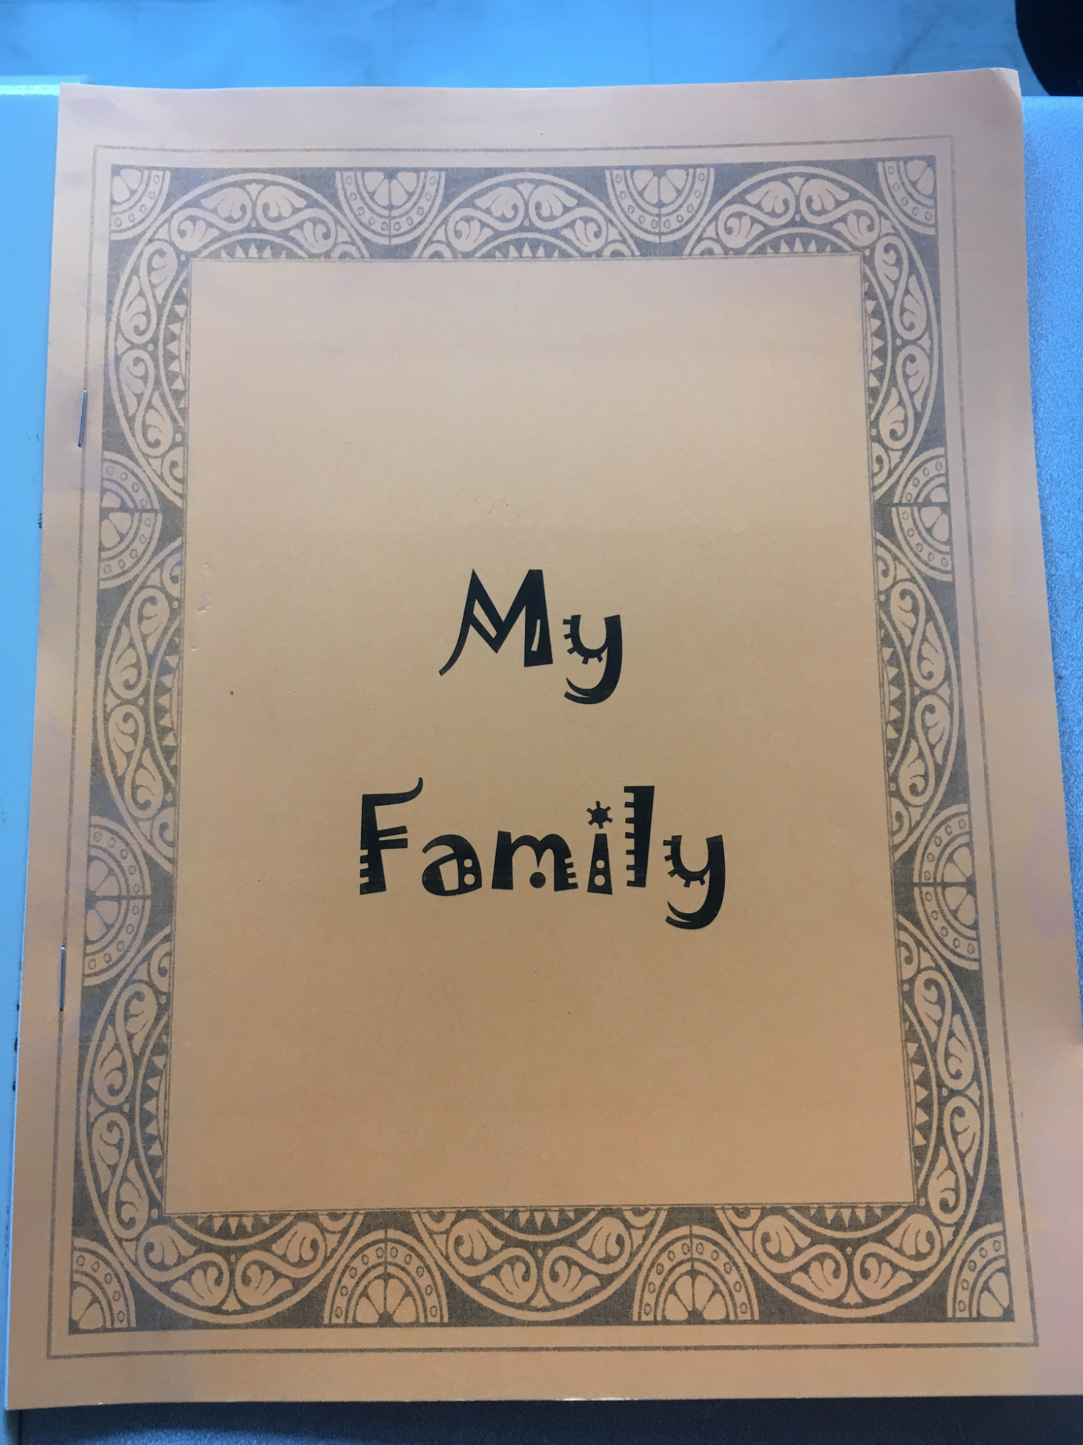
Family scrapbooks

Slide 76
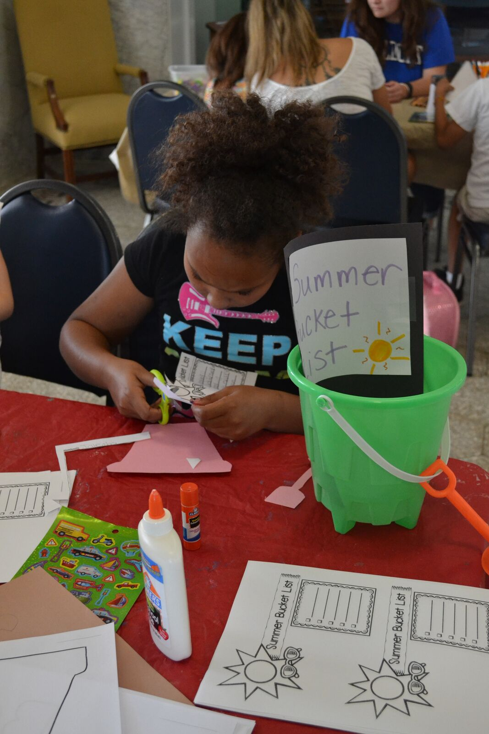
Summer bucket list

Slide 77
Family recipes

Slide 78
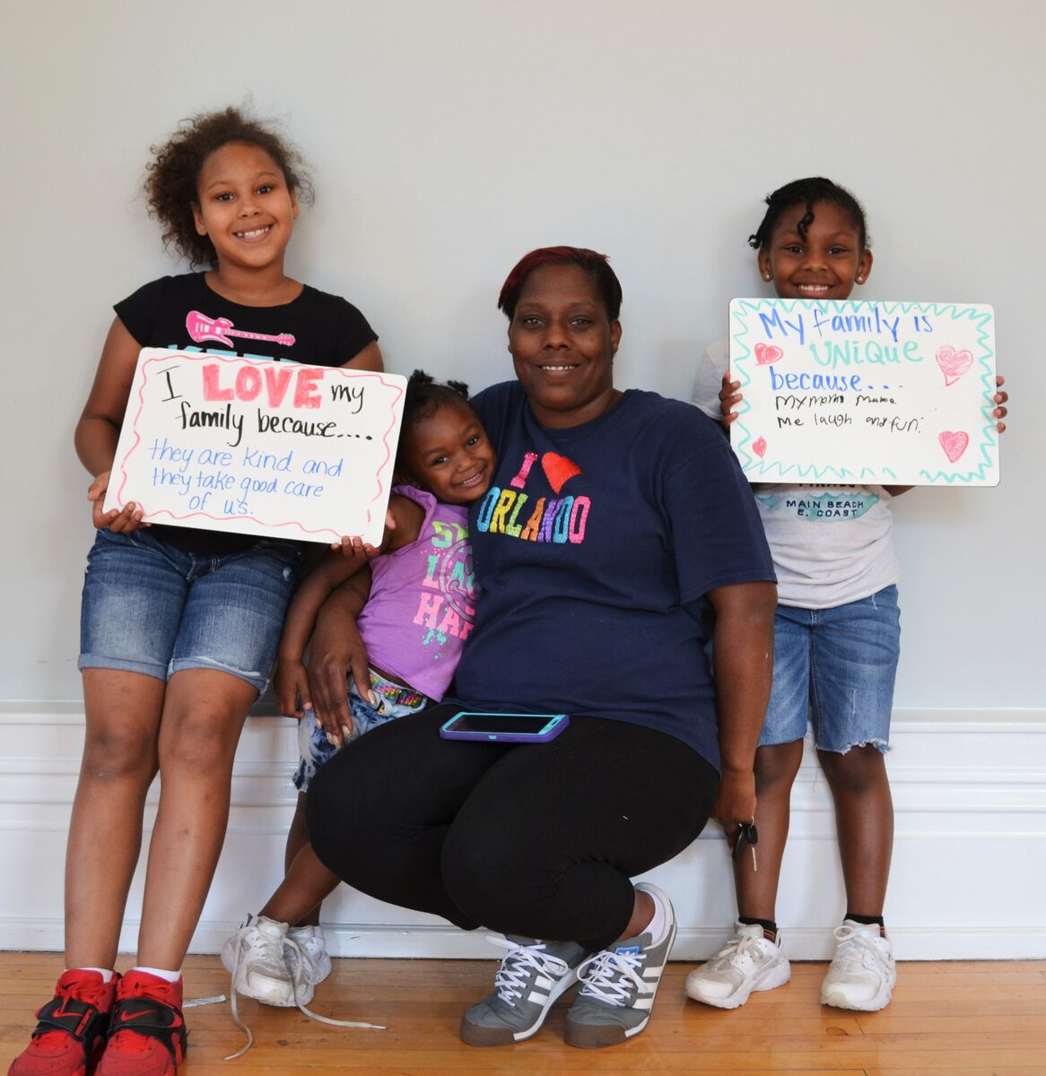
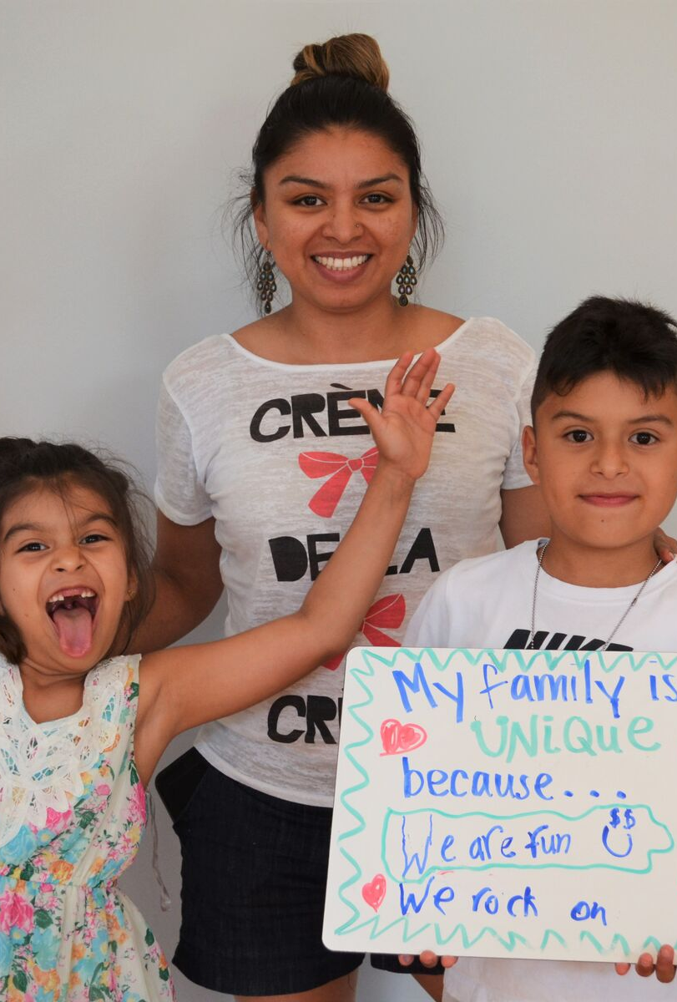
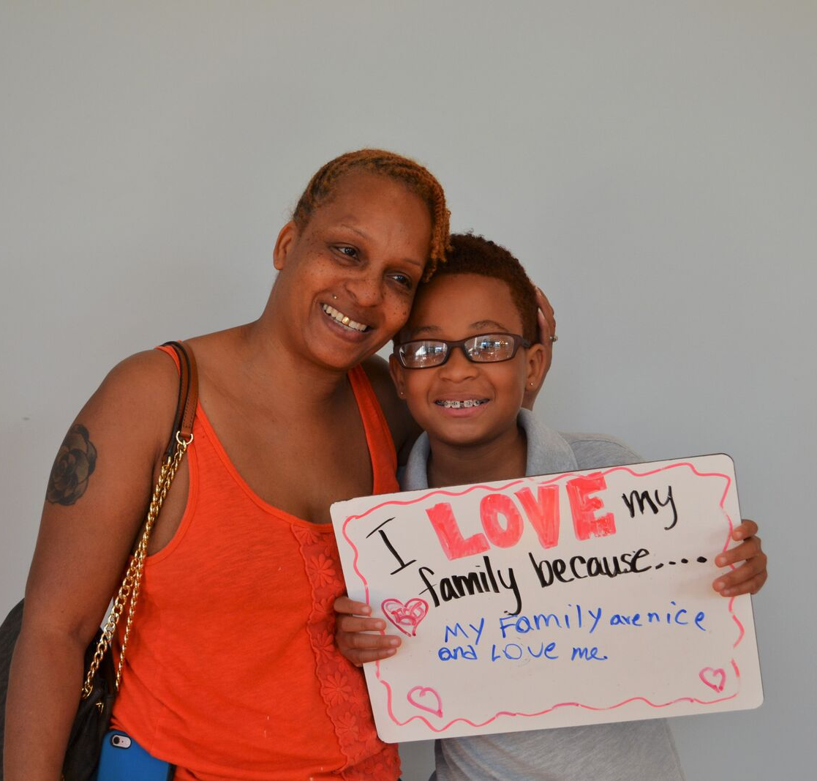
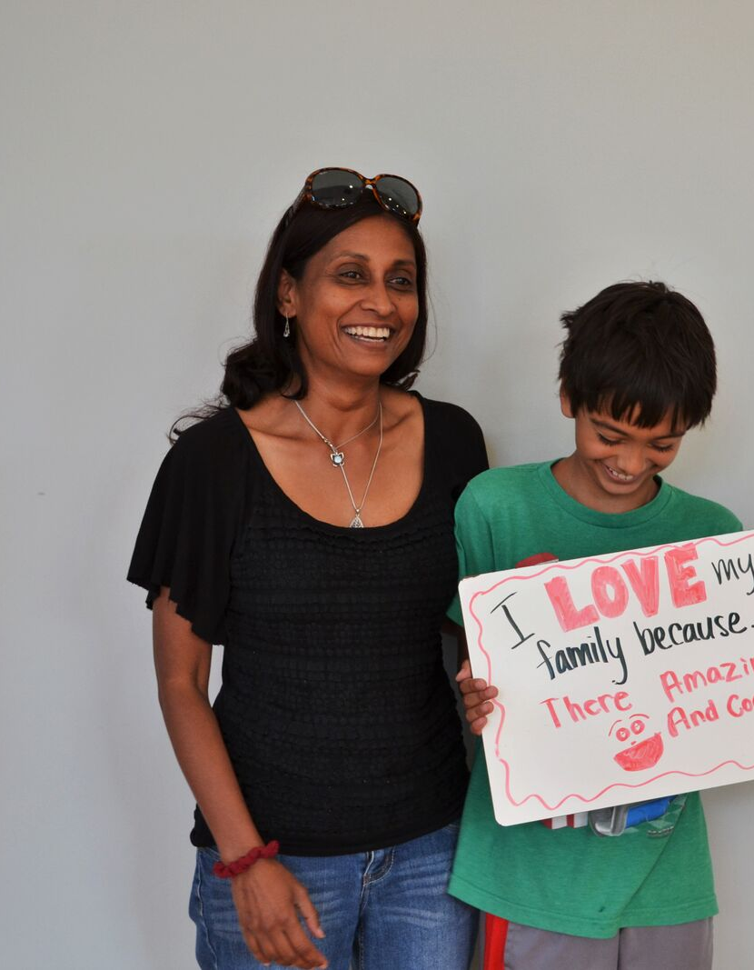
Photobooth (with sentence stems)
I love my family because _________
My family is UNIQUE because _____

Slide 79
Planning
1. How will you use what you learned today to set up your classroom?
2. Use the planning sheet to guide your thinking.
3. Make a "To-do" list to help you stay organized and follow through. What resources will you need? How will you modify your schedule? What contacts do you need to make? How will you get to know your students?

