Slide 1
Project Place Summer Institute
Day 1: July 22, 2019

Slide 2
Morning meeting: Developing class norms
Take a few moments to think about these questions:
What kind of learning community do we want to create together?
What kinds of group norms should we expect?
On a sheet of paper:
Write down three group norms you expect.
Complete this statement: "As a learning community, we ___________."

Slide 3
Developing class norms, Part 2
Pair Up
Get together with a partner
Share
Share your statement and 3 norms
Collaborate
Together, come up with a joint
Statement about our learning community
List of 3 expected norms

Slide 4
Developing class norms, part 3
Create a foursome
Repeat part 2. Each pair should share their statement and 3 norms
As a foursome, come up with a joint
Statement about our learning community
List of 3 expected norms

Slide 5
Developing class norms, Part 4
As a learning community, we....
Our norms:
1.
2.
3.

Slide 6
Language learning experience
Sesotho!

Slide 7
What is sesotho?
It's the language spoken by the Basotho, the people in the country of Lesotho
Lesotho = Country
Basotho = people of Lesotho
Mosotho = one person from Lesotho
Sesotho = language spoken in Lesotho

Slide 8
Videos are a great way to contextualize language....right?
https://www.youtube.com/watch?v=KCN_FQLNlok

Slide 9
Bua Sesotho feela!
1) Determine the meaning of the Sesotho words
2) Pay attention to HOW you figured out the words' meaning.
What strategies did the teacher use?
What strategies did you use as a learner?

Slide 10
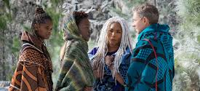
Fun Fact: Lesotho & black Panther!

Slide 11
Characteristics, Assets, and principles
Teaching English Learners

Slide 12
English learners are learning three curricula:
content
language
US culture

Slide 13
Language acquisition is driven by two key processes:
Comprehension
Understanding the new language (oral and written)
Production
Producing language that is communicative and personally meaningful to learners

Slide 14
Language Assets:
Learners come to school with
Diverse world knowledge
Diverse life experiences
Diverse language backgrounds, especially for literacy
These factors have a major impact on academic learning

Slide 15
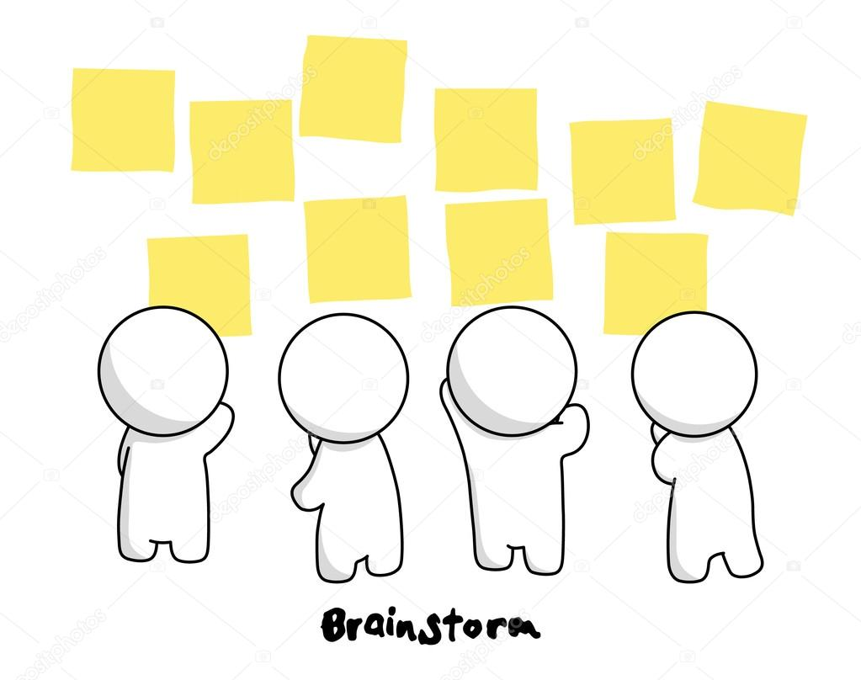
Principles for teaching english learners
On an index card, write the answer to this question:
What is the most critical principle for improving learning for English Learners?
Wander around and exchange cards without looking at them.
When the bell rings, STOP! Exchange cards one last time and read the card silently.
On the back of the card, rate the idea from 1-5 (5=Wow! This is the BEST!; 1=Hmm. I'm not sure about this.)
Repeat steps 2-4 as directed.
Add the scores on the back of your card (If you don't have 5 scores, average the scores and multiply by 5.)

Slide 16
Culturally Responsive Instruction Observation Protocol (CRIOP)
Classroom Relationships
Family Collaboration
Assessment
Instruction
Discourse
Critical Consciousness

Slide 17
Classroom relationships
The teacher demonstrates an ethic of care (e.g. equitable relationships, bonding)
The teacher communicates high expectations for all students
The teacher creates a learning atmosphere that engenders respect for one another and toward diverse populations
Students work together productively

Slide 18
Family Collaboration
The teacher establishes genuine partnerships (equitable relationships) with parents/caregivers
The teacher reaches out to meet parents in positive, non-traditional ways
The teacher encourages parent/family involvement
The teacher intentionally learns about families’ linguistic/cultural knowledge and expertise to support student learning

Slide 19
Assessment
Formative assessment practices are used that provide information throughout the lesson on individual student understanding
Students are able to demonstrate their learning in a variety of ways
Authentic assessments are used frequently to determine students’ competence in both language and content
Students have opportunities to self-assess.

Slide 20
instruction
Instruction is contextualized in students’ lives, experiences, and individual abilities
Students engage in active, hands-on, meaningful learning tasks, including inquiry-based learning
The teacher focuses on developing students’ academic language
The teacher uses instructional techniques that scaffold student learning
Students have choices based upon their experiences, interests, and strengths

Slide 21
Discourse
The teacher promotes active student engagement through discourse practices.
The teacher promotes equitable and culturally sustaining discourse practices.
The teacher provides structures that promote academic conversation
The teacher provides opportunities for students to develop linguistic competence

Slide 22
Critical consciousness
The curriculum and planned learning experiences provide opportunities for the inclusion of issues important to the classroom, school, and community
The curriculum and planned learning experiences incorporate opportunities to confront negative stereotypes and biases
The curriculum and planned learning experiences integrate and provide opportunities for the expression of diverse perspectives

Slide 23
Exploring the CRIOP Elements
Create a web depicting your assigned CRIOP element. Include
Definitions
Examples
Non examples
Questions
Etc.
Notes:
Materials: Charts with CRIOP elements and indicators

Slide 24
Reflect on the CRIOP
Read through the CRIOP self-evaluation tool.
How would you score your own practice? Rate yourself on the examples.
Rank the elements in terms of most to least proficient (Rank from 1-6).
Discuss: What are the elements you need to work on to be more culturally and linguistically responsive?
Notes:
Materials: CRIOP Short Form

Slide 25
Assignment for tomorrow
1. Look at chapter 1 in the Celic book.
2. Bring a family artifact—something that has a story that represents some dimension of your family history or background experiences

Slide 26
Implementing the criop in classrooms
Classroom Relationships—Jill Robertson
Family Collaboration—Becky Wood
Instruction—Emily Banks
Discourse—Brittany Manion
Critical Consciousness—Margot Schenning
This Photo by Unknown author is licensed under CC BY.

Slide 27
Learning from project place Advanced leaders
Choose 3 presentations to visit.
If there are more than 7 people at a table, move to a different presentation.
Rotate through 3 presentations. Listen for the signal to rotate.
Take notes and ask questions at each presentation.
Notes:
Materials: Presentation List and Note-taking Sheet

Slide 28
What? So what? Now what? w3
What?
What did you notice or learn from the presentations?
So What?
What patterns are you noticing? What conclusions are you drawing? Why are these important?
Now What?
What actions will you take based on what you learned from the presentations?

Slide 29
coaching
What to Expect

Slide 30
So...What is coaching??
1. Coaching support is an essential component of professional learning.
2. Project PLACE uses a partnership approach to coaching.
3. The purpose of coaching is to help you implement the CRIOP according to your own goals.
4. Coaches can work with you in a variety of ways.
5. Coaches DO NOT evaluate or take a judgmental stance.

Slide 31
What do coaches do?
Coaches can...
OBSERVE in your classroom and give you feedback on your CRIOP implementation and work with ELs.
PLAN with you on how to meet your implementation goals.
SHARE ideas, strategies, and resources related to your CRIOP goals.
MODEL implementation of strategies connected to your goals.
LEAD PD sessions for your team.

Slide 32
What can you expect?
1. Your coach will visit you the equivalent of a couple of times per month.
2. Your coach will schedule visits with you in advance, at your convenience.
3. Your coach will ask you to set a goal and focus on implementing the CRIOP.
4. Your coach will help you implement through modeling, providing resources, giving feedback, talking through challenges, and celebrating your successes.
5. Your coach will follow up with you on how your implementation is going.

Slide 34
What do coaches expect?
Coaches expect you to
schedule times to meet with them and for you to adhere to the meeting schedule
partner with them on implementing the elements of the CRIOP in your classroom
reflect on your practice, ask for assistance, and share your expertise

Slide 35
Coaching Q&A
Ask Project PLACE Leaders

Slide 36
Coaching Panel
How did you work with your coach in implementing what you learned in Project PLACE?
What kinds of things did your coach do?
How did you feel about the coaching component?
What should teachers expect when working with a coach?
What did you wish you had known going into the coaching relationship that you know now?

Slide 37
Congratulations to advanced leaders!
Dana Boggs, Eastern Elementary
Raychel Harrison, Eastern Elementary
Emily Banks, Russell Cave Elementary
Kelsey Carrico, Coventry Oak Elementary
Margot Schenning, Cassidy Elementary
Brittany Manion, Tates Creek Middle

