Slide 1
Bullying Project 2018-2019
Dilcia Wahnsiedler
Fourth Grade

Slide 2
How It Began
Someone wrote a hurtful comment about one of my students on the slide on the playground.
Every morning we talked about kindness during Morning Meeting.
I brought up the playground incident and we had a conversation about bullying.
This is how it all began!

Slide 3
We began by showing an anti-bullying video.

Slide 4
Next, we had a conversation with the students about whether they would like to help educate others about bullying.
Students seemed to have a misconception about bullying. It’s not about “not being nice.”
Students needed to learn more about the topic.

Slide 5
Students were given post-its and asked to write down examples of bullying. We then classified the post-its into different categories (cyberbullying, physical, verbal/nonverbal).
Students shared many stories about bullying. We had lots of conversations about parents’ lack of knowledge of bullying; they often dismissed it.

Slide 6
Students read texts at different levels during ELA. Most of these were from the NewsELA website.
Olympic gymnast Gabby Douglas teams up with anti-bullying group (level 3)
Gabby Douglas to tour schools in support of anti-bullying campaign (level 5)
Gabby Douglas partners with anti-bullying group after Olympics backlash (high)
La gimnasta Gabby Douglas se une a un grupo para detener el ciberacoso (level 3 Spanish)

Slide 7
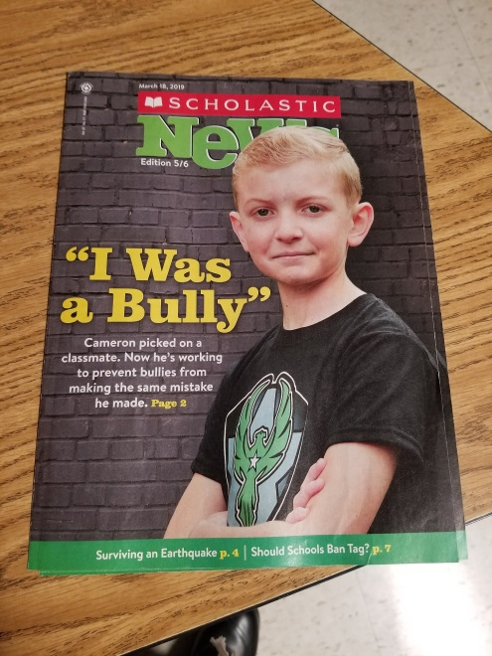
We used a variety of other resources for our research.
Scholastic for Kids
https://pacerkidsagainstbullying.org/

Slide 8
Final Product
We had many conversations about what the final product would “look like,” as well as how it would differ by audience.
Students chose their audiences: K-1, 2-3, 4-5 or parents.
We emphasized the need to gather data. Each group developed surveys based upon their audience.

Slide 11
BULLYING SURVEY: Grades 4 and 5
Bullying is _____________________________________________________________________.
Please answer truthfully. Your answers will be anonymous.
I am a GIRL BOY (circle one)
1. Has anyone ever bullied you?
A. Yes
B. No
C. Not sure
2. Have you ever bullied anyone?
A. Yes
B. No
C. Not sure
3. How often do you get bullied?
A. Daily
B. A few times a week
C. Monthly
D. I don’t get bullied
4. If you’ve ever been bullied, please CIRCLE ALL of the ways you were bullied.
A. Physically (hitting, pushing etc.)
B. Verbally (name calling, saying hurtful things)
C. Cyber bullying (texting or using the internet to post hurtful things)
D. Mocking (acting like they think you act)
5. Have you ever seen anyone get bullied?
A. Yes
B. No
C. Not sure
6. If you have seen others get bullied, what did you do?
A. I have never seen anyone get bullied
B. Joined in the bullying
C. Laughed
D. Just stood there
E. Stood up for the person getting bullied
F. Other: __________________________________________

Slide 12
The final product was a written information piece. Students also created powerpoint presentations and presented these to their selected audiences.
We provided the structure for their written pieces, along with examples: Introduction, paragraphs 1, 2, and 3, Conclusion, and References.

Slide 13
How We Guided Their Writing
Each student had a folder and were provided with a research organizer and a writing organizer.
We provided examples of proficient and non-proficient writing.
We led them through each paragraph.
We provided minilessons on writing quality introductions and conclusions.

Slide 14
Supports for ELs and Less Proficient Writers Included:
Sentence starters
Sentence frames
Academic language/vocabulary
Writing examples

Slide 15
The Writing Process
As students completed their writing pieces, each student was given a self-evaluation checklist and they had to check off the various writing features they had used. They were required to do this before they met with the teacher.
Students signed up for conferences when they needed help with a specific part of their draft, or they felt they were ready to publish.

Slide 16
The Project Addressed Many Standards:
Writing standards (informational writing, persuasive writing)
Technology standards
Speaking and listening standards
We even incorporated math (data from surveys – percentages)

