Slide 1
Advanced leaders

Slide 2
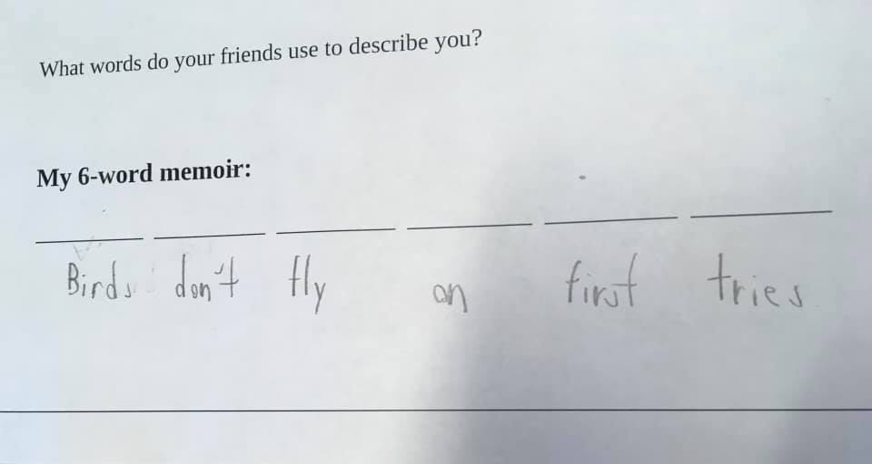
Samantha Arnold

Slide 3
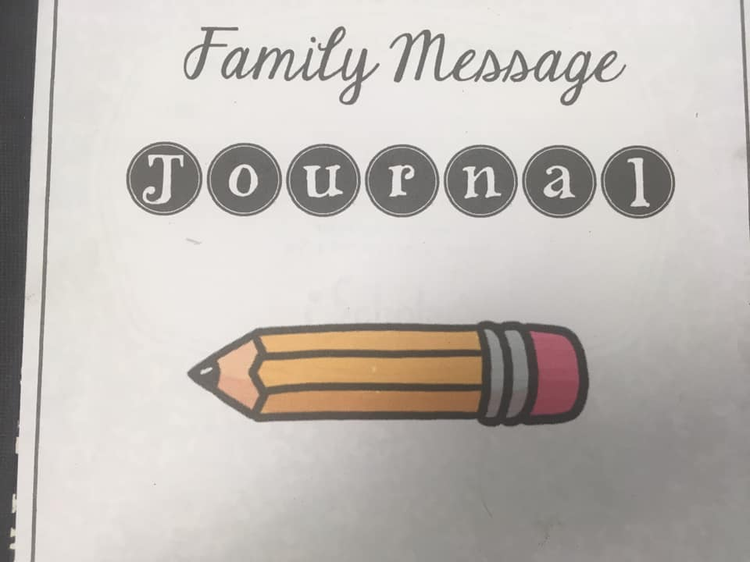
Nicole Naylor

Slide 4
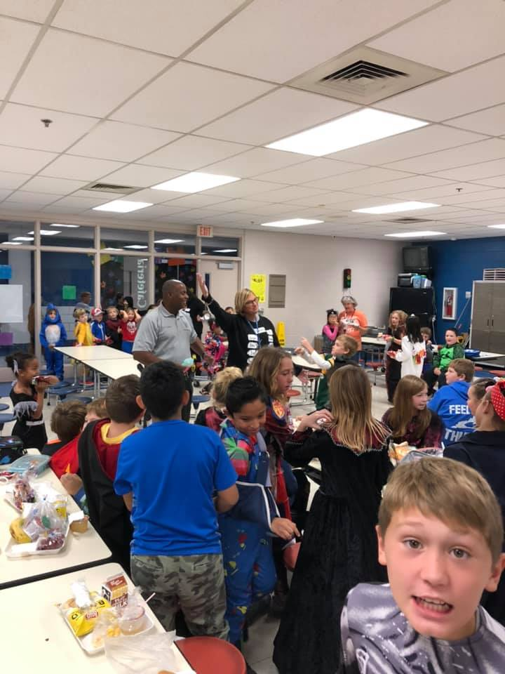
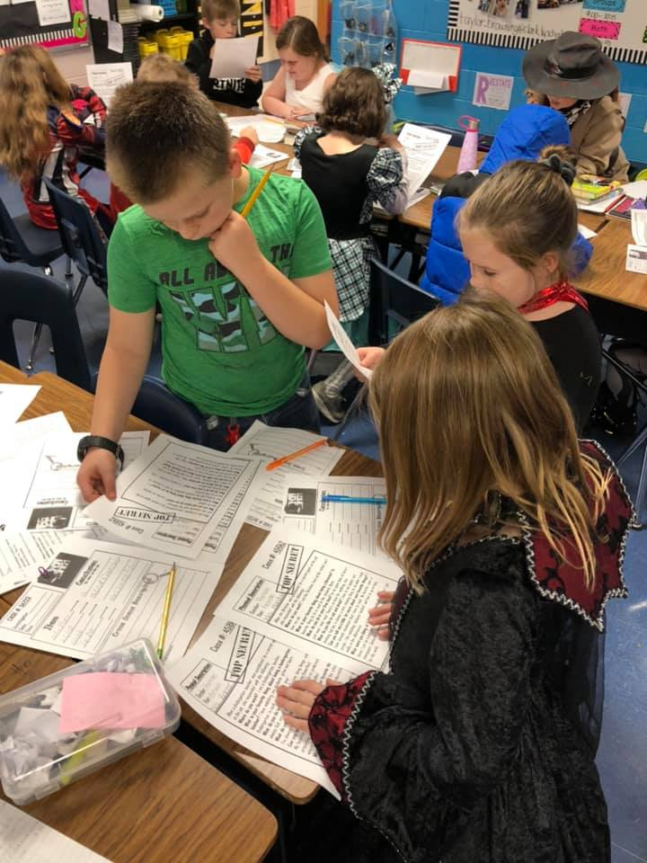
Taylor Cain

Slide 5
Thank you!

