Slide 1
Outline for Brain Injury and Recovery Lectures
Who studies/treats this?
Ways that the NS can be damaged
What happens after injury and are there ways for neuronal circuits to recover?

Slide 2
Who studies and treats brain disorders?
Clinical neuropsychologists
Neurologists
Neurosurgeons
Rehabilitation therapists
Occupational therapists

Slide 3
Brain can be damaged many ways
head injuries via cerebral trauma
Stroke/hypoxia
tumors
Infections
Drugs or toxic substances
exposure to radiation
degenerative conditions

Slide 4
Cerebral Trauma
brain is jarred, bruised or cut **** most common cause -
contra coup - seen in 50 - 80% of closed head injuries
frontal and temporal lobe sites most common
(alcoholics, epilepsy)

Slide 5
some definitions
Concussion - brain is jarred resulting in temporary loss of consciousness (often lasting just few minutes)
threshold and severity issues

Slide 6
Boxing The force of a professional boxer's fist is equivalent to being hit with a 13 pound bowling ball traveling 20 miles per hour, or about 52 g's.

Slide 7
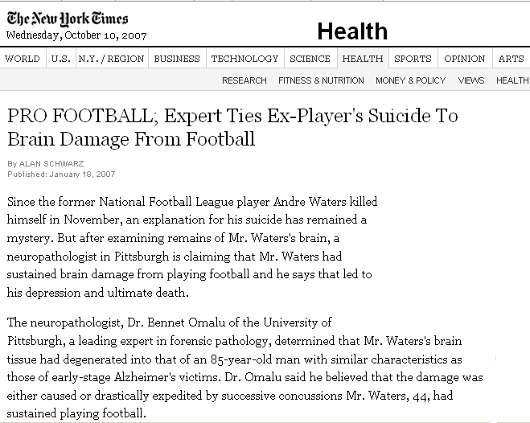

Slide 8
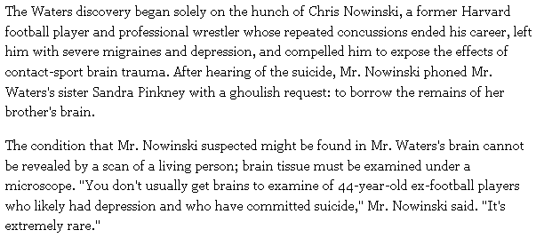

Slide 9
some definitions
Concussion - brain is jarred resulting in temporary loss of consciousness (often lasting just few minutes)
threshold and severity issues
Contusions - more severe than concussion; brain is jarred but also shifted out of position in skull (so generally bruised)
coma, convulsions, speech loss

Slide 10
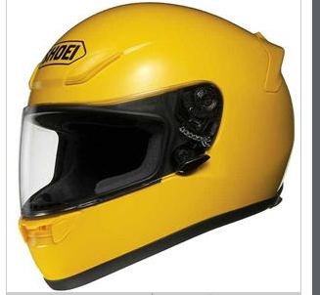
THE LAW
1968 – enacted helmet law for all motorcyclists.
1998 – amended law
under age of 21
instructional permit
cyclists with license for less than one year
anyone who did not have at least 10,000worth of health coverage
2000 – took off the health coverage requirement

Slide 11
Year | Percent Helmeted
1997 | 96
1998 Pre-Change | 96
1998 Post-Change | 76
1999 | 65
2000 | 70
2001 | 56
what direction to you think the trend is going?

Slide 12
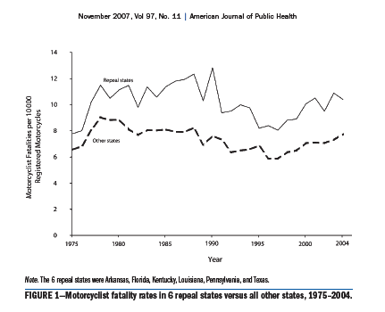

Slide 13
Laceration – foreign object enters skull and damages or destroys brain tissue
depending on area of damage determines extent of damage

Slide 14
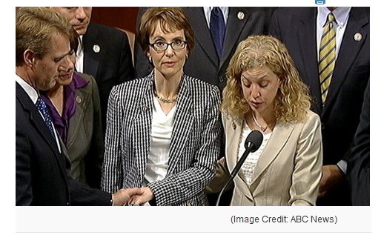
example of laceration
January 8, 2011-

Slide 15
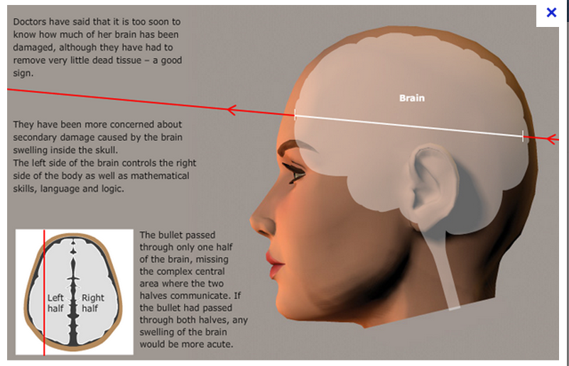

Slide 16
B. Cerebrovascular diseases
Cerebrovascular accident (CVA)
stroke; sudden onset that causes brain damage

Slide 17
B. Cerebrovascular diseases
Cerebrovascular accident (CVA)
stroke; sudden onset that causes brain damage
2 types of cerebrovascular disorders:
cerebral hemorrhage – bleeding in the brain
Most frequent cause – high blood pressure
neurons do not receive necessary blood/oxygen/energy PLUS – flooded with all sorts of chemicals normally contained in blood vessels (causes all sorts of imbalances)

Slide 18
B. Cerebrovascular diseases
Cerebrovascular accident (CVA)
stroke; sudden onset cerebrovascular disorder that causes brain damage
2 types
cerebral hemorrhage –
cerebral ischemia – disruption of blood supply to an area of the brain (caused by blockade/obstruction of blood flow
so neurons do not receive necessary blood/oxygen/energy

Slide 19
B. Cerebrovascular diseases
Cerebrovascular accident (CVA)
stroke; sudden onset cerebrovascular disorder that causes brain damage
2 types
cerebral hemorrhage –
cerebral ischemia -
Estimates as high as 750,000 people/yr
3rd leading cause of death and most common cause of adult disability

Slide 20
What are estimates of the consequences?
10 percent of stroke survivors recover almost completely
25 percent recover with minor impairments
40 percent experience moderate to severe impairments requiring special care
10 percent require care in a nursing home or other long-term care facility
15 percent die shortly after the stroke

Slide 21
Transient ischemic attacks-

Slide 22
Signs of Stroke or TIA

Slide 23
2 ways that strokes kill neurons
1. directly (usually immediate)-
deprivation of oxygen or blood within minutes will kill neurons

Slide 24
2 ways that strokes kill neurons
1. directly (usually immediate)-
deprivation of oxygen or blood
more indirectly (usually more delayed)
overexcitation due to release of ions and NT from dead neurons- particularly glutamate (at NMDA receptors)

Slide 25
Can we save neurons?
PROBABLY NOT neurons that die directly
MAYBE – damage that occurs as 2ndary injury

Slide 26
A variety of clinical trials
NMDA R antagonists
intravenous thrombolysis-
for infarcts

Slide 27
C. CNS infections
Bacterial Infection and viral infections

Slide 28
Differences between bacteria and viruses.
living/ can reproduce/divide
good bacteria/bad bacteria
can be treated with antibiotics
not alive?
piece of nucleic acid that infects other cells
kills host cell
difficult to treat because virus constantly mutates,
Bacteria
viruses

Slide 29
D. CNS infections
bacterial infections –
can result in formation of pus

Slide 30
D. CNS infections
bacterial meningitis or encephalitis
symptoms: high fever, severe headache, nausea, confusion, disorientation, personality changes, convulsions, memory loss, drowsiness, and coma

Slide 31
Other Bacterial Infections
Neurosyphilis
Lyme Disease

Slide 32
Viral Infections
viral encephalitis, meningitis
viruses that have affinity for nervous system
ex rabies –
Viruses that do not have special affinity for ns
West Nile Fever- from mosquitos
HIV, mumps, herpes

Slide 33
HIV dementia
virus infects glia and other cells (probably not neurons) although it causes neuronal damage
impaired concentration, mild memory loss
HIV cocktails and the blood brain barrier

Slide 34
Prion diseases
transmissible spongiform encephalopathies
once disease is apparent – demise is relatively quick

Slide 35
Prion diseases
Prions – abnormal protein that appear to destroy normal proteins and cause them to fold onto themselves in the CNS
(proteinaceous infectious particle)
A number of diseases that are all considered transmissible spongiform encephalopathies
called this because of the spongy nature of what the brain looks like
all are untreatable and fatal

Slide 36
spongiform holes (vacuoles),

Slide 37
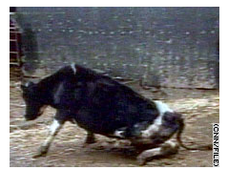
Prion diseases
transmissible spongiform encephalopathies
Kuru – Papau New Guinea
scrapies – in sheep
Mad cow disease – in cows
bovine spongiform (BSE)

Slide 38
Human Prion Diseases
Kuru
Papua New Guinea- late 1950’s
Creutzfeldt-Jakob Disease (CJD) and variant CJD
fatal familial insomnia
inherited prion disease (found in just 40 families)
Notes:
won Nobel Prize in Physiology or Medicine in 1976 for shoing that kuru was transmisslbe to chimps

Slide 39
Classic CJD –
Very rare – total estimates 1 per 1,000,000 people•
Sporadic CJD (occurs occasionally with no known cause) – most common but still rare
• Familial CJD (an inherited form of CJD that occurs in families) - accounts for only 10 – 15%

Slide 40
Both have genetic profile of the prion protein gene.
Variant CJD was first described in 1996 in the United Kingdom

Slide 41
Variant CJD
caused by an unconventional transmissible agent.
since first report in 1996 – 217 patients from 11 countries identified
170 UK, 25 France, 5 spain, 3 US

Slide 42
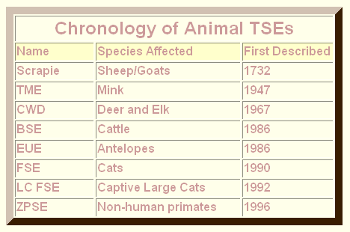
TME – transmissible mink
CWD – chronic wasting disease
BSE- bovine spongiform encephalopathy
EUE – ungulates
FSE- feline spongiform encephalopathy - fed offal
LC FSE – large cat feline….. - fed offal
ZPSE – zoo primate spongiform…….- fed offal

Slide 43
E. Neurodegenerative disorders
Alzheimers Disease, Parkinsons Disease, Huntingtons Disease
neurons begin to die – unclear the cause;
none of the treatments for these diseases stop the progression of the disease
maybe??????????????

Slide 44
Alzheimers disease
most common form of dementia
up to 4 million Americans with it
person can live with disease (although experiencing significant personality changes and ability to function) for many years
characterized by slow decline- most recent information first
characterized by tangles and plaques

Slide 45
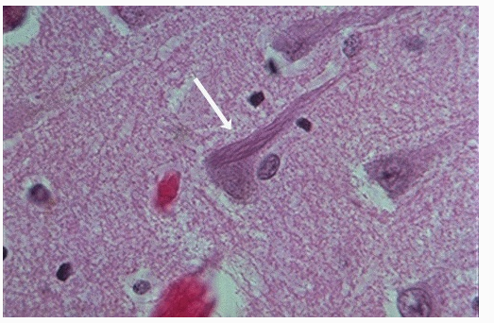
Twists of tangles of filaments within nerve cells, especially in the cerebral cortex, and hippocampus

Slide 46
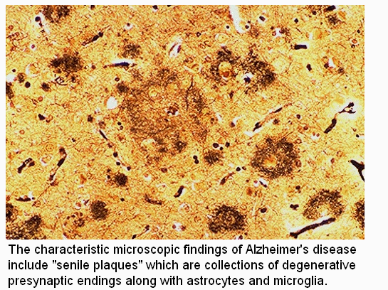

Slide 47
Alzheimers disease
cholinergic neurons are particularly susceptible
treatments mostly increase ACh activity
AChE blockers
ACh agonists
Latest –treatment – memantine
Blocks GLU receptors (NMDA receptors)
early onset AZ vs later onset
Genetics; trisomy 21

Slide 48
Parkinsons Disease
typical onset over 60
younger than 40 (5 per 100,000)
people in 70’s (300 – 700 per 100,000)
etiology still unknown
Famous individuals with PD
Janet Reno, Muhommed Ali, Michael J. Fox

Slide 49
Parkinson’s Disease
Features: difficulty initiating movement, cogwheel rigidity, resting tremor and postural instability (fall easily).
What do we see?
Progressive degeneration of dopamine neurons in the midbrain (substantia nigra) that project to basal ganglia
Depression –
occurs fairly often –estimates of 50% course of disease
Emotional changes

Slide 50
What causes Parkinsons Disease?
unsure; certain risk factors suggest environmental contaminants
age, well water, farmers, boxers
MPTP model

Slide 51
What do we know about the treatment?

Slide 52
Current Treatments for Parkinsonism
Pharmacological: increase dopamine (DA) levels with a drug like l-dopa
other drugs that slow down breakdown of DA or act as DA agonists

Slide 53
Current Treatments for Parkinsonism
rationale:

Slide 54
Problems with drugs that increase DA activity
over time – extended off periods
motor side effects from medication
other side effects of medication

Slide 55
other treatments applied
Various forms of brain surgery
Lesion part of thalamus
deep brain stimulation
fetal tissue implantation
RECENT RISK OF SIDE EFFECTS

Slide 56
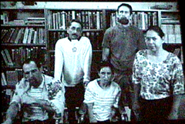
MPTP-induced Parkinsonism
How was it discovered---
1982 – San Francisco
Designer Drug that was supposed to mimic heroin
Seven heroin addicts at ER
All showed signs of severe
Parkinsons like Disease
Found that the drug had been
contaminated with a toxin called MPTP
First human cohort of MPTP-induced parkinsonism

Slide 57
Glial Cell Line-Derived Neurotrophic Factor (GDNF)
_______________________________________
GDNF is currently one of the most potent survival factors for dopamine neurons!

Slide 58
A bit of history
GDNF studies in monkeys
Human Phase 1 Clinical Trials
University of KY- Dr. Don Gash
Drs. Gill and Haywood in Bristol, England
Five PD patients with significant side-effects from l-dopa treatment, on/off symptoms
All received continuous GDNF infusion into the putamen for two years
All showed significant improvements in motor functions

Slide 60
Huntingtons Disease
early symptoms include cognitive dysfunction, memory problems, depression, clumsiness or motor incoordination
first described syndrome in 1872
usually first symptoms emerge between 30 and 45 years of age
characterized by progressive degeneration of CNS
genetic basis –
offspring has 50% of inheriting disorder if parent has it

Slide 61
tremendous progress in genetics of HD
short arm of the 4th chromosome
a gene that codes for a protein called huntingtin
CAG repeats
sequence replicated up to 26 times in normal adults;
HD - 40 to over 100X – more replicates usually the earlier and more severe the onset of disease
still not sure why CAG repeats cause HD

Slide 62
In theory vs in practice……
can screen for this disorder now – from in utero to anytime after birth

