Slide 1
THE NORMATIVE BASES OF PUBLIC OPINION:
DEMOCRATIC THEORIES AND PUBLIC OPINION
Mark Peffley
PS 473 Public Opinion

Slide 2
Lecture Outline I: DEMOCRATIC THEORIES AND PUBLIC OPINION
(posted with the syllabus!)
I. Democratic reform as a 2,500 year-old debate: Historical Examples of Democracy in Ancient Greece and Rome
A. Direct democracy of Greek city-state of Athens.
B. Sparta: members of the Council elected by a method called The Shout
C. Allegory of the Cave in Plato’s Republic.
D. Which is closest to our democracy? Why?
II. Classical Representative Democratic Theory ( Mill, Locke, Jefferson, Dewey)
A. Background: Thomas Jefferson’s Declaration of Independence; John Dewey’s update in 20th Cent.
B. Values: Popular sovereignty, political equality, liberty, public deliberation.
C. Role of elites: Delegates
D. Role of masses: Politically sophisticated, active
E. View of Human Nature: High potential for self-rule and reason, nature is mutable, “enlightenment” through mass education and participation.
F. Consequences for Government: Selection of representatives, delegate representation, responsiveness, potential for electoral mandates.
III. Democratic Elitist/Guardian Democratic Theory (e.g., Plato, Framers, Lippmann)
A. Background: Plato, Framers’ distrust of public, Lippmann’s Public Opinion and experiences in 20th Century)
B. Values: Minimal choice in elections, stability, elite deliberation.
C. Role of Elites: Guardians, trustee representation
D. Role of Masses: Politically unsophisticated, passive
E. View of Human Nature: Masses inherently unsophisticated, inattentive, anti-democratic/authoritarian, and nature is immutable.
F. Consequences for Government: trustee representation, competition of elites in elections, barriers to limit public opinion.

Slide 3
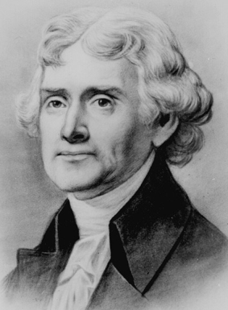
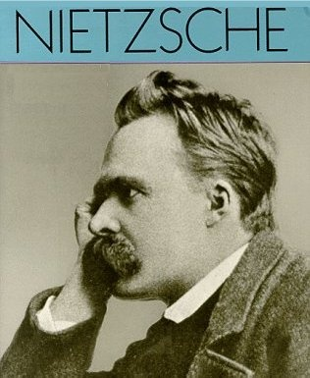
Need A Normative Framework for Evaluating Moral Questions:
When, if ever, should elected politicians listen to the public when making public policy?
Are the masses “asses” (Nietzsche) and intolerant, or rational and capable of reason (Jefferson)?
Examples: Iraq War, health care debate

Slide 4
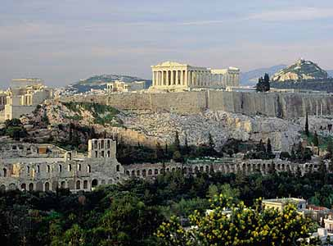
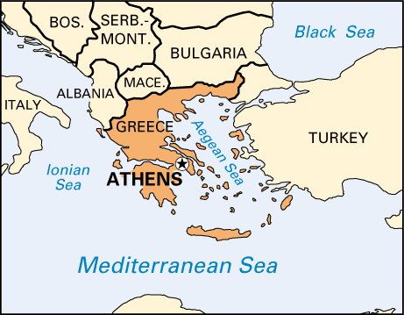
Democratic Theories and Reform:
A 2,500 Year-Old Debate
Direct democracy of Greek city-state of Athens (5th Cent. BC).
  Hired Sophists, trained in the art of classical debate.
Sparta
  “The Shout,” an ancient applause-meter

Slide 5
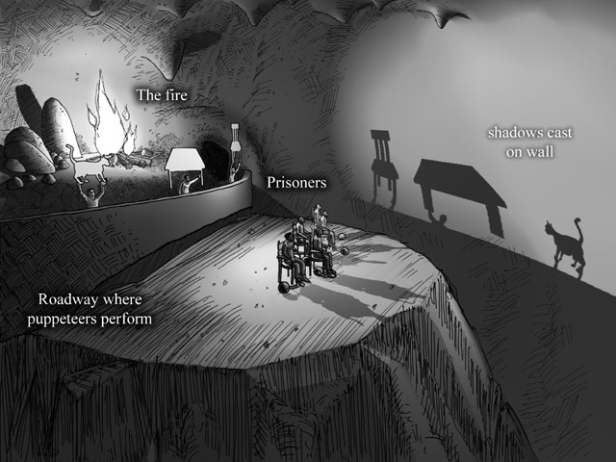
Plato’s Allegory of the Cave, or why the masses aren’t fit to rule
Imagine the condition of men living in a sort of cavernous chamber underground. Here they have been from childhood, chained by the leg and neck, so they can’t move and can see only what is in front of them, because the chains won’t let them turn their heads. They watch manipulated images cast from a fire onto the walls of the cave—a kind of puppet show, with images and voices. This is the only reality of which they are aware, so they think the images in the cave are the real world. They offer prizes to each other to see who can best predict the sequence of images they are presented. These predictions count for “wisdom” among the denizens of the cave.

Slide 6
Which is closest to our democracy?
Athens, The Shout or The Cave?

Slide 7
What if Public is Uninformed, or worse, misinformed?
Surveys demonstrate public ignorance
  In 1986, a majority of Americans didn’t know the name of the Soviet leader (Mikhail Gorbachev)
1992 UMass Report:
  86% could name Bush family dog (Millie)
  15% knew Bush and Clinton support death penalty
  5% knew both support cuts in capital gains tax
More people could identify Judge who ran the “People’s Court” on TV than name a single Supreme Court Justice
Urban Legends

Slide 8
More Evidence…
Iraq War:
22% of Americans believe Saddam Hussein helped plan and support the Sept. 11 terrorist attacks
24% believe several of the hijackers were Iraqis
41% say Saddam had “strong links” to al Qaida.
Healthcare:
NEWT GINGRICH: You're asking us to trust turning power over to the government when there clearly are people in America who believe in establishing euthanasia including selective standards.
REP. PAUL BROUN: This program of government option that's being touted as being this panacea, the savior of allowing people to have quality health care at an affordable price, is going to kill people.

Slide 9
Who’s to Blame for Political Misinformation?
Public?
Media?
Politicians?

Slide 10
Two Extreme Versions of Democratic Theory, differ in:
their view of public opinion, human nature, the role of elites and standards for evaluating public opinion and elite responsiveness to it.

Slide 11
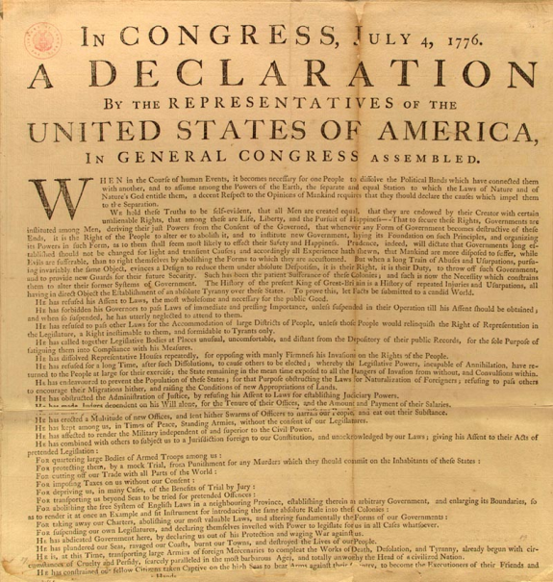
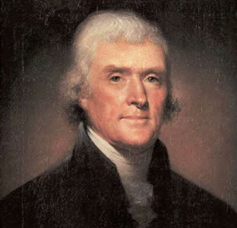
II. Classical Representative Democratic Theory
(Mill, Locke, Jefferson, Dewey)
Background, Historical examples
  Thomas Jefferson’s Declaration of Independence:
  “We hold these Truths to be self-evident, that all Men are created equal, that they are endowed by their Creator with certain unalienable Rights, that among these are Life, Liberty, and the Pursuit of Happiness-That to secure these Rights, Governments are instituted among Men, deriving their just powers from the consent of the governed, that whenever any Form of Government becomes destructive of these Ends, it is the Right of the People to alter or to abolish it, and to institute new Government, laying its Foundation on such Principles, and organizing its powers in such Form, as to them shall seem most likely to effect their Safety and Happiness.”
  Whenever a government does not secure the people’s rights, “it is the Right of the People to alter or to abolish it….”

Slide 12
II. Classical Representative Democratic Theory
(Mill, Locke, Jefferson, Dewey)
Fundamental values
  Popular Sovereignty: the ultimate source of authority rests with the people and the government does the people’s bidding. Know it when we see it by:
    Govt. policies reflect what people want.
    People participate in the political process. More is better.
    High-quality info and debate are available.
    Majority rules.
  Political Equality: Each person carries the same weight in voting and other decision making. "1 person, 1 vote“
    Jefferson: Plowman has common sense, while the professor has abstract ideas and theories.
  Political Liberty → public deliberation: basic freedoms in the formation and expression of the popular will and its translation into policy.

Slide 13
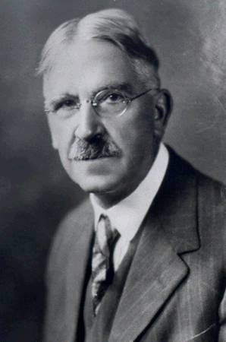
II. Classical Representative Democratic Theory
  View of Human Nature
    High potential for rationality, reasoning, and self-government
    Mutability
    Enlightenment through mass education and participation
      Mass education: John Dewey’s (1859-1952) plan for democratic citizenship
        “Scientific thinking,” the mental habit of free inquiry, tolerance of alternative viewpoints, and free communication.
        Deliberative, practical reasoning in moral situations
        Schools as democratic communities
        “To cure the ills of democracy, need a stronger dose of democracy.”

Slide 14
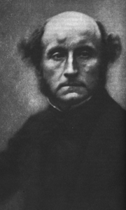
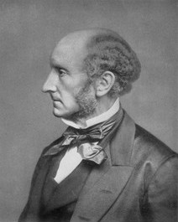
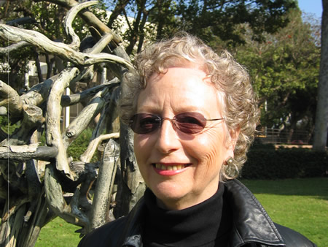
II. Classical Representative Democratic Theory
      Enlightenment through mass political participation (J. S. Mill, Carol Pateman)
        Responsibility, obedience to laws of representative body
        Develop reasoning, intellect by exercising judgment, making pol. decisions
        Incentives to become informed
        Increase political tolerance

Slide 15
II. Classical Representative Democratic Theory
Role of Mass Public in a Democracy: political sophistication
  Rational
  Politically informed
  Politically active
  Politically tolerant
Role of Representatives
  Delegate role vs. trustee
  Responsiveness

Slide 16
Elitist Democracy (Plato, Framers, Lippmann)
Framers:
  Federalist Papers
    Federalist No. 10: Mob rule: they [democracies] have ever been spectacles of turmoil and contention; have ever been found incompatible with personal security or the rights of property; and have in general been as short in their lives as they have been violent in their deaths.”

Slide 17
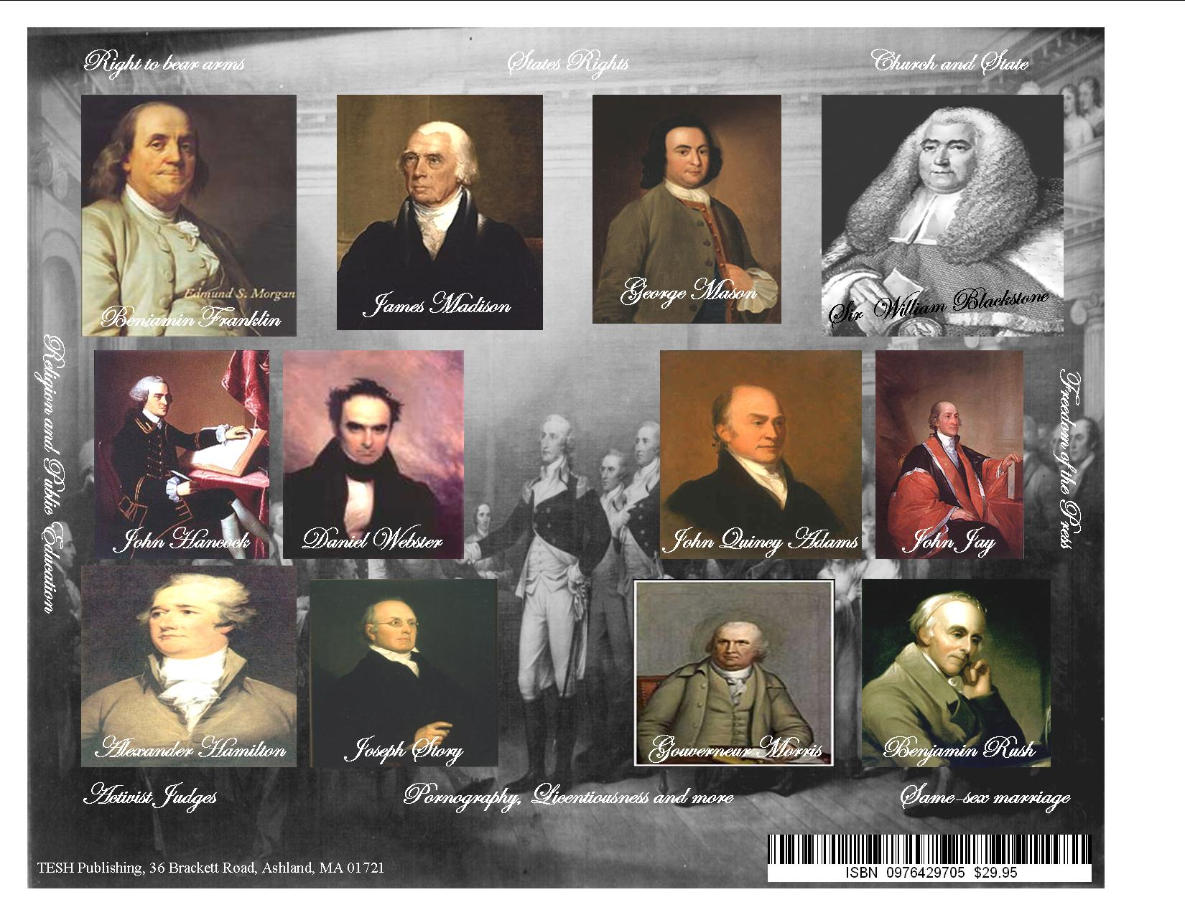

Slide 18
Elitist Democracy (Plato, Framers, Lippmann)
    Federalist 49, Madison argued against the idea of allowing disputes to be settled by appeals to the public convention and in favor of the government intervention to control public passions: “…still, it [a hypothetical dispute] could never be expected to turn on the true merits of the question. It would inevitably be connected with the spirit of pre-existing parties, or of parties springing out of the question itself… [or] would be connected with persons of distinguished character and extensive influence in the community. The passions, therefore, not the reason, of the public would sit in judgment. But it is the reason, alone, of the public, that ought to control and regulate the government. The passions ought to be controlled and regulated by the government.”[emphasis added]

Slide 19
Elitist Democracy (Plato, Framers, Lippmann)
    Federalist 71: “The republican principle demands that the deliberate sense of the community should govern the conduct of those to whom they intrust the management of their affairs; but it does not require an unqualified complaisance to every sudden breeze of passion, or to every transient impulse, which the people may receive from the arts of men, who flatter their prejudices to betray their interests.” (p. 432)

Slide 20
Elitist Democracy (Plato, Framers, Lippmann)
Framers (cont’d)
  Institutional Barriers
    Elections
    Limited government
    Bill of Rights, Constitution

Slide 21
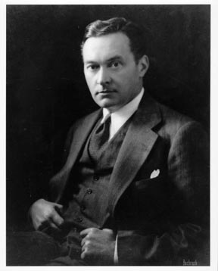

Elitist Democracy (Plato, Framers, Lippmann)
Walter Lippmann:
  On human nature: The “primary defect of popular government is that members of the public are characterized by “violent prejudice, apathy, preferences for the curious trivial as against the dull important, and the hunger for sideshows and three legged calves.” (Public Opinion, 1922, p. 230)
  On the need for trustee representation: Even if the people improved their character, they still would not know enough to guide the government because they simply do not spend enough time learning about political issues to understand them.
  Lippmann’s experiences
    Editor of New Republic during WWI, urging participation in war. WH special rep. Europe writing propaganda leaflets, interrogated prisoners, and coordinated intelligence operations with the Allies.
    Foreign affairs
    Demagogues and dictators in WWII

Slide 22
Elitist Democracy (Plato, Framers, Lippmann)
  Lippmann’s solution
    Trustee representation
    Rule by an expert elite:
      Elite deliberation & filtration of public sentiment
      Intellectuals and journalists would organize the facts for the “men of action”
      Newspapers and magazines would lay out conclusions for the public to follow
    Low participation

Slide 23
The Class Blog:
Should parents keep their kids home to avoid being exposed to President Obama’s address to them on Wednesday?
  KY Republican Party chair & talk show hosts describe the President’s attempt to talk to children without their parents present as “creepy.”
  Does this raise questions about public opinion?

Slide 24
Comparing Democratic Theories
 |  | Classical Representative Democracy |  |  |  | Elitist Democracy
Theorists |  | Locke, Jefferson, Rousseau, Dewey |  |  |  | Plato, Lippmann
Historical Examples |  | Greek city state, face-to-face deliberation |  |  |  | Plato’s “cave” allegory
Human Nature |  | High potential for self-rule & reason, “enlightenment” through mass education & participation, mutable |  |  |  | Masses inherently unsophisticated, inattentive, anti-democratic, & nature is immutable (fixed)
Role of Masses (Sophistication) |  | Highly sophisticated, capable of self-rule, active, tolerant |  |  |  | Unsophisticated, incapable, passive, intolerant
Role of Elites |  | Delegates |  |  |  | Guardians, Trustees
Political Values |  | Popular sovereignty Political equality Public deliberation to achieve the public will |  |  |  | Elite deliberation of modern issues Minimal popular sovereignty to maximize political stability of democracy

Slide 25
Examples of the ongoing debate
Brooker and Schaefer: Not an arcane historical debate; continuing balancing act between the sovereignty of the people and prudent checks on their will
  E.g., public support for anti-terrorist policies in the wake of the attacks on September 11, 2001
  USA Patriot Act: Should the government, even with the support of the overwhelming majority of the people, be able to curtail people’s Constitutional rights by eavesdropping on more people and imprisoning suspected terrorists or enemy combatants without bringing them to trial?

Slide 26
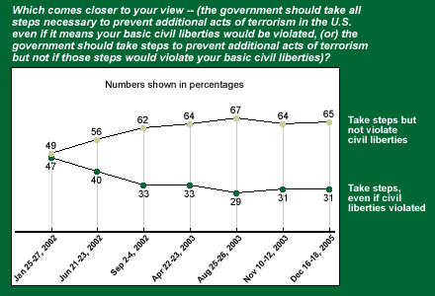
The 21st Century: The Democratic Dilemma Today
USA Patriot Act: Security vs. Civil Liberties over time

Slide 27
Which Democratic Theory Does this Example Support?

Slide 28
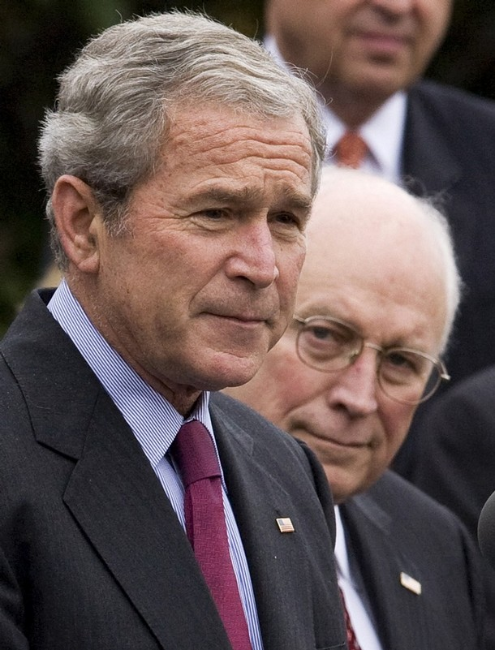
Should the government ignore public opinion on foreign policy matters?
“Cheney, preparing his memoirs, unloads on Bush for bowing to public opinion”
--L.A. Times, 8-13-09
In the second term, Cheney felt Bush was moving away from him. He said Bush was shackled by the public reaction and the criticism he took. Bush was more malleable to that.
It was clear that Cheney's doctrine was cast-iron strength at all times -- never apologize, never explain -- and Bush moved toward the conciliatory.
--Friend of Cheney’s who’s seen notes of book.
Cheney (Fox interview, 1-14-07): “Polls change day by day, week by week. I think the vast majority of Americans want the right outcome in Iraq. The challenge for us is to be able to provide that. But you cannot simply stick your finger up in the wind and say, "Gee, public opinion's against; we'd better quit."

Slide 29

Cheney On Two-Thirds Of The American Public Opposing The Iraq War: “So?”
Mar 20, 2008: interview on ABC
CHENEY: On the security front, I think there’s a general consensus that we’ve made major progress, that the surge has worked. That’s been a major success.
RADDATZ: Two-third of Americans say it’s not worth fighting.
CHENEY: So?
RADDATZ So? You don’t care what the American people think?
CHENEY: No. I think you cannot be blown off course by the fluctuations in the public opinion polls.

Slide 30
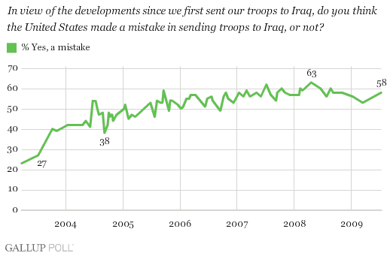
Public Approval of Iraq War

